Slide 1
Cyber Bullying
A presentation by Lemon Grenades

Slide 2
Who are Lemon Grenades?
Jiyun Kim
Trisha Khallaghi
Lewis Milne
Victor Li
Almatkhan
Kuanyshkereyev
Simon Abaigbe
Ian Barker
Trung Tung Tang

Slide 3
Introduction
38% of young people affected by cyber-bullying
31,599 children called ChildLine in 2011/12 about bullying
46% of children and young people say they have been bullied at school at some point in their lives
38% of disabled children are worried about being bullied
18% of children and young people who are worried about bullying said they would not talk to their parents about it

Slide 4
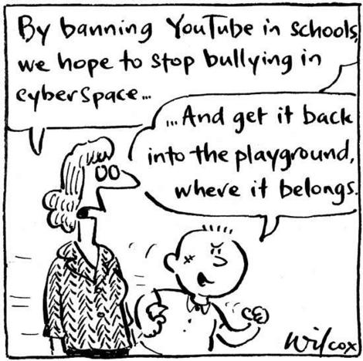
What is cyber-bullying?
When does a person count as ‘cyber bullied’?
It’s not the ‘real world’
A pressure release

Slide 5
Cyber-bullying and the Law
Three main laws
The Malicious Communications Act, 1988
The Protection from Harassment Act, 1997
The Communications Act, 2003
Consequences
Laws regarding Internet Service Providers (ISPs)

Slide 6
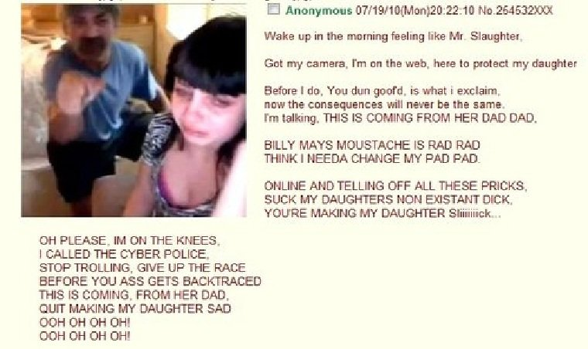
Case study: Jessi Slaughter
11 year-old victim of internet bullying
Escalation stemmed from reaction videos
Police investigation around it
Appeared on Good Morning America

Slide 7
“People STFU This Is A Very Private Matter And Im Dealing With It. This Post Ruined Muh Life… And Yes That Was Muh Status On Myspace! Cuzz I Saw A Squril Fall Out Of A Tree In Muh BakYard! It Was Funnah To Meh! Muh Mom Has Read This And Is Talking To Dahvie On The Fone Right Nao! So I Would Shut Your Mouths If I Were You! I Have Muh Life And Dahvie Has His. We Are Just Friends!”
- Jessica Leonhardt
One of Jessi’s first responses to the harassment on StickyDrama

Slide 8
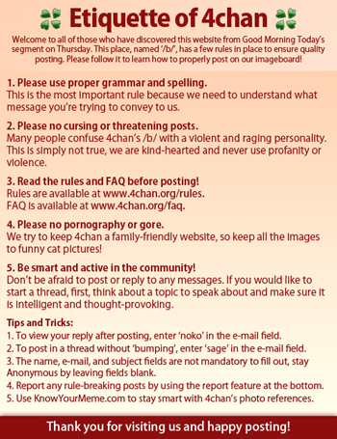
The ‘Etiquette of 4chan’ that greeted users the day Jessi Slaughter appeared on Good Morning America

Slide 9
Taking action
How does one take action if e.g. their child is being cyber bullied?
Addressing the problem by using several steps

Slide 10
Prevention
Set clear expectations with your child
Teach them about technology and the risks of cyber bullying
Keep an eye on your child’s online activities
Parental control software
Computers in common areas
Set up privacy control
Don’t be a cyber bully!

Slide 11
Seeking help
Kindly pass on these contact details if you know anyone that is in need of help or support:
Samaritans (08457 90 90 90) available 24 hours, every day of the year. Also available on e-mail at jo@samaritans.org.
Childline (0800 1111) is a helpline for children and young people in the UK. The number will not show up on your bill and is cost-free.
Bullying UK (http://www.bullying.co.uk/) is a website for people of all ages affected by bullying.

Slide 12
References
National Society for the Prevention of Cruelty to Children (NSPCC) [online]. (2013). Available at: http://www.nspcc.org.uk/inform/resourcesforprofessionals/bullying/bullying_statistics_wda85732.html [Accessed 21 April 2013].
From: Chamberlain, Tamsin, George, Nalia, Golden, Sarah, Walker, Fiona and Benton, Tom (2010) Tellus4 national report (PDF). London: Department for Children, Schools and Families (DCSF).
Stop Cyberbullying [Online], (2013), Available at: http://www.stopcyberbullying.org/what_is_cyberbullying_exactly.html [Accessed 21 April 2013]
The Malicious Communications Act (1988) legislation.gov.uk. Available at: http://www.legislation.gov.uk/ukpga/1988/27/contents [Accessed 21 April 2013]
The Protection from Harassment Act (1997) legislation.gov.uk. Available at: http://www.legislation.gov.uk/ukpga/1997/40/contents [Accessed 21 April 2013]
The Communications Act (2003) legislation.gov.uk. Available at: http://www.legislation.gov.uk/ukpga/2003/21/section/127 [Accessed 21 April 2013]
Cyber Bullying Prevention and Intervention. 2013. American Humane Association [ONLINE]. Available at: http://www.americanhumane.org/children/stop-child-abuse/fact-sheets/cyber-bullying-prevention-and-intervention.html [Accessed 21 April 2013].
Preventing Cyberbullying. 2012. Cyberbullying Research Centre. [ONLINE] Available at: http://www.cyberbullying.us/Top_Ten_Tips_Teens_Prevention.pdf [Accessed 21 April 2013].

