Slide 1
Green IT
Solutions & Benefits
Group J
Tutor: Dr Nicholas Gibbins
Pollawat Poonjiradejma
Lyubomir Vasilev
George Salter
Nathan Thorpe
Mohammad Hossein Sharifkazemi
Julian Yon

Slide 2
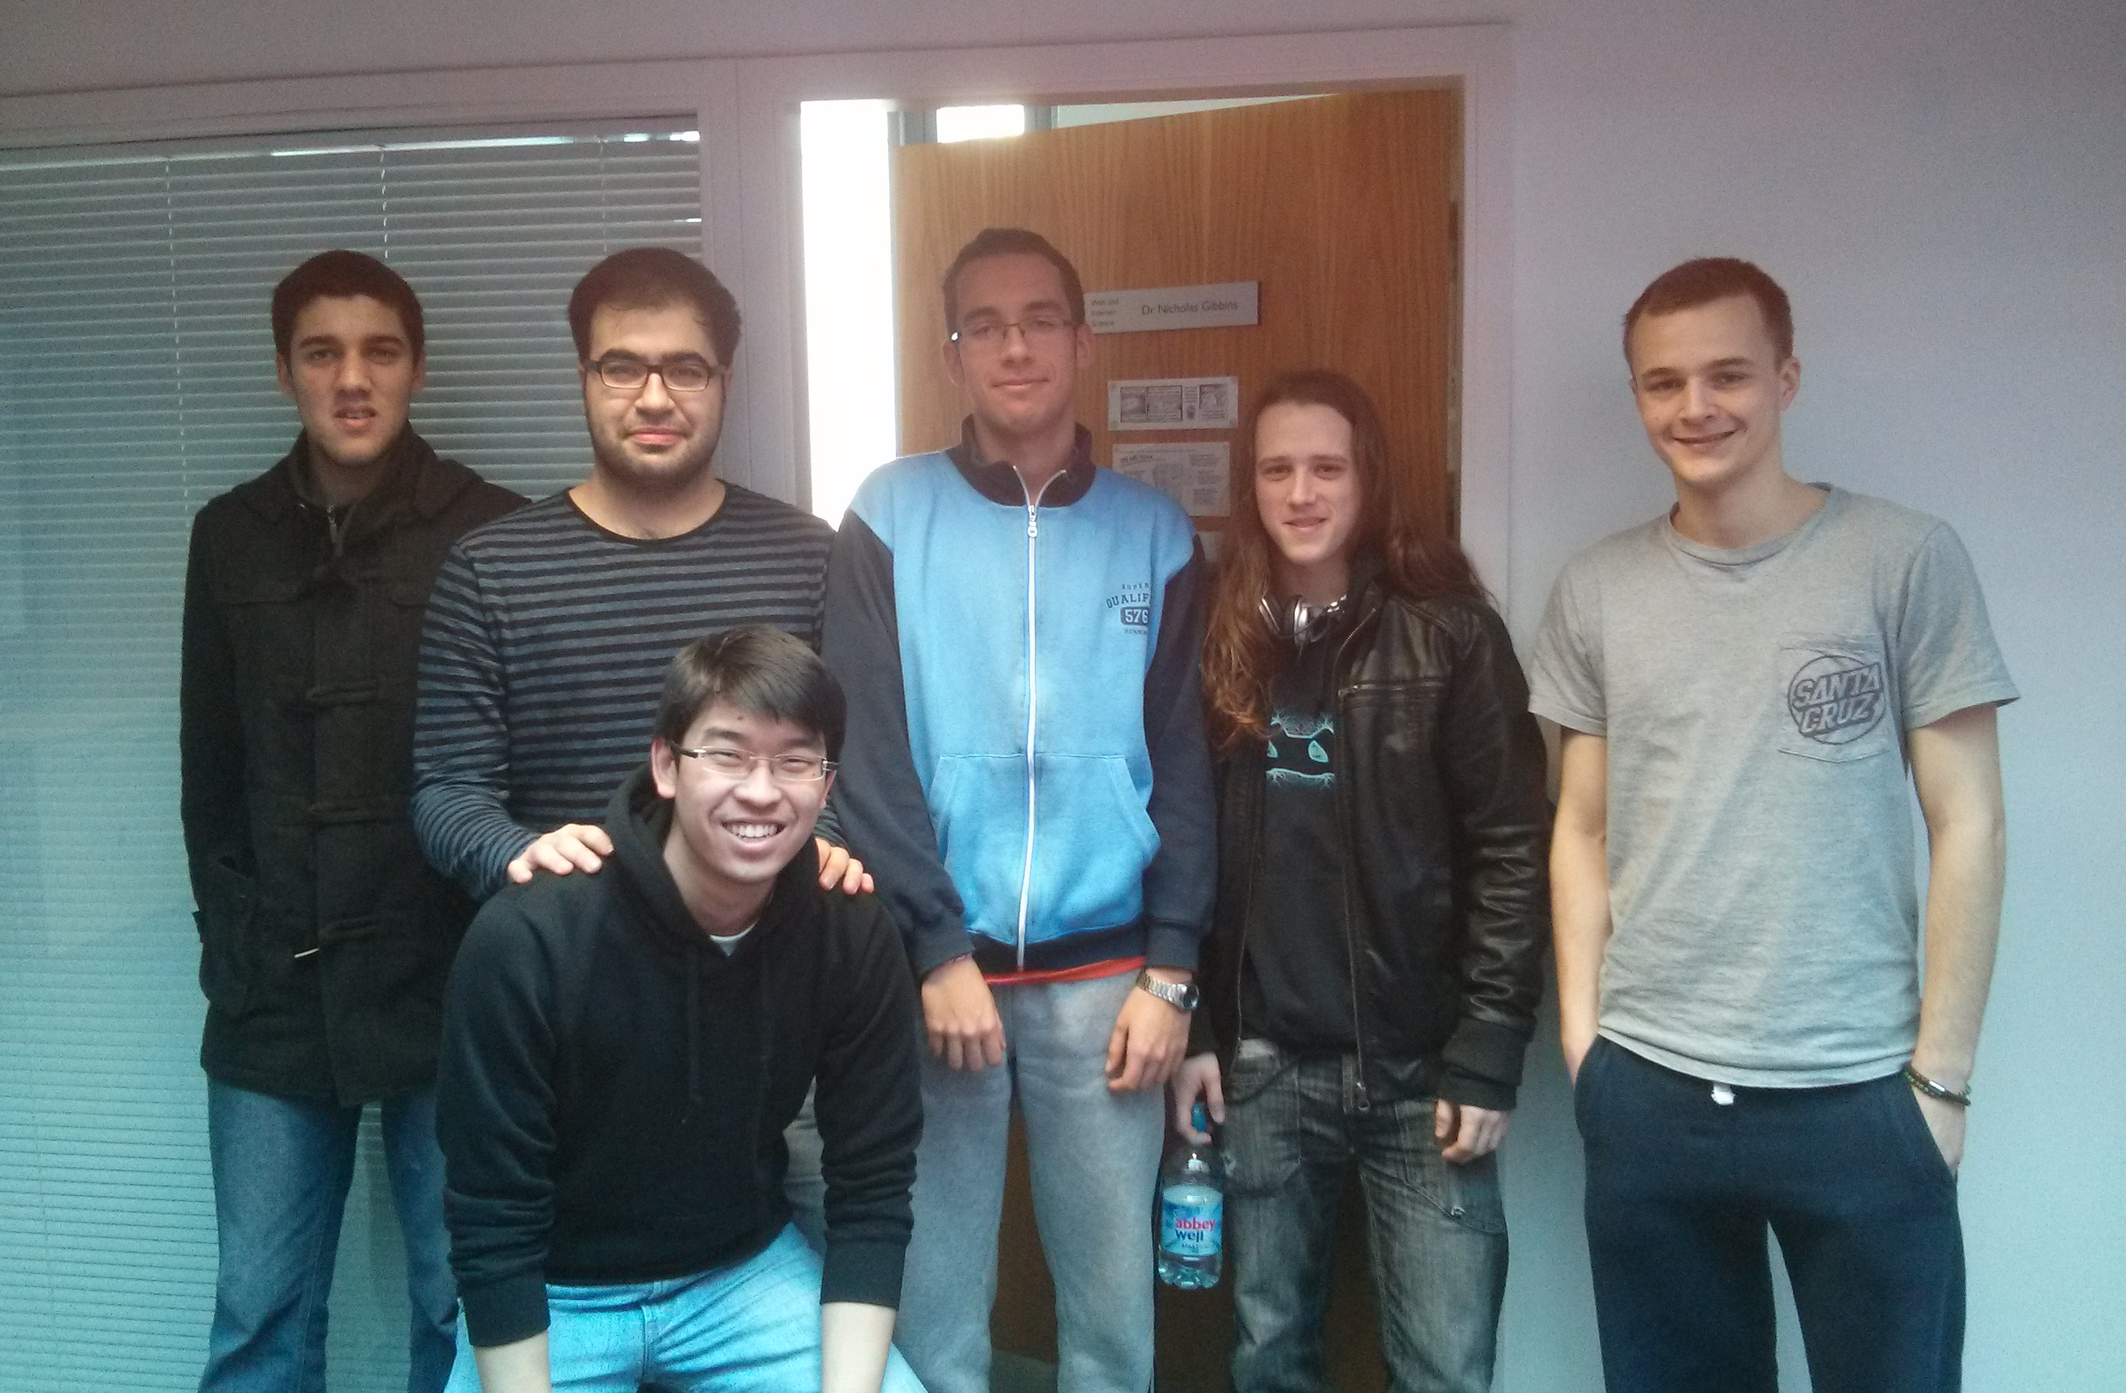
Hossein
Sharifkazemi
Lyubomir Vasilev
George Salter
Julian Yon
Nathan Thorpe
Pollawat Poonjiradejma

Slide 3
Presentation Structure
Personal Computer
Challenges
Data Centre
Challenges
Virtualisation
Cooling Systems
Manufacturing
PC Recycling

Slide 4
Personal Computer
Problems
Manufacturing
PC Recycling
Notes:
Talk about the two sides of the problem (PC versus industrial sized computing)
I will introduce some of the problems with personal computers

Slide 5
The Production Process of Computers:
Production of computer creates waste
How can we make the creation process cleaner?
“The average PC requires 10 times the weight of the product in chemicals and fossil fuels” to manufacture and “Many of the chemicals are toxic… that waste is then dumped in landfill sites… leading to significant health risks.” Hirsch (2004 p.1)
Notes:
Not only is waste from the operation of computers, but from the creation of computers
This means we can’t just look at how we can make the running costs greener, but how can we make the production greener
We must look at the materials used and the emissions caused by the creation of those materials and how things can be improved

Slide 6
Recyclability of Computers
Technology becomes out-dated fast
Physical waste from old hardware and machines is a problem
“Electronic equipment waste is the single largest contributor of heavy metals to the U.S.’s waste stream, aside from lead-acid automotive batteries.” Klatt (2003 pg.212)
Notes:
Often machines become obsolete in 2 or less years
And these machines are very rarely recycled, this contributes hugely to the world’s landfill sites which are filling up fast
Some materials used in computers aren’t recyclable, so could we possibly change which materials are used?
We must also think about the recyclability of computers, how can we make best use of old hardware, or even reduce the need to upgrade?

Slide 7
Personal Computer
Challenges
Manufacturing
PC Recycling

Slide 8
Solutions
Green Materials
The use of non-toxic materials to constructs PCs that will consume less electricity and have a smaller impact on the environment
The use of fewer acids, photochemical and other materials in chip manufacturing
Designing power-effective computers parts
Multi-core processing, power-saving cache segments, 45 nm architecture
Energy efficient displays and flash memory
Laptops with power saving feature

Slide 9
Benefits
Environmental
Reduction of manufacturing processes
Less power consumed during manufacturing processes
Thus reduces green house gases
Financial
Lowers operational costs
Meeting inter-governmental environmental obligations
Higher demand for environmentally friendly goods

Slide 10
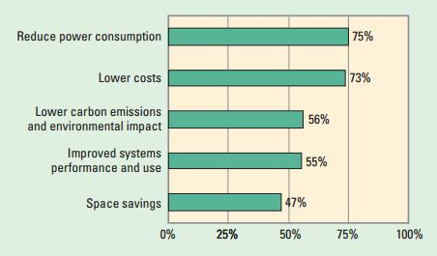
Source: IEEE 2008

Slide 11
Personal Computer
Challenges
Manufacturing
PC Recycling

Slide 12
REUSE
RECYCLE
REFURBISH
Notes:
choices made by the individual whether to recycle or not.
Most obvious choice is to reuse. Is it necessary to buy a new computer?
is it still usable and can it be given away?
Maybe a sensible thing to do is to upgrade your computer with new parts RAM, graphics card etc. this will reduce waste over time.
Refurbishing computers saves making a big investment, can give you the specs you need easily.

Slide 13
REUSE
RECYCLE
REFURBISH
Notes:
Computers contain toxic materials, lead, chromium, cadmium and mercury. which means in landfill these chemicals find their way back into the environment, and obviously if incinerated these chemicals are readily released into the air.
Valuable resource for secondary raw materials. can be reprocessed into the same materials or broken down into constituent materials.
Green design can be used to create computers that use more recyclable materials and are also highly upgradable extending their useful lifetime.

Slide 14
Challenges
Data Centre
Virtualisation
Cooling Systems

Slide 15
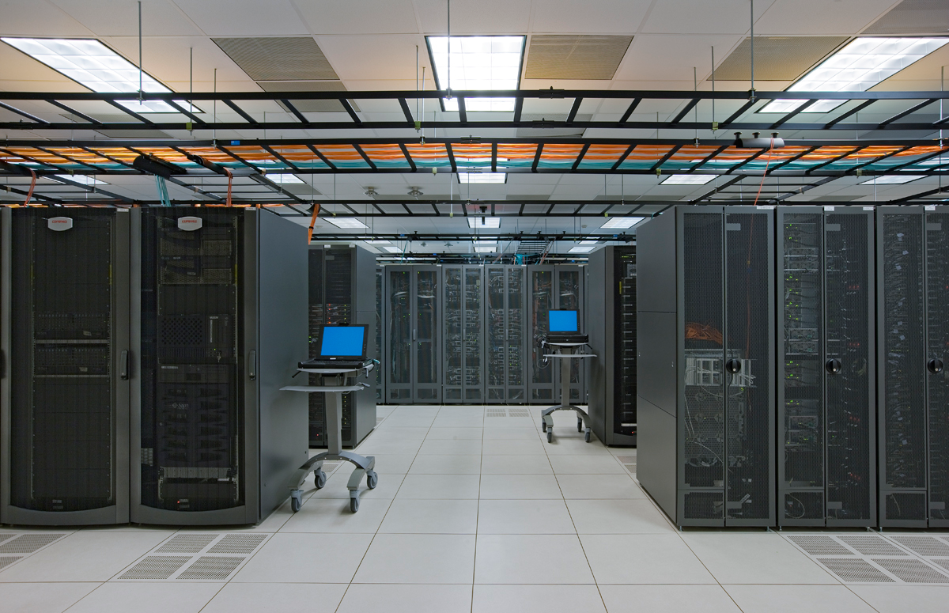

Slide 16
Challenges
Data Centre
Virtualisation
Cooling Systems
Notes:
Virtualisation, the process of creating a virtual version of an object rather than having a physical version, can be used to reduce the power consumption of data centres by hosting several virtual data centres on a single data centre.

Slide 17
= 1 Data Centre
Source: Berl et al. 2009
Notes:
Lets say there is a data centre.

Slide 18
High Utilisation
£100 a day
1MW
Source: Berl et al. 2009
Notes:
At high utilisation, it costs £100 per day, and consumes 1MW.

Slide 19
Lowest Utilisation
£70 a day
700W
Source: Berl et al. 2009
Notes:
At its lowest utilisation, the bare minimum to run it, it costs £70 per day, and consumes 700W.

Slide 20
£70
700W
£70
700W
£70
700W
Notes:
Let’s say there are three of these data centres, each running at their lowest utilisation.

Slide 21
X 3 = £210
2.1MW
At its lowest utilisation
£70
700W
Notes:
To do this would cost £70 per data centre, per day, giving a total of £210 per day, and consuming 2.1 MW.

Slide 22
£100
1MW
£0
0W
£0
0W
Notes:
Now, using virtualisation three virtual data centres can be hosted on one physical data centre.

Slide 23
High Utilisation
£100 a day
1MW
£100
1MW
Notes:
To run these virtual data centres on one physical data centre at high utilisation, it will cost only £100 per day, and consume 1MW.

Slide 24
Notes:
OMG!

Slide 25
Challenges
Data Centre
Virtualisation
Cooling Systems

Slide 26
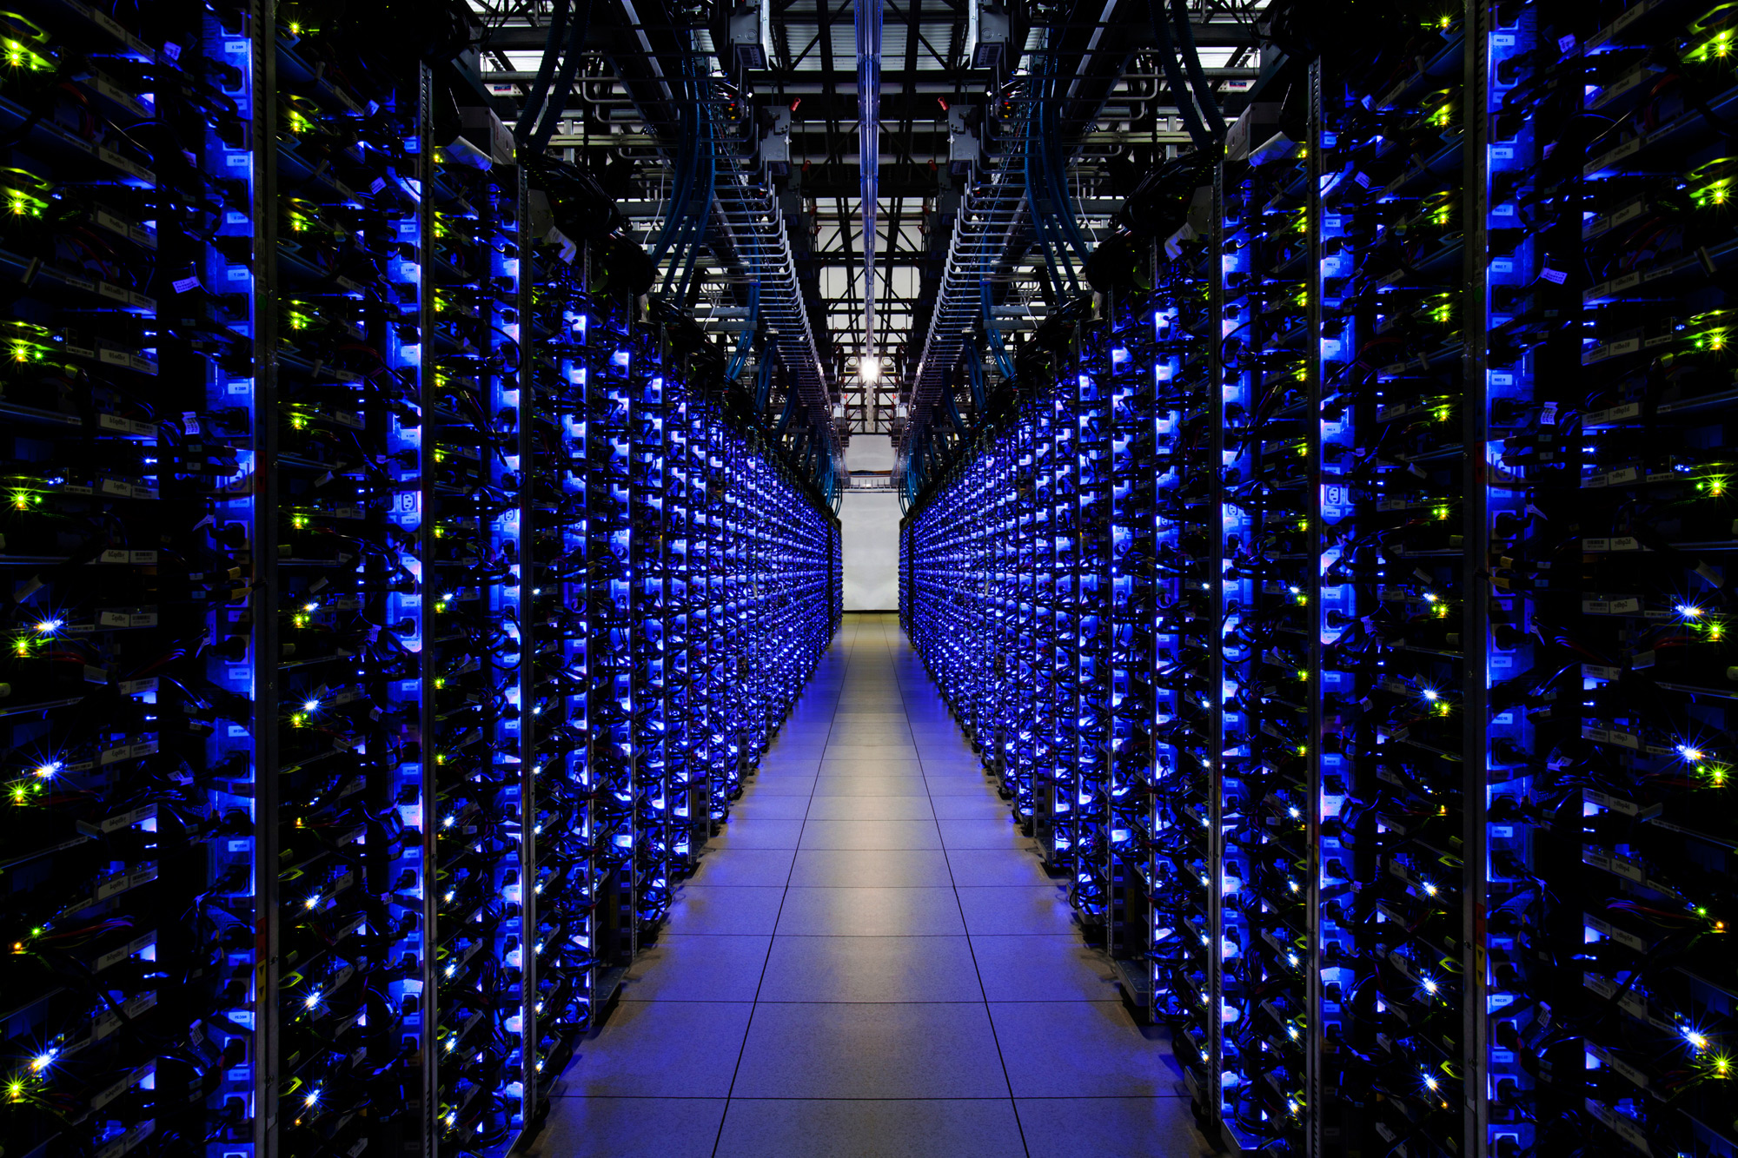
Notes:
It only takes four years for the cost of powering data centre to match the cost of data centre itself. 35 per cent of those power goes to cooling systems. If data centres can be cooled by different means, you can essentially shave off 37 per cent of power cost.

Slide 27
TOTAL COST OF FACEBOOK’S SERVER FARM
$760,000,000
Source: Daily Mail
Notes:
To put this into perspective, Facebook’s new server farm in Sweden costs US$760 million. That’s US$190 million of power a year! $66.5 million of this goes to cooling.
It costs $682 million to be Batman. If Mark Zuckerberg could save this amount a year, he could technically become Batman in just a little over 10 years from this saving in Sweden alone!

Slide 28
If the cost of power in four years is equal to the cost of data centre…
$760 million / 4 =
$190,000,000
worth of power every year
Source: Thome, J., Marcinichen, J., Olivier, J.
Notes:
To put this into perspective, Facebook’s new server farm in Sweden costs US$760 million. That’s US$190 million of power a year! $66.5 million of this goes to cooling.
It costs $682 million to be Batman. If Mark Zuckerberg could save this amount a year, he could technically become Batman in just a little over 10 years from this saving in Sweden alone!

Slide 29
37 per cent of this goes to cooling
$190 million x 0.35 =
$66,500,000
worth of cooling every year
Source: Falcon Electronics Pty Limited
Notes:
To put this into perspective, Facebook’s new server farm in Sweden costs US$760 million. That’s US$190 million of power a year! $66.5 million of this goes to cooling.
It costs $682 million to be Batman. If Mark Zuckerberg could save this amount a year, he could technically become Batman in just a little over 10 years from this saving in Sweden alone!

Slide 30
TOTAL COST OF BEING BATMAN
$682,450,750
Source: moneysupermarket.com
Notes:
To put this into perspective, Facebook’s new server farm in Sweden costs US$760 million. That’s US$253 million of power a year! $93 million of this goes to cooling.
It costs $682 million to be Batman. If Mark Zuckerberg could save this amount a year, he could technically become Batman in just a little over 10 years from this saving in Sweden alone!

Slide 31
Notes:
http://newmediarockstars.com/2012/02/what-batman-can-teach-you-about-social-media/

Slide 32
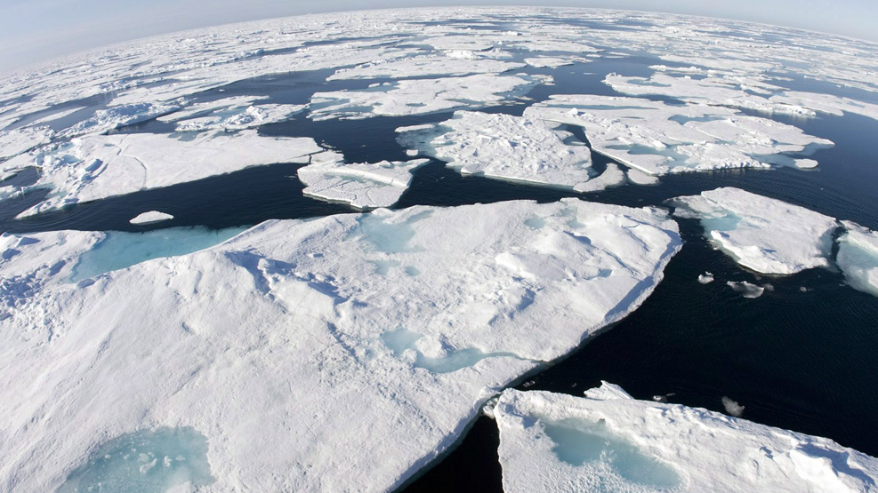
Baffin Bay above Arctic Circle
Notes:
In the past few years, there have been an interesting development in locating data centres. Multinational companies now tend to build their new data centres near Arctic Circle to benefit to ‘free convection’. This means that these companies could make significant saving from having to cool these servers down using traditional method.
But more importantly, this reduction in consumption of power leads to less power usage which is the main cause of environmental problems. Less energy usage, less power required, less pollution.

Slide 33
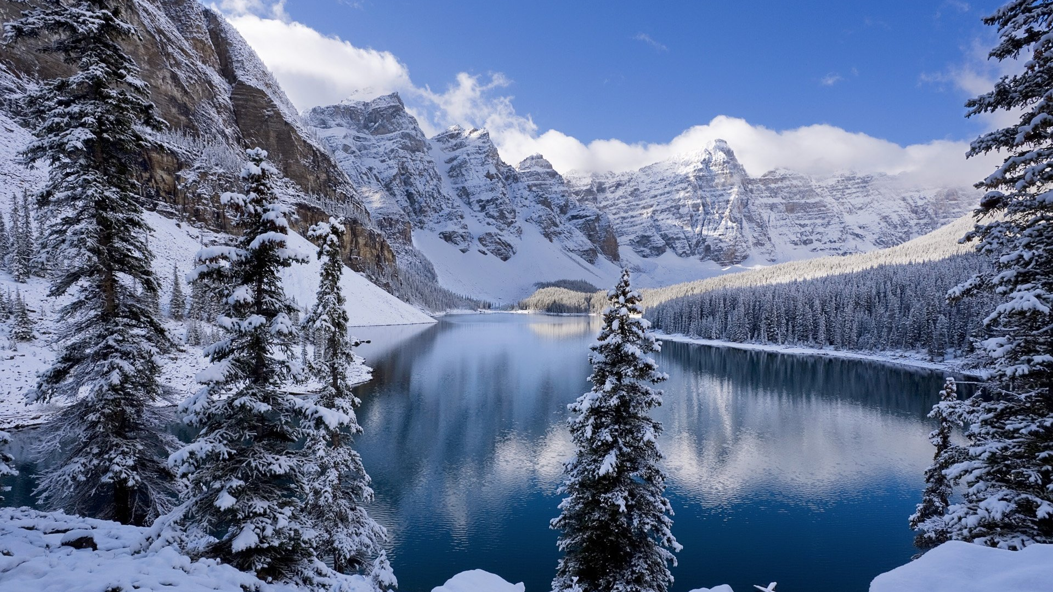
Moraine Lake, Canada
Notes:
For instance, in Canada, servers can run without ‘chillers’ on for 210 days of the year because of the climate.
Companies like Facebook and Google has been building their new data centres near Arctic Circle. However, this option is still very limited. This is because there are only a few countries near Arctic Circle where the infrastructure, especially internet, is good enough to handle such large data centre.
http://www.theglobeandmail.com/report-on-business/economy/canada-competes/why-cold-canada-is-becoming-a-hot-spot-for-data-centres/article6598555/

Slide 34
Sources
Berl, A., Dang, M. Q., Gelenbe, E., Girolamo, M., Giuliani, G., Meer, H. & Pentikousis, K. (2009). Energy-Efficient Cloud Computing. The Computer Journal, 53, 7, 1025-1051. doi:10.1093/comjnl/bxp080
Hirsch T. (2004) BBC, available from http://bit.ly/X0C7GC [Accessed 21 April 2013]
Klatt S. (2003). Recycling Personal Computers. Computers and the Environment: Understanding and Managing their Impacts Eco-Efficiency in Industry and Science, 12, 211-229. doi:10.1007/978-94-010-0033-8_11
Murugesan, S., (2008). Harnessing green IT: Principles and practices. IT professional, (February). doi:10.1109/MITP.2008.10.
Thome, J., Marcinichen, J., Olivier, J. (2012). Energy Efficient Thermal Management of Data Centre, 513-567. doi:10.1007/978-1-4419-7124-1_12

