Slide 1
Virtuality
Group A
Tutor: Dr. Alex Rogers
Matthew Dasilva, Khalifa Aldaharni, Jon Bondoc, Joseph Carver, Christopher Picken, Alexandre Baker, and Adam Atkins

Slide 2





Jon Bondoc
Writer
Alexandre Baker
Writer
Joseph Carver
Writer
Adam Atkins
Writer
Matthew Dasilva
Presenter
Khalifa Aldaharni
Presenter
Christopher Picken
Presenter

Slide 3
What is Virtuality?
The ability to work from remote office, while still allowing them to attend
meetings.
Organisations do not need to have all their employees in one place.
Allows the employee to work from multiple locations
Helps multiple organisations work together in a more integrated environment

Slide 4
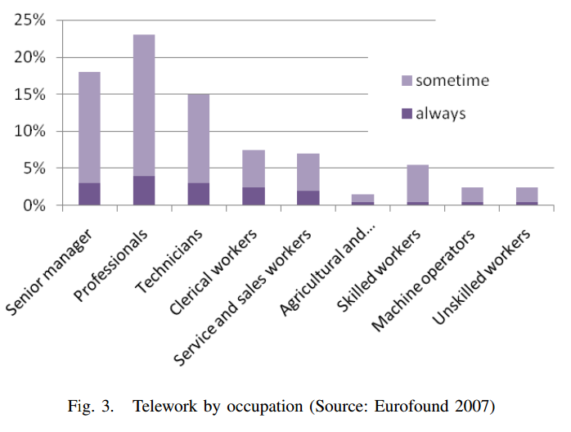
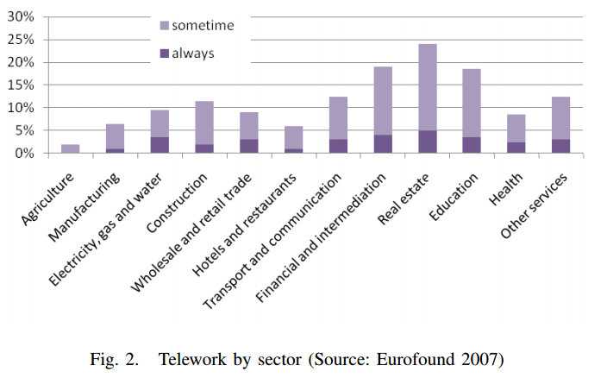
What is Virtuality?

Slide 5
Virtuality – weighing it up
Advantages
The company's experts can be located around the world.
Faster reaction times to new events in the markets around the world.
Increases the scalability of the business – people can be drafted in as freelance
Disadvantages
Working from home reduces employees productivity.
The lack of personal appearances induces trust and respect issues.
There may be a lack of feeling part of a team, especially when working
together on large projects

Slide 6
Where Does It Work?
Globalization of Businesses
Mobile Workers
  Auditors, consultants, salesperson, and service technicians
Changes in employee values and attitude to work
Sharing of knowledge between team and organizations
Usually Works in IT organisations where not much interaction is needed with
clients.
i.e. some programming can be outsourced to foreign countries – this is
advantageous because programming jobs can be worked on in different countries
Where their time zones are different, thus allowing programmers to be constantly
Working on the job at hand.

Slide 7
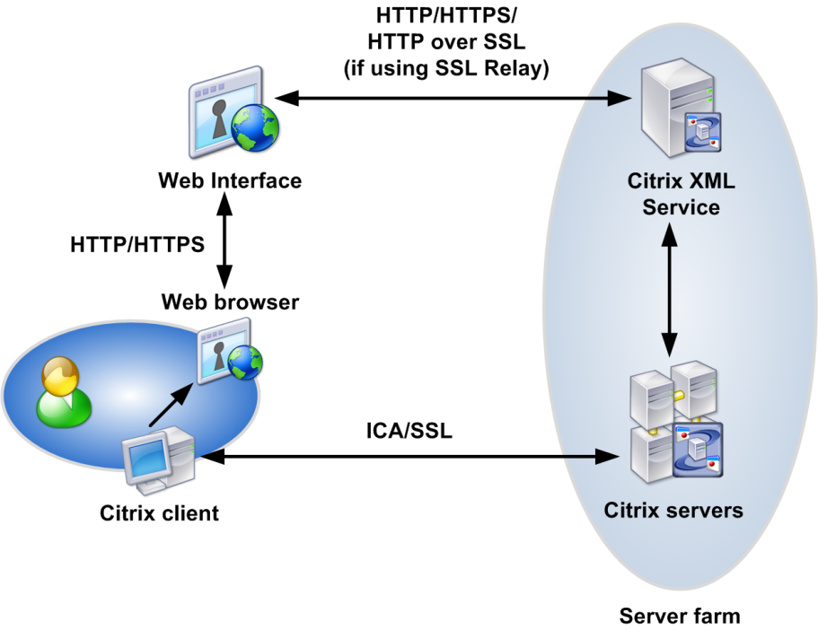
Where Does It Work?
A case study by an IT consultancy showed how a business with multiple offices
Across the UK used ‘Citrix’ to allow staff to optionally work from home or
At the office.
Figure: Shows how Citrix can be used in the IT consultancy scenario

Slide 8

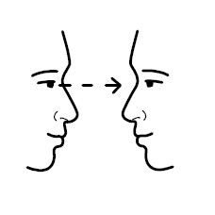
Where Does It Not Work?
  Doesn’t work in companies where a face-to-face interaction is needed with a client
  Skype can be used as an alternative however a lot of people agree that this is not the
  Same as a face-to-face interaction.
  In a company such as an advertising where one would be receiving large paper ad briefs,
  this would be a lot easier for a person to look at in person rather than on a screen
  In companies where a level of customer service is needed, such as test driving a car at a dealer
  or in retail where an employee would need to be on hand to help customers in person
  Typically people prefer interactions to be in person, as it may be harder to build a rapport whilst
  Using a technology such as Skype where it is hard to make eye contact – which is often key
  For building trust in, for instance, a business deal.

Slide 9
Where can it be used?
Mobile working
Telecenter
Virtual teams
Sharing of knowledge between team and organizations
Volunteers online even use virtuality such as creating YouTube videos to help
Others with their studies. A notable example of this is Khan Academy –
https://www.khanacademy.org/

Slide 10
References
Dr. Pang. (2001). Understanding Virtual Organizations. ISACA. 6
Eric Coggins. (2009). Virtual Organizations – Potential Advantages and Disadvantages.
Available: http://suite101.com/article/virtual-organizations--potential-advantages-and-
disadvantages-a353182.
Last accessed 19 April 2013.
Marco Vari, Guelfo Tagliavini, Kristina Ter-Oganesova, 2011,
'Telework: at the crossroads of social demand and technology offer', paper presented at FITCE
Congress,
Rome, date-3 Sept 2011
Platform consultancy, 2013,
http://www.platformconsultancy.com/caseStudies/VirtualisationAndCitrix.php
LifeHacker, 2012,
http://lifehacker.com/5925310/how-to-take-a-conference-call-without-driving-everyone-else-crazy

