Slide 1
Personal Privacy and Security
The Data Protection Act & Facebook Privacy
Tutor: Corina Cirstea
Group C

Slide 2
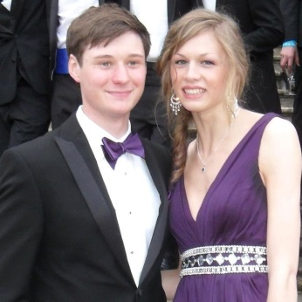




Luke Short
Botty Dimanov
Victor Dama
Tihomir Bozadzhiev
Radu Popescu

Slide 3
What are we covering?
The Data Protection Act – Botty Dimanov
Facebook Privacy – Victor Dama
Facebook Apps Privacy – Tihomir Bozadzhiev
Final thoughts – Radu Popescu

Slide 4

The Data Protection Act
8 main principles
Personal data shall be processed fairly and lawfully and, in particular, shall not be processed unless the data subject has given his consent to the processing ¹
In determining for the purposes of the first principle whether personal data are processed fairly, regard is to be had to the method by which they are obtained, including in particular whether any person from whom they are obtained is deceived or misled as to the purpose or purposes for which they are to be processed ¹
Possible exceptions

Slide 5

The Data Protection Act
Bridget Treacy: “Legislation will always be playing catch up to technology in this area, that's just the way it is” ²
Statistical companies
“Take the data now, find out what it reveals later” ²

Slide 6

Consent
We do share information with social networks
It is passed on to marketing companies and even for “analysis and predictive modelling”
People rely on explicit conformation
Terms and conditions section
Every fourth person from 93% have suffered ³
EU derivatives
Notes:
1-

Slide 7

Facebook Privacy
Is Facebook really private?

Slide 8
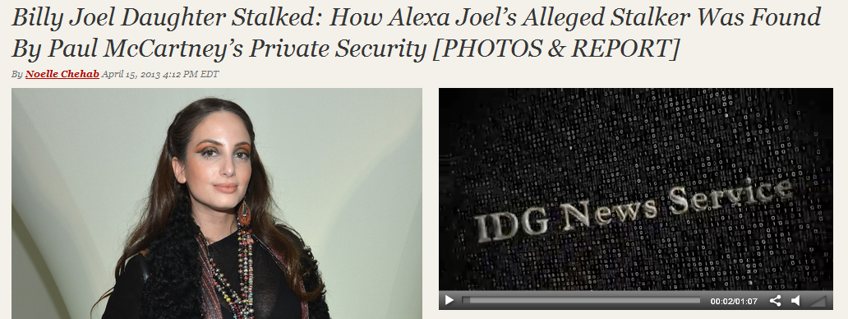
Facebook Privacy
Companies targeted advertisement
Hiring based on Facebook
Cyberstalking ⁵

Slide 9
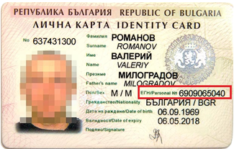


Facebook Apps Privacy
63% of apps post on your behalf, 69% get your email address ⁶
Access to your birthdate can reveal your Personal Identification Number in some countries ⁶
Does Facebook or the apps make money from your data? ⁶

Slide 10
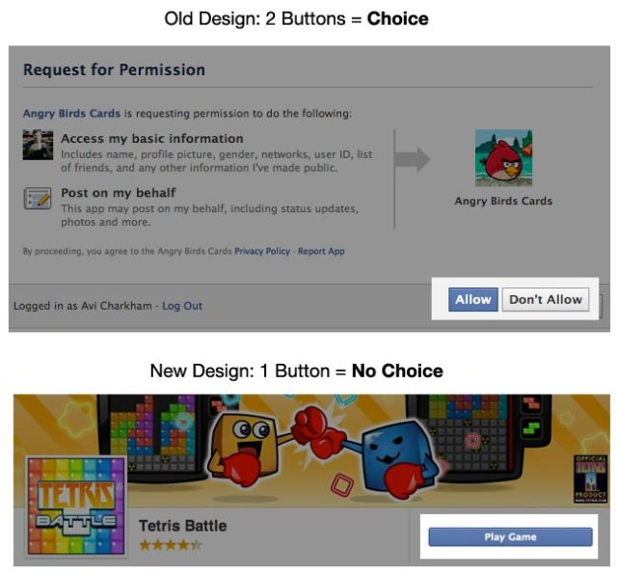
Facebook Apps Privacy
People very rarely carefully read the app privacy info
Recent changes to Facebook design make it even easier to skip the privacy info ⁷
Old design clearly stated that your are allowing the app to access your info ⁷
New design only has a “Play Game” button ⁷

Slide 11
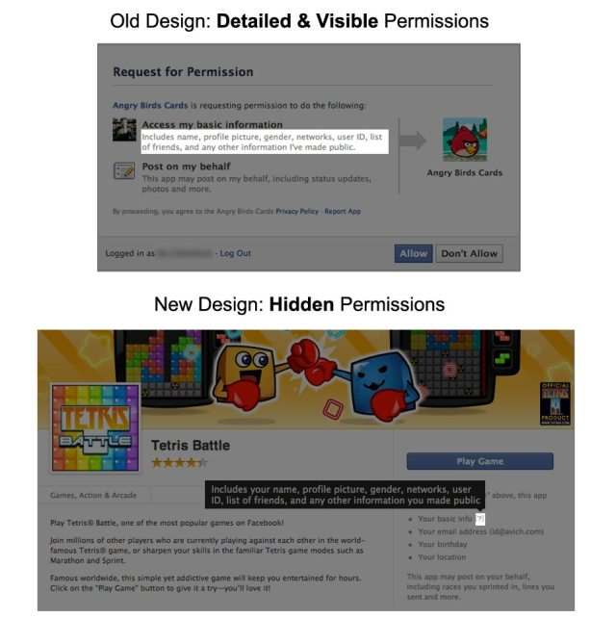
Facebook Apps Privacy
Old design explained every piece of personal data the app will access in detail ⁷
New design hides all that info, you need to hover over the little “?” symbol to see details ⁷

Slide 12
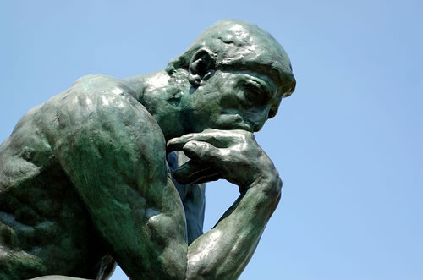
Final thoughts…
We now know the whats and the whos, let’s focus on the why?
Is it good or bad?
We know that most large companies could use our data to find out everything about us. But why would they?

Slide 13



Final thoughts…
The real danger seems to be Facebook stalking and phishing, rather than sharing statistical information with marketing companies
That is something we can easily control
With a little bit of caution, social networks can become a tool, for both the user, the network itself and third parties, such as marketing companies, rather than a threat

Slide 14
References
The Data Protection Act:
1 - http://www.legislation.gov.uk/ukpga/1998/29/schedule/1
2 - http://www.guardian.co.uk/news/datablog/2013/apr/12/data-protection-law-lagging-behind-technology
3 - http://www.guardian.co.uk/money/2011/may/11/terms-conditions-small-print-big-problems
Facebook Privacy:
4 - http://articles.baltimoresun.com/2013-04-19/news/bs-ed-facebook-20130419_1_facebook-privacy-privacy-policies-internet-privacy
5 - http://www.idesigntimes.com/articles/4624/20130415/billy-joel-daughter-stalked-alexa-ray-alleged-stalker-found-paul-mccartney-private-security-detectiv.htm

Slide 15
References
Facebook Apps Privacy:
6 - http://mashable.com/2012/09/04/most-facebook-apps-post-behind-your-back-exclusive/
7 - http://techcrunch.com/2012/08/25/5-design-tricks-facebook-uses-to-affect-your-privacy-decisions/

