Slide 1
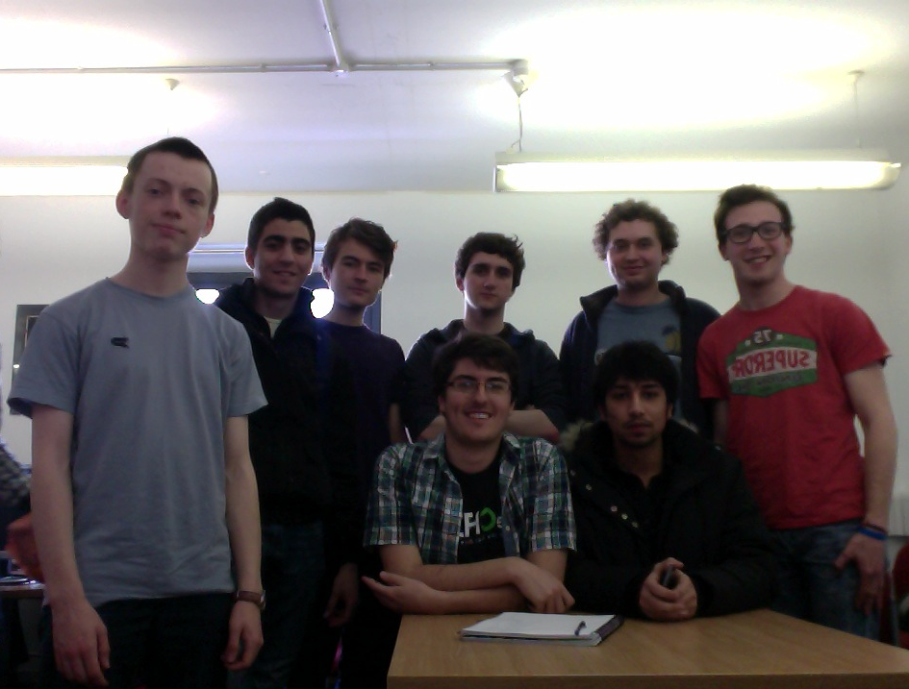
Big Data – The big picture
Group O - Presentation Topic 15
Group:
Alex Lay
George Michael
James Buck
Andrew Howe
Dan Playle
Clayton Jones
George Harris
Gaurav Lohchab
Tutor: Kirk Martinez

Slide 2
BIG
D
A
T
A

Slide 3
Cost and Drawbacks
Big data toolsets – Hadoop / noSQL
Few developers with expertise in these tools
Implementation costs

Slide 4
Diagram: Apache Software Foundation

Slide 5
“I'm not trying to say a [Hadoop-using] startup out there is doing it wrong, but I have worked on projects where I wish they'd use MySQL because they've only had a gigabyte of data.”
- Tim O’Brien @ O’Reilly Strata conference 2013

Slide 6
Social Media
Facebook was using MySQL – good for small data
Could not cope with increasing load
Specialised hardware & software developed

Slide 7
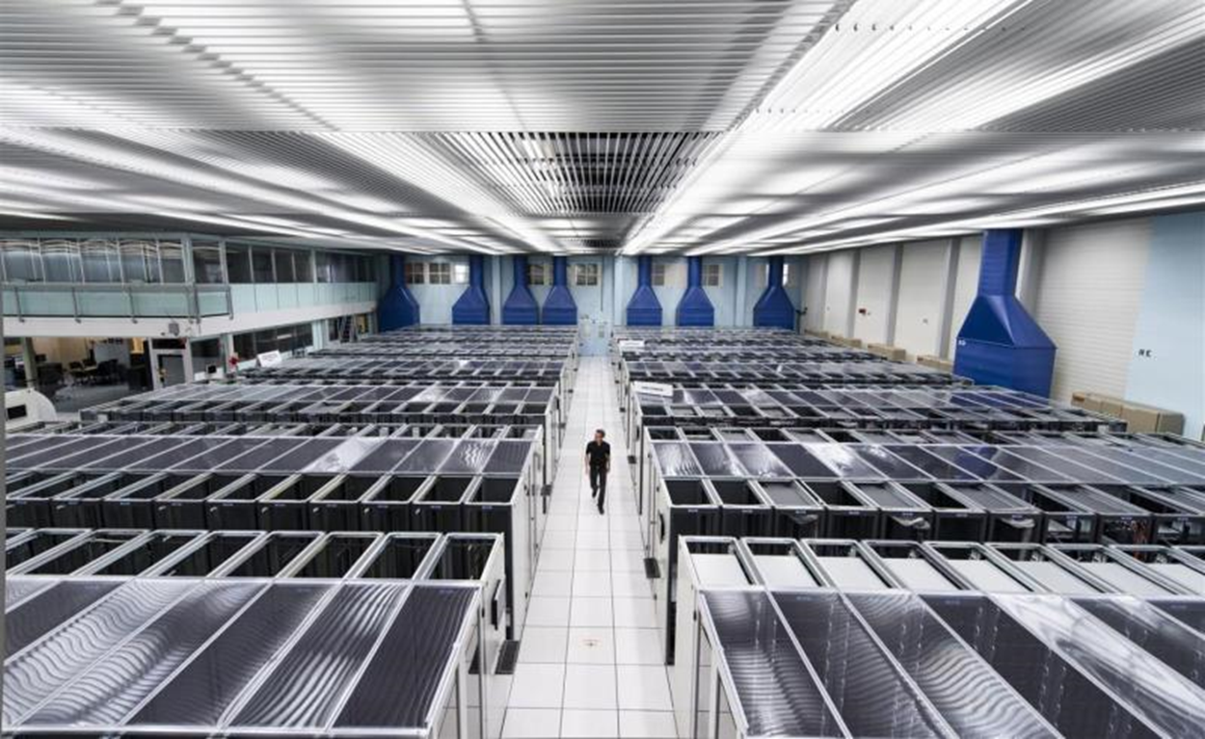
Big Science
LHC at CERN produces 15 petabytes of data per year
An early solution: The world wide web
A modern solution: Distributed Computing
LHC@HOME

Slide 8
The Power of Big Data
“The 2012 Presidential elections not only reiterated the use of social media, it also introduced the world to a more sophisticated technology: the big data analysis.”
- Bosmol.com

Slide 9
References
hadoop.apache.org
http://bosmol.com/2013/02/how-big-data-analysis-helped-president-obama-defeat-romney-in-2012-elections.html#.UXKvdLWkp_b
http://home.web.cern.ch/
http://chronicle.com/section/Big-Data/446/

