Slide 1
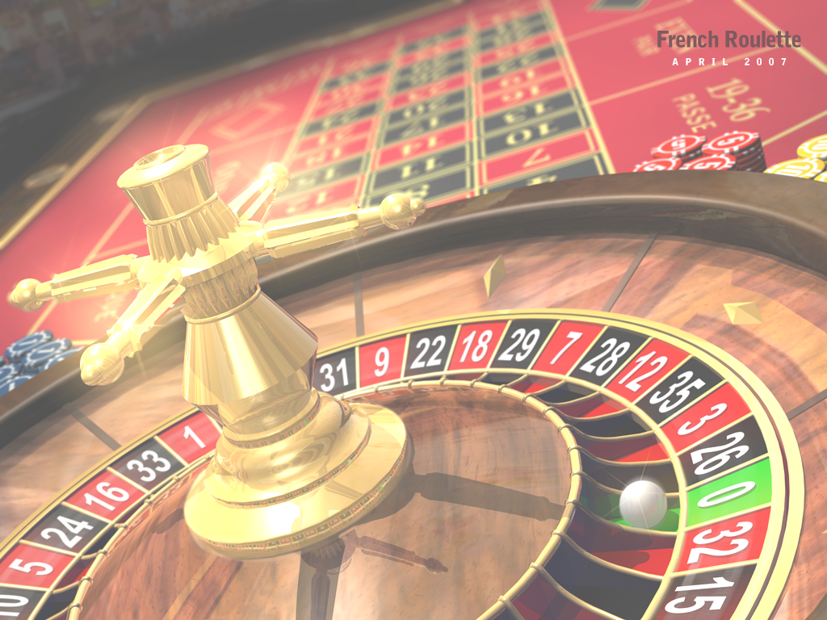
Addiction
Dr David Tarrant
davetaz@ecs.soton.ac.uk
Electronics and Computer Science
Notes:
Have a pack of cards and inform people that they can collect cards for responding and interacting in class.
However you cannot look at the cards until the end of the lecture.

Slide 2
Addiction
To be satisfied in work you need three things:
Autonomy
Complexity
Connection between effort and reward
Notes:
From the book Outliers (by Malcolm Gladwell)
Autonomy (that is, you have some say in what you do day to day);
Complexity (so it's not mind-numbing repetition);
Connection Between Effort and Reward (i.e. you actually see the awesome results of your hard work).

Slide 3
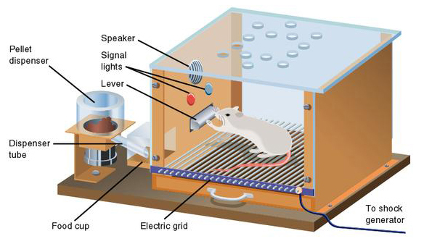
#5 – Putting You In a Skinner Box
Notes:
"Each contingency is an arrangement of time, activity, and reward, and there are an infinite number of ways these elements can be combined to produce the pattern of activity you want from your players.“ – Games researcher at Microsoft
Notice his article does not contain the words "fun" or "enjoyment." That's not his field. Instead it's "the pattern of activity you want."
His theories are based around the work of BF Skinner, who discovered you could control behaviour by training subjects with simple stimulus and reward. He invented the "Skinner Box," a cage containing a small animal that, for instance, presses a lever to get food pellets. Now, I'm not saying this guy at Microsoft sees gamers as a bunch of rats in a Skinner box. I'm just saying that he illustrates his theory of game design using pictures of rats in a Skinner box.

Slide 4
#5 – Putting You In a Skinner Box
Games are no longer $50 per game, complete and return/bin.
The big MMO’s make you do the same task over and over to get reward.
Carefully scheduled rewards are key to success.

Slide 5
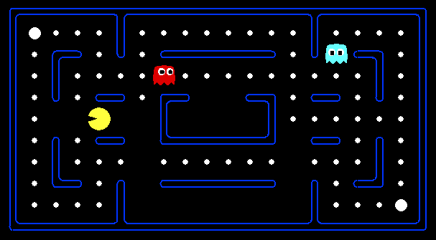
#4 Creating “Virtual” Food Pellets For You To Eat

Slide 6
Question?
How much is the “Virtual Goods” Industry now worth?

Slide 7
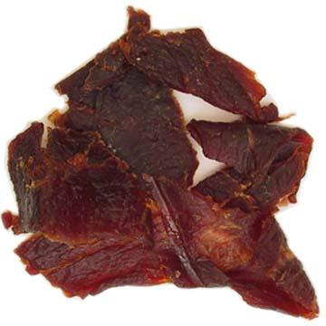
Your brain treats items and goods in the video game world as if they are real.
Because they are.
Notes:
People scoff at this idea all the time ("You spent all that time working for a sword that doesn't even exist?") and those people are stupid. If it takes time, effort and skill to obtain an item, that item has value, whether it's made of diamonds, binary code or beef jerky.
Is money now virtual? So how much are those 0’s and 1’s worth.

Slide 8
Answer:
How much is the “Virtual Goods” Industry now worth?
$5 billion
Notes:
And this goes hand in hand with perpetual MMOs or games where you transfer powers between each mission or edition.

Slide 9
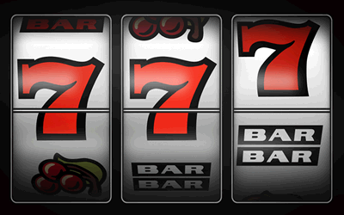
#3 Press the Lever!
Notes:
If you want to make a rat/hamster press the lever as fast as possible, how would you do it? Not by giving him a pellet with every press--he'll soon relax, knowing the pellets are there when he needs them. No, the best way is to set up the machine so that it drops the pellets at random intervals of lever pressing. He'll soon start pumping that thing as fast as he can. Experiments prove it.
They call these "Variable Ratio Rewards" in Skinner land and this is the reason many enemies "drop" valuable items totally at random in WoW. This is addictive in exactly the same way a slot machine is addictive. You can't quit now because the very next one could be a winner. Or the next. Or the next.
In these situations, like slot machines, scratch card games etc. The amount that is paid out is always relative to the cost per play. So 25c might win you $25 but $25 might win you $2500.
In either case the casinos can also change the odds in order to give up to 95% payback over time to get you addicted to the prospect of winning big time.

Slide 10
#3 Press the Lever!
Press to eventually get reward.
Press to get 1000 of one object.
Worse: Person who presses most in a day gets a reward at the end!
ZT Online does this for treasure chests which you open with a key.
The keys cost real money!

Slide 11
#2 Addiction to Pressing!
If the game does nothing but give random rewards for pressing, we’ll eventually get bored.
Human’s need long term goals.

Slide 12
#2 Method 1 – Easing In
Pellets come fast at first but then get slower and slower.
Levelling up in MMO
Once gamers experience the rush, the delayed gratification increases pleasure for player.
http://www.gamasutra.com/view/feature/3085/behavioral_game_design.php?page=1

Slide 13
#2 Method 2 – Eliminating Stop Points
Put save game points further apart.
Don’t inform the player of save points.
Really short “potato chip” levels.

Slide 14
#2 Method 3 – Play it or loose it
Don’t reward for pressing the lever, punish for not pressing it!
Things die, you die, points for movement etc…
Notes:
Ask for examples

Slide 15
Notes:
Note the electric grid

Slide 16
#2 Addiction to Pressing!
Skill and reward is how our brains develop as children.
Hunter gatherers is what we are!
The brain rewards us when we “win”.
The point is to keep you pressing, long after you have mastered the skills.
Combine lever pressing with other rewards. (WoW achievement system)

Slide 17
#1 Getting you to call the Skinner Box Home!
Autonomy:
The ability to define yourself online, make your own decisions.
Complexity:
Collect 40 of item A and 10 of item B to get item C. To find item A you need to get 3 keys.
Notes:
Would you ever call the skinner box home?
Does anyone think they can.

Slide 18
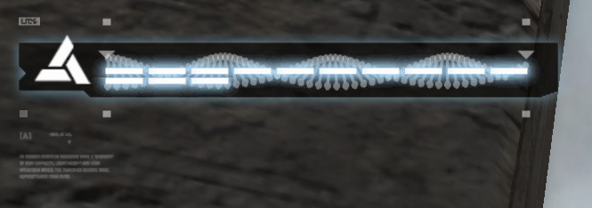
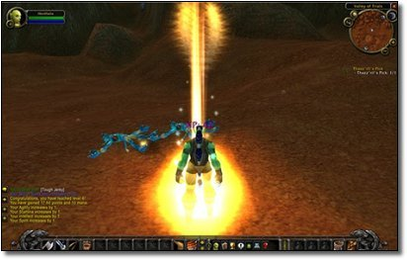
#1 Getting you to call the Skinner Box Home!
Connection between effort and reward

Slide 19
“Addiction is not about what you DO, but what you DON'T DO because of the replacement of the addictive behavior.”
Erin Hoffman – Video Games Designer

Slide 20
Summary
Think about pay-offs in your game and the strategy you are allowing people to play.
For a continued Rich-Application, think about if you can stomach addiction strategies.

Slide 21
Learning Outcomes:
Explain the Prisoners Dilemma and differentiate between dominant and non-dominant examples.
List 3 factors that affect human ‘satisfaction’
List 5 techniques that encourage addictive behaviour
List 3 specific strategies for game construction that encourage lengthy play time.

Slide 22
Resources
Addiction in Modern Games
http://www.cracked.com/article_18461_5-creepy-ways-video-games-are-trying-to-get-you-addicted_p2.html

