Slide 1
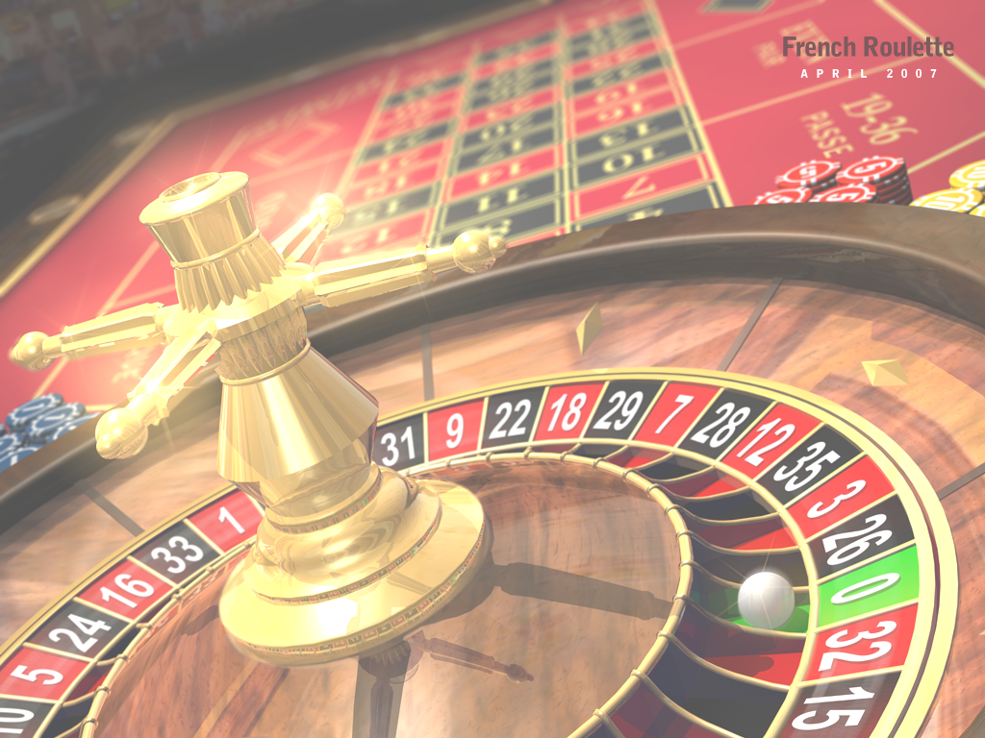
Game Theory A Brief Introduction
Dr David Tarrant
davetaz@ecs.soton.ac.uk
Electronics and Computer Science
Notes:
Have a pack of cards and inform people that they can collect cards for responding and interacting in class.
However you cannot look at the cards until the end of the lecture.

Slide 2
Grade Game
Notes:
Get the pieces of paper back.
Draw on the board the table and record my grades in the squares.
Draw another table and add the pair grades.
Put both tables together.
First grade corresponds the row player.
Second to the column player.
Outcome matrix
Show of hands, how many choose Alpha and Beta.
Why did you choose Alpha?
* Better outcomes for choosing alpha no matter.
Why did you choose Beta?
* Don’t like swings. A = A to B- , B = B+ to C
* Be more conclusive (indignant angel), some people might care about others grades
Business School vs Divinity School.
This is not a GAME, missing pay-offs and objectives.
I cannot tell you what your pay-offs should be.
* Caring about your own grade is one pay-off.
* Caring about another is another pay-off.
Re-draw the grid with numbers.
* numbers represent utilities (their goals)
* A = 3, B+ = 1, B- = 0, C = -1
* Evil Gits
What should you do.
* No matter what the pair does, you get a higher payoff with alpha.
This strategy alpha strictly dominates strategy beta if my pay-off from alpha is strictly greater than that from beta regardless of what others do.
Lessons

Slide 3
Learning Outcomes:
Understand game theory, strategic strategies and identify when this applies.
Explain the prisoners dilemma and differentiate between dominant and non-dominant examples.

Slide 4
Grade Game Explanation
Notes:
Get the pieces of paper back.
Draw on the board the table and record my grades in the squares.
Draw another table and add the pair grades.
Put both tables together.
First grade corresponds the row player.
Second to the column player.
Outcome matrix
Show of hands, how many choose Alpha and Beta.
Why did you choose Alpha?
* Better outcomes for choosing alpha no matter.
Why did you choose Beta?
* Don’t like swings. A = A to B- , B = B+ to C
* Be more conclusive (indignant angel), some people might care about others grades
Business School vs Divinity School.
This is not a GAME, missing pay-offs and objectives.
I cannot tell you what your pay-offs should be.
* Caring about your own grade is one pay-off.
* Caring about another is another pay-off.
Re-draw the grid with numbers.
* numbers represent utilities (their goals)
* A = 3, B+ = 1, B- = 0, C = -1
* Evil Gits
What should you do.
* No matter what the pair does, you get a higher payoff with alpha.
This strategy alpha strictly dominates strategy beta if my pay-off from alpha is strictly greater than that from beta regardless of what others do.
Lessons

Slide 5
Lesson 1
Do not play a strictly dominated strategy.
Why?
Notes:
Why Lesson 1:
What he means by this is that you are always Beta, you are demoniated.
If instead I play the strategy that dominates it I do better.
Shake faith in argument: Look at the payoff matrix again. If we, both choose alpha, then we both be 0, but if we both choose Beta, we both get 1.
You have to able to agree.
Think American series vs. Online MMOG
Look at it this way if we both choose beta I do better. But then I could choose Alpha.
What is all this an example of?

Slide 6
Prisoners Dilemma
2 accused crooks in separate cells,
If neither rats the other guy out both go to jail for a year
If both rat each other out they go to jail for 2 years.
If you rat the other guy and he doesn’t rat you then he’ll go to jail for 5 years.
Notes:
Other Examples:
Politics?
Chris Huhne and Vicky Pryce
So in this strategy who is the evil git and who is the angel?
What role did the press have?

Slide 7
Golden Balls
http://www.youtube.com/watch?v=p3Uos2fzIJ0&feature=player_embedded

Slide 8
Golden Balls
Weakly Dominant Strategy
You can do no worse than the other player, but you can both lose.
Three Nash Equilibria in the Game:
Outcomes where a player can not do better on his or her own by changing his or her strategy

Slide 9
Contracts and Communication
Does communication help?
Who does it help?
Why?

Slide 10
End Video

Slide 11
Lesson 2
Rational choice can lead to outcomes that “suck”.
Notes:
Why Lesson 1:
If instead I play the strategy that dominates it I do better.
Look at it this way if we both choose beta I do better. But then I could choose Alpha
Bad or inefficient outcomes.

Slide 12
Game 2
Without showing your neighbor, put in the box a whole number between 1 and 100.
We will then calculate the average number chosen in the class.
The winner will be the person who picks the number closest to 2/3rds times the average number in the class.

Slide 13
Indignant Angels (Coordination Problem)
 | A | B
A | 0, 0 | -1, -3
B | -3 , -1 | 1, 1
Pair
Me
No Dominant Strategy
For me:
(A,C) → 3 –4 = –1
(C,A) → –1 –2 = –3
Guilt
Indignation
Notes:
Show of hands on who choose what and why?
Best case scenario with Alpha is 0
Worst case with Beta is -3
So is there a dominant strategy.
Called a co-ordination problem.

Slide 14
Payoff’s Matter (lesson 3)
You can’t get what you want, until you know what you want.

Slide 15
Evil Git vs Indignant Angels
 | A | B
A | 0, 0 | 3, -3
B | -1, -1 | 1, 1
Pair (angel)
Me (evil)
A is Dominant Strategy
Notes:
You know the person you are playing against is an Indignant Angel.
A is dominant as is always higher than Beta
Skip in Lecture

Slide 16
 | A | B
A | 0, 0 | -1, -1
B | -3, 3 | 1, 1
Pair
Indignant Angels vs Evil Git
Me
A does not dominate B
16
My A does not dominate B.
But my pairs A dominates her B
So I know she is going to choose A
Notes:
Alpha does not dominate Beta in B,B case.

Slide 17
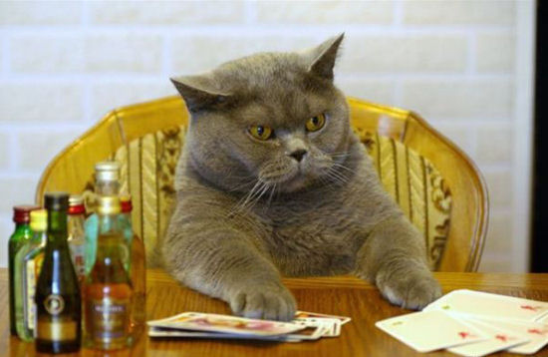
Lessons
When analysing strategy, put yourself in others’ shoes and try and figure out what they will do.
Hard to figure out your opponents pay-offs.
Play the odds.

Slide 18
Grade Game Prediction
70% choose A
30% choose B
Notes:
Why are 30% of people choosing Beta:
Could be moral?
Don’t understand the game?
Long term play-offs?
Lots of stupid people out there, they are doing experiments at the University of Hawaii
Lesson: Soton students are evil.

Slide 19
Resources
Game Theory Lecture Series at Yale:
http://oyc.yale.edu/economics/econ-159/lecture-1
Golden Balls and the Prisoners Dilemma
http://welkerswikinomics.com/blog/2009/04/10/golden-balls-gamaae-theory-the-prisoners-dilemma-and-the-cold-rationality-of-human-behavior/

