Slide 1

UX Design
Thinking beyond HCI
Dr David Tarrant, University of Southampton

Slide 2
Overview
Key Principals
Krugs Laws
Powerful Layouts
The Trunk Test

Slide 3
Krugs Laws
“Get rid of half the words on each page/screen, then get rid of half of what’s left.”
Krug’s Third Law of Usability

Slide 4
Krugs Laws
“It doesn’t matter how many times I have to click, as long as each click is a mindless, unambiguous choice.
Krug’s Second Law of Usability

Slide 5
Key Principals
Key Principals
Familiarity
Unity
Consistency
Variety
Economy
Proportion & Balance
Associations
Performance

Slide 6
Key Principals
Key Principals
Familiarity
Unity
Consistency
Variety
Economy
Proportion & Balance
Associations
Performance
Using well known principals to match the users expectation. These are different depending on the type of site and target audience.

Slide 7
Key Principals
Key Principals
Familiarity
Unity
Consistency
Variety
Economy
Proportion & Balance
Associations
Performance
Showing clear relationships between elements.
Always use AT LEAST two visual cues in each case, e.g. colour and font size.

Slide 8
Key Principals
Key Principals
Familiarity
Unity
Variety
Consistency
Economy
Proportion & Balance
Associations
Performance
Ensure that your experience is consistent.
This is always obvious in the first design however feature creep is a real problem. Especially as you might introduce variety.

Slide 9
Key Principals
Key Principals
Familiarity
Unity
Consistency
Variety
Economy
Proportion & Balance
Associations
Performance
Show clear separation between different elements in different contexts.
Use the same color and bordering tricks to maintain consistency

Slide 10
Key Principals
Key Principals
People scan web pages. Be economical with information presented.
BUT
DO NOT hide common functionality unless you are 1000% sure that the experience is better.
Familiarity
Unity
Consistency
Variety
Economy
Proportion & Balance
Associations
Performance

Slide 11
Key Principals
Key Principals
People like structure.
Consider use of hierarchies and grid layouts to help guide users to the correct content.
These also help with all the issues of re-flow.
Familiarity
Unity
Consistency
Variety
Economy
Proportion & Balance
Associations
Performance

Slide 12
Key Principals
Key Principals
Use every technique available to ensure that the site/application works on as many devices as possible
DO NOT frustrate users
Familiarity
Unity
Consistency
Variety
Economy
Proportion & Balance
Associations
Performance

Slide 13
Powerful Layouts
It’s a numbers game
  Odd is normally better than even
  Lists of 3
  7 ± 2
Don’t undervalue the use of white space.
Try to ensure even spaces between all content
DON’T DISTRACT USERS
Use the ¾ rule
(To make content stand out)

Slide 14
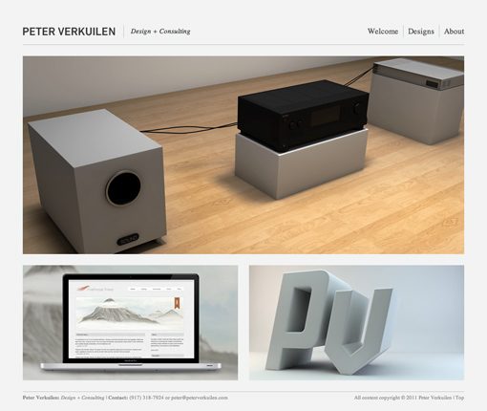
Three Box
Powerful Layouts

Slide 15

Powerful Layouts
3D Effects

Slide 16
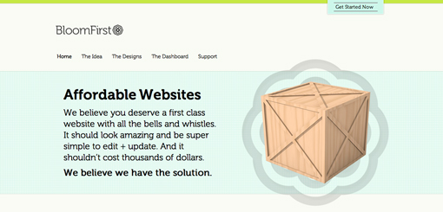
Powerful Layouts
Featured Graphic

Slide 17
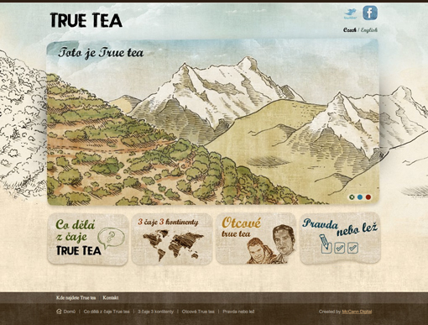
Powerful Layouts
Five Boxes

Slide 18
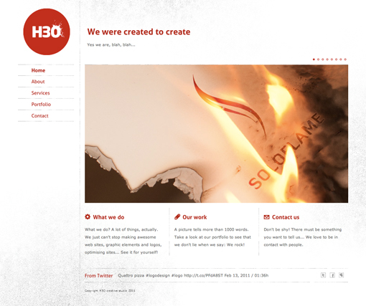
Powerful Layouts
Fixed Sidebar

Slide 19
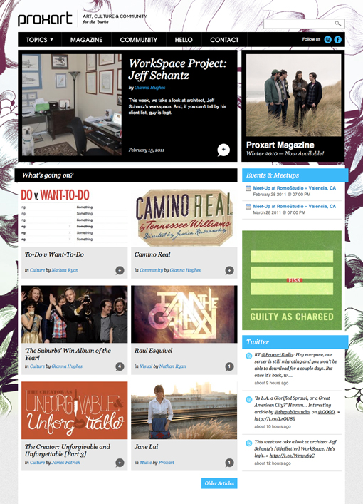
Powerful Layouts
Power Grid

Slide 20
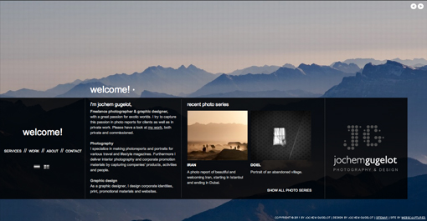
Powerful Layouts
Full Screen Photo

Slide 21

Krugs Laws
Krug, S. Don’t Make Me Think: A Common Sense Approach to Web Usability
(PDF is available using a Google search)

Slide 22
What?
Krugs Laws
Don’t Make me Think!

Slide 23
What?
Krugs Laws
Don’t Make me Think!

Slide 24

I Just Want a Laptop
Krugs Laws
Don’t Make me Think!

Slide 25


Colours!
Krugs Laws
Don’t Make me Think!
Has anyone ever instantly notices the search box at the top of the apple website?
Much better in iTunes

Slide 26
Going WAY to far
Krugs Laws
Don’t Make me Think!

Slide 27
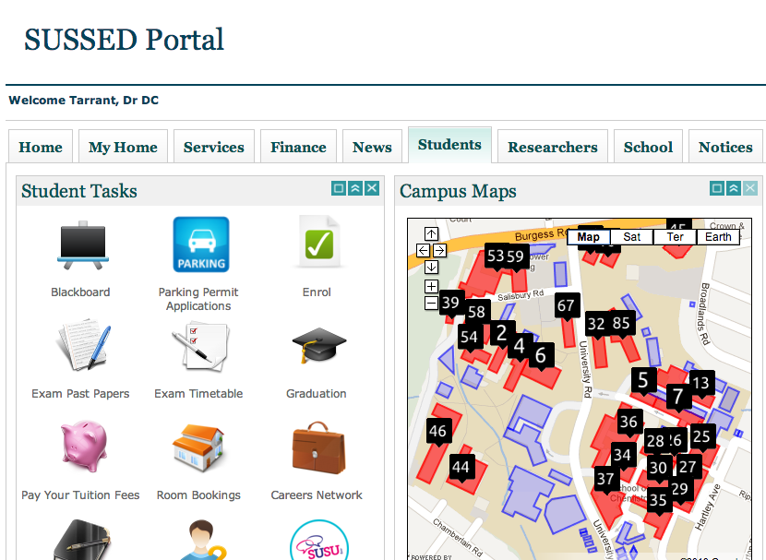
Krugs Laws
Don’t Make me Think!

Slide 28
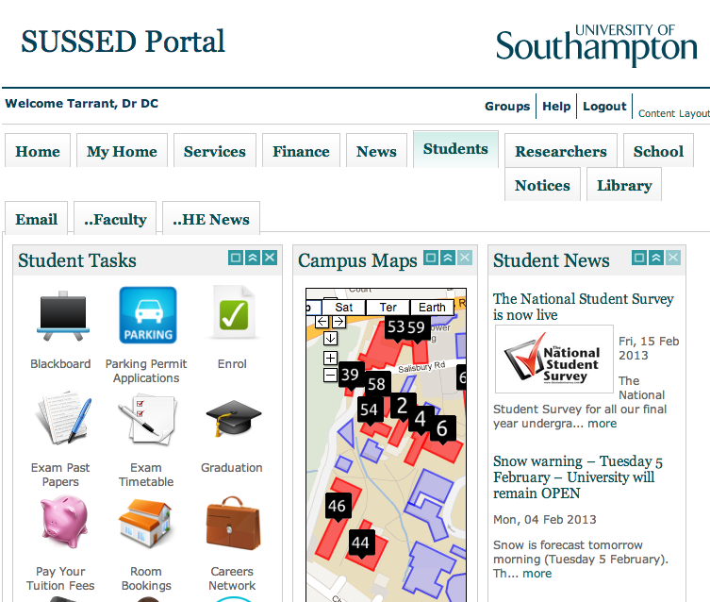
Krugs Laws
Don’t Make me Think!

Slide 29
Krugs Laws
Don’t Make me Think!
How many clickable links?

Slide 30

What Website?
Krugs Laws
Don’t Make me Think!

Slide 31
The Trunk Test
Site ID
  What website is this?
Page Name
  What page am I on?
Sections
  What are the major sections of this site?
Local Navigation
  What are my options at this level?
“You Are Here”
  Where am I in the scheme of things?
Search
  How can I search?

Slide 32
Exercise
In a group of two, do a very quick trunk test on the five sites in your pack.
Then pick one of the sites and sketch a quick re-design that improves the trunk test but does not remove content.

Slide 33
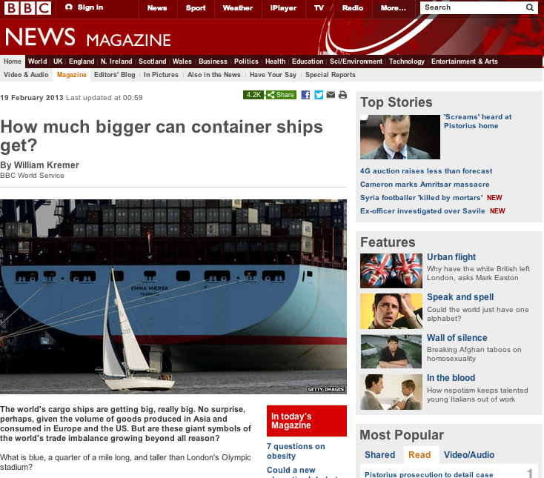
“You Are Here”
Site ID
Search
Sections
Page Title
Local Navigation?

Slide 34
The Trunk Test

Slide 35
The Trunk Test

Slide 36
The Trunk Test

Slide 37
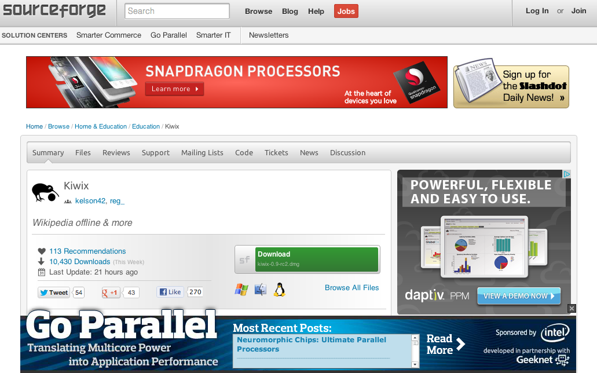
The Trunk Test

Slide 38
The Trunk Test

Slide 39
The Trunk Test
Notes:
“Annuities Step by Step” looks like the page name, but it’s not.
The page name is actually “Fund other plans first,” but you wouldn’t know it because(a) there’s no page name, and (b) there’s no “You are here” indicator in the list on the left.
And there’s no search box or search button, which is amazing for a site as large and varied(and full of useful content) as Quicken.com.

Slide 40
The Trunk Test
Notes:
I’ve added...
> A page name at the top of the content space,
> A “You are here” indicator in the list on the left, and
> A search link, in the Utilities list.

Slide 41
The Trunk Test
Notes:
The Site ID is below the navigation, and hard to spot. It looks too much like the internal promo next to it, and because the Site ID isn’t in the upper left corner, it ends up looking like an ad.
The heading DVD is positioned above the link Audio/Video Main, but it is lower in the hier- archy. And there’s no search, which is baffling in a large e-commerce site full of products.

Slide 42
The Trunk Test
Notes:
I moved the link to Audio/Video above the page name, so the visual hierarchy matches the logical hierarchy. I also made the page name a little more prominent, and moved it flush left instead of centered.(In most cases, I find left or right alignment is more effective than centering in “telegraphing” a visual hierarchy.)
For the same reason, I moved the search button next to the search box, instead of centered below it.

Slide 43
The Trunk Test
Notes:
The navigation is spread out all over the page, making it much harder to tell what’s navigation and what isn’t. The navigation, ads, promos, and content all run together.
There is no list of major sections. The list at the top looks like sections, but it’s actually a list of other sub-sites of CNET.com. What makes it particularly confusing is that Builder.com (the site I’m in) doesn’t appear in that list.
The only navigation that tells me where I am in Builder.com is the Breadcrumbs.
It’s also hard to tell where the content actually starts. This is one of those pages that seems to keep starting over, forcing you to scroll down just to find out what it is.

Slide 44
The Trunk Test
Notes:
This is one of those pages where you have to have the gumption to say, "This is beyond tweaking." There are underlying dilemmas here that need to be resolved before you even think about the page layout.
All I did was tighten up the top a little and try to make the content space easier to spot by adding a background to the column on the left.
At the same time, I made sure that the page name was positioned so it was clearly connected to the content space.

Slide 45
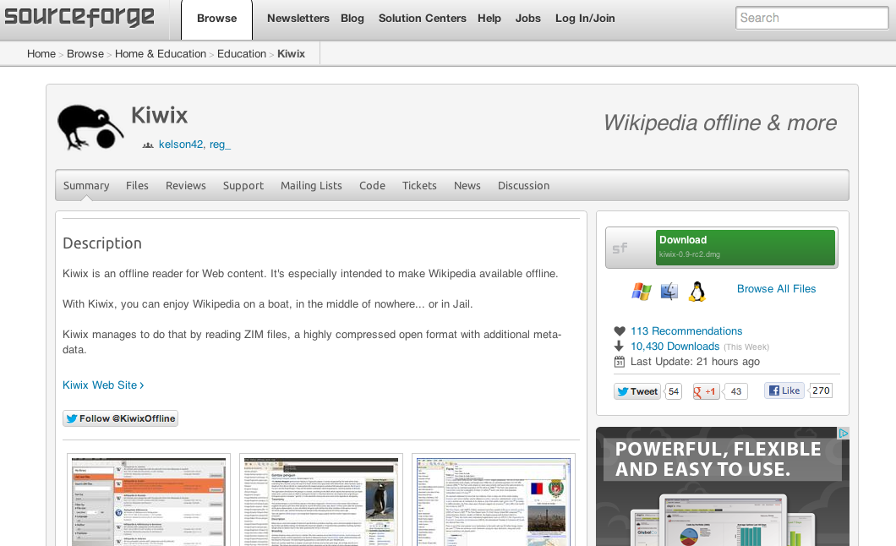
The Trunk Test

Slide 46
The Trunk Test
Notes:
Not much. Did you have trouble finding anything?
I rest my case.

Slide 47
The Trunk Test
Notes:
There’s really almost nothing to improve here.
I did redo the search.(I don’t know why they used "Enter Keywords" here when they use just plain "Search" almost everywhere else in the site.)
And if you’re going to scope a search, it’s worth adding the word "for" so it reads like a sentence: "Search ___ for ___."
I also made the page name a little more prominent to help make the division between the content and navigation spaces even clearer.

Slide 48
References
Krug, S. Don’t Make Me Think: A Common Sense Approach to Web Usability
(PDF is available using a Google search)
Unger, R. Chandler, C. A Project Guide to UX Design
(Chapter 10 Only)
Rogers, Y. et al. Interaction Design: Beyond Human-Computer Interaction

