Slide 1
Data Storage
COMP3017 Advanced Databases
Dr Nicholas Gibbins - nmg@ecs.soton.ac.uk 2012-2013

Slide 2
Hardware

Slide 3
The Memory Hierarchy: Cache
Volatile storage
Very fast, very expensive, limited capacity
Hierarchical
Typical capacities and access times:
Registers – ~10¹ bytes, 1 cycle
L1 – ~10⁴ bytes, <5 cycles
L2 – ~10⁵ bytes, 5-10 cycles
Cache
Main Memory
Secondary Storage
Tertiary Storage
Notes:
Typical figures – Intel Xeon E5-2407 - $250
32B of gp registers
L1 32kiB per core SRAM
L2 256 kiB per core DRAM
L3 10 MiB

Slide 4
The Memory Hierarchy: Main Memory
Volatile storage
Fast, affordable, medium capacity
Typical capacity: 10⁹-10¹⁰ bytes
Typical access time: 10⁻⁸ s (20-30 cycles)
Cache
Main Memory
Secondary Storage
Tertiary Storage
Notes:
Typical figures – Intel Xeon E5-2407

Slide 5
The Memory Hierarchy: Secondary Storage
Non-volatile storage
Slow, cheap, large capacity
Typical capacity: 10¹¹-10¹² bytes
Typical access time: 10⁻³ s (10⁶ cycles)
Cache
Main Memory
Secondary Storage
Tertiary Storage
Notes:
Typical figures – Intel Xeon E5-2407

Slide 6
The Memory Hierarchy: Tertiary Storage
Non-volatile storage
Very slow, very cheap, very large capacity
Typical capacity: 10¹³-10¹⁷ bytes
Typical access time: 10¹-10² s
Cache
Main Memory
Secondary Storage
Tertiary Storage
Notes:
Typical figures – Intel Xeon E5-2407

Slide 7
Hard Disks
Typical storage medium for databases
The focus of this lecture!
Terms:
Platter, surface, head, actuator, cylinder, track, sector, block, gap

Slide 8
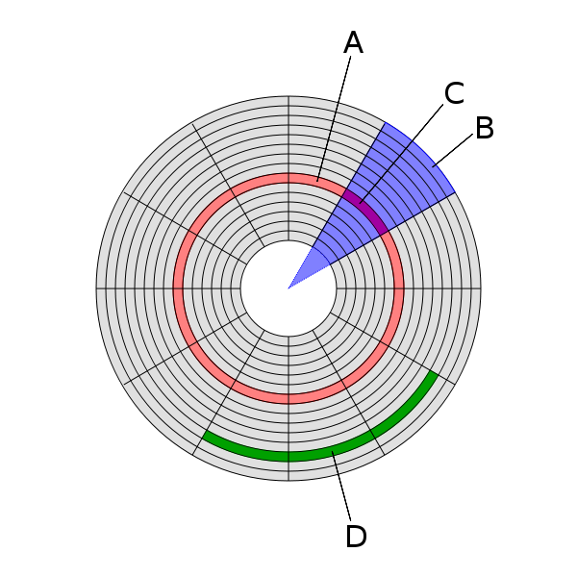
Disk Structure
A – track
B – geometrical sector
C – track sector
D – cluster

Slide 9
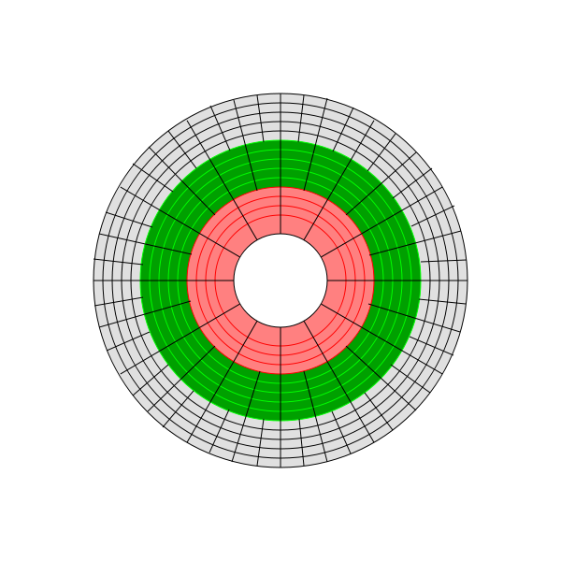
Zone Bit Recording
Tracks closer to the disc edge are longer than those closer to the axis
Bit densities vary in order to ensure a constant number of bits per sector
Instead, we can vary the number of sectors per track (depending on track location)
Improves overall storage density

Slide 10
Disk Access Time: Reading
Access Time = Seek Time + Rotational Delay + Transfer Time
block requested
access time
block in memory

Slide 11
Seek Time
Time taken for head assembly to move to a given track
Average seek time range:
4ms for high end drives
15ms for mobile devices

Slide 12
Rotational Delay
Average delay = time for 0.5 rev
Rotational speed [rpm] | Average delay [ms]
4,200 | 7.14
5,400 | 5.56
7,200 | 4.17
10,000 | 3.00
15,000 | 2.00
head
position
requested
block

Slide 13
Transfer Time
Transfer rate ranges from:
up to 1000 Mbit/sec
432 Mbit/sec 12x Blu-Ray disk
1.23 Mbits/sec 1x CD
for SSDs, limited by interface e.g., SATA 3000 Mbit/s
Transfer time = block size / transfer rate

Slide 14
Sequential Access
So far, random access - what about reading “next” block?
Access time = ( block size / transfer rate ) + negligible costs
Negligible costs:
skip inter-block gap
switch track (within same cylinder)
switch to adjacent cylinder occasionally
In general, sequential i/o is much less expensive than random i/o
Notes:
if double buffer, stagger blocks, etc
random: 10ms
seq: 1ms

Slide 15
Disk Access Time: Writing
Costs similar to those for reading, unless we wish to verify data
Verifying requires that we read the block we’ve just written
Access Time = Seek Time + Rotational Delay (1/2 rotation) + Transfer Time (for writing) + Rotational Delay (full rotation) + Transfer Time (for verifying)

Slide 16
Disk Access Time: Modifying
Read Block
Modify in Memory
Write Block
Verify Block (optional)

Slide 17
Disk Access Time: Modifying
Access Time = Seek Time + Rotational Delay (1/2 rotation) + Transfer Time (for reading) + Rotational Delay (full rotation) + Transfer Time (for writing) + [ Rotational Delay (full rotation) + Transfer Time (for verifying) ]

Slide 18
Block Addressing
Cylinder-head-sector
Physical location of data on disk
ZBR causes problems (sectors vary by tracks)
Logical Block Addressing
Blocks located by integer index
HDD firmware maps LBA addresses to physical locations on disk
Allows remapping of bad blocks

Slide 19
Block Size Selection?
The size of blocks affects i/o efficiency:
Big blocks reduce the costs of access
Fewer seeks (seek time + rotational delay) for the same amount of data
Big blocks also increase the amount of irrelevant data read
If you’re trying to read a single record in a block, larger blocks force you to read more data

Slide 20
The Five Minute Rule

Slide 21
Five Minute Rule
The Five Minute Rule for trading memory for disc accesses Jim Gray & Franco Putzolu May 1985
The Five Minute Rule, Ten Years Later Goetz Graefe & Jim Gray December 1997

Slide 22
Five Minute Rule
Say a page is accessed every X seconds
CD = cost if we keep that page on disk
$D = cost of disk unit
I = numbers IOs that unit can perform
In X seconds, unit can do XI IOs
So CD = $D / XI

Slide 23
Five Minute Rule
Say a page is accessed every X seconds
CM = cost if we keep that page on RAM
$M = cost of 1 MB of RAM
P = numbers of pages in 1 MB RAM
So CM = $M / P

Slide 24
Five Minute Rule
Say a page is accessed every X seconds
If CD is smaller than CM,
keep page on disk
else keep in memory
Break even point when CD = CM, or X = ($D P) / (I $M)

Slide 25
Using 1997 numbers
P = 128 pages/MB (8KB pages)
I = 64 accesses/sec/disk
$D = 2000 dollars/disk (9GB + controller)
$M = 15 dollars/MB of DRAM
X = 266 seconds (about 5 minutes) (did not change much from 1985 to 1997)

Slide 26
Disk Organisation

Slide 27
Overview
Data Items
Records
Blocks
Files

Slide 28
Data Items

Slide 29
Data Items
We might wish to store:
a salary
a name
a date
a picture

Slide 30
Data Items
We have: bytes
8 bits

Slide 31
Representing numbers
Integer (short): 2 bytes
e.g. 57 is
Real numbers: IEEE 754 (floating point)
1 bit sign, n bits for mantissa, m bits for exponent
0
0
0
0
0
0
0
0
0
0
1
1
1
0
0
1

Slide 32
Representing characters
Various coding schemes: ASCII, utf-8
‘A’
‘c’
CR
0
1
0
0
0
0
0
1
0
1
1
0
0
0
1
1
0
0
0
0
1
1
0
1

Slide 33
Representing booleans
1 byte per value
True
False
We can pack more than one value per byte, if we’re desperate
1
1
1
1
1
1
1
1
0
0
0
0
0
0
0
0

Slide 34
Representing dates
Days since a given date (integer)
1st Jan 1900
1st Jan 1970 (UNIX epoch)
ISO8601 dates
Calendar dates: YYYYMMDD (8 characters)
Ordinal dates: YYYYDDD (7 characters)

Slide 35
Representing times
Seconds since midnight (integer)
ISO8601 times
HHMMSS (6 characters)
HHMMSSFF (8 characters, to represent fractional seconds)

Slide 36
Representing strings
Null terminated
Length given
Fixed length
E
C
S
...
3
E
C
S
...
E
C
S

Slide 37
Representing bit arrays
length
bits

Slide 38
In general...
Data items are either
Fixed length (integers, characters, etc)
Variable length (strings, bit arrays) usually with length given at start
May also include type of data item
Tells us how to interpret the item
Tells us size, if fixed

Slide 39
Records

Slide 40
Records
Collection of related data items (fields)
e.g. Employee record consists of:
name field
salary field
employment start date field

Slide 41
Record types
Records may have fixed or variable formats
Records may have fixed or variable lengths

Slide 42
Fixed format records
Schema describes the structure of records:
number of fields
types of fields
order in record
meaning of each field

Slide 43
Example: Fixed format record
Employee record structure:
e#, 2 byte integer
name, 10 char
dept, 2 byte code
schema
5 5
s m i t h
0 2
records
8 3
j o n e s
0 1

Slide 44
Variable format records
Schema-less format
Record itself contains format: “self-describing”
Useful for sparse records, repeating fields, evolving formats
May waste space compared to a fixed format records
Notes:
But repeating fields does not require variable format

Slide 45
Example: Variable format record
code identifying field as name
string type
string length
no. of fields
2
5 I 4 6
4 S 4 F o r d
integer type
code identifying field as e#

Slide 46
Record headers
Data at beginning of record that describes record:
record type (points to schema)
record length
timestamp
Intermediate between fixed and variable format

Slide 47
Blocks

Slide 48
Storing records in blocks
5 5
s m i t h
0 2
8 3
j o n e s
0 1
records
2
5 I 4 6
4 S 4 F o r d
8 3
j o n e s
0 1
2
5 I 4 6
4 S 4 F o r d
5 5
s m i t h
0 2
8 3
j o n e s
0 1
blocks
...
file
Notes:
Assume fixed-length blocks
Assume single file

Slide 49
Placing records in blocks
Considerations:
separating records
spanned vs. unspanned
sequencing
indirection

Slide 50
Separating records in a block
Block
Three approaches:
use fixed length records - no need to separate
use a special marker to indicate record end
give record lengths (or offsets)
within each record
in block header
R1
R2
R3

Slide 51
Spanned vs. Unspanned
Unspanned: each records must fit within a single block
Spanned: records may be split between blocks
R1
R2
R3
R4
R5
R1
R2
R3
(a)
R3
(b)
R4
R5
R6
R7
(a)

Slide 52
Spanned records
R1
R2
R3
(a)
R3
(b)
R4
R5
R6
R7
(a)
need indication of partial record “pointer” to rest
need indication of continuation (from where?)

Slide 53
Spanned vs. Unspanned
Unspanned records are much simpler, but may waste space…
Spanned records are essential if record size > block size

Slide 54
Sequencing
Sequencing: ordering records in file (and block) by some key value
Makes it possible to efficiently read records in order
e.g., to do a merge-join — discussed later in module

Slide 55
Sequencing Options
Next record physically contiguous:
Linked records:
R1
Next (R1)
R1
Next (R1)

Slide 56
Sequencing Options
Overflow area
header
R1
R2.1
Records
in sequence
R2
R1.3
R3
R4.7
R4
R5

Slide 57
Indirection
How do we refer to records?
Many options:
physical addressing
indirect addressing
other options in between
Tradeoff between:
flexibility (easier to move records on insertion/deletion)
cost (of maintaining indirection)
Rx

Slide 58
Physical Addressing
Device ID Cylinder no.
Track no.
Block no.
Offset in block
Record ID =
Block ID

Slide 59
Indirect Addressing
Record ID is arbitrary bit string
map
Record ID | Physical Address
id
physical
address

Slide 60
Indirection in block
Typical implementation
Records can be shifted within block without changing RID
Access to a given RID is fast – only a single block access needed
header
RID for r
Record r
Block
number
Block offset
Block p

Slide 61
Block header
Data at beginning that describes block
May contain:
File ID (or RELATION or DB ID)
This block ID
Record directory
Pointer to free space
Type of block (e.g. contains recs type 4; is overflow, …)
Pointer to other blocks “like it”
Timestamp ...

Slide 62
Insertion and Deletion

Slide 63
Insertion: the easy case
Records not in sequence
Insert new record at end of file or in deleted slot
If records are variable size, not as easy...

Slide 64
Insertion: the hard case
Records in sequence
If free space “close by”, not too bad...
Or use overflow idea...

Slide 65
Insertion considerations
How much free space to leave in each block, track, cylinder?
How often do I reorganize file + overflow?
Free
space

Slide 66
Deletion
block
Rx
Two main options:
Immediately reclaim space
Mark space as deleted

Slide 67
Deletion marking
May need a chain of deleted records (for re-use)
Need a way to mark deleted records:
special characters
delete field
in map

Slide 68
Deletion tradeoffs
How expensive is to move valid record to free space for immediate reclaim?
How much space is wasted?
e.g., deleted records, delete fields, free space chains,...

Slide 69
Deletion considerations
How do we deal with dangling pointers
R1
?

Slide 70
Tombstones
Leave “MARK” in map or old location
Physical IDs
A block
This space This space can
never re-used be re-used

Slide 71
Tombstones
Leave “MARK” in map or old location
Logical IDs
map
ID
LOC
Never reuse
ID 7788 nor
space in map...
7788

Slide 72
Buffer Management

Slide 73
Buffering
We have a file that consists of blocks B1, B2, ...
We have a program that processes the file block-by-block

Slide 74
Single Buffering
Read B1 → Buffer
Process Data in Buffer
Read B2 → Buffer
Process Data in Buffer ...

Slide 75
Single Buffering
Memory
Disk
B1
B2
B3
B4
B5
B6
B7

Slide 76
Single Buffering
processing
Memory
B1
Disk
B1
B2
B3
B4
B5
B6
B7

Slide 77
Single Buffering
Memory
Disk
B1
B2
B3
B4
B5
B6
B7

Slide 78
Single Buffering
processing
Memory
B2
Disk
B1
B2
B3
B4
B5
B6
B7

Slide 79
Single Buffering
Memory
Disk
B1
B2
B3
B4
B5
B6
B7

Slide 80
Single Buffering Cost
Single buffer time = n(P + R) where P = time to process a block R = time to read a block n = number of blocks

Slide 81
Double Buffering
Use a pair of buffers:
While reading a block and writing into buffer A
Process block previously read into buffer B
After block read into A, process A and read next block into B

Slide 82
Double Buffering
Memory
A
B
Disk
B1
B2
B3
B4
B5
B6
B7

Slide 83
Double Buffering
processing
Memory
A
B1
B
Disk
B1
B2
B3
B4
B5
B6
B7

Slide 84
Double Buffering
processing
Memory
A
B
B2
Disk
B1
B2
B3
B4
B5
B6
B7

Slide 85
Double Buffering
processing
Memory
A
B3
B
Disk
B1
B2
B3
B4
B5
B6
B7

Slide 86
Double Buffering
If time to process a block > time to read a block:
Double buffer time = R + nP
Single buffer time = n(R+P)

Slide 87
Address Management
Every block and record has two addresses:
a database address (when in secondary storage)
a memory address (when copied into main memory)
When in main memory, using memory addresses (= pointers) is more efficient
Otherwise, translation table is required:
converts database address
into current memory address

Slide 88
Pointer Swizzling
General term for techniques used to translate database address space to virtual memory address space
Swizzled pointers consist of
One bit to indicate whether the pointer is a database address or a memory address
Database or memory pointer, as appropriate

Slide 89
Swizzling
Memory
Disk
block 1
block 2

Slide 90
Swizzling
Memory
Disk
load into
memory
swizzled
pointer
unswizzled
pointer

Slide 91
Swizzling
Memory
Disk
swizzled
pointer
load into
memory

Slide 92
Swizzling Strategies
Automatic
As soon as block brought into memory, locate all pointers and addresses and enter them into translation table
Replace pointers in blocks with new entries
On Demand
Leave all pointers unswizzled when block in brought into memory
Swizzle pointers only when dereferenced
No swizzling
Use translation table to map pointers on each dereference

Slide 93
Unswizzling
Reverse of the swizzling operation
When a block is written back to disk, rewrite swizzled pointers using the translation table
Need to beware of pinned blocks (that cannot yet be safely written to disk)
Notes:
Pinned due to recovery operations
Pinned due to references from other blocks in memory

Slide 94
Column Stores

Slide 95
Row vs Column Store
So far we assumed that fields of a record are stored contiguously (row store)...
Another option is to store like fields together (column store)

Slide 96
Row Store
Example: Order consists of
id, cust, prod, store, price, date, qty

Slide 97
Column Store
Example: Order consists of
id, cust, prod, store, price, date, qty
ids may or may not be stored explicitly

Slide 98
Row vs Column Store
Advantages of Column Store
more compact storage (fields need not start at byte boundaries)
efficient reads on data mining operations
Advantages of Row Store
writes (multiple fields of one record)more efficient
efficient reads for record access (OLTP)

Slide 99
Storage Comparison

Slide 100
Tradeoffs
Flexibility
Use of space
Complexity
Performance

Slide 101
Choosing
To evaluate a given strategy, compute following parameters:
space used for expected data
expected time to
fetch record given key
fetch record with next key
insert record
append record
delete record
update record
read all file
reorganize file

Slide 102
Further Reading

Slide 103
Further Reading
Chapter 13 of Garcia-Molina et al
Gray, J. and Putzolu, F. 1987. The 5 minute rule for trading memory for disc accesses and the 10 byte rule for trading memory for CPU time. Proceedings of SIGMOD 1987, 395-398.
Gray, J. and Graefe, G. 1997. The five-minute rule ten years later, and other computer storage rules of thumb. SIGMOD Record. 26(4), 63-68.
Graefe, G. 2009. The five-minute rule 20 years later (and how flash memory changes the rules). Communications of the ACM. 52(7), 48-59.

