Slide 1
Knowledge Representation
Dr David Tarrant
Dr Charlie Hargood
University of Southampton
This work is licensed under a Creative Commons Attribution 3.0 Unported License.
Image attribution included when available.

Slide 2
Open Data
<DATA>
Open data is information
that is available for anyone to use,
for any purpose,
at no cost.

Slide 4
★ | Available on the web (whatever format) but with an open licence, to be Open Data
★★ | Available as machine-readable structured data (e.g. excel instead of image scan of a table)
★★★ | as (2) plus non-proprietary format (e.g. CSV instead of excel)
★★★★ | All the above plus, Use open standards from W3C (RDF and SPARQL) to identify things, so that people can point at your stuff
★★★★★ | All the above, plus: Link your data to other people’s data to provide context

Slide 5
Exercise 1
<DATA>
Locate a number of different sources of open datasets and pick one dataset from each.
Identify which star rating the dataset is?
What license is the dataset available under?
How is this license referenced?
What features make this data set usable (or not)?

Slide 6
Exercise 2
<DATA>
Over the weekend, update your ECS profile.
www.ecs.soton.ac.uk/people/username
Then look at the data form.
P.S. Do not change your name to “Professor”, it’s only funny the first time!

Slide 7
The Problem
★★ | Available as machine-readable structured data (e.g. excel instead of image scan of a table)

Slide 8
Evolution
Reorganisation
Optimisation
Streamlining
Alignment
Simplification
Confusion
One Way Stock - http://www.flickr.com/photos/paulbrigham/

Slide 9
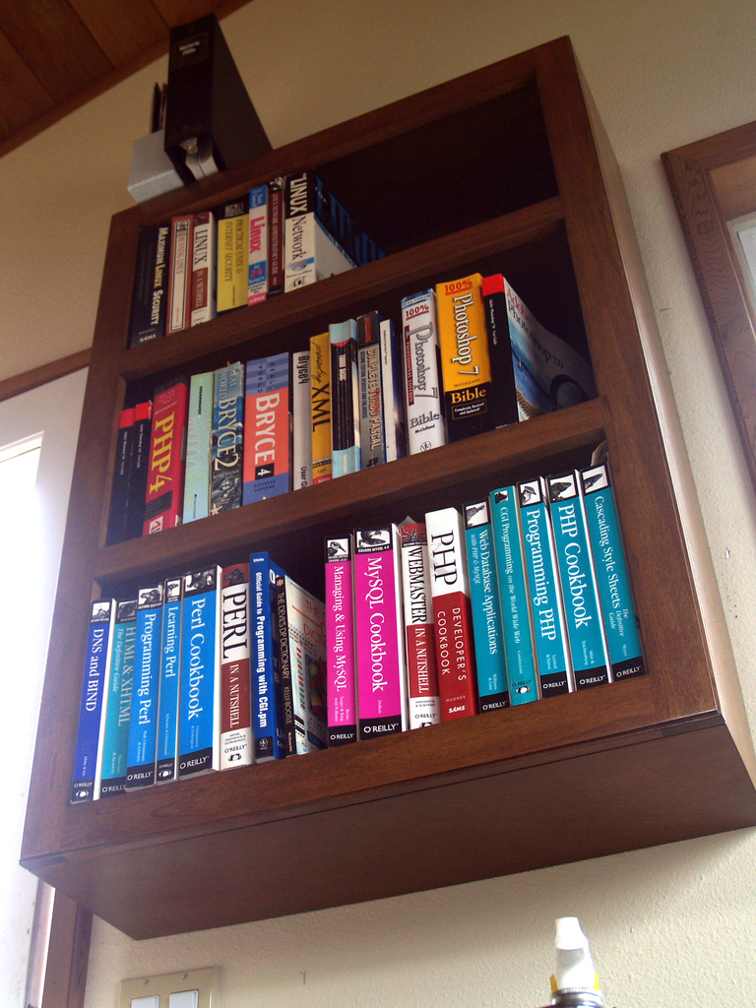
In the Beginning
http://www.flickr.com/photos/simonov/476780331/

Slide 10
In the Beginning
Breaking out of the data model
http://www.flickr.com/photos/simonov/476780331/

Slide 11
Evolution
http://www.flickr.com/photos/andyi/2369617357/

Slide 12
Google Anyone?

Slide 13
Knowledge Representation Languages

Slide 14
changelog
1.0.0
Initial data model
1.0.1
Fixed spelling error in label of column 9
1.1.0
Added new columns for managing expenditure
1.1.1
Re-ordered the set of columns relating to geo-location
2.0.0
Simplified the data model to use geographic normalised references rather than latitude, longitude, constituency and postcode.
2.0.1
Fixed transition errors in resolving old geo-locations to new references

Slide 15
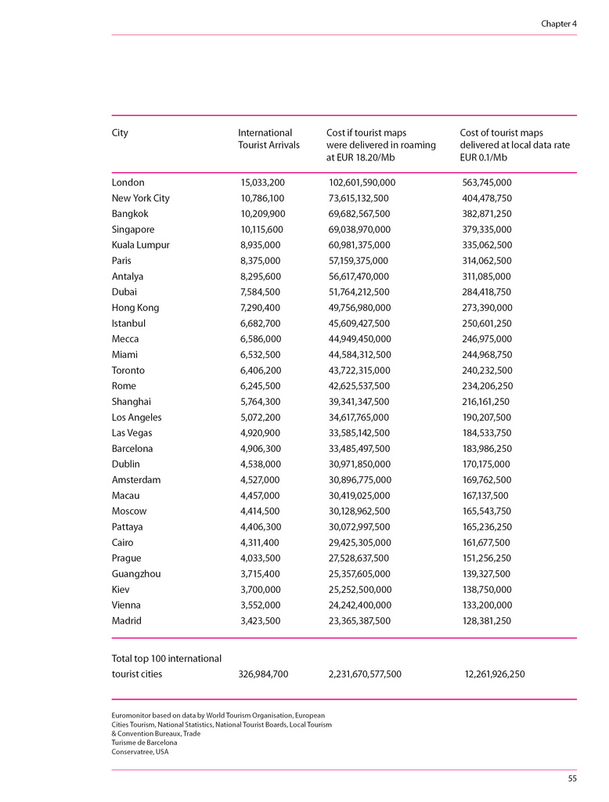
Tabular Data
http://www.flickr.com/photos/interlace-invent/4856781601/

Slide 16
Tabular Data
Labels
Units
Data
http://www.flickr.com/photos/interlace-invent/4856781601/

Slide 17
changelog
1.0.0
Initial data model
1.0.1
Fixed spelling error on label of column 9
1.1.0
Added new columns for managing expenditure
1.1.1
Re-ordered the set of columns relating to geo-location
2.0.0
Simplified the data model to use geographic normalised references rather than latitude, longitude, constituency and postcode.
2.0.1
Fixed transition errors in resolving old geo-locations to new references

Slide 18
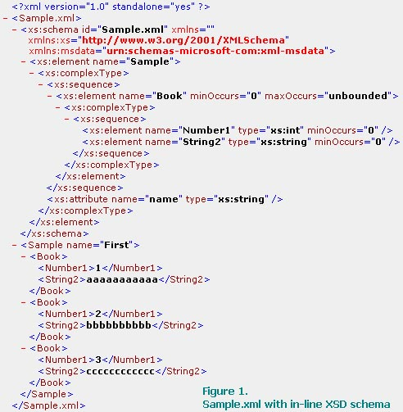
XML

Slide 19
changelog
1.0.0
Initial data model
1.0.1
Fixed spelling error in label of column 9
1.1.0
Added new columns for managing expenditure
1.1.1
Re-ordered the set of columns relating to geo-location
2.0.0
Simplified the data model to use geographic normalised references rather than latitude, longitude, constituency and postcode.
2.0.1
Fixed transition errors in resolving old geo-locations to new references

Slide 20
XML
Cardinality
Units?
Labels
Data

Slide 21
changelog
1.0.0
Initial data model
1.0.1
Fixed spelling error in label of column 9
1.1.0
Added new columns for managing expenditure
1.1.1
Re-ordered the set of columns relating to geo-location
2.0.0
Simplified the data model to use geographic normalised references rather than latitude, longitude, constituency and postcode.
2.0.1
Fixed transition errors in resolving old geo-locations to new references

Slide 22
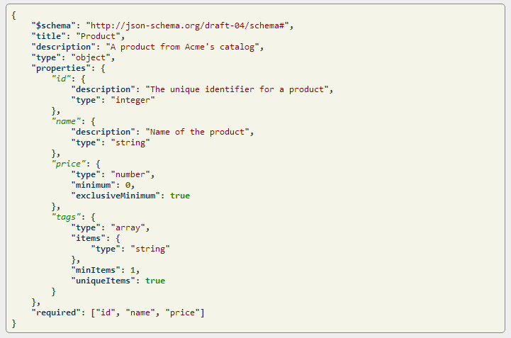
JSON

Slide 23
JSON
Data
Labels
Units/Datatype?
Cardinality

Slide 24
changelog
1.0.0
Initial data model
1.0.1
Fixed spelling error in label of column 9
1.1.0
Added new columns for managing expenditure
1.1.1
Re-ordered the set of columns relating to geo-location
2.0.0
Simplified the data model to use geographic normalised references rather than latitude, longitude, constituency and postcode.
2.0.1
Fixed transition errors in resolving old geo-locations to new references

Slide 25
RDF
<?xml version=“1.0”?>
<rdf:RDF xmlns:rdf=“http://www.w3.org/1999/02/22-rdf-syntax-ns#”
xmlns:dc=“http://purl.org/dc/elements/1.1/”>
<rdf:Description rdf:about=“http://www.sciam.com/”>
<dc:title>Scientific American</dc:title>
</rdf:Description>
</rdf:RDF>
http://www.sciam.com/
Scientific American
http://purl.org/dc/elements/1.1/title

Slide 26
RDF
<?xml version=“1.0”?>
<rdf:RDF xmlns:rdf=“http://www.w3.org/1999/02/22-rdf-syntax-ns#”
xmlns:dc=“http://purl.org/dc/elements/1.1/”>
<rdf:Description rdf:about=“http://www.sciam.com/”>
<dc:title>Scientific American</dc:title>
</rdf:Description>
</rdf:RDF>
Data
http://www.sciam.com/
Scientific American
http://purl.org/dc/elements/1.1/title
Label

Slide 27
changelog
1.0.1
Fixed spelling error in label of column 9
dc:tittle → owl:sameAs -> dc:title

Slide 28
Where is my data?
Tabular data emphasises the data
XML and JSON provide structure
Should users care?
http://www.flickr.com/photos/arlette/3260468/
Notes:
Stop telling me what to do. Stop hiding all my data behind your cruft.

Slide 29
Confusion
One Way Stock - http://www.flickr.com/photos/paulbrigham/

Slide 30
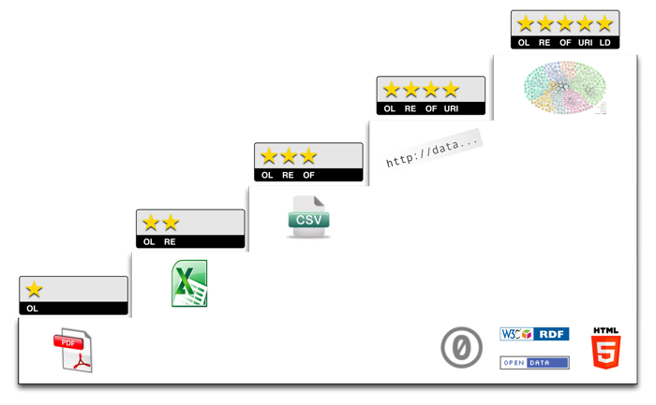
http://5stardata.info/

Slide 31
Errors In Data
Mixed Terms (Male, Female, M, F, Man, Woman)
Abbreviations and Word Order
Scientific American, SCI AM
Representation
05/02/13, 02/05/13, 2013-05-02
Semantics
dc:title = The Hobbit, dc:title = Dr

Slide 32
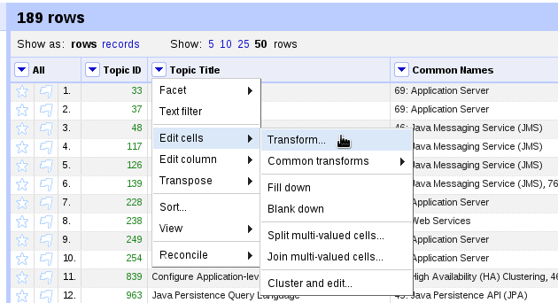
Cleaning Data
Dr Charlie Hargood

