Slide 1
Finding and Evaluation Information
Hugh Davis
COMP1205

Slide 2
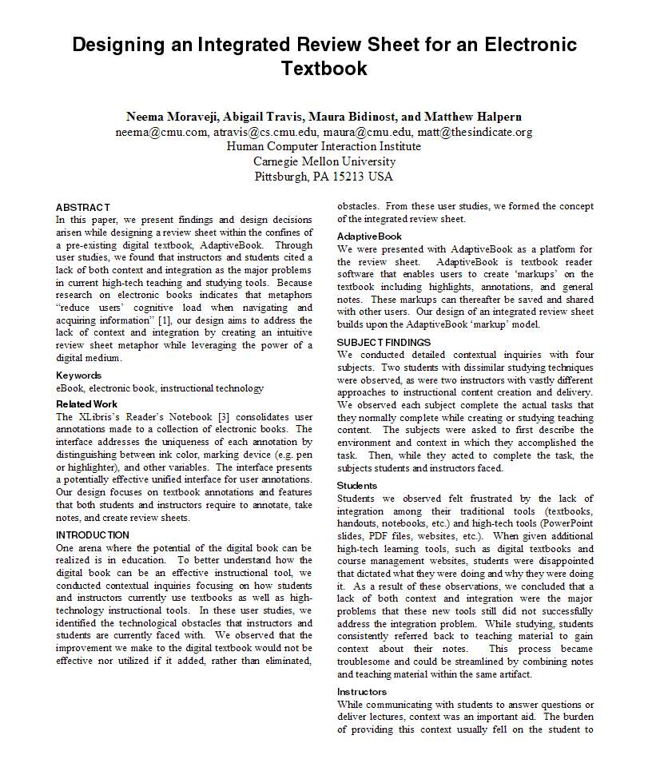
The Scholarly Trail
They cite a source which
will be “referenced” at
the end of the paper
The Blue bubbles are all “Citations”
This person said this
This person has done this
And this person said this
And this person has done this
“
And this
is my summary of this person’s work
”
And this quote came from here

Slide 3
What would make a good source?
A Facebook Page?
Someone’s Blog?
A company website?
A Newspaper Article?
A magazine?
A trade journal?
A talk presented at a conference?
A wikipedia page?
An open source pre-print journal paper?
A scholarly journal paper?
A book?

Slide 4
Why? What makes one source better than another?
We need sources to be
Authoritative
We must believe that the information is reliable and true
(and preferably written by the person who is the authority and not someone quoting them)
Findable
Your reader must be able to follow your reference to find the article or book in their library or on-line.
The thing they find must not have changed since you referenced it.

Slide 5
Where do we find sources of information
We may find useful references in articles and blogs that we have stumbled across by good fortune
More often we must conduct a search
Google
Google Scholar
Wikipedia (but only to follow up the references they have found)
The Library

Slide 6
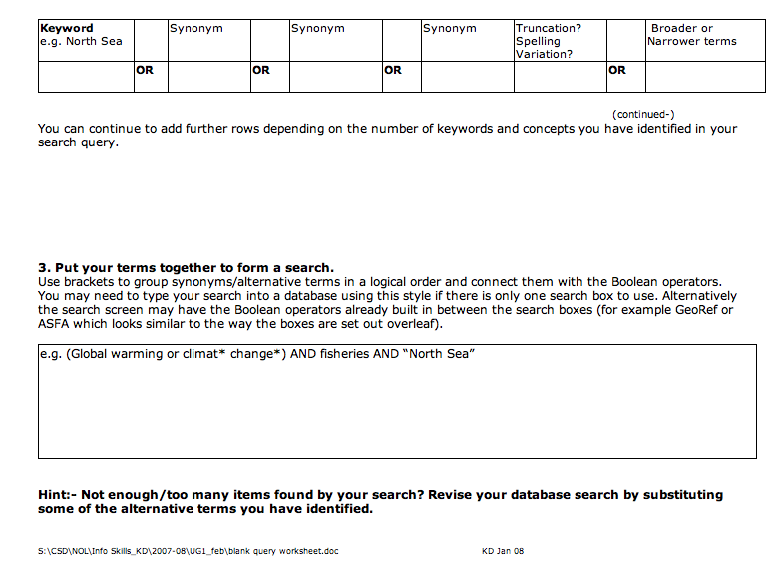
The Library Search Planner
This will be introduced in your activities this week

Slide 7
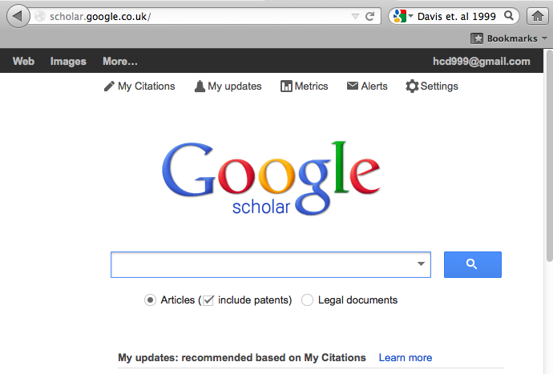
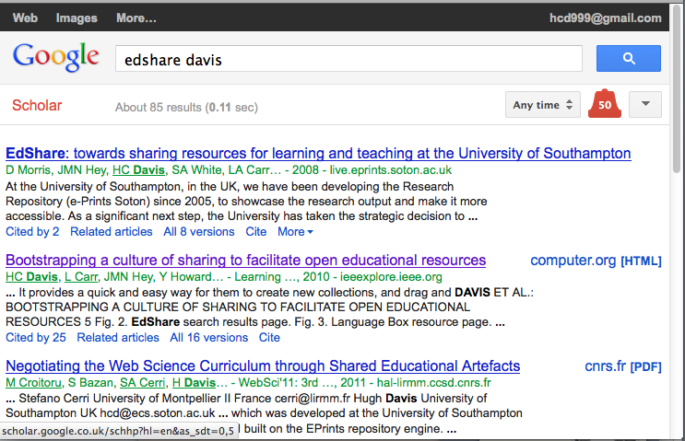
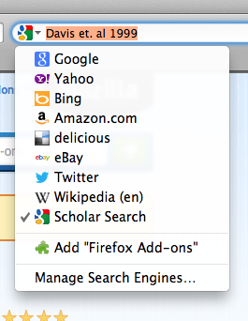
Google Scholar

Slide 8
The Library
Slides from Fiona Nichols larger presentation

Slide 9
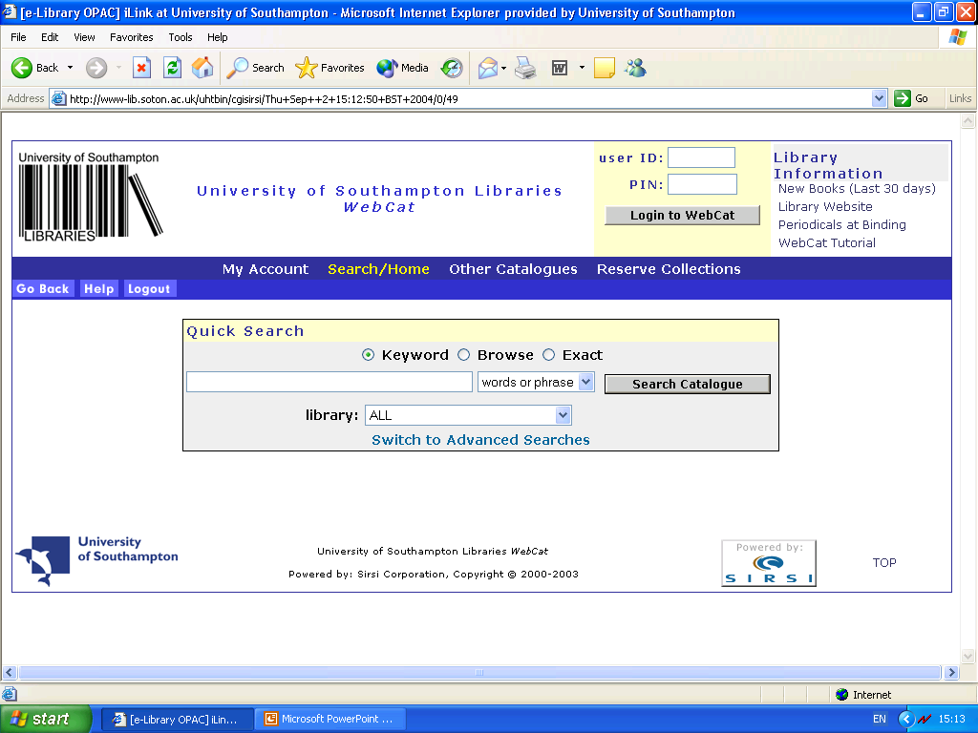
Tutorial link here
Login with your University ID and Library PIN (ask at the loans or a enquiry desk if you don’t have one) here for access to a number of very important features

Slide 10
You can type in some keywords

Slide 11
And get some results …

Slide 12
If all copies of a book are on loan use the Place Hold button to Reserve it.
This button also allows a book from another site to be transferred to Hartley
This book is at the Hartley Library. Call number (TK 7872.16GON) helps you find it on the shelf
We can even find out what’s shelved nearby …

Slide 13
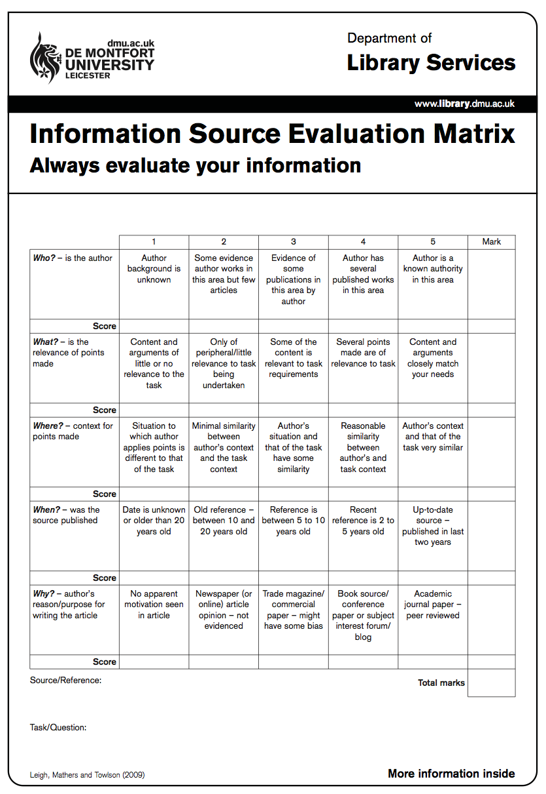
Evaluating the Sources you find
Who is the author
What is the relevance of the points made?
Is the context correct?
When was the source published?
What was the publication medium?

Slide 14
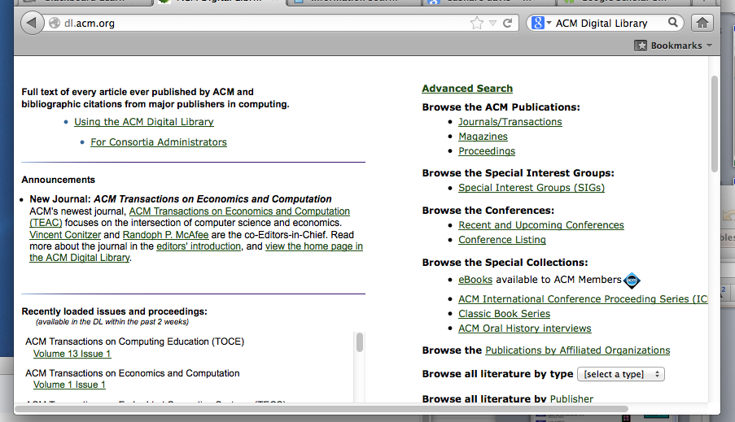
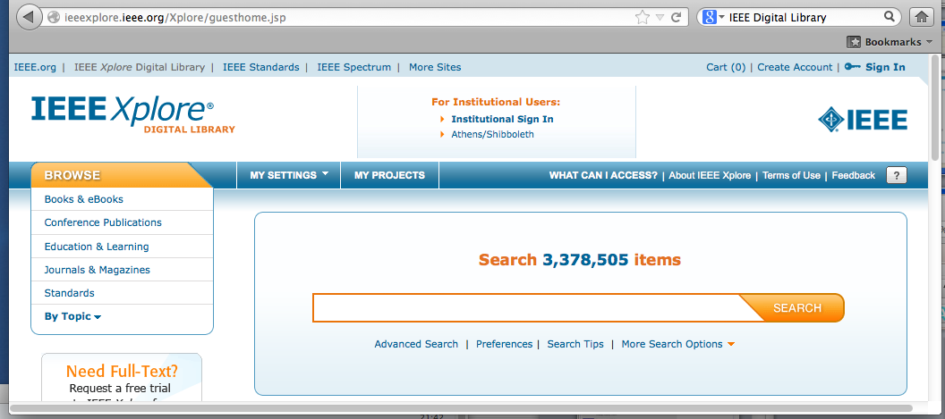
How to find the sources on-line
If you found a reference to an article in a journal, you can go to TDNET (in the Library) and find out if we are subscribed for access to that journal
If we are subscribed then you can go straight to the publishers sight and download the article.
Two important publishers/on-line libraries that you can access using a UoS IP are the ACM Digital Library and the IEEE Xplore

