Slide 1
Rich Applications info6005
Les Carr, Dave Tarrant
lac,davetaz@ecs.soton.ac.uk
Electronics and Computer Science
This work is licensed under a Creative Commons Attribution 3.0 Unported License.
Image attribution included when available.

Slide 2

Key Aim
Data Rich Applications and Open Data

Slide 3
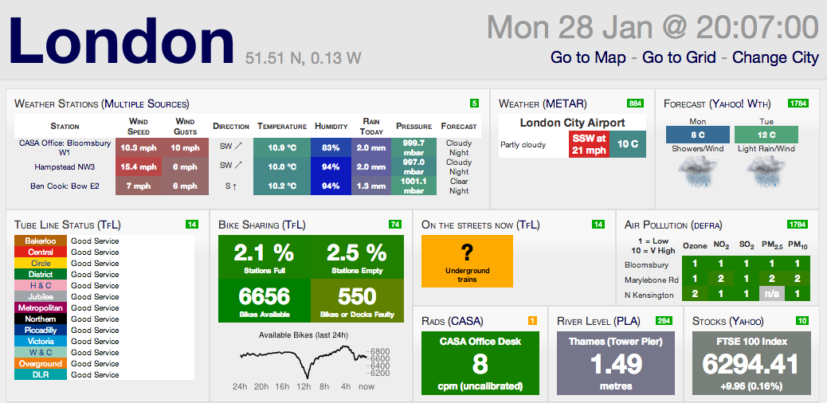
What is a data rich application?

Slide 4
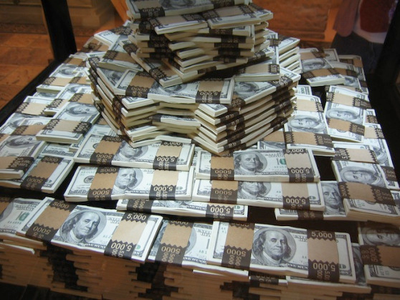
But what makes a rich application?

Slide 8
Applications and data are resources which can be used to build new applications… quickly.
Rich applications source data and services from many places to provide something new.
Presented in the correct way, a simple breakthrough can make a $RICH$ Application.

Slide 9
What makes a rich application?
Pretty
Addictive

Slide 10
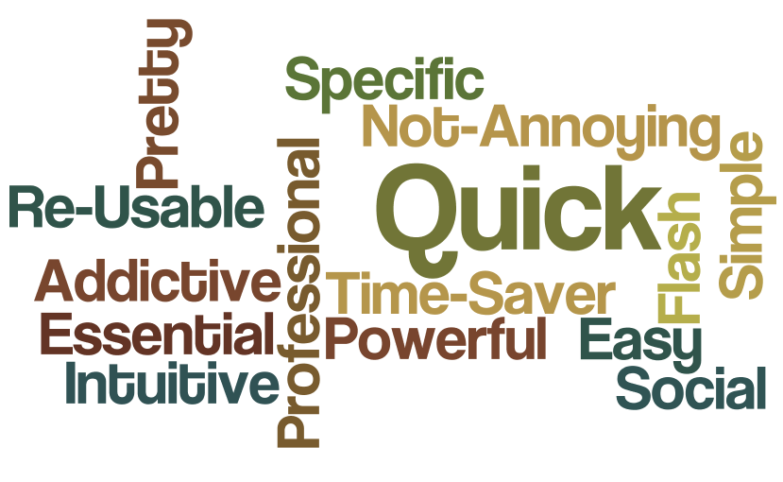
What makes a rich application?

Slide 11
From the Course Outline (1)
User centric (participatory) design
HCI, user experience, limitations and success factors
Top-down development and bottom-up design.
Now called UX Design
(User eXperience)

Slide 12
From the Course Outline (2)
Evidence based research in developing rich, maintainable and usable applications.
Main current debates within the discipline and theories informing these debates.

Slide 13

Lastly….
Agile

Slide 14
Recap…
In this module we are going to look at the benefit of using open data to develop rich applications.
By focusing on the end user and target market we are going to look at how to pitch a product and potential build a business.

Slide 15




Course Topics

Slide 16
Lectures
2 a week until after Easter.
Guest Lectures
  Will fit in schedule dependent on guest availability
Keep an eye on the website and turn up to find out what is happening.
www.ecs.soton.ac.uk/notes/info6005

Slide 17
Course Balance (Teaching)
“The Bigger Picture”
Technologies
Open Innovation
Marketing
Pitching
Psychology
Games
UX Design
Data
Linked-Data
APIs
Mash-ups
Validation
Alignment

Slide 18
Course Outline
First 5/6 Lectures
  Open Data
  Discovering Open Data
  Importing
  Validating
  Aligning
  Visualising
Coursework 1 - Visualisations

Slide 19
Coursework 1 - Visualisations
Take a given data set and visualize the data for discovery and exploration in at least two different ways.
Not sure if maps will be banned.
Individually assessed.
(To Be Confirmed)

Slide 20
Course Outline
~9 Lectures
  Rapid Innovation
  Mobile Development
  UX Theory and Evaluation
  Game Theory
  Addiction
  Open Innovation and IP
  Pitching
Coursework 2 – A Rich Application

Slide 21
Coursework 2 - Develop and Present a Rich Application (Group)
This is an open ended coursework however:
  It must use at least two sources of open data
  Must show good UX Design
  Must be a product with a target market
  Must use at least one technology outlined on this course.
  Must have a working prototype that demonstrates above (not necessarily complete).

Slide 22
Coursework 2 - Assessment
Each application will be pitched to a panel of professional judges (dragons)
  The Pitch is worth a lot of marks
Each application must be accompanied with report (~8 Pages, no more than 12) outlining design choices and target markets

Slide 23
Little tip for success on this course
Produce products, not code
(code is a tool used to produce a product)

Slide 24
Good Luck and Have Fun

