Slide 1
Data Types
COMP3017 Advanced Databases
Dr Nicholas Gibbins - nmg@ecs.soton.ac.uk
2012-2013

Slide 2
Overview
Data types and operations
Modelling data
Temporal data
Spatial data
Multimedia data

Slide 3
Data Types and Operations

Slide 4
Data Types
Numeric
Character
Temporal
Spatial
Image
Text
Audio and Video

Slide 5
Operations on Data
Comparison
Arithmetic
Fuzzy searches
Retrieve all documents that contain a given word
Find a picture that contains blue sky

Slide 6
Which operations are meaningful?
Can you add two weights together?
2kg + 2kg = ?
Can you multiply two weights?
2kg * 2kg = ?
Can you add a weight to a quantity?
13 + 2kg = ?
Can you multiply a weight by a quantity?
13 * 2 kg = ?

Slide 7
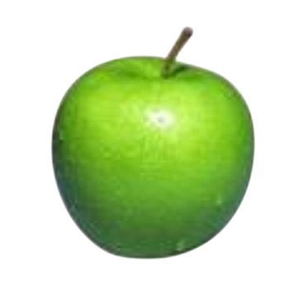
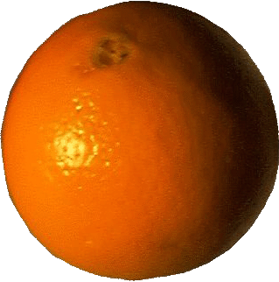
Which operations are meaningful?
Can you compare two images?
=

Slide 8
Which operations are meaningful?
Can you add two images?
+
= ?

Slide 9
Further Questions
Is the data ordered in any sense?
Total order vs. partial order
Does the order actually have any meaning, or is it just a convenience?
Notes:
total – integers
partial – sets and subsets

Slide 10
Modelling Data

Slide 11
Data Domains
A data domain is the set of all the values that may be taken by a particular item of data
UK_TOWNS
Aberdeen, Alnwick, …, Leeds, London, …, Southampton, …, York
GENDER
Male, Female
PERSON_WEIGHT
0-130kg (to 2 sig. fig.)

Slide 12
Domains
The Entity/Relationship model definition:
Each simple attribute of an entity type is associated with a value set, or domain, which specifies the set of values that may be assigned to that attribute for each individual entity

Slide 13
Domains
The Relational model:
A domain is a set of atomic values
By atomic, we mean that each value in the domain is indivisible as far as the relational model is concerned
A common method of specifying a domain is to specify a data type from which the data values forming the domain are drawn

Slide 14
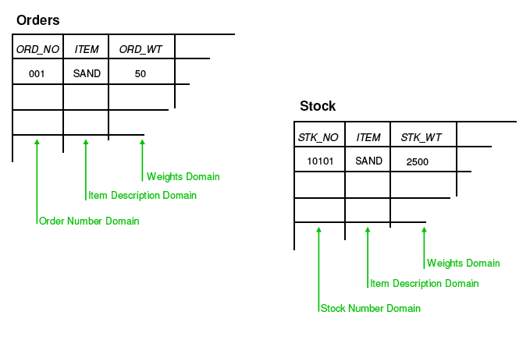
Rows, Columns and Domains

Slide 15
Domains
“Domains are sets of things we can talk about. Relations are (true) statements about those things.” Chris Date
Domain = Data Type = Object Class

Slide 16
Basic Data Types
Numeric data types
Boolean data types
Enumerated data types
Date and Time data types
User-defined data types

Slide 17
Enforcing Type Constraints
Some SQL databases can enforce domain constraints
Column constraints or CHECK constraints
Referential integrity constraints
Enumerated lists
Otherwise, follow the procedural approach; code your own checks within the application program

Slide 18
Complex Object Models
Unstructured
Bitmap image (BLOB)
Long text string (BLOB or CLOB)
Structured
Defined by use of type constructors in an OODBMS
The most basic constructors are atom, tuple and set
Relationships between objects established using an Object ID (OID)

Slide 19
Flat tables in Relational Model
EMPLOYEE
FNAME | MINIT | LNAME | SSN | BDATE | ADDRESS | SEX | SALARY | SUPERSSN | DNO
EMPLOYEE
DNAME | DNUMBER | MGRSSN | MGRSTARTDATE
DEPT_LOCATIONS
WORKS_ON
DNUMBER | DLOCATION
ESSN | PNO | HOURS
PROJECT
PNAME | PNUMBER | PLOCATION | DNUM
DEPENDENT
ESSN | DEPENDENT_NAME | SEX | BDATE | RELATIONSHIP

Slide 20
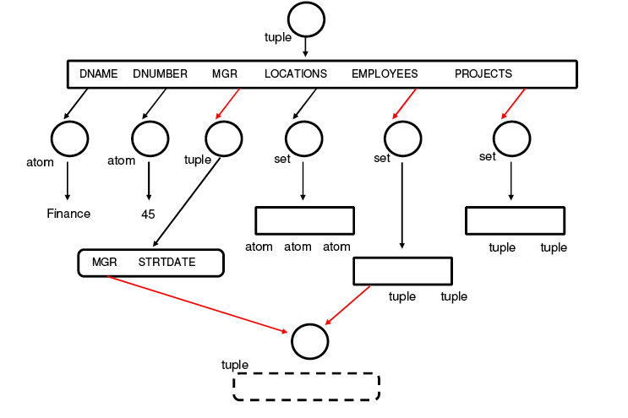
Complex Object - Department

Slide 21
Abstract Data Types
An abstract data type is the OO concept that allows construction of an arbitrarily complex object
Abstract data typing models classes, each with
A name
A collection of operations (methods)
A representation
Abstract data typing supports a much more natural representation of real world problems
Support for (some) complex objects has been added to relational DBMSs.

Slide 22
Temporal Data

Slide 23
Temporal Data
The dimension of time is needed to answer such questions as:
What was the average price of product X during 1995?
In which month did we sell the most copies of video Y?
What was the treatment history for patient Z?

Slide 24
Characteristics of Time
Time structure
Linear
Possible futures
Branching time
Directed acyclic graph
Periodic/cyclic
Boundedness of time
Unbounded
Time origin exists
Bounded at both ends

Slide 25
Time Density: Discrete
Timeline is isomorphic to the integers
Integers have a total order
Timeline is composed of fixed periods, termed chronons
Between each pair of chronons is a finite number of other chronons

Slide 26
Time Density: Dense
Timeline is isomorphic to the rational numbers
Rational numbers have a partial order
Between each pair of chronons is an infinite number of other chronons

Slide 27
Time Density: Continuous
Timeline is isomorphic to the real numbers
Real numbers have a total order
Between each pair of chronons is an infinite number of other chronons

Slide 28
Characteristics of Time
Granularity if important
Event A occurs at 11.00am
Event B occurs at 3.00pm the same day
Does event A precede event B?
The answer is different if
Granularity is one day
Granularity is one minute
There is also a distinction between sequence and time

Slide 29
Storing Times in a Database
Various times may be associated with an event that appears in a database
We may wish to record
The Valid Time of a fact – when the fact is true in reality
The Transaction Time of a fact – when the fact is current in the database, and can be retrieved
Both of these (bitemporal)

Slide 30
SQL Extensions
TSQL includes:
A WHEN clause (see next slide)
Retrieval of timestamps
Retrieval of temporally ordered information
Using the TIME-SLICE clause to specify a time domain
Using the GROUP BY clause for modified aggregate functions

Slide 31
TSQL WHEN Clause
Format of the SELECT … WHEN statement
SELECT { select-list } FROM { list of relations } WHERE { where-clause } WHEN { temporal clause }
Temporal comparison operators include:
BEFORE/AFTER, FOLLOWS/PRECEDES DURING, EQUIVALENT, ADJACENT, OVERLAPS
(compare with Allen’s Interval Calculus)

Slide 32
Spatial Data

Slide 33
Spatial Data
Data Types include:
Points
Regions
Boxes
Quadrangles
Polynomial surfaces
Vectors

Slide 34
Spatial Data
Operations include:
Length
Intersect
Contains
Overlaps
Centre

Slide 35
Spatial Data Applications
Computer Aided Design (CAD)
Computer generated graphics
Geographic Information Systems (GIS
For these systems, the properties of interest would include:
Connectivity
Adjacency
Order
Metric relations

Slide 36
Spatial Data Characteristics
In systems dealing with space:
Data objects may be highly complex
Data volumes may be very large
Data may be held in real time
Performance is not easy to achieve
Access is likely to be through specialised graphical front ends; operator skills are key
Query processing will not be performed using SQL

Slide 37
Multimedia Data

Slide 38
Textual Data
Text data may be
Already in machine-readable form, from a word-processor, spreadsheet or other source
Read using OCR techniques
Text data is essentially unstructured, and an index of some kind needs to be built
By a human operator
Automatically by building a inverted list of every significant word in the database

Slide 39
Textual Data
Markup languages do give some structure to a document
HTML is a markup language for the Web
XML (and its predecessor SGML) allows a programmer to create portable documents that contain structured data
Can also create new markup languages
Character Large Objects (CLOBs) are now commonly supported by vendors
Able to store and handle text documents in addition to standard data
Provision of text search and retrieval facilities

Slide 40
Text and Documents
Much data is stored in the form of text
It would be very useful to be able to ask queries such as:
Find all the legal documents concerning client ‘Jones’
Find all the suspects with false teeth who have been interviewed
Find all the articles on ‘databases’

Slide 41
Image Data
Examples of still images include:
X-Rays
Maps
Photographs
These are all classified as binary large objects (BLOBs)
A BLOB has no semantics attached

Slide 42
Image Databases
An image database needs to provide support for
Image analysis and pattern recognition
Image structuring and understanding
Spatial reasoning and image information retrieval
Mainstream DB vendors now adding
Support for BLOBs
Access using QBIC (Query by Image Content)

Slide 43
Audio Data
Digitised sound
Stored in various formats, such as WAV or MP3
Consumes large amounts of storage
Compression techniques normally used
MIDI (Musical Instrument Digital Interface)
More compact than digitised audio
Consists of a sequence of instructions: Note_On, Note_Off, Increase_Volume
Interpreted by a synthesiser

Slide 44
Video Data
One of the most space hungry formats of all
Images stored as a sequence of frames
Each frame can consume over a megabyte
Frames typically played back at 24-30 fps
To integrate video and audio, interleaved file structures incorporate times sequencing of audio/video playback
Microsoft AVI
Apple Quicktime

