Slide 1

COMP 1205
Professional Development
Introducing
Independent Learning and Time Management
Hugh Davis & Su White
Notes:
The slide set covers the topics to be considered, but you need to do the online activities

Slide 2


The big picture
Why?
Professional accreditation
Personal success
Achieving potential
Enjoying university
Acquire, develop and practice new skills
Learn by doing
Mastering online tools for learning

Slide 3
How do you expect to learn?
OPEN DISCUSSION (GROUPS OF 6)
How might learning at University
be different from my previous experience?
What will I need to do to in order to be successful in my learning?
write down at least six answers.
answer however you see fit

Slide 4
A top level answer
The conditions for learning must be right
Think Objectively
know what you know
know what you don’t know!
You need to
Feel motivated
Work Hard
Work Effectively
You will need work to communicate successfully

Slide 5
What do you know?
“ There are known knowns; there are things we know we know.
We also know there are known unknowns;
that is to say, we know there are some things we do not know.
But there are also unknown unknowns – the ones we don’t know we don’t know. ”
US Secretary of Defence, 2002, Donald Rumsfeld
http://www.youtube.com/watch?v=GiPe1OiKQuk

Slide 6
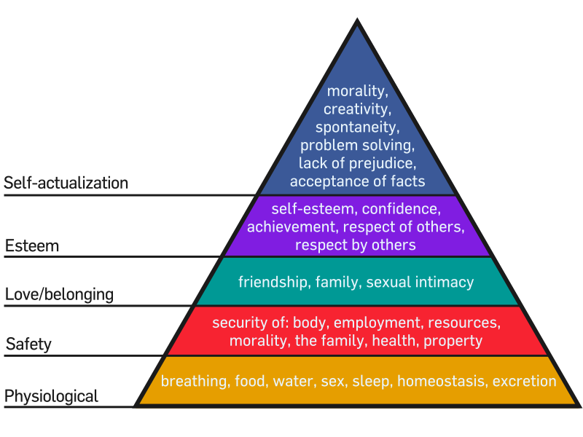
The conditions for learning
Its difficult to concentrate on learning unless other things are sorted
Plans can go awry
J. Finkelstein 2006

Slide 7
Motivation – what’s yours?
Remember
work hard=
10+hrs/week/module
Expressive
Interest for its own sake: understanding/ skill -> satisfaction
Achievement
Desire to succeed:
“I'm not going to let this beat me” mastery is valued/important
Social
seeking social identify/acceptance
within the class/course
being one of a crowd
Instrumental
to gain tangible reward(s)
to avoid negative consequences
Intrinsic
doing something
for
its own sake
Extrinsic
doing something
for
other reasons

Slide 8
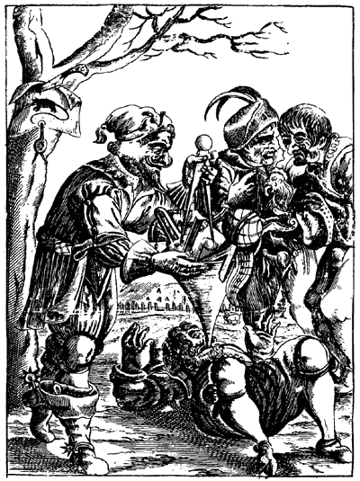
Pour in the knowledge?
Plan and Manage your time
Decide what you want to learn
Learn it
Learning is active
– it does not “just happen”
Lectures
Attend…. and attend!
Reflect
Remembering/memorising… not the same as learning!

Slide 9
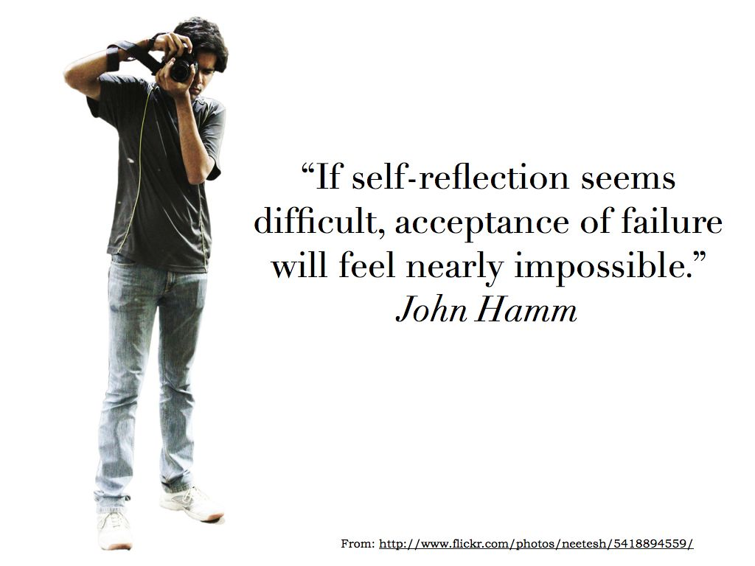
How do you know what you know?
Reflection (again)
You won’t know if you know something unless you try to apply it – don’t wait to be asked.
Use the feedback you get
Make sure you understand if your marks/feedback don’t tally with your expectation

Slide 10
Communication
Knowledge is useless if you do not communicate it.
Communication skills have not traditionally been the strong point of the informatics sector!
Good communication is the sign of a clear mind – and it is increasingly the most important skill to employers.

Slide 11
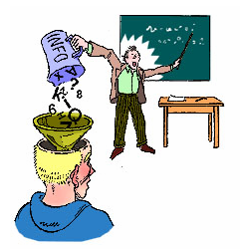
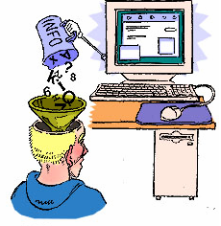
Models of Learning
This is not how we learn
Nor is this!
So how do we learn? …
and why do we retain fixed views on learning?

Slide 12
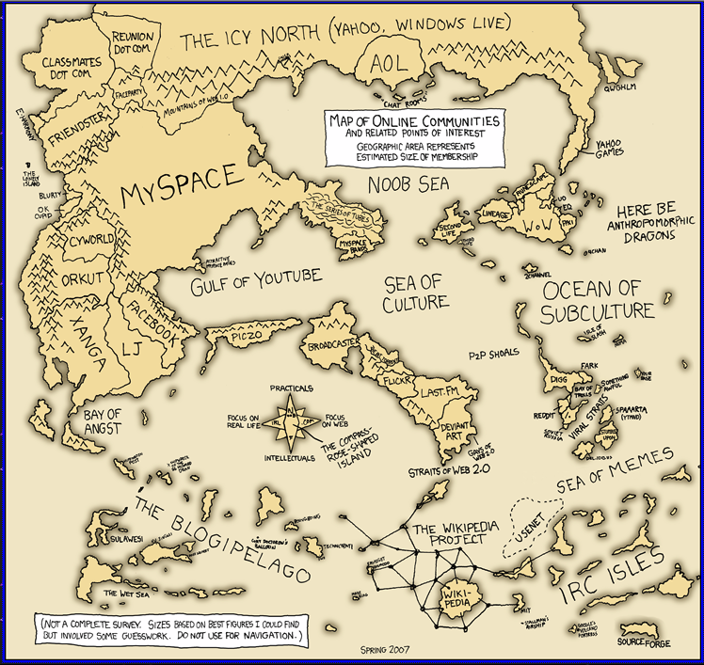
Remember
When it comes to models
The map
is not the territory
http://imgs.xkcd.com/comics/online_communities_small.png
Notes:
Online communities – but what about communities?
We each will have our own map of online communities because our perspectives are partial
This is an old map, and myspace is much smaller than it was…
There is an inherent, necessary and real tension between the technocentric view and the socio-centric view
Real communities, face to face communities are where learning takes place, the most obvious and immediate example is in a conferenrece or workshop (and academic practice generally)
Despite what we may think about our the percentage of our lves spent online, for the vast majority of us, our interactions are face to face and our learning is mediated by social contexts and social contact
Of course we will be influenced by our disciplinary preferences (cf Biglan 1975a,b and White and Liccardi 2006)

Slide 13
Kolb’s Experiential Learning Cycle
Notes:
You will encounter this sort of approach in the teaching you encounter

Slide 14
Deep vs Surface Learning
Deep | Surface
Focus is on “what is signified” | Focus is on the “signs” (or on the learning as a signifier of something else)
Relates previous knowledge to new knowledge | Focus on unrelated parts of the task
Relates knowledge from different courses | Information for assessment is simply memorised
Relates theoretical ideas to everyday experience | Facts and concepts are associated unreflectively
Relates and distinguishes evidence and argument | Principles are not distinguished from examples
Organises and structures content into coherent whole | Task is treated as an external imposition
Emphasis is internal, from within the student | Emphasis is external, from demands of assessment
Deep vs Surface seem similar to
Intrinsic vs Extrinsic motivated behaviours
but it is the Learning approach that is deep/surface
Notes:
What sort of approach do you usually take?

Slide 15
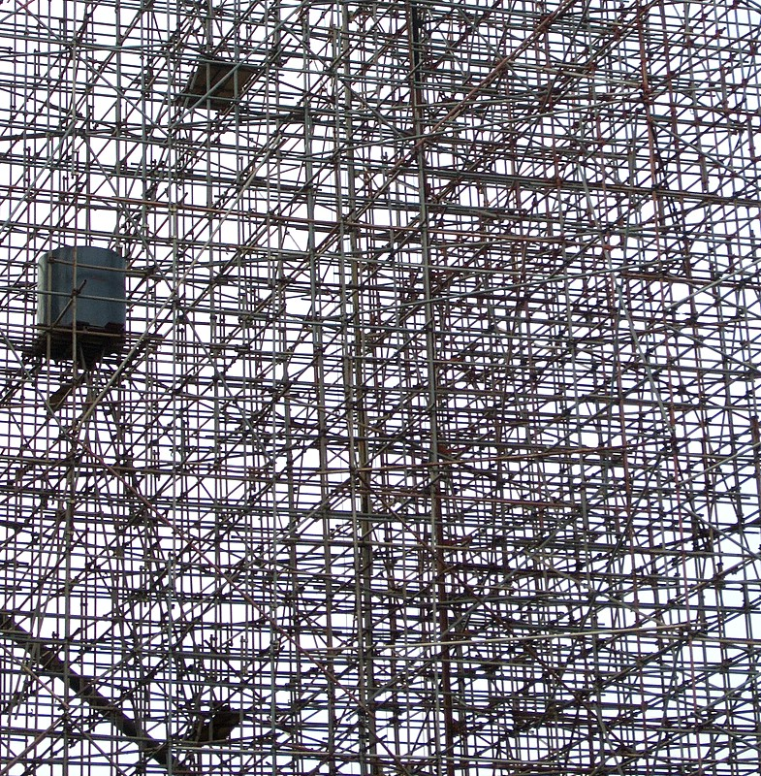
Constructing new knowledge
Constructive learning principles.
1. Knowledge is physically constructed
by learners who are involved in active learning
2. Knowledge is symbolically constructed
by learners who are making their own representations of action
3. Knowledge is socially constructed
by learners who convey their meaning making to others
4. Knowledge is theoretically constructed
by learners who try to explain things they don't completely understand
Notes:
This point of view maintains that people actively construct new knowledge as they interact with their environment.
Everything you read, see, hear, feel, and touch is tested against your prior knowledge and if it is viable within your mental world, may form new knowledge you carry with you.

Slide 16
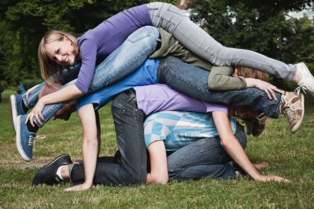

We encourage you to work in groups
Ad hoc groups
Engineered groups
Recognise your strengths
move out of your comfort zone
develop/evolve

Slide 17
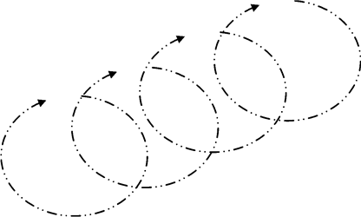
Lecture – attending and attending
Note down the three most important things
Produce brief summary notes from your sequential notes
Check lecture notes when fresh
see if it makes sense
Identify links and relationships,
gaps in your knowledge and any particular problem areas
Deal with any problems immediately
talk to your friends; talk about problems in your tutor group;
seek answers online or in books; talk to the lecturer/your tutor..
Notes:
Ref to learning memorising cycle

Slide 18
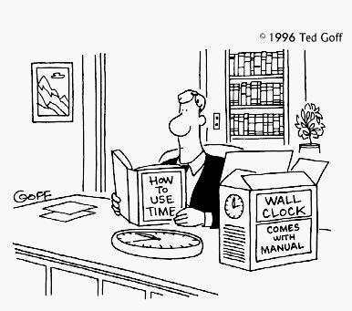
“You may delay, but time will not.”
Benjamin Franklin
Fail to plan…
And you plan to fail
anon

Slide 19
How Good a Planner are you?
Do you have a diary with important deadlines?
Do you put daily plans on paper, to allocate time for your deadlines?
Do you allow flexibility in your plans?
How often do you accomplish all you plan for a given day?
How often do you plan time for what matters most to you?
How often is your daily plan destroyed by interruptions?
Score
1= never
2=seldom
3 = sometimes
4 = often
5 = always
Adapted from Quiz written for USA WEEKEND by time management expert Hyrum Smith, chairman of the Franklin Covey Co.

Slide 20
Results
6-10: Terrible
Life just happens to you. And it often goes wrong.
11-15: Below average planner.
More effective planning will help to reduce the stress and lack of control you feel in your life.
16-20: Average planner.
Not bad. But may need help focusing on priorities and dealing with urgent interruptions.
21-25: Good planner.
You are in control of your life
26-30: Excellent planner--or obsessive compulsive?
Make sure you’re in control of your planning rather than letting it control you.

Slide 21
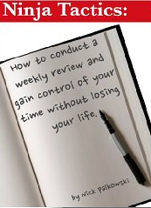


Time Management Technique
Identify deadlines and other time constraints
  e.g. coursework deadlines,
  time to start revising for exams,
  time to apply for the summer holiday job,
  deadline for the entry form for the competition/event
Allocate time in a daily planner to meet the deadlines
  Prioritise the important
  Allow time for the things that matter
  Know yourself; only allocate the time you will actually spend.

Slide 22
What does planning buy you?
If you articulate the objectives you have then you are more likely to achieve them
Helps you differentiate the important from the urgent
Helps to stop procrastination
A plan gives you just one thing you should be doing – rather than trying to decide which of many things to tackle.
Leaves you in control which reduces anxiety

Slide 23
Get Things Done
commonly abbreviated as GTD
action management method created by David Allen
a person needs to move tasks out of the mind by recording them externally
  To free them from the job of remembering everything that needs to be done
  To concentrate on actually performing those tasks.

Slide 24
GTD
See http://en.wikipedia.org/wiki/Getting_Things_Done
5 phases
    Collect
    Process
    Organize
    Review
    Do
6 levels of focus
    Current actions
    Current projects
    Areas of responsibility
    Yearly goals
    5 year vision
    Life goals
Unless you are a very tidy person this is probably overkill for a student:
Probably all you need is
A diary
An ordered ToDo list

Slide 25
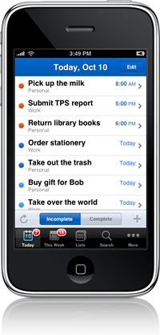



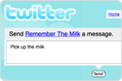
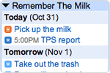
Software Support
Can use Outlook – gives sync to mobile devices
Can use any number of RIAs e.g.

Slide 26
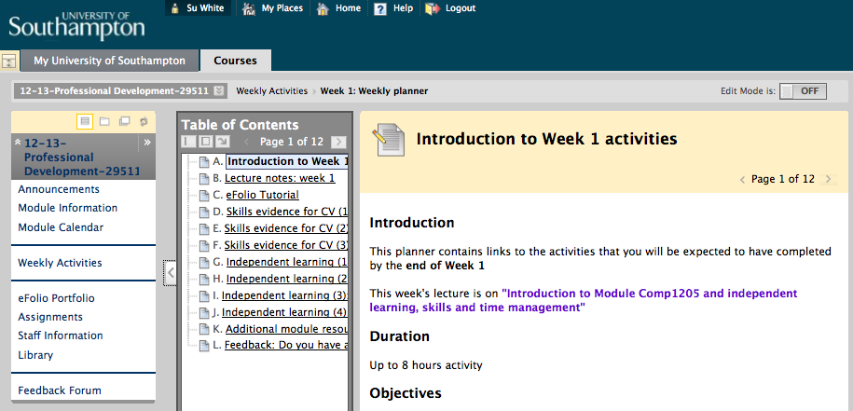
Over to you…

Slide 27



Anything I missed?

Slide 28
addenda
May be of interest but not used
Notes:
When putting together slide sets there is always information which may be relevant or interesting but for which there is no space in the actual presenation slot.
What follows are those sorts of slides
Some things are included as an aide memoire to the creator to use when updating or modifying the slideset
Some things are included to explain to students how parts of the content were composed…

Slide 29
Project Management
When things get complicated
  Multiple tasks
  Multiple people
Then can use Gant Charts
Subject of SE courses
Shows
  Timelines
  Critical dependencies
  Milestones

Slide 30
Student Centred Research–Led Learning
Students can expect to be taught and supervised by researchers at the cutting edge of their discipline.
Students engage in research and scholarship methods and are supported in undertaking these activities
Tasks and learning activities are structured so that student’s work incorporates components which are authentic to the research process
The Student Centred Bit acknowledges that what teachers do is guide, assist, steer, mentor learning.
Only the learner can learn!

Slide 31
Example of how to Allocate time in a daily planner to meet the deadlines
4th Dec 10 mins
email group and set up meeting on 7th
7th Dec (1200)
1 hour group meeting to select topic 2 hour research on allocated topic
11th Dec (1800-2000)
Discuss the topic with tutor at tutorial
12th Dec (1100)
2 hour meeting
14th Dec to agree content, allocate responsibility for parts of presentation, and for putting together final presentation (1400-1600)
2 hours further research and slide production 3rd Jan (and send my slides to group leader)
Sunday 7th January. Meet group at 1500 for 2hours “dress rehearsal” of presentation

Slide 32
Some things in student life that need scheduling
Lectures, tutorials etc.
Time to do courseworks
Time to understand lecture notes (pre and post reading), and do examples
Time to revise for exams
Time for exercise
Time for recreational activities
Employment?
Time to do things needed for longer term goals (write CV’s, job applications, attend meetings etc.)
And don’t forget time to reflect on progress and to re-schedule things!

Slide 33

Note Making and taking
record what happens
in practical situations
in lectures / supervisions.
But, if there are prepared notes, why take more?
  Your notes relate to your needs
  Their production helps you concentrate and remember ideas and information
  You can process and explain (to yourself) difficult concepts, at the time
Don’t try to write everything down
Be an ACTIVE learner – ask yourself what you want to know / don’t understand and make a record
Make Notes don’t Take Notes

Slide 34
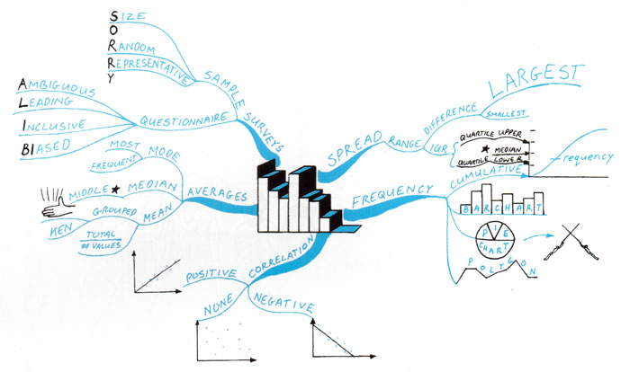
Mindmapping to remember?

Slide 35
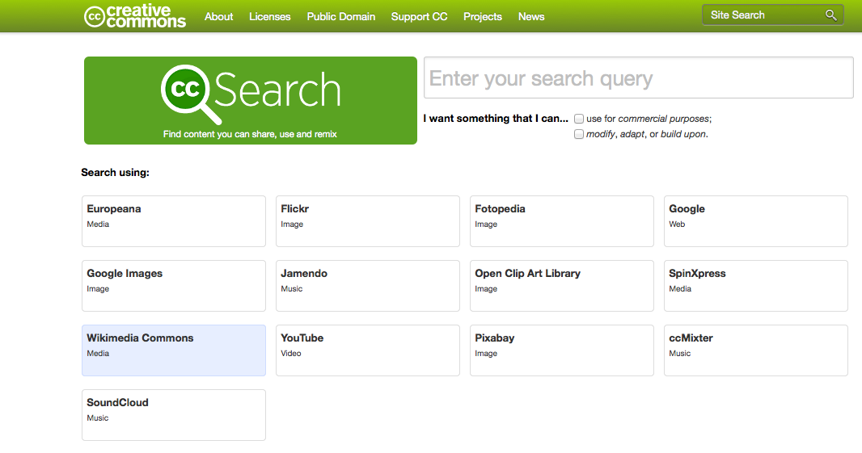
Creative commons search
http://search.creativecommons.org/
Notes:
Used to locate images on these slides which are not part of the clipart stock

Slide 36
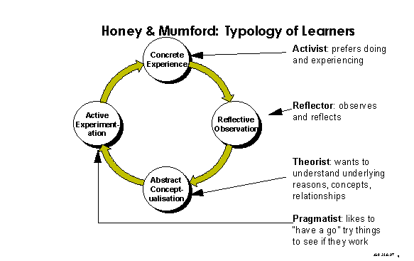
Learning Styles

Slide 37

Which one are YOU?
The Activist /Accommodator
Enjoys the here and now
Is dominated by immediate experiences
Is open minded and enthusiastic about new things – “I’ll try anything once”
Thrives on the new and is bored by implementation and longer term
consolidation
Acts first and considers the consequences afterwards
Prepared to use intuition
The Reflector / Diverger
Ponders experiences and observes them from different perspectives
Collects data and considers it before coming to any conclusions
Postpones reaching a conclusion
Cautious
Observes others before making his/her own points
Tolerant
Low profile and distant
The Theorist / Assimilator
Adapts and integrates observations into complex but logically sound theories
Solves problems in a logical step-by-step way
Is a perfectionist
Likes to analyze and synthesize
Prizes rationality and logic
Tends to be detached and dedicated to rational objectivity
Maximizes certainty and rejects anything subjective
The Pragmatist / Converger
Is keen to try new ideas to see if they work in practice
Searches out new ideas to see if they can be applied
Is the sort of person who will be keen to see if this works!
Likes to get on with things quietly
Is, essentially, a practical, down to earth person
Likes practical decisions – “There’s always a better way … if it works it’s good”

Slide 38
Another Learning Style -VARK
See the UoS Academic Skills website
http://www.academic-skills.soton.ac.uk/index.htm
If you are a Visual Learner, you will remember things best when you've seen them.
  You will like a stimulating and orderly environment.
  You probably like to use diagrams and charts.
  You probably like reading, and may be a good speller
If you are what's called an Auditory Learner, you will learn best when you're listening
  for example, in a lecture
  when you're involved in discussion.
  You will remember things best when you've heard them.
Reading/Writing
  University education is ideal for you.
  You are comfortable reading text and writing notes and essays.
  When you are studying graphs, charts and diagrams, convert them into words.
If you are what's called a kinaesthetic learner, you will learn best when you're moving around. And doing things
  You will remember things best when you've done them (rather than just read about them).
  You may have trouble with spelling.
  In lectures you may make lots of notes but tend never to look at them again.

Slide 39
Whats the good of knowing your learning style?
Visual Learner Tips
Draw pictures, charts and maps to help you understand things
Use mind-mapping
Use planners, organisers or goal-setting charts
Highlight important points with colour (but not in books which you've borrowed!)
Try visualising ideas and facts in your mind
Try changing places in the room while you're studying, to get a different perspective
Use models if they're available
When you need to revise, read over and recopy your notes.
Reading and writing Learners do it at University
Aural Learners Tips
Talk things through as you learn them, with a friend or tutorial group
Get a friend to read aloud to you
When you have to learn facts, try reciting them to yourself, or even singing them aloud.
Find out if you study best in silence, or with music playing in the background
Realise that some people aren't as good as you at remembering what they are told.
Kinaesthetic Learners Tips
Move around as you learn and revise
Work through problems physically
Mentally review what you've been studying while you're swimming or jogging
Use models and machines when you can
Take plenty of breaks while you're studying.

Slide 40
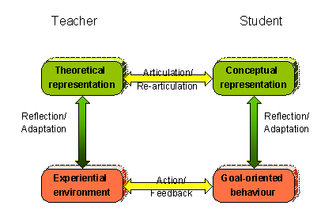
Laurillard’s Conversational Framework
The Teacher can set the task goal
The Teacher can describe their conception of the subject being taught
The Learner can describe their conception of it
The Teacher can re-describe in the light of the Learner's conception or action
The Learner can re-describe in the light of the Teacher's re-description or Learner's action
The Teacher can adapt the task goal in the light of the Learner's description or action.
And so on....

Slide 41
“Live as if you will die tomorrow
Learn as if you will live forever”
Mathatma Ghandi

Slide 42
“Fail to plan
or
Plan to fail”
anon

Slide 43
“Make things as simple as possible
but no simpler”
Albert Einstein

Slide 44
“The brain is like a parachute…
It works best when open”
anon

Slide 45
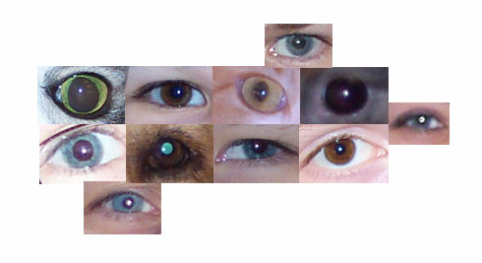
“The real voyage of discovery consists not in seeking new lands, but in seeing with new eyes.”
  Marcel Proust

Slide 46
“Good judgment comes from experience;
experience comes from bad judgment”
Frederick Brooks

Slide 48
Reflections For presentations

Slide 49
“Never express yourself more clearly than you think”
Niels Bohr (1885-1962)
Danish physicist

Slide 50
The way to capture a student's attention is with a demonstration where there is a possibility the teacher may die."
Attributed to:
Jearl Walker, Cleveland State University

Slide 51
A lecture is a process where
information is passed from the notebook of the lecturer to the notebook of the student
without necessarily passing through the minds of either
anon

Slide 52
“A lecturer is one who talks in someone else's sleep”
anon

Slide 53
"Today's CS lecture will be conducted entirely through the medium of interpretive dance”
Something I've always
wanted to hear but never will

Slide 54
“I never lecture, not because I am shy or a bad speaker, but simply because I detest the sort of people who go to lectures and don't want to meet them”
H.L.Mencken

Slide 55
Information was delivered like a ruptured fire hose
- spraying in all directions with no way to stop it!
anon

