Slide 1
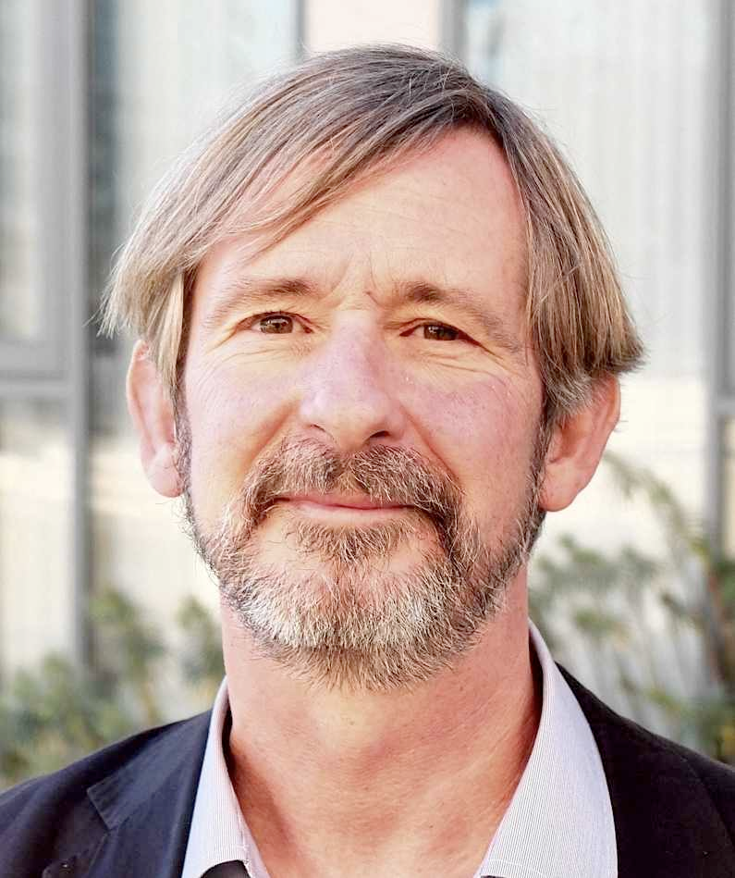
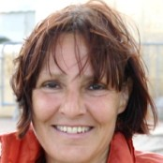
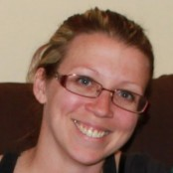
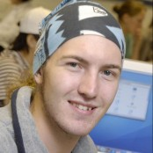
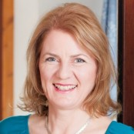
Introduction to Professional Issues COMP 1205
Prof Hugh Davis
Dr Su White
Dr Sarah Fielding
Rikki Prince
Kate Dickens

Slide 2
Where and When
One Lecture Each Week at 1300-1400 every Tuesday in Murray Lecture Theatre (58/1067). This lecture is pretty much compulsory. You may miss important information if you don’t come
A second "Feedback Lecture" each week, also in Murray Lecture Theatre (58/1067) on Thursday. You should only attend this lecture if you need help or feedback on a question that has been asked but not answered on the course feedback discussion board.
There are no other lectures (so ignore the two lecture slots on Tuesday and Thursday at 1700).
(Your attendance will also be required twice in week 9 for the group presentations)

Slide 3
How much time?
A 15 credit unit should take 150 hours over the semester
So 4 courses should take 600 hours over the semester
600/12 = 50 hours a week! (or about 12.5 hours per module per week)
Or 600/15 = 40 hours a week (gives you one week holiday during the Christmas or Easter vac).
For 1 module maybe…
36 hours lectures
12 hours lab
30 hours courseworks
30 hours revision for examination
The other 52 hours is the “hard work”!
Vs

Slide 4
What’s it about?
First six weeks (Personal?)
Second six weeks (Professional?)
Library and information skills
Academic integrity
Presentation skills
Writing technical reports
Group working
Personal presentation and employability skills
Management issues in IT
Professional issues in IT
Codes of Conduct
Ethics
Licensing and open source
Legal issues in IT
Diversity
Sustainability

Slide 5
What we used to do…
Some of the learning objectives were measured by courseworks. Others were left to the students, in that extra time….
INFO 1010
(Sem 1, Yr 1)
10 credits
INFO 2009
(Sem 1, Yr 2)
10 credits
There are on-line activities to support all the learning objectives.
Students will be asked to assess for themselves whether they have achieved the outcomes
COMP 1205
(Sem 2, Yr1)
12 Credits
First six weeks
Second six weeks

Slide 6
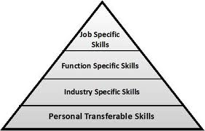
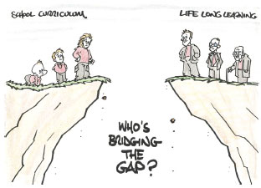
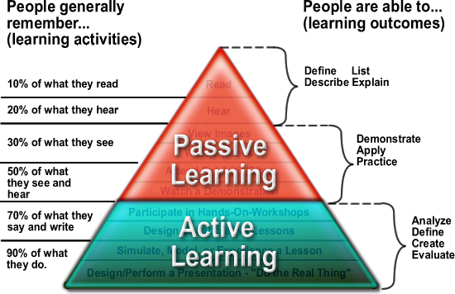
Activities on-line

Slide 7
Assessment
Item | % | Feedback Through
Exam Objective test on-line | 50% | Marks
Technical Report week 4 | 15% | Students will be given feedback by self and peer assessment (with intervention by teaching staff where there is disagreement)
CV week 6 | 5% | Students will self assess their CVs with oversight from teaching staff
Group Presentation week 9 | 15% | Feedback will come from staff and student audience
Annotated Bibliography week 11 | 5% | Students will self assess their CVs with oversight from teaching staff
On-line activities and quizzes | 10% | Blackboard will know what you *say* you have learned. You will know what you have really learned.

Slide 8
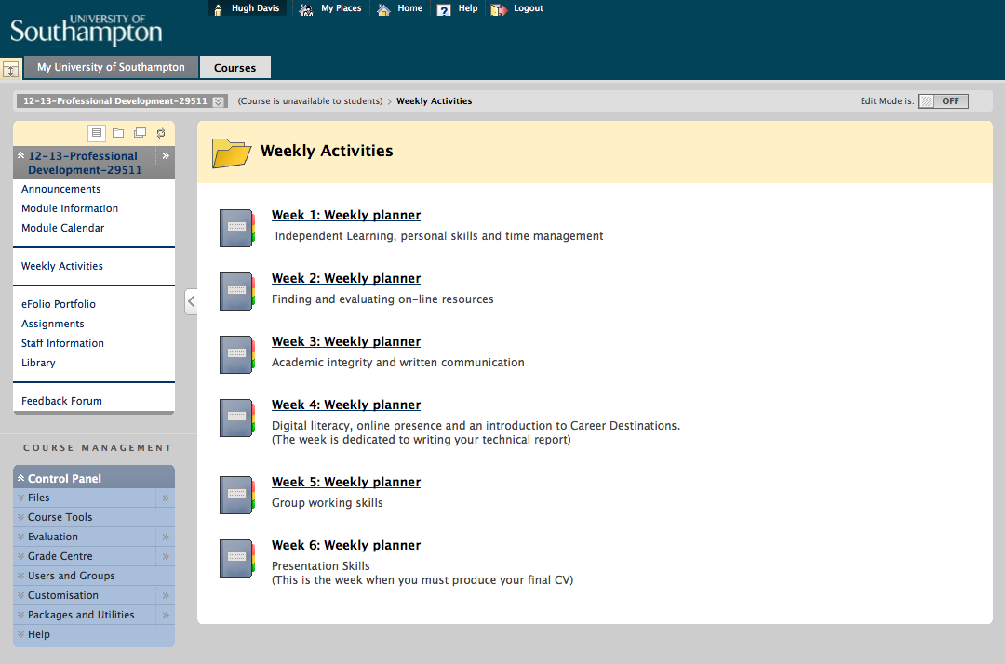

Slide 9
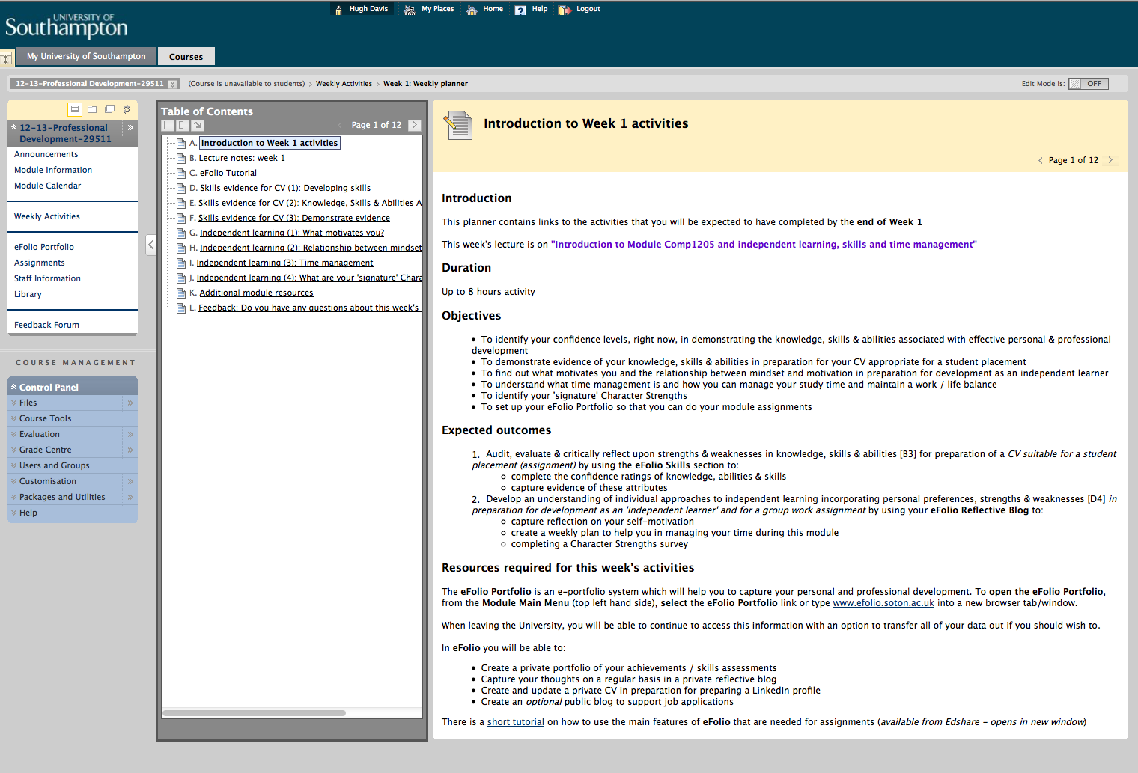

Slide 10
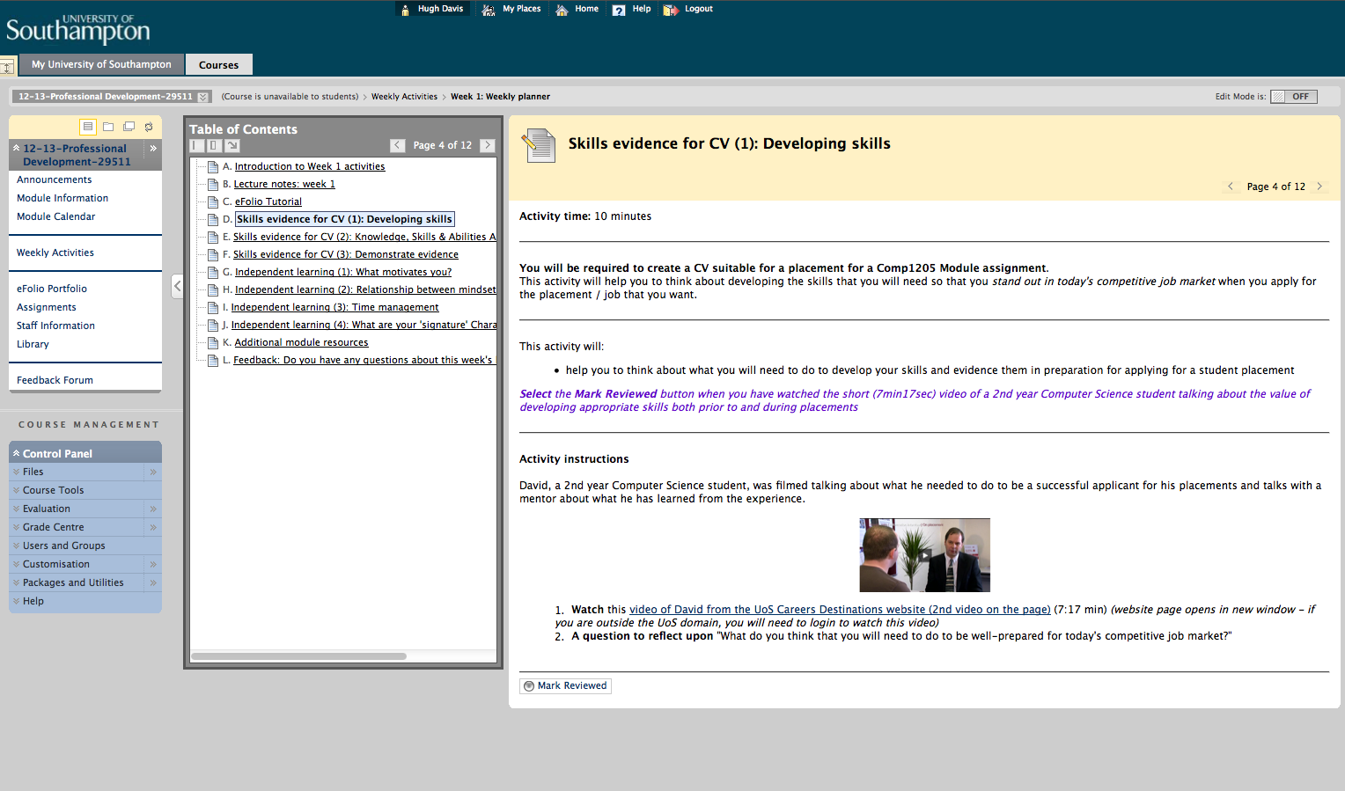

Slide 11
How to do get help?
The intention is that you become independent learners – help yourself!
First: friends and colleagues (Facebook?)
Second option
technically related then ECS STACS
Specialist on-line community discussion board
Particularly COMP1205 Feedback Forum Questions sent to this discussion board may be answered on-line by students or by members of the course teaching team. They may also be used as the focus of the Feedback Lecture.
If (and only if) all this fails, then catch us face-to-face at the end of lectures, or you can email comp1205-instructors@all.soton.ac.uk.

Slide 12
The Feedback Lecture
One of the purposes of this course is to make *you* the expert in your own learning
We are trying to help you to learn how to learn without a teacher
But sometimes you will know you need help,
If you do, so will others!
Ask your question on the Feedback Forum.
We will try to answer all unanswered questions at the Feedback lecture

Slide 13
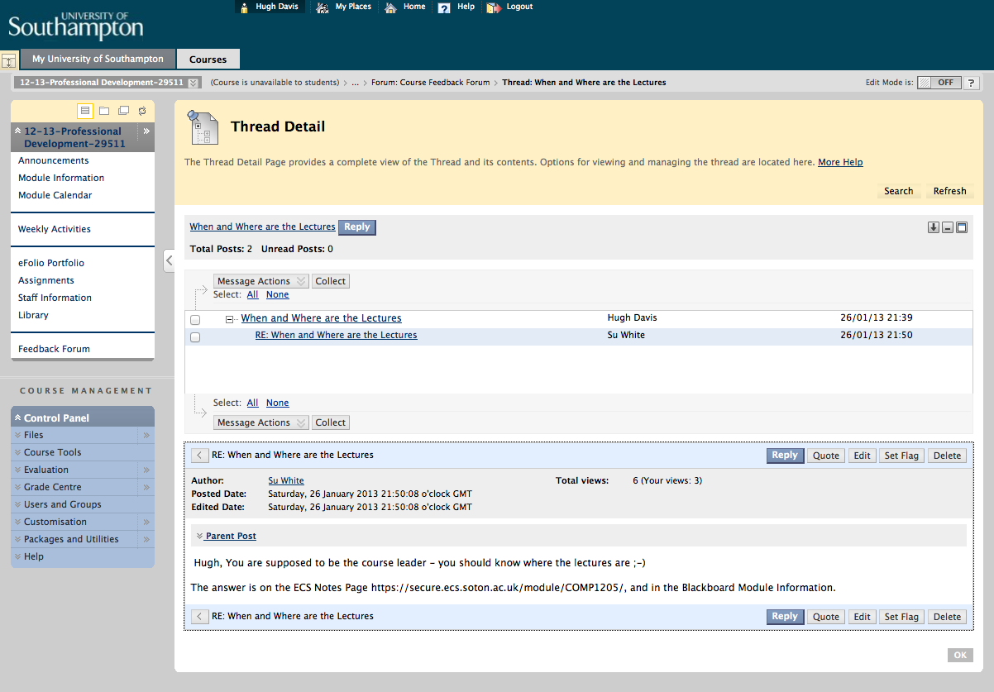
There
are
Behaviour
Rules
for
Forums

Slide 14
Self Assessment
This course is for you
Everyone should pass
The point of the marks is for *you* to know how you are doing
You may find it helpful to compare with others
For life-long learning you need to be able to decide for yourself how you are doing
You can lie if you want to. We will only spot flagrant abuse. You will only damage yourself.
You will learn more from seriously
trying to assess your own grade
than from my feedback
Only the learner can learn

Slide 15
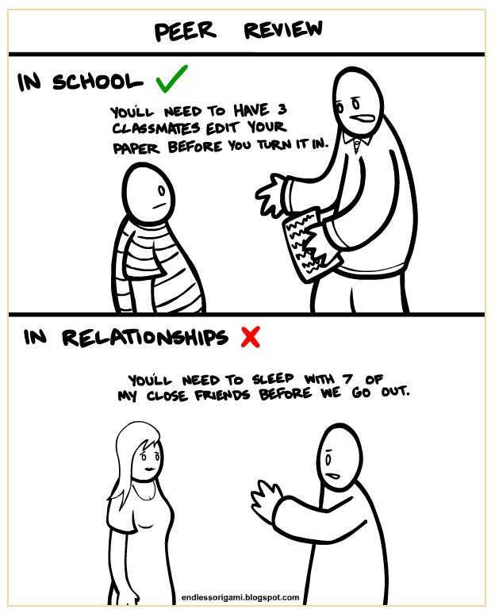
Peer Review
There is wisdom in the crowd
We will teach you all to assess from a marking scheme
Even I hold marks >85% for “better than I could have done”
And then I learn from that student!
We will do basic checks against outliers
Any Questions?
http://endlessorigami.blogspot.co.uk/2010/12/peer-review.html

Slide 16
First Week Activities
To Help you reflect on your
Skills
Character Strengths
Motivation
Mindset
To start recording this in your eFolio along with evidence, in preparation for producing your CV (Week 6 deadline assignment)
To help you develop as an Independent Learner
communication skills - verbal & written
presentation skills
interpersonal communication
teamwork
computer & digital literacy
planning & organisation
adaptability & flexibility
programming skills
problem solving
decision making
initiative
commercial awareness
networking
negotiating
leadership

