Slide 1
EndNote X6 - advanced graduate session - Mac

Slide 2
Work with the EndNote Library

Slide 3
Edit the reference style - footnotes

Slide 4
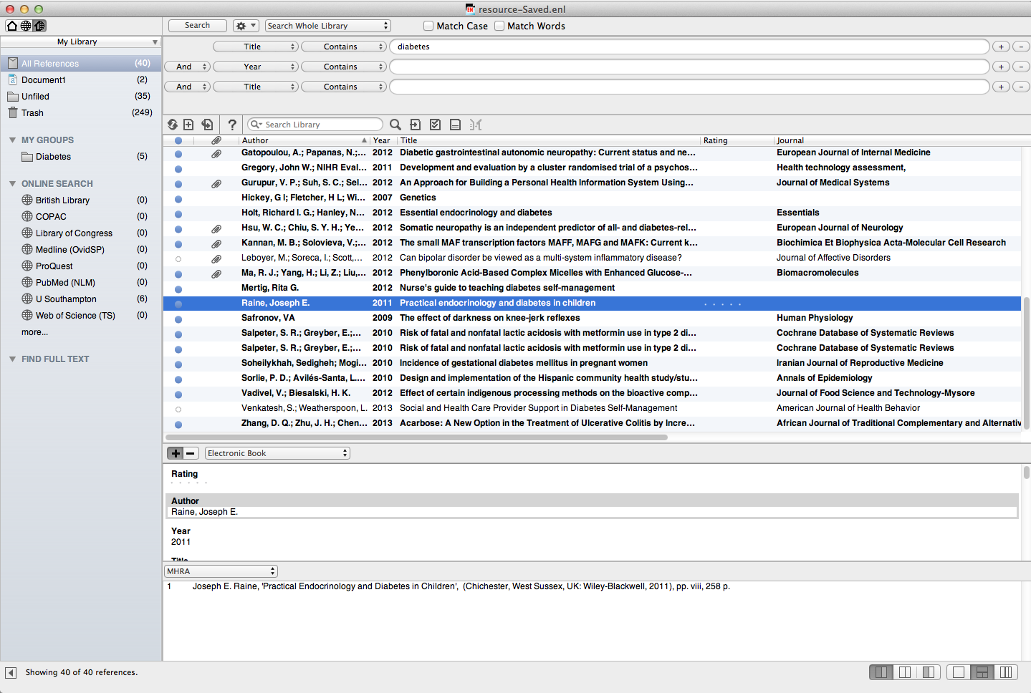
It may be necessary to edit the existing reference style
Notes:
Some schools require variations to standard referencing styles. Harvard in particular is used in a number of slightly differing formats. Footnoting styles such as MHRA may have quite complex referencing requirements.

Slide 5
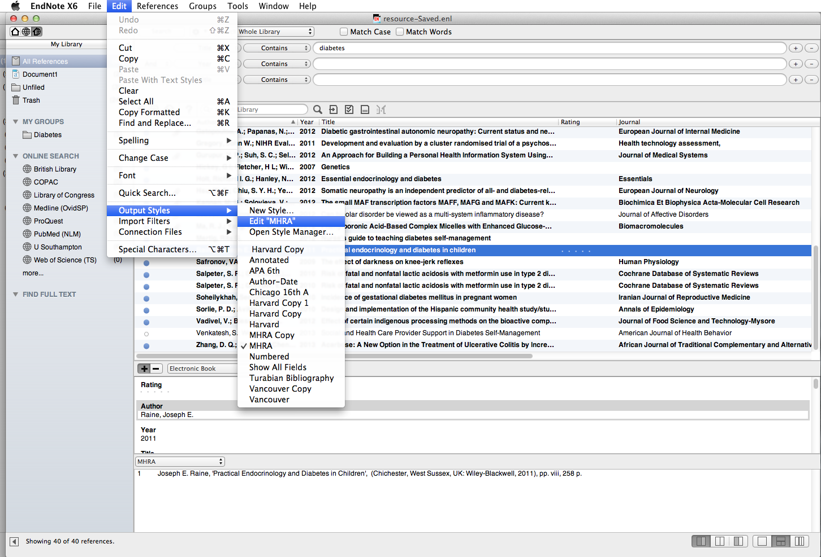
To format the bibliography, go to 'Edit  Output Styles  Edit 'MHRA''
Notes:
To access the referencing style formatting window, go to Edit, Output Styles, Edit 'Reference Style' in this case MHRA.

Slide 6
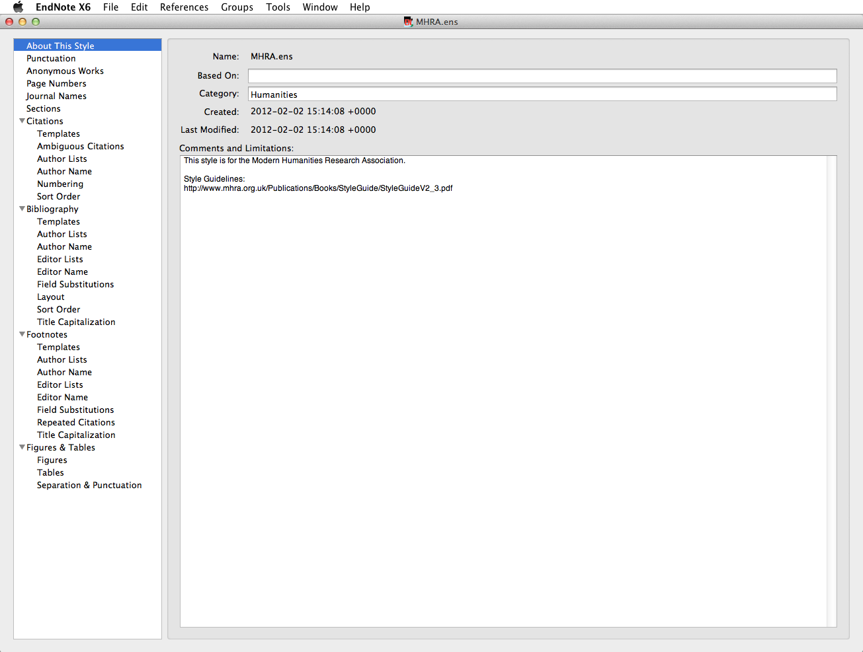
This section allows you to change different elements of footnotes
Notes:
The Footnotes section allows you to control the appearance of the various elements in footnotes. The format of these may be different from the bibliography, depending on the reference style.
The Author Lists section allows you to control how many authors are displayed, and the separating punctuation.
Any changes to Author Lists must be replicated in Editor Lists.

Slide 7
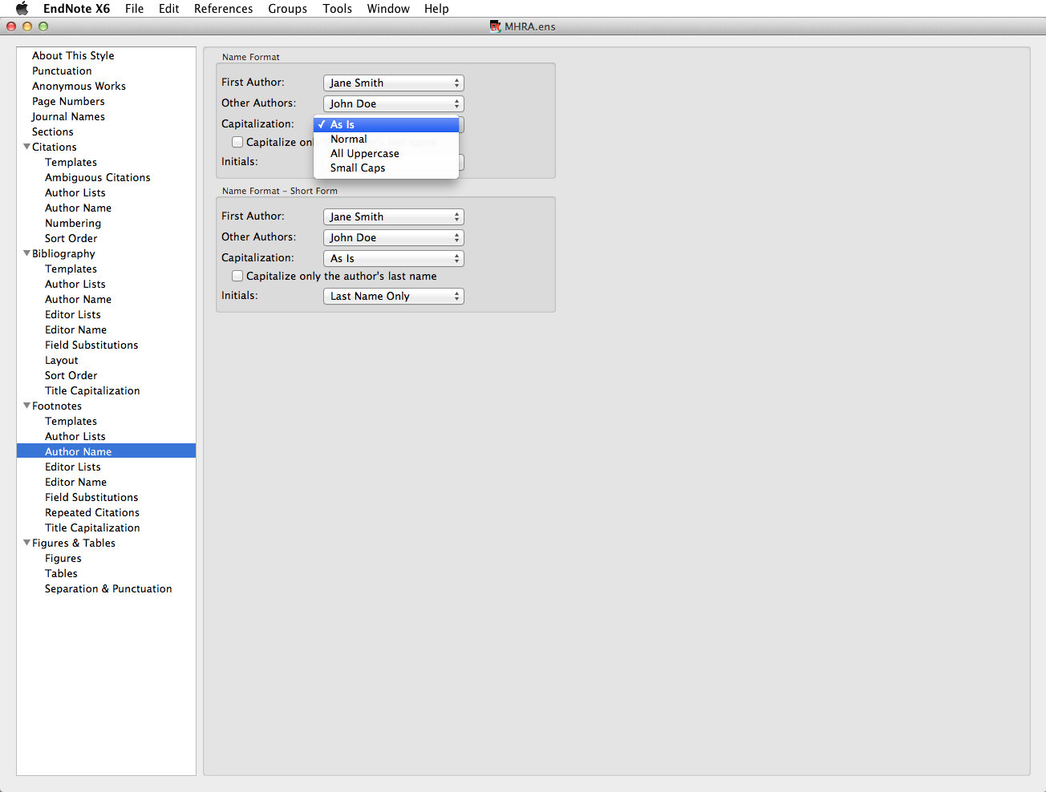
'Author Name' allows choices about capitalisation - choose 'Normal' for names in lower case but with initial capital letters
Notes:
Changes to Author Name must be replicated in Editor Name.
These windows allow you to make choices about capitalisation - the default is As Is. Choose Normal for names in lower case but with initial capital letters.

Slide 8
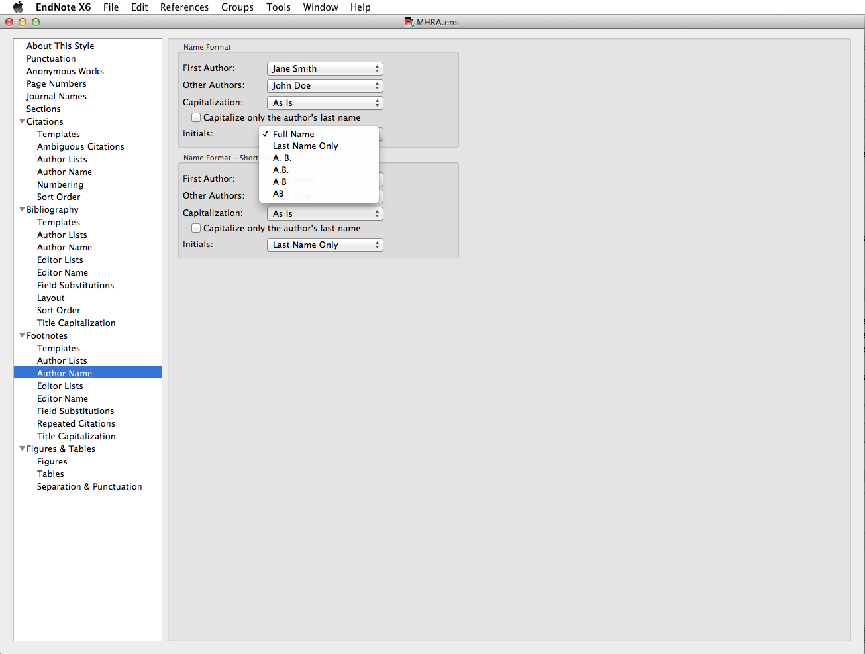
Make choices about the punctuation of initials
Notes:
Choices can also be made about the display of initials: with or without full-stops, with or without spaces between.

Slide 9
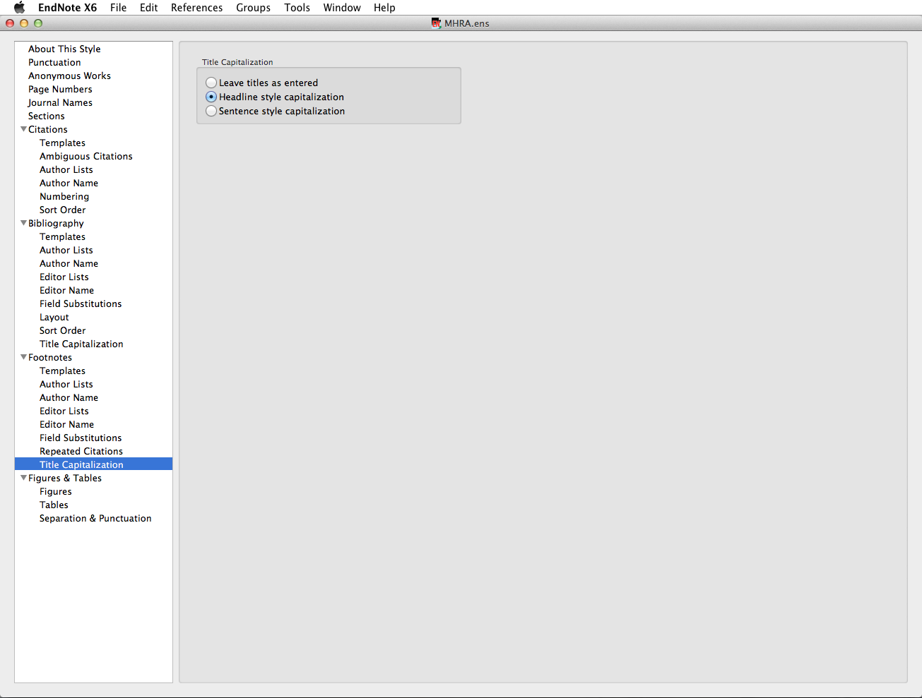
Choose 'Headline Style' to capitalize major words, 'Sentence Style' for initial words only, or leave titles as they were typed in.
Notes:
Choose the style for primary title capitalisation - Headline style will capitalise all major words, Sentence style will capitalise the initial word only.
Note that the same style will be applied to all records in the library: if the conventions for book titles and journal article titles differ, you may wish to leave titles as entered.

Slide 10
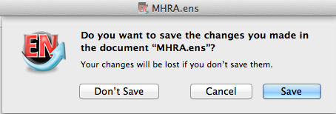
Click 'Save' to save changes
Notes:
You will be prompted to save the edited style with a new name.

Slide 11
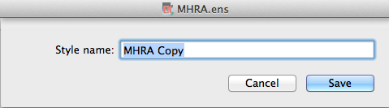
Save with the default Style name or use your own
Notes:
The original reference style remains unchanged, but a variation is created.
This edited style will then appear in EndNote's reference style list and can be applied to any EndNote library. This style is stored in your EndNote Styles folder

Slide 12
Apply an edited reference style

Slide 13
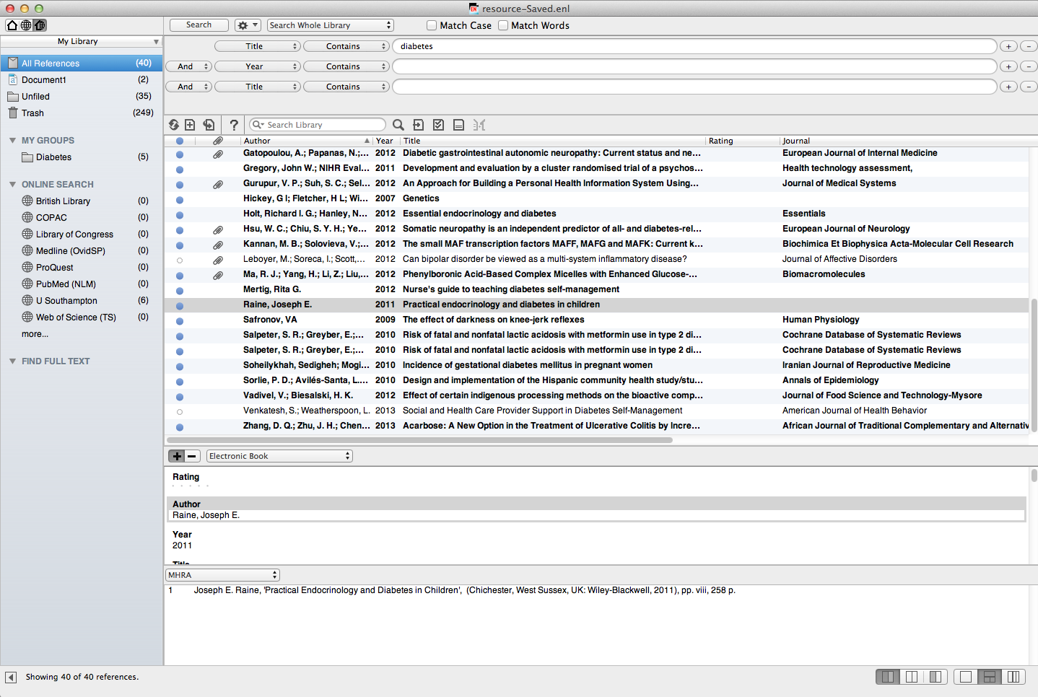
Changes to a Reference Style are not automatically applied:
Notes:
Changes to the Referencing Style are not automatically applied to the EndNote Library.

Slide 14
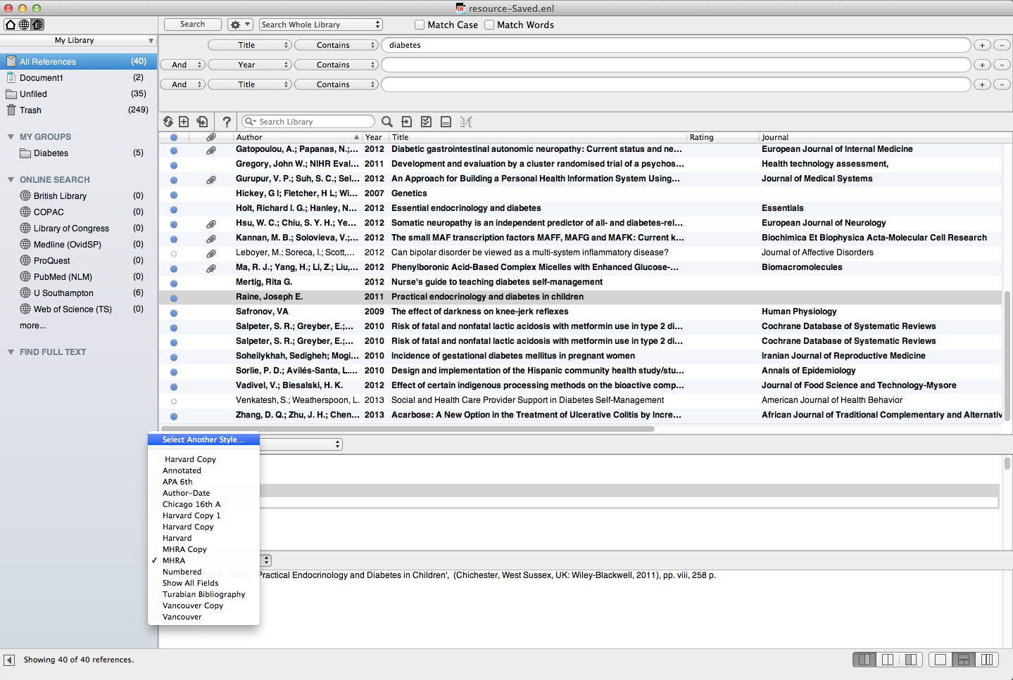
Go to the Reference Style dropdown menu and choose 'Select Another Style'
Notes:
To apply changes, go to the Reference Style dropdown menu and choose Select another style.

Slide 15
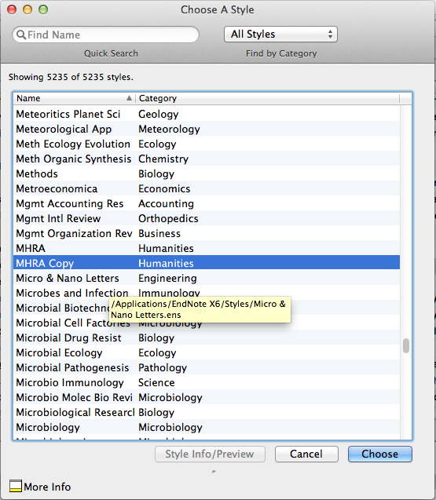
Choose the saved style to apply to the EndNote library
Notes:
Choose the saved style to apply edits to the EndNote Library.

Slide 16

Changes to the Referencing Style are applied
Further edits to the style can be made at any time
Notes:
Further changes can be made at any time, and the same copy style updated and then applied again to the library concerned. If references from the Library have already been used in a document, new changes can only be applied by using the Format Bibliography option in Word.

Slide 17
Templates - how they work

Slide 18
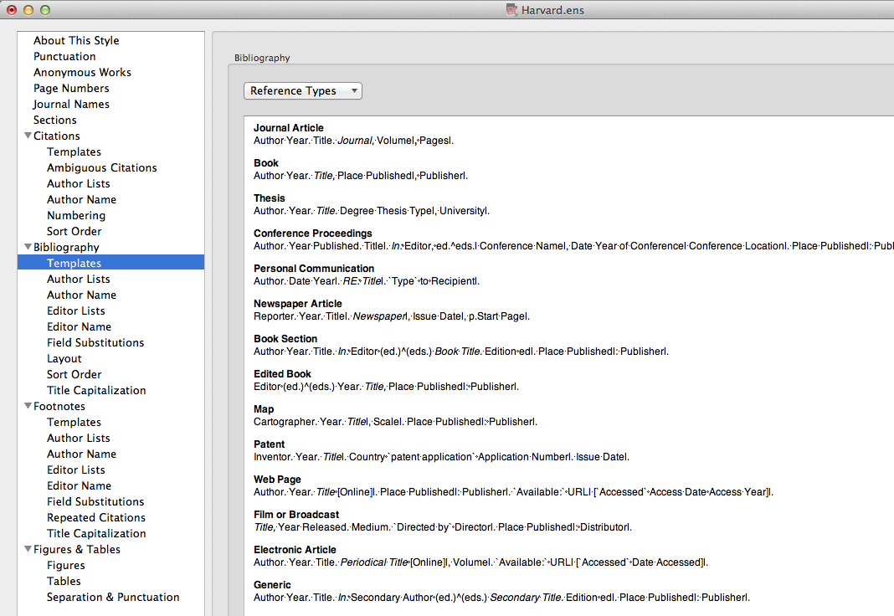
Templates control the appearance of the bibliographic record
A number of templates are already created: use the Reference Types list to create others
Generic is used if there is no template for a given reference type
Notes:
Bibliographic templates control the display of records when EndNote is used with Word documents for citations and references.
Depending on the Reference Style, there are already a number of templates created.
Additional templates can be created by choosing from the Reference Types list.
'Generic' is used when a specific template has not been created for a Reference Type that has been used to create an EndNote record.

Slide 19
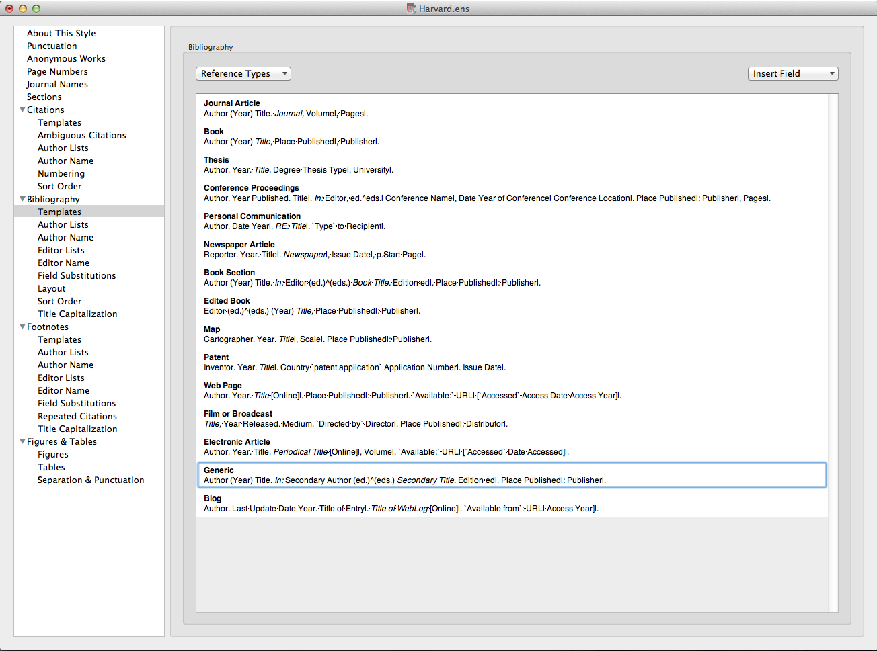
Field Names are replaced by the contents of that field in the individual EndNote record
Other characters are displayed 'as is'
Notes:
Templates are created on the basis of Field Names: wherever a Field Name appears, it is replaced by the contents of that field in the bibliographic record. Words or characters that are not field names are displayed 'as is'.
If a template field contains no data, it is omitted from the record: the vertical lines tie the punctuation to the following field so that stray commas and colons do not appear.

Slide 20
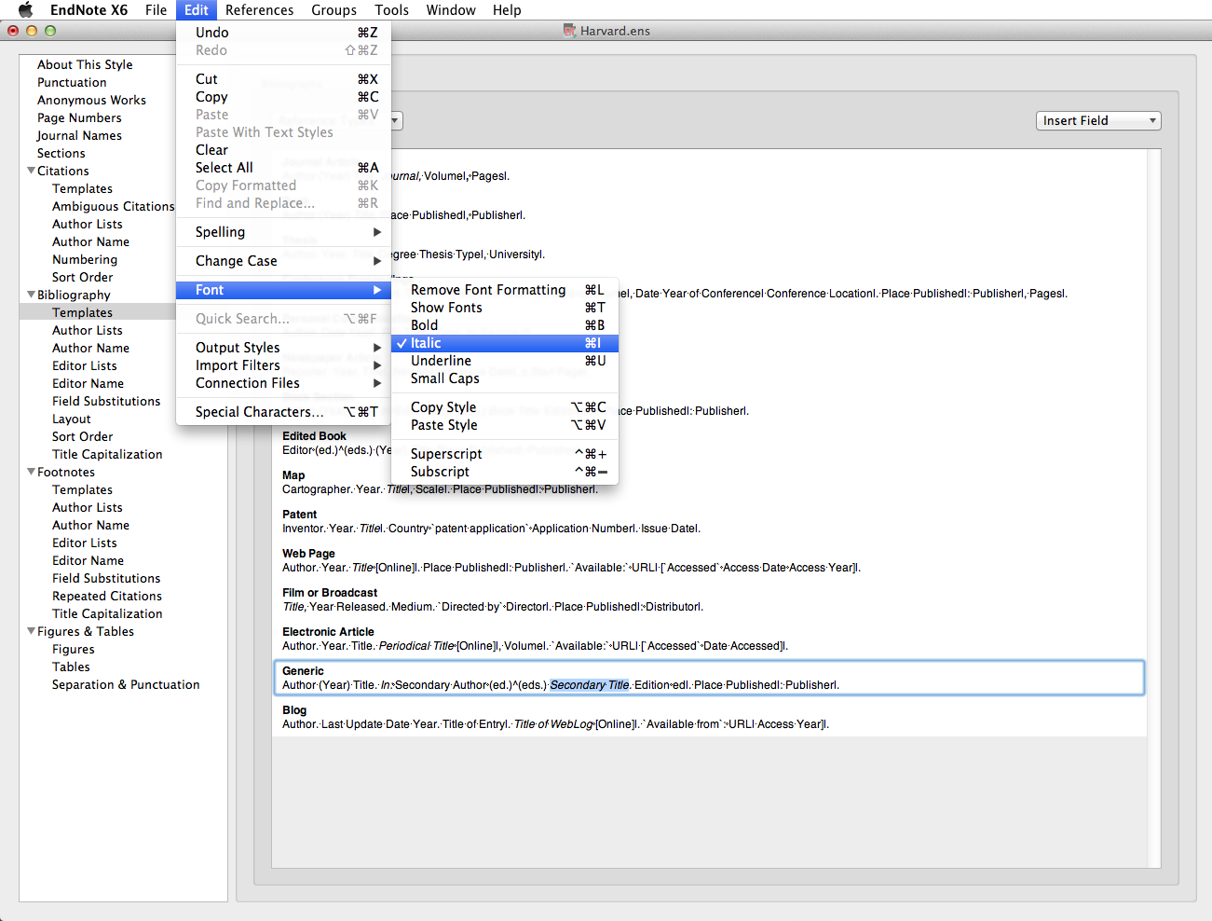
Apply Bold, Italic Underline, Superscript or Subscript to the Field Name using 'Edit  Font …'
Fields are displayed with the format used for the Field Name
Notes:
Bold, Italic, Underline, Superscript or Subscript may be required formats within a citation or bibliographic template. To change the format, go to Edit, Font…
A field is displayed in the format used for the Field Name - hence Journal and Title often appear in italics within the templates.
When an item has editors, EndNote will choose between singular and plural: the circumflex is used.
Templates can be edited at any stage, and the edited reference style applied to the EndNote Library and relevant Word documents.

Slide 21
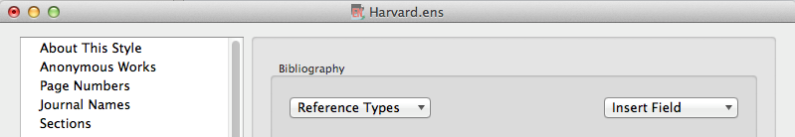
Special characters in templates
EndNote uses special characters to force particular actions within templates
These can be found on the keyboard, or accessed from the 'Insert Field' dropdown menu
Notes:
Some of the templates contain special characters: these are needed for example to avoid stray punctuation in bibliographic records or to manage different numbers of authors/editors.
Use keyboard characters or go to the Insert Field dropdown menu.

Slide 22
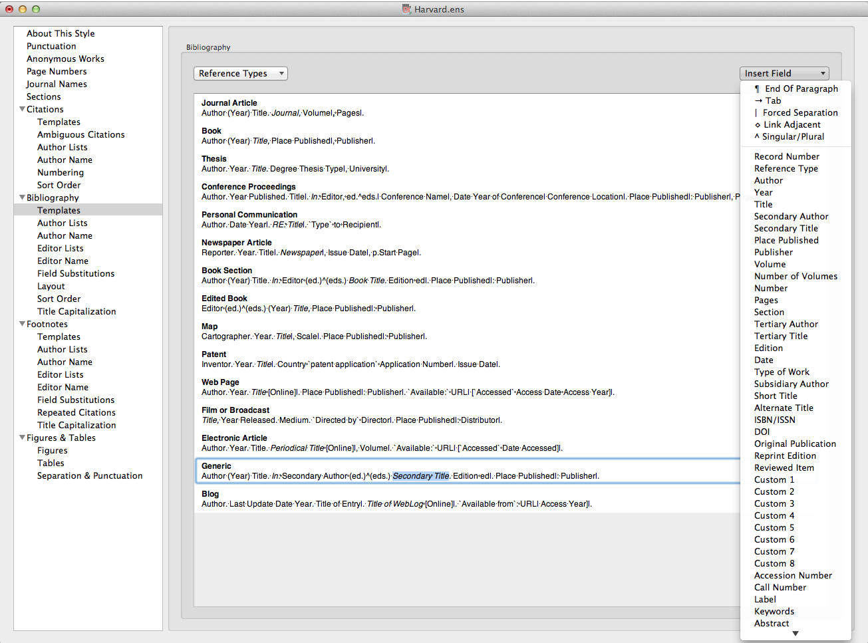
A forced separation | ties following punctuation to the next field
Notes:
Use the forced separation to tie punctuation to the following field: if this field is empty in the EndNote record, the punctuation will not be displayed: in this example, no publisher, no comma.

Slide 23
Use 'Link Adjacent Text'  to tie a word or phrase to the following field
Notes:
The diamond ties plain text to the next field: in this example, the words 'Type to' will only appear if there are details in the Recipient field. The grave accents indicate a phrase to be tied to the following field rather than a single character or word or a word that could be mistaken for a Field name.

Slide 24
Use Singular/Plural ^ to choose text for editors or pages
Notes:
The circumflex ^ is used to allow a choice between text linked to the associated field, in this case dependent on the number of entries in the Editor field.

Slide 25
Use accent grave ` at start and end of text which might be confused with a field name
Notes:
Accents grave are used to identify phrases which need to be linked to preceding or following fields, and also to ensure that any text which also appears in an EndNote record as a field name is displayed in the bibliographic record 'as is'

Slide 26
Set some EndNote preferences

Slide 27
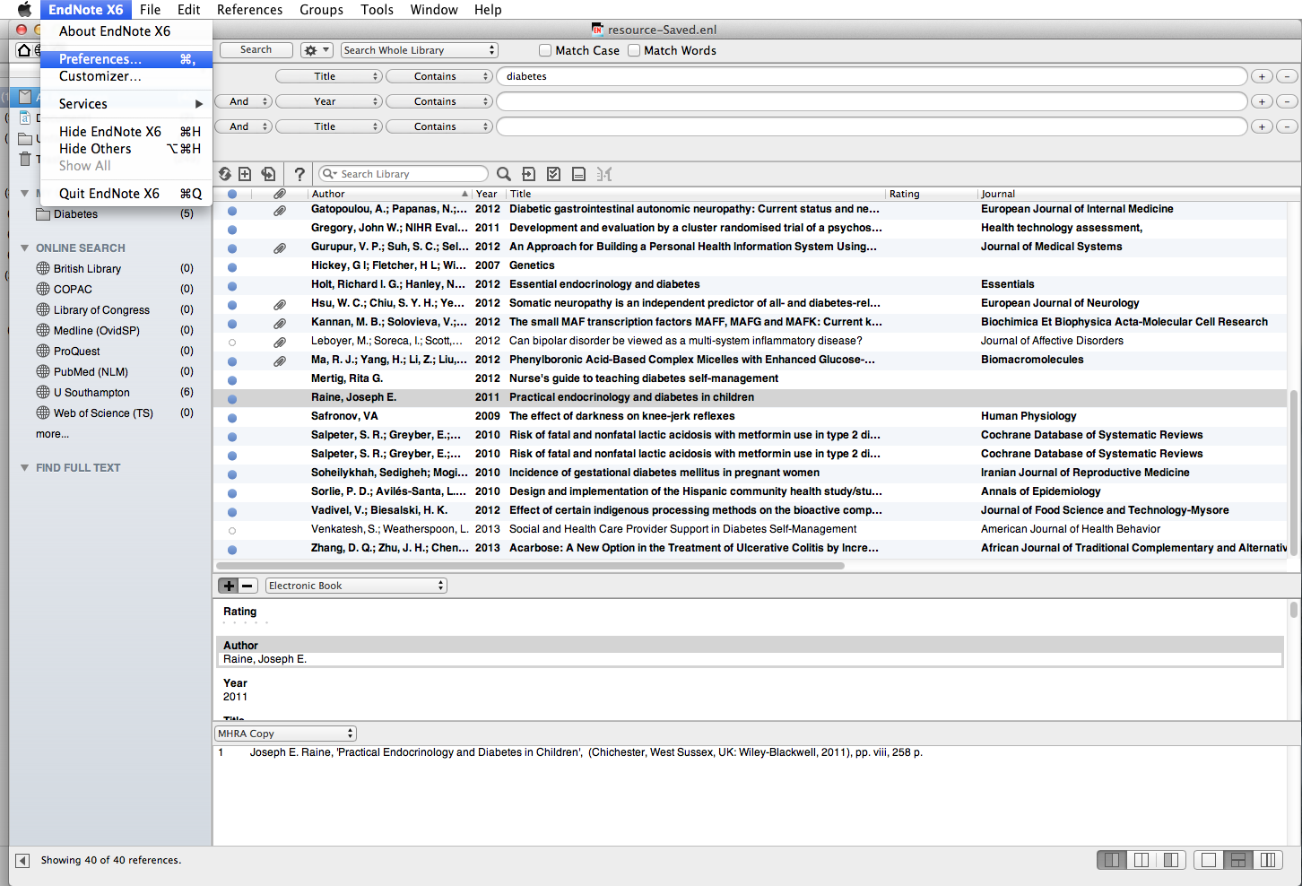
To manage the appearance of the EndNote Library, go to EndNote X6  Preferences…
Notes:
Preferences control how the EndNote Library itself appears, rather than the individual records. To see the options, go to EndNote X6, Preferences.

Slide 28
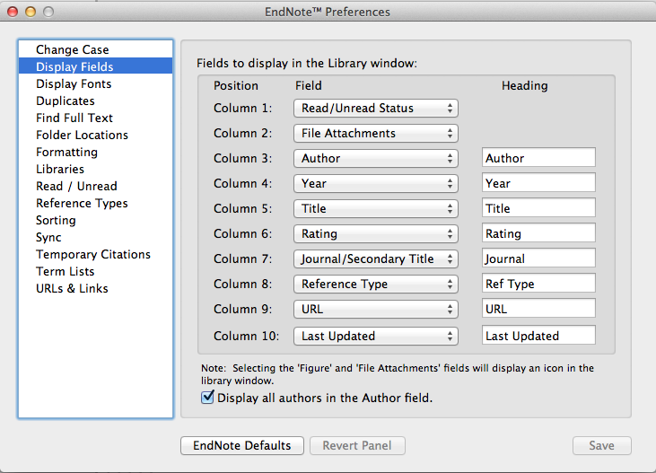
The 'Display Fields' option controls the order and selection for display within the EndNote library
Notes:
Various preferences can be set: Display Fields allows the selection and ordering of significant fields from the record: the columns can be renamed if required.

Slide 29
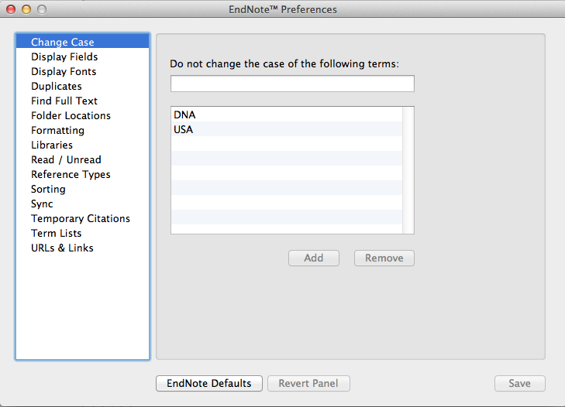
Use the 'Change Case' option to keep abbreviations in all upper case, or for any names with irregular characters or non-standard capitalisation
Notes:
The Change Case option is an important tool: it permits the general rules for bibliographic display to be overridden in special cases e.g. abbreviations, non-English language names and characters. Any character string added to the list will be displayed 'as is' wherever it occurs.

Slide 30
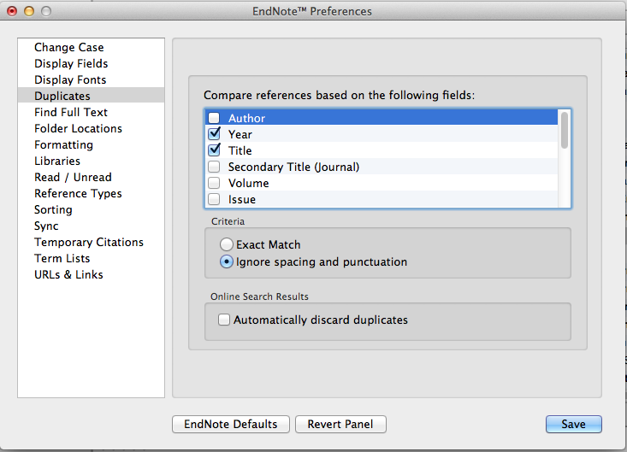
Use the 'Duplicates' option to set criteria for comparing records
Notes:
Set criteria for comparing duplicate records. It is best not to be more specific than Year, Title as databases index author names differently. If your work includes regular database searching, it may be helpful to check the Automatically discard duplicates box.

Slide 31
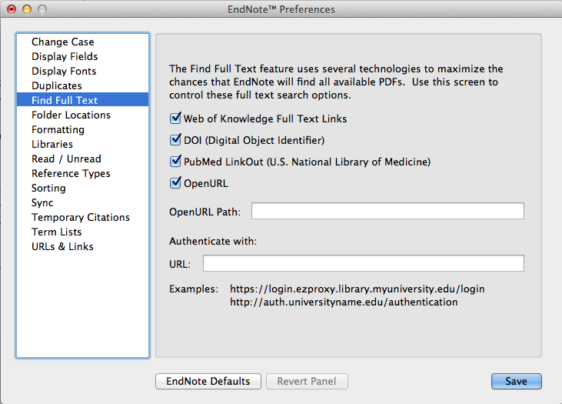
Check the PubMed option
Notes:
In the Find Full Text option, make sure that the PubMed LinkOut option is checked, as well as Web of Knowledge and DOI. This gives the best chance of obtaining the maximum number of PDFs as full text automatically - remember that other articles will need to be checked individually as they may be from journals for which we have a subscription.

Slide 32
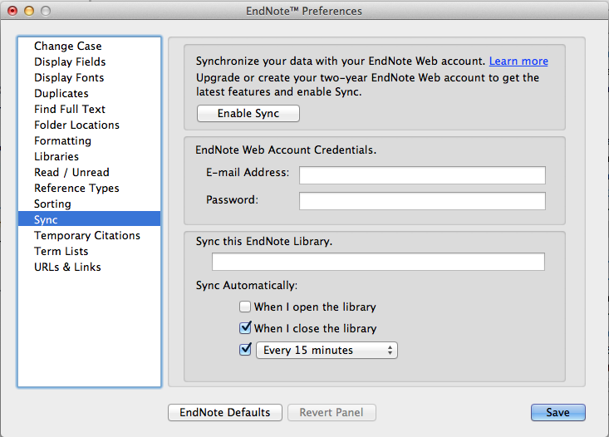
Notes:
Use this window to set Sync choices, and to enable the initial link with EndNote Web.

Slide 33
Using special characters

Slide 34
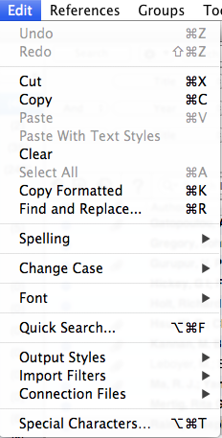
Using special characters
To insert special characters in EndNote records, go to Edit  Special Characters…
Notes:
To edit EndNote records for special characters, for example accented vowels or Greek characters, in any record field, go to Edit, Special Characters.

Slide 35
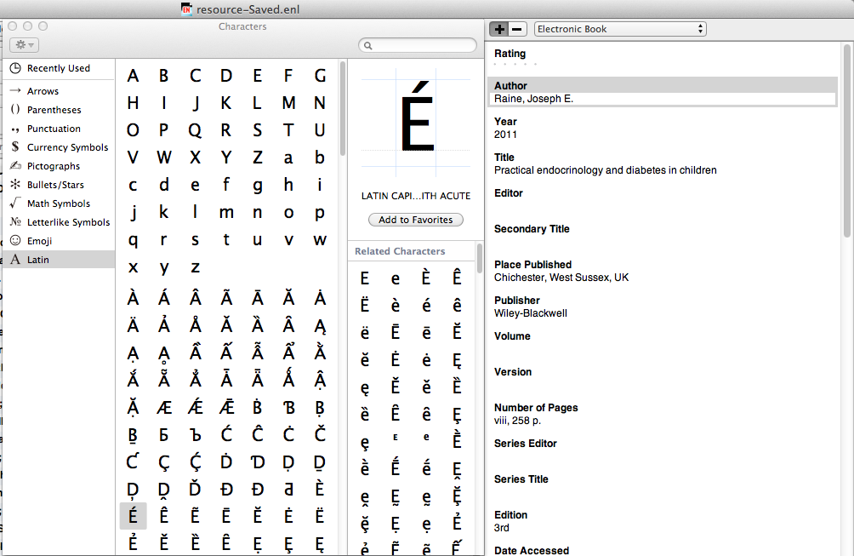
Select EndNote field and select and drag required character
Notes:
Choose the EndNote field to be amended, then select and drag each required character in turn to location in that field.

Slide 36
Managing duplicates

Slide 37
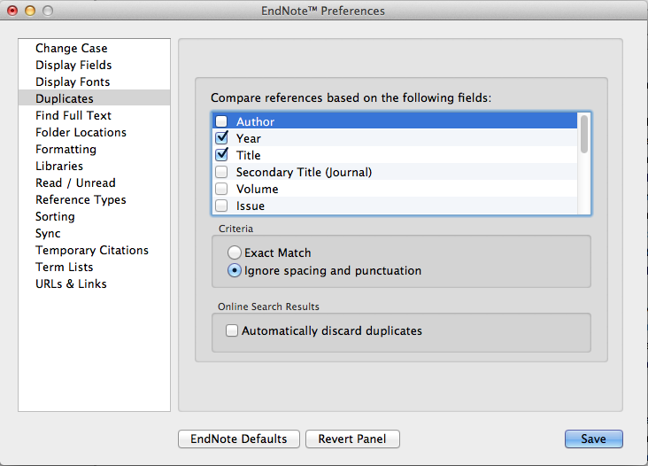
Notes:
Set your duplicate criteria in EndNoteX6, Preferences, Duplicates. Because databases record Author Names differently, you will get the best results by comparing Year, Title, and Reference Type fields. You may wish to tick Automatically discard duplicates if you regularly import references from different sources.

Slide 38
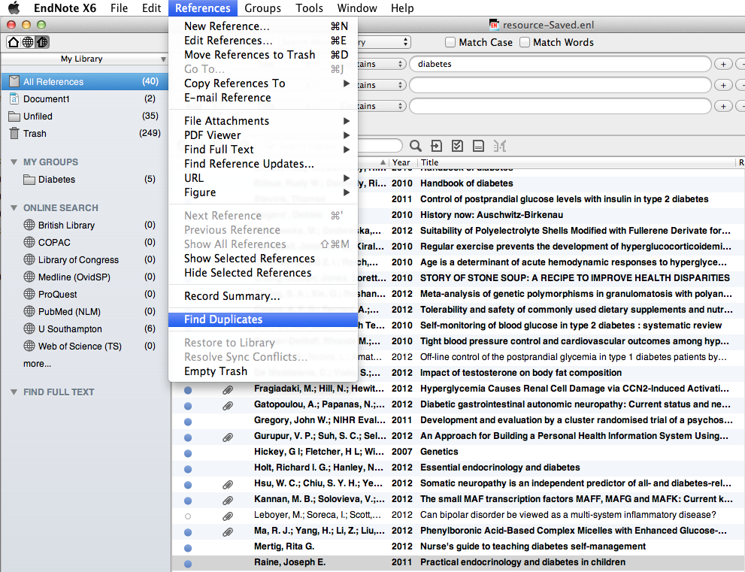
From the 'References' dropdown menu, choose 'Find Duplicates'
Select 'All References'
Notes:
Select All References in the EndNote library, then first click on References and then Find Duplicates.

Slide 39
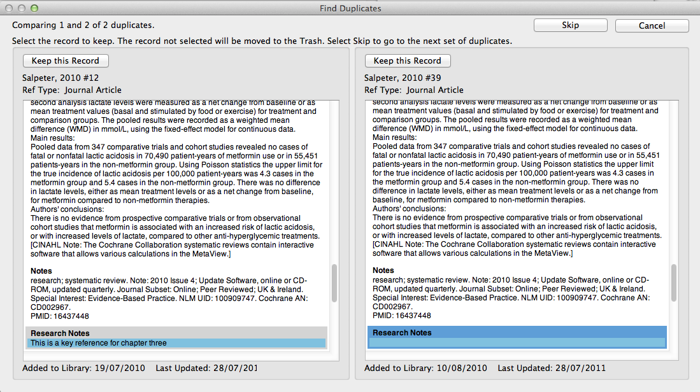
Records are displayed side by side: choose which to keep, or Skip
Notes:
Endnote then carries out a search for duplicates. Each record it finds is displayed alongside its duplicate so that the two can be compared. Check to see whether these two records are indeed duplicates of each other as they may have been matched in error.
If you don’t wish to delete either record then click on the Skip button. Otherwise, click the Keep this Record button above the record that you want to retain: the other is then deleted.
To avoid deleting a reference that you have already cited in a paper, it is advisable that you always delete the duplicate record that was most recently added to Endnote Library.

Slide 40
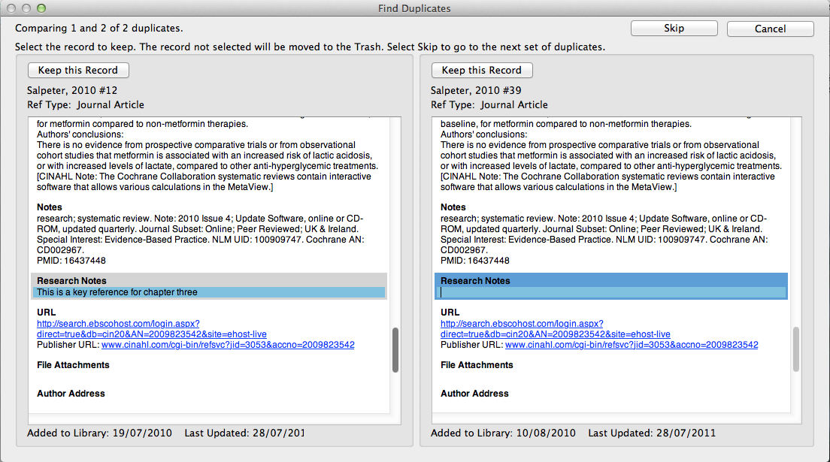
Fields which differ are highlighted
Notes:
For ease of comparison, any fields which differ between the two records are highlighted.

Slide 41
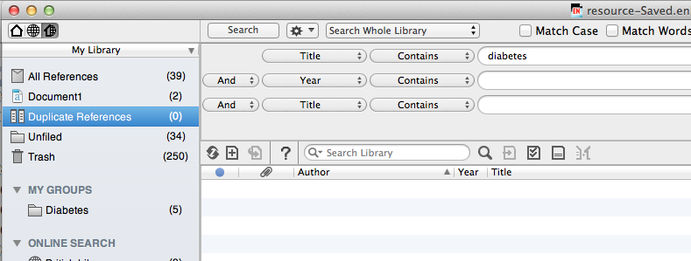
Duplicate records are displayed as a temporary group
Notes:
Duplicate records are displayed as a temporary group. If there is more than one duplicate of a given record, these will be compared in pairs, in turn.

Slide 42
Working with groups

Slide 43
Sort references into groups
Groups can be custom groups or Smart groups
Records can be copied into more than one group
Group sets can be created from a mixture of custom groups and smart groups
New groups can be created from records in existing groups
Notes:
There are a number of methods of sorting references according to your research needs.
Create individual groups for collections of records for particular purposes, collect groups together or combine them with Boolean operators AND, OR, NOT.

Slide 44
Create custom groups

Slide 45
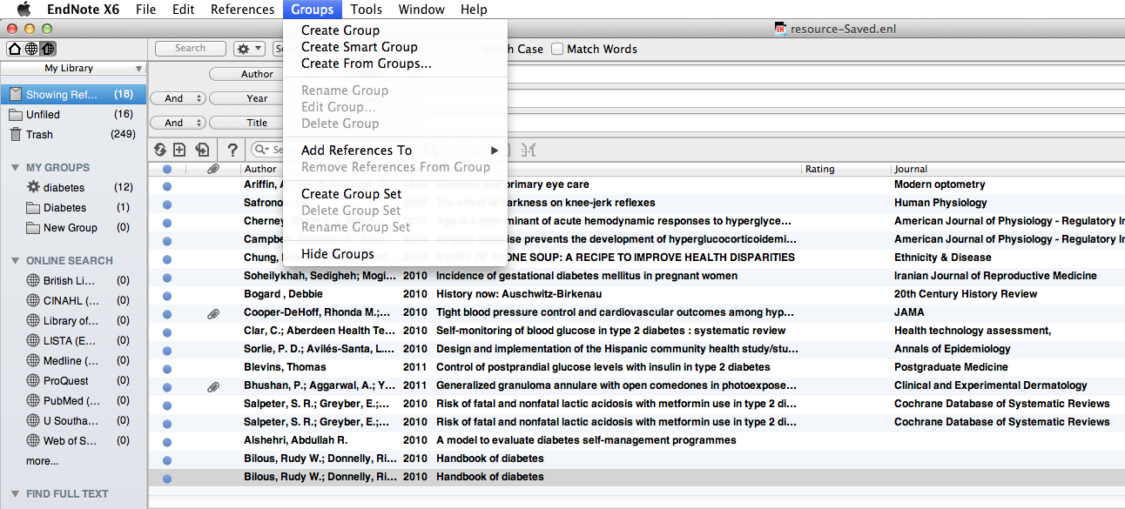
Click to Create a Custom Group
Notes:
The best way of managing a large EndNote Library is to create sublibraries, or groups. Up to 5000 groups can be attached to a single library.
Groups can be custom groups or Smart groups.
Any item in the main library may be included in a custom group.
Smart groups are given set criteria - any item fulfilling these criteria is automatically added to the group. The criteria can be modified at any time. The criteria for a new Smart group will be applied to the existing EndNote Library, and to any items that are added subsequently.
All entries are included in the main EndNote library: they may be copied into more than one group, or be entries in more than one Smart group.
Deleting a record from a main library removes it from all groups: deleting a record from a custom group does not remove it from the main library or from other groups. However, deleting an item from a Smart group will also remove it from All References
To create a Custom group, go to Groups, Create Group.

Slide 46
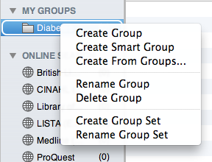
The group can be named, and managed by ctrl + click
Notes:
Name the group. The new group is displayed in the My Groups panel. Options to manage the group are available with ctrl +click.

Slide 47
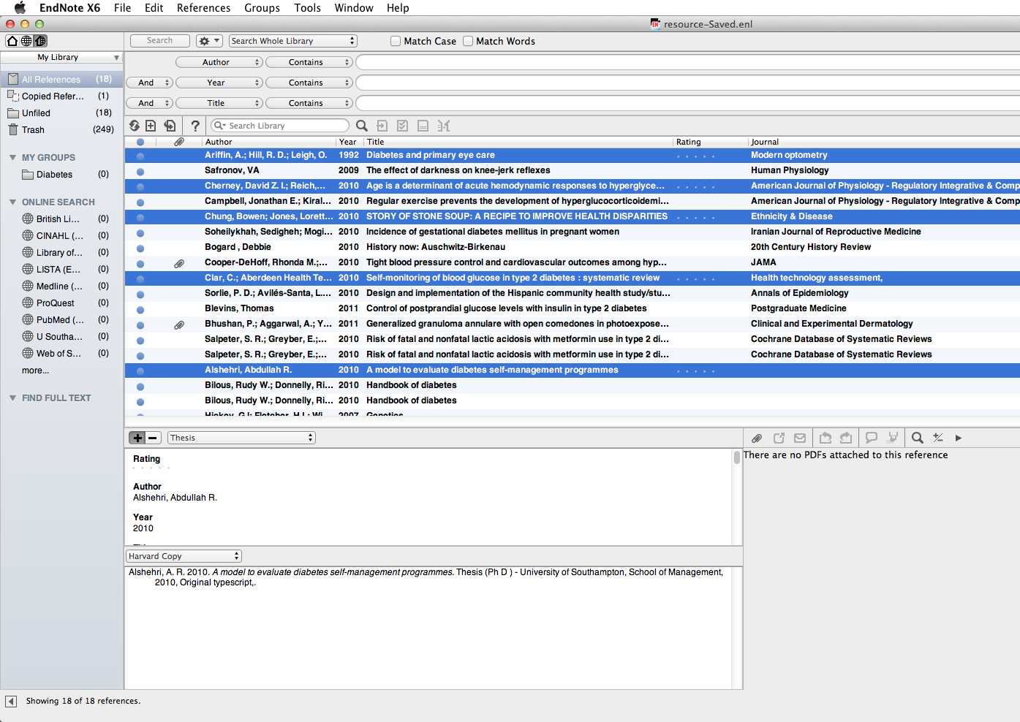
Drag selected records on to the group name to add the records to the group
Notes:
Select the records to be added to the group, and drag on to the group name. Make multiple selections with 'cmd + click'

Slide 48
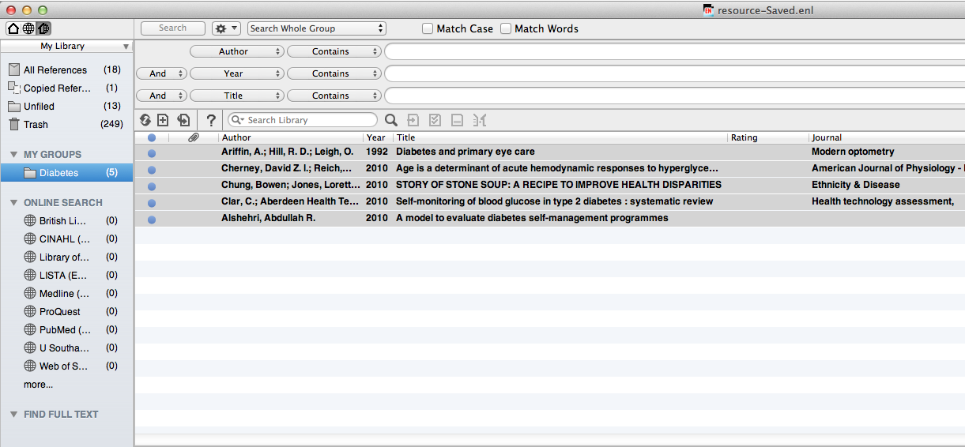
Add or remove records in Custom Groups at any time
Notes:
Custom groups can be populated manually at any time. Records deleted from groups are not deleted from the main library

Slide 49
Create Smart groups

Slide 50
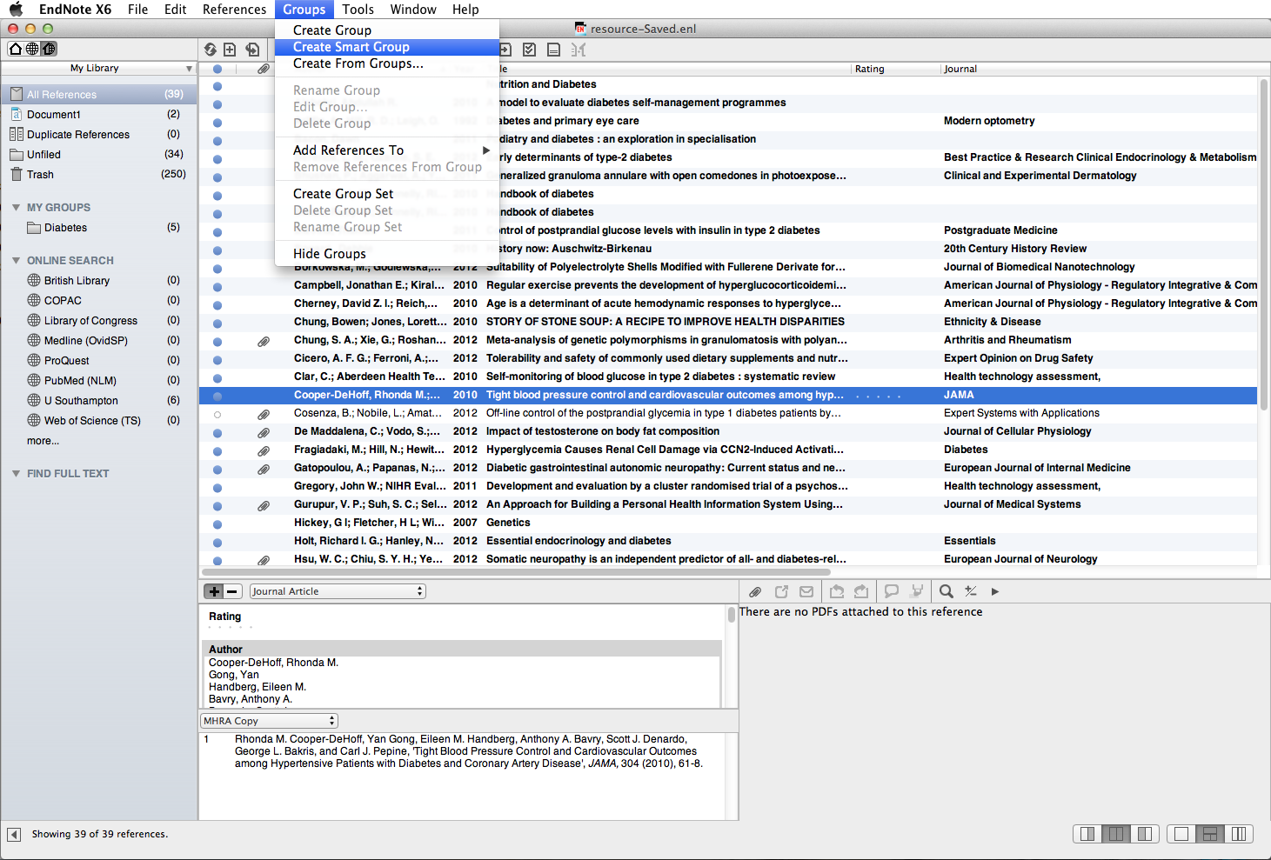
To create a Smart Group go to 'Groups  Create Smart Group'
Notes:
Up to 5000 groups can be attached to a single library.
Groups can be custom groups or Smart groups.
Smart groups are given set criteria - any item fulfilling these criteria is automatically added to the group. The criteria can be modified at any time. The criteria for a new Smart group will be applied to the existing EndNote Library, and to any items that are added subsequently.
All entries are included in the main EndNote library: they may be entries in more than one Smart group.
Deleting a record from a main library removes it from all groups. It is not possible to delete an individual item from a Smart group.
To create a Smart Group, go to Groups, Create Smart Group.

Slide 51
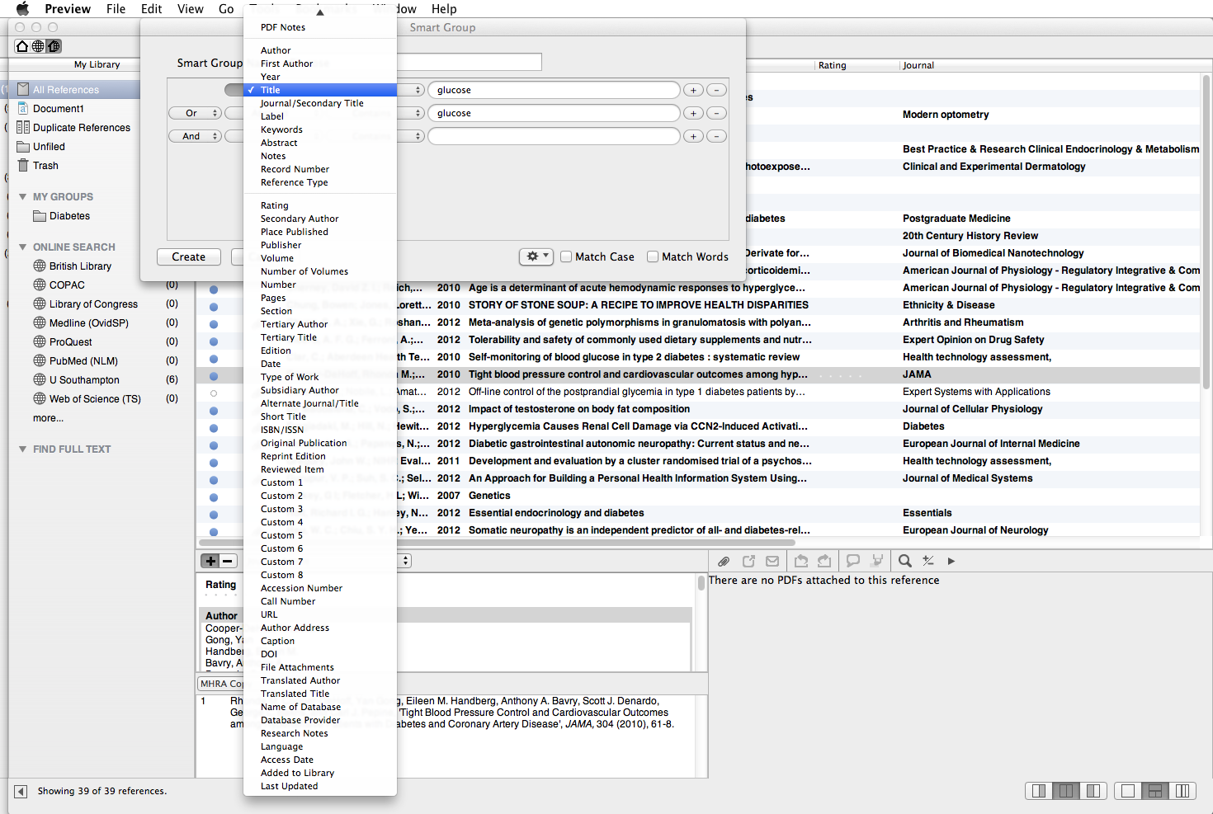
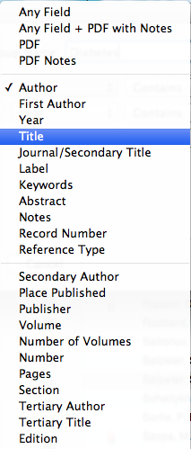
Name the group and set the search criteria
Search criteria can be applied to any field in the record
Notes:
The Smart Group window is displayed. Name the Group, and select the search criteria. Additional lines can be inserted if required.

Slide 52
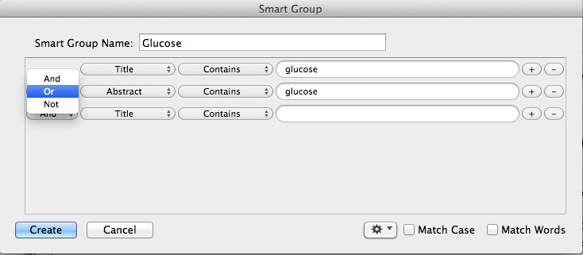
This group will include any record that has 'glucose' in the title or abstract
Notes:
In this example, the group will include any item that has the word 'glucose' in the title or abstract field. Click Create.

Slide 53
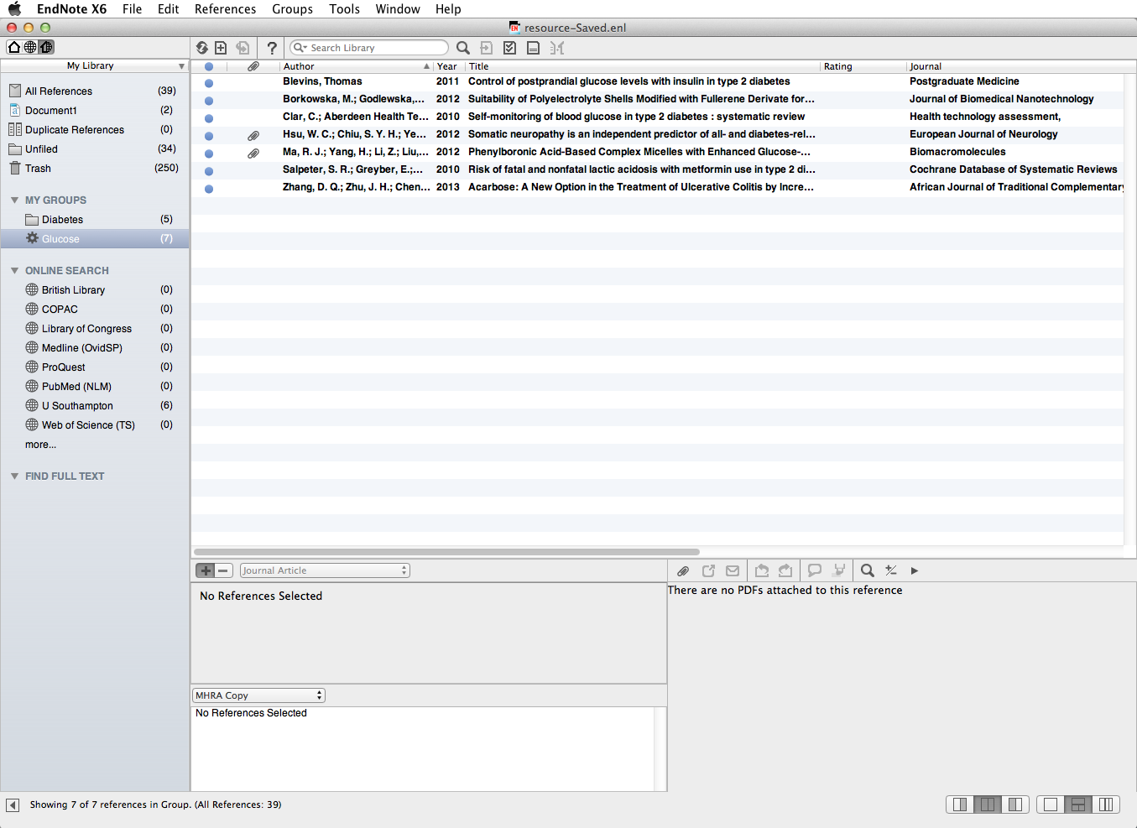
The group is automatically updated with any future items fitting these criteria
Items already in the library that fit the Smart Group criteria have been added to the group
Notes:
Seven items have been added to this Smart group from titles already in the EndNote Library.
Any future title added to the Library will also be added to any group for which it fits the search criteria.
Individual items cannot be deleted from Smart groups: they will also be deleted from the main library.

Slide 54
Group sets
You can further organise your groups:
  Combine selected Custom Groups and
  Smart Groups into a Group Set

Slide 55
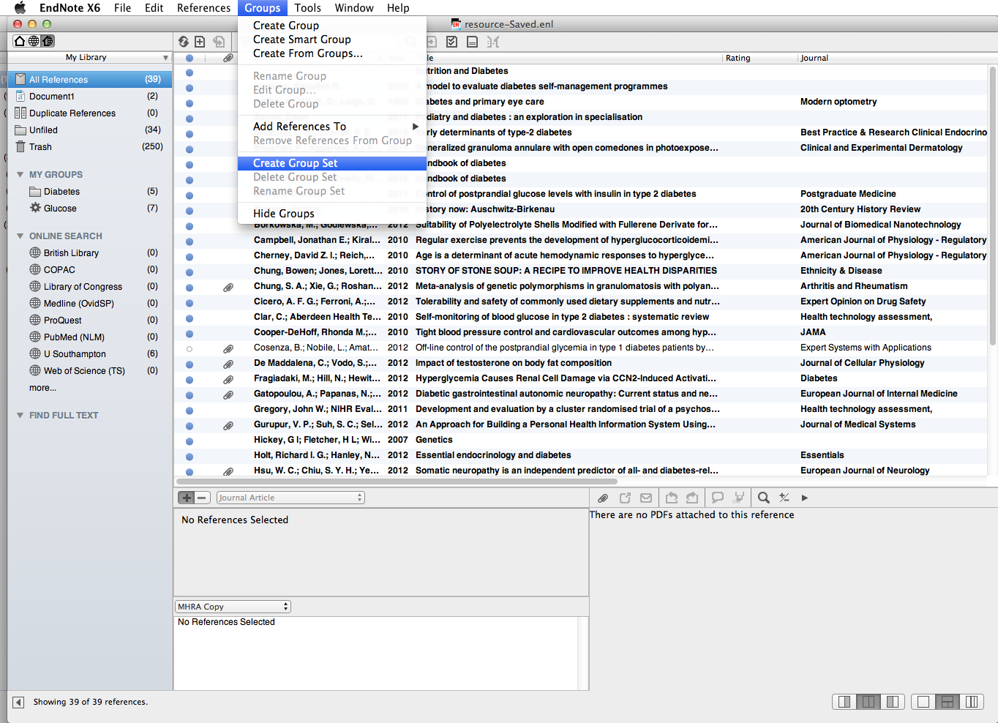
Choose 'Create Group Set'
55
Notes:
Go to Groups then select Create Group Set
55

Slide 56
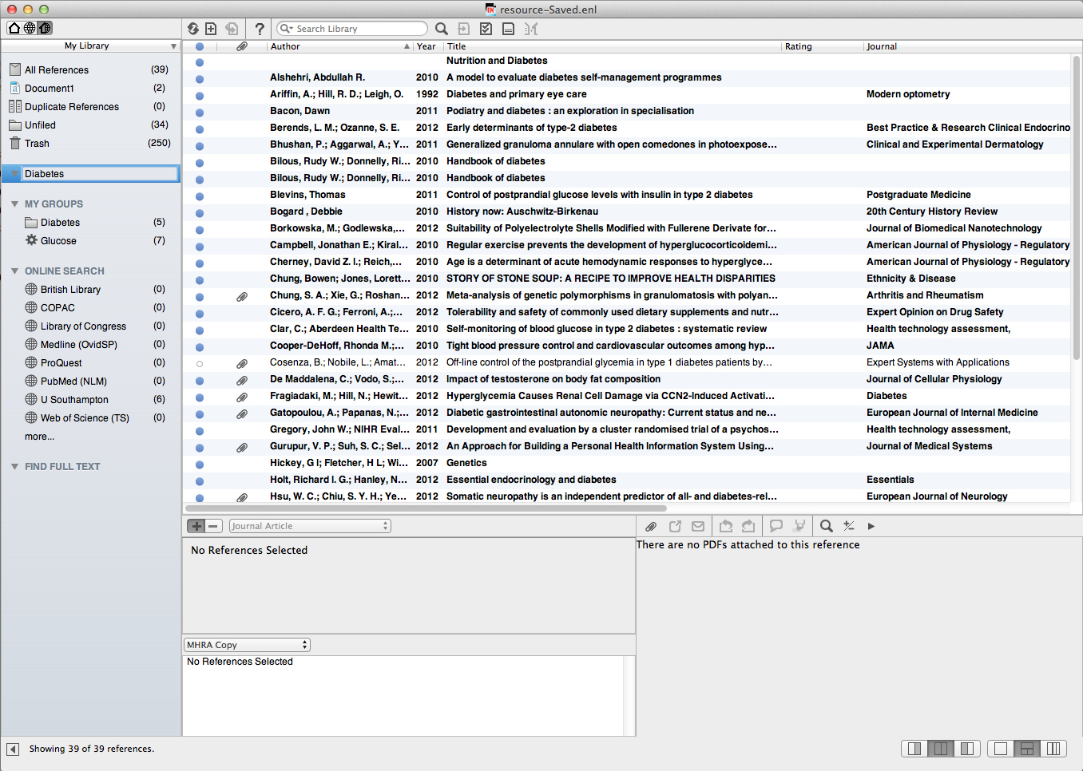
Name the new Group Set
56
Notes:
Name the group set.
56

Slide 57
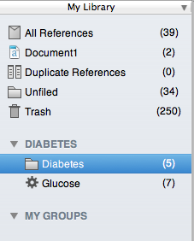
Drag existing groups into the new 'Group Set'
57
Notes:
When you first create a Group Set it will be empty. Drag groups to move them from one Group Set to a new Group Set, or create new Custom Groups and/or Smart Groups under the new heading.
57

Slide 58
Create from groups
Existing groups can be combined with AND/OR operators
Identify records appearing in a particular combination of groups
Identify records appearing in one group but not in another

Slide 59
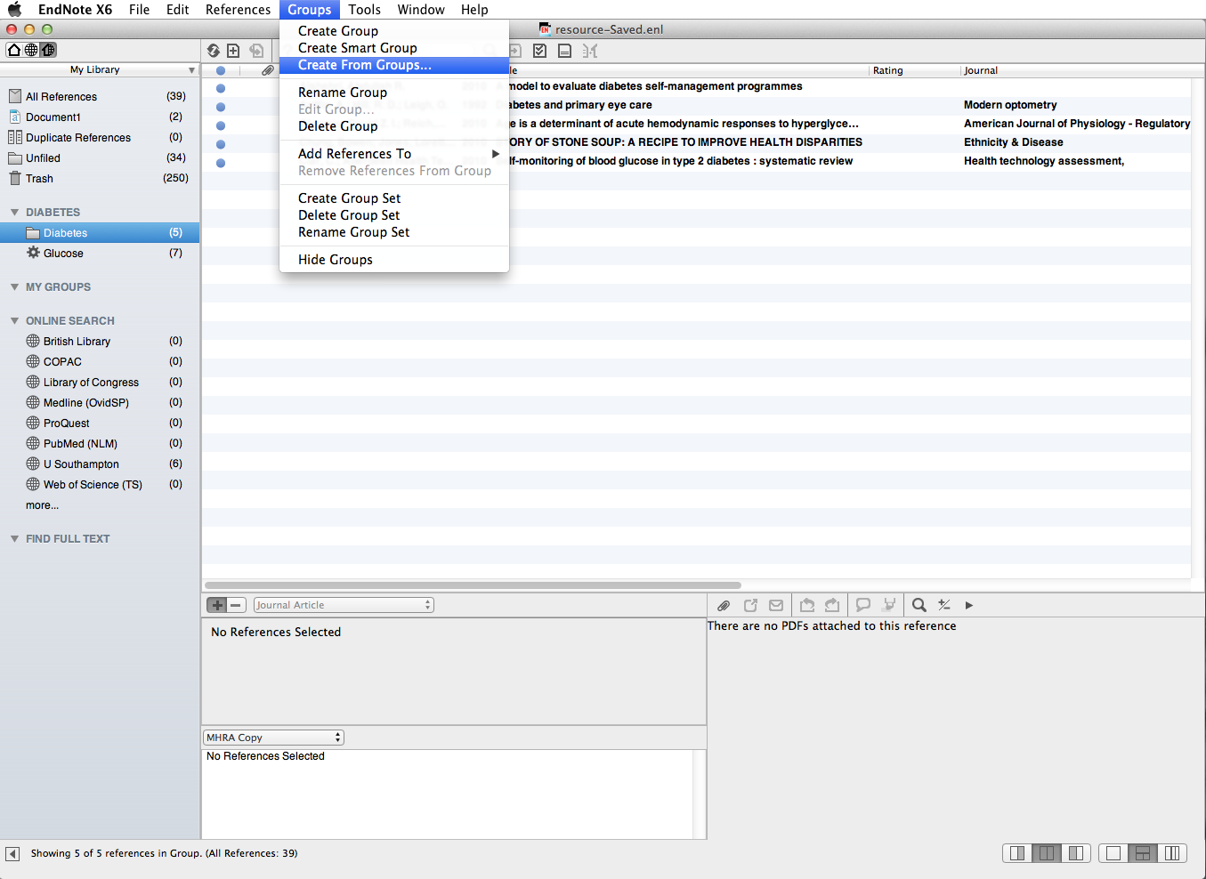
Go to 'Groups ➔ Create From Groups…'
Notes:
On the Groups dropdown menu, go to Groups, Create From Groups

Slide 60
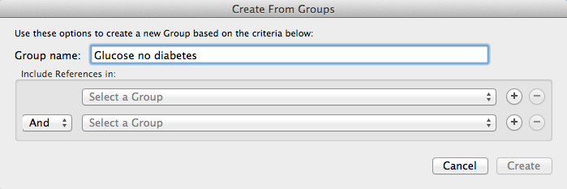
Choose which groups to combine using the dropdown list
Identify the Boolean operator
Notes:
Existing groups are listed in the dropdown menu. Choose which to combine using the operators And, Or, Not

Slide 61
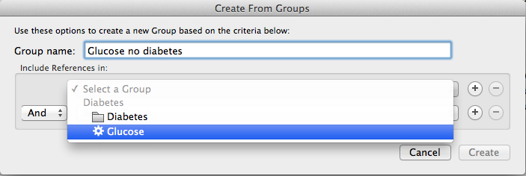
Notes:
This option selects the Smart group Glucose

Slide 62
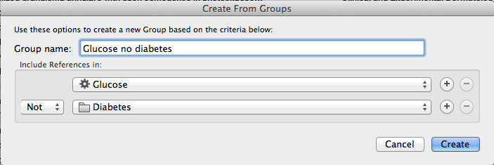
The new group will contain references that appear in the specified combination. Click 'Create'
Notes:
This group will contain references that appear in the Smart Group Glucose but not in the Custom Group Diabetes. Click Create to combine the groups.

Slide 63
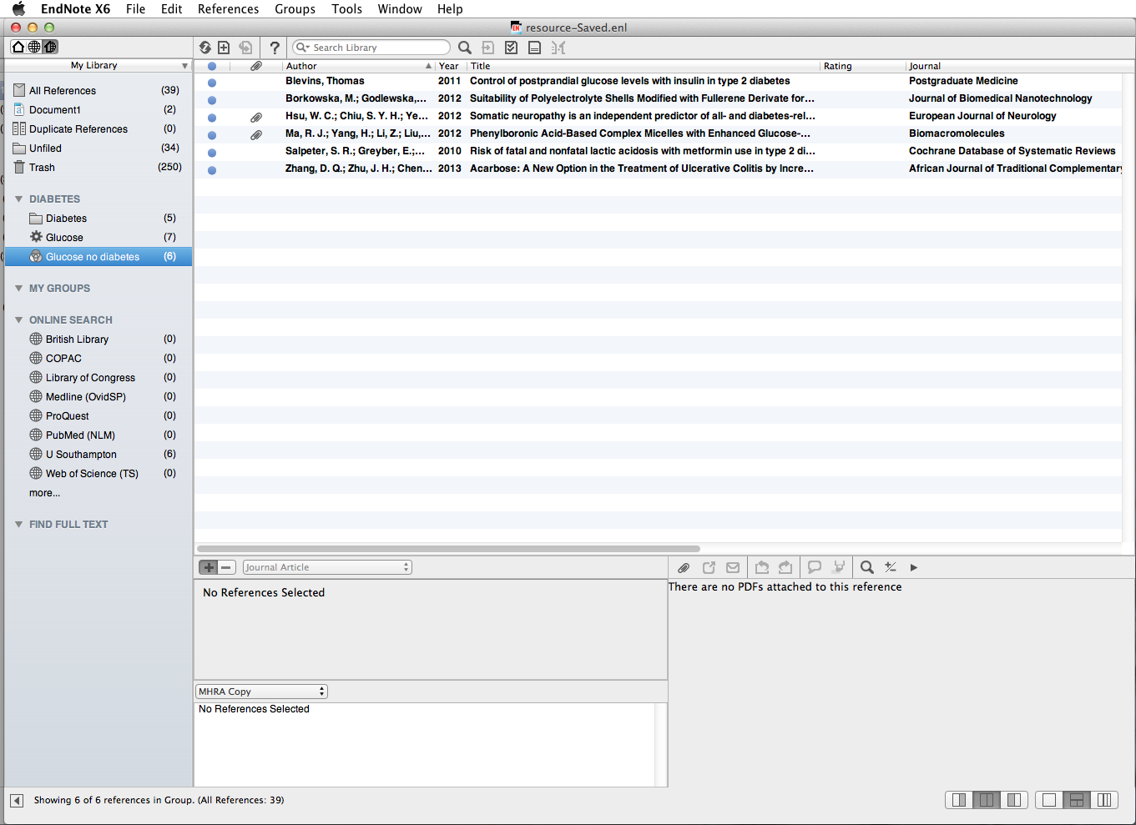
A new group is created in the Group Set 'Diabetes'
Notes:
This new group includes the selection of records as specified.

Slide 64
Edit an existing reference

Slide 65
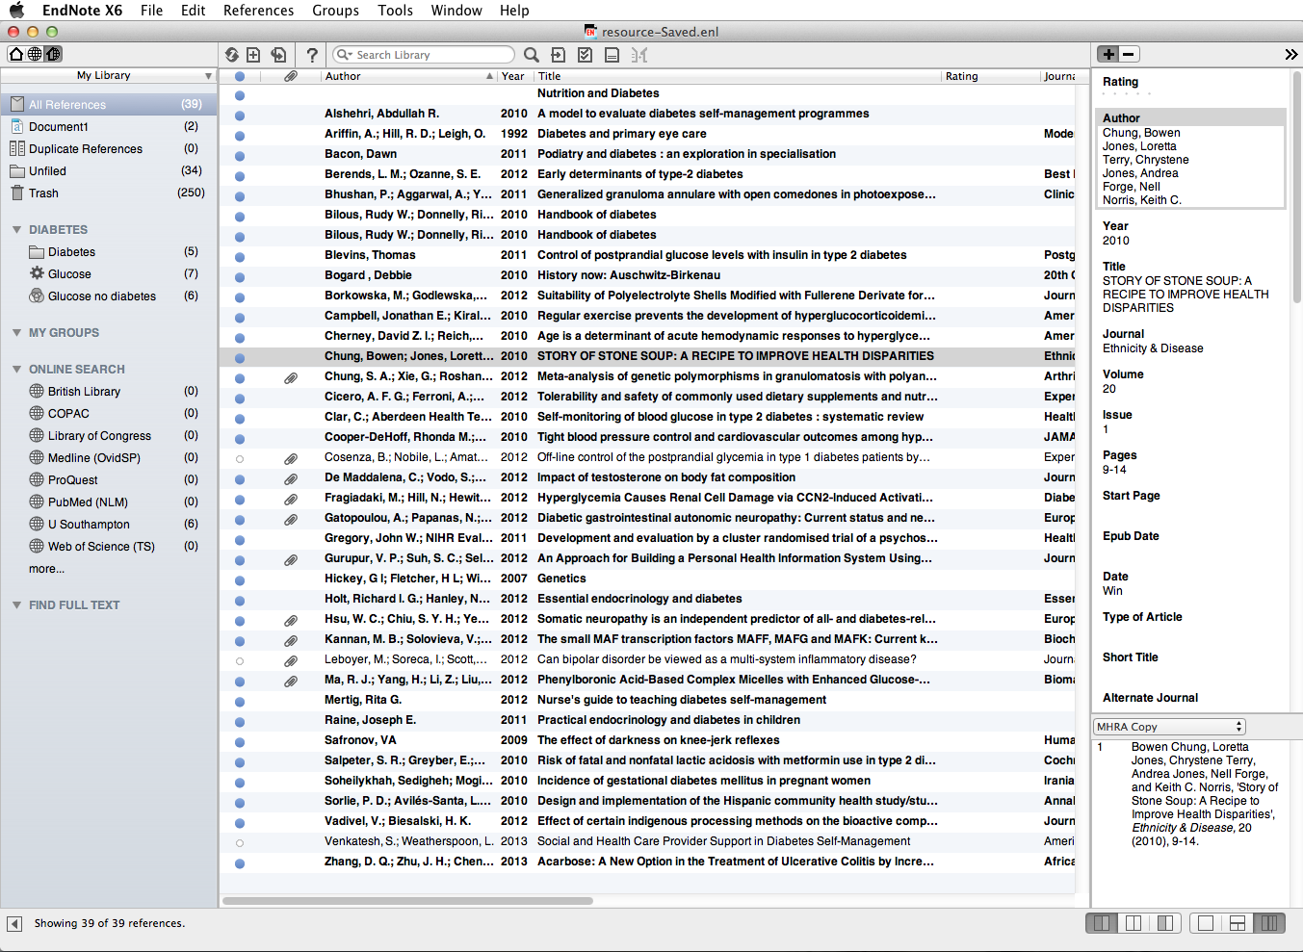
There is a formatting error in the title: go to the 'PDF & Quick Edit' tab
Notes:
Errors in existing records can be easily corrected.
In this example the record by the author Chung is showing in the Reference pane to the right of the window. The title of the paper appears in upper case.

Slide 66
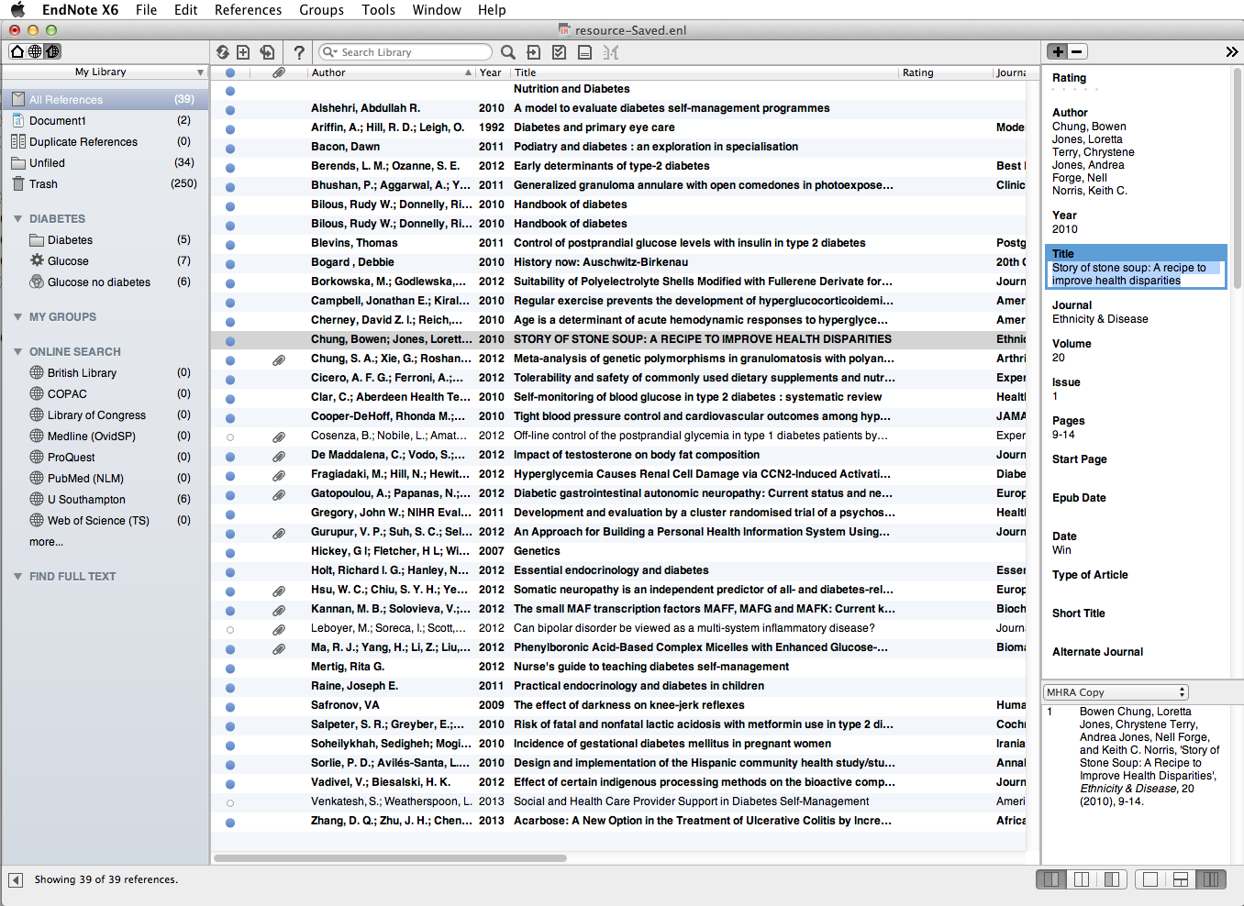
Click to hide/show all record fields
Notes:
With the reference highlighted in the library section of the screen, click on the Reference tab to see the record. Go to the title field and click to correct. Choose whether to see all fields or to hide empty fields in the Quick Edit window.

Slide 67
When all edits are complete, click the next record in the library pane
Notes:
When all edits are complete, click on the next record in the top section of the screen.

Slide 68
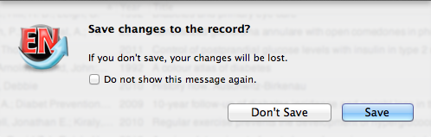
The 'Save' prompt displays
Notes:
Choose Save if edits are correct.

Slide 69
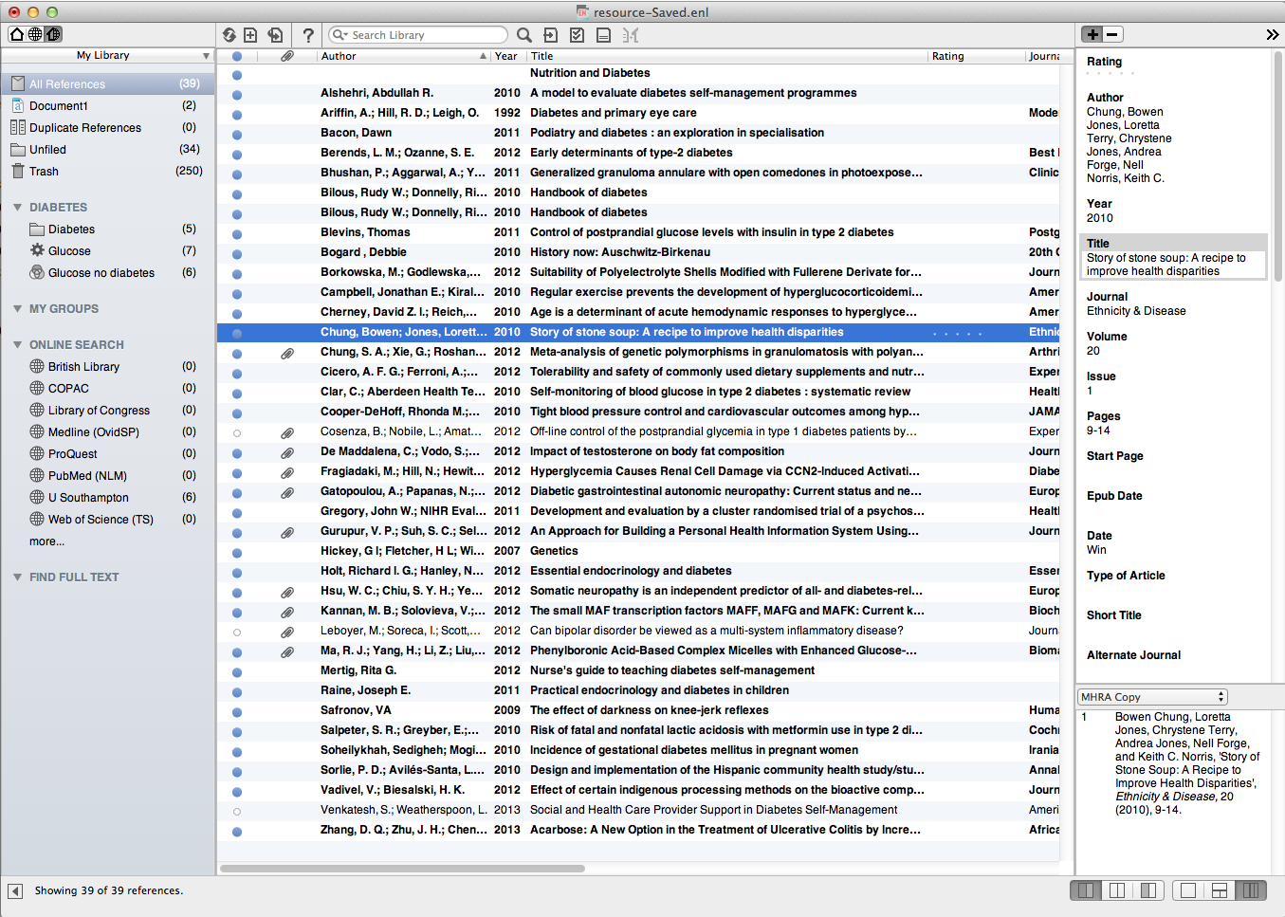
The edited record is displayed
Notes:
The edited record is displayed.

Slide 70
Edit a group of references
Make changes to any field in all references or a group of references
Useful for adding keywords, or research notes, to a group of references

Slide 71

Select the references to be edited and create a separate group if necessary
Notes:
Select the group of references to be edited - if necessary create a new group for these. The group can be deleted later - the changes will remain in the individual library records. In this case, the same changes will be made to all the records in the group Glucose no diabetes'.

Slide 72

Go to 'Tools  Change/ Move/Copy Fields…'
Notes:
Go to Tools, Change/Move/Copy Fields…

Slide 73

Use the 'Change Fields' tab
Notes:
Click on the Change Fields tab. Choose where in the selected field the new text will appear.

Slide 74

Select the field to modify
Notes:
Select the field to modify, for example to add a term to the Keywords field of selected records.

Slide 75

This adds the term 'Chapter 3' to selected records as the first term in the keyword field
Notes:
Add the required text and click OK. Use the Insert Special menu to add a carriage return if required.

Slide 76

A popup window confirms the number of records selected
Notes:
A popup window confirms the number of records being edited.

Slide 77

The text is added to the chosen field in the selected records
Notes:
The text appears in the chosen field for each record in the selection.

Slide 78
Search the Endnote Library

Slide 79

For a quick search of the whole Library use 'Quick Search'
For a more sophisticated search use the Search tab
Notes:
As your Endnote Library becomes larger, you may wish to search for references rather than scrolling through lists. You can either search your whole Library or a group of references.
If you just want to search your whole library quickly, use the Quick Search box on the Main toolbar.
For a more sophisticated search, or to search a group, select the Search tab.

Slide 80

Enter search terms and choose fields, operators and limiters
Search any field, PDFs or added PDF notes
Notes:
Search any field in the EndNote record, attached PDFs or sticky notes added to PDFs.

Slide 81

Select other limiters
Notes:
The Search Tab enables you either to search all words in your references using Any Field or to search specific fields, such as Author, Title or Keywords. Add extra search boxes if required, using the + symbols on the right.
Create more complex searches using the Boolean operators, And, Or and Not. Other limiters are available, such as Greater than, Less than, and others. Click Search when all choices have been made.

Slide 82

Ensure that the search is set to 'Search Whole Library'
Use Boolean operators
Notes:
To search the whole Library, select All References.
Make sure the search is set to Search Whole Library.
Enter the search terms, select the fields to search and any Boolean operators or limiters required.

Slide 83

Click to carry out the search
Search results appear in a temporary folder
Notes:
Click on Search to run the search.
The search results will appear in a new folder called Search Results and be displayed in the main window. The Search Results folder is only temporary and will be over-written at the next search. To save the research results as a group, create a new group and drag the results into it.

Slide 84

Ensure that the search is set to 'Search Whole Group'
Select Group to be searched
Notes:
To search a group, select the relevant group.
Make sure the search is set to Search Whole Group
As before, enter the search terms, select the fields to search and any Boolean operators or limiters needed. Then click Search.
Again, search results are displayed as a temporary group.

Slide 85
Working with figures

Slide 86
Attach a figure to any reference in the Endnote Library
The 'figure' can be:
an image file (JPEG, GIF, TIFF, BMP)
a multimedia file (MOV, QuickTime)
Audio files can also be added (WAV, MP3)
86
Notes:
86
Note that if required, a figure may have its own EndNote record

Slide 87


Open the reference
87
Notes:
87
This image is to be attached to the reference for Patchin. Open the reference by double-clicking on the entry for Patchin.

Slide 88

Scroll down to the 'Figure' field
88
Notes:
88
In the EndNote Library record, scroll down to the Figure field.

Slide 89

Go to 'References  Figure  Attach Figure' or Apple + click in the 'Figure' field
89
Notes:
89
Go to the References dropdown menu or 'ctrl + click' in the Figure field. Select Figure and Attach Figure.

Slide 90

Click 'Choose File' to browse for the figure
90
Notes:
90
In the Attach Figure window, find the image by clicking on the Choose File… button.

Slide 91

Locate the image file, and click 'Open'
91
Notes:
91
Locate the image and then click Open.

Slide 92

A thumbnail of the image is inserted in the 'Figure' field
Enter a title for the figure in the 'Caption' field
92
Notes:
92
A thumbnail of the image is then added to the figure field. Only one figure can be attached to a reference. If you attempt to add any more, the original image will be deleted.
Always enter some text in the Caption field. This will be included if the image is cited in a Word document.

Slide 93

Notes:
You will be prompted to save changes to the record

Slide 94
Insert figures in Word documents

Slide 95

CWYW tools
95
Notes:
Figures are inserted in a similar way to text references. Insert the Facebook image into this Word document as an in-text citation.
Put the cursor at the point in the text for the citation to appear. Then click the CWYW Tools tab on the EndNote toolbar.
95

Slide 96

Go to 'Find Figure(s)…'
96
Notes:
Select Find Figure(s) from the drop-down menu.
96

Slide 97

Enter keywords from the caption text, and press 'Enter'
97
Notes:
Enter part of the Caption Name that was given to the image in the Endnote Library and press Enter.
97

Slide 98

Select the required image, and click 'Insert'
98
Notes:
Select the correct image from the list that appears and then click Insert.
98

Slide 99

The image, with caption, is inserted at the next paragraph break following the insertion point
99
Notes:
The image is then inserted in the next paragraph break just under the insertion point. The output style for this document is Harvard; other output styles may place the image at the end of the document in a 'List of Figures'. Make choices about location for a given Reference Style using the EndNote 'Edit Style' function. A list of figures can also be created using tools on the EndNote tab in Word.
99

Slide 100
Working with tables and charts

Slide 101
Charts or tables cannot be inserted into existing references in Endnote
A separate reference must be created for each table or chart that you want to add.
101
Notes:
101

Slide 102


Go to 'New Reference'
This pie chart is in an Excel spreadsheet
Notes:
This pie chart is stored in an Excel file. Add a separate record for this to the Endnote Library. First of all click the New Reference button.

Slide 103

Choose the Reference Type 'Chart or Table'
Notes:
Choose the reference type Chart or Table.

Slide 104

Click to attach figure
Insert the bibliographic details
Notes:
Enter as much information as possible about the chart. Then insert the Excel file using the Attach Figure button.

Slide 105

Browse to locate the file
Notes:
In the popup window, find the file by clicking on the Choose File… button.

Slide 106

Locate the file containing the chart, and click 'Open'
Notes:
Locate the file containing the chart and click Open.

Slide 107

The file is added to the 'Figure' field
Enter descriptive text in the 'Caption' field
Notes:
The file is added to the Figure field. Only one table or chart can be attached to a reference. Each new table or chart must be saved as a separate EndNote record.
Always enter a piece of text in the Caption field. This label will make it easier to identify the chart to add to a Word document at a later stage.

Slide 108

Notes:
You will be prompted to save changes to the record.

Slide 109

Go to 'Edit ➔ Output Styles ➔ Edit 'Style''
Notes:
The chart or table will need to be included in your bibliography if the source is not already listed. Check the Reference style detaisl: go to Edit, Output Styles, Edit "Style"

Slide 110

Check the bibliographic templates
Notes:
Check the list of bibliographic templates: Generic is not appropriate for this Reference type.

Slide 111

Go to 'Chart or Table'
Notes:
Go to Bibliography, Templates, Chart or Table

Slide 112

Create a new reference type
Notes:
Create a new reference type.

Slide 113

Notes:
Changes to the reference types will be saved in the copy style file.

Slide 114

Go to CWYW tools
114
Notes:
Table and charts are inserted in a similar way to text references.
Locate the cursor at the chosen insertion point in the text. Click the CWYW Tools tab to display EndNote tools.
114

Slide 115

Select 'Find Figure(s)…' from the dropdown list
115
Notes:
Select Find Figure(s)… from the drop-down menu.
115

Slide 116

Enter part of the Caption name, and click 'Find'
Select the correct entry, and click 'Insert'
116
Notes:
Enter part of the Caption Name that was given to the image in the Endnote Library and click Enter.
Select the correct entry from the list that appears and then click Insert.
116

Slide 117

The chart is inserted at the next paragraph break beyond the insertion point
117
Notes:
The chart is then inserted in the next paragraph break just under the insertion point. The output style for this document is Harvard, but other output styles may place the image at the end of the document in a ‘List of Figures’. Manage the location of the caption using the Edit (Style) function in EndNote. Reference details appear in the Bibliography.
117

Slide 118
Manage caption layout for tables and figures

Slide 119

Go to 'Edit ➔ Output Style ➔ Edit "Style"'
Notes:
On the Edit dropdown menu, go to Output Styles, Edit "Style", in this case a version of Harvard.

Slide 120

Choose the 'Figures' or 'Tables' option
Notes:
Choose the Figures or Tables option.

Slide 121

Choose the location for the figure
Choose the location for the caption
Notes:
In the Figure window, choose the location of the figure and its caption.

Slide 122

Choose the location for the table
Choose the location for the caption
Notes:
In the Tables window choose the location for the table and placement of the caption.

Slide 123
Attach PDF files to records

Slide 124

Go to 'File Attachments  Attach File…'
Notes:
PDF and other types of file such as word, Excel, graphics, can be attached to the EndNote record, using the File Attachments field. Open the required record.
On the References dropdown menu, go to File Attachments, Attach File.

Slide 125

Notes:
Browse to locate a previously saved PDF file. Click Open.
Note that it is helpful to rename PDF files when saving from online resources so that they can be more readily identified for addition to the EndNote records.

Slide 126

Notes:
The pdf is attached to the record

Slide 127

Save changes to attach the pdf permanently
Notes:
When you close the record you will be prompted to save changes.

Slide 128

The pdf shows in the record and in the pdf pane
Notes:
The pdf is shown in the File Attachments field

Slide 129

Select and drag the PDF file on to the record in main library view
Notes:
If there are a number of records to be updated, it is helpful to save all the PDFs in a single folder and open this window alongside the EndNote Library. Alternatively, transfer the files directly from Current Downloads.
Select the required PDF file and drag it on to the main library record as displayed in the main library view.

Slide 130

The file attachment symbol displays in the record
Notes:
The File Attachment symbol displays in the library window.
In either case, the PDF is added to the File Attachments field.

Slide 131
Importing references from
PDF files
Notes:
This feature allows you to convert existing collections of PDF files into EndNote references with minimal typing and copying by extracting Digital Object identifiers (DOI) from PDF files. The system matches DOI information with data available from CrossRef (www.CrossRef.org) by capturing bibliographic content and creating new EndNote references.

Slide 132

Choose 'Import '
Notes:
From the File menu, choose Import...

Slide 133

Locate the required file, and choose the Import Option 'PDF File or Folder'
Notes:
The Import window opens. Locate the required file and select. Choose PDF File or Folder from the Import Options list.
Leave the Duplicates list unchanged so that it will Import All (see separate section on managing duplicates) and accept the default value of No Translation in the Text Translation box.
Click Import to import the file.

Slide 134

The pdf appears in 'File Attachments'
An EndNote record is created with the pdf file attached
Notes:
When the import is complete, the new record is stored in the Imported References group, and will include bibliographic information given for the Digital Object Identifier (DOI) mined from the PDF file such as title, author, volume, issue, page, year, and DOI. Always check the imported data. If an article contains more than one DOI on the first two pages, EndNote will attach the PDF to a new record, but the bibliographic data will need to be inserted manually.

Slide 135
Importing files from a pdf folder containing pdf files
Notes:
This feature allows you to convert existing collections of PDF files into EndNote records with minimal typing and copying by extracting Digital Object identifiers (DOI) from PDF files. The system matches DOI information with data available from CrossRef (www.CrossRef.org) by capturing bibliographic content and creating new EndNote records.

Slide 136

Choose 'Import '
Notes:
From the File menu, choose Import...

Slide 137

Locate the required folder, and choose the Import Option 'PDF File or Folder'
Notes:
Browse to select the required folder. Choose PDF File or Folder from the Import Option list. Leave the Duplicates list unchanged so that it will Import All (see separate section on managing duplicates). Click Import to import the files in the selected folders.

Slide 138

EndNote records are created with the PDF files attached
Notes:
When the import is complete, the new records are stored in the Imported References group, and will include bibliographic information given for the Digital Object Identifier (DOI) mined from the PDF file, such as title, author, volume, issue, page, year, and DOI. Check through the imported data to make sure it has imported as expected. The Imported References group is a temporary group that is replaced each time you import another set of references. It is removed when you exit EndNote (although the references remain in the library. When more than one DOI appears on the first two pages of an article, the PDF will be imported and attached to the record, but bibliographic data must then be created manually as EndNote cannot identify the primary DOI.

Slide 139
Use EndNote with Word

Slide 140
Insert footnote references into Word

Slide 141

On the 'Document Elements' tab, go to 'Footnote'
Notes:
With footnoting referencing styles such as MHRA, a combination of EndNote citation and the Footnote tool in Word is used. Click the required point of insertion in the document. On the Document Elements tab in Word, go to Footnote.

Slide 142

A footnote location is created at the bottom of the current page
Click in the footnote then 'Go to EndNote'
Notes:
A numbered footnote displays at the bottom of the current page. Move the insertion point to the footnote, and then click Go to EndNote on the X6 toolbar.

Slide 143

Select the reference to be inserted in the footnote, and click the 'Insert' icon
Notes:
In the EndNote Library, select the reference to be cited, and click the Insert icon.

Slide 144

The citation is inserted in the footnote in the required format
Notes:
The citation is inserted in the footnote according to the format set in the Footnote template in EndNote and an end of document bibliography reference created.

Slide 145


Open the Insert menu to format footnotes and endnotes
An end of document bibliography may also be created
Notes:
Multiple footnotes can also be formatted in Word: click Footnote… on the Word Insert menu to see options.
According to the Reference Style chosen, an end of document bibliography may also be created.

Slide 146
Manage the bibliography layout

Slide 147


Go to 'CWYW Tools'  'Bibliography Settings…'
Notes:
Use the CWYW Tools drop-down menu. Choose Bibliography Settings.

Slide 148

… or remove the hanging indent
Insert a line space between references if required …
Click OK when all choices have been made
Notes:
Use the Layout tab. This window lets you manage indents, the line spacing within a reference, and the line spacing between references.
To insert a single space between references, go to the Space after drop down list and choose Single
Remove the hanging indent by changing to 0cm. Click OK when all choices have been made.

Slide 149


Slide 150

Click 'Browse' to select a new reference style
Notes:
EndNote contains reference styles for many popular academic journals. An existing document created with one reference style can be reformatted for a specific publication.
Click the Format Bibliography tab.
Browse to choose a new reference style, and click OK. This will change all the citations and bibliographic references to the new format. Note that the reference style of the EndNote Library must also be changed if further citations are to be inserted.

Slide 151

Choose a new referencing system…
Notes:
Use the Format Bibliography tab to apply a different reference style to a previously created document. This document is currently referenced in Harvard. Browse to choose a new reference style, in this case Vancouver, and click OK

Slide 152

The document displays in the selected reference style
Notes:
The document is reformatted in the selected reference style.

Slide 153
Remove field codes

Slide 154
Create a plain text document
A completed Word document carries all EndNote field codes
For publication, a 'plain copy' is required
Make a copy of the Word document before creating the plain text version - if you make a mistake there is no way back to the original
Notes:
A Word document with EndNote citations carries hidden field codes. If the paper is to be submitted for publication, a plain copy is usually required. It is good practice to make a backup copy of the document before starting this process

Slide 155

Go to 'CWYW Tools' and choose the 'Convert to Plain Text' option
Notes:
In CWYW Tools, choose the Convert to Plain Text option.

Slide 156
Creating a subject bibliography

Slide 157

Select the references to be included in the Subject Bibliography
157
Notes:
A subject bibliography can be created in several ways. This example demonstrates the creation of a Subject Bibliography by choosing references from the All References list; use the cmd key to help with the selection.

Slide 158
Choose 'Show Selected References'
158
Notes:
From the References menu choose Show Selected References.

Slide 159

Selected references are displayed
Notes:
The selection is displayed.

Slide 160

Choose 'Subject Bibliography'
160
Notes:
Go to the Tools menu, then select Subject Bibliography.

Slide 161

Choose the subject field
…then click OK
161
Notes:
Choose how to display references in the Subject Bibliography; for this example Reference Type (eg. Book, journal article, etc) has been selected.

Slide 162

Choose 'Select All'
162
Notes:
To use all the Selected Terms choose Select All and click OK.

Slide 163

Change the 'Output Style' and 'Layout' if needed
Print or Save…
163
Notes:
Make changes to the Output Style and Layout as required. Then Print or Save the Subject Bibliography

Slide 164

Control the subject bibliography layout by using the tabs
Notes:
Use the Subject Bibliography Setup tabs to vary the layout. To omit the numbers beside the Subject Term headings, on the Terms tab, uncheck the Subject Term Counts box.

Slide 165

Notes:
Label and sort the bibliography if required.

Slide 166
Use abbreviated journal titles
Notes:
Some departments and publications require the use of abbreviated rather than full journal titles.

Slide 167

Go to 'Tools  Open Term Lists  Journals Term List'
Notes:
There are three stages to this process: first the existing journal term list must be deleted, then a list of titles and abbreviations imported, and then EndNote must be instructed to use the abbreviation field when inserting the reference.
To delete the existing Journals Term List, go to Tools, Open Term Lists, Journals Term List

Slide 168

Go to the 'Terms' tab: titles of journals currently listed in the EndNote Library are displayed - these must be deleted
Notes:
Go to the Terms tab: this shows only the full titles, with no abbreviations. These existing titles must first be deleted.

Slide 169

Select a single title, go to Edit and choose 'Select All'
Notes:
Click a single title, then go to Edit on the top menu bar. Choose Select All.

Slide 170
Click 'Delete Term'
Notes:
When all the journal titles are highlighted, click Delete Term.
All titles are deleted from the list.

Slide 171

Now go to the 'Lists' tab: click 'Import List'
Notes:
Now go to the Lists tab, choose Journals and click the Import List option.

Slide 172

Go to 'Applications  EndNote X6  Terms'
Notes:
Browse to locate the Terms List folder which is contained within the EndNote Program software.
Go to Applications, EndNote X6, Terms

Slide 173
Select the Terms List for the relevant subject area, and click 'Choose'
Notes:
Select the Terms List for the general subject area, in this case Medicine, and click Choose.

Slide 174

A new 'Journals' term list is created
Notes:
All accepted abbreviations for medical journals are then downloaded to the Journals Term List within the EndNote Library.

Slide 175

The Journals Term List now includes abbreviations as well as full titles
Notes:
Click the Terms tab in the Term Lists window: abbreviated titles now show alongside full titles.

Slide 176

To apply the abbreviations to the current referencing style and library, go to 'Edit  Output Styles  Edit '(Reference Style)'
Notes:
EndNote must be instructed to use the abbreviated titles in bibliographic references: go to Edit, Output Styles, Edit (Reference Style) in this case Vancouver.

Slide 177

Go to 'Journal Names'
Notes:
On the Reference Style edit window, go to Journal Names.

Slide 178

Choose 'Abbreviation 1' and save changes to the reference style
Notes:
Choose Abbreviation 1 and save changes to the reference style in the usual way.

Slide 179

The journal title will appear in full in the EndNote Library record
When this reference style is applied to the library, journal titles will show in the Preview pane in abbreviated form
Notes:
When this reference style is applied to the library, and relevant Word documents, the journal titles will be applied in abbreviated form.
Within the EndNote Library, the full journal title continues to appear in the individual EndNote record. The abbreviated form is shown in the Preview pane.

Slide 180
Combine chapters into a single document
Separate Word documents with their own reference list can be combined into a single document
Choose whether to have:
  a reference list at the end of each chapter
  a combined reference list at the end of the complete new document
  or both!
Notes:
Large documents such as theses may be created as individual chapters, each with their own set of cited references. At some stage, these chapters need to be combined into a single document. EndNote tools are available for various configurations.

Slide 181

First create a new Word document
Notes:
Create a new Word document.

Slide 182


These chapters currently have separate reference lists
Notes:
Open the chapters to be combined.

Slide 183

Copy and paste the text from each chapter in turn into the new Word document
Notes:
For each chapter, copy and paste the text section only into the new document (All the bibliographic information required later is in the field codes attached to each citation).

Slide 184

Go to 'Layout ➔ Page Breaks ➔ Next Page'
Insert a section break at the end of each chapter text
Notes:
Insert a section break after each chapter: this would normally be Next Page but Continuous is used in this example for ease of illustration. Go to Layout, Page Breaks, Section Breaks, Next Page.

Slide 185

Repeat for each chapter
Notes:
Repeat for each chapter, including a Section Break at the end of the final chapter.

Slide 186

Go to 'Edit ➔ Output Styles ➔ Edit "Reference Style"'
Notes:
To create the new bibliography, in EndNote, go to Edit, Edit "Reference Style", (in this case Harvard Copy)

Slide 187

Choose the 'Sections' tab
Notes:
Choose the Sections tab to view options. Make choices and save selection to the current reference style. In this case a single bibliography will be created at the end of the whole document. These changes must be reselected if a different reference style is used.

Slide 188

Save changes to the reference style

Slide 189

Go to 'CWYW Tools ➔ Bibliography Settings…'
Notes:
In the Word document, go to CWYW Tools, Bibliography Settings….

Slide 190

Click OK to reformat the current Word document
Notes:
Click OK to reformat in the chosen reference style and apply changes..

Slide 191

Notes:
An end of text bibliography is generated.

Slide 192

Use this option to create both section and end of document bibliographies
Notes:
It is also possible to create end of chapter and end of document bibliographies. Apply the saved reference style to the document to make changes.

Slide 194

Notes:
Reformat the document with the chosen referencing style

Slide 195

End of section and end of text bibliographies are created
Notes:
End of section bibliographies are created together with a combined end of text bibliography.
With numbered reference styles, choose whether to retain the numbering for each section, or combine into a single list.

Slide 196
Export the EndNote Library

Slide 197

Go to File ➔ Compressed Library (.enlx)…
Notes:
To export a copy of all or part of the EndNote library, go to 'File, Compressed Library (.enlx)…'

Slide 198

Choose to export all or part of the library
Notes:
Choose to export all or part of the library, with or without file attachments. The compressed library can be saved to another location, or emailed (although with attachments, these files can be quite large).

Slide 199

Single groups can be selected
Notes:
References in a single group can be selected.

Slide 200

Choose a location for the Compressed Library and click 'Save'
Notes:
Choose a location for the compressed library, and click Save.

Slide 201

Notes:
The exported file opens as a new EndNote Library. If using the same computer, you will be prompted to save with another filename.

Slide 202

Notes:
If the Save as package box is selected, the library will open with a .enlp extension.

Slide 203

Export references from external databases
Notes:
Note that with Safari, export is generally a two stage process.
If searches are done in Firefox these generally download directly All downloads in this presentation use Firefox.

Slide 204
Export from OVID databases

Slide 205

This is the Medline home page
Carry out a simple search for 'diabetes'
Notes:
This procedure applies to any database on the OVID platform.
It is best, but not essential, to open the EndNote library before starting the search.
Use the library website to access the OVID platform. In this case a search of Medline has been used.
The instructions here are for exporting required articles to EndNote rather than conducting an effective search strategy.
This example uses a simple search for diabetes literature.

Slide 206

When all selections have been made, go to 'Export'
Check boxes for required papers
Notes:
When the search is complete, click Display to view the results.
Check the boxes for required results. When selections are complete, go to Export.

Slide 207

Choose 'Export to EndNote'
Notes:
In the Export Citation List window, choose the Export option EndNote.

Slide 208

Then choose the 'Complete Reference' option
Notes:
Then in Select Fields to Display choose the Complete Reference option. Other choices may not import Author and Year information correctly. Click Export Citation(s) to complete the process.

Slide 209
Select the 'Include URL' option and click 'Export Citation(s)
Notes:
It is useful to include the Link to External Resolver and the URL link. When all choices have been made, click Export Citation(s)
The references are exported to 'Downloads' as an ovidweb.cgi file.

Slide 210

References are imported as a temporary group
Click any entry to view full details
Notes:
You will be prompted by Firefox to choose an application to use when downloading the export files of type ovidweb-cgi.
Choose Applications, EndNoteX6, EndNoteX6 and save this choice for future downloads.
Selected references are imported directly to the EndNote Library. These are displayed as a temporary group, and are added to All References. The temporary group will be overwritten at the next import. Click on any entry to display full record details.

Slide 211

Follow the link to the full Medline database record
Notes:
The URL provides a link back to the full Medline database record.

Slide 212
Search Web of Knowledge

Slide 213

This is the Web of Science home page
Carry out a simple search for 'diabetes'
Notes:
This is the Web of Science home page on the Web of Knowledge. Carry out a simple search for 'diabetes'.

Slide 214

Mark the items required and go to 'Marked List'
Notes:
Mark the required results, and go to Marked List

Slide 215

Choose to export to EndNote

Slide 216

Select an application to open the file
Notes:
Firefox will ask which application to use with files from this source. Go to Open with Choose

Slide 217

Go to 'Applications ➔ EndNote X6 ➔ EndNote X6
Click 'Open'
Notes:
Go to Applications, EndNote X6, EndNote X6 and click Open.

Slide 218

Notes:
Check the 'Do this automatically…' box, and click OK

Slide 219

References are downloaded as a temporary group
Notes:
References are downloaded automatically as a temporary group of Imported References and are added to All References. Click any reference to view.

Slide 220

The URL links to the Database page
Notes:
Bibliographic information is imported, together with a hyperlink to the Web of Science record

Slide 221
Export from EBSCO databases

Slide 222

This is the CINAHL home page
Carry out a simple search for 'depression'
Notes:
This procedure applies to any database on the EBSCO platform.
Use the library website to access the EBSCO platform. In this case a search of CINAHL has been used.
The instructions here are for exporting required articles to EndNote rather than conducting an effective search strategy.
This example uses a simple search for literature on depression.

Slide 223

Click to add/remove items in Folder
Click to view selected records
Notes:
Click the Add to Folder option in the record. Record details will be added to the current folder. Click Go to Folder View to see all selections.

Slide 224

Click 'Export'
Notes:
Select all results and click Export.

Slide 225

Choose 'Direct Export in RIS format' and click 'Save'
Notes:
To create a file compatible with the MAC platform, choose Direct Export in RIS format and click Save. You will be prompted to choose a file name and location in the usual way.

Slide 226

Go to 'Choose'
Notes:
Firefox will prompt you to choose an application for the download - go to Choose

Slide 227

Go to 'Applications ➔ EndNote X6 ➔ EndNote X6
Click 'Open'
Notes:
To choose the application, go to Applications, EndNote X6, EndNote X6, and click Open

Slide 228

Check the 'Do this automatically …' box and click 'OK'
Notes:
To save repeating this process on future occasions, check the Do this automatically … box. Click OK

Slide 229

Click any record to view
Notes:
Selected items are downloaded automatically as a group of Imported References and are added to All References. Click any record to view full details.

Slide 230

Click to return to the EBSCO database record
Notes:
The URL field contains a hyperlink to the EBSCO database record

Slide 231
Exporting from the Cochrane Library

Slide 232

Select the required results
232
Notes:
After conducting a search on the Cochrane Library, choose your results.

Slide 233
Choose 'Export Selected'
Notes:
Then Export Selected.

Slide 234

Choose the 'Abstract and citation' and 'Mac' options and click to export
Notes:
Use the dropdown menu to choose the Abstract and Citation option and the Mac file type and click Export Citation.

Slide 235

Go to the dropdown to choose the application
Notes:
The downloaded file is in an Endnote compatible format. Firefox will prompt you to choose an application to download the file: go to the dropdown and find the Choose option

Slide 236
Go to 'Applications ➔ EndNote X6 ➔ EndNote X6
Click 'Open'
Notes:
To choose the application, go to Applications, EndNote X6, EndNote X6, and click Open

Slide 237

Check the 'Do this automatically… box and click OK
Notes:
To avoid carrying out this part of the process in the future, check the 'Do this automatically…' box and click OK

Slide 238

Imported references are displayed as a separate group
Notes:
Imported references will be displayed as a temporary group and are also added to All References.

Slide 239

Follow the hyperlink…
Notes:
Follow the hyperlink to view the full database article. …and view the full database entry.

Slide 240
Export from Emerald

Slide 241

Register
Notes:
Before creating a list of references to export to Endnote, it is recommended that you first set up a user profile with Emerald. Otherwise you are restricted to just being able to create a single list with a maximum of ten items. With a user profile, it is possible to create several marked lists, which may contain an unlimited number of items. Click Register

Slide 242

Complete profile details

Slide 243

Complete profile details
Notes:
The username and password become the log-in for subsequent visits to Emerald. Input required information and click Submit.

Slide 244

Go to the 'Marked lists' link
Notes:
Before beginning to select items for export, create a marked list. Go to Marked lists in the lefthand navigation panel

Slide 245

Enter the listname and click 'Add'
Notes:
Enter the list title in the Add a new list box. single character string names are preferred – no spaces. Click Add

Slide 246

Go to 'Advanced search'
Notes:
A new marked list, 'internetshopping' has been created. Go to Advanced search.

Slide 247

Search for 'internet shopping' and 'consumer behaviour'
Notes:
Carry out the search, in the case for 'internet shopping AND consumer behaviour'

Slide 248

Click to view all results
Notes:
Click to view all results: blank check boxes will then appear beside individual records.

Slide 249

When all items required from the current page have been selected, click 'Go'
Choose the destination list
Check boxes for items to be added to the list
Notes:
To select references for export, select the appropriate marked list, in this case 'internetshopping'. Check the boxes for required references, then choose Go. Selected references will now be added to this list. Repeat for subsequent pages.

Slide 250

When all required items have been selected, click the 'Marked lists' link
Notes:
When all references for export have been selected, click the Marked lists link on the lefthand navigation panel.

Slide 251

Choose the required list and click 'Select'
Notes:
Choose the marked list internetshopping from the drop-down menu and click Select

Slide 252

Choose 'Export options'
Notes:
Deselect any items on the list not now required and go to Export options. Choose Export

Slide 253

Go to 'Export a text file… Download file'
Notes:
Select the Export a text file (RIS format) section and Download file

Slide 254

Click to save the file
Notes:
Identify the results file to be downloaded

Slide 255

Open the download file and choose an application
Notes:
Double clicking on the download file opens the Launch Application window. Click Choose

Slide 256
Go to 'Applications ➔ EndNote X6 ➔ EndNote X6
Click 'Open'
Notes:
To choose the application, go to Applications, EndNote X6, EndNote X6, and click Open

Slide 257

Check the 'Remember…' box and click OK
Notes:
Check the Remember my choice… box for future searches, and click OK

Slide 258

Notes:
References are imported as a temporary group of Imported references. They are also added to All References. The temporary group will be overwritten at the next import activity or when the library is closed. Double –click on any reference to view more details

Slide 259

Follow the hyperlink to the record
Notes:
The URL contains a direct link to the full record

Slide 260
Export references from Engineering Village databases

Slide 261

Select the databases to search
Notes:
Select the databases to be searched.

Slide 262

This is a search of GEOBASE
Notes:
This is a search of Geobase, but the process is the same for Compendex or the 'All databases' options. Enter the search terms or keywords, in this case 'gulf of mexico' AND 'oil' and click Search.

Slide 263

Select 'Download'
Mark the required records
Notes:
The search has found a number of results. Select required records. Then click Download.

Slide 264

Choose the 'RIS, EndNote…' option and click 'Download'
Notes:
The Download Records box will open. Choose the Detailed record format and the RIS, EndNote, ProCite, Reference Manager option and then click Download.

Slide 265

Click 'Choose'
Notes:
Firefox will ask which software to use to open this file. Click Choose.

Slide 266
Go to 'Applications ➔ EndNote X6 ➔ EndNote X6
Click 'Open'
Notes:
To choose the application, go to Applications, EndNote X6, EndNote X6, and click Open

Slide 267

Check the box and click 'OK'
Notes:
Check the Do this automatically… box to save time on future searches, and click OK

Slide 268

References are displayed as a temporary group of imported references, and are added to the main library
Notes:
The references are automatically transferred to the EndNote library as a temporary group of imported references. This temporary group is deleted at the next import, or when the library is closed, but remain in All References when you close a library, however only the group is deleted; the references remain in the library and they will be visible when you next open the library in the All References group. Double click on any record to open.

Slide 269

Imported references contain a hyperlink to the database
Notes:
A URL is also imported. Follow the link to view the full record.

Slide 270


Slide 271
Export from IBSS (Proquest)

Slide 272

This is the Advanced Search page
Enter search terms and click 'Search'
Notes:
This is the IBSS database. Choose the Advanced Search option on the home page, enter search terms and click Search. This search is for a single term holocaust.

Slide 273

Select required records and click 'Export/Save'
Notes:
Use the check boxes to select the required items and go to Export/Save.

Slide 274

Choose 'EndNote'
Notes:
In the pop-up window choose the EndNote, Reference Manager or ProCite option and follow instructions to save the file.

Slide 275

Go to Continue'
Notes:
In the EndNote Library, go to File, Import…

Slide 276

Click 'Choose'
Notes:
Firefox will ask which program to use to open this file. Click Choose.

Slide 277
Go to 'Applications ➔ EndNote X6 ➔ EndNote X6
Click 'Open'
Notes:
To choose the application, go to Applications, EndNote X6, EndNote X6, and click Open

Slide 278

Check the 'Do this automatically…' box and click 'OK'
Notes:
Check the Do this automatically.. box to save time with future searches, and click OK

Slide 279

Selected references are imported
Click any entry to view full details
Notes:
References are imported as a temporary group and are added to All References. Double click any reference to view.

Slide 280

Follow the URL link to the full database record
Notes:
Click the URL link to return to the full database record.

Slide 281


Slide 282
Export from IEEE Explore

Slide 283

Follow the 'Advanced Search' link
Notes:
Find links to IEEE Xplore on the library website. On the search screen. Use the Advanced Search link.

Slide 284

Build a focused search and limit results as required
Notes:
Build a focused search and limit the results.

Slide 285

Mark the required results and click 'Download Citations'
Notes:
This is a search for 'ferrybox'. Mark any required records by checking the boxes then click on the Download Citations button at the top of the screen.

Slide 286

Choose 'Citation & Abstract', 'EndNote..' format, and click 'Download Citation'
Notes:
The download citations dialogue box will open. It is usually a good idea to capture the abstract along with the citation so highlight that option. Then choose the format for EndNote, ProCite, RefMan and finally click the Download Citation button.

Slide 287

Go to 'Choose'
Notes:
Firefox will ask you to select the software to open the download. Go to Choose.

Slide 288
Go to 'Applications ➔ EndNote X6 ➔ EndNote X6
Click 'Open'
Notes:
To choose the application, go to Applications, EndNote X6, EndNote X6, and click Open

Slide 289

Check the box and click 'OK'
Notes:
Check the Do this automatically… box to save time with future downloads and click OK

Slide 290

The selected references appear as a temporary group of imported references and are added to the main library
Notes:
The selected references are imported as a temporary group into the open EndNote library and are also added to 'All References'.

Slide 291
Exporting from JSTOR

Slide 292

Use the 'Advanced Search' option
Notes:
It is best, but not essential, to open the EndNote library before searching JSTOR.
Use the library website to access JSTOR.
The instructions here are for exporting required articles to EndNote rather than conducting an effective search strategy.
On the JSTOR homepage, go to the Advanced Search option

Slide 293

Search for 'human rights'
Notes:
This example uses a search for 'human rights'.

Slide 294

Click on 'Export'
Select references for export
Notes:
To export references from a single page of results, begin by selecting the references you wish to export. Then click on Export.

Slide 295

Choose the 'RIS file' option
Notes:
Choose the RIS file option.

Slide 296

Click 'Choose'
Notes:
Firefox will ask which application to use to open the file

Slide 297
Go to 'Applications ➔ EndNote X6 ➔ EndNote X6
Click 'Open'
Notes:
To choose the application, go to Applications, EndNote X6, EndNote X6, and click Open

Slide 298

Records are imported to the EndNote Library
Notes:
The records will import directly into the EndNote library. These become a temporary group of Imported References, but are already added to the main library of All References. The temporary group will be overwritten at the next import activity, or when the library is closed.
Double click on any of the imported references to view.

Slide 299

Click to view JSTOR record
Notes:
Individual records contain hyperlinks back to the original database record.

Slide 300


Slide 301
Import references from Google Scholar

Slide 302

Go to 'Settings'
Notes:
Unlike the main Google search engine, Google Scholar enables references to be exported to Endnote. However, before any searches are carried out, check that Google Scholar is properly configured to do this. To do this choose Scholar Preferences.

Slide 303

In the Bibliography Manager, select 'Show links to import citations into EndNote'
Click 'Save'
Notes:
Near the bottom of the page, is the Bibliography Manager section. Check that the Show links to import citations option is marked and that Endnote is chosen from the drop-down menu beside it. To return to the search screen, click Save.

Slide 304

Open the EndNote Library, and perform the Google Scholar search
Notes:
You can now perform a search. It is recommended that you open the EndNote Library before starting the search on Google Scholar.
This search is for material on the human genome.

Slide 305

Click the 'Import into EndNote' option
Notes:
Google Scholar produces a large number of results for this search. To import information from any of these websites into Endnote, select the Import into EndNote link that appears at the end of each entry.

Slide 306

Click 'Choose'
Notes:
Firefox will ask which software to use to open this file. Click Choose.

Slide 307
Go to 'Applications ➔ EndNote X6 ➔ EndNote X6
Click 'Open'
Notes:
To choose the application, go to Applications, EndNote X6, EndNote X6, and click Open

Slide 308

Check the 'Do this…' box and click OK
Notes:
Check the Do this automatically… box to save time on future searches, and click OK

Slide 309

The record is imported as a temporary group and is added to the main library of all references
Notes:
Bibliographic details are then imported into Endnote. These become a temporary group of Imported References, but are already added to the main library of All References. The temporary group will be overwritten at the next import activity, or when the library is closed.
Click on this reference in order to view its full record.

Slide 310

Note that only one record at a time can be exported from Google Scholar
Notes:
Google Scholar won’t allow you to import more than one reference at a time. To export more items from the ‘human genome’ search into Endnote then you will need to return to the Google Scholar search page and select the next reference required.

Slide 311
Search and export from library catalogues

Slide 312

Use the same procedure for other library catalogues
In the 'Online Search' pane, click 'more'
Notes:
Most library catalogues, including Southampton's own, do not have a bibliographic export facility. However the catalogues can be searched and results downloaded by initiating the search via EndNote. Note that this is a less sophisticated search than those commenced from within an individual database.
To make the connection with the University of Southampton catalogue, in the Online Search section of the lefthand panel, click More…

Slide 313

Select 'U Southampton' and click 'Choose'
Notes:
In the Choose a Connection window, scroll down to select U Southampton and click Choose.
Search catalogues of other libraries in the same way.

Slide 314

Click 'Search'
Select as many search fields, criteria and search terms as required. More lines can be added if necessary
The Search tab is now linked to the library catalogue and the new connection appears in the 'Online Search' list
Notes:
The new connection will now appear in the Online Search list.
The search tab below the library pane is directed to the selected library catalogue.
A range of search fields, search criteria and search terms can be selected.

Slide 315

If the number of hits is too large, it may be necessary to refine the search
Click 'OK' to add the retrieved records to the EndNote Library
Notes:
The Confirm Online Search window shows the number of records retrieved. Refine the search if necessary.
Click OK to add the retrieved records to the EndNote Library.

Slide 316

Imported records display as a temporary group and are also added to the main library
Notes:
Imported records display as a temporary group and are also added to the main library.
Double click on any record to view. All fields in the catalogue record will be imported to the EndNote Library.

Slide 317

Follow link to e-resources
Follow the hyperlink to access e-resources
Notes:
Electronic resources listed in the library catalogue include hyperlinks

Slide 318
Searching COPAC
COPAC is the merged online library catalogue for many major university, specialist and national libraries in the UK and Ireland.

Slide 319

In the 'Online Search' section, select 'more…'
Notes:
Go to Online Search and select more….

Slide 320

Select COPAC then click 'Choose'
Notes:
Search for COPAC in the Choose A Connection box, then select Choose.

Slide 321

A link to COPAC will appear in the Online Search list, and the Search tab is also linked to COPAC
Notes:
A link to COPAC will appear. Always follow this link in the future to start a COPAC search.

Slide 322

Click 'Search'
Enter the search criteria
Notes:
Add your search criteria. Then click Search.

Slide 323

Click 'OK'
Notes:
The number of results matching the search criteria will be displayed; click OK.

Slide 324

Unwanted results can be deleted from this imported group, and will also be deleted from the main library
Notes:
Your results will be displayed. Unwanted results can be deleted from this group, and will be deleted from All References.

Slide 325
Working with e-prints

Slide 326

Access 'eprints.soton.ac.uk' and carry out a search for relevant papers
Notes:
Search or browse the eprints repository for required items.

Slide 327

This is a simple search for 'diaspora' and '2011'
The search can be refined if required
Notes:
Note that the only export option is for all results, so use the Refine search option to reduce the number of results if necessary.

Slide 328

Click 'Export'
Export as 'Reference Manager' type
Notes:
Choose to Export n results as Reference Manager format. Click Export.

Slide 329

Go to 'File ➔Save Page As…
Notes:
The formatted results are displayed. In the File menu, go to Save Page As…

Slide 330

Save as .ris import file
Notes:
The file exports in .ris format

Slide 331

Save to 'Downloads'
Notes:
Choose a location for the saved file – in this case to Downloads

Slide 332
Click 'Save'
Notes:
When all choices have been made, click Save. Ignore the following 'Save Plain Text' prompt, and choose Don't append.

Slide 333

Go to 'File ➔ Import…'
Notes:
In the EndNote library, go to File, Import…

Slide 334

Select the download file
Click 'Import'
Choose Reference Manager (RIS)
Notes:
Browse to locate the download file, and choose the Import Option Reference Manager (RIS)

Slide 335

Selected references are imported to the EndNote library
Notes:
The selected references are imported as a temporary group and are also added to All References. Unwanted references can be discarded at this stage if necessary.

Slide 336

Follow the hyperlink…
Notes:
The URL field carries a hyperlink to the eprint record

Slide 337

…to the full eprint record

Slide 338
Sharing a library on EndNote Web
Notes:
This process enables several users e.g. members of a research team, to have access to a common EndNote library. There are two stages to this process: identifying users and access rights and transferring the library between the web and the desktop.

Slide 339

Choose the Web of Knowledge
Notes:
To set up the user group, go to the Resources page of the Library website, then select A-Z list of databases and websites and open the Web of Knowledge via the W listing.

Slide 340

Open the Web of Knowledge
Notes:
Follow the Web of Knowledge link.

Slide 341
… or 'Sign In'
Register on the Web of Knowledge database…
Notes:
If you have not previously created a user area on Web of Knowledge, follow the Register link, otherwise, go to Sign In.

Slide 342

Sign in to Web of Knowledge
Notes:
Enter your Web of Knowledge username and password

Slide 343

Select 'My EndNote Web'
343
Notes:
Select the My EndNote Web link.

Slide 344

Initially, no references are stored
Notes:
Initially there are no references to show in All My References

Slide 345

Go to 'EndNote X6 ➔ Preferences'
Notes:
In the EndNote Library, go to EndNote X6, Preferences

Slide 346

Use Web of Knowledge details
Choose Sync options
Notes:
Go to the Sync option, and enter email address and password as used with Web of Knowledge. Choose whether to Sync automatically at set times. Click Enable Sync. Note that it is only possible to Sync with a single desktop X6 library.
EndNote Web will synchronise All References and ordinary Groups. It will not sync Smart Groups as these are not a web option..
Note that the first synchronisation will take a long time, regardless of the number of references in the library - subsequent syncs will be much quicker.

Slide 347

Confirm your Web credentials
Notes:
On future visits you may be asked to confirm your EndNote Web credentials.
Important - if you are working with EndNote Web on a computer that does not have EndNote X6, make sure that the Word EndNote toolbar Cite While You Write options are set to EndNote Web, otherwise the software will look for an X6 upgrade and not function.

Slide 348

Sync the library at any time
Notes:
Click the Sync icon to start the procedure.

Slide 349

At the first Sync you will be prompted to create a back up Library
Notes:
It is recommended that you create a backup copy of the library before syncing.

Slide 350

Click 'Save'
Notes:
Save the compressed library in an appropriate location.

Slide 351

Numbers in the libraries are calculated differently
Notes:
When the sync is complete, numbers in the two libraries may appear inconsistent - this is because empty groups are counted in the local library but not on the web, and records in the Trash are included in the web count but not in the local library.
If the same record has been edited in both libraries since the last sync, EndNote will post this as a conflict and ask you which record to keep.

Slide 352

All references and normal groups are copied
Notes:
All references and normal groups are copied, with attachments.

Slide 353

Check the Sync status at any time
Notes:
The Sync status can be checked at any time - click the link in the Groups panel to view.

Slide 354

Go to 'Organize ➔ Manage My Groups'
Notes:
It is possible to give other people access to some or all of your references.
Go to Organize, Manage My Groups.

Slide 355

Choose 'Manage Sharing'
355
Notes:
Choose Manage Sharing for an individual group.

Slide 356

…followed by 'Start sharing this group'
356
Notes:
followed by Start sharing this group.

Slide 357

Add email address(es)
Choose access level, then 'Apply'
357
Notes:
Add the email addresses of the people you wish to share your group with; they will need to have an (updated) EndNote Web account. Choose access, Read only or Read & Write, then Apply.

Slide 358

Sharing permissions can be changed at any time
358
Notes:
Sharing levels can be changed at any time for individual members of a group. Note that for copyright reasons, attachments are not shared.

Slide 359

Go to 'Others' Groups' to view references that other users have chosen to share with you
Notes:
Go to the Other' Groups tab to access references that other users are sharing with you.

Slide 360
Get more help
Find library guides (Word and Presenter) at
http://www.soton.ac.uk/library/infoskills/bibliographic/endnote/endnotetraining.html
These slides are available on EdShare
www.edshare.soton.ac.uk
EndNote Help pages
Contact libenqs@soton.ac.uk

