Slide 1
Comp1202: Events
Event Driven Programming in Java

Slide 2
Overview
What is event driven programming?
  The Observer Pattern
A brief introduction to Java GUIs
Event Listeners and Adaptors

Slide 3
What is Event Driven Programming?

Slide 4
Types of Program
A typical procedural program starts at the beginning and proceeds until the end
In Object-Oriented programs we create objects and they then communicate through method calls
  But this chain is still in effect a sequence…
  …and still ends when all the tasks are done!
main

Slide 5
Types of Program
So what about a program that has to respond to user input – how might that work?

Slide 6

The Observer Pattern
The Observer Pattern is when a manager class looks after some data
  Other classes then register with it
  When the data changes the data manager notifies all the registered classes who can then take some action
Just like in Hollywood
  Don’t call us, we’ll call you!

Slide 7
Event Driven Programs
Operates just like the Observer Pattern
One part of the program monitors has a permanently running loop that monitors what is happening
Other objects can register to be notified when an event occurs

Slide 8
Event Driven Java
In Java GUI programs the loop is taken care of for you
And it is up to you to create classes to
  register as listening for events
  handle the events when they happen
Still an OO solution
But requires a different mindset to normal OO programs

Slide 9
Brief Introduction to Java GUIs

Slide 10
Simple GUI Example
import javax.swing.*;
public class Boing {
private JLabel label;
public static void main(String[] args) {
Boing boingprogram = new Boing();
boingprogram.initialise();
}
public void initialise() {
JFrame frame = new JFrame("It goes boing!");
label = new JLabel("Click Me");
label.setHorizontalAlignment(SwingConstants.CENTER);
frame.add(label);
frame.setSize(300,200);
frame.setVisible(true);
}
}
In Java the set of classes to do GUI work are called the Swing framework
A JFrame is a simple window with a title
A JLabel is a basic text element

Slide 11
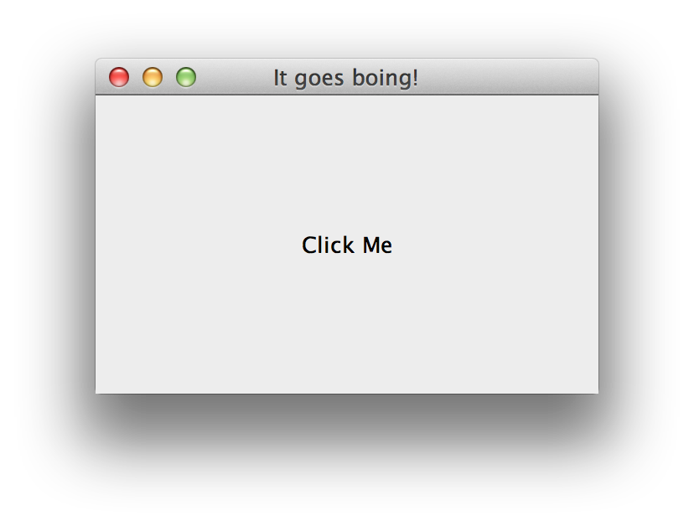
Simple GUI Example
import javax.swing.*;
public class Boing {
private JLabel label;
public static void main(String[] args) {
Boing boingprogram = new Boing();
boingprogram.initialise();
}
public void initialise() {
JFrame frame = new JFrame("It goes boing!");
label = new JLabel("Click Me");
label.setHorizontalAlignment(SwingConstants.CENTER);
frame.add(label);
frame.setSize(300,200);
frame.setVisible(true);
}
}

Slide 12
Event Driven Programming in Java

Slide 13
Simple GUI Example
import javax.swing.*;
public class Boing {
private JLabel label;
public static void main(String[] args) {
Boing boingprogram = new Boing();
boingprogram.initialise();
}
public void initialise() {
JFrame frame = new JFrame("It goes boing!");
label = new JLabel("Click Me");
label.setHorizontalAlignment(SwingConstants.CENTER);
frame.add(label);
frame.setSize(300,200);
frame.setVisible(true);
}
}

Slide 14
Adding a MouseListener
import javax.swing.*;
import java.awt.*;
import java.awt.event.*;
public class Boing implements MouseListener {
private JLabel label;
public static void main(String[] args) {
Boing boingprogram = new Boing();
boingprogram.initialise();
}
public void initialise() {
JFrame frame = new JFrame("It goes boing!");
label = new JLabel("Click Me");
label.setHorizontalAlignment(SwingConstants.CENTER);
frame.add(label);
frame.setSize(300,200);
frame.setVisible(true);
}
public void mouseClicked(MouseEvent e) {
//Invoked when the mouse button has been clicked (pressed and released) on a component.
label.setText("Clicked");
}
}
The event listening classes are in the awt and awt.event packages
We are going to implement the MouseListener interface
Because we implement MouseListener we have to provide a mouseClicked method

Slide 15
Adding a MouseListener
import javax.swing.*;
import java.awt.*;
import java.awt.event.*;
public class Boing implements MouseListener {
private JLabel label;
public static void main(String[] args) {
Boing boingprogram = new Boing();
boingprogram.initialise();
}
public void initialise() {
JFrame frame = new JFrame("It goes boing!");
label = new JLabel("Click Me");
label.setHorizontalAlignment(SwingConstants.CENTER);
label.addMouseListener(this);
frame.add(label);
frame.setSize(300,200);
frame.setVisible(true);
}
public void mouseClicked(MouseEvent e) {
//Invoked when the mouse button has been clicked (pressed and released) on a component.
label.setText("Clicked");
}
}
The event listening classes are in the awt and awt.event packages
We are going to implement the MouseListener interface
We also need to register our class with the JLabel
Because we implement MouseListener we have to provide a mouseClicked method

Slide 16
MouseListener methods
public void mouseClicked(MouseEvent e) {
//Invoked when the mouse button has been clicked (pressed and released) on a component.
label.setText("Clicked");
Toolkit.getDefaultToolkit().beep();
}
public void mouseEntered(MouseEvent e) {
//Invoked when the mouse enters a component.
label.setText("Entered");
}
public void mouseExited(MouseEvent e) {
//Invoked when the mouse exits a component.
label.setText("Exited");
}
public void mousePressed(MouseEvent e) {
//Invoked when a mouse button has been pressed on a component.
label.setText("Pressed");
}
public void mouseReleased(MouseEvent e) {
//Invoked when a mouse button has been released on a component.
label.setText("Released");
}
In fact MouseListener defines 5 methods – so we need to provide an implementation for all of them!

Slide 17
Adding a MouseListener
import javax.swing.*;
import java.awt.*;
import java.awt.event.*;
public class Boing implements MouseListener {
private JLabel label;
public static void main(String[] args) {
Boing boingprogram = new Boing();
boingprogram.initialise();
}
public void initialise() {
JFrame frame = new JFrame("It goes boing!");
label = new JLabel("Click Me");
label.setHorizontalAlignment(SwingConstants.CENTER);
label.addMouseListener(this);
frame.add(label);
frame.setSize(300,200);
frame.setVisible(true);
}
public void mouseClicked(MouseEvent e) {
//Invoked when the mouse button has been clicked (pressed and released) on a component.
label.setText("Clicked " + e.getX() + "," + e.getY());
Toolkit.getDefaultToolkit().beep();
}
}
When we are notified of an event happening we receive an event object that contains info about that event – in this case the mouse x and y (and what button is pressed)
We can take whatever action we like in the event handler – so lets make a boing noise!

Slide 18
Adding a MouseListener
import javax.swing.*;
import java.awt.*;
import java.awt.event.*;
public class Boing implements MouseListener {
private JLabel label;
public static void main(String[] args) {
Boing boingprogram = new Boing();
boingprogram.initialise();
}
public void initialise() {
JFrame frame = new JFrame("It goes boing!");
label = new JLabel("Click Me");
label.setHorizontalAlignment(SwingConstants.CENTER);
label.addMouseListener(this);
frame.add(label);
frame.setSize(300,200);
frame.setVisible(true);
}
public void mouseClicked(MouseEvent e) {
//Invoked when the mouse button has been clicked (pressed and released) on a component.
label.setText("Clicked " + e.getX() + "," + e.getY());
Toolkit.getDefaultToolkit().beep();
}
}
Lets try it out

Slide 19
Adapters
import javax.swing.*;
import java.awt.*;
import java.awt.event.*;
public class Boing implements MouseListener {
private JLabel label;
public static void main(String[] args) {
Boing boingprogram = new Boing();
boingprogram.initialise();
}
public void initialise() {
JFrame frame = new JFrame("It goes boing!");
label = new JLabel("Click Me");
label.setHorizontalAlignment(SwingConstants.CENTER);
label.addMouseListener(this);
frame.add(label);
frame.setSize(300,200);
frame.setVisible(true);
}
public void mouseClicked(MouseEvent e) {
//Invoked when the mouse button has been clicked (pressed and released) on a component.
label.setText("Clicked " + e.getX() + "," + e.getY());
Toolkit.getDefaultToolkit().beep();
}
public void mouseClicked(MouseEvent e) {
//Invoked when the mouse button has been clicked (pressed and released) on a component.
label.setText("Clicked");
Toolkit.getDefaultToolkit().beep();
}
public void mouseEntered(MouseEvent e) {
//Invoked when the mouse enters a component.
label.setText("Entered");
}
public void mouseExited(MouseEvent e) {
//Invoked when the mouse exits a component.
label.setText("Exited");
}
public void mousePressed(MouseEvent e) {
//Invoked when a mouse button has been pressed on a component.
label.setText("Pressed");
}
public void mouseReleased(MouseEvent e) {
//Invoked when a mouse button has been released on a component.
label.setText("Released");
}
}
Given that we are only interested in mouse clicks, this is an awful lot of code…
The problem is MouseListener. Because it is an interface we have to provide code for all 5 of its methods, even if we are only interested in one!

Slide 20
Adapters
import javax.swing.*;
import java.awt.*;
import java.awt.event.*;
public class Boing implements MouseListener {
private JLabel label;
public static void main(String[] args) {
Boing boingprogram = new Boing();
boingprogram.initialise();
}
public void initialise() {
JFrame frame = new JFrame("It goes boing!");
label = new JLabel("Click Me");
label.setHorizontalAlignment(SwingConstants.CENTER);
label.addMouseListener(this);
frame.add(label);
frame.setSize(300,200);
frame.setVisible(true);
}
public void mouseClicked(MouseEvent e) {
//Invoked when the mouse button has been clicked (pressed and released) on a component.
label.setText("Clicked " + e.getX() + "," + e.getY());
Toolkit.getDefaultToolkit().beep();
}
}
Java gives us a convenience class called a MouseAdapter to solve this problem.
MouseAdapter is an abstract class that implements the MouseListener interface and provides empty stubs for all of the MouseListener methods

Slide 21
Adapters
import javax.swing.*;
import java.awt.*;
import java.awt.event.*;
public class Boing extends MouseAdapter {
private JLabel label;
public static void main(String[] args) {
Boing boingprogram = new Boing();
boingprogram.initialise();
}
public void initialise() {
JFrame frame = new JFrame("It goes boing!");
label = new JLabel("Click Me");
label.setHorizontalAlignment(SwingConstants.CENTER);
label.addMouseListener(this);
frame.add(label);
frame.setSize(300,200);
frame.setVisible(true);
}
public void mouseClicked(MouseEvent e) {
//Invoked when the mouse button has been clicked (pressed and released) on a component.
label.setText("Clicked " + e.getX() + "," + e.getY());
Toolkit.getDefaultToolkit().beep();
}
}
Java gives us a convenience class called a MouseAdapter to solve this problem.
MouseAdapter is an abstract class that implements the MouseListener interface and provides empty stubs for all of the MouseListener methods
If we extend MouseAdapter we can then override the specific methods we need and ignore the rest

Slide 22
Multiple Listeners
class Boing extends MouseAdapter {
...
public void initialise() {
...
label.addMouseListener(this);
label.addMouseListener(new ShellUpdater("One"));
label.addMouseListener(new ShellUpdater("Two"));
label.addMouseListener(new ShellUpdater("Three"));
...
}
}
class ShellUpdater extends MouseAdapter {
String id;
public ShellUpdater(String id) {
this.id = id;
}
public void mouseClicked(MouseEvent e) {
System.out.println("Mouse Clicked " + id);
}
}
Possible to add multiple listeners to a single GUI element
Each listener is added to a queue
And events are passed to each in turn

Slide 23
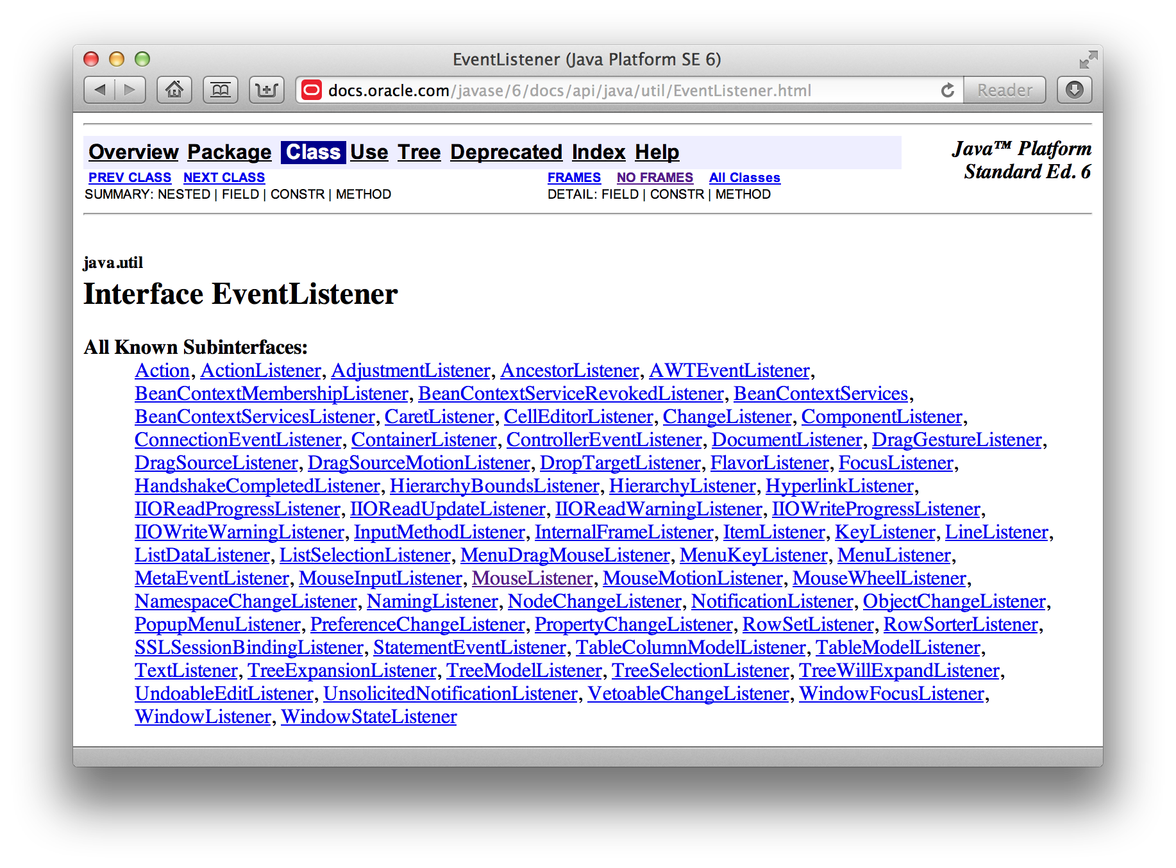
Other Listeners!

Slide 24
Some things to look out for
Java moved from an old set of GUI classes called the Abstract Windows Toolkit to the snazzy new Swing ones (in Java 1.2)
They share certain classes (like Event)
But don’t mix the components up*
  Swing classes tend to start with J
    Frame is an AWT class
    JFrame is a Swing class
* Allegedly this has been fixed in Java 6 but I have not verified this!

Slide 25
Some things to look out for
Remember that the thread that is responding to user input is the one that is executing your event handling code
This means… ?

Slide 26
Some things to look out for
Remember that the thread that is responding to user input is the one that is executing your event handling code
This means…
  Don’t hog the processor! Your code needs to execute quickly otherwise it will feel as if your program has hung.
  If you need more time, you need to create a new thread to do the work for you

Slide 27
Summary
What is event driven programming?
  The Observer Pattern
A brief introduction to Java GUIs
Event Listeners and Adaptors

