Slide 1
Testing
Yvonne Howard ymh@ecs.soton.ac.uk
Computational Systems
COMP1209

Slide 2
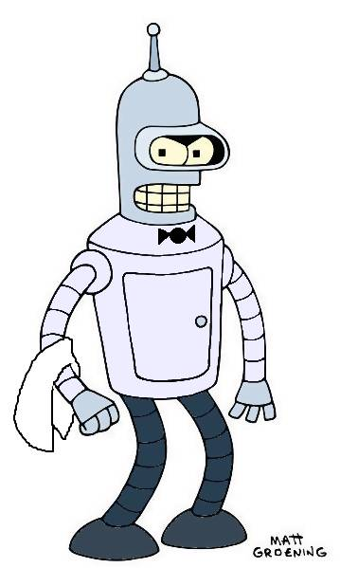
A Problem
A café wants to build an automated system to provide breakfasts. The robot waiter greets people before taking their order by name.
Customers can order different combinations of ingredients for their meal, and also ask for one drink. The system then cooks the breakfast. It must be able to fry sausages, bacon, eggs and mushrooms; toast bread, waffles and muffins; and pour their orange juice or coffee.
The waiter then serves the breakfast.

Slide 3
The all new RoboCafe
Waiter, waiter – There’s no coffee in my cup
***!!
Waiter, waiter – I’ve been sitting here for two days, all I want is my breakfast
Waiter, waiter – I don’t like my eggs
toasted
Waiter, waiter – I didn’t order 25 sausages
Waiter, waiter

Slide 4

So what went wrong and how can we have happiness café?
***!!
Waiter, waiter –this breakfast is perfect - here’s a huge tip

Slide 5
Software Engineering: Big Picture
Requirements Gathering
Surveys
Specification
UML
Implementation
Software code
User studies
Focus groups
Use Cases
Scenarios
Storyboards
APIs
Document formats
Testing
Unit Tests
Black Box Tests
Etc…
Deployment
Configuration
Bug Tracking
User Support
Design
UML
Class Diagrams
Activity Diagrams
Sequence Diagrams
Etc…
SSM
This is rarely a straightforward progression – in reality there are lots of iterations and points of feedback

Slide 6
We can do some software engineering
Testing
  Used for most software systems
Or
  Formal verification
    Build a model of the software
    Use a prover to prove that the model is correct
    Only a very small proportion of systems are verified this way, mostly safety critical systems
We’re going to talk about testing

Slide 7
Cost of Change Curve ( Barry Boehm 1981)
.
The cost to address a defect rises exponentially the longer it takes you to find it.
if you inject a defect into your system and find it a few minutes later and fix it, the cost is almost negligible.
if you find it three months later the cost of fixing rises exponentially
  to fix the original problem
  to fix any work based on the defect

Slide 8
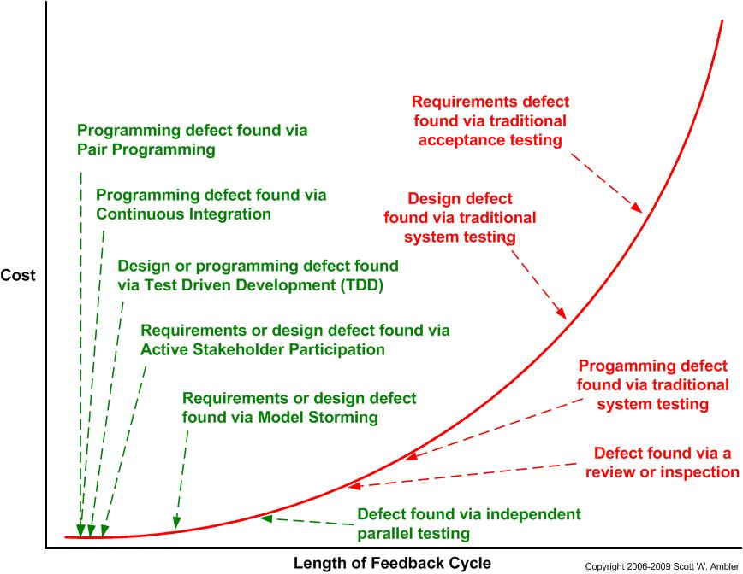
The Cost of Change Curve: Traditional versus Agile
Agile techniques have feedback cycles on the order of minutes or days,
Traditional techniques have long feedback cycles ( end of development)
Traditional strategies can be effective at finding defects but the cost of fixing them can be much higher

Slide 9
What are we testing for?
Which of these might be valid?
1. Find bugs?
2. Try to break the software?
3. Reduce risk?
4. Check that performance is OK?
5. Prove the software is defect free?
“Program testing can be used to show the
presence of defects, but never their absence”
Edgar Dijkstra

Slide 10
The goal of testing
To increase to an acceptable level the
user’s confidence that the system under
test will behave correctly under all
circumstances of interest
We have to define
    Correct behaviour
    Level of confidence
    Domain of concern
USER FOCUS

Slide 11
Correct behaviour
Bender takes Dave’s order for:
  2 sausages, 1 fried egg, 2 slices of toast and a cup of coffee
Bender serves Dave his breakfast of:
  2 sausages 1 fried egg, 2 slices of toast and a cup of coffee
Other issues (known as Non Functional requirements NFRs, ‘ilities) which describe Quality
  How long should Dave wait to order?
  Is burnt toast acceptable?
  Is the user experience/usability good enough?
You can build a defect free system that is unusable or has poor quality

Slide 12
Correct Behaviour
Definition of ‘correct behaviour’ required
Provided by a “Baseline” or “Blueprint”
Depends on level of testing
  Whole system – Requirements specification
  Increment – user stories
  One module – Program specification
  … and so on
Compare results of the test with what was supposed to happen
Test result – Pass or Fail

Slide 13
Level of Confidence
Usually specified as ‘residual defect discovery rate’
  Number of defects found in a given test or series of tests, or
Number of defects found in a given time
  “Less than 10 non-critical defects discovered in last 7 days”
An alternative – Reliability specification
  “Mean time between failures shall be not less than 5000 hours”
  Difficult to determine until software goes “Live”

Slide 14
Tests are supposed to find errors
A good test is focused to find errors
A successful test finds new classes of errors
So how do we do good, successful, systematic testing?
  Choose the right test method
  Make test cases
    A set of input values and expected outcomes for a software feature
  Make a test plan
    All the test cases necessary to test the software thoroughly
  Follow good testing practice
    Plan testing early (agile testers, write tests before code)
    User focus, not designer or programmer
    Use independent testing staff, not the people who designed or built the software ( except agile teams where testers and developers are interchangable)

Slide 15
When do we test?
During implementation
  Unit tests - For each module or submodule
  Integration tests - When you put modules together –
  Regression tests - When you change or add a component, to make sure that everything still works together
when you think you are ready to deliver
  Alpha – in house
  Beta - with your pals
  Acceptance – on official delivery

Slide 16
Two main types of testing
White box
Black Box

Slide 17
Structural (White Box) Testing
Uses knowledge of the program structure and algorithms
Construct test cases that will follow every path through the system
  Every statement in a method is executed at least once
  Every branch has been exercised for true/false conditions
This is very expensive and is usually done only for a small, critical part of the system

Slide 18
Black box testing
?
inputs
outputs
Tests without reference to internal processing
Considers the correct behaviour of inputs and expected outputs
Uses techniques to reduce the amount of testing needed to satisfy correctness
  Equivalence partitioning
  Boundary value analysis

Slide 19
We are going to concentrate on black box testing
?
inputs
outputs

Slide 20
Strengths and weaknesses of Black Box Testing
Strengths
  More effective for larger units of code than glass box testing
  Tester needs no knowledge of implementation
  Tester and developer can be independent
  Test’s are from the user’s point of view
  Exposes ambiguities in the spec (but it’s a bit late in the game for that)
  Test cases can be designed early, from the specification
Weaknesses
  Only a small number of possible inputs can reasonably be tested
  Good test cases need clear specifications
  Some program paths will be untested
  Cannot target code directly

Slide 21
What is meant by a ‘test case’?
“A set of test inputs, execution conditions, and expected results developed for a particular objective, such as to exercise a particular program path or to verify compliance with a specific requirement” (IEEE standard)
“Input – processing – output”
Example (informal):
  Insert a card into an ATM (cash machine). The ATM reads the card and asks for the PIN
Inputs may include data and/or controls
  E.g. Numbers entered into a program
  E.g. Bank card inserted into ATM
The expected result is a statement of what the system should do – from the point of a satisfied customer

Slide 22
Test Cases Problem
A user ID consists of two characters < 1 alpha char> < 1 digit>
  The < 1 alpha char> consists of the characters A..Z or a..z
  < 1 digit> consists of the characters 0..9
What test cases do you think that you might need to ensure that software processes a user ID correctly?

Slide 23
Some possible test cases -
Test case | System action | Test data input | Pass criteria | Pass/fail
1 | When the system asks for a userID | R6 | Accept user ID and continue
2 | When the system asks for a userID | xyz | Reject userID with error message ‘only 2 chars’
3 | When the system asks for a userID | 6R | Reject userID with error
4 | When the system asks for a userID | R% | Reject userID
5… | … | … | …
For a 2 char userID! – How can we stop the test case explosion?

Slide 24
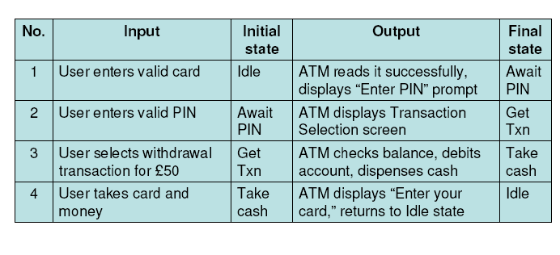
Test Scenarios
Scenarios are sequences of test cases which
represent a typical use of the system
    Example of an ATM Scenario
Choice of Scenario has to take account of
    Valid sequences (must work correctly)
    Invalid sequences must produce correct error messages (and not proceed)

Slide 25
Where do we find our test cases and scenarios?
Test cases and scenarios need to explore
  Correct behaviour
  Error cases
Baseline (or blueprint) documents define correct behaviour, depending on the level of testing
  Requirements – System Test
  High level design – Integration Test
  Low level design – Unit Test
  Agile developers write tests before they write code
Test cases and scenarios are derived from the baseline documentation
  Large numbers are often required, determined by
    Logical complexity – Unit test and Integration test
    Number and nature of requirements – Higher test levels

Slide 26
How Many Tests?
A balance must be struck
  We want high quality - thorough testing
  We need to deliver the software – cannot go on testing for ever
We have to pick specific values to use in test
cases
  Not enough time to test all possible values
Equivalence Partition Analysis helps to select a sensible number of test cases to run
Boundary Value Testing helps to choose values for those tests

Slide 27
Equivalence Partition Analysis
To reduce the number of test cases to a necessary minimum.
  Only one test case of each partition is needed to evaluate the behaviour of the program for the related partition.
  To use more or even all test cases of a partition will not find new faults in the program.
  The values within one partition are considered to be "equivalent".
  Thus the number of test cases can be reduced considerably
To select the right test cases to cover all possible behaviour
  you also find the so called "dirty" test cases.
  An inexperienced tester may be tempted to use as test cases the input data range and forget to select some out of the invalid partitions.
  This would lead to a huge number of unnecessary test cases on the one hand, and a lack of test cases for the dirty ranges on the other hand.

Slide 28
Equivalence Partition Analysis
Equivalence partitions are usually derived from the specification of the systems or component 's behaviour.
  consider
    Input equivalence partitions
    Output equivalence partitions
An input has values which are valid and other values which are invalid.
  These can be used to identify the equivalence partitions
If you had defined a function which has to pass the parameter "month" of a date.
  What are the valid and invalid values?

Slide 29
Equivalence partitions
The valid range for the month is 1 to 12, standing for January to December.
  This valid range is called a valid partition.
there are two partitions of invalid ranges.
  The first invalid partition would be <= 0
  and the second invalid partition would be >= 13.
    ... -2 -1 0 1 ......…….......12 13 14 15 ....
    --------------|--------|-----------|--------------------
    Invalid partition 1 P1 Invalid partition 2
    valid partitions

Slide 30
Equivalence Partitioning
Divide the domain of all possible inputs into classes of equivalent inputs
input conditions
Type of input condition | Number of Valid equivalence classes needed | Number of Invalid equivalence classes needed
range | 1 | 2
value | 1 | 2
set | 1 | 1
Boolean (true/false) | 1 | 1
Construct one test case for each class

Slide 31
Equivalence Partitions – for value ranges
An input has certain ranges which are valid and other ranges which are invalid.
An example is the value range for the month parameter that we looked at earlier
  The valid range for the month is 1 to 12, standing for January to December. This is the valid partition
  There are 2 invalid ranges
  these are the invalid partitions: <= 0 and >= 13

Slide 32
Equivalence Partitions – for a set
Test particular input item matches a set of values
  If each case will be treated the same way
    Identify one valid class for values in the set
    and one invalid class representing values outside the set
    E.g valid course codes for semester 1 are: (COMP1209, COMP1202, COMP1216, COMP1201)
    Valid class: code is one of (COMP1209, COMP1202, COMP1216, COMP1201)
    Invalid class: code not one of (COMP1209, COMP1202, COMP1216, COMP1201)
  If each case will be treated differently, Identify:
    one valid equivalence class for each element and
    one invalid equivalence class for values outside the set
    E.g valid boat codes are (catamaran, dinghy, rib)
      Valid class is catamaran
      Valid class is dinghy
      Valid class is rib
      Invalid class is not one of (catamaran, dinghy, rib)

Slide 33
Boundary Value Analysis - Selecting Values for Test Data for each Equivalence Class
Once equivalence classes (partitions) are identified, we can think about test data values
  We need some values that fall into each class
Select values at the boundaries and somewhere in the middle of each class
  This called Boundary Value Analysis
  If these data points produce correct results, it is fairly safe to assume that other values will also be correctly processed
• NOTE: Correct operation at the other points is not guaranteed but we have to find sensible ways to limit testing

Slide 34
Boundary Value Analysis
Using the domain of all possible inputs and outputs
Divide the domain into valid and invalid classes
For each boundary: construct test cases with these inputs
Test case | Test case Inputs
1 | Boundary value as input
2 | Slightly less than boundary value
3 | Slightly less than boundary value

Slide 35
Test plan for a student enrolment system
A student enrolment system:
the system accepts students between 16 and 99 years of age
Find the equivalence partitions
Use boundary value analysis to identify values for your test cases
Equivalence class | value (age) | Expected result (message) | Pass/fail

Slide 36
Using Equivalence Partitioning & Boundary Value Analysis for the userID problem
Going back to our first example: A user ID consists of two characters < 1 alpha char> < 1 digit>
  The < 1 alpha char> consists of the characters A..Z or a..z
  < 1 digit> consists of the characters 0..9
What test cases do you think that you might need to ensure that software processes a user ID correctly - using equivalence partitioning (and boundary value analysis?)

Slide 37
Loan Interest calculator example

Slide 38
Equivalence Partitions
Build a table for your equivalence classes:
showing inputs and expected outputs

Slide 39
Selecting Values – Valid Partition

Slide 40
Selecting Values – Interest Error

Slide 41
Summary
Test cases are the smallest steps
Test cases are assembled into scenarios
  Represent a typical usage of the system
Equivalence Partitioning
  Used to find groups of inputs / outputs that produce similar behaviour
Boundary Value Analysis
  Used to select values for each equivalence partition

Slide 42
Happiness café?
***!!
Waiter, waiter –this breakfast is perfect - here’s a huge tip

Slide 43
Oh for crying out loud. I never wanted to be a dev anyway. What I *really* want is to be a...tester!
I'm a tester and I'm okay,
I sleep all night and I work all day.
(He's a tester and he's okay,
he sleeps all night and he works all day.)
I look for bugs, I log those bugs, I do it all with glee.
And the really good ones, I show off repeatedly.
(He looks for bugs, he logs those bugs, he does it all with glee.
And the really good ones, he shows off repeatedly.)
I'm a tester and I'm okay,
I sleep all night and I work all day.
(He's a tester and he's okay,
he sleeps all night and he works all day.)
I pester PMs, I pester devs, I make them despair and cry.
I know I've done my job, when I hear them wail "Why oh why?"
(He pesters PMs, he pesters devs, he makes them despair and cry.
He knows he's done his job, when he hears them wail "Why oh why?")
I'm a tester and I'm okay,
I sleep all night and I work all day.
(He's a tester and he's okay,
he sleeps all night and he works all day.)
I black box test, I white box test, I write docs and PR too.
I wish I was in marketing, 'cause then I'd rule the roost.
(He black box tests, he white box tests, he writes docs? and PR too??
He wishes he was in marketing??? Where's my Nerf gun? Get him!!!)
[The dev runs out, chased by the backup singers who continue to sing:]
He's a tester and he's okay,
he sleeps all night and he works all day.
He's a tester and he's okaaaaaaaaaaaaaaaaaay.....
he sleeps all night and he works all day.
The braidy tester
http://www.thebraidytester.com/blogs.html

