Slide 1
Technology Enhanced Learning
Hugh Davis
Professor of Learning Technologies
Director of CITE
November 2012
These slides are in Dropbox at http://bit.ly/TmH3Sn
Or in Edshare at http://edshare.soton.ac.uk/9947

Slide 2
The purpose of this session
You will understand the Southampton perspective on Technology Enhanced Learning (TEL)
You should know what systems and help are available at Southampton via CITE
We will consider what one has to do introduce some e-learning
We will consider the pros and cons of some applications of e-learning

Slide 3
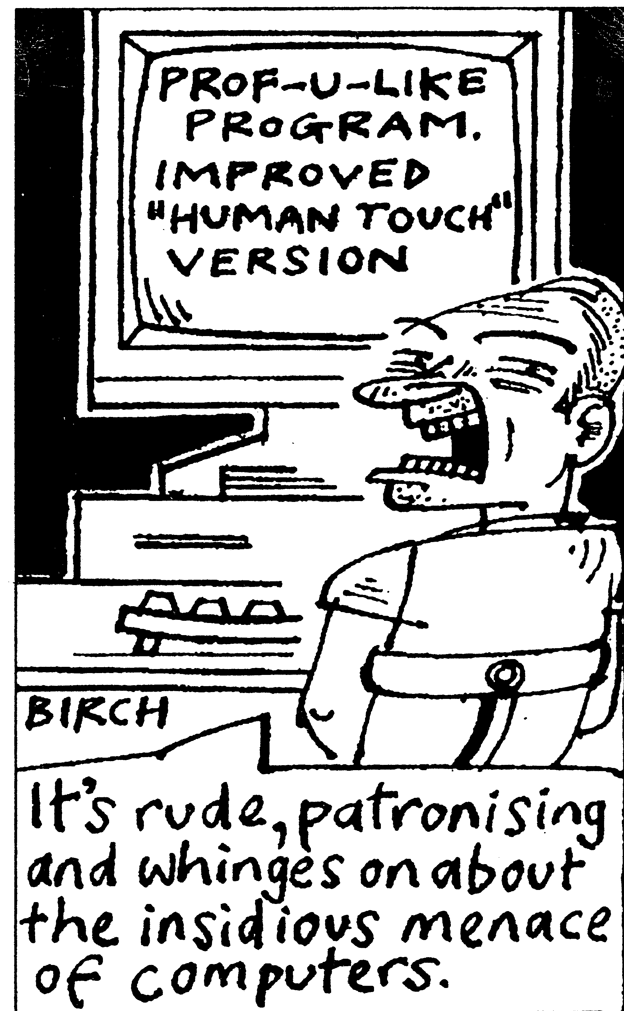
What is TEL?
Any learning which is enabled by the use of digital hardware, on-line resources or communication technologies

Slide 4
Some Technologies
VLEs/MLEs
web-based teaching materials
hypertext/hypermedia
multimedia CD-ROMs
web sites
on line journals
eBooks
OER Repositories
wikipedia
google
2nd Life
discussion boards /forums
collaborative software
Video conferencing
computer aided assessment
ePortfolios
e-mail
blogs
wikis
text chat
animations
simulations
games
mobile Learning
Podcasts
electronic voting system (Zappers)

Slide 5
Distance vs Blended
E-learning is clearly useful for distance learning but…..
Blended Learning is about using on-line activities blended with conventional f2f learning to:
  Allow students to solve authentic problems with authentic tools
  To improve student engagement – active learning
  Provide any time/any place learning
  Benefit learners with different learning styles
The Question is how much of the learning should be at computers?

Slide 6
Teaching approaches
Wright and White, 2001

Slide 7
Learning activities

Slide 8
The Levels of engagement (is level 1 a given?)
Foundation – a web site provides
  Syllabus / Course Handbook
  Lecture notes (PowerPoints?)
  Description (at a week by week level) of what students need to do
  Timetables
  Announcements
  Old exams and indicative answers/ examiners comments
  Coursework Specifications
  Reading Lists
  Links to appropriate resources
  Course Forum /Wiki
  (In other words everything a student who had missed something, or was trying to follow at a distance, would need to know what they should do)
Higher levels of engagement will be concerned with interactive on-line learning activities
The Question is, in a university that is focussed on student centeredness, should Foundation Level be part of student entitlement?

Slide 9
Drivers and Benefits
excellent vehicle for enquiry/research led learning
exciting, novel and authentic learning experiences
e-learning can support student centred learning, providing flexibility in
  time
  place
  learning style
  pedagogic style
allow us the opportunity to provide reliable and equitable student support;
ideal for developing and supporting lifelong learners
supplements and enhances accessibility of face-to-face learning
support assessment and recording of student achievement
the opportunity to develop new markets
after initial cost and effort, e-learning can provide financial and time savings

Slide 10
Some Examples of Blended Learning
Recording Lectures (Flipped Classroom)
Podcasts of FAQs /problem solving
Immediate Feedback from Lectures
Self and Peer Review, ePortfolio (Putting the student at the centre of their learning)
Web Quests /enquiry-led learning
On-line activities / virtual labs
Supported Group/Social learning
Use of OERs
Making Students take responsibility for their learning
Get students to do the work, not academics
Putting the Student at the centre of their own learning

Slide 11
What are the barriers to progress?
Does not fit with existing curriculum development models (time/cost)
Lack of *staff* skills
Belief that current teaching methods are better
IPR/Copyright issues
Some students’ preference for f2f methods in which they do not contribute

Slide 12
What Is CITE?
USB
ESEAG
Steering Group
Professional Educational Development
CITE
TELL AG
Learning Design/Consultancy Team
Multimediaand Web Design
Research and Prototype Team

Slide 13
Support for Faculties and Professional Services:
Consultancy on and support for learning design;
Assisting teachers in identifying and building appropriate innovative activities;
Just-in-time support for innovative learning technologies;
Sharing and dissemination events;
In-house events as requested by individual faculties;
Special interest groups;
Development of digital literacies
Identifying OERs
Producing online activities, videos and animations.

Slide 14

Developing and Supporting Community
Fellows and Associates from the faculties and academic services
Seminar series
Away Days
Events to promote dissemination of good practice.
“Bar camps” and “plug fests” and similar events to interact with students
Support interns and student projects from the student body to work with the Centre

Slide 15
What does it take to set up Technology Enhanced Learning?
Time, Skills, Access to software and hardware, help
Foundation Level – JIT …
Level 2 – really needs a top down curriculum led approach to identifying
  What will benefit from investment
  Where the investment will come from
  The team that will be responsible
If you have a big project then there are funding bodies that may help:
  JISC, HEA, HEFCE, Your Professional Body, Various charities and foundations

Slide 16
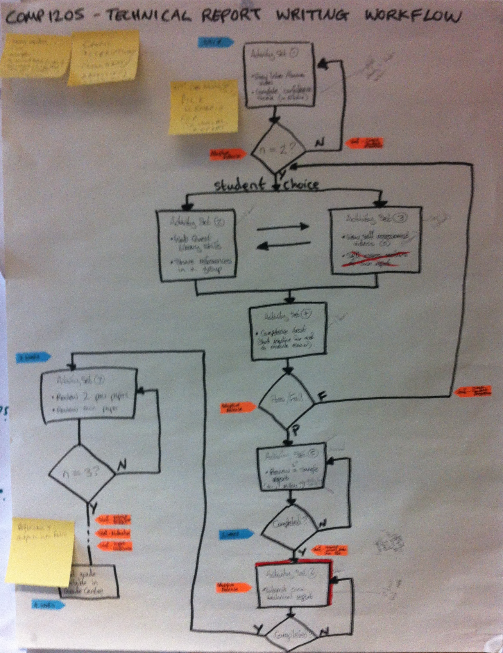
Learning
Design
The workflow through the learning activities which embody your particular pedagogical approach
And the selection and design of appropriate activities
This example is concerned with students learning to evaluate technical reports, then evaluate their own report and two others.

Slide 17
Finding,
evaluating,
processing,
organising,
analysing,
presenting
Using applications and services
Business
Models
Beliefs and
Practices
Digital
Citizenship
Digital
Workpractices
Street Wisdom on the Digital
Highway
Information
Literacy
Digital Academic Practices
ICT
Skills
Identity and Reputation
Communication
Collaboration
Media
Literacy
Social
Networking
Networks
(of People)
Evaluating
Affordances

Slide 18
Digital Literacies are the skills needed to live, learn, work, collaborate, influence and lead in the virtual and digital world
Business
Models
Beliefs and
Practices
Digital
Citizenship
Digital
Workpractices
Street Wisdom on the Digital
Highway
Information
Literacy
Digital Academic Practices
ICT
Skills
Identity and Reputation
Communication
Collaboration
Media
Literacy
Social
Networking
Networks
(of People)
We are preparing students for jobs that don’t yet exist, using work-practices we don’t yet know supported by tools not yet invented.
Evaluating
Affordances

Slide 19
Disciplinary Differences
Applied
Social Sciences
and
Humanities
Engineering
Hard
Soft
Natural
Sciences
Nursing
or
Education
Pure
Biglan, 1973

Slide 20
What works in your discipline?
In groups of 3 from different disciplines:
  Discuss applicability of Foundation Level in your subject
  List a few other higher level applications within your domain
    How does the technology enhance the learning?
    What are the sort of learning outcomes they are trying to get (e.g. using Blooms taxonomy?)

Slide 21
Student Survey - Major Findings
The responses were broadly consistent with knowledge framework.
Students in Hard areas valued
online tutorials
reference materials
objective tests (also VLEs)
Support the mastery of facts, principles and concepts.
Quantitative, Closed
Students in Soft areas valued
synchronous discussions
role play and games
access to open web
Access to online journals
Support the development of argumentation skills and critical thinking
Qualitative Open
Notes:
I ‘Hard’ Subjects
More than a quarter (27%) of all students expressed a desire to follow lectures from home. Some students even suggested recording lectures so that students can replay them for revision purposes or if a lecture was missed. There was no desire to entirely abandon the lecture system.
Virtual Learning Environments: In general, Hard Applied found the use of VLEs useful as containers of online testing for exams and testing. Amongst medical students (Hard Applied) who had direct experience of VLEs, most (76%) the students in this study area wanted online electronic learning to be an integral part of their degree along with computer-based presentations and assessment materials.
Assessment: Of students studying Hard Applied subjects (113), 98% said they would like more online tests, while 26% identified the need for more online materials for their subject. They also expressed a desire for more interaction in the classroom for example via interactive tests, so that both teacher and student can see if the subject was fully understood. Students in Hard Pure subjects did not seem to prefer online tests. Only 15% of the 58 students who took the survey stated that it would have been useful for exams. 25% of the 21 physics and mathematics students also showed an interest in computer-aided assessment materials, as some subjects require solving exercises quickly and precisely, by visualising the problem.
Visualizations: Most respondents from the Hard Pure area (89%) replied that they would like more computer-based learning materials to help visualise problems. Half of the 21 bioscience and environmental science students believed that more computer-based presentations and simulated environments would be useful in their subject. Students in this subject area in general liked the idea of being able to follow lectures from home, although some commented that it would be good to be able to interact with the environment more directly, in opposition to a conventional lecture (in the jungle or under the sea were given as examples). The emphasis shown here on visualisation supports the suggestion that visualisation of problems is effective for Hard Pure subjects.
II Soft Subjects
Students in Soft Pure subjects seemed to prefer online teaching in the form of discussion, simulated environments and online tests. 30% of the 64 students who took the questionnaire seemed to prefer to have the chance of having online tests in order to practise subject areas for their exams. They also found the idea of having lectures from home appealing as if they were learning a new language or history it would be useful to be able to watch documentaries.
Simulated Environments: In students belonging to the Soft Applied subjects the response was unanimous: all preferred online simulation, in particular, role-playing games. 86% of the 48 students who responded said that they would not like the chance to attend lectures from home, as in some classes live discussion takes place. Possibly this could be replaced by online discussion but they did not seem enthusiastic about the idea. It was noted that 12 economic students found simulated environments useful, and that it helped them to have a deeper or more practical approach to the subject. They pointed out that similar techniques were used in class, although with little success, as it took a long time to understand. The 13 Law students expressed a desire for more online role-playing games. This strong desire for online simulations and role-playing games supports the categorisation theory, which recommends the use of such simulations as effective e-learning techniques for teaching these subjects.
Discussions Online: amongst the small number of Soft Pure (Philosophical and Religious Studies) respondents 5 students suggested online discussion were useful enabling discussion with other students from their own university and other universities. The 8 English students commented that online materials are used in many of their courses and that they found them very useful. From the 23 students studying Soft Applied (Linguistics and Area Studies), 89% wanted more online materials for their course as it is quite hard to find relevant information for their subject outside the university area.

Slide 22
A useful Toolset
Blackboard
Describe your course
Guide the students through what they need to do to successfully complete your course
What are the things they need to do (week-by week?),
How do they check they are succeeding? (formative assessment – and how to ask questions)
What summative assessments they must complete
Blackboard is not the best place to actually keep your resources
EdShare
The best place to keep resources. Link to them as appropriate form Blackboard
Perception
Objective Testing for Summative assessment
Group Workin
Wikis and Forums available in Bb, but cloud tools often better. Google Docs allows group editing. We have WebPA
eFolio
For keeping a portfolio which can be exported
iSurvey – for you or students
WordPress – for bloggs and Web Sites

Slide 23
References
CITE Website. https://www.cite.soton.ac.uk/ (
  sEpecially https://www.cite.soton.ac.uk/using_technology) (information on using some technologies to support learning)
  And https://www.cite.soton.ac.uk/tel-resources/topics (information on technologies available at Southampton)
V. Wright and S. White, "Technology and Language Learning," in Supporting Lifelong Language Learning. Theoretical and Practical Approaches, L. Arthur and S. Hurd, Eds.: Open University & CILT, 2001.
The IMS Global Learning Consortium (e-learning specifications and standards) http://www.imsglobal.org/
Accessibility – Checkpoints and Bobby Tool. http://www.vordweb.co.uk/standards/bobby_approved_level_aaa.htm
HEA Page on the SENDA Act http://www.ukcle.ac.uk/directions/previous/issue4/senda.html
Why Make Web Sites Universally Accessible? http://www.mardiros.net/univ-accessible.html
The Professional Development Unit http://www.southampton.ac.uk/pdu/
Su White & Ilaria Liccardi. Harnessing Insight into Disciplinary Differences to Refine e-learning Design. In Proceedings of FIE 2006. San Diego, October 2006. http://fie.engrng.pitt.edu/fie2006/papers/1784.pdf
A. Biglan, "The Characteristics of Subject Matter in Different Academic Areas," Journal of Applied Psychology, vol. 57, pp. 195–203, 1973.

