Slide 1
EndNote X6 - basic graduate session - Mac
Notes:
This guide introduces the main features of EndNote.

Slide 2
What is EndNote for?
Build a personal reference library
Search databases and export references
Customise EndNote
Insert citations and build bibliography
Notes:
EndNote is bibliographic management software that allows you to collect all the references from a range of resource types in a single location.
The results of a database search can be automatically exported to EndNote, and other notes, files and graphics can be added to individual records, allowing all information to be stored in a single location.
EndNote works alongside Word, inserts short citations within the text and generates full bibliographic references at the end of the current document. The appearance and management of citations and references is controlled through the EndNote Library.
Using EndNote, a document created with references in one referencing style can be automatically converted to a different referencing style if required.
All features of EndNote can be edited to suit personal preferences.

Slide 3
Create or open a library
Go to the Endnote icon on the taskbar
Notes:
Go to the EndNote icon on the taskbar
When you first load EndNote the welcome screen invites you to create a new library or open an existing library.
To create a new library, click on the picture.

Slide 4
Go to 'File' and choose 'New'
It is best to save all libraries in a folder called 'EndNote' or 'EndNote X6'
Notes:
The system will ask you where to save the new library: it is best to create a new folder called EndNote or EndNote X6 and save the library within that.

Slide 5
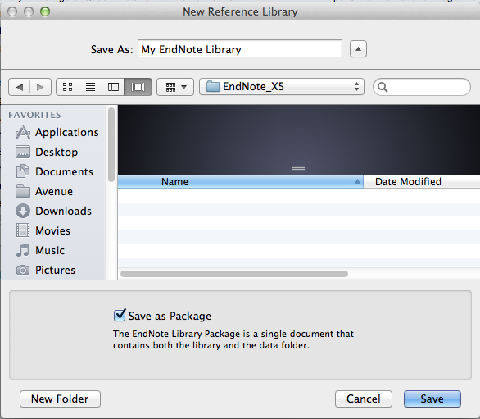
Choose the 'Save as Package' option to combine both elements of the EndNote library
Notes:
The Endnote library is saved in two parts: a data folder, and a library file with a .enl extension. Choosing the ‘Save as package’ option combines these two into a single file with a .enlp extension

Slide 6
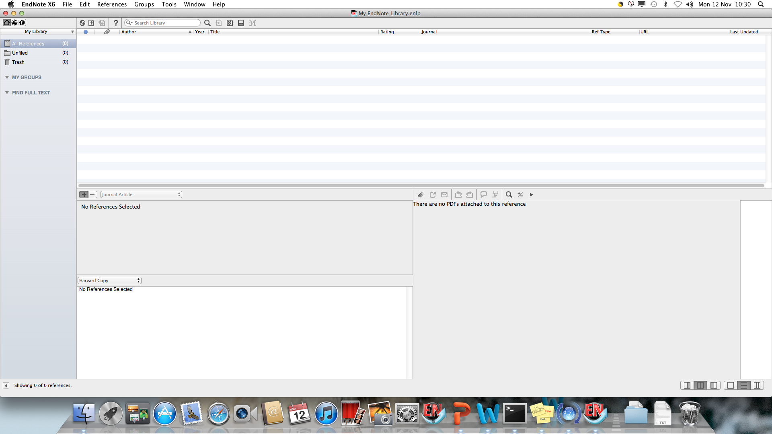
It is usually best to keep all references in one main library
Smaller libraries for particular topics can be created using the 'Groups' option
Notes:
It is best to keep all references in a single library: smaller libraries for particular purposes can be created using the Groups option, which is described later.

Slide 7
Add a new reference

Slide 8
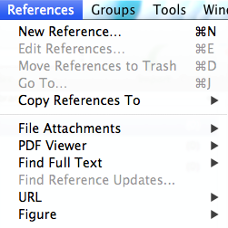
Add a new reference
Click on the 'New Reference' icon…
… or go to 'New Reference' on the dropdown menu
Notes:
To add a new reference, click on the New Reference icon on the toolbar, or go to New Reference… on the References dropdown menu.

Slide 9
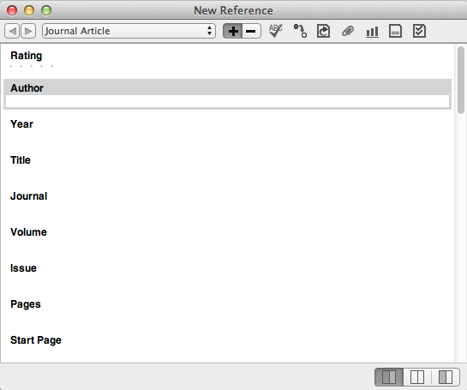
Scroll down to see more fields
Notes:
EndNote records are constructed from many fields - scroll down to see more of these.
Selection and order of fields is determined by the reference type.
Check the appearance of the bibliographic record.
Changes can be made at any time.
To edit an existing record, double click on the EndNote library entry.

Slide 10
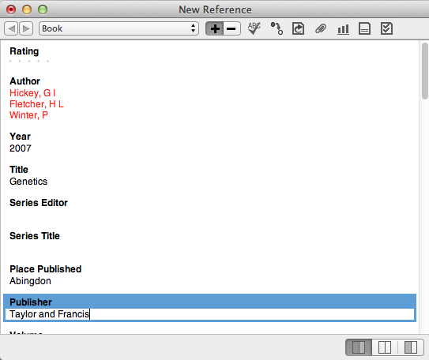
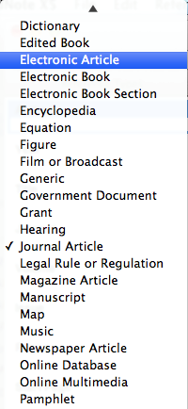
Click the record's 'close' icon to save the completed or edited record automatically
Choose the reference type from the dropdown menu
The reference type can be changed at any time
Notes:
Use the dropdown menu to change the reference type. You can change the reference type at any time.
Choose the 'best fit' for the medium and complete all useful fields.
Reference type definitions in EndNote may not always fit with UK practice, for example in Law.
Custom types are available to create unusual reference types.
When all details are completed, click the record's Close icon (the red circle)
This will save the record details automatically.

Slide 11
More about record fields

Slide 12
Enter one author per line, surname first, followed by a comma
Author, Journal and Keyword fields are indexed
Notes:
Note some important points about the various record fields:
Use one author or editor per line, as EndNote counts the number of lines in order to establish the number of authors.
Enter the surname, followed by a comma, which is an important character, then first names or initials - EndNote will format this field according to the instructions given. Corporate authors must always be terminated by a comma.
The author, journal title and keywords fields are indexed and displayed in red.
Use only the record fields required: the bibliographic templates can be modified to include additional fields if required.
The URL field provides an automatic hyperlink.
Some fields, such as Notes and Research Notes, are free format and can be used for text or graphics. Files in other formats can also be attached to the records.
It is best to use Research Notes for your own comments
When using the keywords field, terms can be created in advance, to ensure consistency. New terms can be added at any time.

Slide 13
When all chosen fields have been completed, click the record close icon
Notes:
When all chosen fields have been completed, Click the RECORD Close icon - the red circle.

Slide 14
Click 'Save' to confirm any changes to the record
Notes:
You will be prompted to save any changes to the record, including edits and file attachments etc.

Slide 15
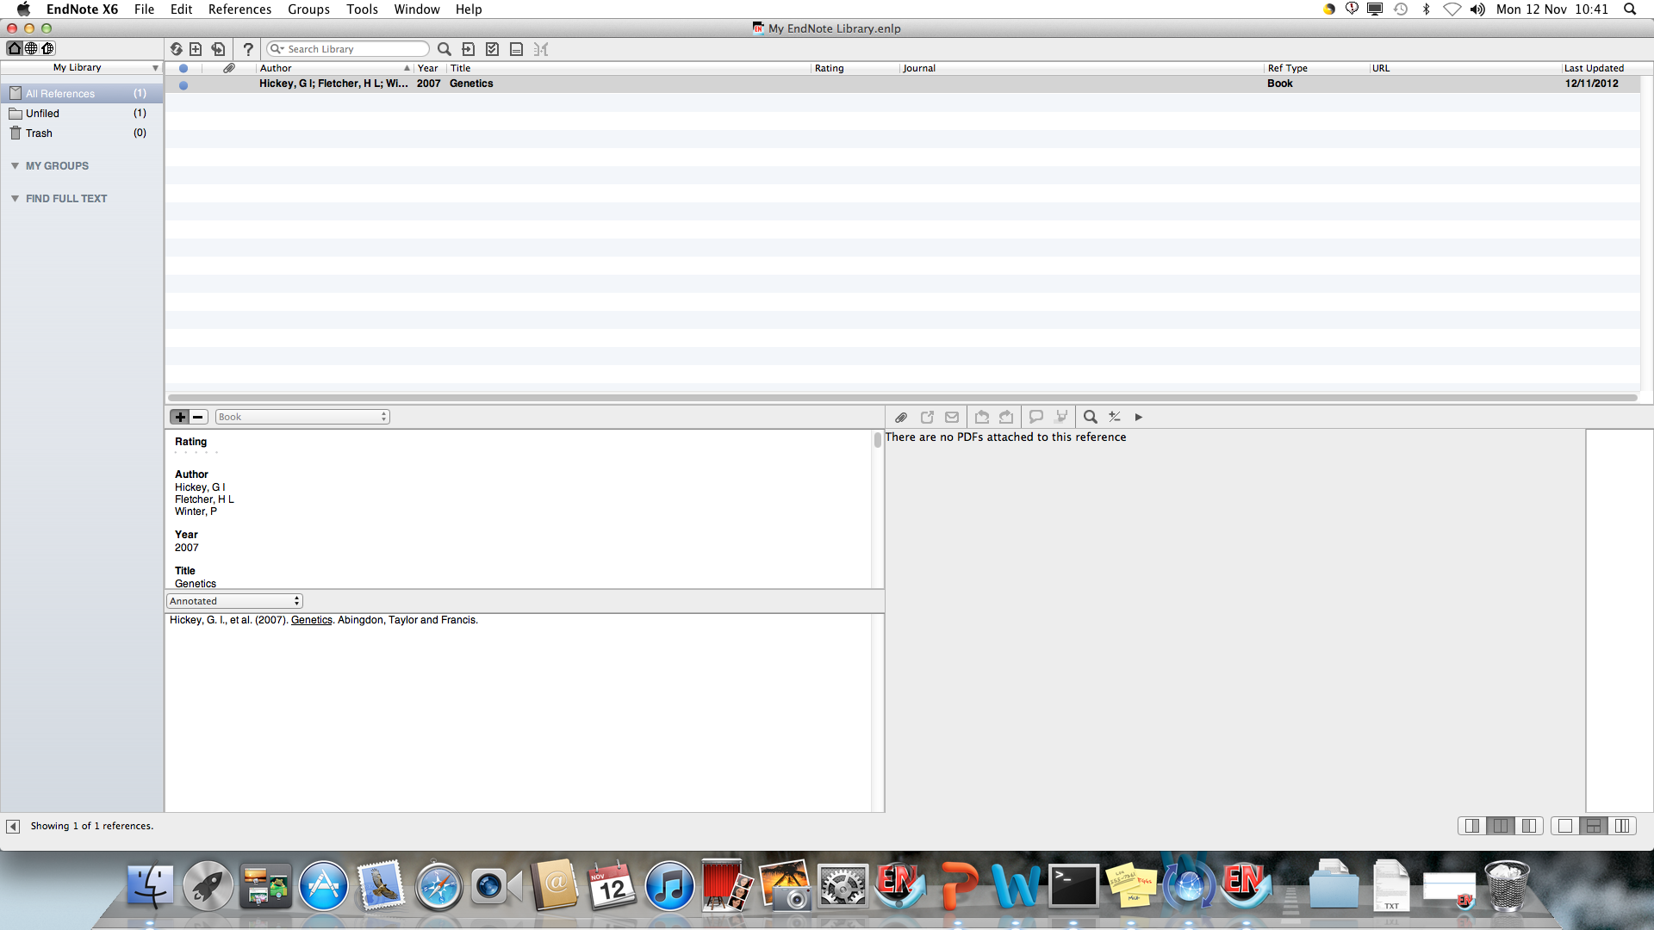
The record is added to the library
The Preview pane shows the full bibliographic reference in the chosen reference style
Notes:
The record is then added to the library and the bibliographic record displayed in the Preview pane, in accordance with the chosen reference style.

Slide 16
Use these icons to control the library layout
Notes:
There are various options for the overall layout of the EndNote Library

Slide 17
PDF panel not visible
All panels visible
Preview panel not visible
References only view
Bottom split view
Right split view
Notes:
Make choices according to whether you want to see the preview panel and/or the pdf window, and whether you want these displayed below or to the right of the References window.

Slide 18
Change the reference style

Slide 19
Add all styles to the list

Slide 20
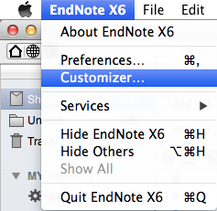
Go to the Endnote X6 dropdown menu and choose 'Customizer'
Notes:
When EndNote is installed on a Mac, only a basic set of Styles, Filters, and Connection Files is downloaded.
To make sure all files are available, go to the EndNote dropdown menu, and choose the Customizer option.

Slide 21
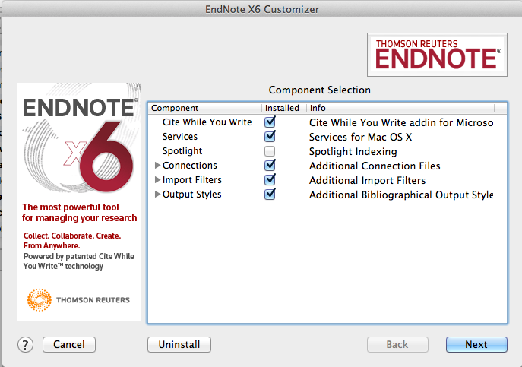
Check the boxes for 'Connections, Import Filters and Output Styles' and choose 'Next'
Notes:
Check the boxes for Connections, Import Filters and Output Styles and click Next.

Slide 22
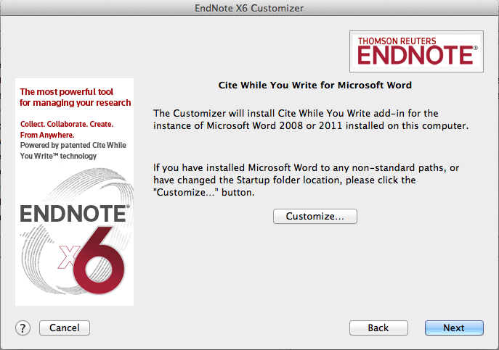
Notes:
Choose Next on this window

Slide 23
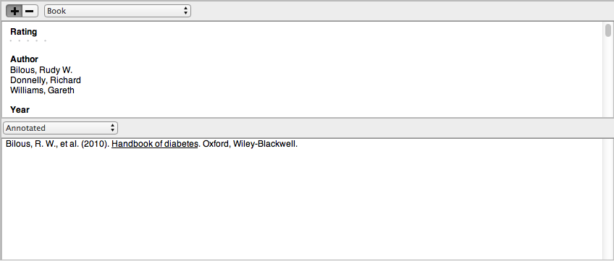
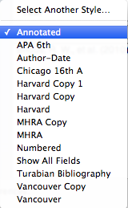
The default style is 'Annotated'
Go to the dropdown menu and choose 'Select Another Style'
Notes:
The default reference style is 'Annotated'
Use this process to select another style - changes can be made at any time.
Go to the dropdown menu beside the current reference style, and choose Select Another Style..

Slide 24
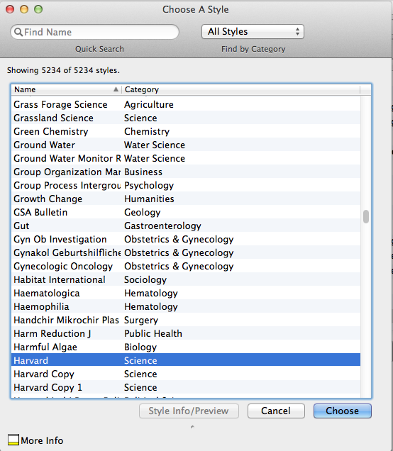
EndNote has over 5000 reference styles
Scroll down to select the required reference style and click 'Choose'
Notes:
The Choose a Style window opens.
There are over 5000 choices, including general reference styles, journal house styles and academic libraries.
Select a new style, in this case 'Harvard' and click Choose.

Slide 25
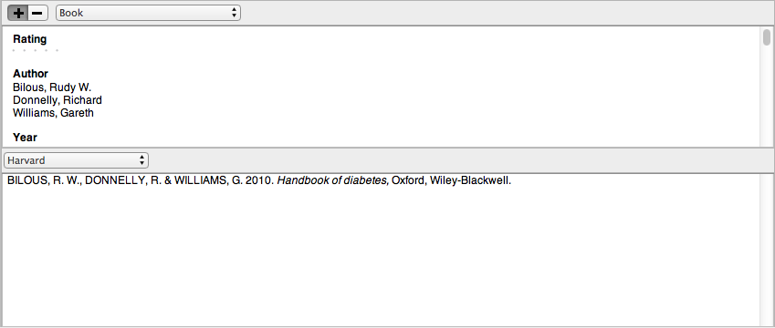
The library is now formatted in the selected Reference Style
Notes:
The EndNote Library is displayed in the new reference style.
The reference style can also be modified - changes will be saved to an EndNote folder in 'My Documents' so that they are automatically accessed next time the EndNote library is opened.

Slide 26
Edit the reference style

Slide 27
It may be necessary to edit the existing reference style
Notes:
Some faculties require variations to standard referencing styles. Harvard in particular is used in a number of slightly differing formats. There are some Southampton specific EndNote styles: Harvard SotonHS, Harvard SotonMANG and Vancouver SotonMED.
These styles are also available on EndNote Web

Slide 28
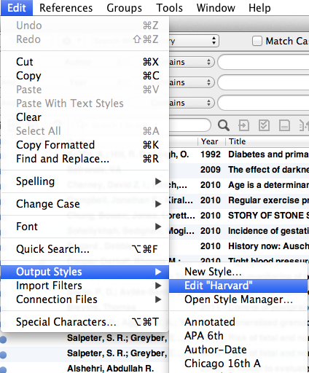
Go to Edit  Output Styles  Edit 'Harvard'
Notes:
To edit the referencing style, go to Edit, Output styles, Edit 'Reference Style', in this case, Harvard.

Slide 29
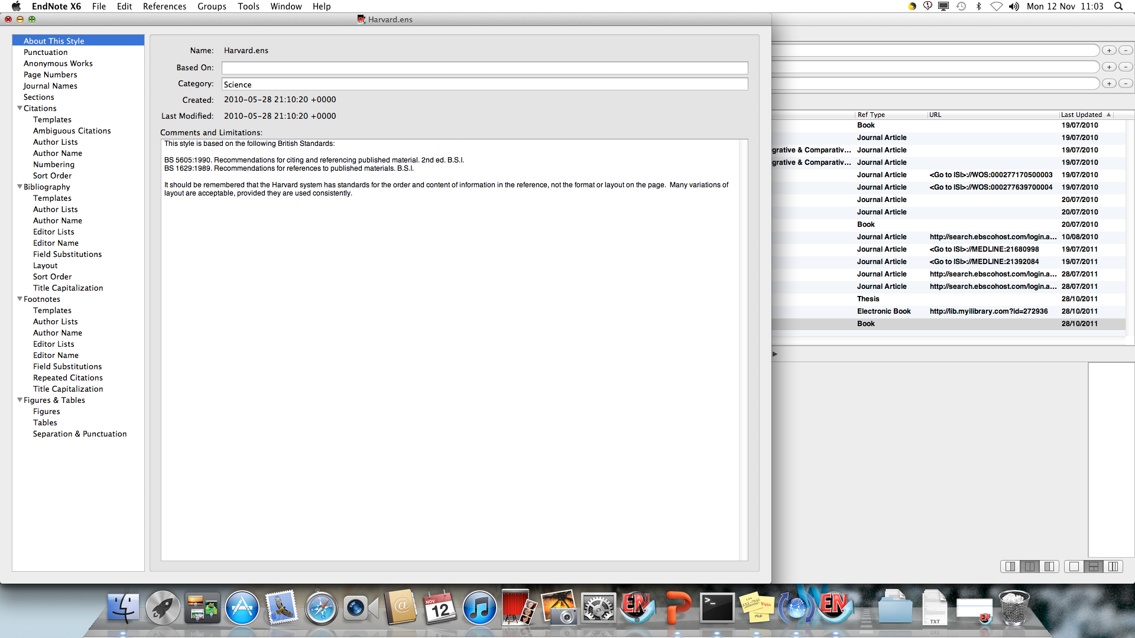
This window controls all aspects of the referencing style
Notes:
This window controls all aspects of the referencing style: there are sections for in-text citation, full bibliographic references, and also for footnotes, which are used by some referencing styles.

Slide 30
Edit the reference style - citations

Slide 31
Go to Edit  Output Styles  Edit 'Harvard'
Notes:
To edit the referencing style, go to Edit, Output styles, Edit 'Reference Style', in this case, Harvard.

Slide 32
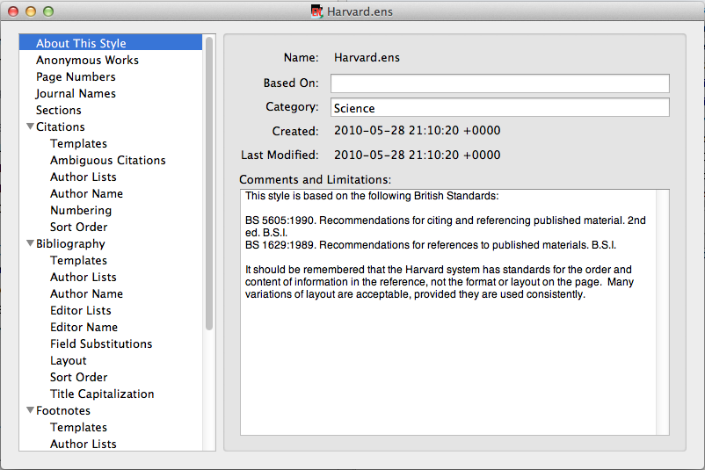
Any element of the citation, bibliographic record or footnote can be edited using this page
Notes:
This window allows you to edit all aspects of the Endnote bibliographic record. The main groups are Citations which are the short references within the written text, Bibliography which is the list of full references at the end of the document, and Footnotes, which are used at the bottom of individual pages in some referencing systems.

Slide 33
When all changes have been made, click the record 'close' icon
Notes:
Click Citations then Templates to see how this tool works. The operation of other fields is similar to those described in the Format Bibliography section.
In this example, EndNote picks up the contents of the 'Author' field from the record, adds a comma, then the contents of the 'Year' field and encloses everything in brackets.
The vertical line lines tie the following punctuation to the next field, so that if the field is empty, you do not get stray punctuation in the record.
Make any changes you require, and then click the close record icon.

Slide 34
Choose preferred citation sort order here
Notes:
Use this option to edit the in-text citation sort order.
The default order is 'Don't sort'
If you have multiple citations at single points in the text, you may wish to arrange these either alphabetically or chronologically. Choose the relevant option from the list.

Slide 35
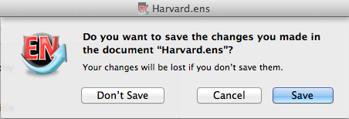
Click 'Save'
Notes:
Click Save to save the changes.

Slide 36
Save with the default Style name or use your own
Notes:
You will be prompted to save the edited style with a new name.
This edited style will then appear in EndNote's reference style list and can be applied to any EndNote library. This style is stored in your EndNote Styles folder.

Slide 37
Edit the reference style - bibliography

Slide 38
Go to Edit  Output Styles  Edit 'Harvard'
Notes:
To edit the referencing style, go to Edit, Output styles, Edit 'Reference Style', in this case, Harvard.

Slide 39
Any element of the citation, bibliographic record or footnote can be edited using this page
Notes:
This window allows you to edit all aspects of the Endnote bibliographic record. The main groups are Citations which are the short references within the written text, Bibliography which is the list of full references at the end of the document, and Footnotes, which are used at the bottom of individual pages in some referencing systems.

Slide 40
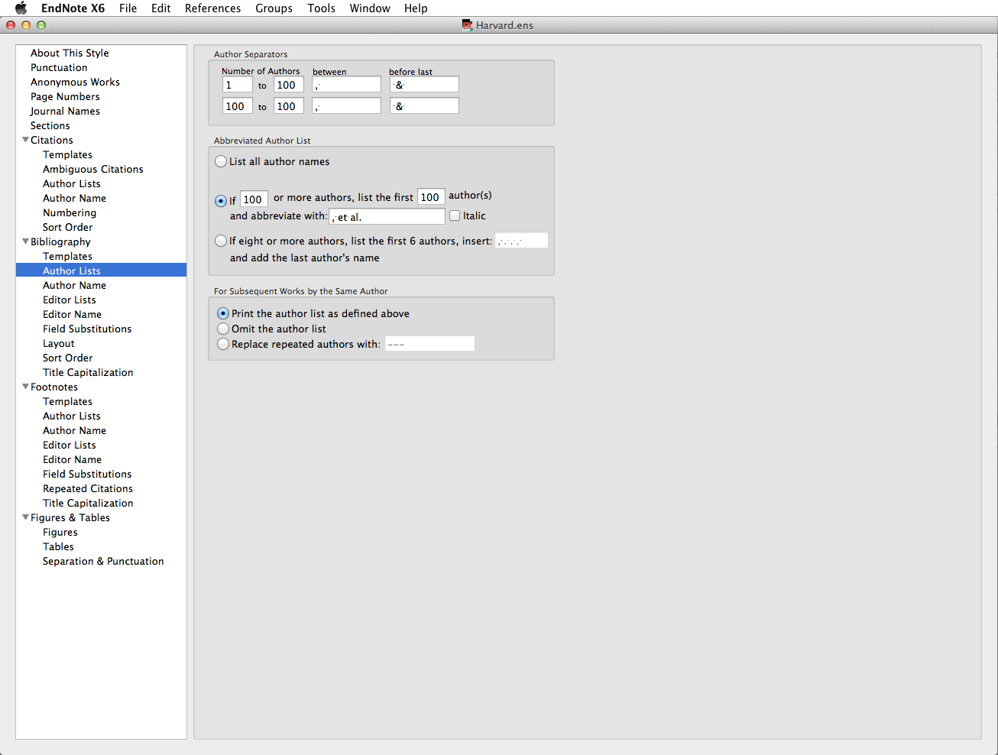
'Author Lists' lets you control how many authors are displayed
Notes:
The Author Lists section allows you to control how many authors are displayed, and the separating punctuation.
Any changes to Author Lists must be replicated in Editor Lists.

Slide 41
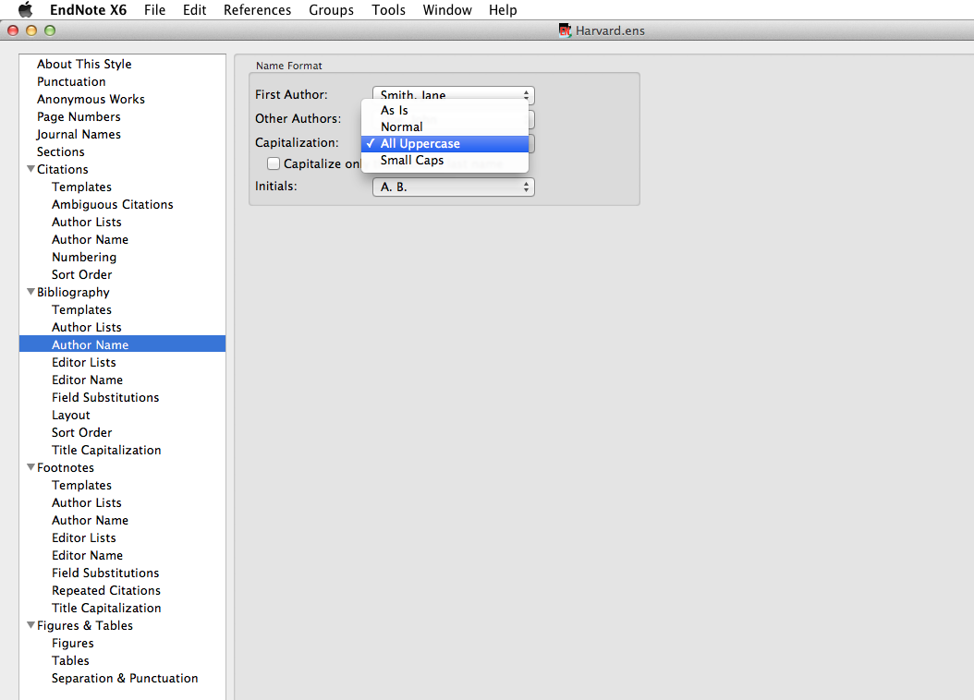
'Author Name' allows choices about capitalisation - choose 'Normal' for names in lower case but with initial capital letters
Notes:
Changes to Author Name must be replicated in Editor Name.
These windows allow you to make choices about capitalisation - the default is All Uppercase. Choose Normal for names in lower case but with initial capital letters.

Slide 42
Make choices about the punctuation of initials
Notes:
Choices can also be made about the display of initials: with or without full-stops, with or without spaces between.

Slide 43
Choose the order in which bibliographic records are displayed…
Notes:
Control the order in which bibliographic records are displayed -this is normally by author, year, title, but it is possible to sort according to any field in the EndNote record. To do this, click Other.

Slide 44
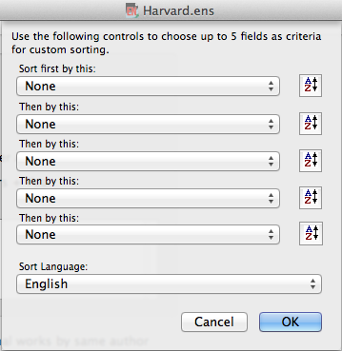
Use this window to sort e.g. by media type
Notes:
In the Sort Options window, choose the sorting field from the dropdown.

Slide 45
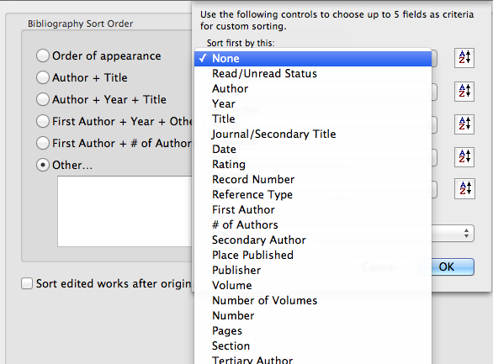
Use the dropdown menus to select up to five criteria for sorting
Notes:
To divide the bibliography into sections, the easiest way is to put the relevant section headings in the Keyword field and then choose to sort by keyword, author, year, title in that order.

Slide 46
The Title Capitalization control applies to all primary titles in the EndNote Library
Choose 'Headline Style' to capitalize major words, 'Sentence Style' for initial words only, or leave titles as they were typed in.
Notes:
Choose the style for primary title capitalisation - Headline style will capitalise all major words, Sentence style will capitalise the initial word only.
Note that the same style will be applied to all records in the library: if the conventions for book titles and journal article titles differ, you may wish to leave titles as entered.

Slide 47
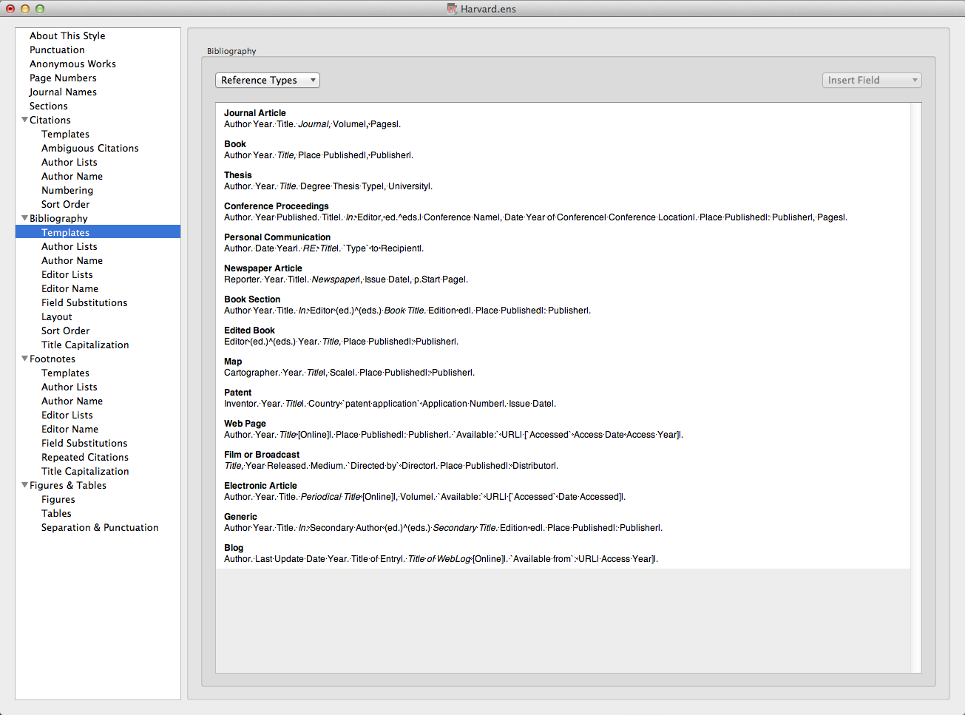
'Generic' is used for any Reference Type without a specific template
Further Reference Type templates can be created, or existing templates edited
The templates show which fields will be used from the EndNote record, and how they will be displayed, for a range of Reference Types
Notes:
The Templates window shows how the bibliographic record will be displayed for a wide range of reference types. More can be added, by clicking the Reference Types button and creating a template on the principles of existing types.
Generic is used for any reference type which does not have a specific template.
In the templates, where the name of an EndNote record field appears, this will be replaced by the contents of that field, according to the format in the template (bold, italic etc) Other characters are displayed as typed. Field Names are case-sensitive.
The vertical bar links punctuation to the next field, so that if there is no data in a given record field, stray punctuation is eliminated. The ^ means that Endnote will choose whether to display the singular or plural option according to the number of authors/editors.

Slide 48
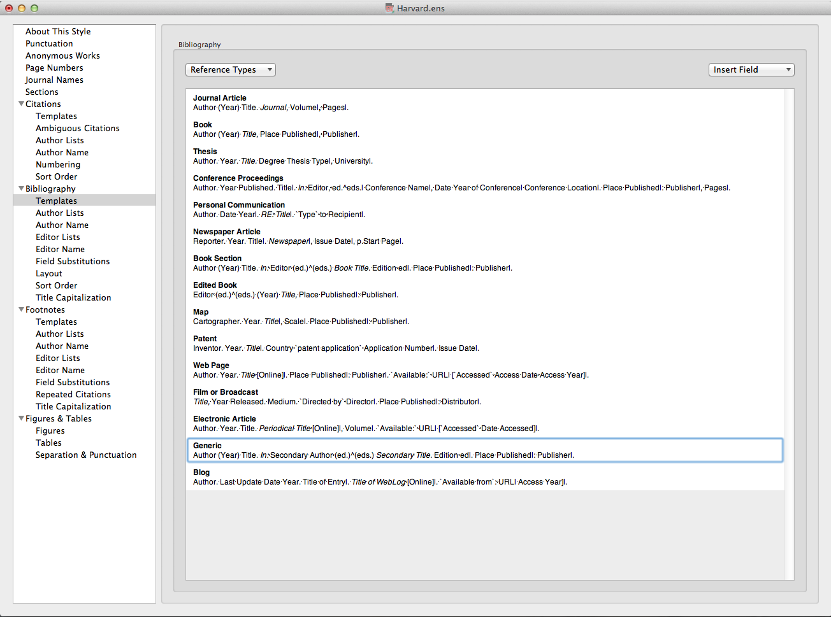
Click the record's 'close' icon to save the changes automatically
Here the Year field has been edited to include brackets for all Reference Types, including Generic, likely to be used
Notes:
Existing reference type templates can be edited, for example, displaying the year in brackets or inserting the issue number in the journal article template.
It is not necessary to edit Reference Types that will not be used, but Generic must always be included.
In this case the Year field has been edited for some Reference types.
When all changes have been made, click the record Close icon.

Slide 49
Click 'Save'
Notes:
You will be prompted to save the edited style with a new name.

Slide 50
Save with the default Style name or use your own
Notes:
The original reference style remains unchanged, but a variation is created.
This edited style will then appear in EndNote's reference style list and can be applied to any EndNote library. This style is stored in My Documents, so can be accessed at any time.

Slide 51
Templates - how they work

Slide 52
Templates control the appearance of the bibliographic record
A number of templates are already created: use the Reference Types list to create others
Generic is used if there is no template for a given reference type
Notes:
Bibliographic templates control the display of records when EndNote is used with Word documents for citations and references.
Depending on the Reference Style, there are already a number of templates created.
Additional templates can be created by choosing from the Reference Types list.
'Generic' is used when a specific template has not been created for a Reference Type that has been used to create an EndNote record.

Slide 53
Field Names are replaced by the contents of that field in the individual EndNote record
Other characters are displayed 'as is'
Notes:
Templates are created on the basis of Field Names: wherever a Field Name appears, it is replaced by the contents of that field in the bibliographic record. Words or characters that are not field names are displayed 'as is'.
If a template field contains no data, it is omitted from the record: the vertical lines tie the punctuation to the following field so that stray commas and colons do not appear.

Slide 54
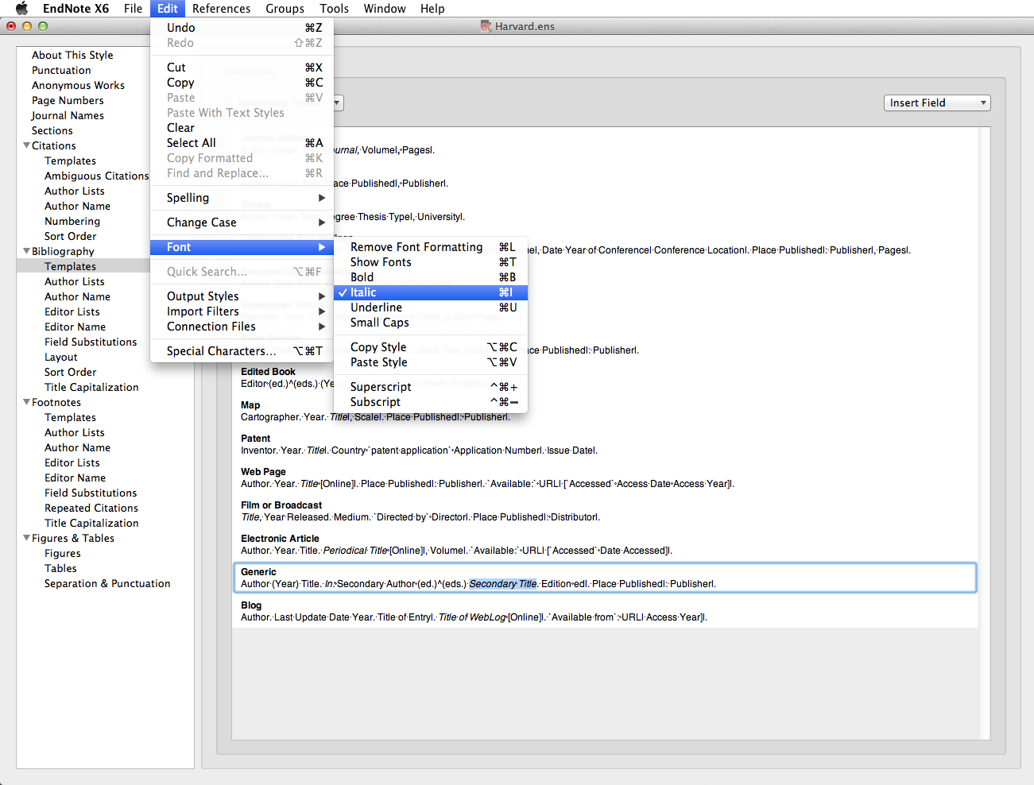
Apply Bold, Italic Underline, Superscript or Subscript to the Field Name using 'Edit  Font …
Fields are displayed with the format used for the Field Name
Notes:
Bold, Italic, Underline, Superscript or Subscript may be required formats within a citation or bibliographic template. To change the format, go to Edit, Font…
A field is displayed in the format used for the Field Name - hence Journal and Title often appear in italics within the templates.
When an item has editors, EndNote will choose between singular and plural: the circumflex is used.
Templates can be edited at any stage, and the edited reference style applied to the EndNote Library and relevant Word documents.

Slide 55
Special characters in templates
EndNote uses special characters to force particular actions within templates
These can be found on the keyboard, or accessed from the 'Insert Field' dropdown menu
Notes:
Some of the templates contain special characters: these are needed for example to avoid stray punctuation in bibliographic records or to manage different numbers of authors/editors.
Use keyboard characters or go to the Insert Field dropdown menu.

Slide 56
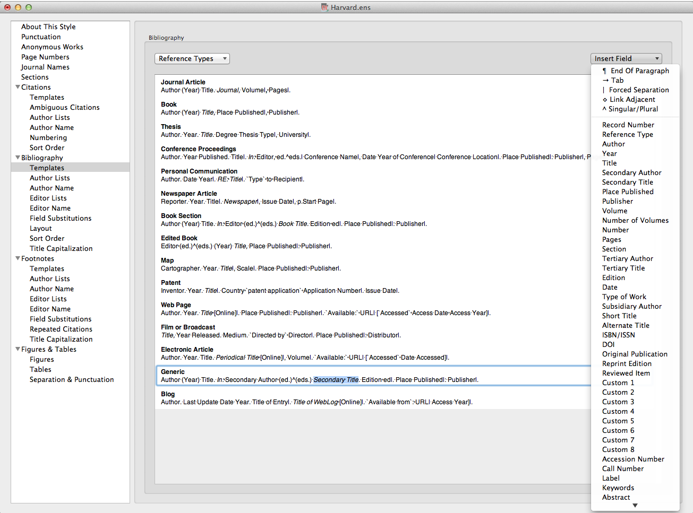
A forced separation | ties following punctuation to the next field
Notes:
Use the forced separation to tie punctuation to the following field: if this field is empty in the EndNote record, the punctuation will not be displayed: in this example, no publisher, no comma.

Slide 57
Use 'Link Adjacent Text'  to tie a word or phrase to the following field
Notes:
The diamond ties plain text to the next field: in this example, the words 'Type to' will only appear if there are details in the Recipient field. The grave accents indicate a phrase to be tied to the following field rather than a single character or word or a word that could be mistaken for a Field name.

Slide 58
Use Singular/Plural ^ to choose text for editors or pages
Notes:
The circumflex ^ is used to allow a choice between text linked to the associated field, in this case dependent on the number of entries in the Editor field.

Slide 59
Use accent grave ` at start and end of text which might be confused with a field name
Notes:
Accents grave are used to identify phrases which need to be linked to preceding or following fields, and also to ensure that any text which also appears in an EndNote record as a field name is displayed in the bibliographic record 'as is'

Slide 60
Apply an edited reference style

Slide 61
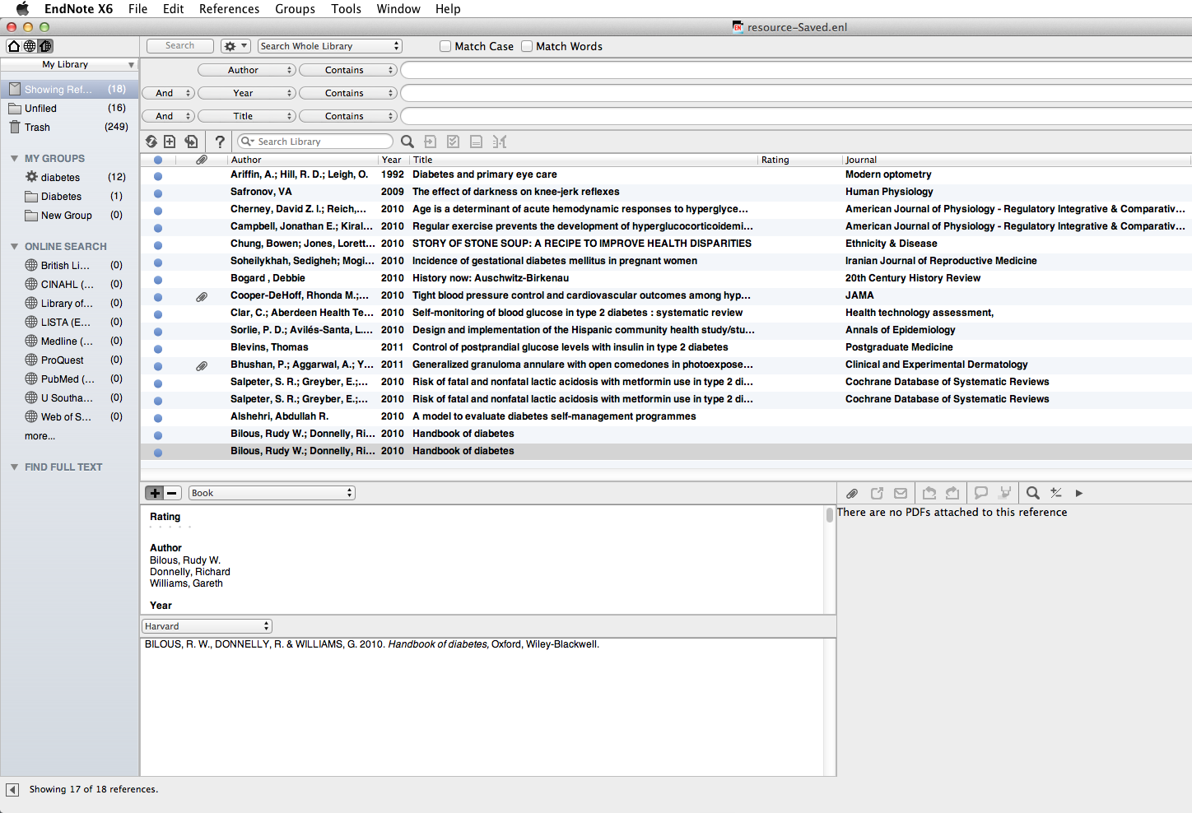
Changes to a Reference Style are not automatically applied:
Notes:
Changes to the Referencing Style are not automatically applied to the EndNote Library.

Slide 62
Go to the Reference Style dropdown menu and choose 'Select Another Style'
Notes:
To apply changes, go to the Reference Style dropdown menu and choose Select another Style.

Slide 63
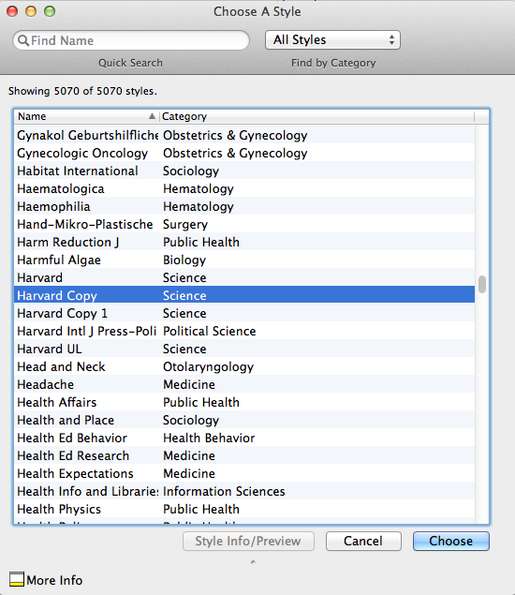
The edited reference style now appears in the Style list
Select the style and click 'Choose'
Notes:
The edited style is now one of the choices - select and click Choose.

Slide 64
Changes to the Referencing Style are applied
Further edits to the style can be made at any time
Notes:
The edits are now applied to the EndNote Library.
Further changes can be made at any time, and the same copy style updated and then applied again to the library concerned. If references from the Library have already been used in a document, new changes can only be applied by using the Format Bibliography option in Word.

Slide 65
Set some EndNote preferences

Slide 66
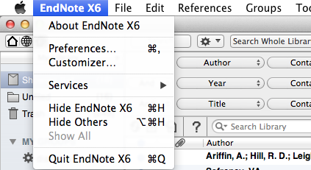
To manage the appearance of the EndNote Library, go to EndNote X6  Preferences…
Notes:
Preferences controls how the EndNote Library itself appears, rather than the individual records. To see the options, go to EndNote X6, Preferences.

Slide 67
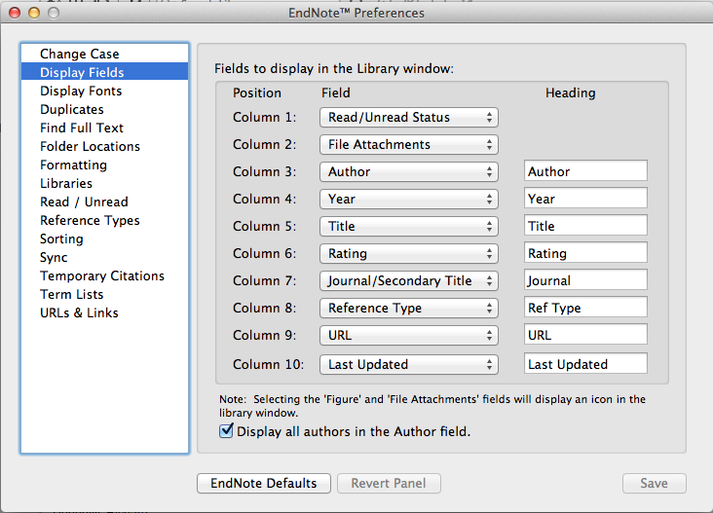
The 'Display Fields' option controls the order and selection for display within the EndNote library
Notes:
Various preferences can be set: Display Fields allows the selection and ordering of significant fields from the record: the columns can be renamed if required.

Slide 68
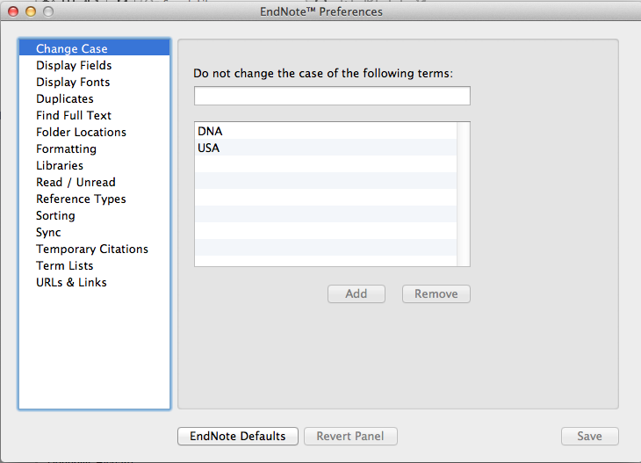
Use the 'Change Case' option to keep abbreviations in all upper case, or for any names with irregular characters or non-standard capitalisation
Notes:
The Change Case option is an important tool: it permits the general rules for bibliographic display to be overridden in special cases e.g. abbreviations, non-English language names and characters. Any character string added to the list will be displayed 'as is' wherever it occurs.

Slide 69
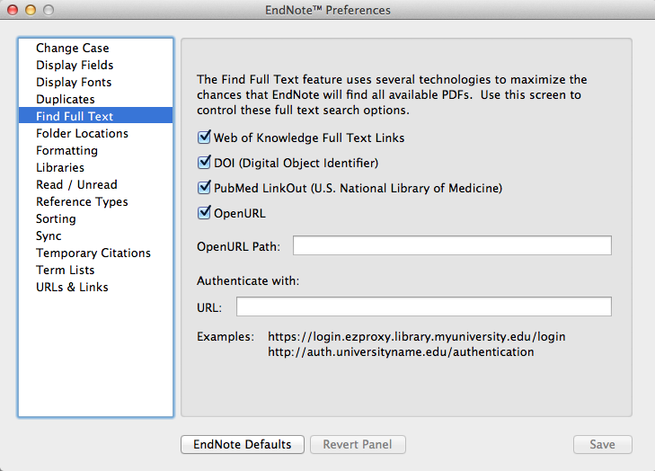
Notes:
To ensure maximum retrieval of full text journal articles when searching databases, make sure the PubMed LinkOut option is checked in Find Full Text preferences.

Slide 70
Sort references into groups

Slide 71
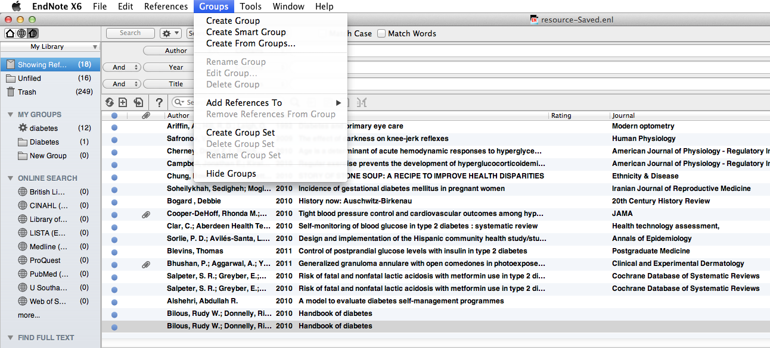
Click to Create a Custom Group
Notes:
The best way of managing a large EndNote Library is to create sublibraries, or groups. Up to 5000 groups can be attached to a single library.
Groups can be custom groups or Smart groups.
Any item in the main library may be included in a custom group.
Smart groups are given set criteria - any item fulfilling these criteria is automatically added to the group. The criteria can be modified at any time. The criteria for a new Smart group will be applied to the existing EndNote Library, and to any items that are added subsequently.
All entries are included in the main EndNote library: they may be copied into more than one group, or be entries in more than one Smart group.
Deleting a record from a main library removes it from all groups: deleting a record from a custom group does not remove it from the main library or from other groups. However, deleting an item from a Smart group will also remove it from All References
To create a Custom group, go to Groups, Create Group.

Slide 72
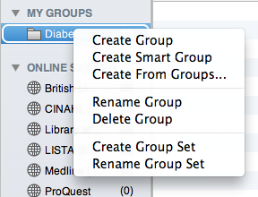
The group can be named, and managed by ctrl + click
Notes:
Name the group. The new group is displayed in the My Groups panel. Options to manage the group are available with ctrl +click.

Slide 73
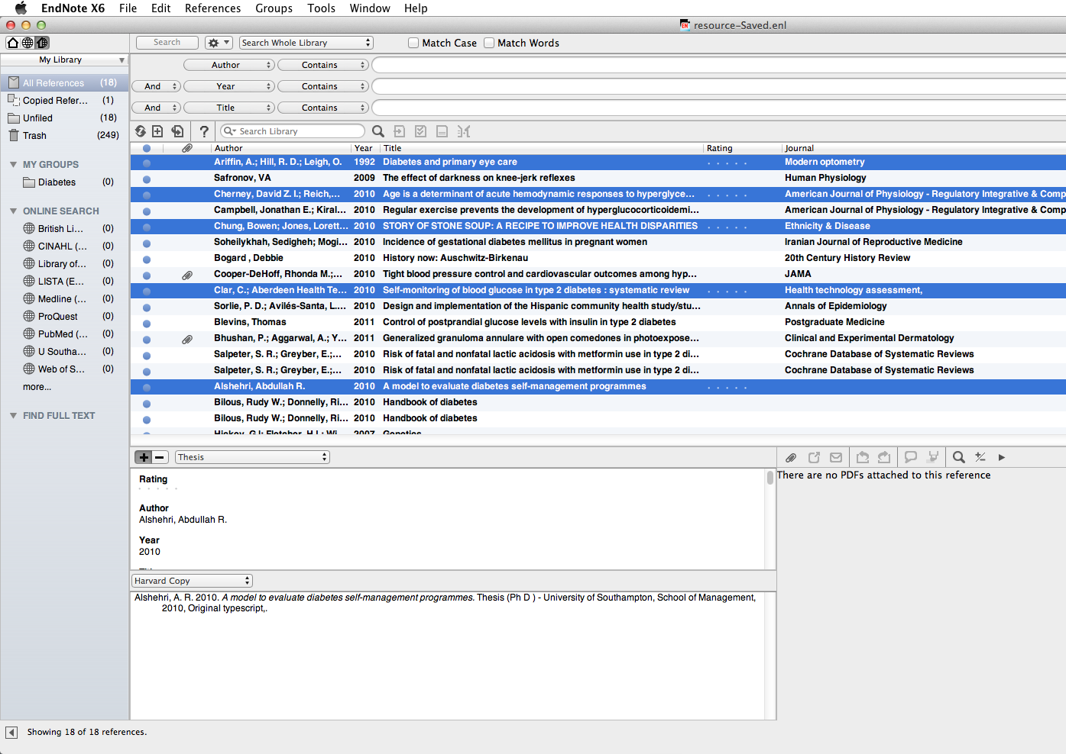
Drag selected records on to the group name to add the records to the group
Notes:
Select the records to be added to the group, and drag on to the group name. Make multiple selections with 'cmd + click'

Slide 74
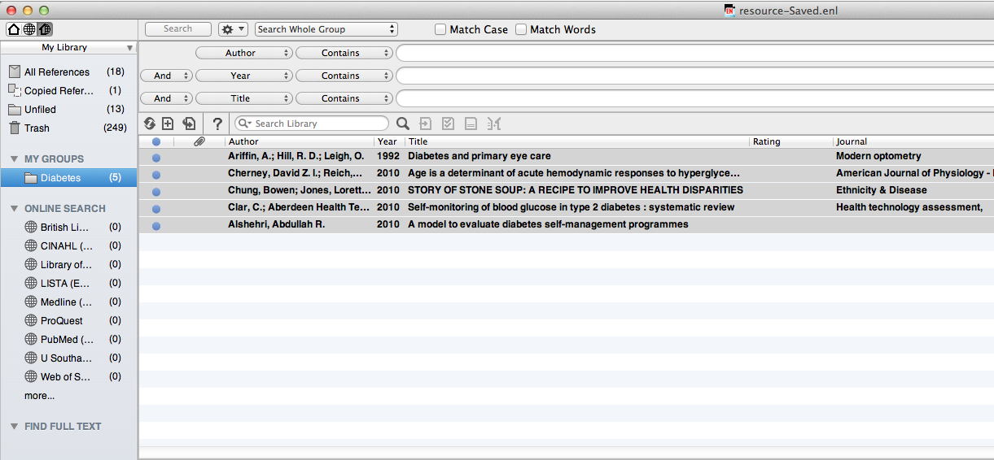
Add or remove records in Custom Groups at any time
Notes:
Custom groups can be populated manually at any time. Records deleted from groups are not deleted from the main library

Slide 75
Export database information to EndNote
Export references to a new or existing library or group
Use Firefox to export directly to EndNote - it is a more complex two-stage process in Safari
A number of databases export URL links as part of the record
The export process is common to all databases on a given platform
There is a separate process for searching any library catalogue
Notes:
Information can be exported directly from many databases into a new or existing library or group. The information from the database will populate the relevant fields in the EndNote record. This can include the abstract, and in many cases a URL link to the original database entry.
The EndNote export process uses connection files and import filters: all these are installed on public workstations. If you have purchased a copy of EndNote then additional files and filters can be downloaded from the supplier's website. Use Firefox as the internet browser - most databases will download automatically into EndNote. With Safari it is a two stage process, and for some platforms this browser does not work at all.
Some databases will provide automatic hyperlinks back to the original database record.
Every database operates on a 'platform' - all databases on a given platform export records in the same way.
Bibliographic information can also be downloaded from library catalogues including University of Southampton and this uses a slightly different process -see the separate section.

Slide 76
Search Web of Knowledge

Slide 77
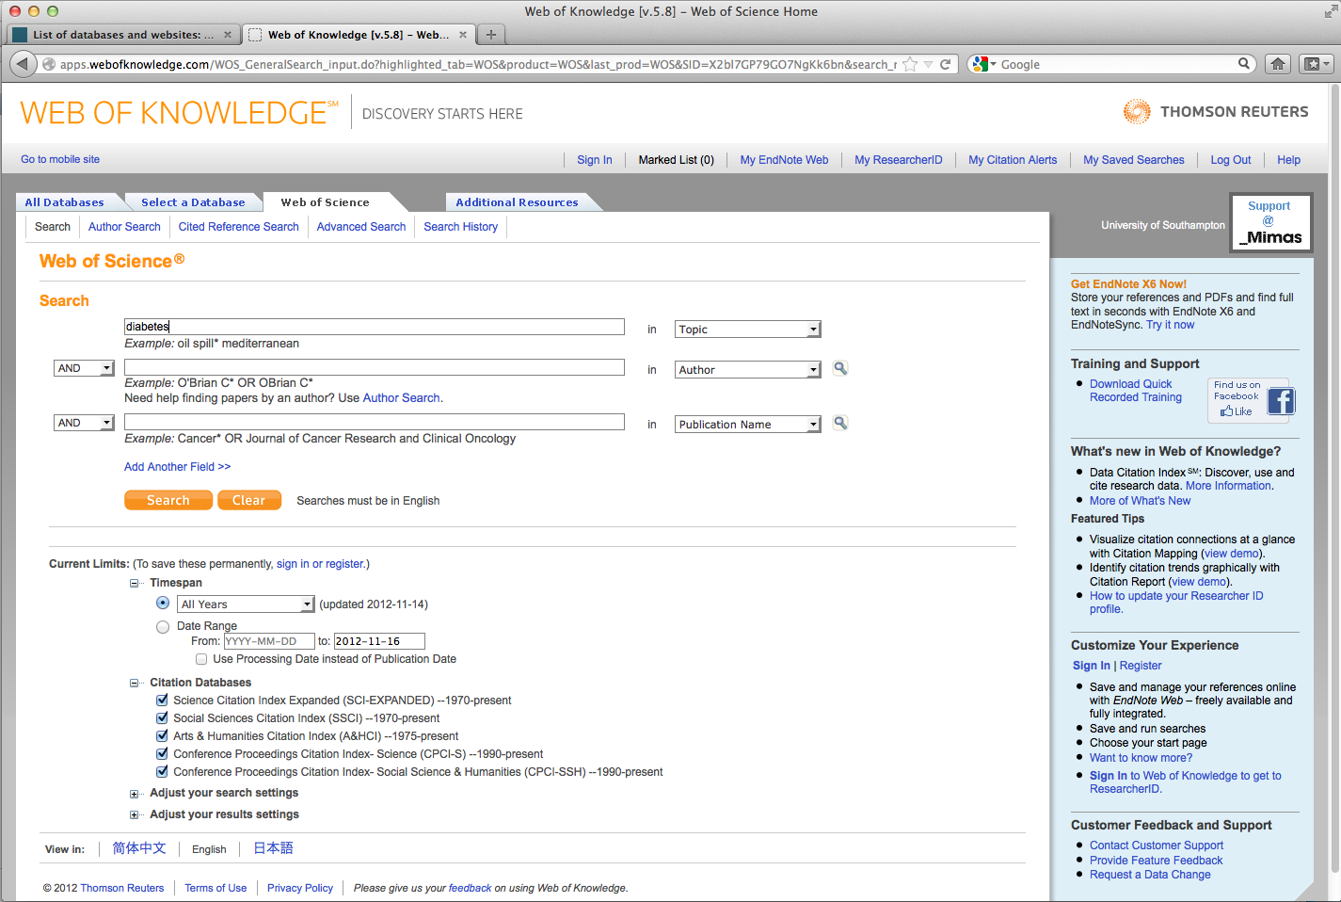
This is the Web of Science home page
Enter a search term - in this case 'diabetes' and click 'Search'
Notes:
This procedure applies to any database on the Web of Knowledge platform.
It is best, but not essential, to open the EndNote library before starting the search.
Use the library website to access the Web of Knowledge platform. In this case a Web of Science database search has been chosen.
The instructions here are for exporting required articles to EndNote rather than conducting an effective search strategy.
Enter a search term, in this case 'diabetes' and click Search.

Slide 78
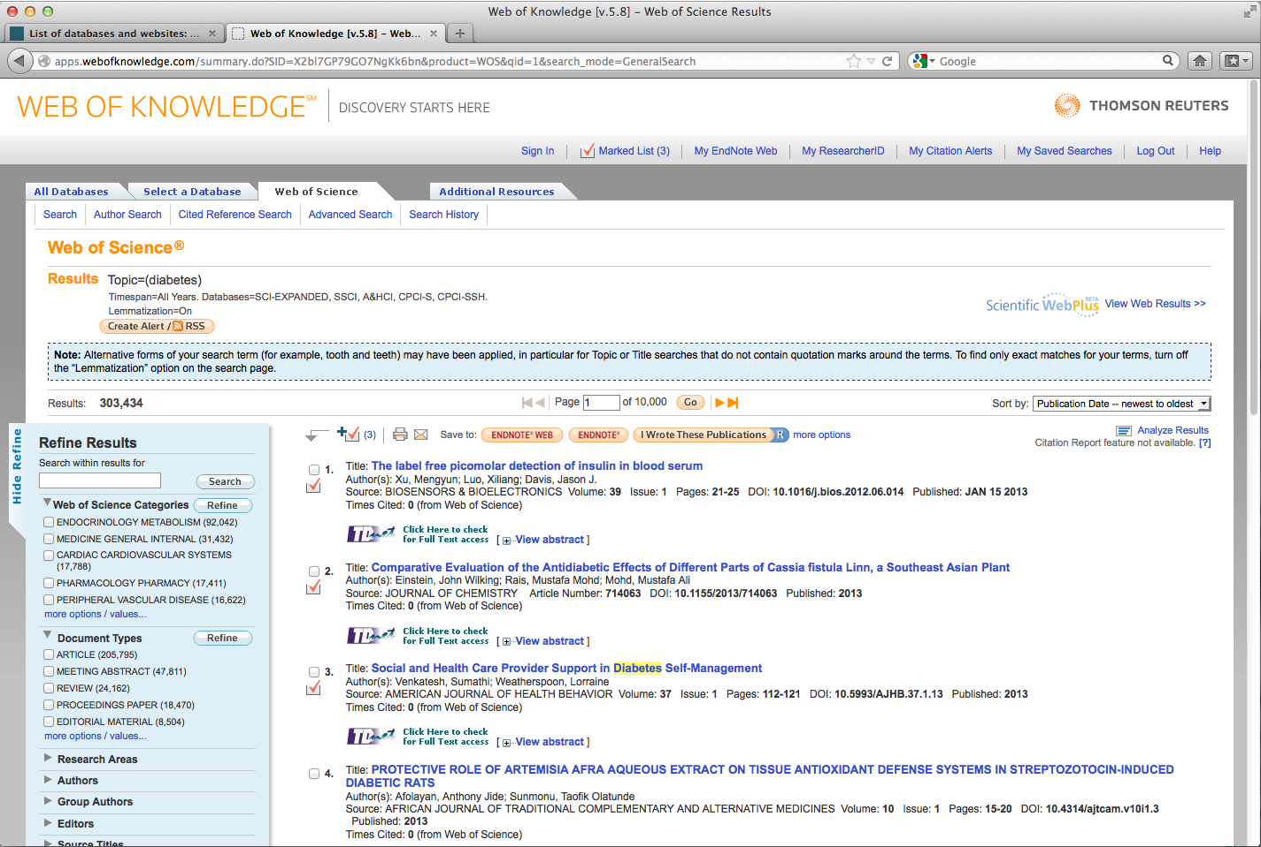
Open the Marked list to view the selected records
On the Results pages, click required items, then add to marked list
Notes:
When the search process is complete, click on the number of results to display the records. Check the boxes for any required records, and add to the marked list.
Added items will be denoted by a red tick, and the total number of entries on the marked list shown.
Click the Marked List tab to view at any time.

Slide 79
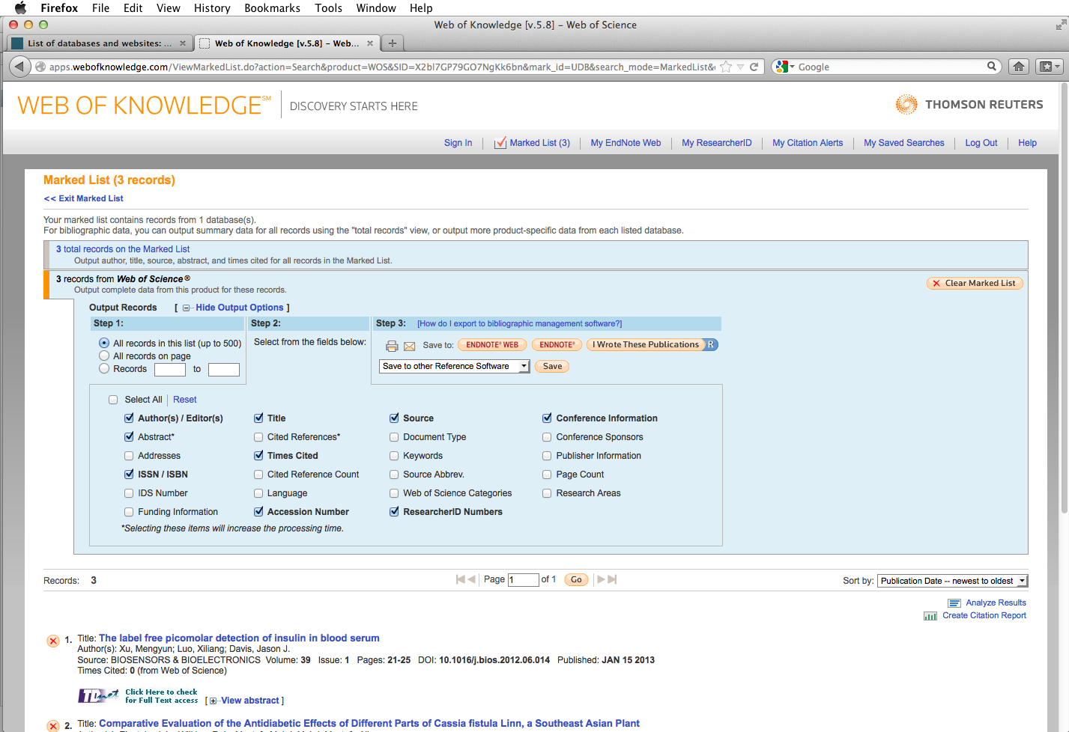
It is helpful to include the abstract in exported records
Select fields to be included in output, then click 'EndNote'
Notes:
Select the fields to be included in the output (check the 'abstract' box as well) and then click the EndNote option.

Slide 80
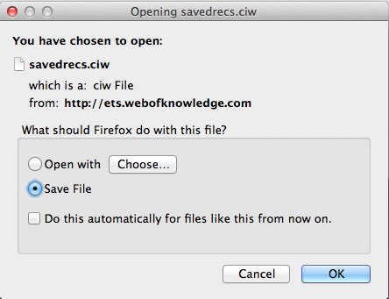
Click 'Choose'
Notes:
The first time you export from this platform you will be asked to set preferences in Firefox. Click Choose

Slide 81
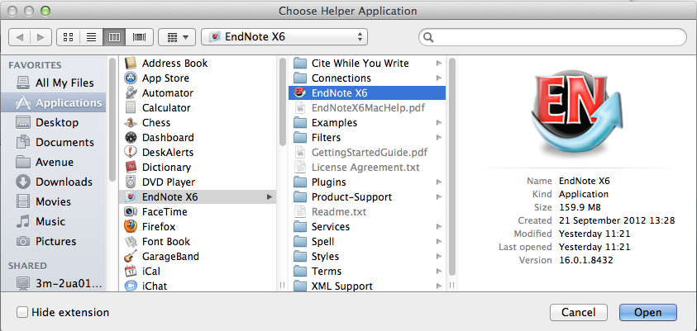
In the Applications folder, go to EndNote X6, and click 'Open'
Notes:
Go to Applications, EndNote X6, EndNote X6 and click Open

Slide 82
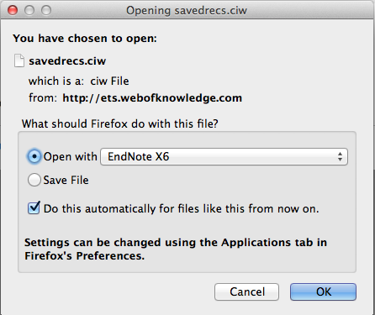
Click to save choices
Notes:
Check the box to save the preferences for future searches on the Web of Knowledge platform. Click OK.

Slide 83
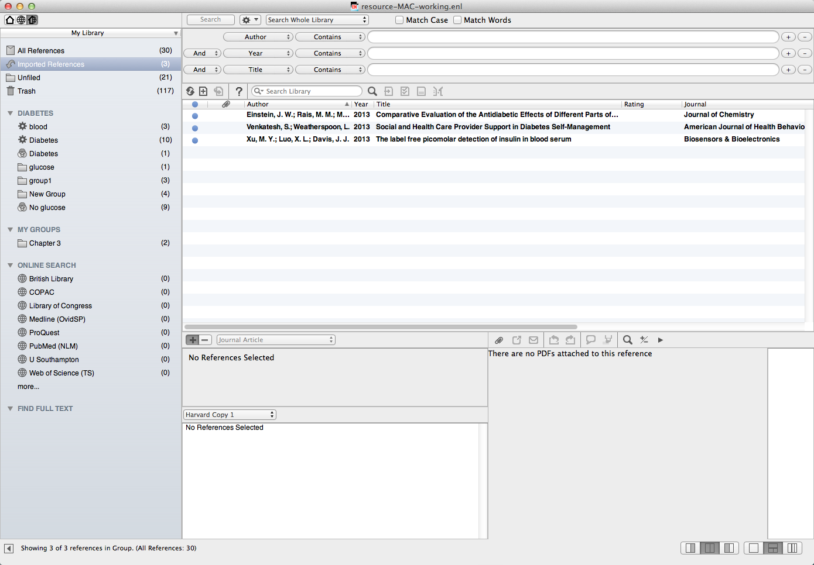
Click on any imported reference to view details of the record
A temporary group 'Imported References' is created. The references have already been added to the main library
Selected references are imported to the open EndNote Library
Notes:
The records will import directly into the EndNote library. These become a temporary group of Imported References, but are already added to the main library of All References. The temporary group will be overwritten at the next import activity, or when the library is closed.
Double click on any of the imported references to view.

Slide 84
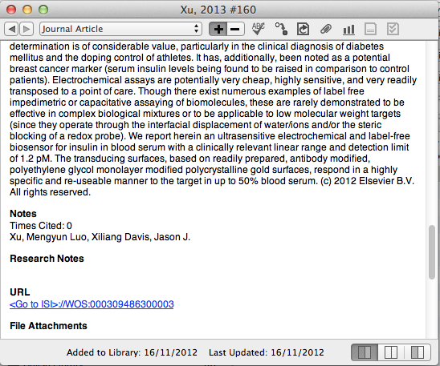
Notes:
The link in the URL field goes to the database entry in Web of Science.

Slide 85
Find full text of articles

Slide 86
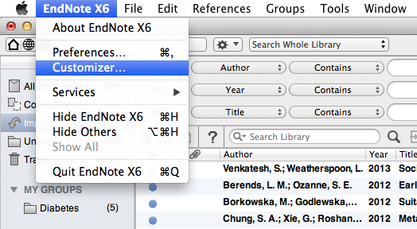
Go to ' EndNote X6  Customizer…'
Notes:
To use the 'Find Full Text' option, the links must be enabled. Go to EndNote X6, Customizer…

Slide 87
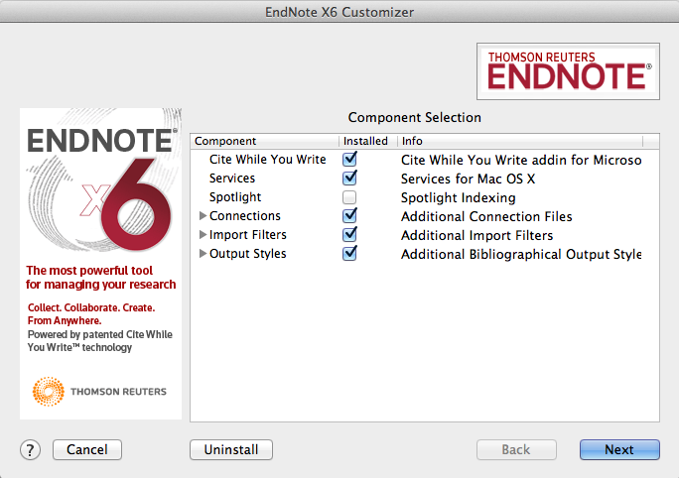
Check 'Services' and follow 'Next'
Notes:
Services for Mac OS X must be enabled. Check the box and click Next to install.

Slide 88
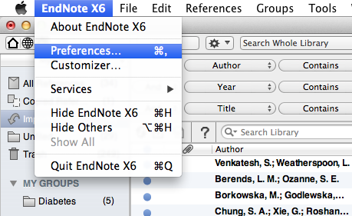
Then go to 'EndNote X6 ➔ Preferences'
Notes:
There are also parameters to be set in EndNote. Go to EndNote X6, Preferences

Slide 89
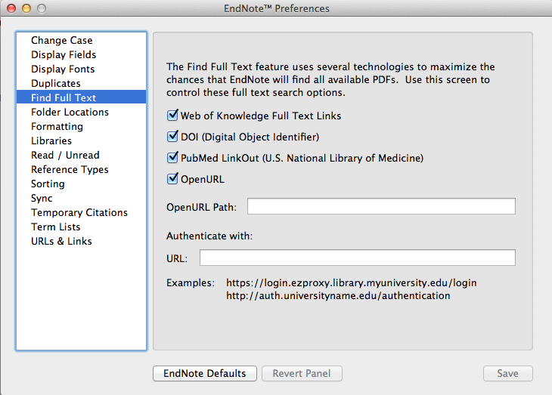
Use the 'Find Full Text' option and check all the boxes
Notes:
In the Find Full Text window, check all the searching options to enable maximum PDF retrieval. Note that the university may have subscription access to individual journals, so check via TDNet for any PDFs not found by this method.

Slide 90
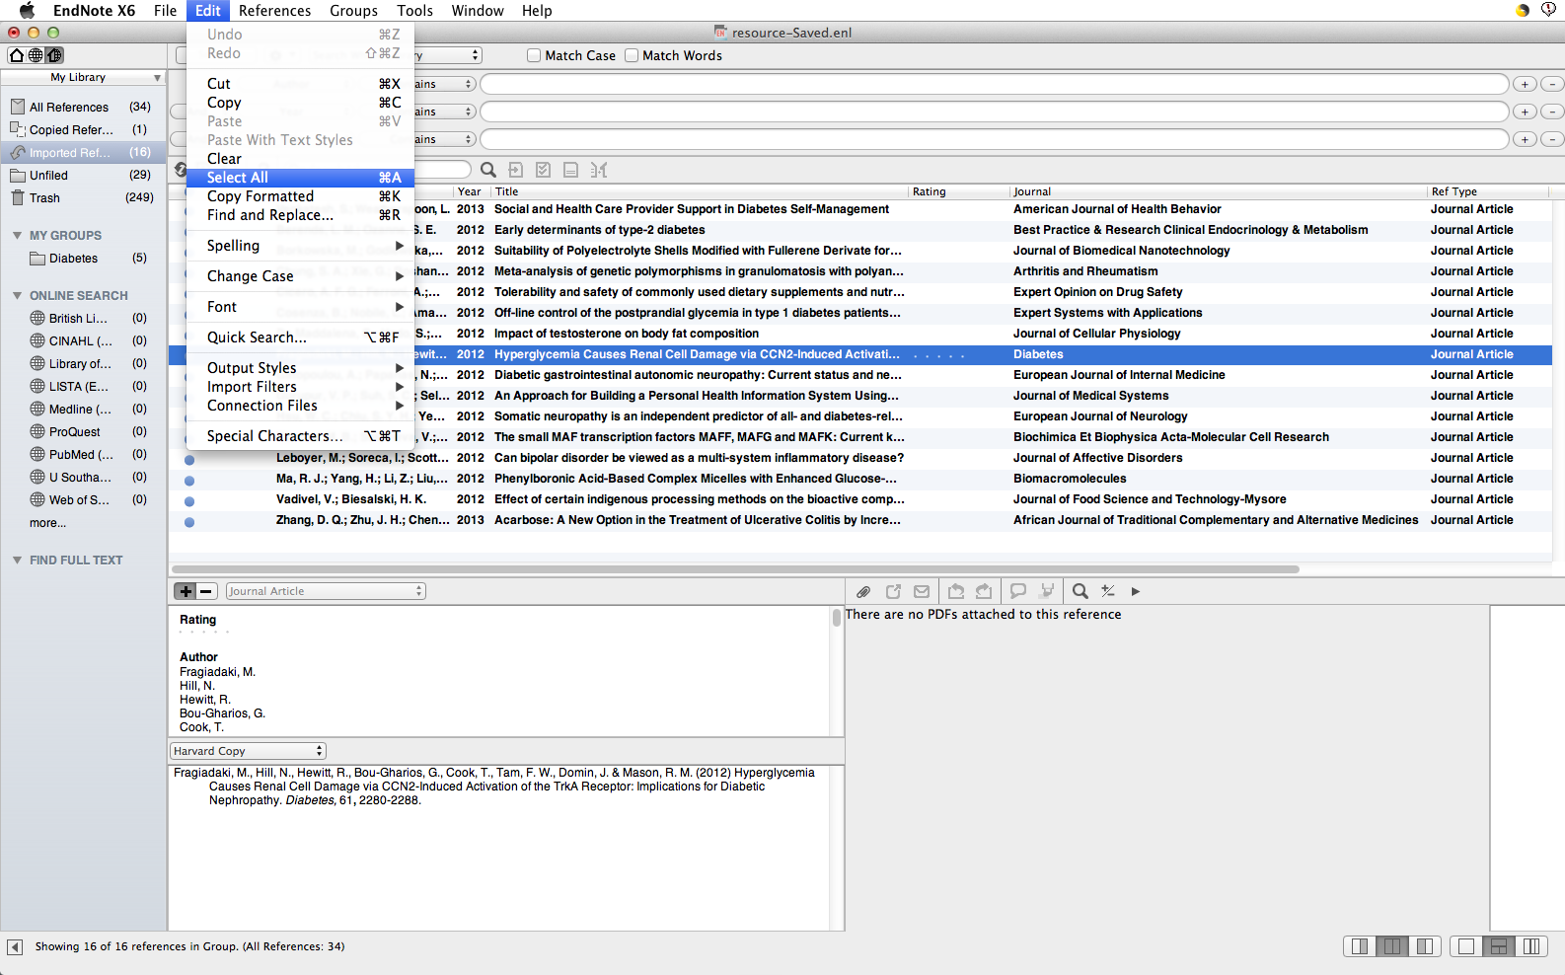
To search the whole library for free full text, select a single item, then go to 'Edit  Select All'
Notes:
The Find Full Text option currently works between EndNote and Web of Knowledge/PubMed to automatically download PDF files and attach these to the EndNote record for any papers which are either publicly available, or supplied free of charge through the database platform. This does not currently include papers from journals for which the university pays a subscription.
To search all records in the EndNote Library, select one entry, then go to Edit, Select All.

Slide 91
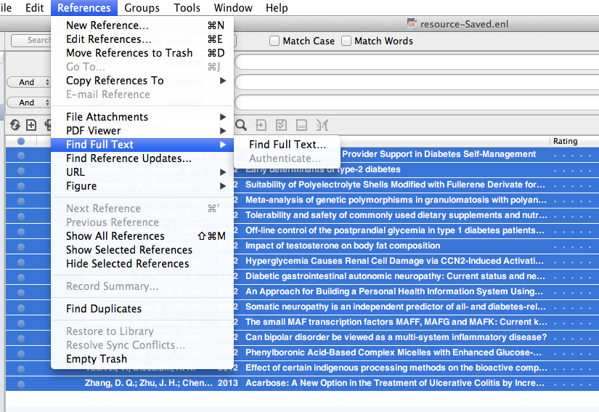
Select 'Find Full Text  Find Full Text …'
Notes:
In the dropdown menu, select Find Full Text, then Find Full Text …

Slide 92
EndNote searches Web of Knowledge for full text and attaches items found to the individual records
Notes:
EndNote works through the library, searching for full text and reports progress in the left hand pane. Any full text PDFs located are automatically attached to the File Attachments field of the individual EndNote record and denoted by a paperclip in the library or group window.

Slide 93
The .pdf file appears in the 'File Attachments' field
Notes:
Access the full text directly from the EndNote Library record.

Slide 94
Attach PDF files to records

Slide 95
Go to 'File Attachments  Attach File…'
Notes:
PDF and other types of file such as word, Excel, graphics, can be attached to the EndNote record, using the File Attachments field. Open the required record.
On the 'References' dropdown menu, go to File Attachments, Attach File.

Slide 96
Notes:
Browse to locate a previously saved PDF file. Click Open.
Note that it is helpful to rename PDF files when saving from online resources so that they can be more readily identified for addition to the EndNote records.

Slide 97
Notes:
The pdf is attached to the record

Slide 98
Notes:
When you close the record you will be prompted to save changes.

Slide 99
Notes:
The pdf is shown in the File Attachments field

Slide 100
Select and drag the PDF file on to the record in main library view
Notes:
If there are a number of records to be updated, it is helpful to save all the PDFs in a single folder and open this window alongside the EndNote Library. Alternatively, transfer the files directly from Current Downloads.
Select the required PDF file and drag it on to the main library record as displayed in the main library view.

Slide 101
The file attachment symbol displays in the record
Notes:
The File Attachment symbol displays in the library window.
In either case, the PDF is added to the File Attachments field.

Slide 102
Use the PDF viewer

Slide 103
Select the required record click to view pdf in new window
Notes:
When a pdf file is attached to an Endnote record, the file name will be shown on the PDF panel. Click the Display icon to view the pdf in a new browser window

Slide 104
Use the PDF toolbar to navigate and annotate the document
Notes:
Use the PDF toolbar to copy, print, scroll through the document pages, magnify or rotate pages.

Slide 105
Highlight sections of the document
Notes:
Sections of the document can be highlighted select and drag over relevant sections, then click on the highlight tool on the PDF toolbar.

Slide 107
Add a sticky note at the selected location
Notes:
Sticky notes can also be attached: click the sticky note icon in the toolbar and then click the insertion point in the document. A timed and dated Notes window displays. Add further comments at any time.

Slide 108
Click to save changes and return to the EndNote Library
Notes:
Click the minimise icon to return to the EndNote library: you will be prompted to change highlight and note changes.

Slide 109
Notes:
Highlights are saved and can be viewed on screen: they will also show if the document is printed.

Slide 110
Use the search function 'PDF Notes' to view sticky notes content
Notes:
Use the search window to search the EndNote library, PDF text or the content of sticky notes.

Slide 111
Search and export from library catalogues

Slide 112
Select 'U Southampton' and click 'Choose'
In the 'Online Search' pane, click 'more'
Use the same procedure for other library catalogues
Notes:
Most library catalogues, including Southampton's own, do not have a bibliographic export facility. However the catalogues can be searched and results downloaded by initiating the search via EndNote. Note that this is a less sophisticated search than those commenced from within an individual database.
To make the connection with the University of Southampton catalogue, in the Online Search section of the lefthand panel, click More…
In the Choose a Connection window, scroll down to select U Southampton and click Choose.
Search catalogues of other libraries in the same way.

Slide 113
The Search tab is now linked to the library catalogue and appears in the Online Search list
Notes:
The new connection will now appear in the Online Search list.
The search tab above the library pane is directed to the selected library catalogue.

Slide 114
Click to carry out the search
Select as many search fields, criteria and search terms as required. More lines can be added if necessary
Notes:
A range of search fields, search criteria and search terms can be selected.

Slide 115
If the number of hits is too large, it may be necessary to refine the search
Click 'OK' to add the retrieved records to the EndNote Library
Notes:
The Confirm Online Search window shows the number of records retrieved. Refine the search if necessary.
Click OK to add the retrieved records to the EndNote Library.

Slide 116
Imported records display as a temporary group and are also added to the main library
Notes:
Imported records display as a temporary group and are also added to the main library.
Double click on any record to view. All fields in the catalogue record will be imported to the EndNote Library.

Slide 117
Use EndNote with Word

Slide 118
Insert citations in a document

Slide 119
Use EndNote with Word
The EndNote toolbar is displayed in Word
Move from the Word document to the Endnote library
Insert citations from either toolbar
Notes:
Always open EndNote first and then Word. This causes the EndNote tab to display in Word. The CWYW option must be enabled in EndnoteX6 Customizer
Some icons occur on both toolbars allowing operation from either window.
The icon with the red down arrow/grey right arrow is used to insert citations, and CWYW Tools to manage the bibliography.

Slide 120
Click the EndNote icon to go to the EndNote Library
Identify the point in the text to insert a citation
Notes:
EndNote inserts citations and creates a simultaneous bibliography at the end of the text. It is helpful to insert a page break.
In the Word document, select the point in the text to insert the reference.
Go to EndNote to select the required reference.

Slide 121
Insert the reference from this toolbar
Click to highlight the required reference
Notes:
Click to highlight the required reference in the EndNote Library.
Click the right arrow on the EndNote toolbar and then return to Word automatically.

Slide 122
… or return to Word and click to insert the citation
The citation is displayed in the text, with the full reference at the end
Notes:
Alternatively, return to Word and click the red down arrow on the EndNote toolbar there.
The citation is inserted at the selected point in the text, and a full bibliographic record created at the end of the document.

Slide 123
A document citation folder is created
Notes:
EndNote creates a new folder of references cited in the current document.

Slide 124
Citations and references are displayed according to choices made within the edited reference style
Notes:
Multiple references can be inserted at a single point in the text: locate the cursor immediately to the right of the close bracket then select the reference from the EndNote library as before.
The citation will be included within the brackets and the full reference at the appropriate location in the end of document bibliography. Note that the sort order for citations and bibliography is determined by editing parameters in the referencing style.

Slide 125
Edit citations

Slide 126
Click in the citation to highlight and then go to 'Edit and Manage Citations'
Notes:
The common forms of editing are to add page numbers to a citation, to remove author and/or year from a citation, or to remove a citation altogether.
It is essential that all these changes are made using the relevant EndNote tools, so that linked field codes are also amended. Click in the citation to highlight it, then go to Edit and Manage Citations.

Slide 127
Highlight the specific citation
Change selection to remove author or year from the citation or show only in the bibliography
Click OK to complete the action
Notes:
Highlight the specific citation to be edited in the top panel.
To include an item in the bibliography without citing in the text, insert in the document, and then edit the citation to Show Only in Bibliography. Click OK. The citation disappears from the text but remains in the bibliography. This is useful for example for an edited book, where individual chapters by different authors are cited in the document. There is also an option for Author (Year) format in the text if required.

Slide 128
To remove a reference from the document, go to 'Tools' and 'Remove Citation'
Notes:
To remove a record completely, go to Tools, select the reference to be removed, click Remove Citation and then OK.
Both the citation and the full reference are removed from the document. Note that if the same source is cited elsewhere in the document, it will not be removed from the bibliography.

Slide 129
The citation and end of text reference are removed from the document
Notes:
The citation (and reference if not cited elsewhere) is removed together with hidden field codes.

Slide 130
To add page numbers to a citation, type the exact letter string required in the SUFFIX box, then click 'OK'
Notes:
To add page numbers to a citation, use the same Edit & Manage Citations tool. Select the required citation, then type the exact letter string, including any required leading/following spaces in the Suffix box, note, not in the Pages box. Then click OK.

Slide 131
The suffix text is attached to the citation
Notes:
The suffix text is added to the citation.

Slide 132
Manage the bibliography layout

Slide 133
Go to 'CWYW Tools'  'Bibliography Settings…'
Notes:
Use the CWYW Tools drop-down menu. Choose Bibliography Settings.

Slide 134
… or remove the hanging indent
Insert a line space between references if required …
Click OK when all choices have been made
Notes:
Use the Layout tab. This window lets you manage indents, the line spacing within a reference, and the line spacing between references.
To insert a single space between references, go to the Space after drop down list and choose Single
Remove the hanging indent by changing to 0cm. Click OK when all choices have been made.

Slide 136
Get more help
Find library guides (Word and Presenter) for PC and Mac at
http://www.soton.ac.uk/library/infoskills/bibliographic/endnote/endnotetraining.html
www.edshare.soton.ac.uk
EndNote Help pages
Contact libenqs@soton.ac.uk

