Slide 1
Security
COMP6017 Topics on Web Services
Dr Nicholas Gibbins – nmg@ecs.soton.ac.uk
2012-2013

Slide 2
Overview
Background
  Primary network security issues
  Cryptographic fundamentals
  Well known security protocols
Web Services security specifications
  For primary network security issues
  Federation and single sign on
  Other Related specifications
Conclusion

Slide 3
Background

Slide 4
Primary network security issues
Confidentiality – messages exchanged across network remains private
Integrity – contents of messages are not modified while in transit
Authentication – determining the identity of entities involved in message exchanges
Authorization / Access control – determining the resources that an entities are allowed to access and in what manner
Non-repudiation – ensures that parties cannot deny having sent messages.

Slide 5
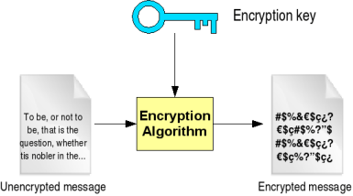
Encryption
Addresses confidentiality
Uses an encryption algorithm and an encryption key
For a given plain text message, encrypted version will differ for different key sequences

Slide 6
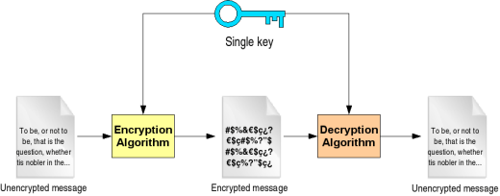
Symmetric encryption
Same key used for encrypting and decrypting
Fast and simple to implement
Both sender and receiver must agree on same key
Examples: 3DES, AES, RC4

Slide 7
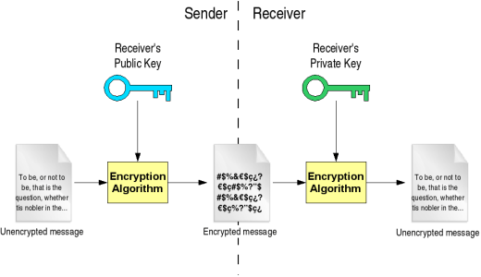
Asymmetric encryption
Two types of keys: public and private
Private key only known to entity, public key is distributed
Encryption by public key, decryption by private key or vice versa
Generating public key from private key computationally trivial, but not vice versa
Not as efficient as symmetric encryption

Slide 8
Digital signatures
Most common use for asymmetric encryption
Piece of data attached to a message to guarantee integrity
Involves the use of digests and hashing functions
  A hashing function takes data as input and produces a smaller piece of data (digest) as output
  If original input data changes slightly, digest is different
Assurances:
  Message had been created/accessed by the holder of the private key (authentication)
  Holder of private key cannot deny having created/accessed the message which has been signed (non-repudiation)
  Message has not been tampered with (integrity)
  Does not provide confidentiality as message is sent in the clear
Example algorithms: RSA, DSA, ECDSA

Slide 9
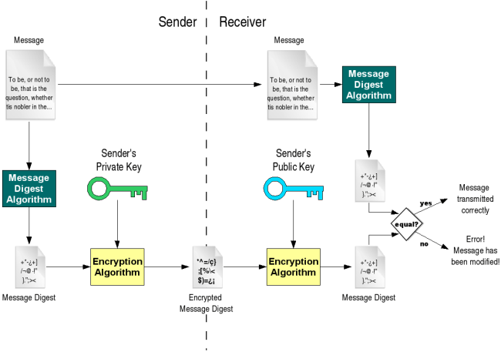
Digital signatures

Slide 10
Certificates and Certificate Authorities
For authentication, need to guarantee public key corresponds to correct private key
Certificate is a digital document that certifies a public key belongs to a specific user with an identity
Certificate is signed by a trusted third party – Certificate Authority (CA) with its private key
Public key of CA distributed widely in standard applications (e.g. Web browsers)
Well known CAs: Verisign, Thawte, GlobalSign

Slide 11
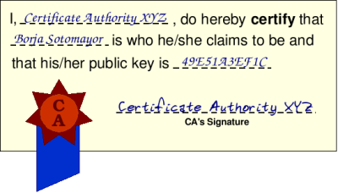
Digital Certificate

Slide 12
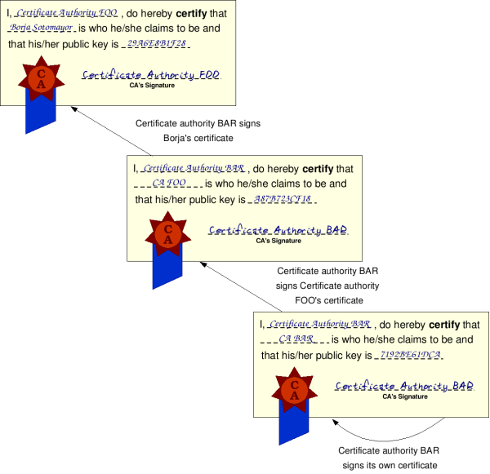
Hierarchy of CAs
Root CA

Slide 13
Public Key Infrastructure (PKI)
Infrastructure through which certificates are managed
Involves:
  Generation of new certificates and private keys
  Storage of certificates
  Distribution
  Revocation
  Archival

Slide 14
Public Key Infrastructure (PKI)
Widely used standard for certificates in PKI: X.509 v3
  User identities are represented as Distinguished Names (DNs)
  These include: Organization (O), Organizational Unit (OU), Common Name (CN), Country (C)
  Example: O=University of Southampton, OU=Department of Electronics and Computer Science, CN=Mr Anderson

Slide 15
Web Services Security Specifications

Slide 16
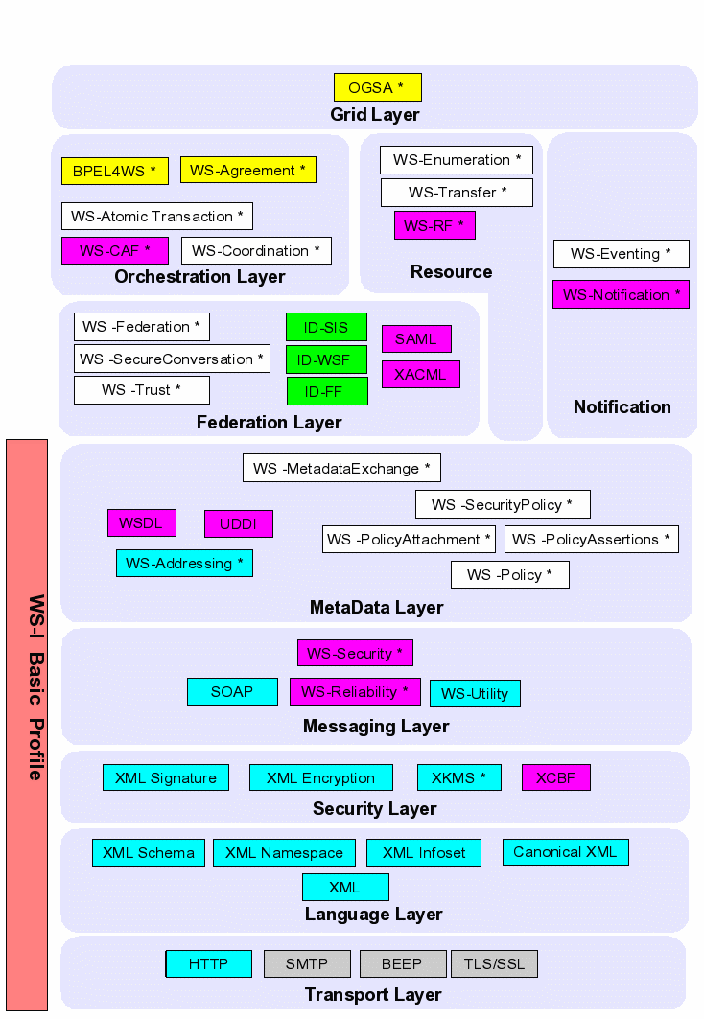

Slide 17
Web Services security specifications
WS-Secure
Conversation
WS-
Federation
WS-
Authorization
WS-Policy /
WS-Security Policy
WS-Trust
WS-Privacy
WS-Security
SOAP Foundation
Standards
Body
Published
Specs
Unpublished
Specs

Slide 18
WS-Security (WSS)
Defines a format for including security tokens and mechanisms to protect SOAP messages
Supports signatures and encryption, based on W3C XML-Encryption and XML-Digital Signature standards
  XML-Digital Signature needs canonicalization (i.e. standard form for different but logically equivalent XML documents)
  XML-Encryption applied on contents of SOAP ssmessage – message level encryption (as opposed to SSL).

Slide 19
WSS in SOAP
WSS information stored in SOAP security header
One or more security tokens carried in header to identify the transaction
XML Signature blocks provide integrity and link the identity to the transaction
  Key information within the security token may be used
Privacy provided using XML encryption
SOAP Envelope
SOAP Header
Security Header
wsse:
security token
key info
SOAP Body
signature
Message
Body

Slide 20
WSS Security Tokens
Username/password
Binary Security Tokens
  X.509 certificates
  Kerberos tickets
XML Tokens
  SAML
  XRML

Slide 21
WS-Trust
Defines how to request and issue security tokens
A Security Token Service (STS) issues tokens that can be used in WSS
Token issuance, exchange and validation are handled by an STS
The services of an STS may be required by web services and their clients
Examples of STS:
  CA (PKI)
  KDC (Kerberos)

Slide 22
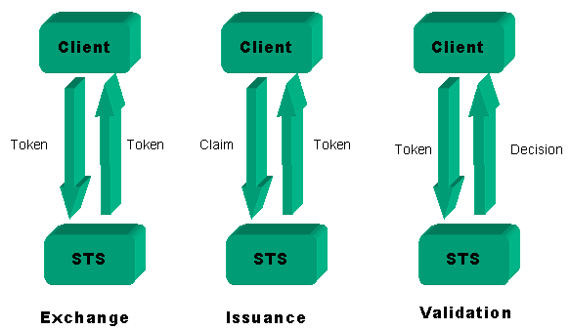
STS in WS-Trust
A Security Token Service allows:
Token Exchange
Token Issuance
Token Validation

Slide 23
Request-challenge operation
Client
STS
Client requests token from STS
STS sends a challenge to Client
Client sends an answer to STS
STS sends token(s) to Client

Slide 24
WS-Policy
Framework for defining policies that affect web services
Policy is defined as a series of assertions
Each has a usage (required, optional, rejected etc) and preference (ranking of this assertion)
  WS-PolicyAttachment describes how policies are associated with a resource (WSDL definition, UDDI entity, etc)
  WS-PolicyAssertions defines a common set of assertion types

Slide 25
WS-Policy
Establishes a mechanism for exchanging requirements between a web services provider and client
Provides machine readable policy statements that describe the operational parameters for interactions between a service and a client
Supports negotiation of the parameters defined within a policy

Slide 26
WS-SecurityPolicy
Defines policy assertions for the security properties for Web services.
Designed to represent the characteristics defined in WSS, WS-Trust and WS-SecureConversation
Looks at assertions that represent common ways to describe how securing messages on a communication path.
Leverage the WS-Policy framework as far as possible

Slide 27
WS-SecurityPolicy
SecurityToken identifies
  Types of security tokens accepted
  Issuer of the token
  Optional details about particular token types (e.g. what set of user names are supported)
Integrity
  What parts of a message are signed
  XML signature algorithms used
  Parameters defining how the algorithm should be executed

Slide 28
WS-SecureConversation
Targets performance issues
Uses security context idea in SSL / TLS
  First establish security context via handshake protocol
  Use security context for subsequent interactions
  E.g. use public key encryption to exchange secrets to initially establish secret key, then use secret key for encrypting and integrity
Eliminates the overhead of carrying and validating authentication information in each message through mutually authenticated security context

Slide 29
WS-SecureConversation
Like SSL, it provides a session oriented authenticated and encrypted data pipe
Creates an end-to-end secured channel at the application layer unlike SSL (restricted to point-to-point sessions between intermediate nodes)

Slide 30
Extensible Access Control Markup Language
XACML describes both an XML-based authorization policy language and a request/response language.
  The policy language is used to express authorization policies and rules
  The request/response language expresses queries about whether a particular access should be allowed (requests) and describes answers to those queries (responses).
Support of role based access control

Slide 31
Extensible Access Control Markup Language
XACML provides for fine-grained control of activities (such as read, write, copy, delete) based on criteria like:
  Attributes of the user requesting access (e.g., "Only division managers and above can view this document.")
  The protocol over which the request is made (e.g., "This data can be viewed only if it is accessed over HTTPS.")

Slide 32
XACML rules
The language and schema support include data types and functions, which allow complex rules to be defined
Combining logic to combine rules in different ways to provide response to an access control request
Request
Response
Rules
1. Bob can read file X
2. Anyone from group Admin can read file X
3. Anyone from group Users cannot read any files
Rule combining logic: Ordered-permit-overrides
Alice (belonging to group Users and Admin) wants to read file X
Permit

Slide 33
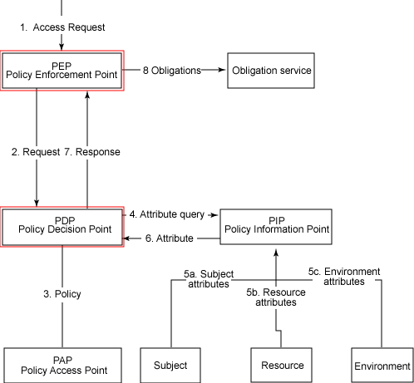
XACML architecture

Slide 34
Example Scenario

Slide 35
Tying it together - Example scenario
Requirements
  Encryption – to protect messages, particularly credit card details
  Non-repudiation – ensure buyer cannot deny making an order
  Authentication – all entities must be sure of their identities before exchanging information
  Access control – ensure specific types of buyers are only permitted to make specific types of orders
1. Purchase order
2. Stock check
Buyer
Company
Supplier
4. Invoice
3. Credit check
Bank

Slide 36
Example scenario
STS B (Kerberos)
WS-Trust
WS-Trust
WS-Security: Encryption (card details)
WS-Security: Signature (order)
WS-SecureConversation
1. Purchase order
2. Stock check
Buyer
Company
Supplier
4. Invoice
XACML
WS-Policy / WS-SecurityPolicy
WS-Security: Signature (invoice)
WS-Trust
3. Credit check
WS-Trust
WS-Security: Encryption (card details)
STS A (CA)
Bank

Slide 37
Federation
Each security infrastructure has scope of management in terms of participant and resources – security domain
Examples:
  multiple root CAs in a PKI; certificates with different root CAs cannot trust each other.
  online accounts with Ebay and Amazon; each account has different login credentials and identity information
Useful to share security information (e.g. identity, attributes) between different domains to allow flexible use of applications that access resources across domains

Slide 38
Single Sign On (SSO)
Basic idea is to sign on once (e.g. username/password) and gain access to resources in different domains
Targets ease of application use when performing a transaction with inter domain access as part of a cross enterprise integration

Slide 39
Single Sign On (SSO)
Examples:
  planning a trip at a tourism site requires interaction with an airline, hotel and a car sites; all in different domains
  shopping portal that provides a front end to various vendors
Usually relies on federation of identity in some manner
  Identity information can be centralized (e.g. Microsoft Passport)
  Identity information can be distributed and maintained independently by each domain administrator
For second case, there needs to be mechanisms for sharing and managing identity information between domains

Slide 40
Security Assertions Markup Language
An XML-based specification that provides a common language for three kinds of assertions:
  Authentication assertions: declarations about a user's identity
  Attribute assertions: declarations about a user's details (credit line, citizenship, etc)
  Authorization decision assertions: specify what the user is allowed to do at a particular site

Slide 41
Security Assertions Markup Language
Assertions are issued by SAML authorities:
  authentication authorities
  attribute authorities
  policy decision points.
Primary specification used for communication between different domains in the Web Services world for SSO and federated identity management

Slide 42
SAML
SAML defines a request/response protocol which defines the way that SAML requests and receives assertions.
While SAML makes assertions about credentials, it doesn't actually authenticate or authorize users.
When a subject (person or computer) successfully requests access to a protected resource, a SAML authority issues a digitally signed token that the subject can use for further requests without re-authenticating within any domain that trusts the issuer of the token.
Some overlap with XACML (authorizations)

Slide 43
SAML bindings and profiles
This is where SAML itself gets made secure
  A binding is a way to transport SAML requests and responses
  SOAP-over-HTTP binding is a baseline
A profile is a pattern for how to make assertions about other information
  Web browser profile for SSO
  SOAP profile for securing SOAP payloads

Slide 44
WS-Federation
Primary goal is to enable federation of identity, attribute, authentication, and authorization information.
Brokering of trust and security token exchange
Describes how models defined in WS-Security, WS-Trust and WS-Policy can be combined and extended to support federation
  Extends the WS-Trust model to allow attributes and pseudonyms to be integrated into the token issuance mechanism
  Tokens issued by one domains STS are used to request a new security token from the STS of another domain
Uses SAML in certain standards (Liberty Alliance)

Slide 45
WS security related specifications
WS Authorization
  Defines security tokens for authorization
  Defines how Web services manage authorization data and policies.
WS Privacy
  Specifies privacy policy dictating the nature and use of information
  Related to WS Policy

Slide 46
Extensible Rights Markup Language
Used for specifying and managing rights and conditions associated with all kinds of resources including digital content as well as services
Intended to accelerate digital content distribution and Web Services initiatives by enabling interoperability in the distribution value chain for digital goods or services
Supports standards such as XSLT, XPath, XML Signature and XML Encryption for authentication and protection of the rights expressions

Slide 47
Extensible Rights Markup Language
Rights and conditions can be securely assigned at varying levels of granularity to individuals as well as groups of individuals
Example of XrML rules:
  Consumer can view film 6 times within 6 months
  Consumer can view any content in super subscription plan for 1 month
  Consumer can listen to audio track X on the devices P, Q, R.
  Content Owner can define distributors and their respective rights on the content

Slide 48
XML Key Management Specification
Defines concrete operations for key management operations in a PKI through a WS interface
Two main protocols
  XML Key Information Service Specification (XKISS) - used for obtaining cryptographic key information and validating bindings between keys and names
  XML Key Registration Service Specification (XKRSS) - used for registration of keys, as well as revocation and recovery.
Some functionality overlap with WS-Trust
  WS-Trust = XKISS + other things (Kerberos, etc)
  WS-Trust does not do XKRSS

Slide 49
Summary
Confidentiality – WSS (encryption), WS-SecureConversation
Integrity – WSS (signatures, encryption, Kerberos), WS-SecureConversation
Authentication – WSS (signatures, encryption, Kerberos, usernames), WS-SecureConversation, SAML
Authorization / Access control – SAML, XACML
Non-repudiation – WSS (signatures)
Federation / SSO – SAML, WS-Federation, WS-Trust

Slide 50
Conclusion
Many standards, sometimes overlapping functionalities. E.g. SAML / XACML, WS-Trust / XKMS
Modular architecture, standards designed to build on top of each other
Federation is likely to be the next big driver in the area of emerging standards
Performance is still an issue; public key technologies incur significant cost
However, Web Services without security is dead on arrival !

