Slide 1
Professional and Legal Issues Academic Integrity in an Ethical Context 2012-13 INFO2009 (Professional and Legal Issues) http://www.edshare.soton.ac.uk/6003/
Su White (saw)
Notes:
First half includes activities for students to help them understand the scope of the module, and to think about how they will make it part of their

Slide 2
Plan for today
Independent Study
Academic integrity tutorial – W3
Academic Integrity in an Ethical Context
Academic integrity in the bigger picture
Professional Integrity

Slide 3
Another view

Slide 4
Review: Assessments
Prepare an annotated bibliography 10%
Produce and present a resource 45%
Complete a stage test 20%
Answer a case study 25%
See https://secure.ecs.soton.ac.uk/module/1213/INFO2009/for details

Slide 5
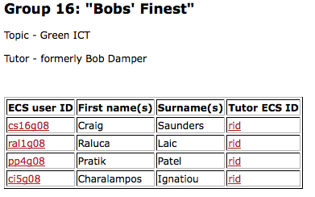
Review: task – wiki edit
You did it… mostly ;-)
Leave the number part empty

Slide 6
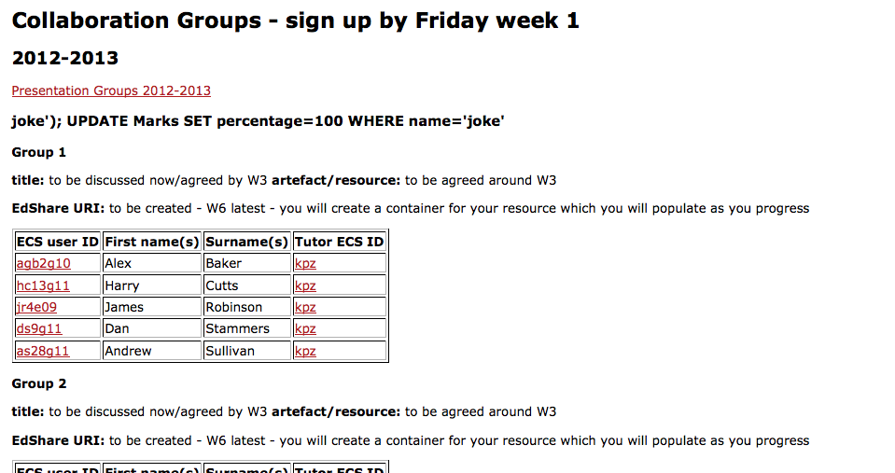
Can you move them onto the sub page please!
Well done to the one set of folk who did!

Slide 7
What I really want ☺

Slide 8
What we got – mostly there
https://secure.ecs.soton.ac.uk/module/1011/INFO2009/wiki

Slide 9
This week…
Independent Study
http://www.ait.ecs.soton.ac.uk/

Slide 10
expectations
You can expect to find some questions relating to independent study activities in the stage test
Understanding of Academic integrity is something which is very easy to include in an online multiple choice question test
You are strongly advised to find time for this activity ☺

Slide 11
University Resources

Slide 12
Look at the scenarios
http://www.edshare.soton.ac.uk/3493/

Slide 13
Academic Integrity links
Academic Integrity
Read the general guidance http://www.studyskills.soton.ac.uk/integrity/
Work through the ECS academic integrity tutorial http://www.ait.ecs.soton.ac.uk/
See the rules and regulations http://www.calendar.soton.ac.uk/sectionIV/academic-integrity-procedures.html
They are also explained in the ECS student handbook https://secure.ecs.soton.ac.uk/ug/handbook/0809/SectionA07DM3.doc

Slide 14
An ethical context
Academic integrity in the bigger picture
Professional Integrity
Codes of conduct

Slide 15
Scenario: group discussion
You discover a fellow student has been using rent a coder to solve programming assignments
What are their possible motivations?
How would you describe this person's character?
How would you describe this person's capabilities?
What kind of employee do you think this person will be when they enter the professional workplace?
What would or could you do? Does your group agree?

Slide 16
Sophocles…
Rather fail with honour than succeed by fraud

Slide 17
Dishonesty in the workplace
There are many different types of potential dishonesty in the workplace
In your groups (2/3) write a list (interim feedback/check options)
Rank the activities in order (least to most offensive)
What makes things appear least offensive?
What makes things appear most offensive?
Can you identify any flaws in this type of argument?

Slide 18
Where next?
We will return to personal ethics and the workplace later in the course
when we look at workplace contexts
Law which protects those who report crimes and misconduct (whistleblowing, industrial tribunals)
Codes of conduct which guide workers (BCS, IET)
Organisations which provide legal support for workers (trades unions)

Slide 19
Thank You :-)
Over the next week
Think about
the topics which are within INFO2009
For your bibliography
For your group project
Careers Fairs
Internships and other vacation employment

Slide 20
For ref...

