Slide 1
Semantic Web and Web2.0
Dr Nicholas Gibbins – nmg@ecs.soton.ac.uk
2011-2012

Slide 2
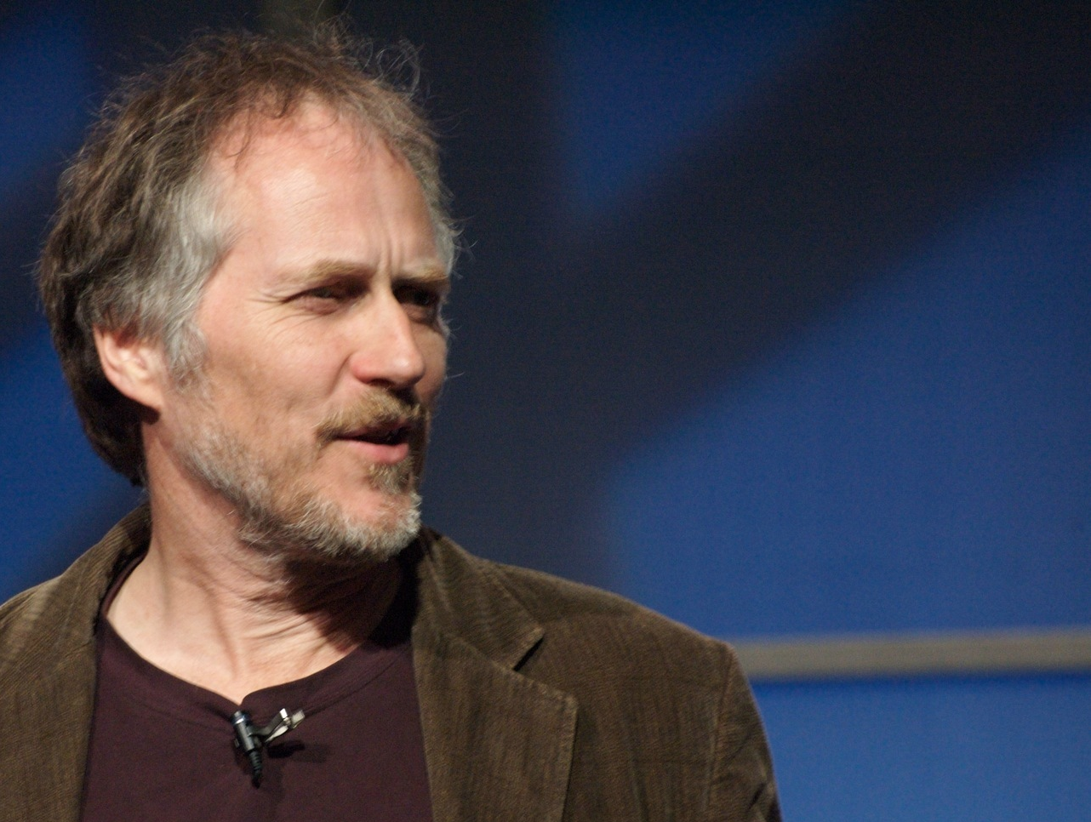
Web 2.0 is the business revolution in the computer industry caused by the move to the internet as platform, and an attempt to understand the rules for success on that new platform.
Chief among those rules is this: Build applications that harness network effects to get better the more people use them
Tim O’Reilly, 2006
http://www.fotopedia.com/items/flickr-2309701375

Slide 3
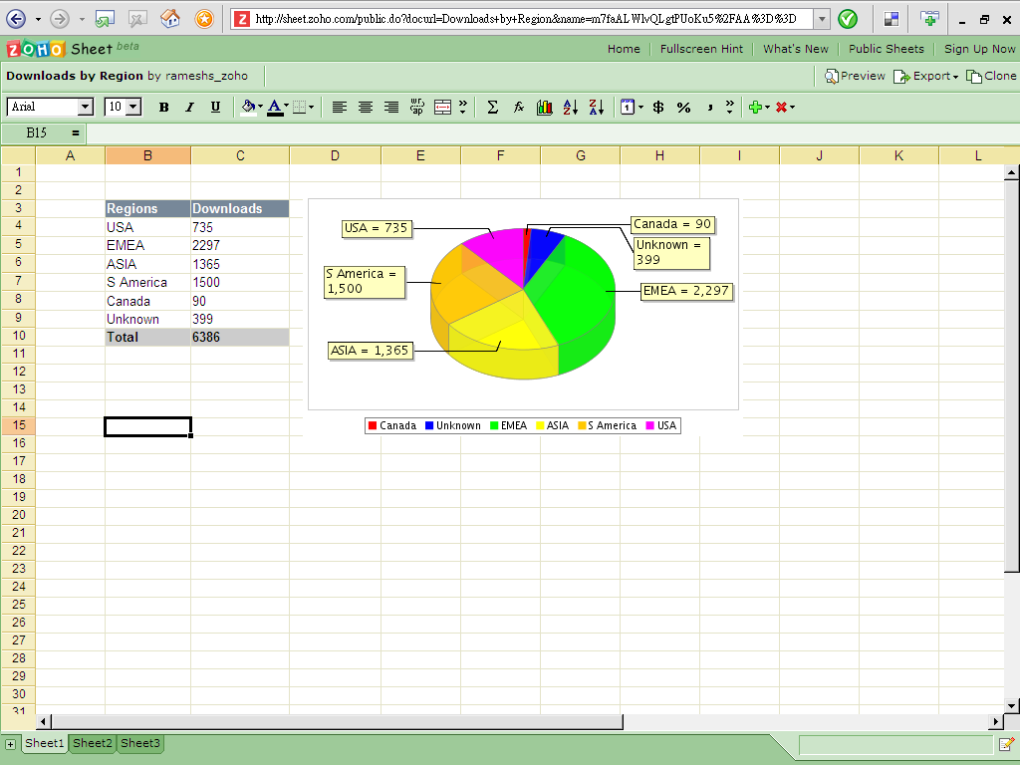
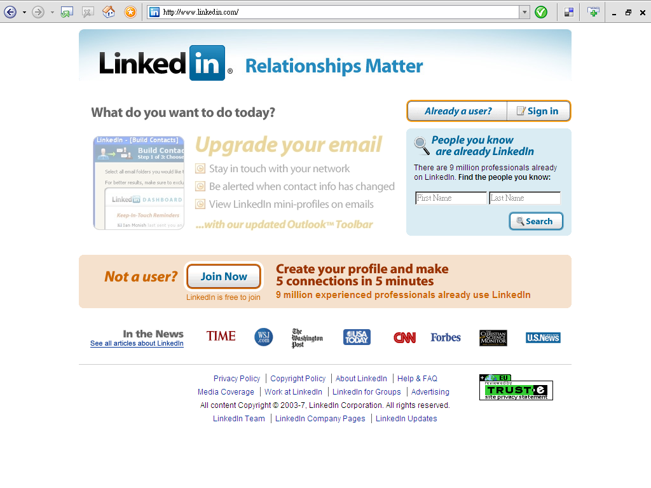
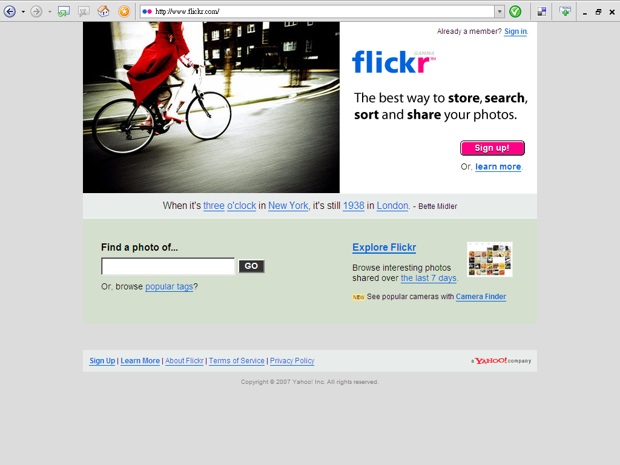
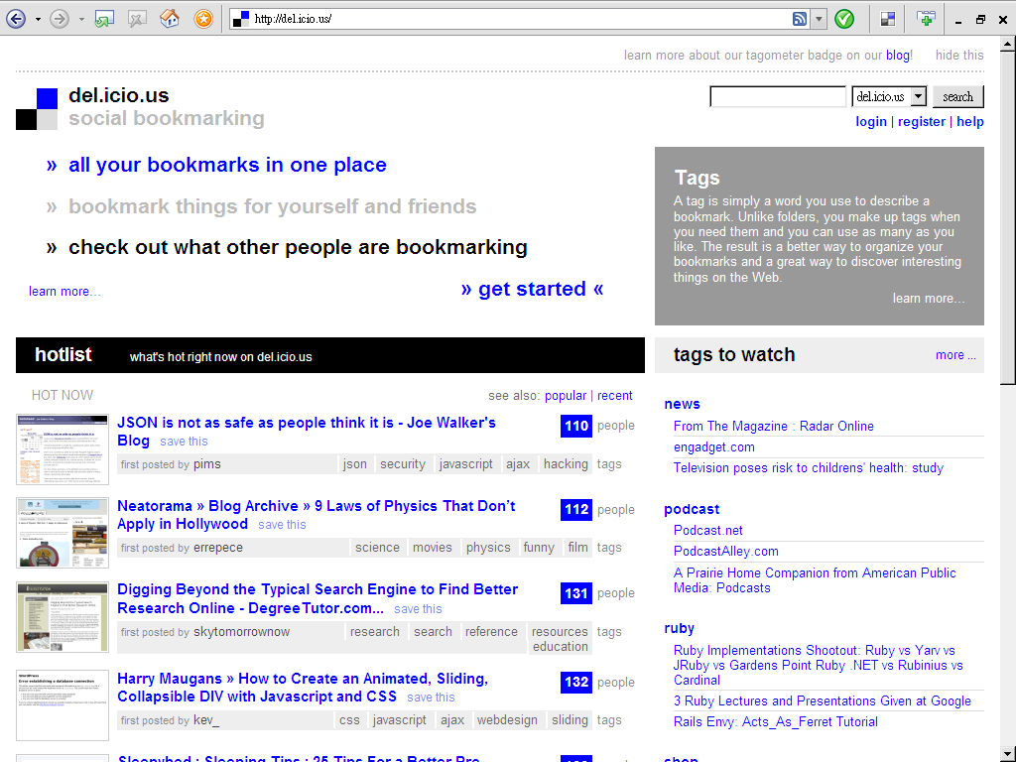
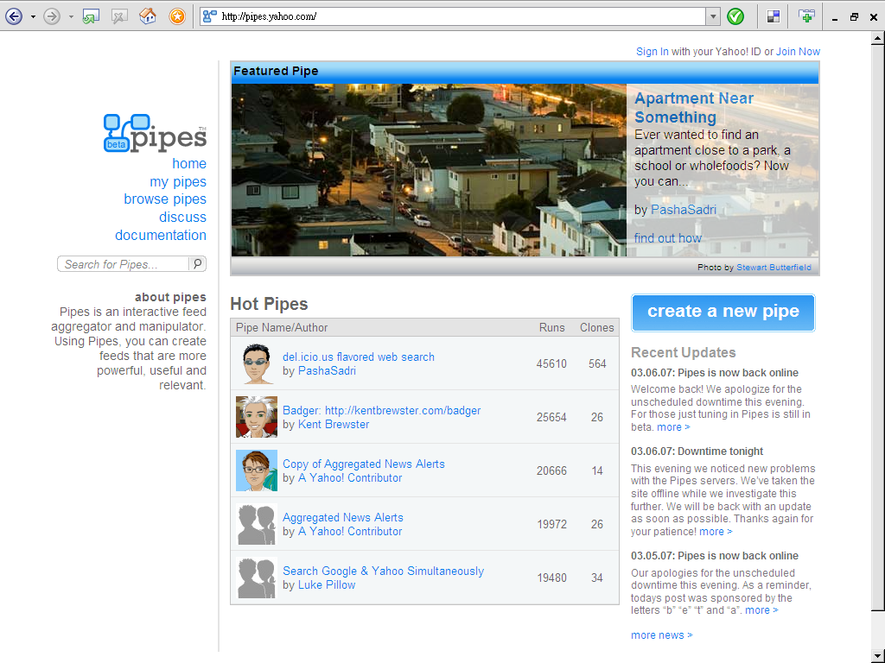
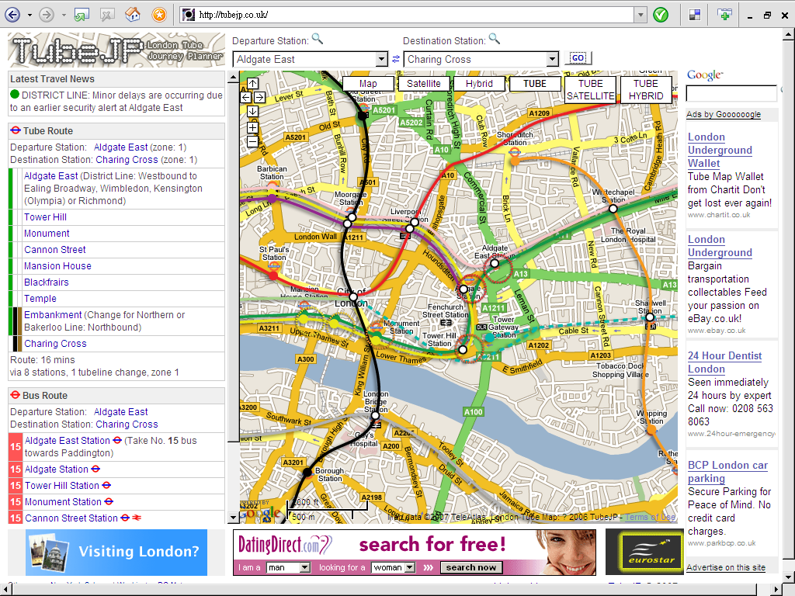
Characteristics of Web2.0
Enhanced user interface, experiences
  Use of AJAX, software in the Web browser
Linking people, forming communities
  Social networking sites, online sharing of resources
Organizing resources
  Social tagging, Flickr, Yahoo Pipes, etc
Mix and merge of the real and virtual
  Mashups, Google Maps

Slide 4
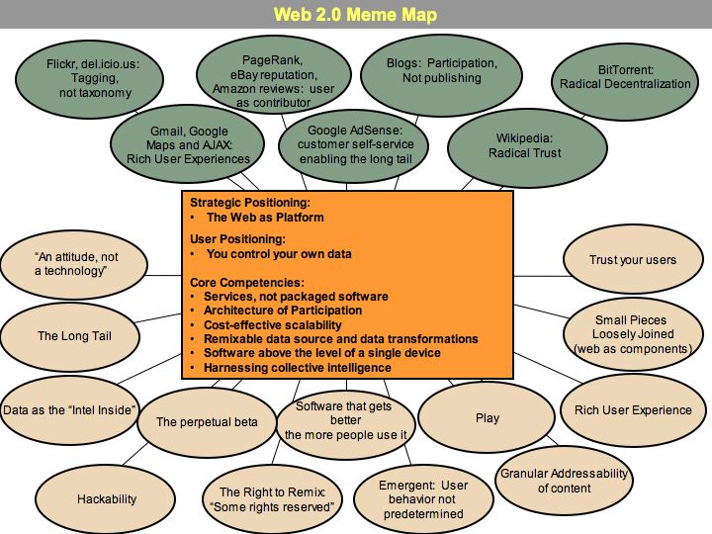

Slide 5
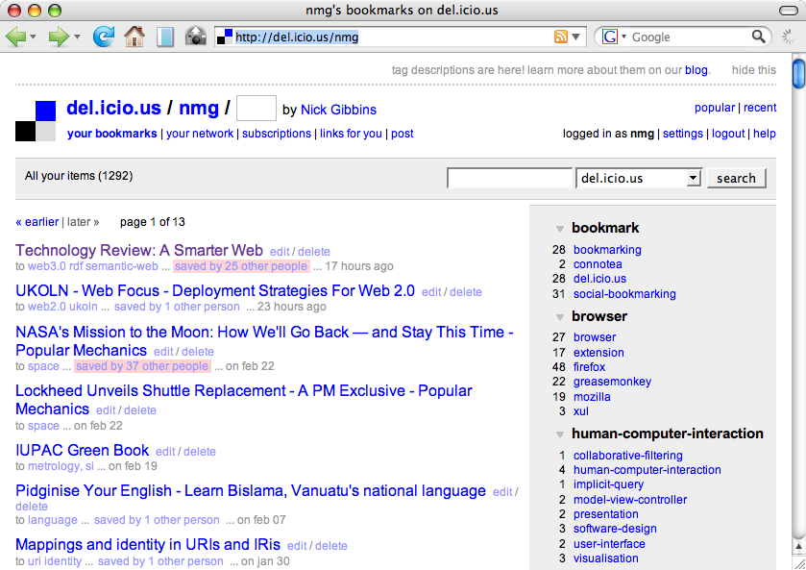
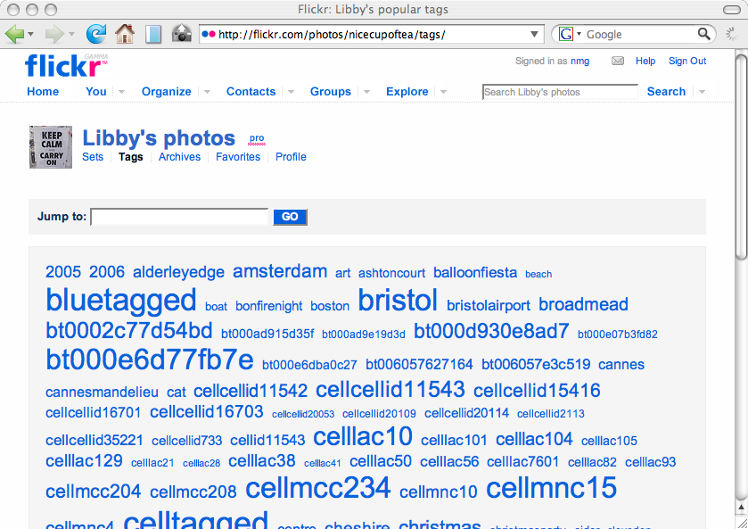
Tagging, not taxonomy
Resources described by bags of keywords
  “nyc, www2004, libby miller, posters”
  Vocabulary is not controlled
Cheaper annotations – users more likely to annotate resources
Notes:
Source of friction with Semantic Web community
No hierarchy or explicit relations
Ambiguity (SF = San Francisco or Science Fiction?)
Death of the META tag
Rarely truthful, ignored by search engines

Slide 6
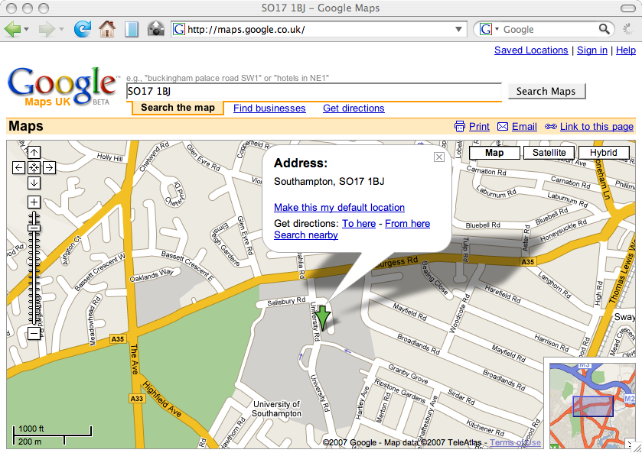
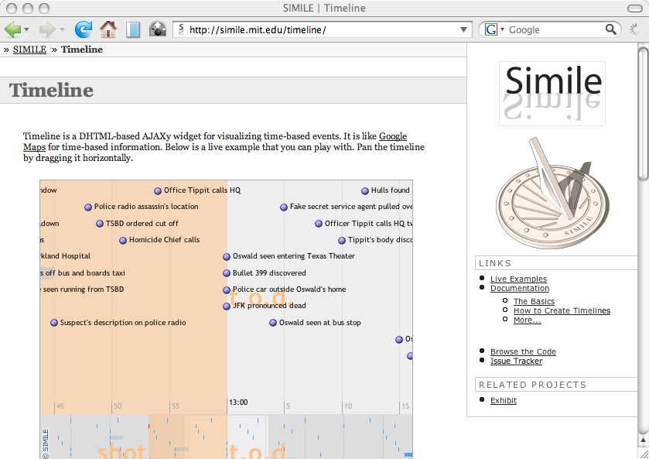
Rich User Experiences
AJAX: Asynchronous JavaScript and XML
  Googlemaps, GMail
  More responsive interfaces
  Richer interaction (beyond the click)
Notes:
New term for old ideas
Thick clients (a reaction against thin web clients?)
Potential issues with accessibility

Slide 7
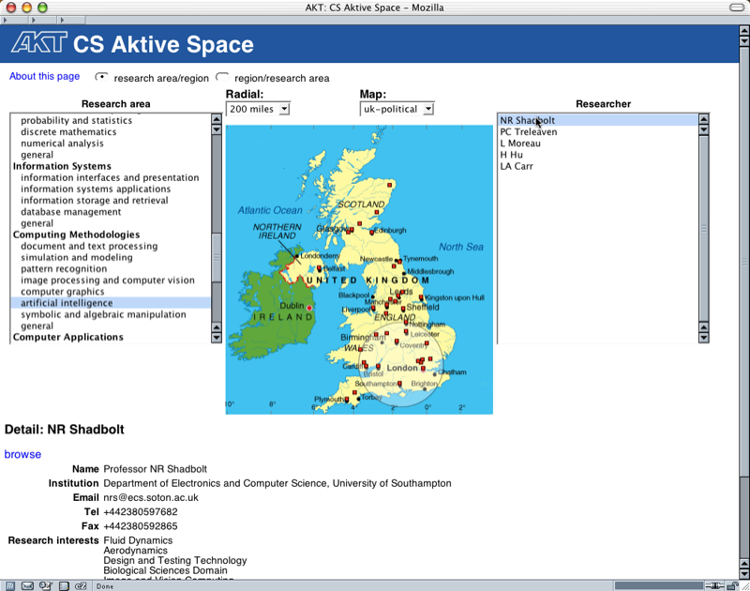
Notes:
CS AKTiveSpace was AJAX before AJAX existed

Slide 8
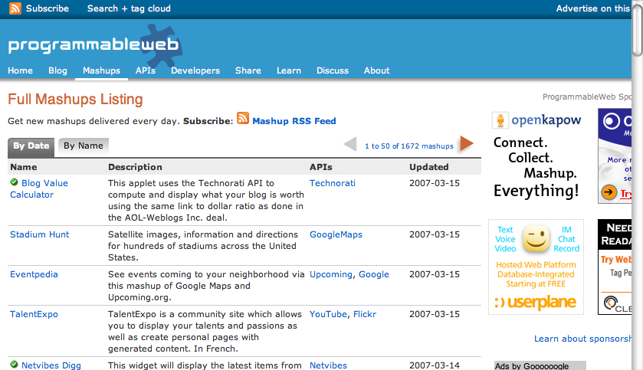
Radical Decentralisation
Decentralisation of resources and processing
Peer-to-peer computing (remember that?)
Application components on Web
Service orientation
Open APIs allow service reuse in unexpected ways
  Remixes, mashups and hackability
Notes:
Fits in well with our existing research agenda
Agents
Grid Computing

Slide 9
User as contributor
User-written material forms basis for community websites
  eBay feedback
  Amazon reviews
Rich-get-richer behaviour
  The more people that contribute to a website, the more useful it is to you
  Social bookmarking
  Recommender systems
Notes:
Likely to encourage a small number of large websites

Slide 10
Enabling the Long Tail
Amazon sells more minority books than mass-market bestsellers
Small sites make up the bulk of the Web
  DoubleClick used by large corporate sites
  Google AdSense aimed at small sites

Slide 11
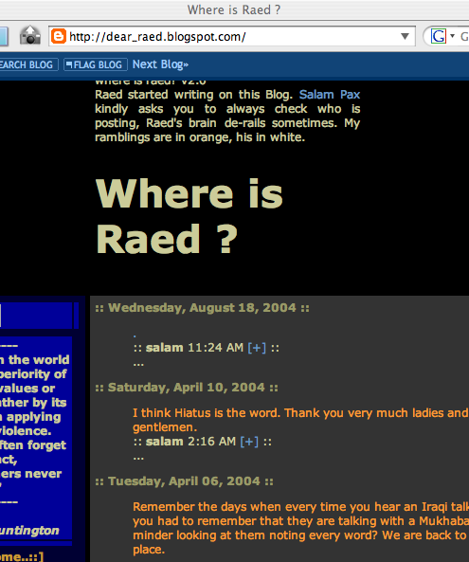
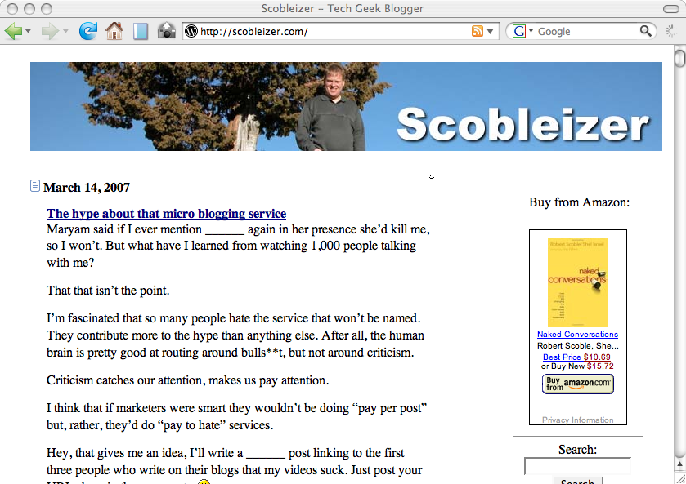
Participation, not publishing
The rise of the blogosphere
Publishing in a social context
  Feedback and comments from readers
  Ongoing polylogue
Some high-profile successes
  Blogs vs traditional news media (Iraq war, etc)
  Grass-roots political blogging
Notes:
Everyone’s got a blog
50 million blogs and nothing’s on
Sturgeon’s Law
“l'enfer, c'est les autres”

Slide 12
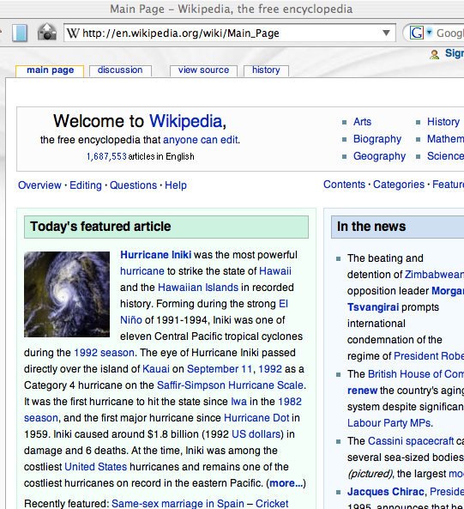
Radical Trust
No controls on authorship
Everyones an author/editor
“With enough eyeballs, all bugs are shallow”
Content becomes trusted because (it is assumed that) many people have vetted it
Notes:
Mobs are more knowledgeable than experts?
Sufficient provenance for trust?
High-profile Wikipedia scandals

Slide 13
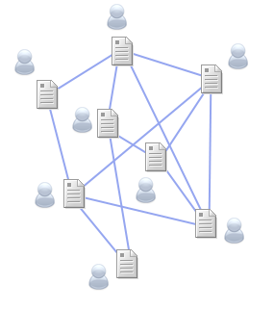
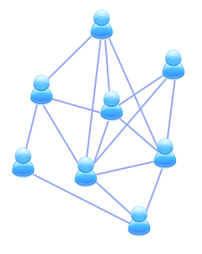
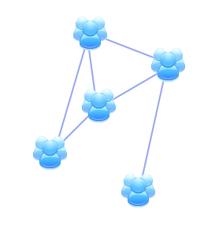
Changing links
Linking Documents
Linking Users
Linking Communities

Slide 14
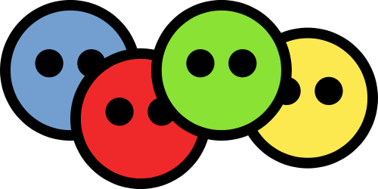
Social applications
Harnessing the network effect
Distinct functionality/Social groups/Domains
  Wikipedia: building an open encyclopedia
  Flickr: sharing photographs
  Facebook: meeting new people and keeping in touch with friends
  Last.fm: finding new music
  Deli.cio.us: sharing bookmarks
Notes:
This is what he calls harnessing collective intelligence …
Semantic Web was here before all of the above! (FOAF)

Slide 15
The Personal and Social Dimensions
 | Personal | Social
Blogs | Publish one’s own thoughts and opinions | Understand each other’s thoughts and opinions
Tagging | Organize in one’s own way | Understand how other people organize things
Social Network | Present oneself on the Web | Identifying common interests and topics
Sharing | Present one’s interest and attentions | Users get to know each other’s interests
Notes:
Move from Web1.0 to Web2.0 could be characterised as a move from the personal to the social

Slide 16
Facebook
Clean interface with good usability
Immediate results after actions
An understanding of the audience and the domain
The ability to refer to other members of the network.
Vanity and the act of publishing
Notes:
Usability still good?
Domain has expanded beyond college students
Refer using URIs? Siloing?

Slide 17

Facebook
Maximise data collection by:
  Making publishing easier
  Adding immediate value for the users
  Hiding the underlying system
Expose the data
  And make it fun….
SELECT name, pic FROM user WHERE uid=211031 OR uid=4801660
Notes:
Ulterior motives – monetising personal data?

Slide 18
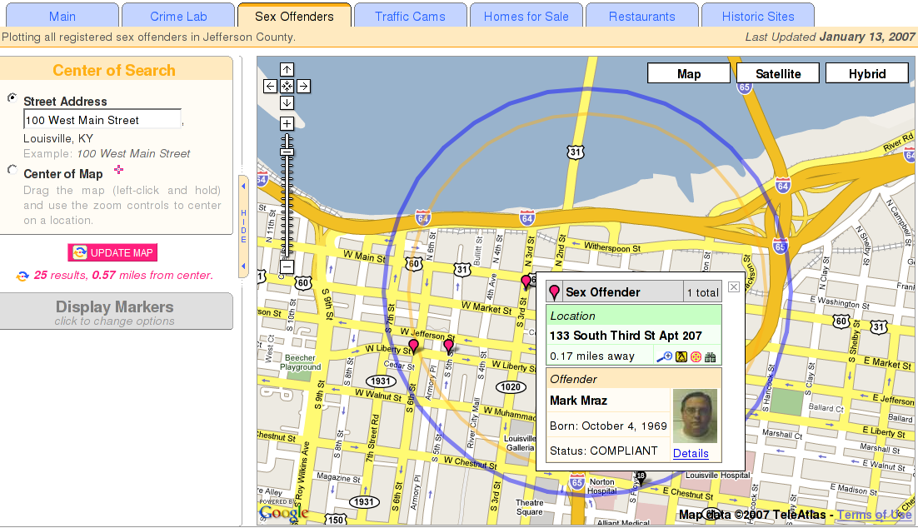
Personal Information
You will be known for your online behaviour
Mash-ups …
If you could refer to yourself using a single URI, could you more easily see where you’ve been mentioned?
Notes:
Online activities, online CVs
Georgia Sex Offenders

Slide 20
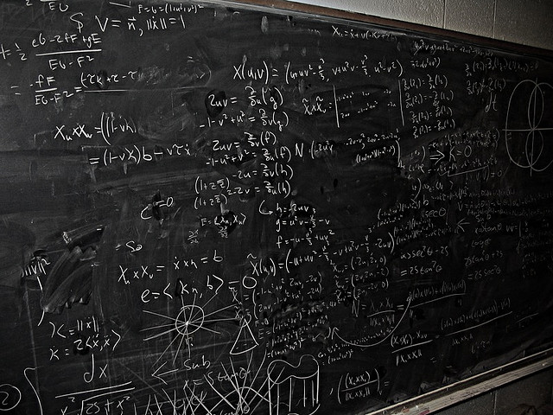
Lessons Learned
http://www.flickr.com/photos/shonk/418180402/

Slide 21
Lessons Learned
Interfaces for the Semantic Web
  mSpace, Tabulator, Dbpedia, Haystack
  Concentrate on ease of use and immediate feedback
Get the Data Exposed!
  Resolvable URIs!
  Google’s View of the Web – links as votes of confidence
Useful data need not be formal
  Folksonomies, etc
Notes:
PageRank – but does this still hold?

Slide 22
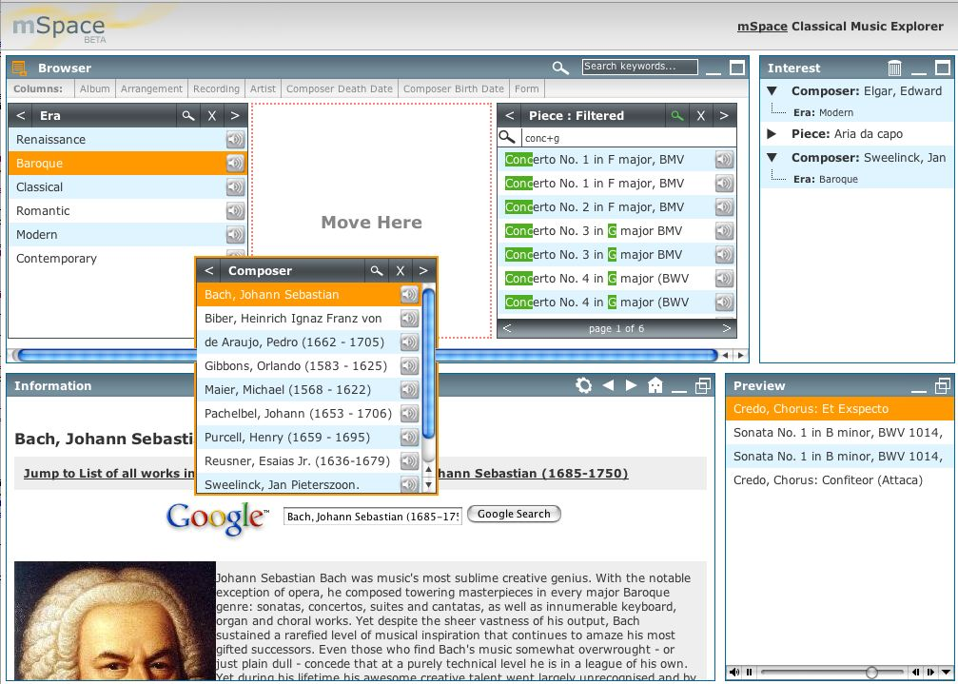
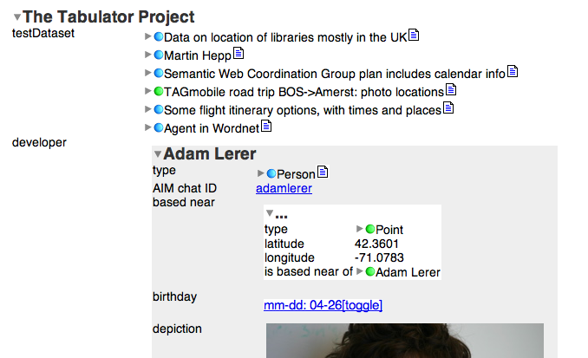
User Interfaces

Slide 23
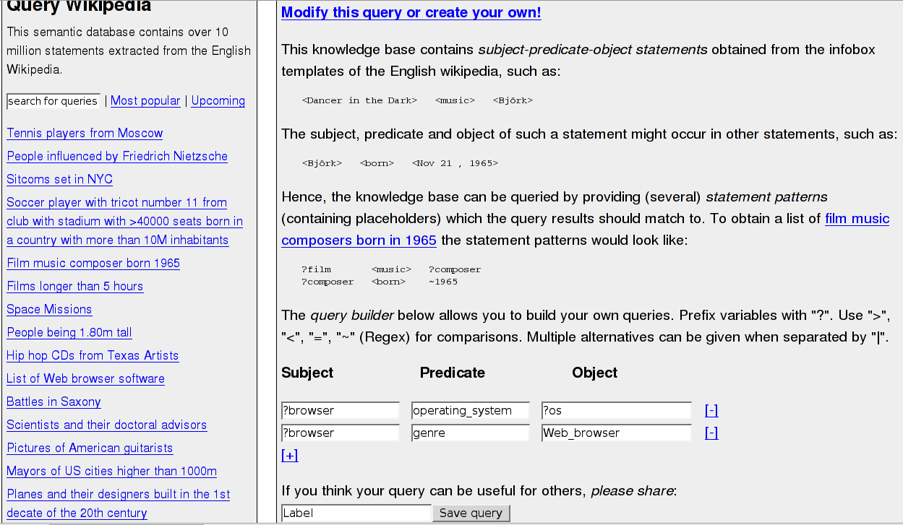
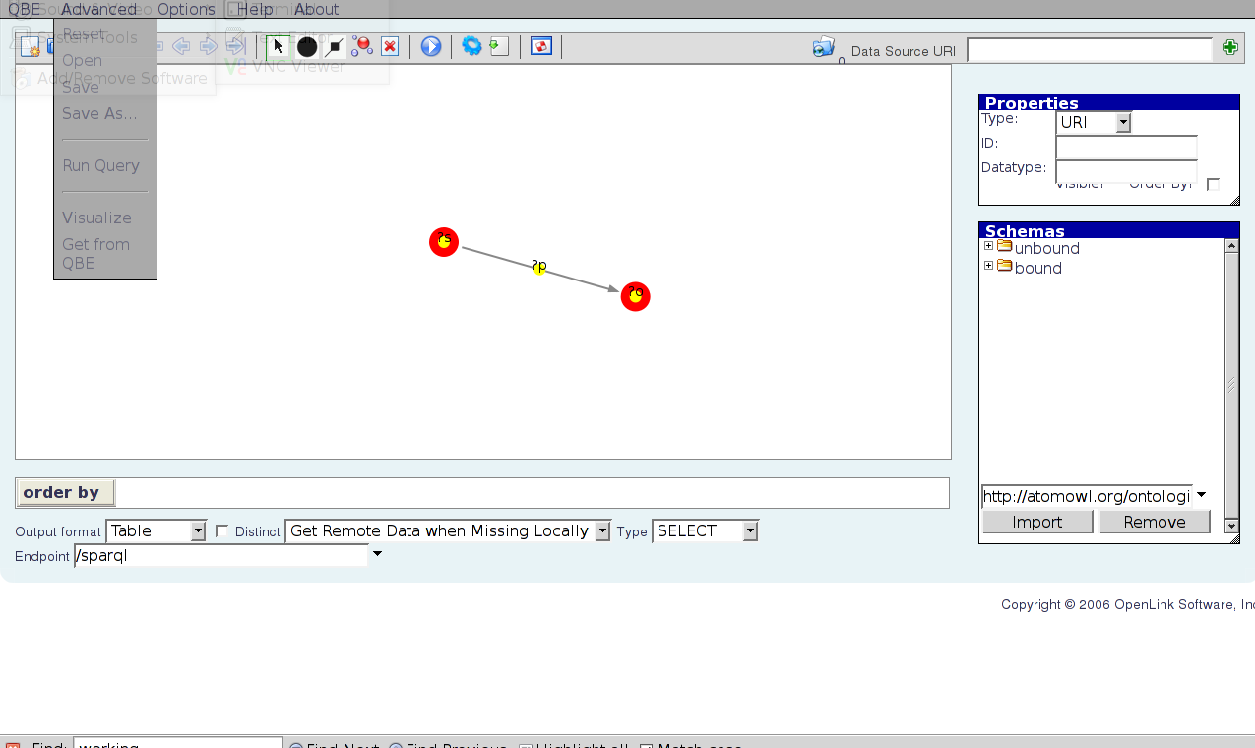
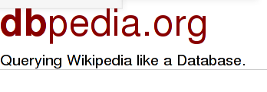
User Interfaces
DISCO
OpenLink QBE
visual query builder

Slide 24
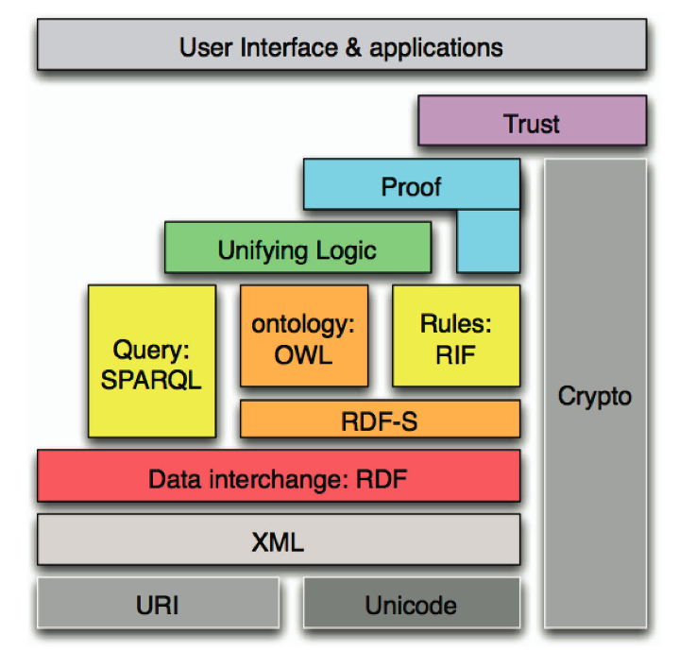
The New Layer Cake
Encourage the
deployment and publishing of Data

Slide 25
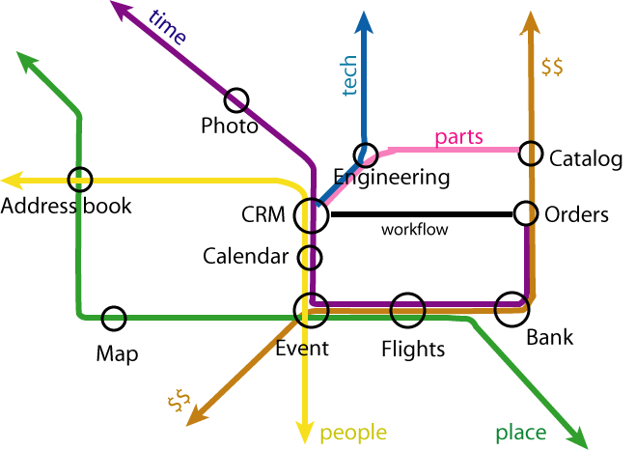
Linking Data
Tim BL
Notes:
Resolvable URIs

Slide 26
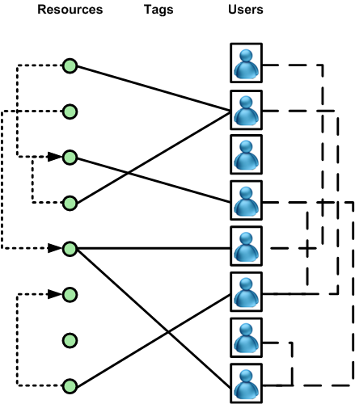
Tagging in context
Users
Assign tags to resources
Associated with other users
Connected by the resources they tag
Resources
Connected to other resources
Implicit relationship through the users that tag them

Slide 27











Applications

Slide 28
Ontologies and other animals
Uncontrolled
Emergent
Folksonomies
Controlled
Vocabularies
Taxonomies
Thesauri
Ontologies
Controlled
Designed
Less structure
More structure

Slide 29
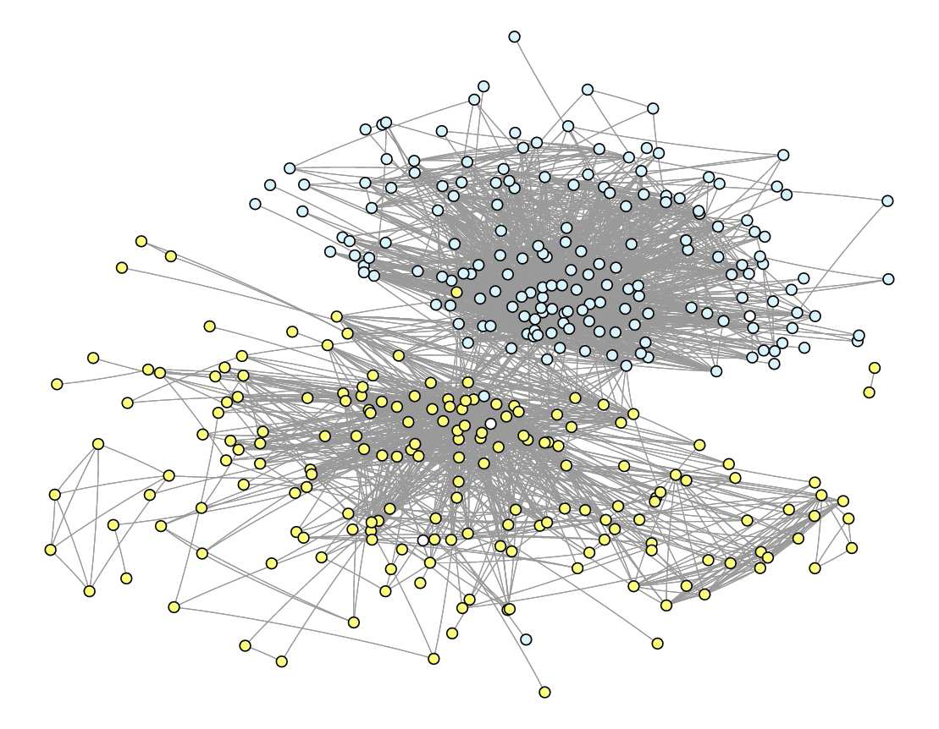
Documents tagged with ‘sf’
Science Fiction
San Francisco

Slide 30
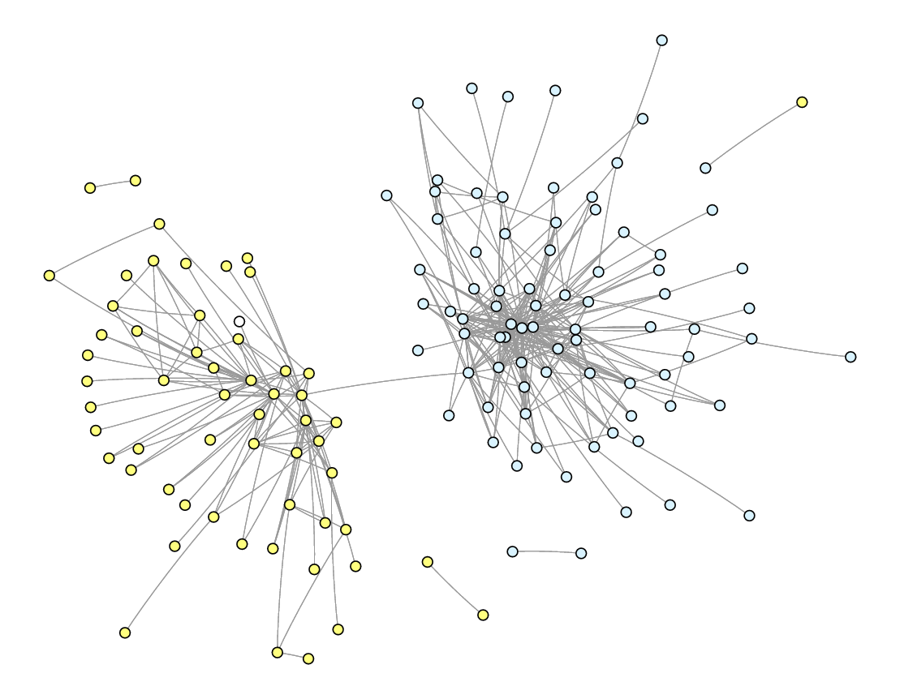
Documents tagged with ‘sf’
(edge weights > 2)
Science Fiction
San Francisco

Slide 31
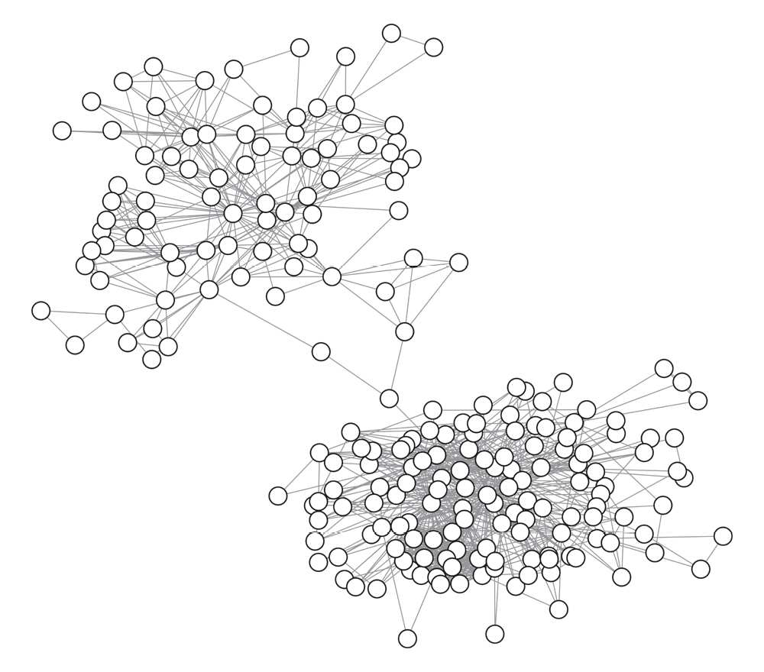
Users using the tag ‘sf’

Slide 32
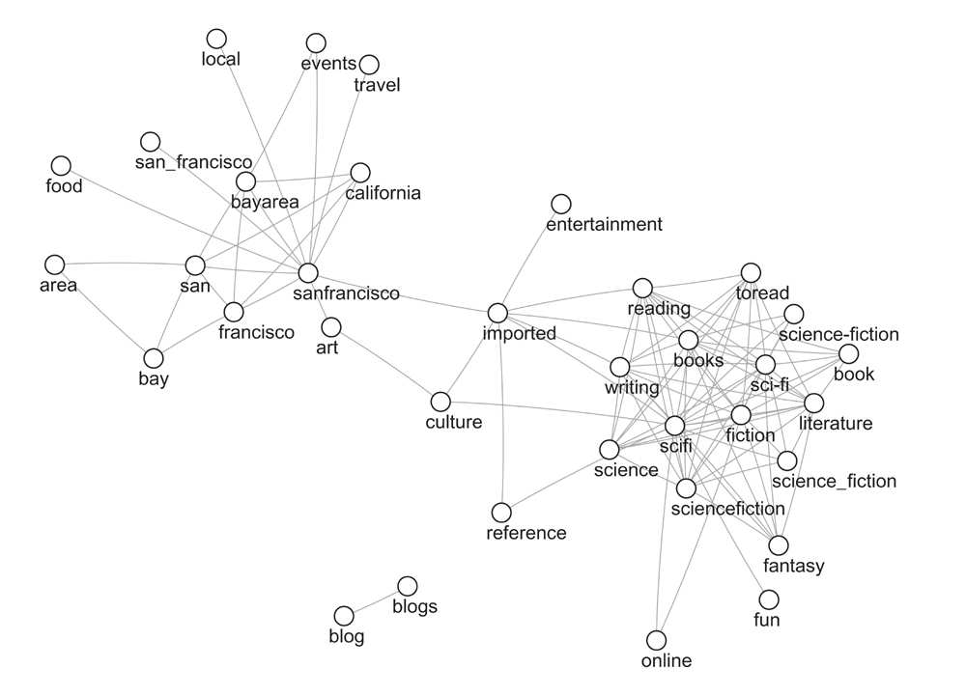
Most frequently used tags

Slide 33
Summary

Slide 34
Web 2.0 for the Semantic Web
A platform with high demands:
  Structured data
  Information integration
  Information discovery
Richer user interfaces
Domains with vibrant user communities
(travel, web design, programming, photos, etc.)

Slide 35
Semantic Web for Web 2.0
A true mashup of data from different sources
(not dealing with different APIs of different sites)
A true social network for users
(not separate data being locked up in different SNS)
A better way for users to represent themselves
(not different identities in different sites)

Slide 36
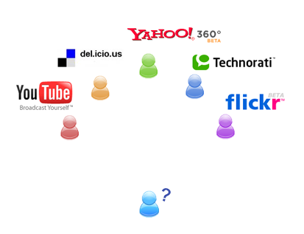
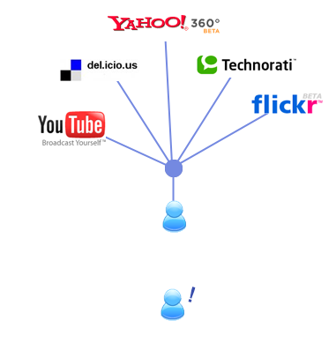

Slide 37
Conclusions
Web 2.0 needs more efficient ways to integrate data
The Semantic Web offers ways to integrate data
The Semantic Web and Web 2.0 open mutual opportunities

