Slide 1
The Impact of User Generated Content in Journalism
Steve Hill,
Freelance technology journalist / lecturer in electronic publishing , Southampton Solent University
T: @pow365
B: www.newjournalismreview.com
E: steve.hill@solent.ac.uk

Slide 2
A little about me…
Freelance technology journalist for Sunday Express, The Independent, New Media Age, Web Designer Magazine, Computing……and many, many, others…
Worked for EMAP in London editing Internet Magazine (now defunct). Back in the 90s EMAP was home to FHM, Zoo, Smash Hits consumer magazines
During 1999,2000, 2001 reported extensively on dotcom boom (and eventual ‘bust’).
Academic: At Solent my research interests include how technology is used in the digital newsroom.
Notes:
I have been in journalism for nearly 20 years and during this time it has gone through a massive change brought about by the Internet and digital technologies.
My background is in the arts.
Although I write about technology and business
I graduated from University in the early 90s and the Internet was just coming up.
At that time very few people new much about it and there were new magazines launching.

Slide 3
Journalism has changed…
“When I started in journalism, I wrote one or two stories a week on a clunky mechanical typewriter - it was the last century but it really wasn't that long ago…..
Now I write up to five or six blogs in a single day, I broadcast on the Today programme, the Ten O'Clock News, as the broadcasting pillars of my output - and up to 20 or so other channels and programmes in a single day”
Robert Peston, BBC Business Editor,
(http://www.bbc.co.uk/blogs/thereporters/robertpeston/2009/08/what_future_for_media_and_jour.html)
Notes:
This speech from Robert Peston is very interesting – it highlight that fact that journalism is becoming about technology and that older journalists were struggling to adapt to new skills.
The pressure has increased on journalists to learn new technical skills
Deliver content at a time and on platform of users choosing
Audiences also increasingly wish to interact with content – after all the web is an interactive media

Slide 4
A skills gap has emerged where technology meets journalism
Traditional journalism skills | SKILLS GAP! | Digital world
Research |  | Data journalism / mapping
Interviewing / shorthand |  | Blogging / social media
Writing: News, features etc |  | Apps – social media and tablets.
Legal (media law) |  | Usability
Ethical issues - impartiality, objectivity etc. |  | CMS, CSS, MySQL, PHP etc.
Industry NEEDS people who understand technology .
This is a profitable area to work in!
Notes:
Most journalists come from arts backgrounds
“Not why I became a journalist”
Technology skills are in huge demand on big media companies

Slide 5
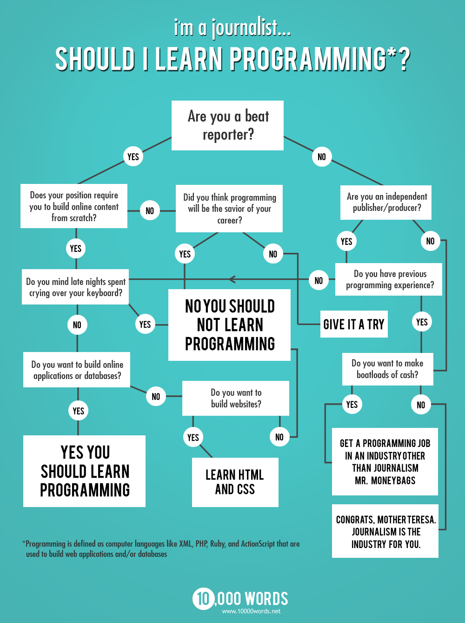
Partly Funny / Deadly serious!
Source: 10,000 Words blog
Notes:
This is from an American site and journalism in the states is about a year in advance.
It’s rallying cry to journalists not to be scared by technology

Slide 6
Internet brings ‘creative disruption’
‘Software is eating the world’ Marc Andreessen, The Economist 2012
Transforming once profitable media publishing industries…music, books…journalism.
Users unwilling to pay for news content in digital format?
New threats from ‘pure-play’ online providers. Huffington Post (est . 2000) versus The Times (est . 1845)
Legacy media companies face – ‘re-invention or oblivion’
Notes:
The Internet has brought about radical change to the media industry
In Creative Disruption Simon Walmna describes legacy industries – those that had huge amounts of success selling physical products (newspapers on paper) struggling to come to terms with changes brought by digital.
Many initially took a head in the sand approach.
Dot coms, small, highly adaptable, don’t empoy expensive journalists.

Slide 7
Impact of user-generated content (UGC) on journalism…
UGC = where non-professionals produce content.
(Dan Gillmor – the ‘read-write’ web.
It is closely related to ‘sharing web apps’
Web 2.0
Citizen Journalism
Users carry out roles associated with professional journalists
Social media

Slide 8
Definition of UGC
The Organization for Economic
Co-operation and Development (OECD, 2007) states…
UGC must:
Be published either on a publicly accessible website or on a social networking site accessible to a selected group of people.
Show a certain amount of creative effort / originality
Created outside of professional routines and practices (amateur / pro-am)

Slide 9
UGC – covers many different areas
General chit-chat / sharing content between friends on social media.
Comments on news sites / message forums
News content about breaking news events that is shared on social media or supplied to news providers
Collaborative journalism projects
Notes:
(Journalists have to be careful when using UGC material from social media – user may not want it to be published widely).

Slide 10
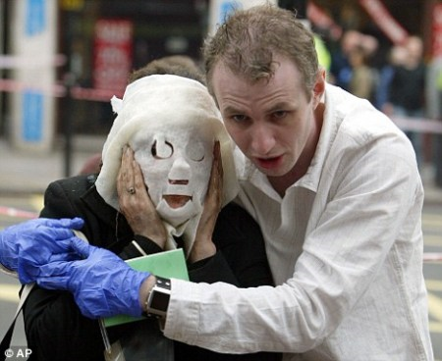
London Tube Bombings (July 2005)
Photojournalist’s image of woman being helped to safety. Well-composed... an image that stays in the memory.
Phone image: ‘A discussion was held within the BBC [UGC Hub] about the quality of the pictures with some people feeling that it was inappropriate for the BBC to show such evidently amateur footage.
Notes:
London Tube Bombings
Asian Tsunami
Mombai Terrorist Attacks
Arab Spring (Iran / Syria – journalists banned)
Libya – very different. Large number of rookie journlists in area.
August 2011 London Riots
Here are Two Iconic images that were widely used in mainstream media.
First time BBC had UGC Hub
By the London bombings, which was the first major news event where user footage was included alongside user generated output. The most often cited example of pictures being available via UGC is the mobile phone footage of victims of the London bomb attacks walking along the underground tunnel after a suicide bomber had blown up part of the train.

Slide 11
Story production process
Story Creation
News event
BBC reporter on scene
News Agency (PA / Reuters)
Social media (Tweets from users etc)
BBC - NEWS DESK
Distribution
Social Media (Tweets etc)
Online Publishing
TV/ Radio
(Distribution over 8 hours for big story)
Notes:
Twitter is there right from the start – as a tool for users to report news, for the BBC to distribute news and users to respond to it
All of this is available on mobile.
However, news organisations have to handle hoaxes.

Slide 12
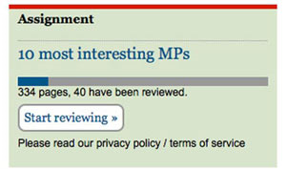
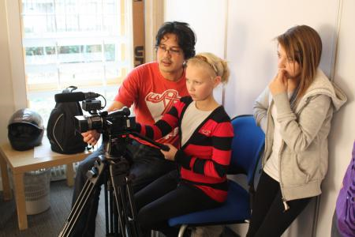
Collaborative Journalism
Seeking ‘collective intelligence’ of large numbers of users
‘Deep intervention’ – e.g. BBC training residents living in rural community in Wales.
http://mps-expenses.guardian.co.uk/
Notes:
Guardian
Join us in digging through the documents of MPs' expenses to identify individual claims, or documents that you think merit further investigation. You can work through your own MP's expenses, or just hit the button below to start reviewing. (Update, Fri pm: we now have a virtually complete set of expenses documents so you should be able to find your MP's) Already created an account? Log in here.
We have 458,832 pages of documents. 32,908 of you have reviewed 225,674 of them. Only 233,158 to go...
Deep Interventions
Training just a few families to document lives
Huge degree of empowerment
Very expensive – BBC didn’t get any usable material.
Knowle West Media Centre does similar work
- Knowle West is a very deprived area in South Bristol – high unemployment, poor techical skills.

Slide 13
Key academic interests…
Alleged ‘democratic potential’ of technology..anyone take part
Cheap (or free) technology / very accessible
Horizontal media (sharing p2p) rather than top-down (traditional media – one way broadcast to the masses)
But is this pseudo-empowerment?
(are journalists STILL acting as ‘information gatekeepers’.
Notes:
Clay Shirky of New York University and Dan Gillmor have been the most excited theorists.
Yokai Benkler – wealth of networks slightly more scepticle.

Slide 14
Future
When a news story breaks journalists trawl social media for content (a source equal to agency feeds)
Better tools needed to verify quality of UGC…prevent hoaxes. (how can journalists use geo-location tools?)
Media companies investing heavily in technology…..it’s ‘spaghetti throwing’.
The big one…how can we get monetize digital content?

Slide 15
Key texts:
Gillmor, D (2004): We The Media: Grassroots Journalism by the People, for the People (
Shirky, C (2009) Here Comes Everybody
Keen, A (2008) The Cult of The Amateur
Waldman, S, (2010) Creative Disruption,

Slide 16
The End…
That’s it!
No more!
Nothing to see here.

Slide 17
Video example – Olympic Torch Relay
BBC News – 6th April 2008
‘Citizen Journalist’ – 6th April 2008

Slide 18
‘UGC Clip’
Shot with a Canon IXUS 50 (compact camera)
Format: AVI
It’s shaky, needs editing..won’t do for TV.
Sound often biggest problem with cheap cameras.
Street level view, better than BBC’s long zoom?

Slide 19
Motivations:
Media companies use UGC to reach out to audiences
Is it cheaper than using professional content? Not usually a motive.
Why do people participate?
It is a minority activity.
Very rarely will anyone be involved in a news incident.
Those who take part often local ‘activists’ – male, white, middle class
Should users be paid for their contributions if their work is used?

Slide 20
We only have 45 minutes, so I’ll need to be brief…
How technology has become central in journalism – (global audience / highly fragmented)
The impact of user generated content (UGC)
Mad predictions for the future…(Philip Meyer predicted the death of printed newspapers by September 2043!)
Very happy to answer any questions – today or via email / Twitter afterwards.
Notes:
I’d like to thank the team of MA Web Science for inviting me to be here.
The topic I’m here to talk to you today about is citizen journalism. But you won’t here me mention it much.
To be honest this is a phrase I’m not comfortable with.
It suggests that anyone can ‘do’ journalism – so I prefer to use the phrase participatory journalism.
We don’t have very long, so I’ve divided this lecture up to some key areas

