Slide 1
Institutional Personal Learning Environments – Paradise or Paradox?
A digital literacy perspective
(http://slidesha.re/ISgkNs)
Hugh Davis (@HughDavis) (and Su White(@suukii))
CSEDU
April 2012

Slide 2
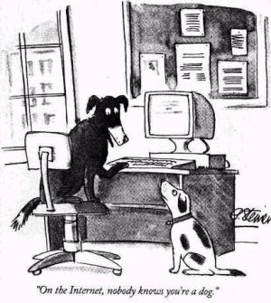
Context

Slide 3
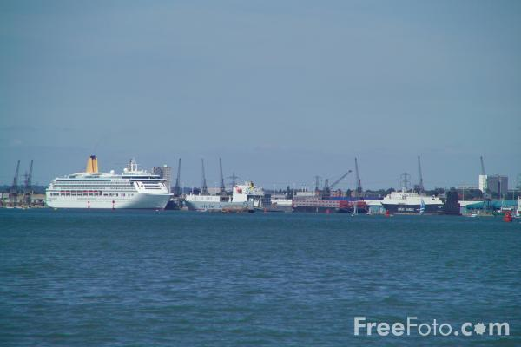
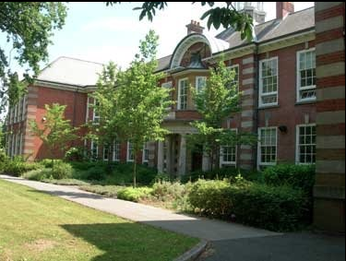
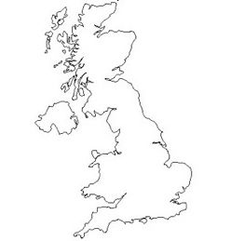


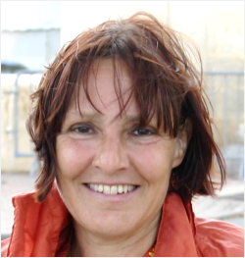
Founded 1862, Charter 1952
25,000 Students
Russell Group
Top 20 UK
WUN
Excellence in:
(Opto) Electronics
Computer Science
Oceanography
Engineering (esp. Nautical and Aero)
Acoustics
Notes:
Just a little bit about the university, inter-relationship between teaching and research

Slide 4

CITE
THE UNIVERSITY
Faculties
Academics and Teaching Staff
Students
COMMITTEES
Technology Enhanced Living and
Learning (TELL)
Education and Student
Experience (ESEAG)
University Systems Board (USB)
RESEARCH
Web and Internet Science Group
Learning Societies Lab
ACADEMIC SERVICES
Information Services (iSolutions)
Library
Student Services

Slide 5
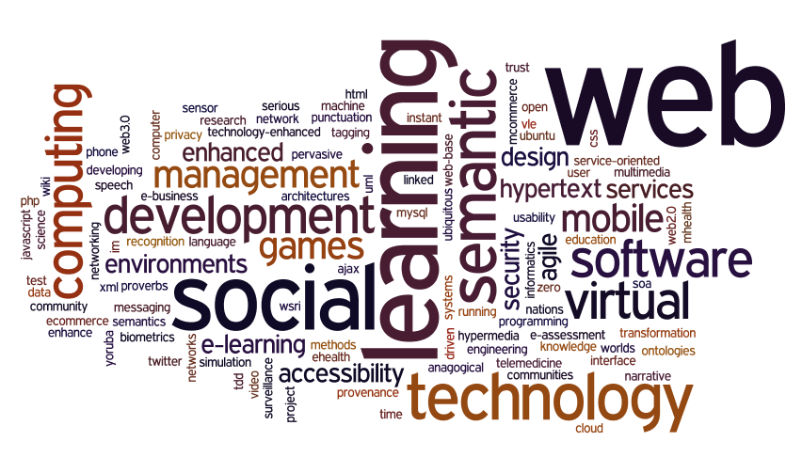
CITE Research

Slide 6
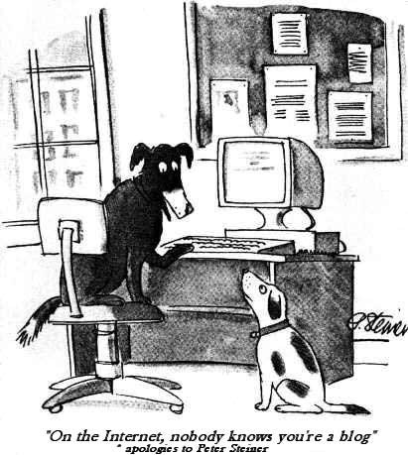
The thesis of this talk:
The world is changing
Digital literacies are a central and essential skills for the modern graduate
The curriculum and the tools we use must change to meet this challenge
This talk will examine some of these changes (mostly) from the tools perspective.
Notes:
Preparing students for jobs that don’t yet exist
Graduate Attributes
Digital Literacies - the ability to live, learn, collaborate and influence in a digital world

Slide 7
How we got here
What are the digital literacies we need now?
What is the role of the institution in this learner centred world?
What tools do people use to learn and organise their lives?
Web 1.0
The VLE
Technological Timeline
Learning Timeline
The world is changing

Slide 8
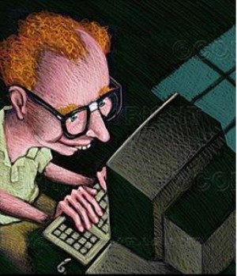
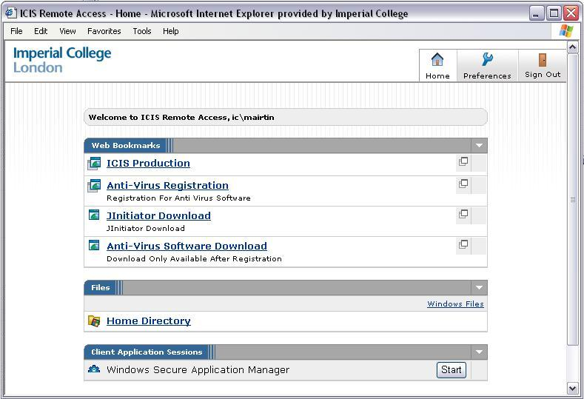

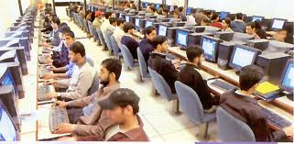
Web 1.0 (mid 1990s)
Webmaster
html Static Web Pages
What model of learning does this assume?
ftp
http
+ Teacher

Slide 9
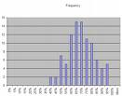
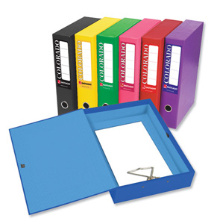
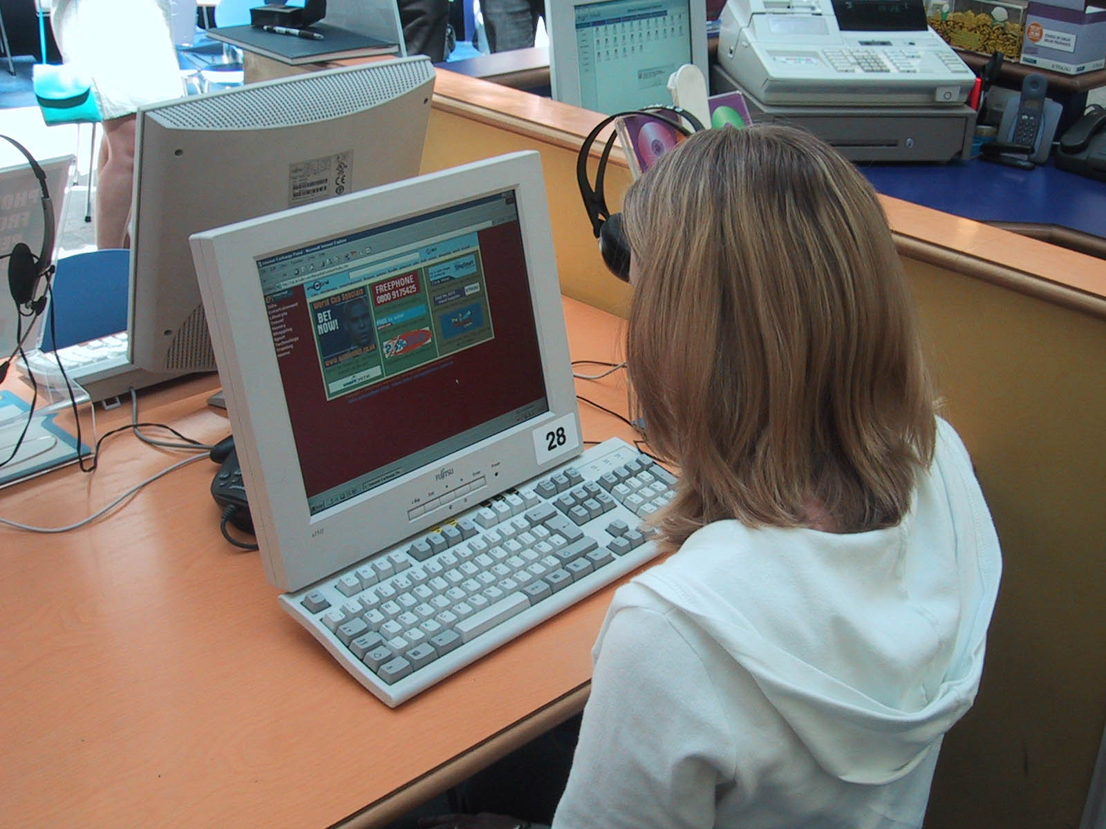
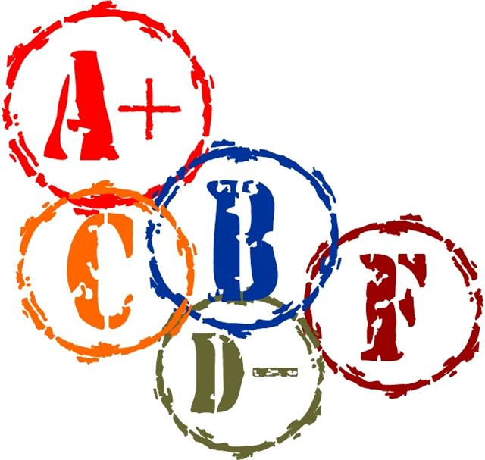
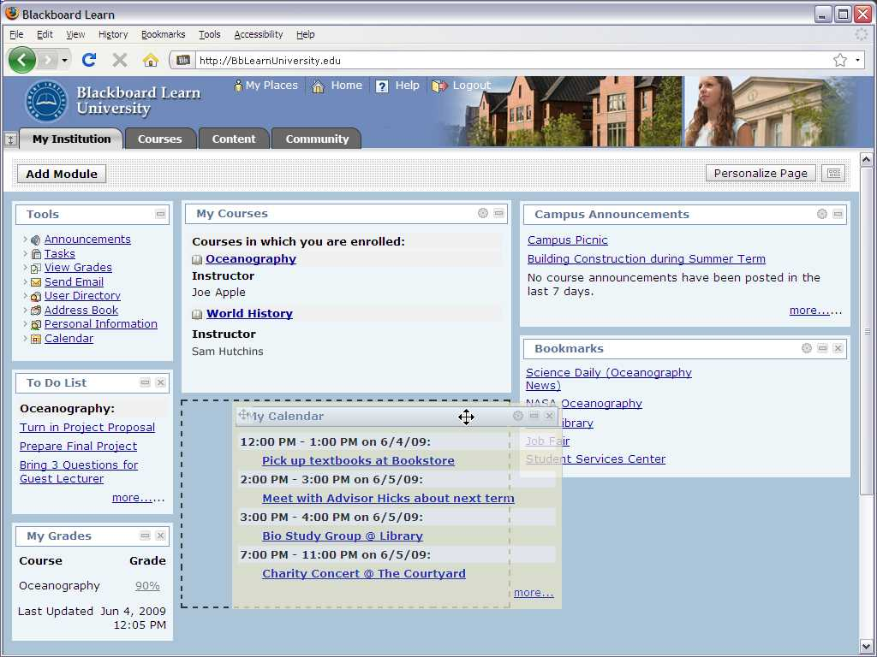

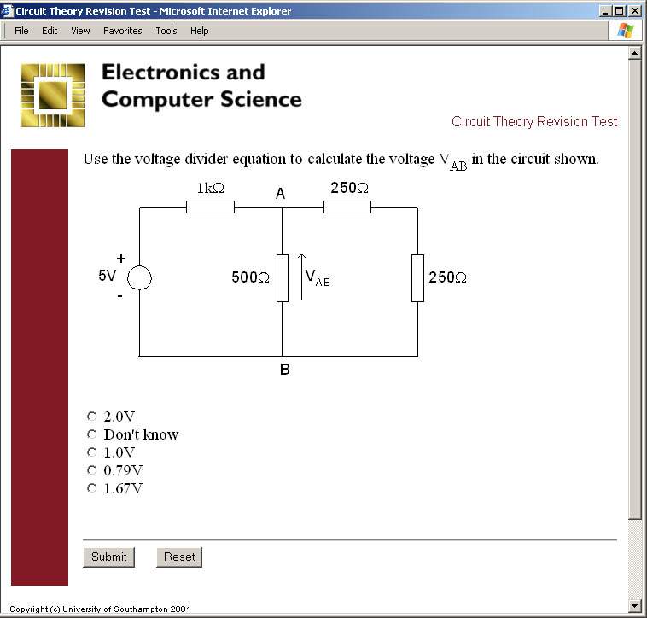
Virtual Learning Environments (VLE)
VLEs replicated (a perception of) traditional teaching by providing content delivery on-line

Slide 10
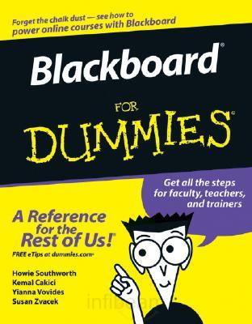
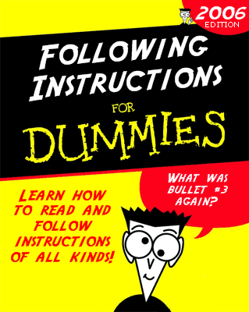
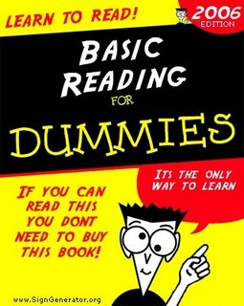
But Why VLEs?
Historically most teachers did not do (or even understand) html or FTP
Many teachers and students did not have email (or other communication tools)
IT literacy was not high
Teachers were reluctant to allow their online work to be widely seen
- Or they had licences which control the distribution of resources
Notes:
1 Historically most teachers did not do html or FTP
So we needed an on-line authoring tool for web pages
But now there are lots of tools for creating websites/pages
2 Many teachers and students did not do email (or other communication tools)
So we needed a system to provide tools to all members of the class
Now everyone has email, and most use other 3rd party comms tools too.
3 Information literacy was not high
So we needed tools to reliably record and store student grades
Most people are up to transferring a CSV file these days
4 Teachers were not confident for their on line work to be widely seen
So we needed systems to easily control the visibility of files
We should have got over this by now!

Slide 11
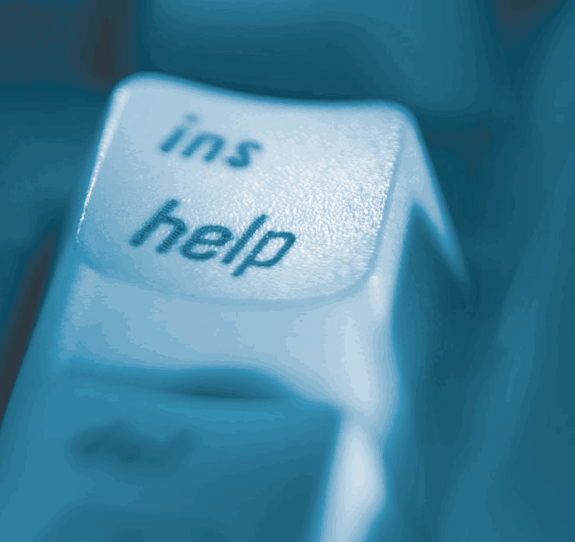
Why VLEs? (2)
VLEs are ultimately supportable
In summary:
VLEs provided a toolkit to enable teachers to do:
  file creation and distribution,
  email and announcements,
  chats and forums,
all in a safe controlled environment

Slide 12
Timeline - technological
1987
Multimedia Apps on PCs & Macs (Guide / Hypercard)
1990
The Web
Virtual Learning Environments
Virtual research Environments
Open Content/Repositories
Web based Multimedia
Web 2.0
Semantic driven Web sites
Semantics
Personal Learning Environments
The Mobile Web
Linked Data
2010
Semantic Wikis
Personalised Institutional Environments
Open Data

Slide 13
Timeline - Learning
Instructivist
1997
1990
The Web
Vicarious Learning
Social
Constructivism
2000
Web 2.0
Communities of practice
Semantics
Informal Learning
Linked Data
2010
Constructivist
Connectivism
Notes:
knowledge exists independently of the learner, and is transferred to the student by the teacher. A teacher-centered model, epitomized by the lecture.
the learner constructs new knowledge through a process of analyzing new information and comparing it to previous knowledge. Student-responsible for their own learning

Slide 14

What’s Wrong with VLEs
VLEs
embody outdated views of teaching as “push”
put the teacher at the centre rather than the student or the network
do not integrate with the tools and environments students or lecturers use.
are fundamentally closed - they do not have any understanding of networked learning
lock you in
don’t encourage learners to take responsibility for their own learning, tools or digital literacy

Slide 15
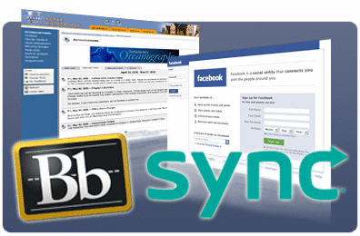
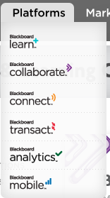
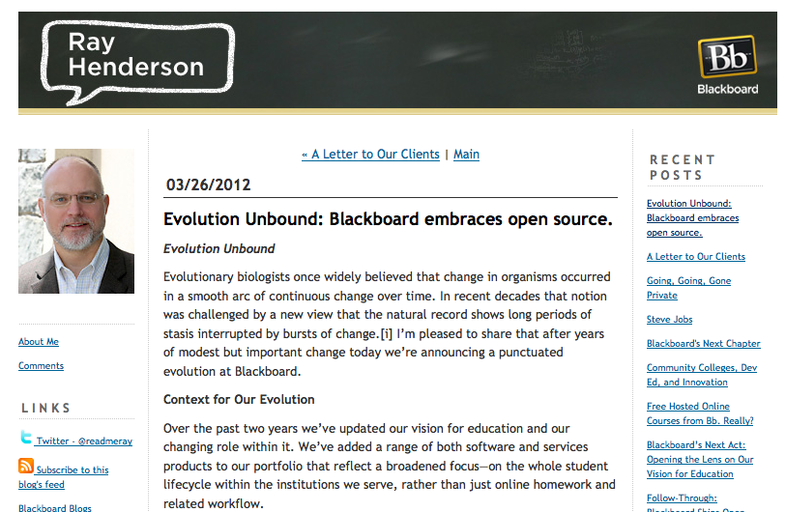
Are VLEs dead?
Not according to the market leaders

Slide 16
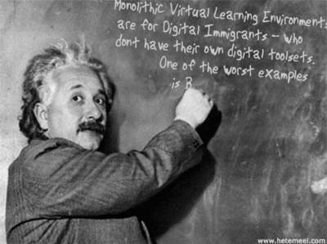
The VLE is Dead – long live the VLE
(above image is from a generator at http://generator.kitt.net/)

Slide 17
How we got here
What are the digital literacies we need now?
What is the role of the institution in this learner centred world?
What tools do people use to learn and organise their lives?
Defining Digital Literacies
The digital native myth
The Facebook problem

Slide 18
Finding,
evaluating,
processing,
organising,
analysing,
presenting
Using applications and services
Business
Models
Beliefs and
Practices
Digital
Citizenship
Digital
Workpractices
Street Wisdom on the Digital
Highway
Information
Literacy
Digital Academic Practices
ICT
Skills
Identity and Reputation
Communication
Collaboration
Media
Literacy
Social
Networking
Networks
(of People)
Evaluating
Affordances

Slide 19
The learner is given the stuff via the network
The learner finds stuff on the network
The learner finds stuff from the network (of people)
The learner is part of the network and contributes
  Stuff
  ontology
Business
Models
Beliefs and
Practices
Digital
Citizenship
Digital
Workpractices
Street Wisdom on the Digital
Highway
Information
Literacy
Digital Academic Practices
ICT
Skills
Identity and Reputation
Communication
Collaboration
Media
Literacy
Social
Networking
Networks
(of People)
Evaluating
Affordances

Slide 20
Business
Models
Beliefs and
Practices
Digital
Citizenship
Digital
Workpractices
Street Wisdom on the Digital
Highway
Information
Literacy
Digital Academic Practices
ICT
Skills
Identity and Reputation
Communication
Collaboration
Media
Literacy
Social
Networking
Networks
(of People)
Evaluating
Affordances

Slide 21
Digital Literacies are the skills needed to live, learn, work, collaborate, influence and lead in the virtual and digital world
Business
Models
Beliefs and
Practices
Digital
Citizenship
Digital
Workpractices
Street Wisdom on the Digital
Highway
Information
Literacy
Digital Academic Practices
ICT
Skills
Identity and Reputation
Communication
Collaboration
Media
Literacy
Social
Networking
Networks
(of People)
We are preparing students for jobs that don’t yet exist, using work-practices we don’t yet know supported by tools not yet invented.
Evaluating
Affordances

Slide 22
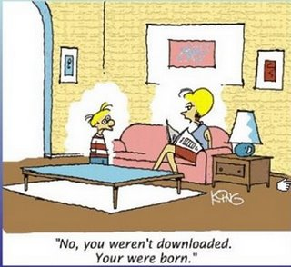
An aside on “Digital Natives” argument
Learning has not changed
but expectations of how its done may have
Recent research shows that although students may not be scared of technology and may live in Facebook, they have increasingly naïve understandings of finding and evaluating information
White and Le Cornu suggest a better distinction might be Digital Visitors and Residents
White, D.S. and Le Cornu, A., ‘Visitors and Residents: A New Typology for Online Engagement’, First Monday, Vol 16 No 9, 5th Sept 2011

Slide 23
Southampton Survey (2008) n~1000
Q16 | How often do you use the following tools/websites/systems?
 |  | More than once a day | Daily | More than once a week | Weekly | Monthly | Have used | Never
 | Blackboard | 143 | 218 | 215 | 122 | 65 | 72 | 82
 | Online assessments | 15 | 20 | 51 | 100 | 164 | 342 | 190
 | SUSSED Portal | 312 | 252 | 102 | 77 | 54 | 59 | 30
 | Facebook | 422 | 189 | 101 | 50 | 29 | 36 | 84
 | Text Messaging | 571 | 195 | 71 | 28 | 11 | 17 | 19
 | Instant Messaging | 215 | 128 | 139 | 75 | 74 | 142 | 126
 | Skype/VoIP etc | 99 | 68 | 82 | 68 | 69 | 194 | 320
 | Google | 566 | 204 | 99 | 23 | 6 | 4 | 13
 | Google Scholar | 66 | 57 | 130 | 91 | 104 | 176 | 268
 | Wikipedia | 103 | 103 | 242 | 159 | 123 | 141 | 35
 | YouTube etc | 120 | 131 | 216 | 154 | 116 | 119 | 57
 | Flickr (or similar) | 14 | 12 | 30 | 46 | 49 | 201 | 548
 | Del.ic.ous / DIgg or other Bookmarking sites | 18 | 15 | 19 | 23 | 17 | 70 | 742
 | Twitter | 27 | 18 | 22 | 16 | 11 | 70 | 737

Slide 24
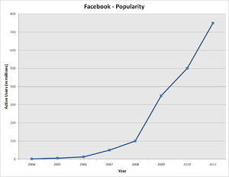
An aside on The Facebook Problem
Everyone is on Facebook (actually our 2010 survey said 95%)
Good examples of teachers using Facebook
(but mostly with mature classes)
Generally students very unhappy to have
teachers in their groups.

Slide 25

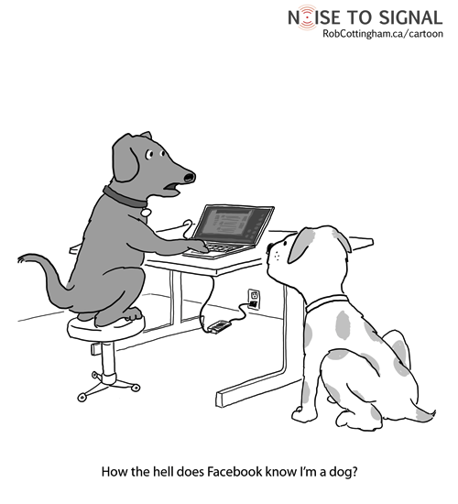
Typically a group is formed for the
class/yr (eg CS Yr2)
  Groups are self defined – other students missing out? E.g. joint honours
  No continuation from year to year.
  Lack of class awareness for teachers.
On-line bullying
Time management

Slide 26
How we got here
What are the digital literacies we need now?
What is the role of the institution in this learner centred world?
What tools do people use to learn and organise their lives?
The PLE
The Wine example

Slide 27
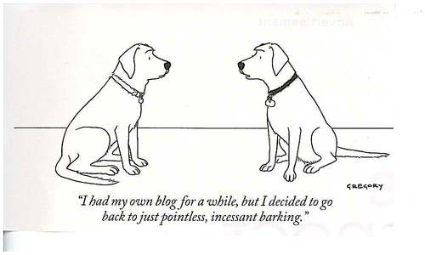
The Personal Learning Environment
Digital “residents” create their own toolsets
Manage their learning
Set their own goals
Manage content
Communicate and
collaborate with
other learners
and (micro)tutors

Slide 28













My (cloud) Tools
Notes:
Tell the story of the time my hard-disk backup failed during

Slide 29
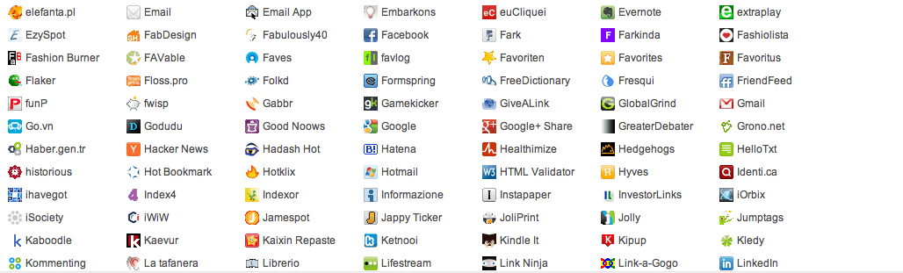
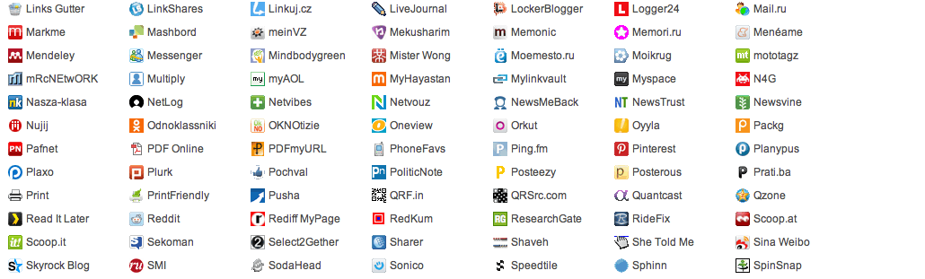
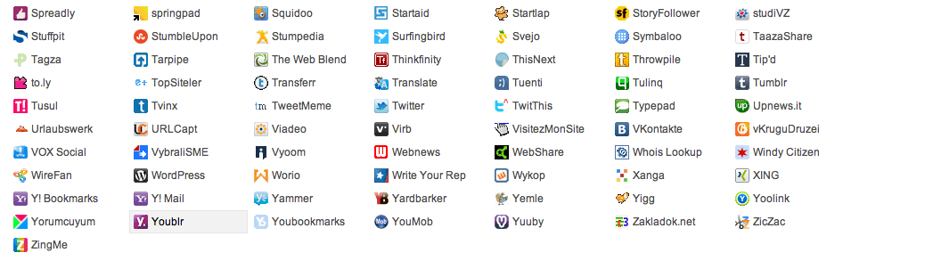
http://elearnmag.acm.org/
Notes:
Just about ¾ of the various ways you can link/note/promote/save an article found on the acm eLearn site

Slide 30
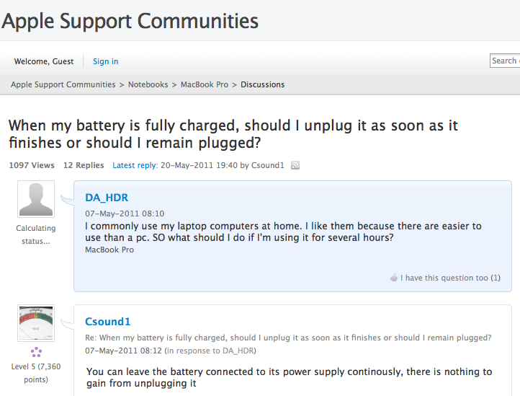
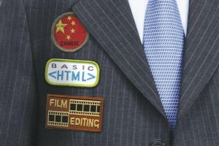
We build On-line Identity and Reputation
Profile
Blogs
Tweets
Web site
Search Engine Recognition
Contributions (e.g SlideShare)
What does the web think of you (pipl.com, zoominfo.com)
Badges and Stars

Slide 31
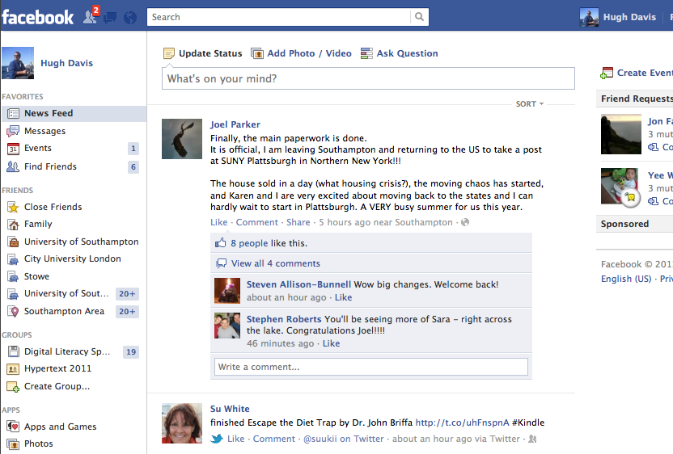

Slide 32
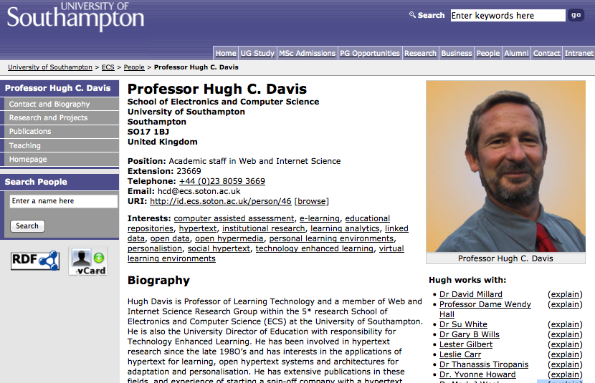

Slide 33
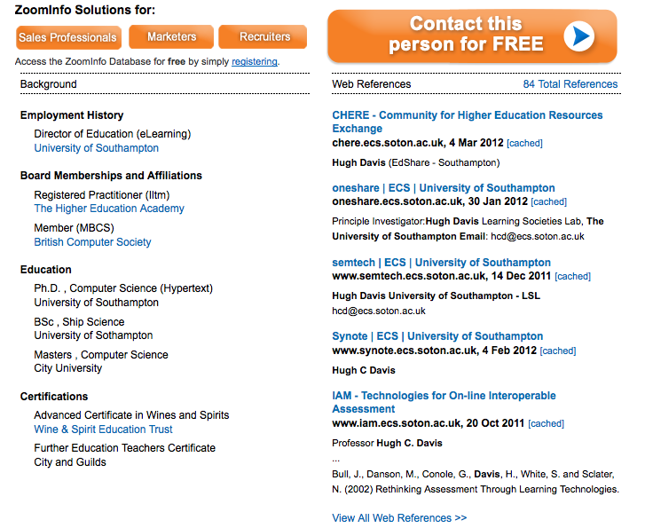

Slide 34
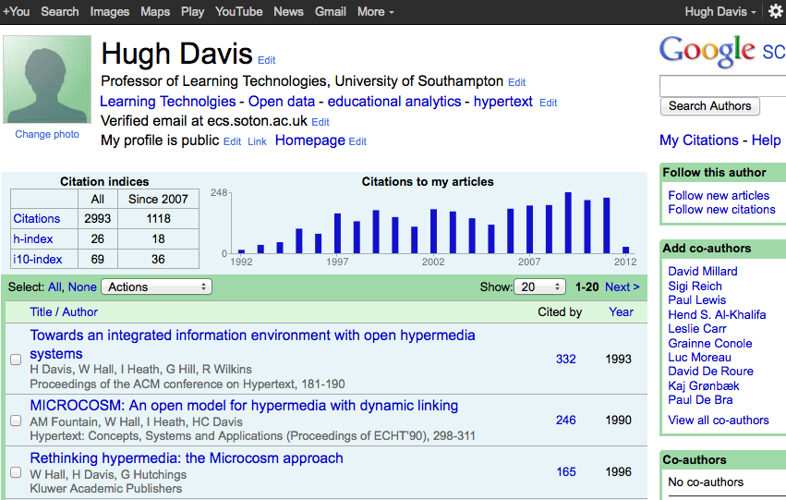

Slide 35
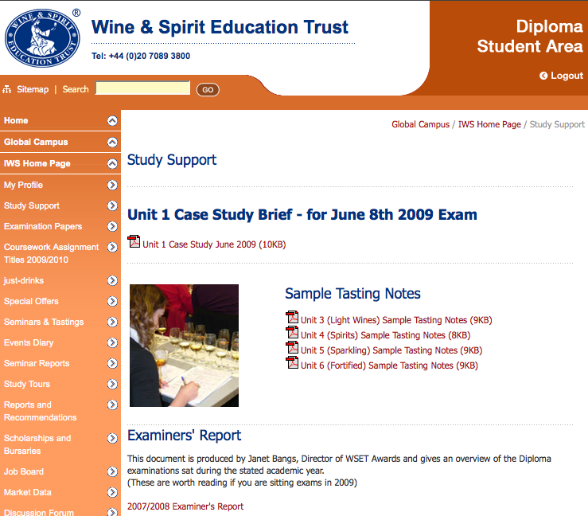
The Student of Wine Example

Slide 36
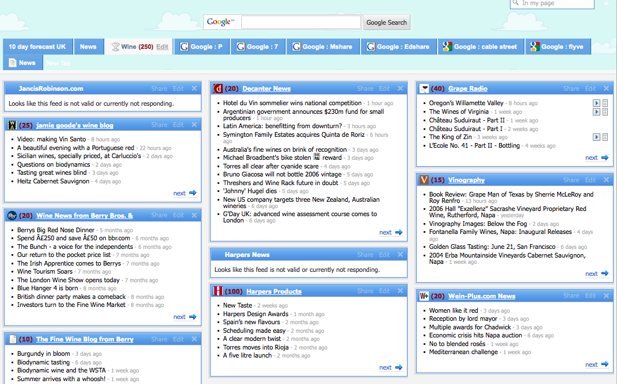
RSS Feed (and Email lists)

Slide 37
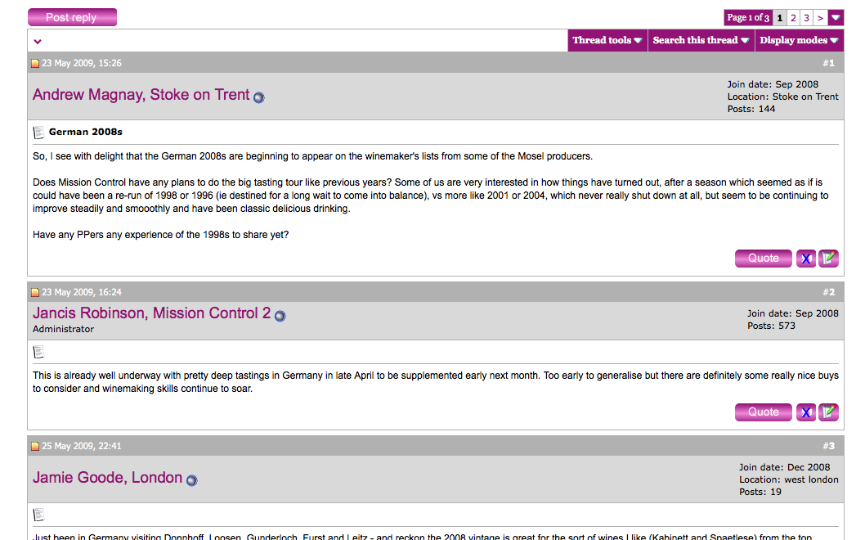
Forums

Slide 38
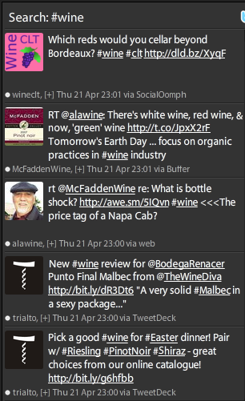
Twitter

Slide 39
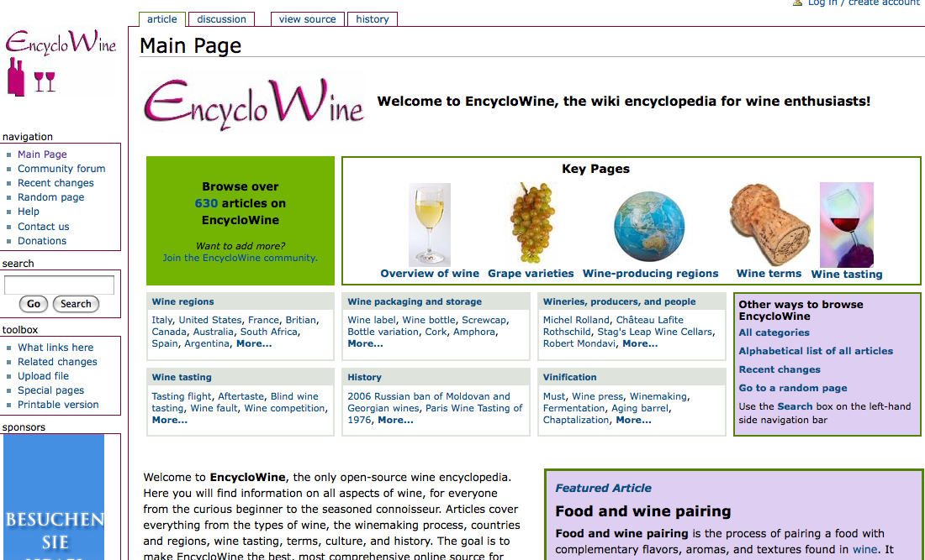
Wiki

Slide 40
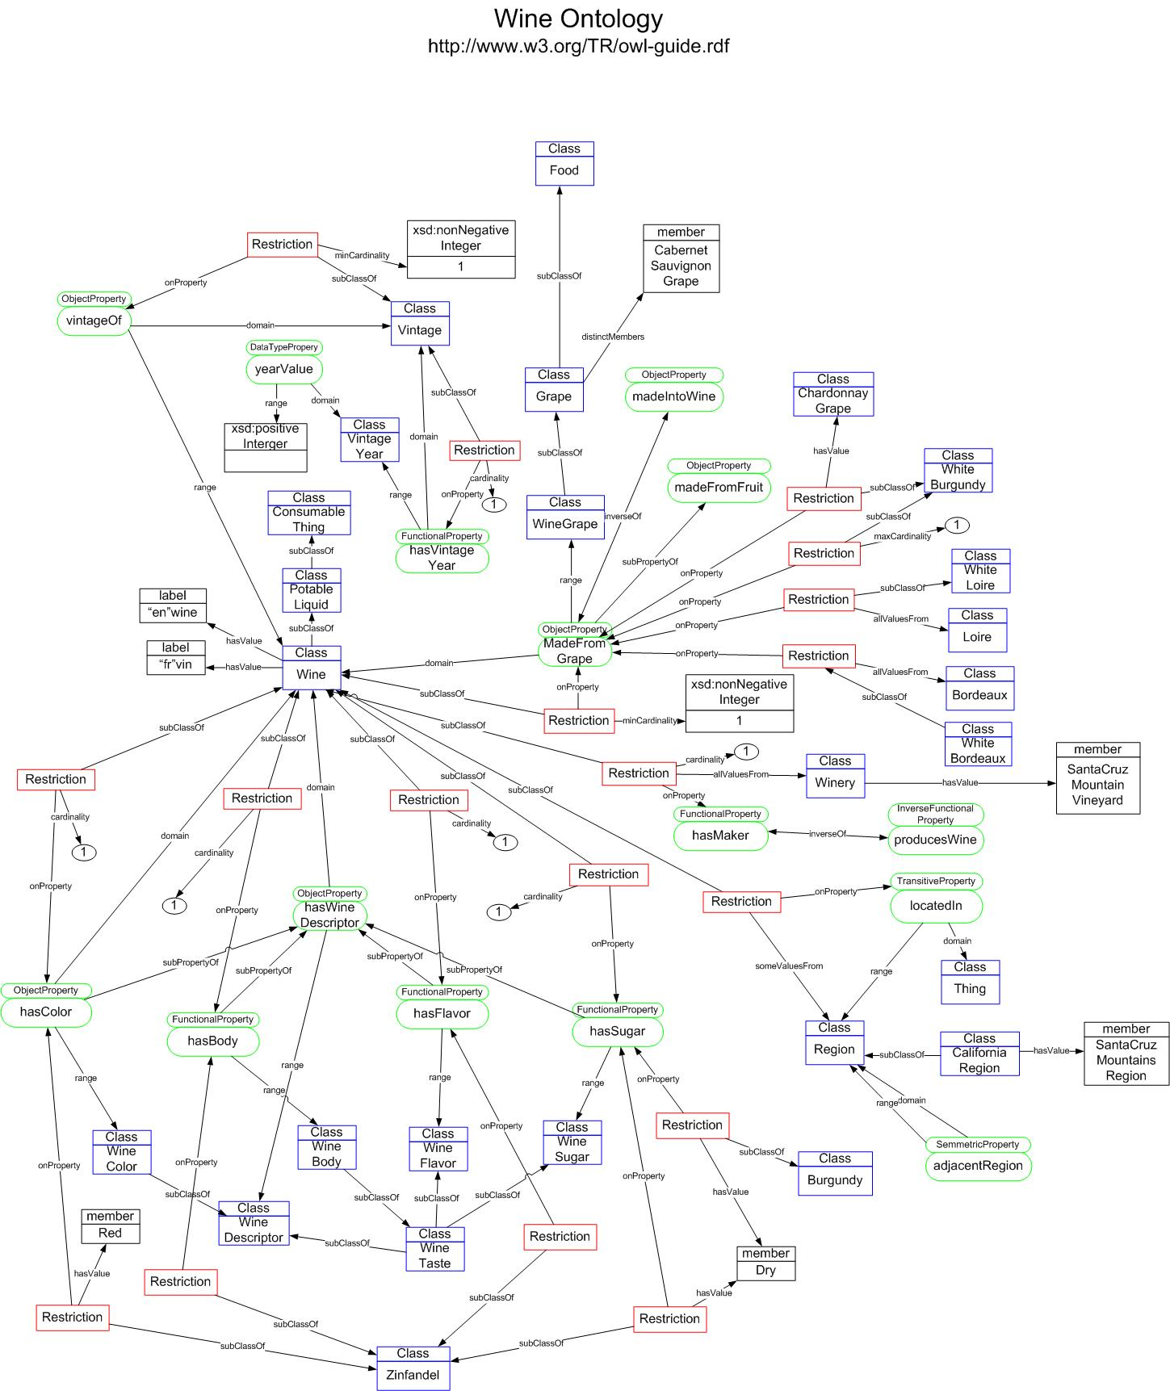
Ontology
<owl:Class rdf:ID="Wine">
<rdfs:subClassOf rdf:resource="&food;PotableLiquid" />
<rdfs:subClassOf>
<owl:Restriction>
<owl:onProperty rdf:resource="#hasMaker" />
<owl:someValuesFrom rdf:resource="#Winery" />
</owl:Restriction>
</rdfs:subClassOf>
...
</owl:Class>

Slide 41
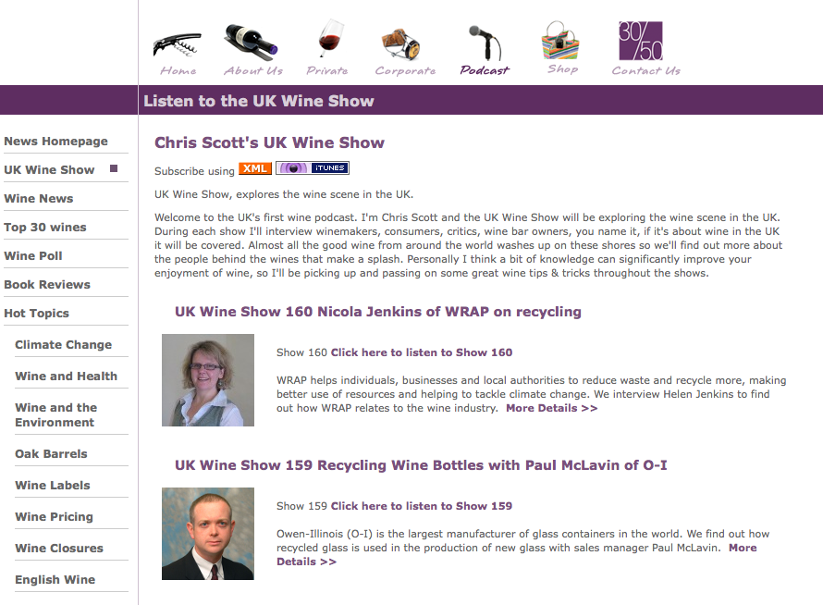
Podcasts

Slide 42
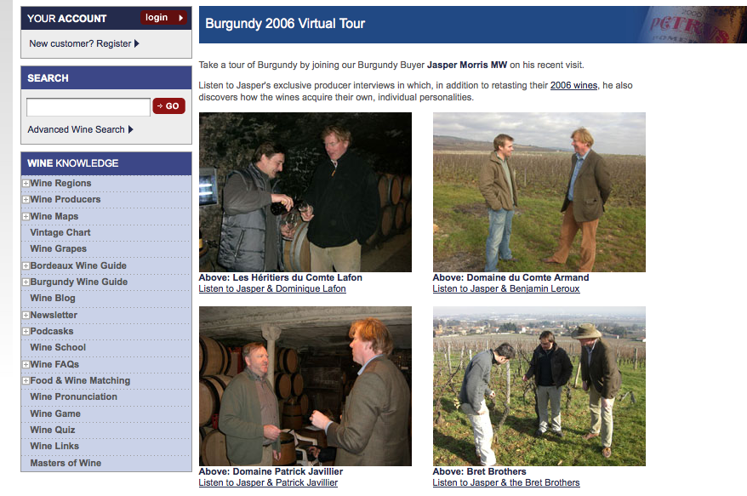
And Podcasks!

Slide 43
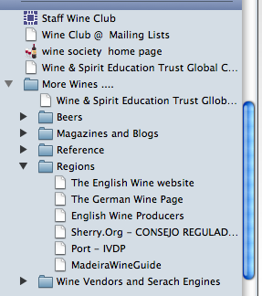
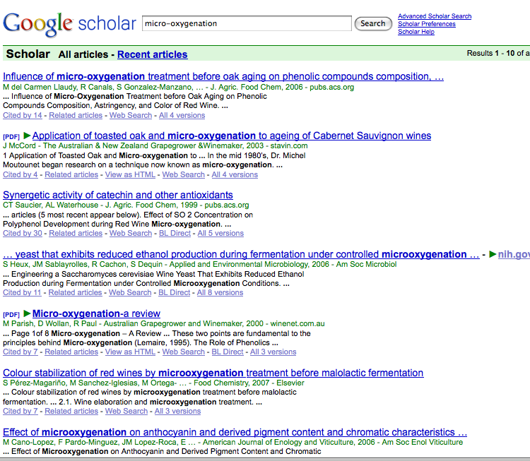
Bookmarks and Google

Slide 44
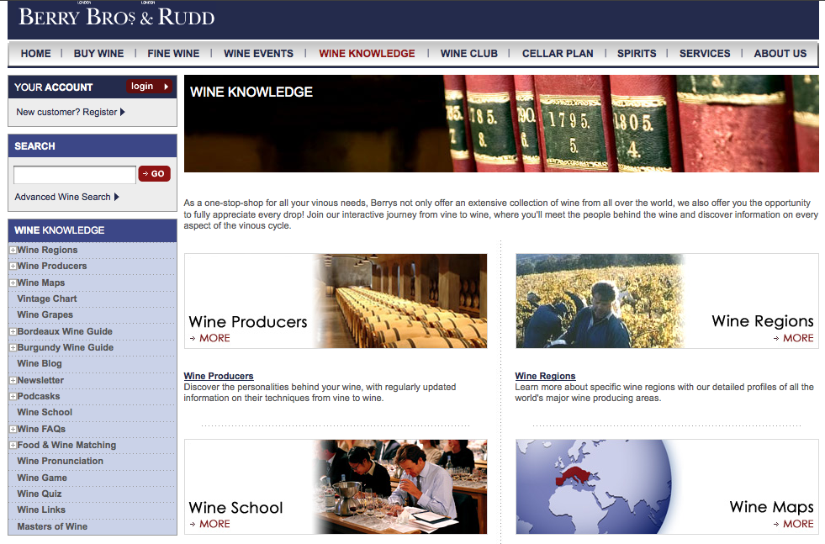

Slide 45
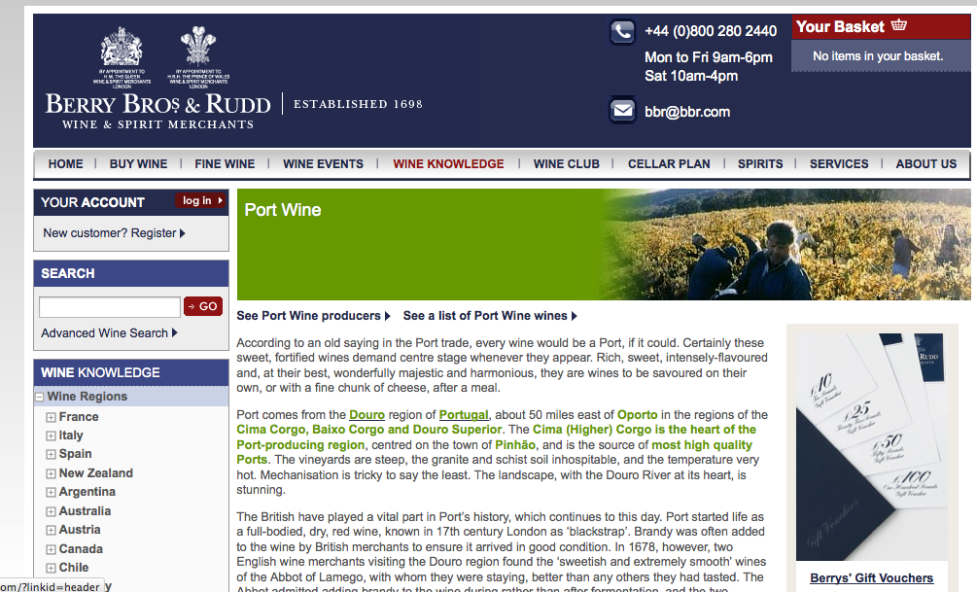

Slide 46
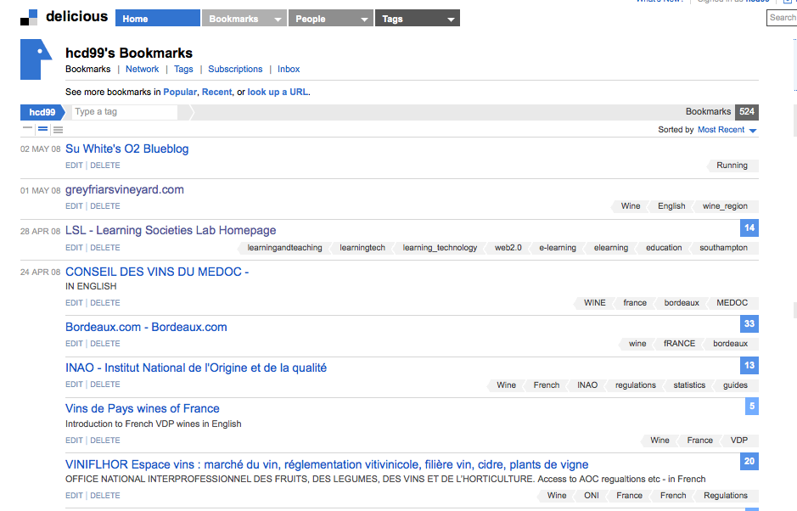
Social Bookmarking / Tags

Slide 47

Contributing to knowledge

Slide 48
Collaboration?
I tried to get the other students to collaborate on the assignments – but they didn’t understand!
(So much for digital natives!)

Slide 49
How we got here
What are the digital literacies we need now?
What is the role of the institution in this learner centred world
What tools do people use to learn and organise their lives?
The Digital Cognitive Apprenticeship
The iPLE
Living and Learning examples at Southampton

Slide 50
The Digital Cognitive Apprenticeship
Students do not “absorb” learning skills
We must provide a curriculum that supports them to acquire the skills
Learners should use authentic tools and authentic data to solve authentic problems
They may need some scaffolding
Not all teachers have the skills needed to create such a curriculum
The Institution must support learners (and teachers) to achieve the skills

Slide 51

CC Leigh Blackall

Slide 52
The Institutional VLE
Some might suggest that an Institutional VLE is by definition an Oxymoron
The arguments for iPLEs include:
  Need to scaffold learners (and teachers) in understanding the affordances of tools
  There are some real requirements about finding all things “Southampton” at one place (or with one search engine)
  Need to protect some teaching materials
  Legal responsibilities (e.g. accessibility)
  Need intranet for some discussions and data
  People may wish not to be seen world-wide
  Concern to have control of availability of info (is Cloud reliable enough?)
  Preservation
  Students may need to be assessed on their use of tools
  and the World Wide Web is probably not the right place for this
“The union of two apparent contraries”
e.g. ‘Extremely Average’
‘Military Intelligence’

Slide 53

S. Wilson, O. Liber, P. Beauvoir, C. MIlligan, M. Johnson, and P. Sharples, "Personal Learning Environments: Challenging the dominant design of educational systems," 2006. EC-TEL 2006

Slide 54

Tosh, D. & Werdmuller, B. (2004) The Learning Landscape: a conceptual framework for e-portfolios, Interact, 29, pp. 14-15.

Slide 55

Towards an eLearning 2.0 provisioning strategy for universities, Oskar Casquero (oskar.casquero@ehu.es) University of the Basque Country, PLE conference 2010

Slide 56














Wrapping the institution around the learner
Mark Stubbs
news, events
past exams, digitizations
deadlines, enrolments
timetables
resource lists
news, events
moodle.mmu.ac.uk
email, storage

Slide 57



SAPO CAMPUS

Slide 58

Southampton Learning Environment
Organizational View:

Slide 59
The Southampton Learning Environment - Goals
make it possible to undertake every aspect of
  living
  learning
  teaching
support a wide range of pedagogical approaches
a single place where you can go for
  tools
  communication
  collaboration
  information
  resources
act as a vehicle for reviewing and aligning our educational processes across the University
provide much more flexible systems
single login to all university tools and repositories (and search)
online
appropriate to your role in the university

Slide 60
SLE Principles
Support full learner journey
Personalised and personalisable
Support collaboration
Intuitive to search, navigate and use
Flexible and agile development
Location independence
Single (and essential) point of access
Platform independence
Meet all legal requirements and responsibilities

Slide 61

We want to climb over the walls…
With apologies….
Adapted from image used by tbl, originally from the economist I think

Slide 62
We want to integrate tools and information
Wikis
Communication tools
Infrastructure
Cloud services
Video
Conferencing
Forums
Email
Presence
PUBLIC
WORKSTATIONS
TurnItIn
DropBox
Chat
GoogleDocs
Internal
Services
CLASSROOMS
Podcasting
Live@Edu
Search
EXTRANET
E-Assignment
External RSS Feeds
COLLABORATION
SPACE
Blackboard (or other VLE?)
Delicious
Lecture Capture and Replay
PROFILES
Podcasts
Question Mark Perception
SEARCH
Uni/SUSU announcements
WIFI
STORAGE
Push
Module selection
Course Announcements
On-line forms
INTRANET
Internal RSS Feeds
INTERNAL
SOFTWARE
Resources
Student Records
HR Records
E-Books
Open Educational
Resources
Library Catalogue
Timetable
Room Bookings
On-line Journals
EdShare
Student Handbook
Fees Payment/records
Institutional data
The SRN
Programme/Module Catalogue
Notes:
Externa;l sertvices (DropBox, TurnutIn, Live at Edu Google Docs, Delicious

Slide 63


Some applications we are leading on
Let me personalise my personal timetable
Let me select my module options (fully informed)
Let me book an un-used classroom near me for a SEG group meeting
Tell me what bus I need to leave home to get to my next lecture in time
Remind me of the name of my tutee who is standing in front of me now, and let me know their current progress.
Create a workflow to allow submission of papers and redistribute anonymously for peer review

Slide 64





An iPLE needs to be a lightweight binding between authentic applications
Collaboration
Resources
Learning Activities
My Space
SLE
Public
Profiles
Communication
User generated
On-line forms
Mobility
Notes:
Where being in an institution adds value….

Slide 65
Take away messages
Digital literacies are essential attributes of our students;
The institution can play a role in this by providing a digital environment that scaffolds the development of these skills;
The iPLE must
  Be lightweight binding between services/applications;
  Add value by integrating institutional data;
  Be flexible and personalisable

Slide 66



Thank you
Any questions?
Thanks to Su White for her contributions to this talk
Hugh Davis
CITE
The University of Southampton, UK
users.ecs.soton.ac.uk/hcd (saw)

Slide 67
Helen Beetham, Lou McGill, Prof. Allison Littlejohn. Thriving in the 21st century: Learning Literacies for the Digital Age (LLiDA project). June 2009 Available from http://www.caledonianacademy.net/spaces/LLiDA/
Oskar Casquero. Towards an eLearning 2.0 provisioning strategy for universities, PLE conference, Barcelone, 2010
Davis, Hugh C., Carr, Leslie A., Hey, Jessie M.N., Howard, Yvonne, Millard, David E., Morris, Debra and White, Su (2010) Bootstrapping a culture of sharing to facilitate open educational resources. [in special issue: Open Educational Resources] IEEE Transactions on Learning Technologies, 3, (2), 96-109. (doi:10.1109/TLT.2009.34)
Kraan, Wilbert, Yuan, Li. Cloud Computing in Institutions, A Briefing Paper for JISC-CETIS. 2010
Sheila MacNeill and Wilbert Kraan. Distributed Learning Environments. A Briefing Paper for JISC-CETIS. 2010
Milllard, David E., Davis, Hugh C., Howard, Yvonne, McSweeney, Patrick, Yorke, Chris, Solheim, Heidi and Morris, Debra (2011) Towards an institutional PLE. In, Personal Learning Environment Conference 2011, Southampton, GB, 11 - 13 Jul 2011. 14pp.
Santos, C., Pedro, L., Ramos, F. & Moreira, A. Sapo Campus: what users really think about an institutionally supported PLE. The PLE Conference 2011 1-11 (2011).at <http://journal.webscience.org/565/>
Mark Stubbs, “An Adaptive Response to the CETIS 2007 Innovation Challenge”. (Slides from CETIS 2012 Keynote) http://www.slideshare.net/markstubbs/jisccetis-2012-closing-keynote, CETIS, 2012
Tosh, D. & Werdmuller, B. (2004) The Learning Landscape: a conceptual framework for e-portfolios, Interact, 29, pp. 14-15.
White, D.S. and Le Cornu, A., ‘Visitors and Residents: A New Typology for Online Engagement’, First Monday, Vol 16 No 9, 5th Sept 2011
White, Su and Davis, Hugh C (2011) Making it Rich and Personal: crafting an institutional personal learning environment. International Journal of Virtual and Personal Learning Environments
S. Wilson, O. Liber, P. Beauvoir, C. Milligan, M. Johnson, and P. Sharples, "Personal Learning Environments: Challenging the dominant design of educational systems," 2006. EC-TEL 2006

