Slide 1
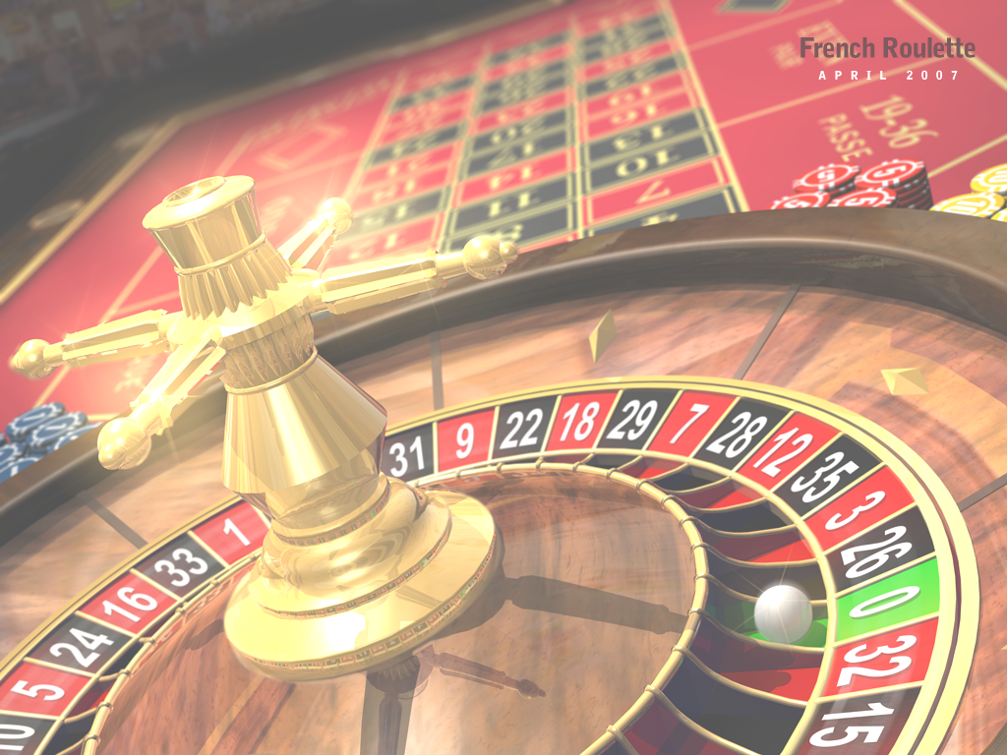
Game Theory & Addiction A Brief Introduction
Dr David Tarrant
davetaz@ecs.soton.ac.uk
Electronics and Computer Science
Notes:
Have a pack of cards and inform people that they can collect cards for responding and interacting in class.
However you cannot look at the cards until the end of the lecture.

Slide 2
Grade Game
Notes:
Get the pieces of paper back.
Draw on the board the table and record my grades in the squares.
Draw another table and add the pair grades.
Put both tables together.
First grade corresponds the row player.
Second to the column player.
Outcome matrix
Show of hands, how many choose Alpha and Beta.
Why did you choose Alpha?
* Better outcomes for choosing alpha no matter.
Why did you choose Beta?
* Don’t like swings. A = A to B- , B = B+ to C
* Be more conclusive (indignant angel), some people might care about others grades
Business School vs Divinity School.
This is not a GAME, missing pay-offs and objectives.
I cannot tell you what your pay-offs should be.
* Caring about your own grade is one pay-off.
* Caring about another is another pay-off.
Re-draw the grid with numbers.
* numbers represent utilities (their goals)
* A = 3, B+ = 1, B- = 0, C = -1
* Evil Gits
What should you do.
* No matter what the pair does, you get a higher payoff with alpha.
This strategy alpha strictly dominates strategy beta if my pay-off from alpha is strictly greater than that from beta regardless of what others do.
Lessons

Slide 3
Learning Outcomes:
Explain the _________ _______ and differentiate between ________ and ___-________ examples.
List 3 factors that affect human ‘satisfaction’
List 5 techniques that encorage addictive behaviour
List 3 specific strategies for game construction that encourage lengthy play time.

Slide 4
Grade Game Explanation
Notes:
Get the pieces of paper back.
Draw on the board the table and record my grades in the squares.
Draw another table and add the pair grades.
Put both tables together.
First grade corresponds the row player.
Second to the column player.
Outcome matrix
Show of hands, how many choose Alpha and Beta.
Why did you choose Alpha?
* Better outcomes for choosing alpha no matter.
Why did you choose Beta?
* Don’t like swings. A = A to B- , B = B+ to C
* Be more conclusive (indignant angel), some people might care about others grades
Business School vs Divinity School.
This is not a GAME, missing pay-offs and objectives.
I cannot tell you what your pay-offs should be.
* Caring about your own grade is one pay-off.
* Caring about another is another pay-off.
Re-draw the grid with numbers.
* numbers represent utilities (their goals)
* A = 3, B+ = 1, B- = 0, C = -1
* Evil Gits
What should you do.
* No matter what the pair does, you get a higher payoff with alpha.
This strategy alpha strictly dominates strategy beta if my pay-off from alpha is strictly greater than that from beta regardless of what others do.
Lessons

Slide 5
Lesson 1
Do not play a strictly dominated strategy.
Why?
Notes:
Why Lesson 1:
If instead I play the strategy that dominates it I do better.
Look at it this way if we both choose beta I do better. But then I could choose Alpha.
What is all this an example of?

Slide 6
Prisoners Dilemma
2 accused crooks in separate cells,
If neither rats the other guy out both go to jail for a year
If both rat each other out they go to jail for 2 years.
If you rat the other guy and he doesn’t rat you then he’ll go to jail for 5 years.

Slide 7
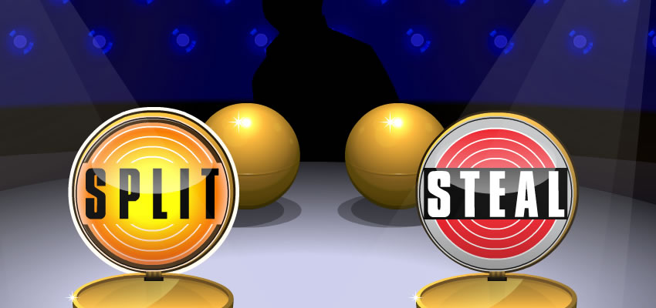
Golden Balls
http://www.youtube.com/watch?v=p3Uos2fzIJ0&feature=player_embedded

Slide 8
Golden Balls
Weakly Dominant Strategy
You can do no worse than the other player, but you can both lose.
Three Nash Equilibria in the Game:
Outcomes where a player can not do better on his or her own by changing his or her strategy

Slide 9
Contracts and Communication
Does communication help?
Who does it help?
Why?

Slide 10
End Video

Slide 11
Lesson 2
Rational choice can lead to outcomes that “suck”.
Notes:
Why Lesson 1:
If instead I play the strategy that dominates it I do better.
Look at it this way if we both choose beta I do better. But then I could choose Alpha

Slide 12
Indignant Angels (Coordination Problem)
 | A | B
A | 0, 0 | -1, -3
B | -3 , -1 | 1, 1
Pair
Me
No Dominant Strategy
For me:
(A,C) → 3 –4 = –1
(C,A) → –1 –2 = –3
Guilt
Indignation
Notes:
Show of hands on who choose what and why?
Best case scenario with Alpha is 0
Worst case with Beta is -3
So is there a dominant strategy.
Called a co-ordination problem.

Slide 13
Payoff’s Matter (lesson 3)
You can’t get what you want, until you know what you want.

Slide 14
Evil Git vs Indignant Angels
 | A | B
A | 0, 0 | 3, -3
B | -1, -1 | 1, 1
Pair (angel)
Me (evil)
A is Dominant Strategy
Notes:
You know the person you are playing against is an Indignant Angel.
A is dominant as is always higher than Beta
Skip in Lecture

Slide 15
 | A | B
A | 0, 0 | -1, -1
B | -3, 3 | 1, 1
Pair
Indignant Angels vs Evil Git
Me
A does not dominate B
15
My A does not dominate B.
By my pairs A dominates her B
So I know she is going to choose A
Notes:
Alpha does not dominate Beta in B,B case.

Slide 16
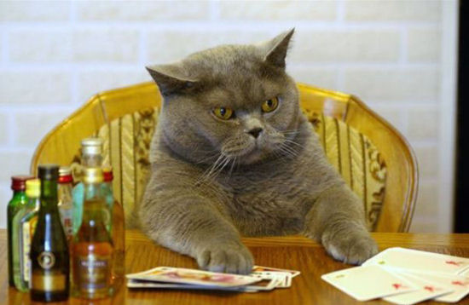
Lessons
Put yourself in others’ shoes and try and figure out what they will do.
Hard to figure out your opponents pay-offs.
Play the odds.

Slide 17
Grade Game Prediction
70% choose A
30% choose B
Notes:
Lesson: Soton students are evil.

Slide 18
Addiction
To be satisfied in work you need three things:
Autonomy
Complexity
Connection between effort and reward
Notes:
From the book Outliers (by Malcolm Gladwell)
Autonomy (that is, you have some say in what you do day to day);
Complexity (so it's not mind-numbing repetition);
Connection Between Effort and Reward (i.e. you actually see the awesome results of your hard work).

Slide 19
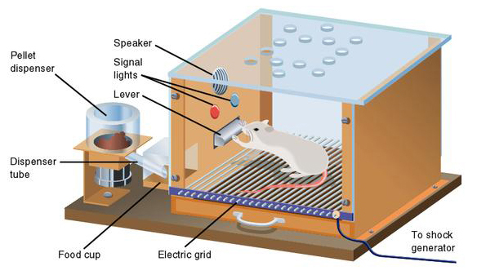
#5 – Putting You In a Skinner Box
Notes:
"Each contingency is an arrangement of time, activity, and reward, and there are an infinite number of ways these elements can be combined to produce the pattern of activity you want from your players.“ – Games researcher at Microsoft
Notice his article does not contain the words "fun" or "enjoyment." That's not his field. Instead it's "the pattern of activity you want."
His theories are based around the work of BF Skinner, who discovered you could control behaviour by training subjects with simple stimulus and reward. He invented the "Skinner Box," a cage containing a small animal that, for instance, presses a lever to get food pellets. Now, I'm not saying this guy at Microsoft sees gamers as a bunch of rats in a Skinner box. I'm just saying that he illustrates his theory of game design using pictures of rats in a Skinner box.

Slide 20
#5 – Putting You In a Skinner Box
Games are no longer $50 per game, complete and return/bin.
The big MMO’s make you do the same task over and over to get reward.
Carefully scheduled rewards are key to success.

Slide 21
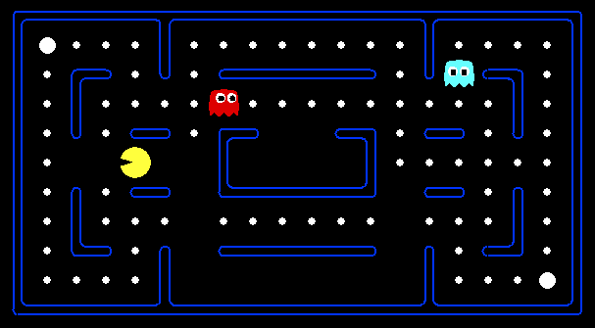
#4 Creating “Virtual” Food Pellets For You To Eat

Slide 22
Question?
How much is the “Virtual Goods” Industry now worth?

Slide 23
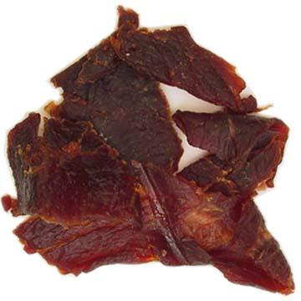
Your brain treats items and goods in the video game world as if they are real.
Because they are.
Notes:
People scoff at this idea all the time ("You spent all that time working for a sword that doesn't even exist?") and those people are stupid. If it takes time, effort and skill to obtain an item, that item has value, whether it's made of diamonds, binary code or beef jerky.
Is money now virtual? So how much are those 0’s and 1’s worth.

Slide 24
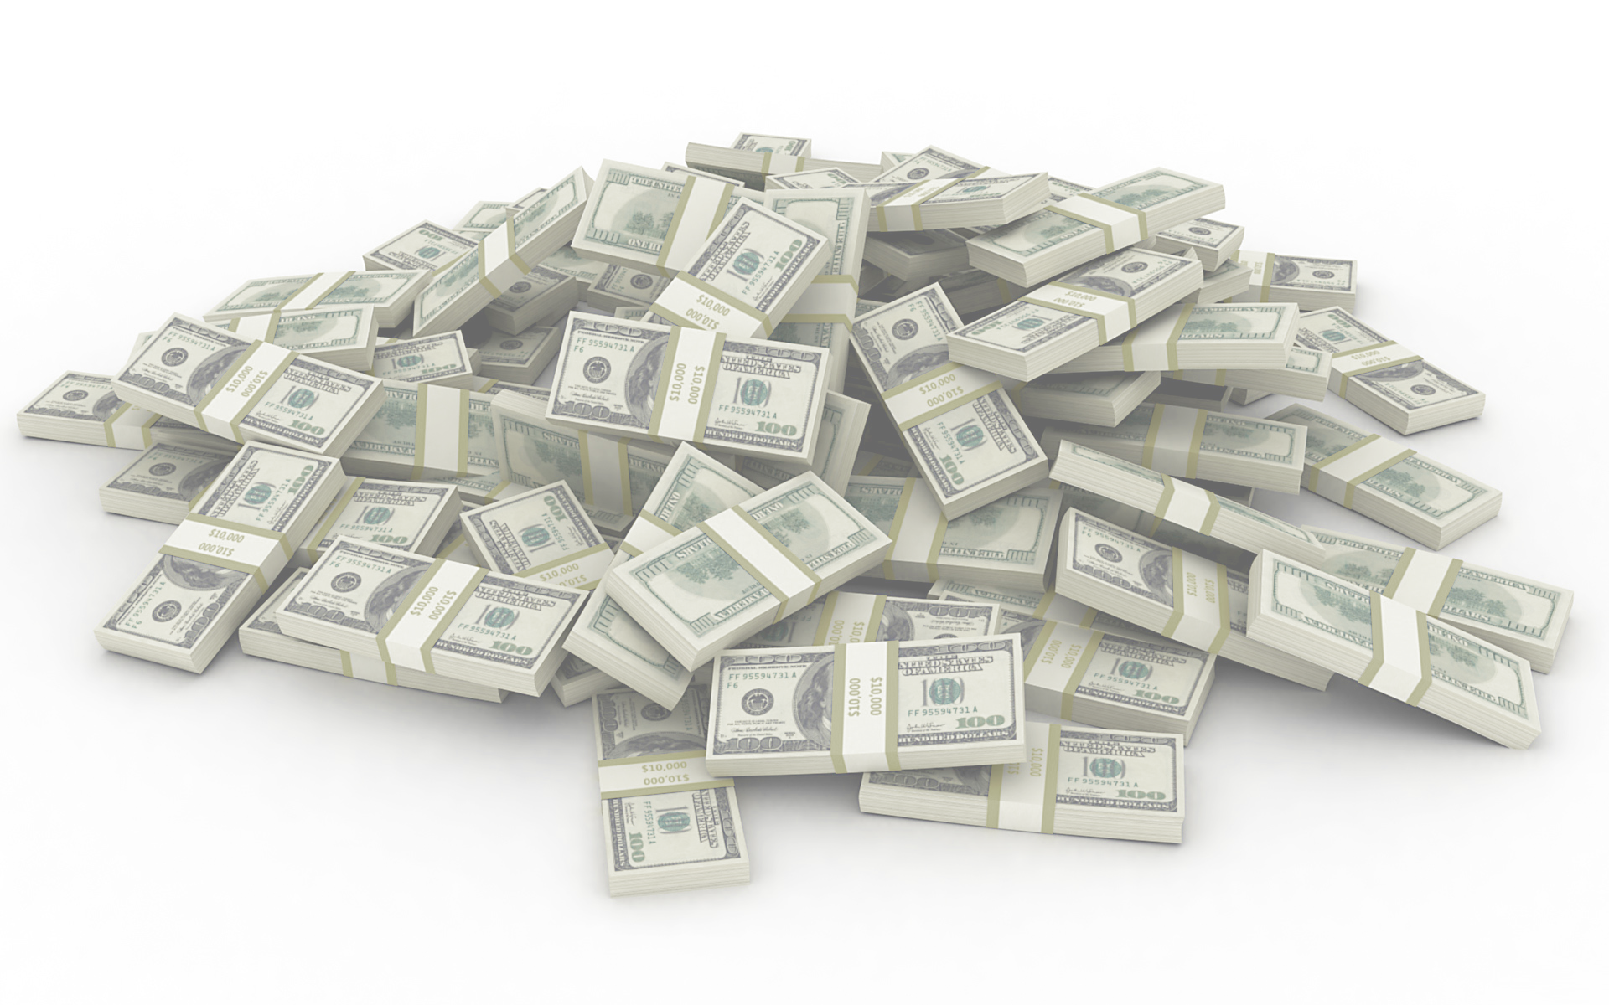
Answer:
How much is the “Virtual Goods” Industry now worth?
$5 billion
Notes:
And this goes hand in hand with perpetual MMOs or games where you transfer powers between each mission or edition.

Slide 25
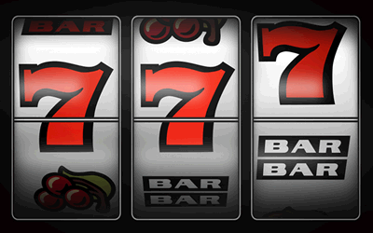
#3 Press the Lever!
Notes:
If you want to make a rat/hamster press the lever as fast as possible, how would you do it? Not by giving him a pellet with every press--he'll soon relax, knowing the pellets are there when he needs them. No, the best way is to set up the machine so that it drops the pellets at random intervals of lever pressing. He'll soon start pumping that thing as fast as he can. Experiments prove it.
They call these "Variable Ratio Rewards" in Skinner land and this is the reason many enemies "drop" valuable items totally at random in WoW. This is addictive in exactly the same way a slot machine is addictive. You can't quit now because the very next one could be a winner. Or the next. Or the next.
In these situations, like slot machines, scratch card games etc. The amount that is paid out is always relative to the cost per play. So 25c might win you $25 but $25 might win you $2500.
In either case the casinos can also change the odds in order to give up to 95% payback over time to get you addicted to the prospect of winning big time.

Slide 26
#3 Press the Lever!
Press to eventually get reward.
Press to get 1000 of one object.
Worse: Person who presses most in a day gets a reward at the end!
ZT Online does this for treasure chests which you open with a key.
The keys cost real money!

Slide 27
#2 Addiction to Pressing!
If the game does nothing but give random rewards for pressing, we’ll eventually get bored.
Human’s need long term goals.

Slide 28
#2 Method 1 – Easing In
Pellets come fast at first but then get slower and slower.
Levelling up in MMO
Once gamers experience the rush, the delayed gratification increases pleasure for player.
http://www.gamasutra.com/view/feature/3085/behavioral_game_design.php?page=1

Slide 29
#2 Method 2 – Eliminating Stop Points
Put save game points further apart.
Don’t inform the player of save points.
Really short “potato chip” levels.

Slide 30
#2 Method 3 – Play it or loose it
Don’t reward for pressing the lever, punish for not pressing it!
Things die, you die, points for movement etc…
Notes:
Ask for examples

Slide 31
Notes:
Note the electric grid

Slide 32
#2 Addiction to Pressing!
Skill and reward is how our brains develop as children.
Hunter gatherers is what we are!
The brain rewards us when we “win”.
The point is to keep you pressing, long after you have mastered the skills.
Combine lever pressing with other rewards. (WoW achievement system)

Slide 33
#1 Getting you to call the Skinner Box Home!
Autonomy:
The ability to define yourself online, make your own decisions.
Complexity:
Collect 40 of item A and 10 of item B to get item C. To find item A you need to get 3 keys.
Notes:
Would you ever call the skinner box home?
Does anyone think they can.

Slide 34
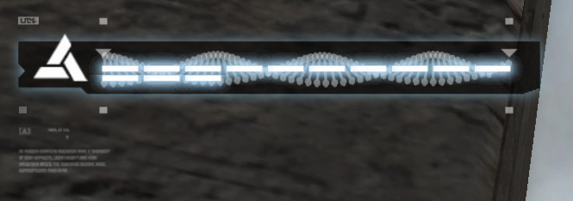
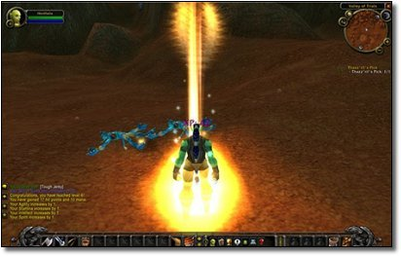
#1 Getting you to call the Skinner Box Home!
Connection between effort and reward

Slide 35
“Addiction is not about what you DO, but what you DON'T DO because of the replacement of the addictive behavior.”
Erin Hoffman – Video Games Designer

Slide 36
Summary
Think about pay-offs in your game and the strategy you are allowing people to play.
For a continued Rich-Application, think about if you can stomach addiction strategies.

Slide 37
Learning Outcomes:
Explain the Prisoners Dilemma and differentiate between dominant and non-dominant examples.
List 3 factors that affect human ‘satisfaction’
List 5 techniques that encourage addictive behaviour
List 3 specific strategies for game construction that encourage lengthy play time.

Slide 38
Resources
Game Theory Lecture Series at Yale:
http://oyc.yale.edu/economics/econ-159/lecture-1
Golden Balls and the Prisoners Dilemma
http://welkerswikinomics.com/blog/2009/04/10/golden-balls-gamaae-theory-the-prisoners-dilemma-and-the-cold-rationality-of-human-behavior/
Addiction in Modern Games
http://www.cracked.com/article_18461_5-creepy-ways-video-games-are-trying-to-get-you-addicted_p2.html

Slide 39
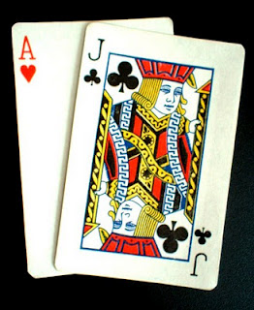
Blackjack (21)
Aim is to get closest 21 (or 21)
All pictures are worth 10
Ace is 11
You play against the dealer only
Dealer must hit at least 17 and then has to stick.
Winnings
Double your bet + another ½ (so 250%)
Beat the dealer to receive double your bet.

Slide 40
Odds
In One Pack:
4/52 aces (1 in 13)
16/52 value 10 cards (4/13)
20/52 cards force dealer to hit (5/13)
Logically however, if a player draws a 10 on their first card, then the subsequent probability of drawing an ace is higher with fewer decks.

Slide 41
Odds
In One Pack:
4/52 aces (1 in 13)
16/52 value 10 cards (4/13)
20/52 cards force dealer to hit (5/13)
Logically however, if a player draws a 10 on their first card, then the subsequent probability of drawing an ace is higher with fewer decks.

Slide 42
House Advantages
Number of Decks | House Advantage
Single deck | 0.17%
Double deck | 0.46%
Four decks | 0.60%
Six decks | 0.64%
Eight decks | 0.66%
Roughly speaking however most games have a house edge of between 0.5% and 1%, making Blackjack one of the cheapest games to play.

Slide 43
Beating the House
Card Counting, you get to see all the cards as they are played
Wear Markings
Shuffle Tracking

Slide 44
Problems with the 1%?
Problem is that the dealer has unlimited money.
People are greedy and un-trained.
Time pressures
Addicted to the reward

