Slide 1
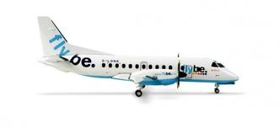
Research Proposal for Flybe
Advertising Design Management Pathway
Runjie Xia (Lucie)
24886203

Slide 2
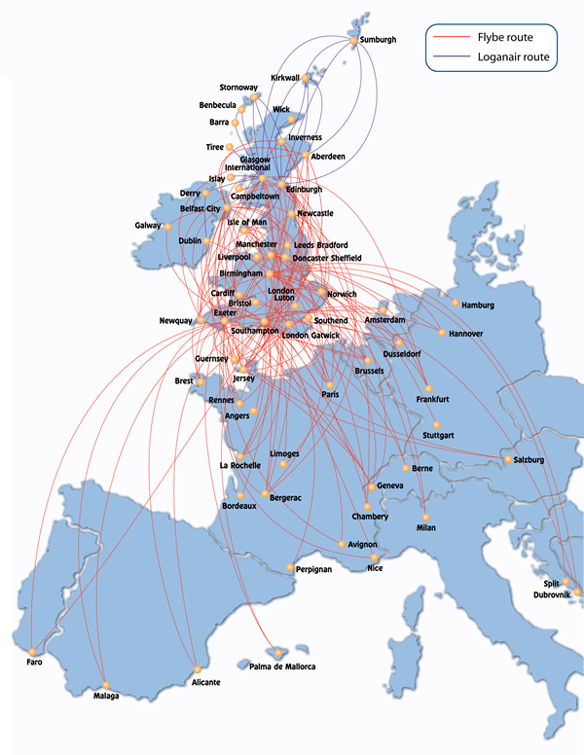
Introduction
UK based low cost airline
UK domestic routes & EU routes
Notes:
Flybe is a British airline based in Southampton, Manchester, Birmingham and Belfast. The airline also operates a franchise agreement with Scottish airline Loganair
UK’s largest domestic carrier 2009

Slide 3
Management Issue
Share routes, miles points, aircrafts and landing slots.
Cooperation with AirFrance
Stock price
declined 36%
Economic Crisis
2008
2009
2010
2011
Profit
Warning
Profit
Warning
Fuel price increase, Travel demand decline, small airline bankrupt….

Slide 4
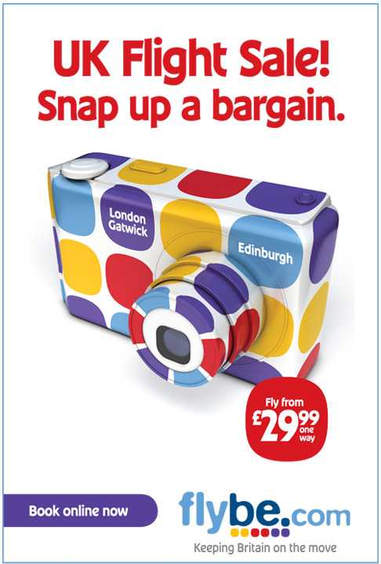
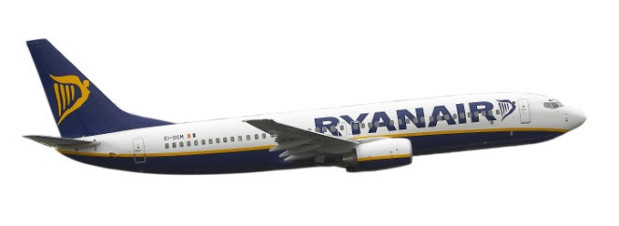
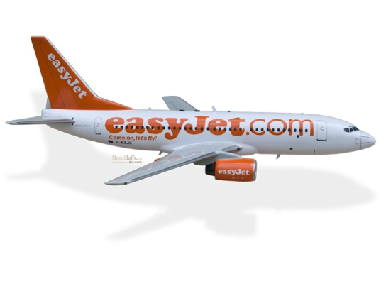
Management Issue
Should Flybe continue cooperate with AirFrance?
Cheap! Cheap! Cheap!
Cheap + Added values
Notes:
Low brand awareness- lack of promotion
Brand positioning-stratigic clock
confusing the customers.
Low brand awareness- lack of promotion
Brand positioning-stratigic clock
confusing the customers.

Slide 5
Research Questions
What effects will be caused by the cooperation with AirFrance
Customer
Who are their main passengers, are they Flybe really target?
What do Flybe’s customers really need?
Why did customers chose Flybe, what are they most care about(price, service, destination)…..
Brand
Is Flybe brand awareness hign or low?
What do their consumers perceive the brand position of Flybe as?
Will their perceptions about Flybe change, after the cooperation….

Slide 6
Methodology
Primary research:
Focus Group 1-Never heard
Focus Group 2-know but no try
Focus Group 3- tried & know
(4-6 people)
Location: WSA campus
Focus Group
Data Analysis
Questionnaires
5000 questionnaires
Location: Southampton Airport, Birmingham Airport, Manchester Airport.

Slide 7
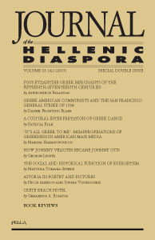
Methodology
Secondary research: Book, Online resources (WARC, Key Note…), journals, previous research.

Slide 8
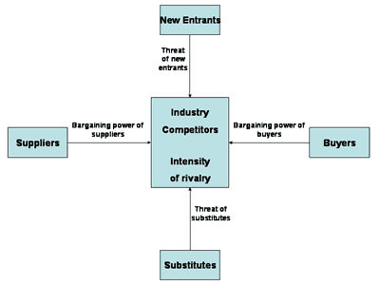
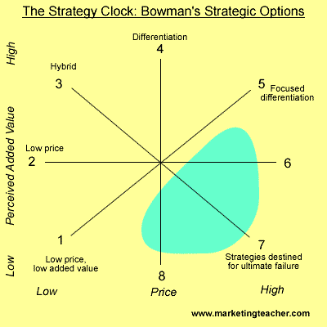
Supporting Theories
Porter’s Five Force Analysis
Bowman’s Strategic Clock, Brand positioning
Consumer Oriental
More…

Slide 9
Timeline
Tasks | Dec | Jan | Feb | Mar | Apr | May | Jun | Jul | Aug
Data collection
Primary data
Secondary data
Data analysis
Final submission

Slide 10
References
Sayre, S. (2001), Qualitative Methods for Marketplace Research, London: SAGE
WARC (2006), Global industry overview: Air Transportation. [Accessed: 07 Nov 2011]
Graham, B. & Shaw, J. (2008), Low-cost airline in Europe: Reconciling liberalization and sustainability, Geoforum, Vol. 39, pp.1439-1451
Dobruszkes, F. (2006), An analysis of European low cost airline and their networkes, Journal of Transport Geography, Vol. 14, pp. 259-261
Mason, K. J. & Alamdati, F. (2007), EU network carriers, low cost carriers and consumer behaviour: A Delphi study of future trends, Journal of Air Transport management. Vol.13, pp.299-310
Johnson, G & Scholes, K & Whittington, R. (2009) Fundamentals of strategy. Essex: Pearson Education Limited.
Flybe, Company history, [Online], Available: http://www.flybe.com/corporate/about-flybe/, [Accessed: 7th November 2011].
Milmo, D. (2011), Flybe profit warning sends share price crashing down. [Online], Available: http://www.guardian.co.uk/business/2011/may/05/flybe-profit-warning [Accessed: 5th November 2011]
Mcwhirter, A. (2010), Flybe to codeshare with Air France. [Online], Available: http://www.businesstraveller.com/news/flybe-to-codeshare-with-air-france. [Accessed: 3th November 2011]
Harvey, G. & Turnbull, P. (2010), Walking the high road at a low cost airline, The International Journal of Human Resource Management. Vol.21, No.2, pp. 230-241

