Slide 1
Research Methods and Methodology Introduction for INFO1010
Hugh Davis and Su White
WAIS
ECS
The University of Southampton, UK
users.ecs.soton.ac.uk/hcd

Slide 2
Purpose of this lecture
The pupose is to
Formalise understanding of research process
So that you can
Understand that there are many possible research methods
Explain the rationale for your chosen methodology for a particular piece of research (i.e. what method and why its appropriate).

Slide 3
The logical positivist tradition of scientific method
Students are using Facebook to collaborate on their learning
Observation
The use of Facebook to collaborate will effect performance
Theory
Method to test hypothesis
??
(see next slide)
Students who collaborate using Facebook will achieve higher marks than those who do not
Hypothesis

Slide 4
Method
I asked the all 143 members of the class of 2009-10 whether they used facebook to collaborate on learning for my course, and split them into the two groups
I looked at the average marks of both groups.
The group who used Facebook scored an average of 68.2% on the course (SD 9.52) and the group who did not scored an average of 59.4% (SD 7.34%)
This enables me to predict with a high confidence level (that I could calculate) that using Facebook Improves Learning.
Or does it? – in small groups, discuss

Slide 5
Critisism
Were we measuring the benefit of *Facebook* to collaborate or the benefit of *Collaboration* ?
There could be other (confounding) factors – e.g. maybe the students who used Facebook were more engaged – so were going to do better anyway.
It is not really interesting to know that the Facebook collaborators did better without knowing *why* they did better

Slide 6
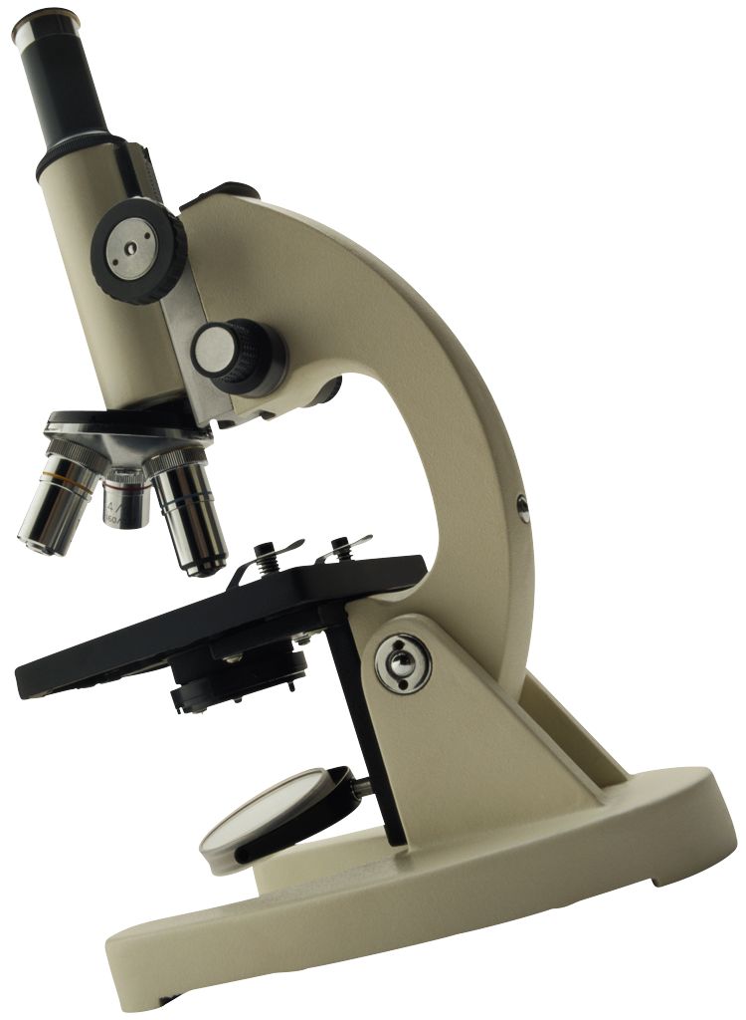
Method and Methodology
Method
the tools, techniques and instruments of (scientific) investigation
Methodology
the principles that determine how such tools are deployed and interpreted.
A body of practices, procedures, assumptions and rules used by those who work in a discipline or engage in an inquiry;
an acknowledged, defined or recognised set of working methods

Slide 7
approaches
measure
observe
model
experiment
investigate
theorise
test

Slide 8
Some research methods
Ethnographic study
Interview
Survey
Case study
Meta analysis
Mixed methods
Action research
Focus
group
Nominal
group
Network
analysis
Simulation
Observation

Slide 9
Research traditions*
Positivism
Interpretivism
Social Constructionism
Critical approaches
*Are these paradigms? (c.f. Thomas Kuhn 1962)
Considering the definitions which are you most familiar with or most comfortable with?
Do you recognise them from the abstracts?

Slide 10
Positivism
Realist (assumes that there is a stable reality ‘out there’ independent of what we think about it)
Empiricist (we know by observing)
Objective (value-free inquiry, rational and neutral, free from bias)
‘mature’ sciences will all share the same scientific methods which seek to establish cause and effect, generate laws etc

Slide 11
Interpretivism
Human beings are not like the objects of study in other ‘sciences’; they have views which they can tell us about and they can change behaviours ‘at will’
therefore
we need to understand people’s interpretations of the world, understand the meaning and significance of the world for people who live in it.

Slide 12
Social constructionism
Questions the very idea of a pre existing reality (relativist) and argues that ‘reality’ is socially constructed
this leads to questions about how this ‘construction’ happens; who ‘makes and sustains’ particular versions of reality?

Slide 13
Critical approaches
Science is a social process so cannot be separated from the social world (it can never be objective)
Research/science is political (it should not be value-free)
Methodology should strive to expose power; e.g. feminist methodology
Science should be moved away from a small elite and used to liberate/emancipates (e.g. participatory/action research)

Slide 14
How can we study the world?
Experiment – identify causal relationships by comparing measures from an experimental and a control group before and after an intervention.
Naturalism – study people/phenomena in their ‘natural’ occurring environment, e.g. people tell their own story, or observe everyday interactions/behaviour

