Slide 1
Organisational
Perspectives
Su White

Slide 2
Today
Housekeeping
….
Thinking about organisations and you ☺
Organisation types
Your preferences
Typical destinations
Suggestions for the vacation…

Slide 3
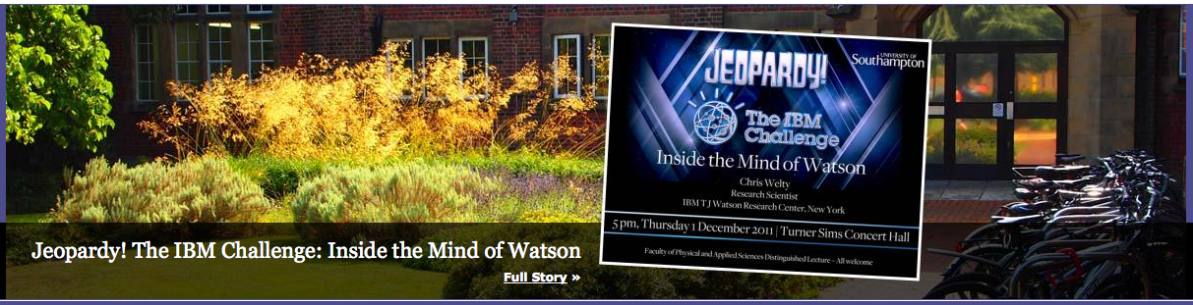
reminder
i) 17:00 – public lecture or small group
ii) group choices

Slide 4
Today
Consolidate work from INFO1010
Reflection on progress this term (overall)
Give you a few objectives for the vacation
Suggestions for some web browsing
Prepare you for those awkward family christmas conversations ;-)

Slide 5
Why do we want to know?
Personal…
Generic….
No apologies – this revisits some stuff from earlier in the term
BUT perspective is different!
… organisations and how they work
Notes:
Personal
Future careers
Understanding the world
Sources of funding

Slide 6

What sort of organisation?

Slide 7
Small businesses
~95% of UK employees in the UK in businesses with less than 100 staff
Most satisfied
Committed and loyal
Less stress
Less complaints about working hours
Only 14% grads go into graduate training schemes

Slide 8
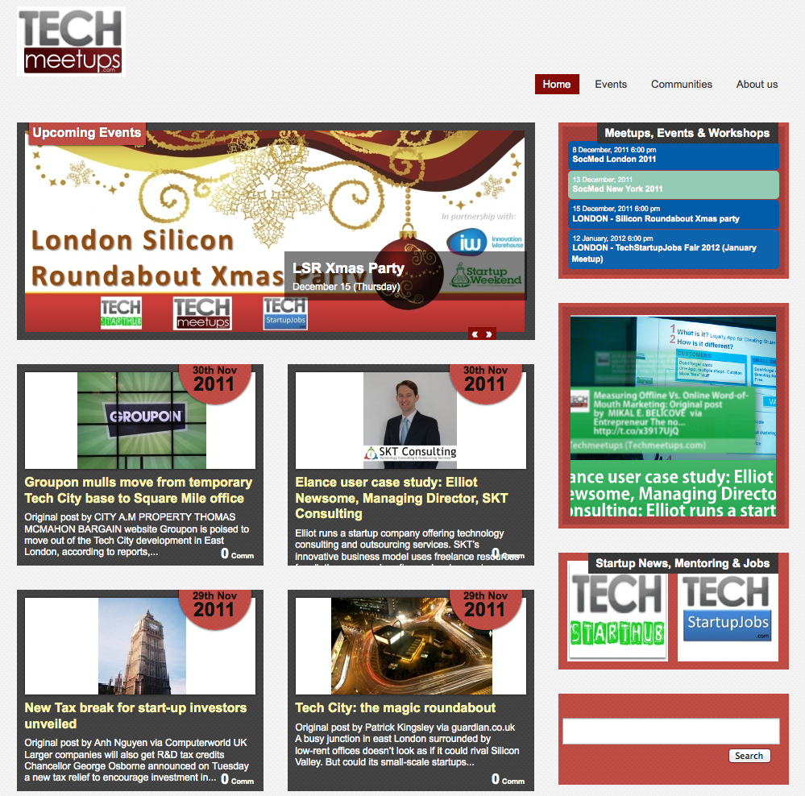

Tech startups

Slide 9
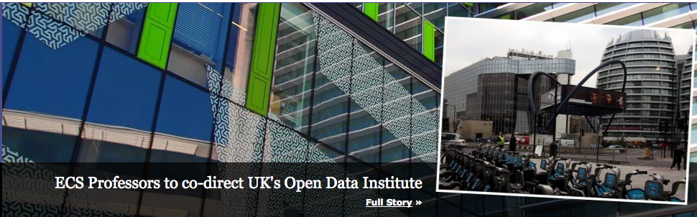
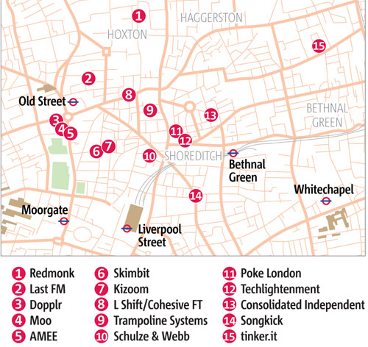
Silicon Roundabout

Slide 10

What sector?

Slide 11
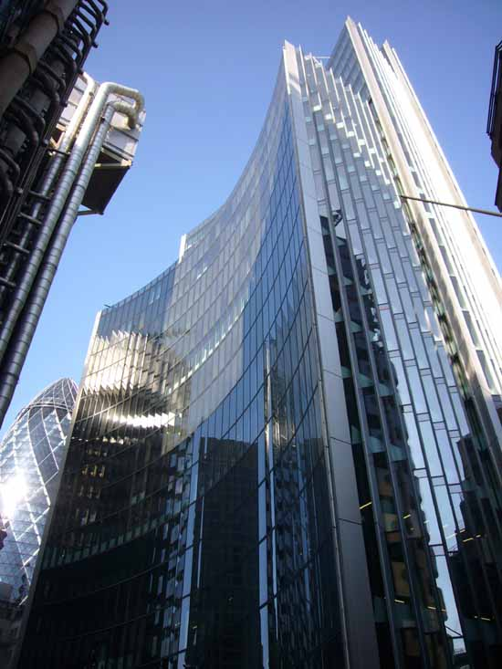
Roles and Infrastructure
Where will you be?
What team will be yours?
Management
Support
Infrastructure
Core
It will vary by organisation….

Slide 12
Expertise on Campus
  Career Destinations
  What Graduate Recruiters look for when selecting graduates
  The importance of team working
  Perceptions of ECS students and how they rate their employability
  What ECS students have gone on to do
  Where to go to find out more

Slide 13
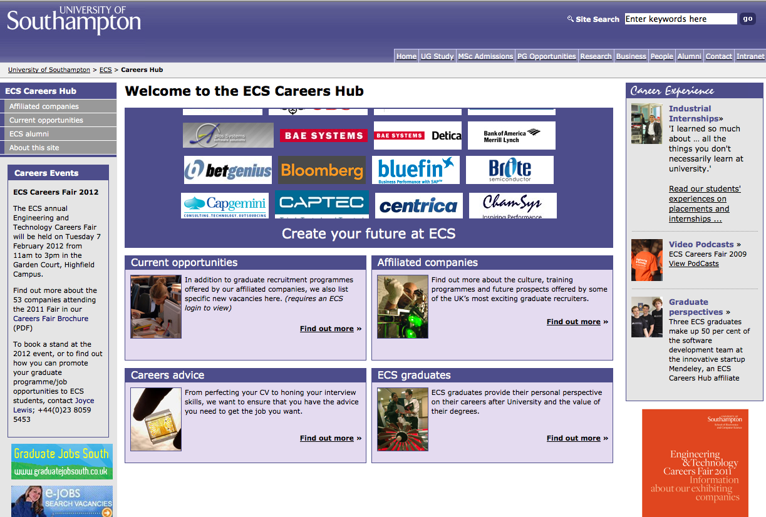
Careers Hub

Slide 14
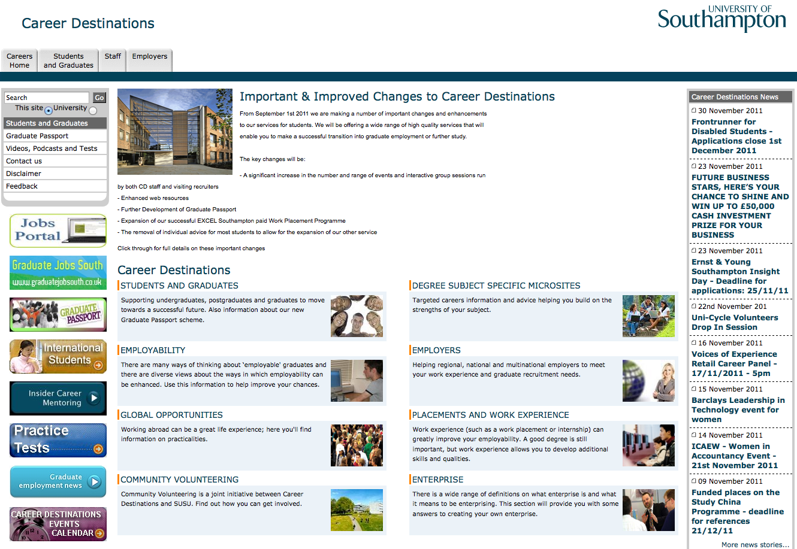
Career Destinations

Slide 15
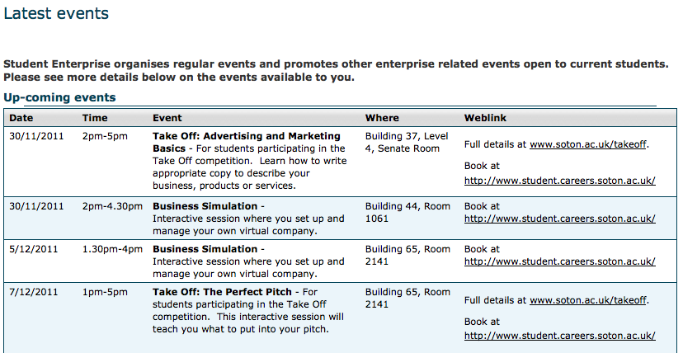
Student Enterprise

Slide 16
The changing world of work
Technology
Globalisation
The power of the customer
Flatter structures
Multi-skilling and re-skilling of the workforce
Change is the only constant
Uncertainty and volatility

Slide 17
The changing career
Only 65% of graduates go straight into work
Many graduates go into jobs rather than careers after university
End of a job for life
Many graduates will have several careers in their working life
Changing life styles
A career path is like crazy paving and you have to lay it yourself!

Slide 18
Changing recruitment practice
Seeking needles in haystacks
Using on-line technology
  High volume low access to low volume high success
On-line applications
Self-deselection tools
Competency based selection models
Employment trials

Slide 19
Think, pair, share
Five Minutes….
Where would you like to fit in to an organisation
For your first job
By the time you have been working for three years…

Slide 20
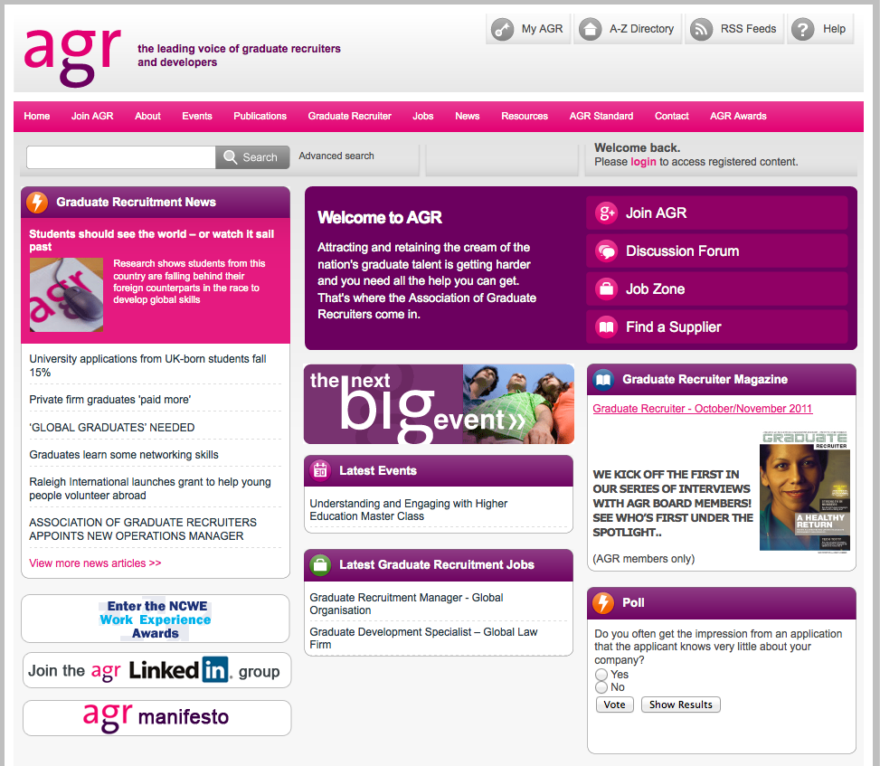
Association of Graduate Recruiters

Slide 21
Rate Yourself: 2 mins
important
scarce
Important skills | Difficult to find skills
1. Motivation & enthusiasm | 1. Commercial awareness
2. Team working | 2. Leadership
3. Oral communication | 3. Risk taking/enterprise
4. Written communication | 4. Project management
5. Flexibility | 5. Managing own learning
6. Customer focus | 6. Second language
7. Problem solving | 7. Problem solving
8. Managing own learning | 8. Customer focus
9. Commercial awareness | 9. Report writing
10. Planning and organisation | 10. Cultural sensitivity
Skills and attributes checklist: Top ten in 2006 (AGR)

Slide 22
Global graduates
1. A global mindset
2. Global knowledge
3. Cultural agility
4. Advanced communication skills
5. Management of complex interpersonal relationships
6. Team-working and collaboration
  work collaboratively and empathetically with diverse teams
  from across the globe.
7. Learning agility
8. Adaptable, flexible, resilience, drive and self-awareness

Slide 23
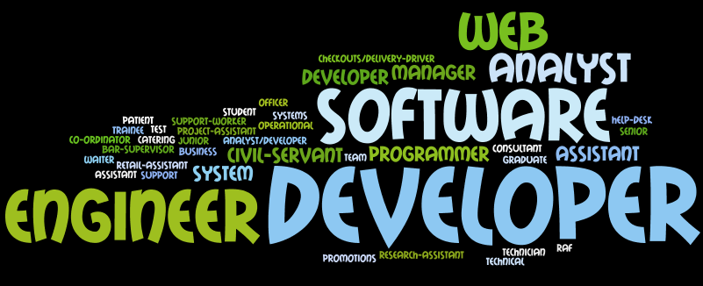
Typical Roles

Slide 24
Roles and Destinations ‘07
  Systems Engineering,
  Air Traffic Control
  Graduate Trainee Engineer, Ministry of Defence
  Electronic IT Consultant,
  Detica
  Electronic Engineer,
  Finlow Engineering
  Analyst, Accenture
  Porting Programmer, making games for mobile phones, IOMO
  Graduate Technologist,
  CAP Gemini UK PLC
  Lead Developer for internet company, www.moneysavingexpert.com
  Facilities Runner, visual effects and post production, feature film co
  Software Analyst,
  Scott Wilson
  IT Graduate Trainee,
  HSBC

Slide 25
Roles 09-10
Web Developer*
Assistant Technical Manager
RAF Officer Trainee
Operational Analyst
IT Help-Desk
System Analyst/Developer
Software Engineer*
Developer
Senior Analyst
IT Engineer
Programmer/Analyst Programmer*
IT technician
Test Engineer
Project-Assistant
Research-Assistant
Business Analyst
Consultant
System Developer
Software Developer*
Graduate Software Engineer
Civil-Servant*
IT support team student assistant

Slide 26
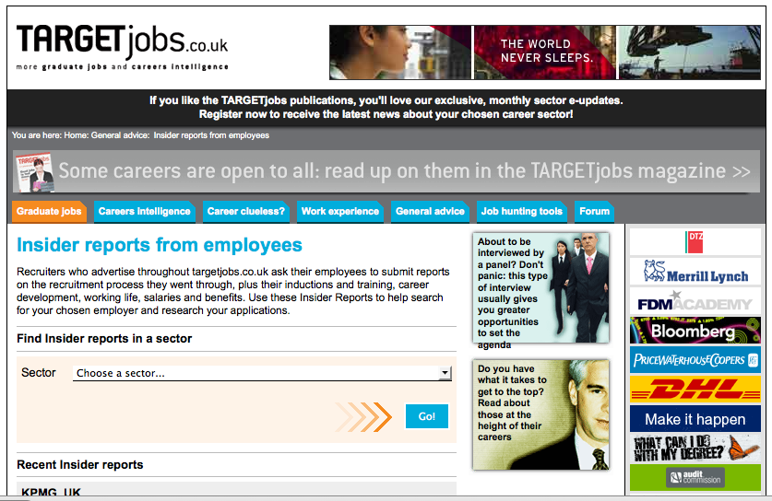
Get some inside information….

Slide 27
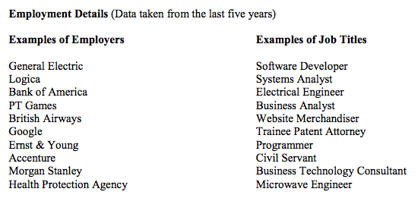
Destinations overview

Slide 28
Your challenge
Go social (professional)
  Linked in
  Twitter, blog
  Outings and visits
Go online sleuthing…
  Soton alumni, destinations
  Your ideal employer(s)…
Go cerebral
Think about what you would enjoy doing
Organise
Yourself (and/or your friends)

Slide 29
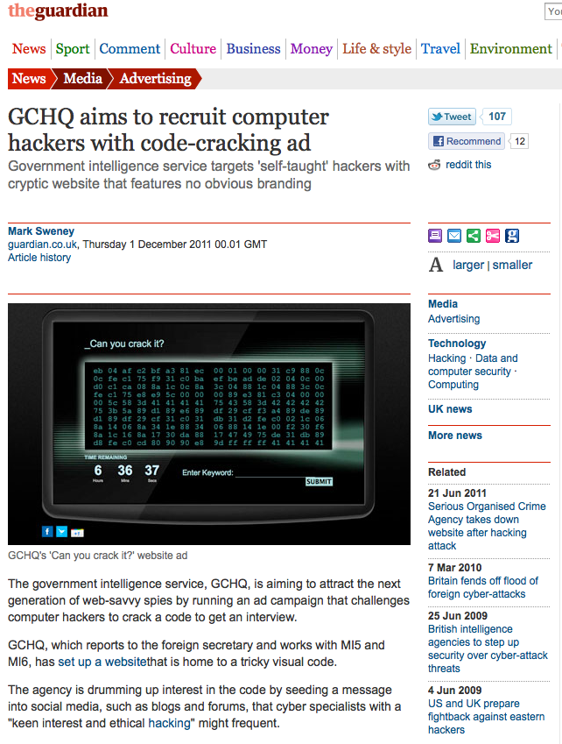
Aside…
http://www.canyoucrackit.co.uk/

Slide 30
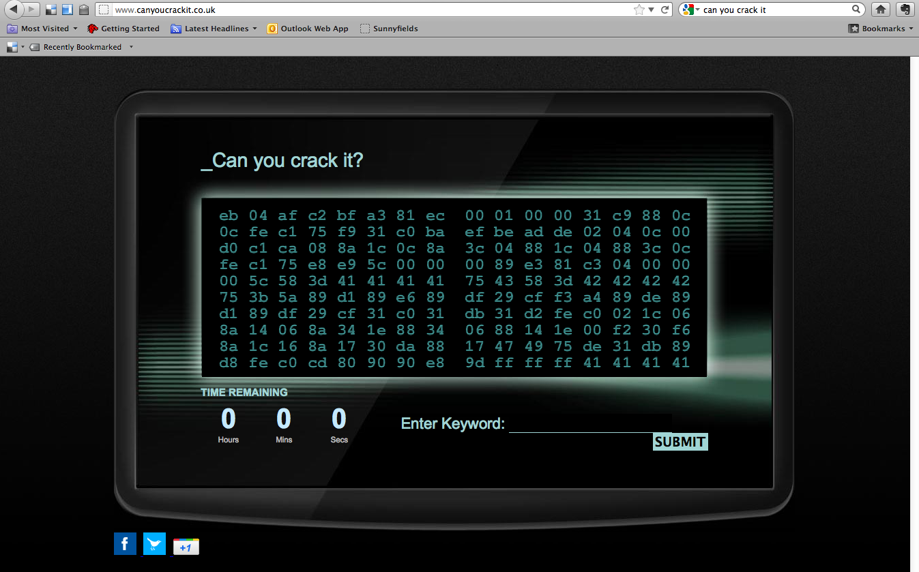

Slide 31
reminder

Slide 32
Thank you ;-)
Su White
saw@ecs.soton.ac.uk
+44 (0)23 8059 4471
http://www.ecs.soton.ac.uk/~saw

