Slide 1
COMP6049 Surveys: Purpose Paradigms Protocols and Pragmatics November
Dr Su White http://www.edshare.soton.ac.uk/3747/

Slide 2
Introduction and Objectives
How I will run this class – with you! What I want – us all to think! What do you want? – keep that in sight
Notes:
This class is a bit different in its format
Use OHPs to explain interactive approach
Use OHPs to set thinking tasks Use Coloured Cards to record student objectives

Slide 3
The plan
I may skip over some slides, but use them as notes
Surveys – what are they
All the time… considering what we know already about research methods
Linking methods to design
Conclusion/reflection
Notes:
5/10 WK 1 Background and course structure by LC & SAW Susan White: anecdotal tales of an exemplar of interdisciplinary research.
12/10 WK 2 Comparison/ Social science methodologies (Gerry Stoker introduced by LC. SAW to listen.) BOTH LECTURES ACTUALLY ON THURSDAY 10-11:30
19/10 WK 3 Research design Su White?
Background and course structure by LC & SAW Su White: anecdotal tales of interdisciplinary research. Intro by CP Methodology & method, strategies and underlying philosophies Disciplinary and paradigm differences and how they influence research practice 12/10 Comparison/ Social science methodologies Prof Gerry Stoker . BOTH LECTURES ACTUALLY ON THURSDAY 10-11:30 Experiments /causality Prof Gerry Stoker 19/10 Research design

Slide 4
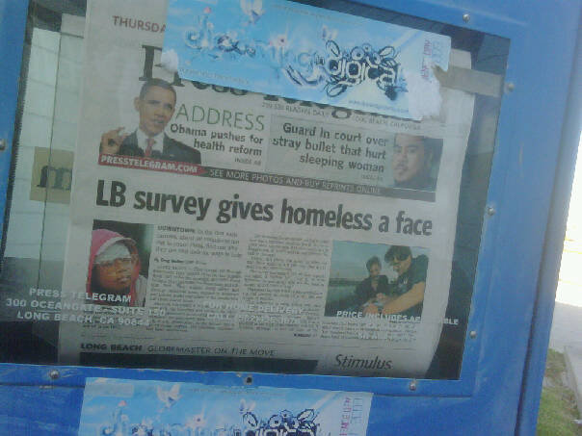
Surveys we know and love
National Student Survey
Module Evaluations
Vox Pop
‘evidence’ based practice
NICE
Populist?

Slide 5
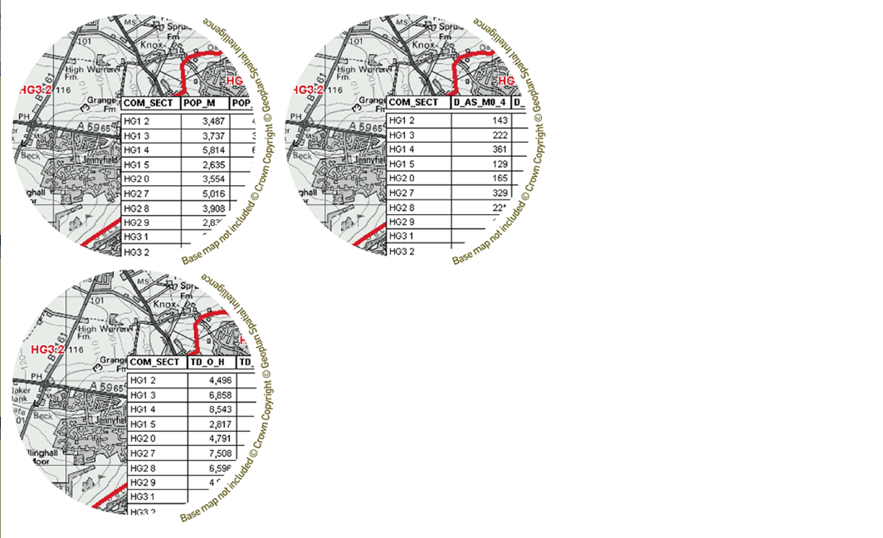
All surveys have data - somewhere

Slide 6
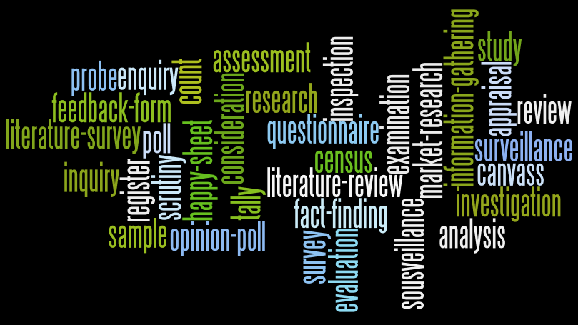
Thinking about surveys…

Slide 7
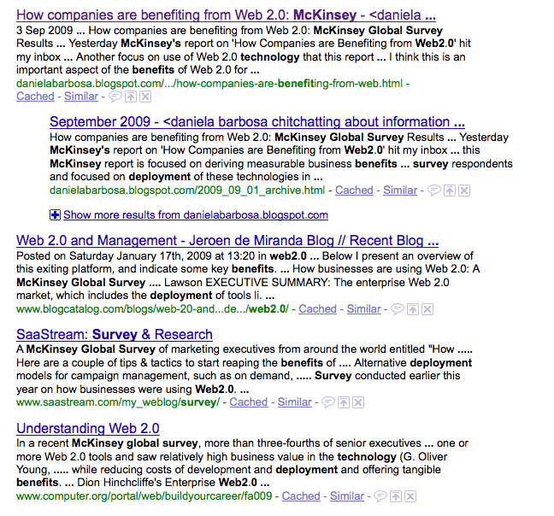
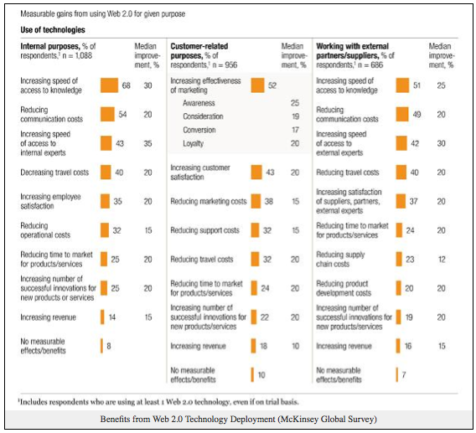
Surveys grab attention…

Slide 8
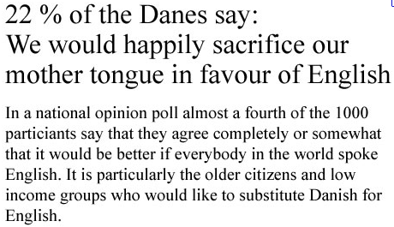
Surveys grab headlines
source: qualitativeresearch.net

Slide 9
Approaching a survey
Purpose
Protocols
Pragmatics
Paradigm

Slide 10
Purpose
Why do we conduct research?
Validate
Confound
Generate new evidence
What sort of evidence
Convincing
Objective
Valid
Does this raise issues?
Enable analysis
Generate Conclusions
Publication

Slide 11
Purpose: to publish…
This is the way the world is (survey?)
This is what is wrong with the world (evidence?)
This is my startling idea (remember paradigm/epistemology)
This is what I found (valid method, evidence and conclusions)

Slide 12
Paradigm
Epistemology
Will determine where we start
Where we want to engage in discourse
May constrain our beliefs
May determine the contents of our survey
Methodology
What sort of survey?
What sort of data
Anticipates analysis

Slide 13
Paradigm: What tools do we have?
Methodology – a way of thinking about or studying (social reality)
Method – a set of procedures and techniques for gathering and analysing data
Analytical Processes – the application of set techniques appropriate to quantitative or qualitative methodologies
Thanks (in part) to Strauss and Corbin)
Notes:
Background and course structure by LC & SAW Su White: anecdotal tales of interdisciplinary research. Intro by CP Methodology & method, strategies and underlying philosophies Disciplinary and paradigm differences and how they influence research practice 12/10 Comparison/ Social science methodologies Prof Gerry Stoker . BOTH LECTURES ACTUALLY ON THURSDAY 10-11:30 Experiments /causality Prof Gerry Stoker 19/10 Research design

Slide 14
What type of survey?
Telephone surveys
Self-administered questionnaires: mail surveys and other applications
Internet surveys
IVR: Interactive Voice Response
Mixed mode surveys
Also includes face-to-face interviews
Our interest today is surveys which gather predominantly quantitative data

Slide 15
Paradigm: an example…
Folksonomies are internet based collections of user assigned labels, or “tags”, for web resources. There is a debate within the Web Science community as to the importance of social tagging in general, and folksonomies in particular.
This report surveys a range of current social tagging systems and distinguishes between true folksonomy systems such as Del.icio.us, which attempt to enhance the classification of resources, and simple tagging systems such as Flickr, which merely improve description.
The paper concludes by describing some research work in progress to extract semantic metadata from folksonomies in order to improve search engine performance.

Slide 16
Or this….
In recent years, under the impacts of educational reform, economic changes, and globalization… Therefore, the researcher, an ESP teacher with over twenty years' teaching experience, intended to explore the ESP pedagogy, design and teach an ESP course, and employ the phenomenographic approach to examine ESP teaching and learning.
The qualitative data were collected from an online syllabus survey, needs analysis survey, student journals, and individual interviews with 19 adult ESP learners. The researcher developed a constructivist, e-learning model for ESP teaching which encompasses the fields of EFL teaching, adult learning, and cross-cultural study, and learning psychology.
The phenomenographic study identified four major categories of ESP learning conceptions which are: following, discussing, applying, and reflecting.

Slide 17
Or this…
Patterns of students’ use of technologies
The paper describes the findings from a study of students’ use and experience of technologies. A series of in-depth case studies were carried out across four subject disciplines, with data collected via survey, audio logs and interviews.
The paper will concentrate on the survey data, which consisted of a mixture of qualitative and quantitative results. It will compare this findings with related international surveys on students use of technologies and argue that taken together this wider body of evidence indicates that students are immersed in a rich, technology-enhanced learning environment and that they select and appropriate technologies to their own personal learning needs.
The paper concludes by suggesting that the findings have profound implications for the way in which educational institutions design and support learning activities.

Slide 18
Protocols
Ethics, Privacy and Data Protection
Just think about the personal…
You are asking for information
Respect your contributors
You don’t want to bias the outcomes
Protocols may help

Slide 19
Pragmatics
Constraints
Timing and access
Population/sample size
Consequences
Data Volume
Design
Expertise
Tools
Draft and Review
Solutions
Smart surveys
Existing data
Previous Surveys
Sanity Check
Peer Review
Process
Pre-test/Trial/Pilot …then survey
Follow up survey

Slide 20
Pragmatics – bringing it together
What you want to explore/find out/prove/discover?
Who will you survey?
How you will do it?
What you will ask?
Pre-test, pilot
Conduct survey/collect data
Analyse data
Interim conclusions/discussion/
Draft, review, publish

Slide 21
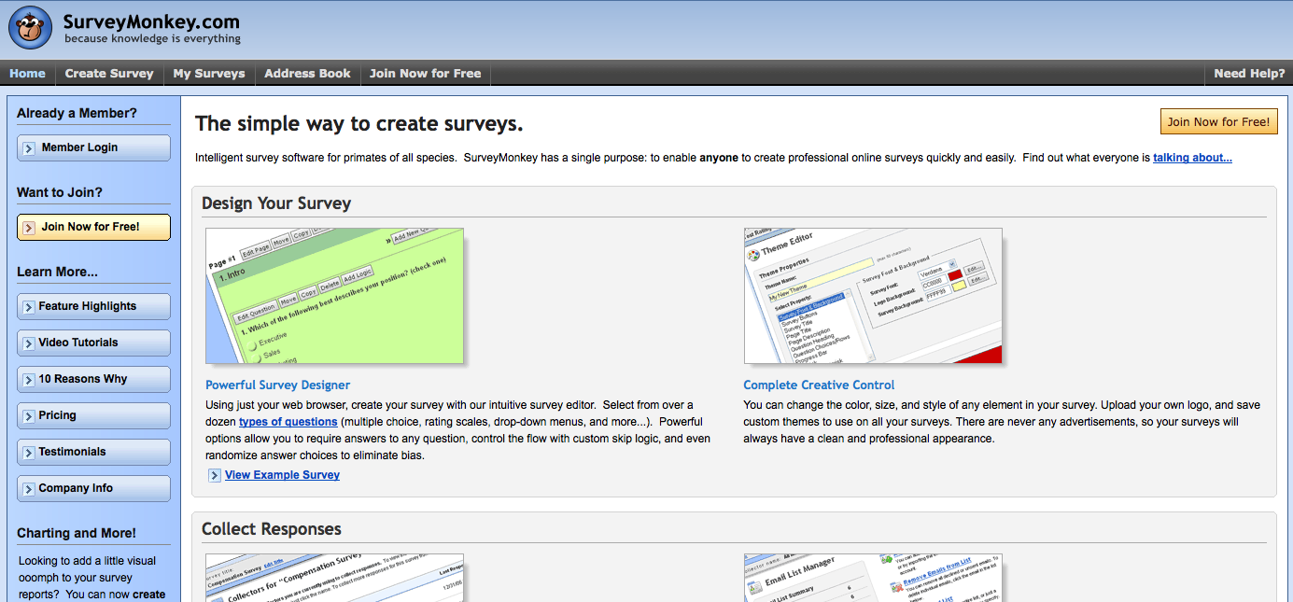
Pragmatics: some options

Slide 22
Pragmatics – some options
Thanks to Tony Hirst http://ouseful.wordpress.com/2009/02/17/creating-your-own-results-charts-for-surveys-created-with-google-forms/

Slide 23
iSurvey – the soton survey tool
http://www.isurvey.soton.ac.uk/

Slide 24
References
for background and related material and references please see the course web page (resources)
Useful text:
International handbook of survey methodology de Leeuw et al, 2008
Available from library, also supported by companion web site
http://www.xs4all.nl/~edithl/surveyhandbook/contents.htm

Slide 25
references
Research design : qualitative, quantitative, and mixed methods approaches Creswell, John W.
Summary
The third edition of this textbook on qualitative, quantitative and mixed methods of research design has been expanded to include new information on ethics, web-based technologies and an updated glossary that reflects these new technologies. Creswell (U. of Nebraska- Lincoln) has aimed this book at students in the behavioral and social sciences who need to sharpen research skills in terms of methodology and overall purpose. Topics include the use of theories to establish a research design, writing out strategies and ethical considerations and the growing trend toward mixed methods of research. Annotation ©2008 Book News, Inc., Portland, OR (booknews.com)
Creswell 2009
Notes:
Research design : qualitative, quantitative, and mixed methods approaches Creswell, John W.
Summary
The third edition of this textbook on qualitative, quantitative and mixed methods of research design has been expanded to include new information on ethics, web-based technologies and an updated glossary that reflects these new technologies. Creswell (U. of Nebraska- Lincoln) has aimed this book at students in the behavioral and social sciences who need to sharpen research skills in terms of methodology and overall purpose. Topics include the use of theories to establish a research design, writing out strategies and ethical considerations and the growing trend toward mixed methods of research. Annotation ©2008 Book News, Inc., Portland, OR (booknews.com)

Slide 26
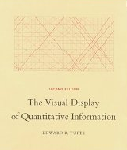
Further Reading
Moore McCabe and Craig - Introduction to the practice of statistics (and associated excel manual)
Tufte – The visual display of quantitative analysis

Slide 27
Next Class – survey tutorial
Working in small groups
Making an initial design
Selecting question types
++
Prepare by reviewing the handout associated with today’s class
Taking a look at iSurvey
Resources: http://www.edshare.soton.ac.uk/6254/

Slide 28
my details
Dr Su White
saw@ecs.soton.ac.uk
+44 (0)23 8059 4471
http://www.ecs.soton.ac.uk/~saw

