Slide 1
Privacy.
Some Web Science Issues
Kieron O’Hara 29 November 2011
Notes:
Please use the dd month yyyy format for the date for example 11 January 2008. The main title can be one or two lines long.

Slide 2
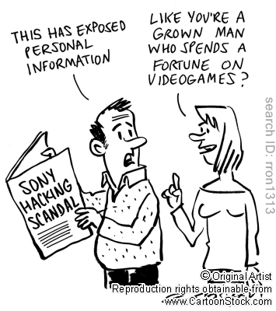
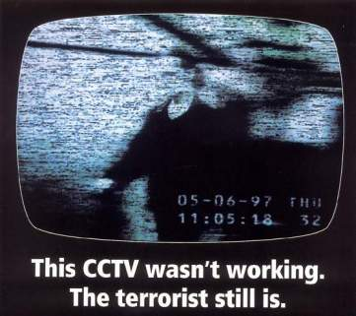
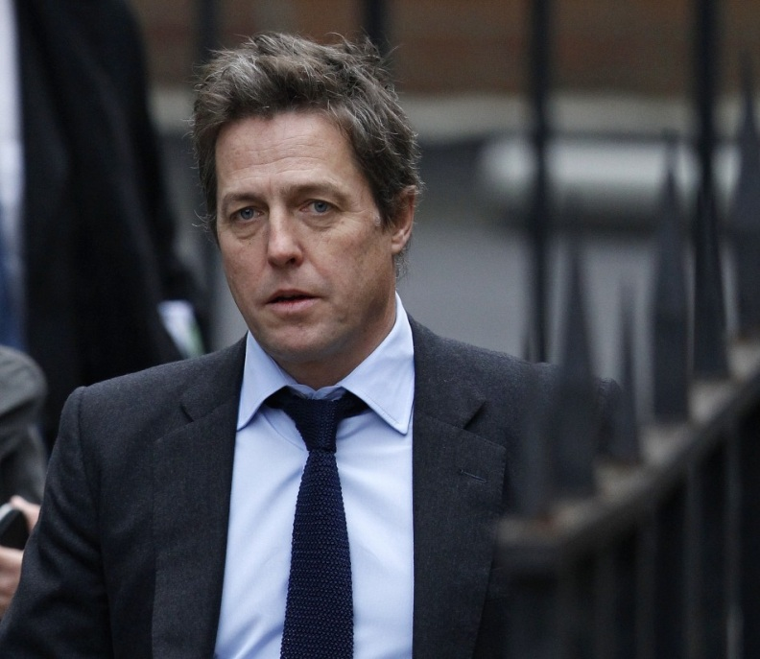
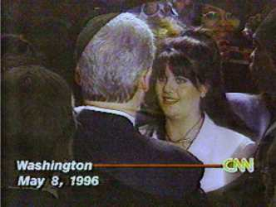
Why Privacy?

Slide 3
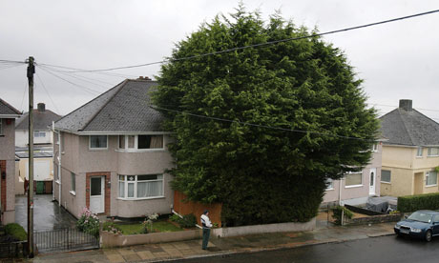
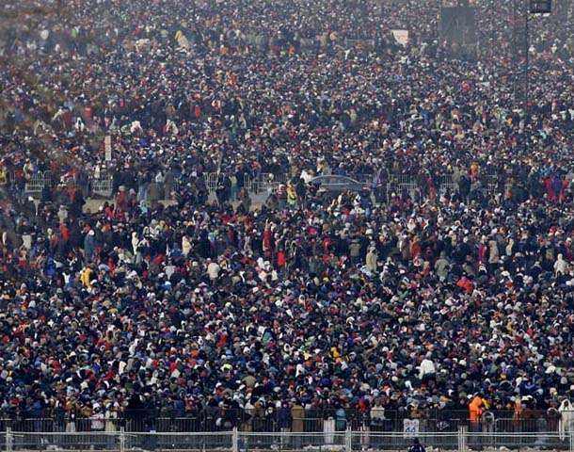
What is Privacy?

Slide 4
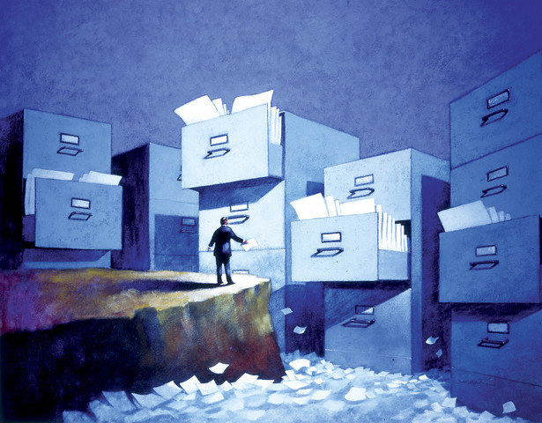
The End of Practical Obscurity

Slide 5
A Right or a Preference?
Article 8 of European Convention
1. Everyone has the right to respect for his private and family life, his home and his correspondence.
2. There shall be no interference by a public authority with the exercise of this right except such as is in accordance with the law and is necessary in a democratic society in the interests of national security, public safety or the economic well-being of the country, for the prevention of disorder or crime, for the protection of health or morals, or for the protection of the rights and freedoms of others.
US Constitution
1st (freedom of speech), 4th (unreasonable search), 5th (due process) amendments
Four torts, based on common law ‘right to be left alone’ (Prosser 1960)
Appropriation (of likeness or name)
False light (misrepresentation)
Disclosure (wrongful publication of private facts)
Intrusion (wrongful information gathering in a private space)
OECD Guidelines
8 principles including collection limitation, purpose specification and use limitation

Slide 6
Norms

Slide 7
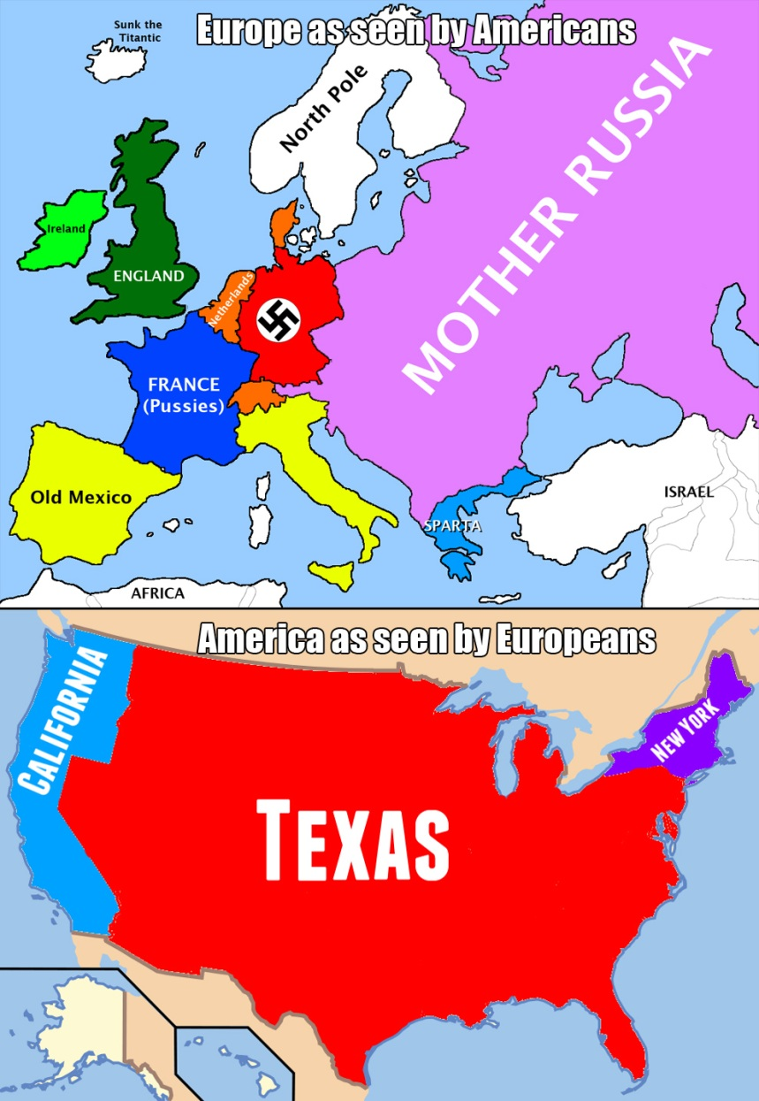
Different Strokes
Consumer protection
Preventative regulation
‘Positive law’ obligations
Day-to-day
Liberty from intrusive gov’t
Criminal law
Sectoral approach
Low impact on economic activity
Trades description approach

Slide 8
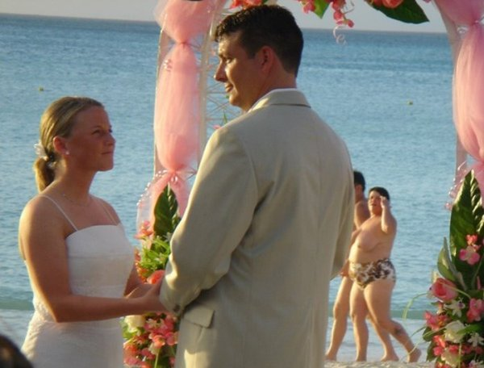
Accountability and Tracing

Slide 9
Data Protection
Balances data sharing benefits with privacy costs
EU Data Protection Directive 95/46/EC
Personal data when subject is identifiable from the data
UK Data Protection Act 1998
Personal data when subject is identifiable by data controller from the data
Can’t transfer info to duff data protection regimes
Er … like the US
Safe Harbor Principles
Self regulating
Many false claims
Many ignore the rules (e.g. no or minimal privacy policies)

Slide 10
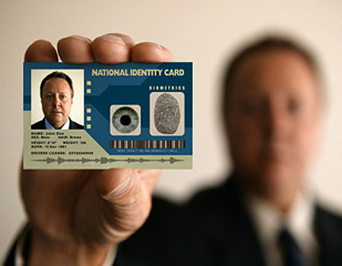
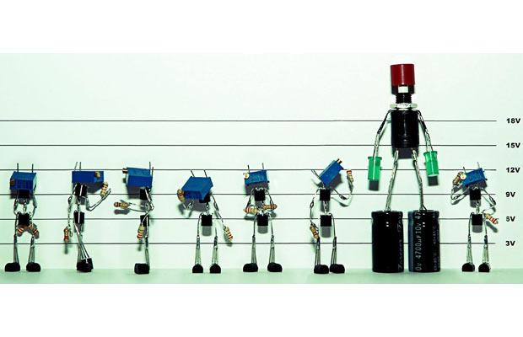
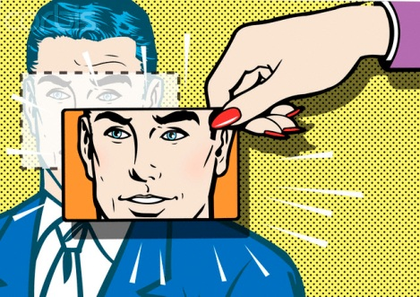
ID

Slide 11
Profiling & Jigsaw ID

Slide 12
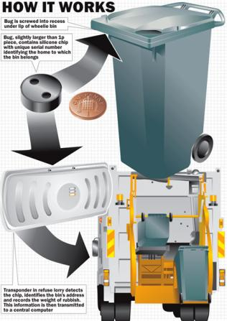
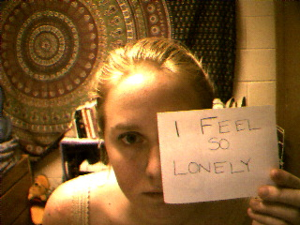
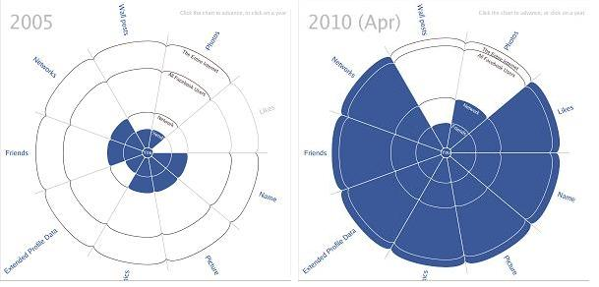
Who’s In Charge?

Slide 13
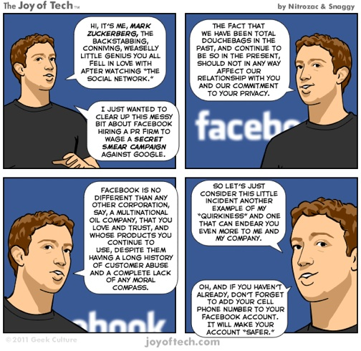
The Elephant in the Room

Slide 14
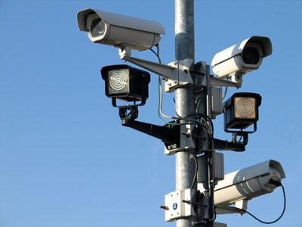
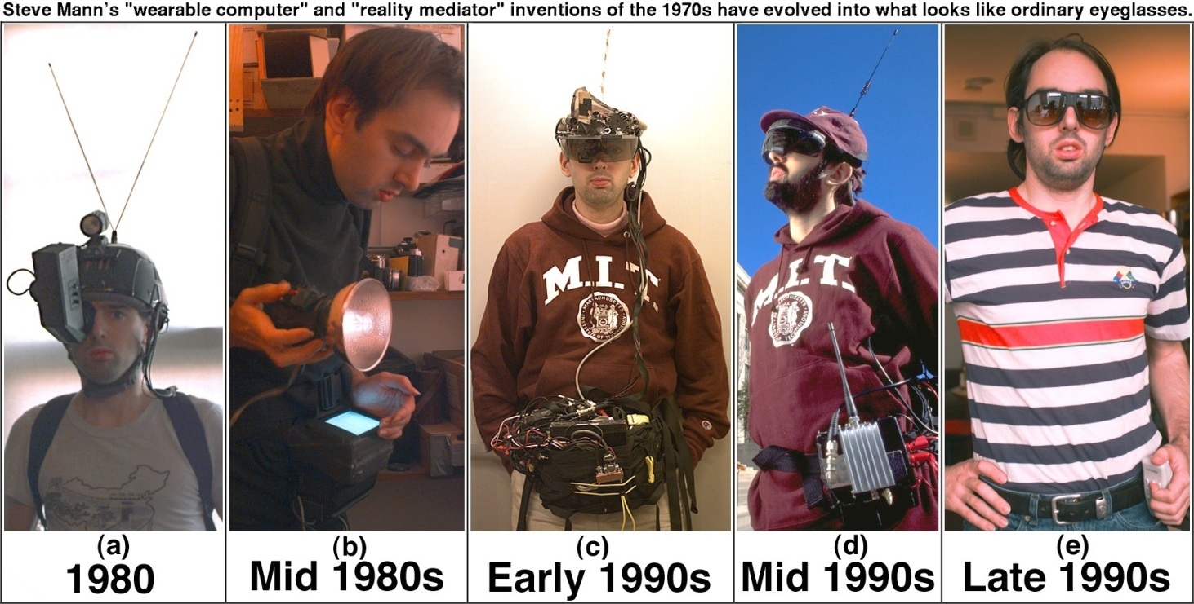
Surveillance v Sousveillance

Slide 15
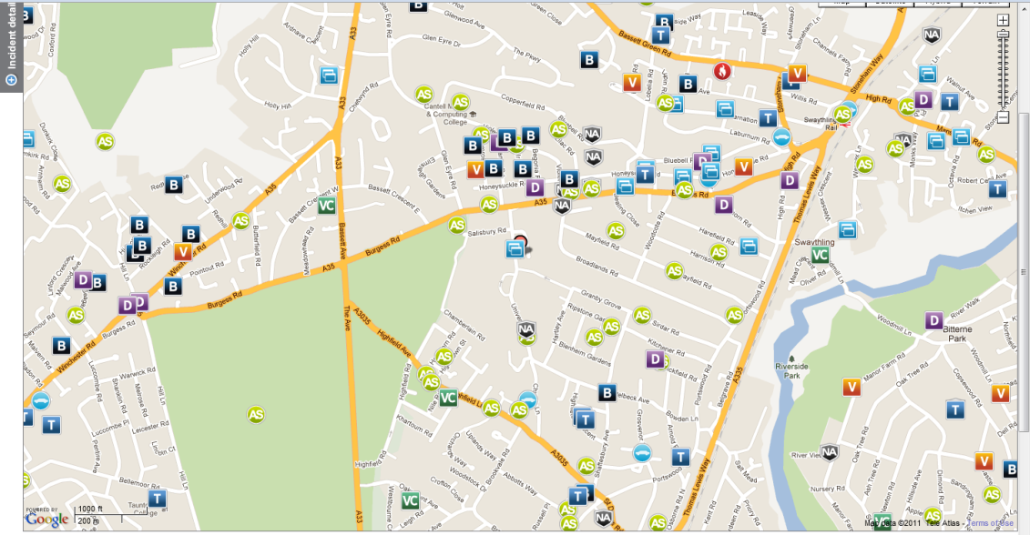
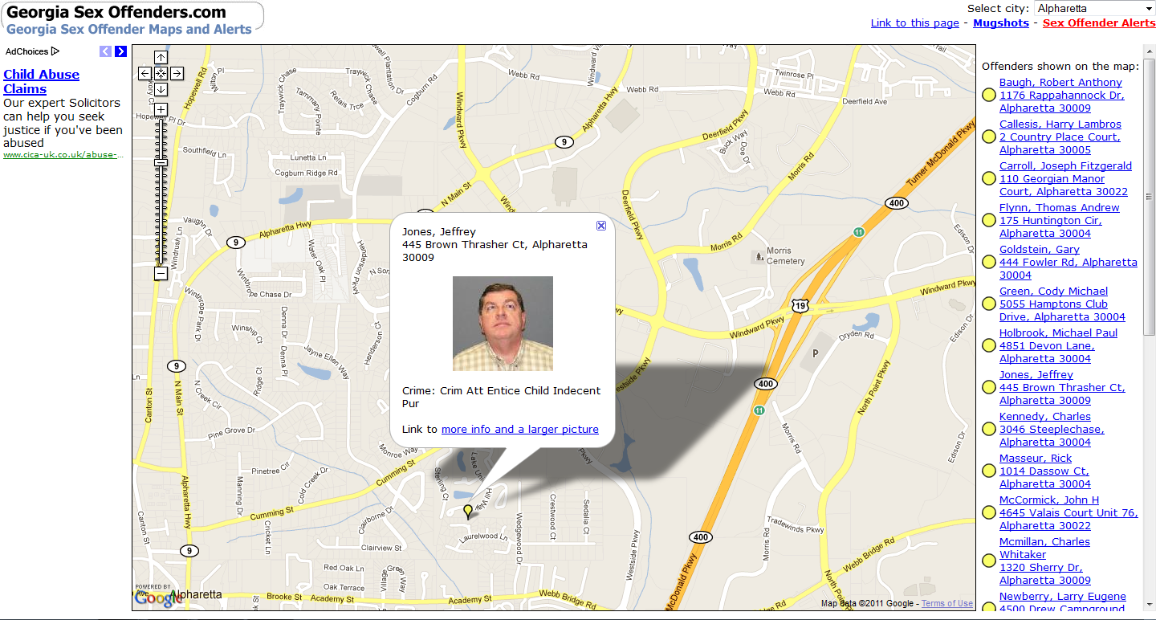
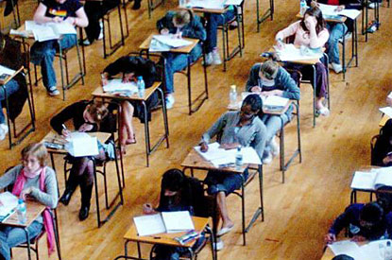
Transparency

Slide 16
Relevant Disciplines
Philosophy – what is privacy?
Law – what are our obligations?
Computer science – what architectures are secure?
Politics – what is the role of our privacy rights?
Sociology – what do people use privacy for?
Economics – what are the incentives threatening privacy, and how can we incentivise privacy protections?
Management – how can good practice be embedded in organisations consistent with their business models?

Slide 17
Further Reading
Ross Anderson, Security Engineering (Computing and information management) *
danah boyd, Taken Out of Context, (Online, sociology and information management) *
Charles Dickens, Bleak House (Novel)
Amitai Etzioni, The Limits of Privacy (Political philosophy)
Michel Foucault, Discipline and Punish (History and critical theory)
Helen Nissenbaum, Privacy in Context (Philosophy) *
Kieron O’Hara, Transparent Government, Not Transparent Citizens (Online, technology and politics) *
Kieron O’Hara & Nigel Shadbolt, The Spy in the Coffee Machine (Technology and politics) *
Paul Ohm, ‘Broken Promises of Privacy’, UCLA Law Review (Online, law) *
Chris Reed & John Angel, Computer Law (Law) *
Beate Rössler, The Value of Privacy (Moral philosophy)
Ferdinand D. Schoeman (ed.), Philosophical Dimensions of Privacy (Law and philosophy)
Richard Sennett, The Fall of Public Man (History and sociology)
Daniel J. Solove, Understanding Privacy (Law and philosophy) *

Slide 18
Disclaimer
Texts, marks, logos, names, graphics, images, photographs, illustrations, artwork, audio clips, video clips, and software copyrighted by their respective owners are used on these slides for non-commercial, educational and personal purposes only. Use of any copyrighted material is not authorized without the written consent of the copyright holder. Every effort has been made to respect the copyrights of other parties. If you believe that your copyright has been misused, please direct your correspondence to: kmo@ecs.soton.ac.uk stating your position and I shall endeavour to correct any misuse as early as possible.

