Slide 1
INFO1010 Personal and Professional Development October 2011
Professional Ethics Su White

Slide 2
Revisions for 2009
Need 100+copies of BCS Code of Conduct
Boxes for handback at the end of the class
Do the activity first - maybe??

Slide 3
Ethics: a definition
Ethics: “The science of morals; the department of study concerned with the principles of human duty”. OED

Slide 4
Seeing with new eyes
“The real voyage of discovery consists not in seeking new lands, but in seeing with new eyes.”
Marcel Proust

Slide 5
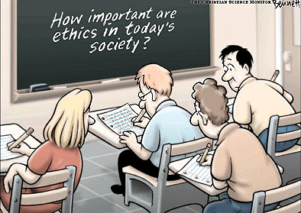
“How important are ethics in today’s society”?
From Pepperdine University Graziadio School of Business and Management

Slide 6
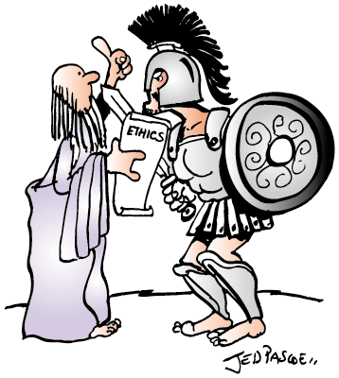
“Buster you do your job and I’ll do mine”
IET ethics article http://www.iee.org/

Slide 7
How this lecture is structured
Style
Mostly Practical
Thinking
Discussing
Feedback
Process
Context
Activities
Reflection
Follow up
NB: The slides are designed to make up a set of notes. Appendix is further reading/references

Slide 8
TPS: Ethical Dilemmas
What sort of ethical dilemmas have you encountered?
Have you experienced people being unethical?
At collect/school?
On the sports field?
In work?
In public life?
Notes:
Two minutes designed to focus down on the issues and make the lecture relevant to your needs/perspective

Slide 9
Why is this is relevant to you?
Professional Accreditation
Developing my own set of values
Preparing for the future
Informing my future behaviour
++

Slide 10
Ethical Values and Obligations
Statutory
Personal
Organisational
Professional

Slide 11
Do you follow the crowd?

Slide 12
BCS Code of Conduct
http://www.bcs.org/content/conWebDoc/39989

Slide 13
BCS code of practice: details
http://www.bcs.org/content/conMediaFile/393
Topics
1. Public Interest
2. Professional Competence and Integrity
3. Duty to Relevant Authority
4. Duty to the Profession

Slide 14
Activity
In your group of three look through the copy of the code of conduct you have been given
On the acetates you have been given
create a code for ECS undergraduates
Two of three groups will be asked to come forward and present their code

Slide 15
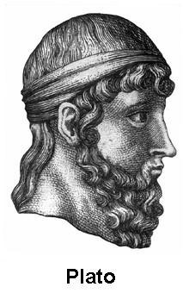
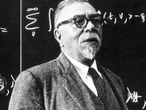
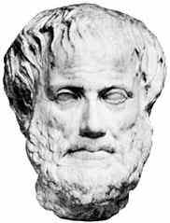
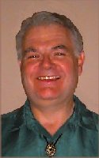
Who has led the thinking?
Weiner
Parker
Aristotle
Maner
Notes:
Maner, W. (1996) Unique Ethical Problems in Information Technology. Science and Engineering Ethics, 2:2, 137-154.
Parker, D. B. (1968) Rules of Ethics in Information Processing. 11:3, 198-201.
Parker, D. B. (1979) Ethical Conflicts in Computer Science and Technology, AFIPS Press.
Wiener, N. (1954) The Human Use of Human Beings: Cybernetics and Society, Doubleday.

Slide 16
What might ethics include?
Ethics: “The science of morals; the department of study concerned with the principles of human duty”. OED
Principles
Professional Behaviour
Ethics
Codes of Conduct
Fairness
Values
Standards
Integrity
Morals
Computer Law
Justice
Moral Codes
Moral Principles
Beliefs
Rights
Professional Practice
Rules and Responsibilities
Moral Values

Slide 17
Consequences of poor ethics?
Hacking and Cracking
Computer Crime
Identity Theft
Phishing
Invasion of Privacy
Snooping
Incompetence
disasters caused by computer failures
law suits regarding software ownership
Whistle Blowing
Unethical and Illegal use of Computers
Scandals
Breach of copyright
invasions of privacy via computer databases
computer-enabled crime
Breach of confidentiality
Deceit
Misconduct
Source included Bynum, Terrell, "Computer Ethics: Basic Concepts and Historical Overview"

Slide 18
Examples of codes

Slide 19
Who might make a difference?
Electronic Frontier Foundation
Creative Commons
SourceForge
CopyLeft
Professional Bodies
…YOU?

Slide 20
Suggested topics
Computers in the Workplace
Computer Crime
Privacy and Anonymity
Intellectual Property
Professional Responsibility
Globalization
The Meta-ethics of Computer Ethics
From - Bynum, Terrell, "Computer Ethics: Basic Concepts and Historical Overview"

Slide 21
TPS: Examples of computer crime
Can you identify three examples of ethical issues in computing and IT

Slide 22
Activity
In your group look through the copies of the code of conduct you have been given
On the paper you have been given
create a code for ECS undergraduates
I would like to be able to show off a couple of sets of codes to the rest of the students
In previous years we have had some very good efforts ☺

Slide 23
Five Questions…
Did I practice any virtues today? In The Book of Virtues, William Bennett notes that virtues are "habits of the heart" we learn through models--the loving parent or aunt, the demanding teacher, the respectful manager, the honest shopkeeper. They are the best parts of ourselves.
Ask yourself, Did I cross a line today that gave up one of those parts? Or was I, at least some of the time, a person who showed integrity, trustworthiness, honesty, compassion, or any of the other virtues I was taught as a child?
Did I do more good than harm today? Or did I try to? Consider the short term and long-term consequences of your actions.
Did I treat people with dignity and respect today? All human beings should be treated with dignity simply because they are human. People have moral rights, especially the fundamental right to be treated as free and equal human beings, not as things to be manipulated, controlled, or cast away.
How did my actions today respect the moral rights and the dignified treatment to which every person is entitled?
Was I fair and just today? Did I treat each person the same unless there was some relevant moral reason to treat him or her differently? Justice requires that we be fair in the way we distribute benefits and burdens. Whom did I benefit and whom did I burden? How did I decide?
Was my community better because I was in it? Was I better because I was in my community? Consider your primary community, however you define it--neighborhood, apartment building, family, company, church, etc. Now ask yourself, Was I able to get beyond my own interests to make that community stronger? Was I able to draw on my community's strengths to help me in my own process of becoming more human?
http://www.scu.edu/ethics/publications/iie/v8n1/everydayethics.html

Slide 24
Thank you ☺

Slide 25
webliography
If you are especially interested in this topic you may like to follow it up through the following web sites:
The Internet Encyclopaedia of Philosophy http://www.iep.utm.edu/
Research Center on Computers and Society
http://www.southernct.edu/organizations/rccs/
Computerethics.org http://www.computerethics.org - takes you to the site above!!
Ten Commandments of Computer Ethics http://computerethicsinstitute.org/publications/tencommandments.html

Slide 26
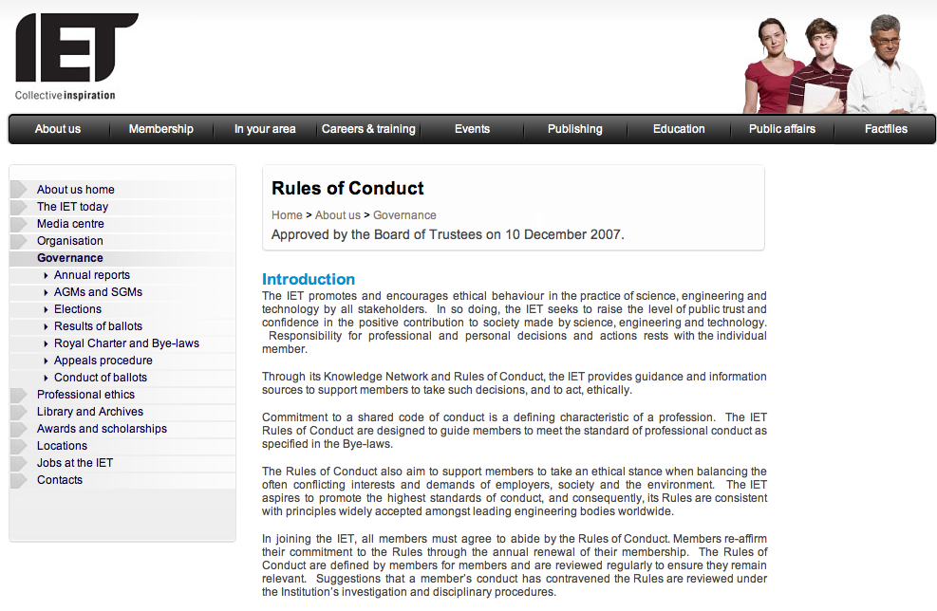
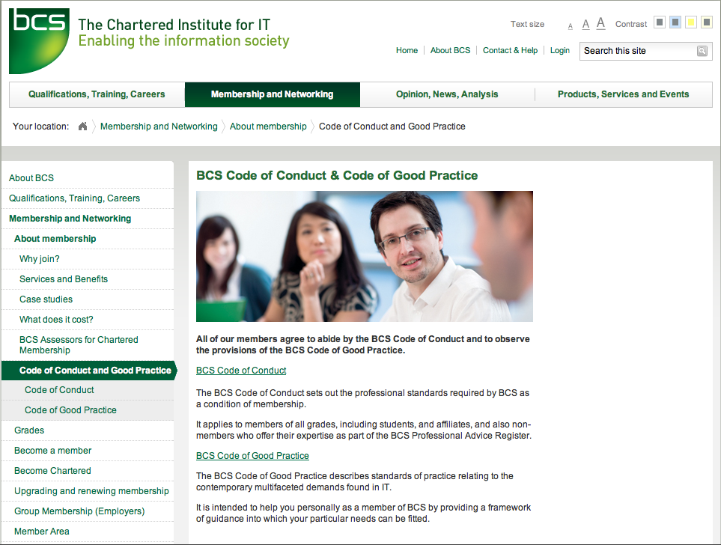
Codes of Ethics…
IET Rules of Conduct
http://www.theiet.org/about/governance/rules-conduct/
BCS Code of Conduct and Code of Good Practice
http://www.bcs.org/server.php?show=conWebDoc.1587
Notes:
National Society of Professional Engineers (NSPE) Code of Ethics
This code is very detailed. The NSPE Board of Ethical Review applies this code in making judgments on cases. These judgments serve to educate its members on what the NSPE considers ethical practice.
Note: Murdough Center maintains all of the NSPE BER cases from 1976 - 2001 on their site at http://www.niee.org/pdd.cfm?pt=NIEE&doc=EthicsCases
The National Society of Professional Engineers (NSPE) Ethics in Employment Task Force Report
Developed by NSPE, this report emphasizes the right and the obligation of engineers to raise ethical concerns in the work place, and provides guidance on how best to raise such issues. It also guides companies that want to guarantee a working environment where employees can feel free to raise concerns.
Principles of Ethical Conduct in Engineering Practice Under The North American Free Trade Agreement
Developed by the Murdough Center at Texas Tech under a grant form the National Science Foundation.
Software Engineering Code of Ethics and Professional Practice
Standard for teaching and practicing software engineering as recommended by the IEEE-CS/ACM Joint Task Force on Software Engineering Ethics and Professional Practices and Jointly approved by the ACM and the IEEE-CS. (Version 5.2)
Codes of Ethics Maintained by other Organizations
American Association of Engineering Societies (AAES) Model Code of Ethics
(draft): "In recognition of the importance of our technologies in affecting the quality of life throughout the world, and in accepting a personal obligation to the profession, its members and the communities served, engineers shall commit themselves to the highest ethical and professional conduct."
Accrediation Board for Engineering and Technology (ABET) Code of Ethics of Engineers
Fundamental principles and canons given by the ABET, a federation of professional engineering and technical societies recognized by the Council on Higher Education Accreditation.
Code of Conduct of the Accreditation Board for Engineering and Technology, Inc. (ABET)
Approved by the board of directors on October 30, 1999. Guidelines for ABET's volunteers and staff members.
Universal Declaration of Engineers Rights
Walter L. Elden, editor. Revised and endorsed by several past or current members of IEEE. "This declaration is intended to apply to those professional employees (engineers) addressed in the Guidelines to Professional Employment for Engineers and Scientists, Third Edition, October, 1989 and to the members of its endorsing societies."
The System Administrators Guild of Australia
Software Ethics
The University of Western Ontario's guide to the ethical and legal use of software
British Computer Soceties Report on Whistle Blowing
A paper addressing the topic of whistle-blowing in the contexts of information systems (IS) and environments and BCS members. The current BCS codes of conduct and practice are examined. This site examines and draws the conclusion that more work needs to be carried out before the BCS can adequately guide its members where and when whistle-blowing might be involved.
Ethics and the Internet
A memo from the Internet Activities Board stating their policy concerning the proper use of the resources of the Internet

Slide 27
Actual references
Bynum, Terrell, "Computer Ethics: Basic Concepts and Historical Overview", The Stanford Encyclopedia of Philosophy (Winter 2001 Edition), Edward N. Zalta (ed.), URL = http://plato.stanford.edu/archives/win2001/entries/ethics-computer/
Terrell Ward Bynum and Simon Rogerson, Eds., Computer Ethics and Professional Responsibility, Blackwell, 2004.

Slide 28
Want to know more?
Read the text…
Computer ethics and professional responsibility Bynum, Terrell Ward and Simon Rogerson. Hartley Library Location QA 76.9M65 BYN
Play the game
Oracle Education Foundation’s ThinkQuest Computer Ethics http://library.thinkquest.org/26658/
Surf the Web
Ethics on the World Wide Web http://commfaculty.fullerton.edu/lester/ethics/computer.html
Code of the Geeks – a rather different take on Codes… http://www.geekcode.com/geek.html

Slide 29
Appendix
Additional
Materials

Slide 30
Books
The Real World of Technology (CBC Massey Lectures series) by Ursula Franklin
http://www.anansi.ca/titles.cfm?pub_id=58
http://www.onlineethics.org/codes/index.html

Slide 31
Computing and Moral Responsibility
Journals On-line
ETHICOMP Journal. Publishes papers presented at ETHICOMP conference series, an international conference series of interest to those working in computer ethics.
Ethics and Information Technology. Published by Klewer; peer-reviewed journal spanning a wide variety of issues and approaches to exploring in the intersection of moral philosophy and information / communications technology.
Metaphilosophy Published by Blackwell; peer-reviewed journal that has been publishing articles in the area of computer ethics (including computing and responsibility) since the 1980's.
Minds and Machines: Journal for Artificial Intelligence, Philosophy and Cognitive Science. Published by Klewer; peer-reveiwed journal that occasionally includes articles related to the ethics / moral responsibility of artificially intelligent computer systems.
Centers
Research Center on Computing and Society (at Southern Connecticut State University)
Centre for Computing and Social Responsibility (at De Montfort University)
Computer Professionals for Social Responsibility (CPSR)
Organizations
INSEIT: International Society for Ethics and Information Technology
Sources
Computing and moral responsibility

Slide 32
Research centre for computing and society
http://www.computerethics.org
Material on ethical decision making and case analysis. I think many computer ethics courses and textbooks tend to over do this part, offering far too many ethical theories and concepts that go way beyond what the students will ever need or use. I believe that Chapter 3 of the Bynum/Rogerson textbook gets it right (but, of course, I would say this, since I wrote Chapter 3!)
Material on the concepts of professionalism and professional ethics. Don Gotterbarn’s writings are terrific, including some that he has on-line on his SEERI web site: http://www-cs.etsu-tn.edu/seeri/index2.htm as well as his chapters (5 and 8) in the Bynum/Rogerson textbook.
Materials on the concept of a professional code of ethics, as well as sample codes of ethics from professional organizations like ACM, BCS, ACS, IMIS, etc. See Part III of the Bynum/Rogerson textbook.
Materials covering a representative sampling of “traditional” and “new” computer ethics topics like computer security (viruses, hacking, terrorism, etc.); ownership of intellectual property (e.g. software and open source, music and video files on the Internet, etc.); privacy (e.g., computerized profiles, data mining, matching, etc.); globalization (e.g. cultural conflicts, jurisdiction of laws across borders, international computing agreements, etc.), and so on. See Part IV of the Bynum/Rogerson textbook, as well as the textbook-related web site:

Slide 33
Textbook - Web Resources
From the web resources for Computer Ethics: Basic Concepts and Historical Overview Part I:
Bynum, T. W. “Computer Ethics: Basic Concepts and Historical Overview” http://plato.stanford.edu/entries/ethics-computer/
Centre for Computing and Social Responsibility, De Montfort University, UK http://www.ccsr.cse.dmu.ac.uk/index.html
Research Center on Computing & Society, Southern Connecticut State University, USA http://www.computerethics.org
Tavani, H. T. “Computing, Ethics and Social Responsibility: A Bibliography” http://cyberethics.cbi.msstate.edu/biblio/

Slide 34
Part II:
The Association for Computing Machinery http://www.acm.org
The Australian Computer Society http://www.acs.org.au
The British Computer Society http://www1.bcs.org.uk
Computer Professionals for Social Responsibility http://www.ccsr.org
Professional Accountability Section of the Website of the Online Ethics Center http://onlineethics.org/topics/accountability.html
Professionalism Section of the Website of the Centre for Computing and Social Responsibility http://www.ccsr.cse.dmu.ac.uk/resources/professionalism

Slide 35
Part III:
ACM Position Papers on Software Engineering and Licensing http://www.acm.org/serving/se_policy/papers.html
Codes of Ethics links on the web site of the Centre for Computing and Social Responsibility http://www.ccsr.cse.dmu.ac.uk/resources/professionalism/codes/
Commentary on “The Ten Commandments of Computer Ethics” by N. Ben Fairweather http://www.ccsr.cse.dmu.ac.uk/resources/professionalism/codes/cei_command_com.html
The Software Engineering Ethics Research Institute at East Tennessee State University at Johnson City, TN, USA http://seeri.etsu.edu

Slide 36
Part IV: SECURITY
Center for Education and Research in Information Assurance and Security (CERIAS) at Purdue University, Eugene H. Spafford, Director http://www.cerias.purdue.edu/
Computer Security Group, Cambridge University, UK http://www.cl.cam.ac.uk/Research/Security/
Computer Security Institute http://www.gocsi.com/
Computer Security Research Center, London School of Economics http://csrc.lse.ac.uk/
The Risks Digest: Forum On Risks To The Public In Computers And Related Systems, ACM Committee on Computers and Public Policy, Peter G. Neumann, Moderator http://catless.ncl.ac.uk/Risks

Slide 37
Part V: PRIVACY
The Electronic Privacy Information Center http://www.epic.org
The Information Commissioner of the United Kingdom http://www.dataprotection.gov.uk
The Office of the Federal Privacy Commissioner, Australia http://www.privacy.gov.au
Privacy International http://www.privacy.org/pi/
Privacy.net http://www.privacy.net
Privacy.org http://www.privacy.org

Slide 38
Part VI: OWNERSHIP
Electronic Frontier Foundation “Intellectual Property Online: Patent, Trademark, Copyright” Archive http://www.eff.org/pub/Intellectual_property
Raymond, E. “The Cathedral and the Bazaar” a website on the open source movement http://www.firstmonday.dk/issues/issue3_3/raymond/
Softward Ownership and Intellectual Property Rights: A Monograph (See especially the article “A Plea for Casual Copying” by Helen Nissenbaum) http://www.computerethics.org/resources/research/intellectual_property/ownership_mono/ownership_contents.html
Volkman, R. “Softward Ownership and Natural Rights” http://www.computerethics.org/resources/research/intellectual_property/volkman_nat-rights.html
World Intellectual Property Organization http://www.wipo.org

Slide 39
Part VII: GLOBALIZATION
The Cyber Rights Working Group, Computer Professionals for Social Responsibility http://www.cpsr.org/cpsr/nii/cyber-rights/
“The Global Culture of Digital Technology and Its Ethics,” an abstract of a paper by Krystyna Gorniak-Kocikowska http://www.ccsr.cse.dmu.ac.uk/conferences/ccsrconf/ethicomp2001/abstracts/gorniak.html
The Internet Society – an international organization for global cooperation http://www.isoc.org/isoc/
UNESCO’s Info-Ethics Program, The United Nations http://www.unesco.org/webworld/infoethics/infoethics.htm

Slide 40
Activities

Slide 41
TPS: Ethical Dilemmas
What sort of ethical dilemmas have you encountered?
Have you experienced people being unethical?
At collect/school?
On the sports field?
In work?
In public life?
Notes:
Two minutes designed to focus down on the issues and make the lecture relevant to your needs/perspective

Slide 42
TPS: Examples of computer crime
Can you identify three examples of ethical issues in computing and IT

Slide 43
Activity
In your group of three look through the copy of the code of conduct you have been given
On the acetates you have been given
create a code for ECS undergraduates
Two of three groups will be asked to come forward and present their code

