Slide 1
Data: From Bits to Databases
Chapter 1: Data Storage
Slides selected from Brookshear for MSc Web Science. Not for redistribution

Slide 2
Computer Data
All computer data is most conveniently thought of as numbers.
the numbers are interpreted to represent characters, words, documents, images
To understand computer data, you must understand computer numbers
Computers count not with ten "denary" digits, but with two (binary digits).
The following slides will teach you to count
and then teach you about computer data

Slide 3
Learning to Count with 10 Fingers
1 2 3 4 5 6 7 8 9 10
Ten digits are needed: 0 1 2 3 4 5 6 7 8 9

Slide 4
Learning to Count with 10 Fingers
11 12 13 14 15 16 17 18 19 20

Slide 5
Learning to Count with 10 Fingers
21 22 23 24 25 26 27 28 29 30

Slide 6
Learning to Count with 10 Fingers
...etc...

Slide 7
Learning to Count with 10 Fingers
91 92 93 94 95 96 97 98 99 100

Slide 8
Learning to Count with 10 Fingers
...etc...

Slide 9
Learning to Count with 10 Fingers
991 992 993 994 995 996 997 998 999 1000

Slide 10
Let's Get Rid of a Digit
A terrible industrial accident has occurred
Only 9 digits are needed now:
0 1 2 3 4 5 6 7 8 9

Slide 11
Learning to Count with 9 Fingers
1 2 3 4 5 6 7 8 10
1 2 3 4 5 6 7 8 9

Slide 12
Learning to Count with 9 Fingers
11 12 13 14 15 16 17 18 20
10 11 12 13 14 15 16 17 18

Slide 13
Learning to Count with 9 Fingers
21 22 23 24 25 26 27 28 30
19 20 21 22 23 24 25 26 27

Slide 14
Learning to Count with 9 Fingers
...etc...

Slide 15
Learning to Count with 9 Fingers
81 82 83 84 85 86 87 88 100
73 74 75 76 77 78 79 80 81

Slide 16
Learning to Count with 9 Fingers
...etc...

Slide 17
Learning to Count with 9 Fingers
881 882 883 884 885 886 887 888 1000
721 722 723 724 725 726 727 728 729

Slide 18
Only Three Fingers Left Now
Things have got out of hand
Only 3 digits are needed now:
0 1 2 3 4 5 6 7 8 9

Slide 19
Learning to Count with 3 Fingers
1 2 10
1 2 3

Slide 20
Learning to Count with 3 Fingers
11 12 20
4 5 6

Slide 21
Learning to Count with 3 Fingers
21 22 100
7 8 9

Slide 22
Learning to Count with 3 Fingers
101 102 110
10 11 12

Slide 23
Learning to Count with 3 Fingers
111 112 120
13 14 15

Slide 24
Learning to Count with 3 Fingers
121 122 200
16 17 18

Slide 25
Learning to Count with 3 Fingers
201 202 210
19 20 21

Slide 26
Learning to Count with 3 Fingers
211 212 220
22 23 24

Slide 27
Learning to Count with 3 Fingers
221 222 1000
25 26 27

Slide 28
Only TWO Fingers Left Now
When Will It All End?
Only 2 digits are needed now:
0 1 2 3 4 5 6 7 8 9

Slide 29
Learning to Count with 2 Fingers
1 10
1 2

Slide 30
Learning to Count with 2 Fingers
11 100
3 4

Slide 31
Learning to Count with 2 Fingers
101 110
5 6

Slide 32
Learning to Count with 2 Fingers
111 1000
7 8

Slide 33
Learning to Count with 2 Fingers
1001 1010
9 10

Slide 34
Learning to Count with 2 Fingers
1011 1100
11 12

Slide 35
Learning to Count with 2 Fingers
1101 1110
13 14

Slide 36
Learning to Count with 2 Fingers
1111 10000
15 16

Slide 37
This is Binary
This is binary, the internal numeric representation used by computers
Not fingers, but voltage levels
high/low
on/off
true/false
1/0

Slide 38
Some Binary Numbers
one | 0001
two | 0010
three | 0011
four | 0100
five | 0101
six | 0110
seven | 0111
eight | 1000
nine | 1001
ten | 1000
eleven | 1001
twelve | 1100
thirteen | 1101
fourteen | 1110
fifteen | 1111
sixteen | 10000
one | 1
two | 10
four | 100
eight | 1000
sixteen | 10000
thirty-two | 100000
sixty-four | 1000000
one hundred and twenty eight | 10000000
two hundred and fifty six | 100000000
five hundred and twelve | 1000000000
one thousand and twenty four | 10000000000

Slide 39
Bits and Bit Patterns
Bit: Binary Digit (0 or 1)
Bit Patterns are used to represent information.
Numbers
Text characters
Images
Sound
And others

Slide 40
Hexadecimal Notation
Hexadecimal notation: A shorthand notation for long bit patterns
Divides a pattern into groups of four bits each
Represents each group by a single symbol
Example: 10100011 becomes A3
Base 16 arithmetic
ie someone with sixteen fingers
(here we go again)

Slide 41
Learning to Count with 16 Fingers
1 2 3 4 5 6 7 8 9 A B C D E F 10
1 2 3 4 5 6 7 8 9 10 11 12 13 14 15 16

Slide 42
Learning to Count with 16 Fingers
11 12 13 14 15 16 17 18 19 1A 1B 1C 1D 1E 1F 20
17 18 19 20 21 22 23 24 25 26 27 28 29 30 31 32

Slide 43
Learning to Count with 16 Fingers
...etc...

Slide 44
Learning to Count with 16 Fingers
91 92 93 94 95 96 97 98 99 9A 9B 9C 9D 9E 9F A0
145 146 147 148 149 150 151 152 153 154 155 156 157 158 159 160

Slide 45
Learning to Count with 16 Fingers
A1 A2 A3 A4 A5 A6 A7 A8 A9 AA AB AC AD AE AF B0
161 162 163 164 165 166 167 168 169 170 171 172 173 174 175 176

Slide 46
Learning to Count with 16 Fingers
...etc...

Slide 47
Learning to Count with 16 Fingers
F1 F2 F3 F4 F5 F6 F7 F8 F9 FA FB FC FD FE FF 100
241 242 243 244 245 246 247 248 249 250 251 252 253 254 255 256

Slide 48
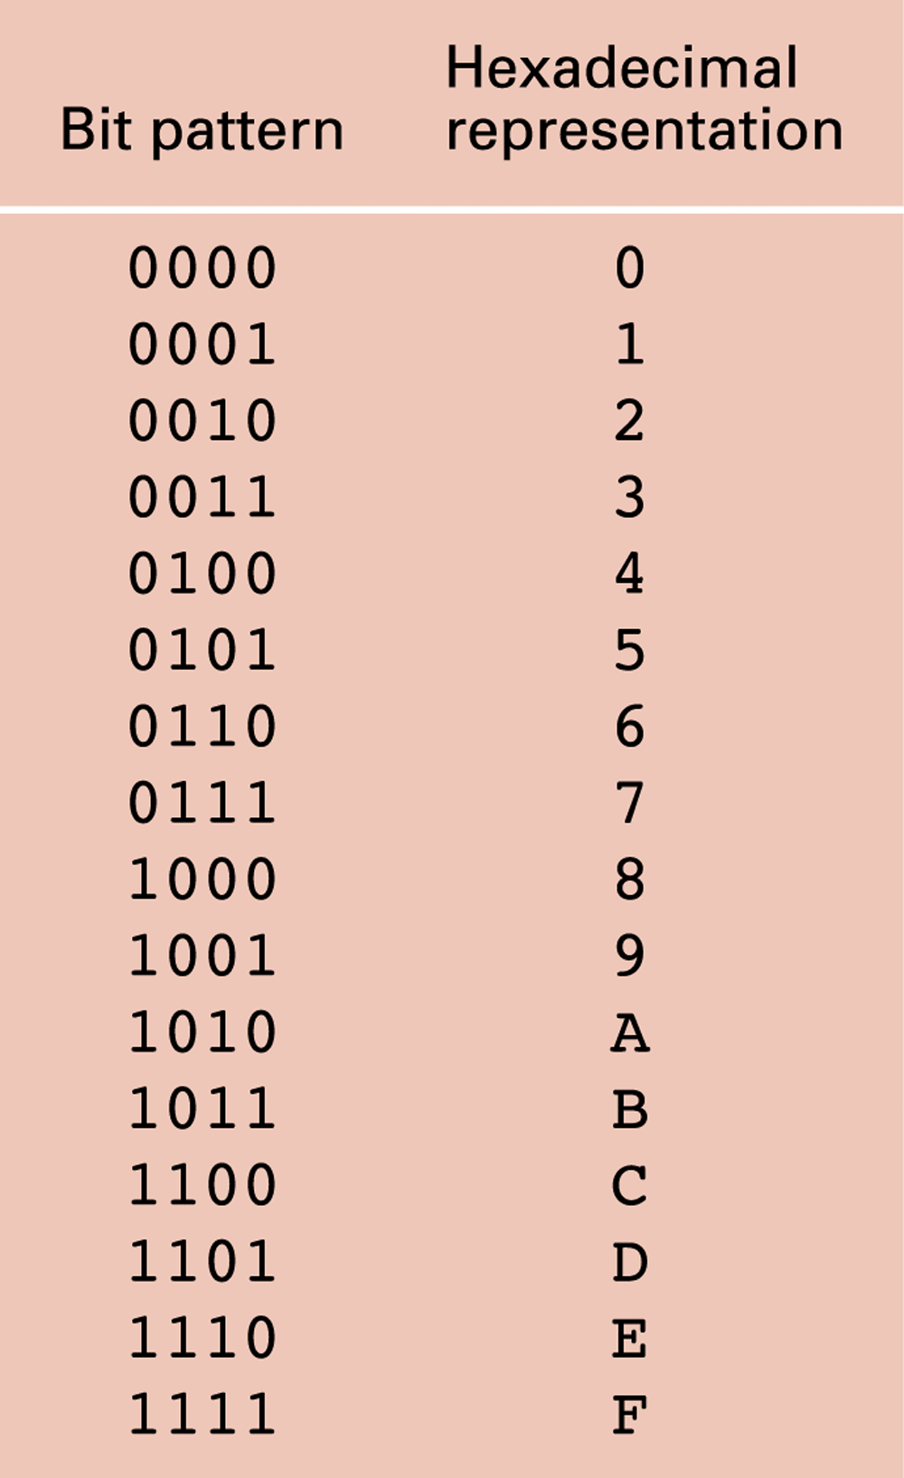
Figure 1.6 The hexadecimal coding system

Slide 49
Main Memory Cells
Cell: A unit of main memory (typically 8 bits which is one byte)
Most significant bit: the bit at the left (high-order) end of the conceptual row of bits in a memory cell
Least significant bit: the bit at the right (low-order) end of the conceptual row of bits in a memory cell

Slide 50
Figure 1.7 The organization of a byte-size memory cell

Slide 51
Main Memory Addresses
Address: A “name” that uniquely identifies one cell in the computer’s main memory
The names are actually numbers.
These numbers are assigned consecutively starting at zero.
Numbering the cells in this manner associates an order with the memory cells.

Slide 52
Figure 1.8 Memory cells arranged by address

Slide 53
Memory Terminology
Random Access Memory (RAM): Memory in which individual cells can be easily accessed in any order
Dynamic Memory (DRAM): RAM composed of volatile memory

Slide 54
Mass Storage Systems
Magnetic Systems
Disk
Tape
Optical Systems
CD
DVD
Flash Drives

Slide 55
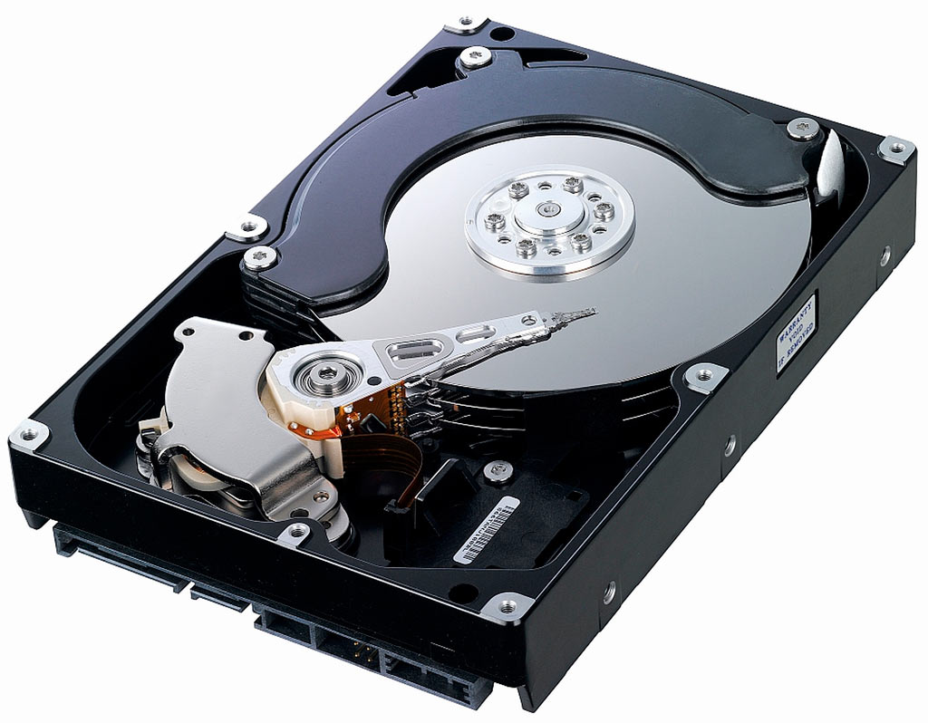
Inside A Hard Disk
A "hard disk" is many disks of magnetic material spinning at 72000rpm

Slide 56
Figure 1.9 A magnetic disk storage system
About 4k per sector
About 50,000 tracks per inch
spins 72,000rpm

Slide 57
Bits to Bytes to Information to Databases to Cloud
Computer Science data handling is about successive levels of interpretation and abstraction: hardware -> information
Latest stage: routinely handling datasets much (much) larger than 1 machine’s memory or storage capacity can handle
Cloud
Storage farms
Google, Facebook, Amazon, Apple

Slide 58
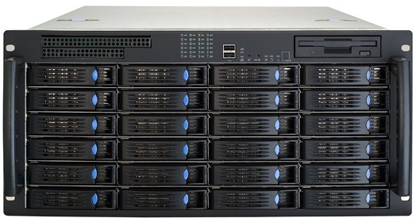
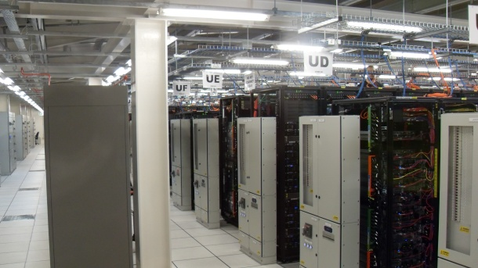
Storage Centres
24Tb storage farm
Data centre
1000 Tb per rack

Slide 59
Representing Text
Each character (letter, punctuation, etc.) is assigned a unique bit pattern.
ASCII: Uses patterns of 7-bits to represent most symbols used in written English text
Unicode: Uses patterns of 16-bits to represent the major symbols used in languages world side
ISO standard: Uses patterns of 32-bits to represent most symbols used in languages world wide

Slide 60
Figure 1.13 The message “Hello.” in ASCII

Slide 61
Representing Numeric Values
Binary notation: Uses bits to represent a number in base two
Limitations of computer representations of numeric values
Overflow – occurs when a value is too big to be represented
Truncation – occurs when a value cannot be represented accurately

Slide 62
Representing Images
Bit map techniques
Pixel: short for “picture element”
RGB
Luminance and chrominance
Vector techniques
Scalable
TrueType and PostScript

Slide 63
Representing Sound
Sampling techniques
Used for high quality recordings
Records actual audio
MIDI
Used in music synthesizers
Records “musical score”

Slide 64
Figure 1.14 The sound wave represented by the sequence 0, 1.5, 2.0, 1.5, 2.0, 3.0, 4.0, 3.0, 0

Slide 65
User-defined Data Type
A template for a heterogeneous structure
Example:
define type EmployeeType to be
{char Name[25];
int Age;
real SkillRating;
}

Slide 66
Chapter 8: Data Abstractions

Slide 67
Figure 8.1 Lists, stacks, and queues
d. Array

Slide 68
Terminology for Lists
List: A collection of data whose entries are arranged sequentially
Head: The beginning of the list
Tail: The end of the list

Slide 69
Terminology for Stacks
Stack: A list in which entries are removed and inserted only at the head
LIFO: Last-in-first-out
Top: The head of list (stack)
Bottom or base: The tail of list (stack)
Pop: To remove the entry at the top
Push: To insert an entry at the top

Slide 70
Terminology for Queues
Queue: A list in which entries are removed at the head and are inserted at the tail
FIFO: First-in-first-out

Slide 71
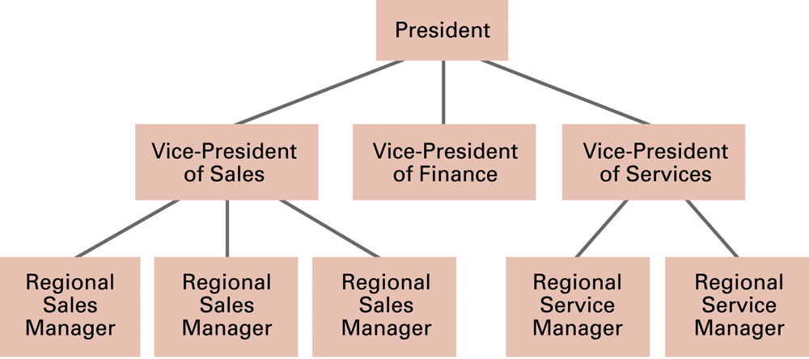
Figure 8.2 An example of an organization chart

Slide 72
Terminology for a Tree
Tree: A collection of data whose entries have a hierarchical organization
Node: An entry in a tree
Root node: The node at the top
Terminal or leaf node: A node at the bottom

Slide 73
Terminology for a Tree (continued)
Parent: The node immediately above a specified node
Child: A node immediately below a specified node
Ancestor: Parent, parent of parent, etc.
Descendent: Child, child of child, etc.
Siblings: Nodes sharing a common parent

Slide 74
Terminology for a Tree (continued)
Binary tree: A tree in which every node has at most two children
Depth: The number of nodes in longest path from root to leaf

Slide 75
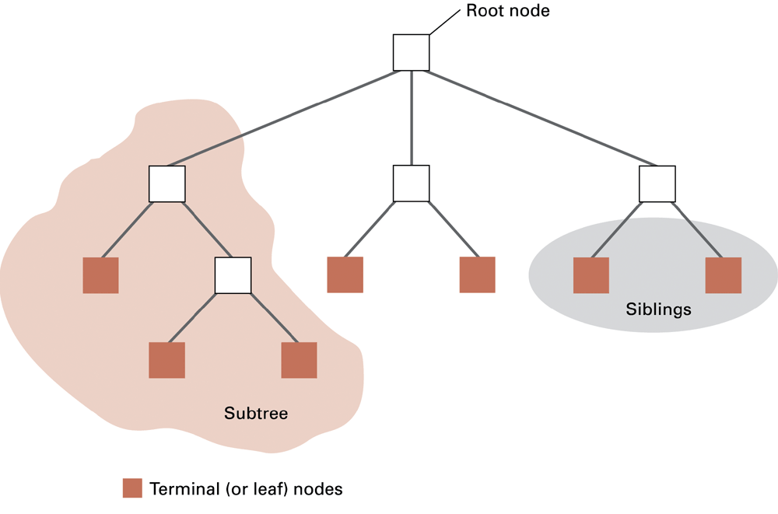
Figure 8.3 Tree terminology

Slide 76
Additional Concepts
Static Data Structures: Size and shape of data structure does not change
Dynamic Data Structures: Size and shape of data structure can change
Pointers: Used to locate data

Slide 77
Figure 8.4 Novels arranged by title but linked according to authorship

Slide 78
Storing Arrays
Homogeneous arrays
Row-major order versus column major order
Address polynomial
Heterogeneous arrays
Components can be stored one after the other in a contiguous block
Components can be stored in separate locations identified by pointers

Slide 79
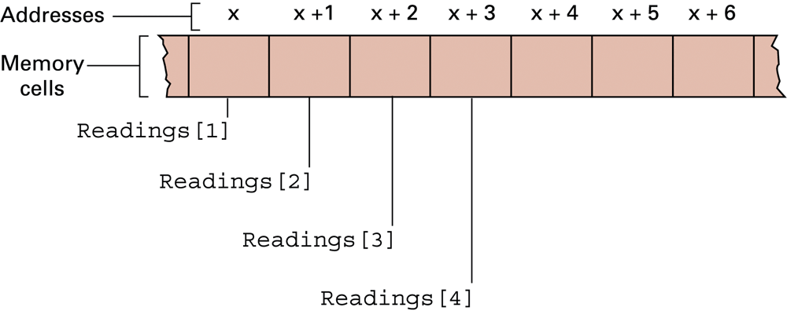
Figure 8.5 The array of temperature readings stored in memory starting at address x

Slide 80
Storing Lists
Contiguous list: List stored in a homogeneous array
Linked list: List in which each entries are linked by pointers
Head pointer: Pointer to first entry in list
NIL pointer: A “non-pointer” value used to indicate end of list

Slide 81
Figure 8.8 Names stored in memory as a contiguous list

Slide 82
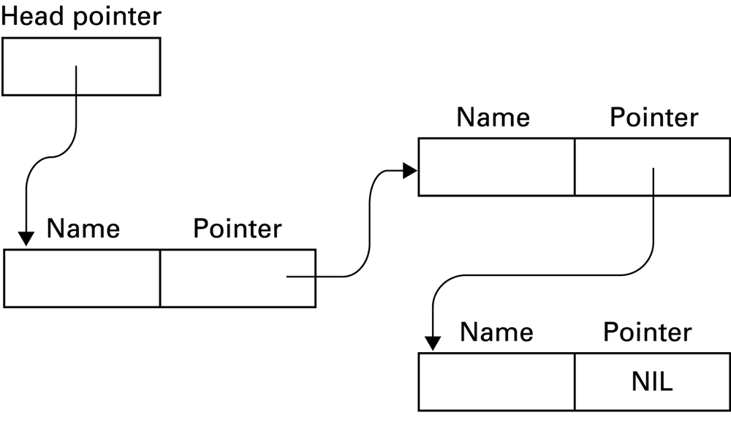
Figure 8.9 The structure of a linked list

Slide 83
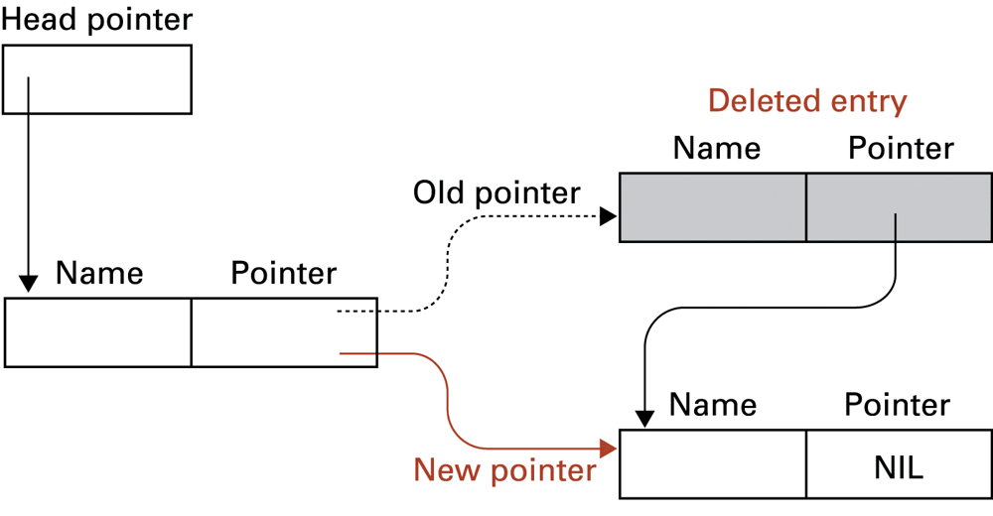
Figure 8.10 Deleting an entry from a linked list

Slide 84
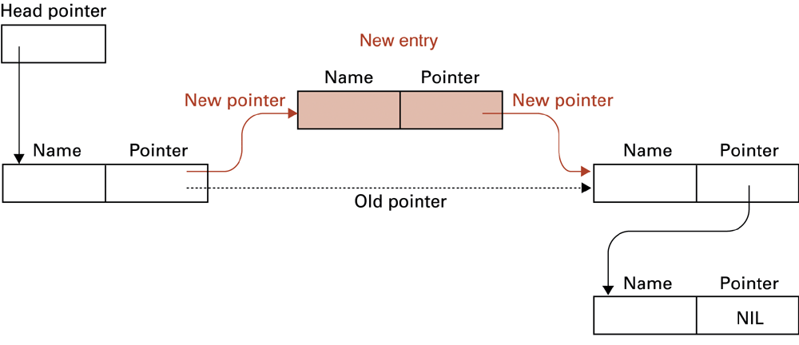
Figure 8.11 Inserting an entry into a linked list

Slide 85
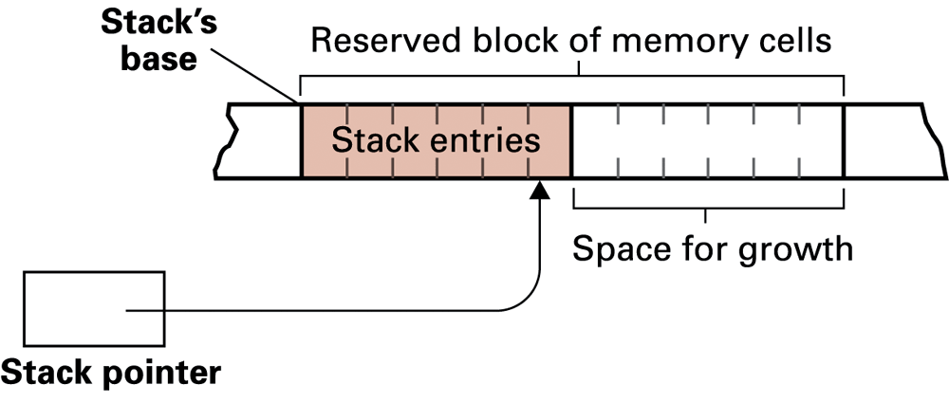
Figure 8.12 A stack in memory

Slide 86
Chapter 9: Database Systems
Computer Science: An Overview Tenth Edition
by J. Glenn Brookshear

Slide 87
Database
A collection of data that is multidimensional in the sense that internal links between its entries make the information accessible from a variety of perspectives

Slide 88
Schemas
Schema: A description of the structure of an entire database, used by database software to maintain the database
Subschema: A description of only that portion of the database pertinent to a particular user’s needs, used to prevent sensitive data from being accessed by unauthorized personnel

Slide 89
Database Management Systems
Database Management System (DBMS): A software layer that manipulates a database in response to requests from applications
Distributed Database: A database stored on multiple machines
DBMS will mask this organizational detail from its users
Data independence: The ability to change the organization of a database without changing the application software that uses it

Slide 90
Database Models
Database model: A conceptual view of a database
Relational database model
Object-oriented database model

Slide 91
Relational Database Model
Relation: A rectangular table
Attribute: A column in the table
Tuple: A row in the table

Slide 92
Figure 9.3 A relation containing employee information

Slide 93
Relational Design
Avoid multiple concepts within one relation
Can lead to redundant data
Deleting a tuple could also delete necessary but unrelated information

Slide 94
Improving a Relational Design
Decomposition: Dividing the columns of a relation into two or more relations, duplicating those columns necessary to maintain relationships
Lossless or nonloss decomposition: A “correct” decomposition that does not lose any information

Slide 95
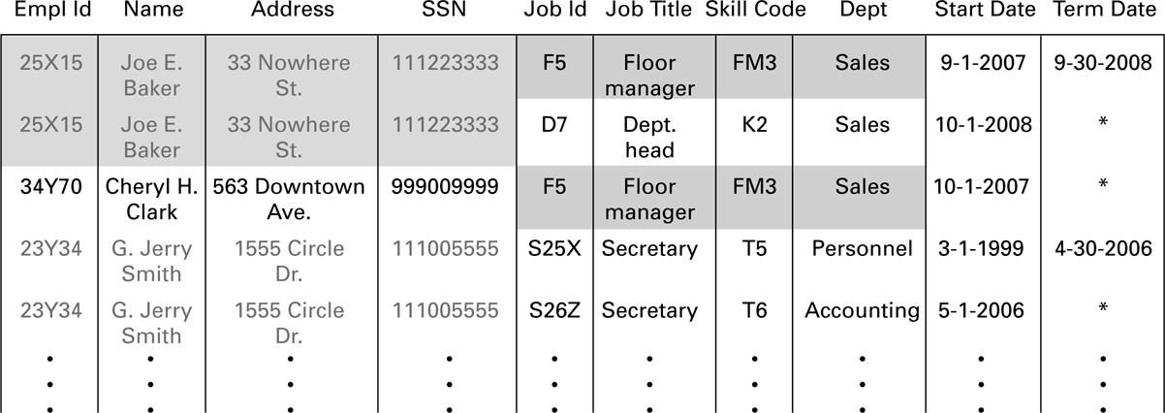
Figure 9.4 A relation containing redundancy

Slide 96
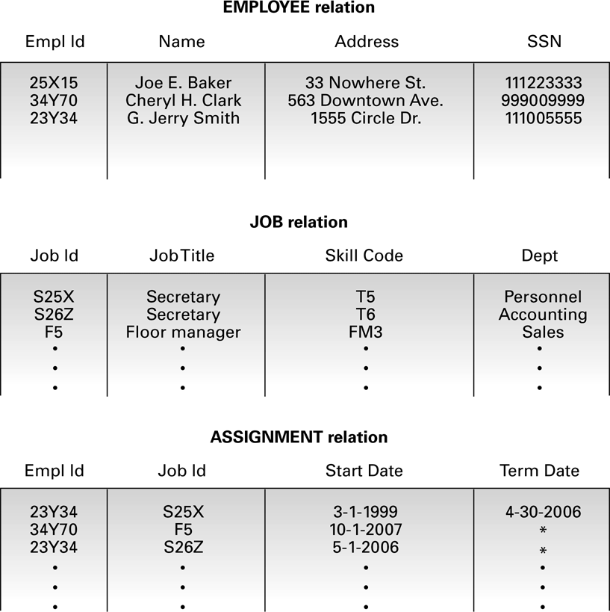
Figure 9.5 An employee database consisting of three relations

Slide 97
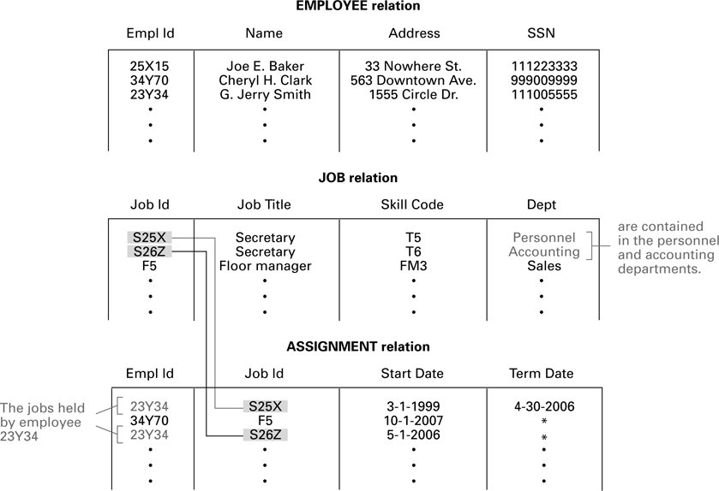
Figure 9.6 Finding the departments in which employee 23Y34 has worked

Slide 98
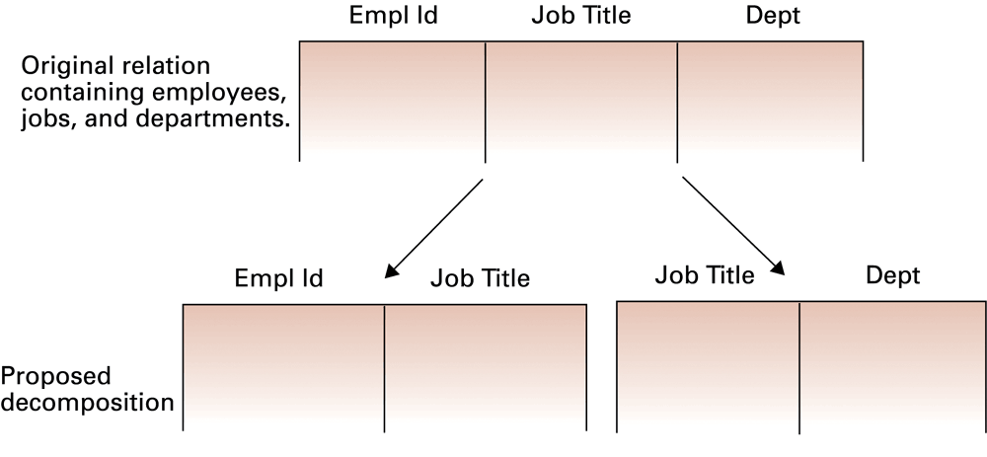
Figure 9.7 A relation and a proposed decomposition

Slide 99
Relational Operations
Select: Choose rows
Project: Choose columns
Join: Assemble information from two or more relations

Slide 100
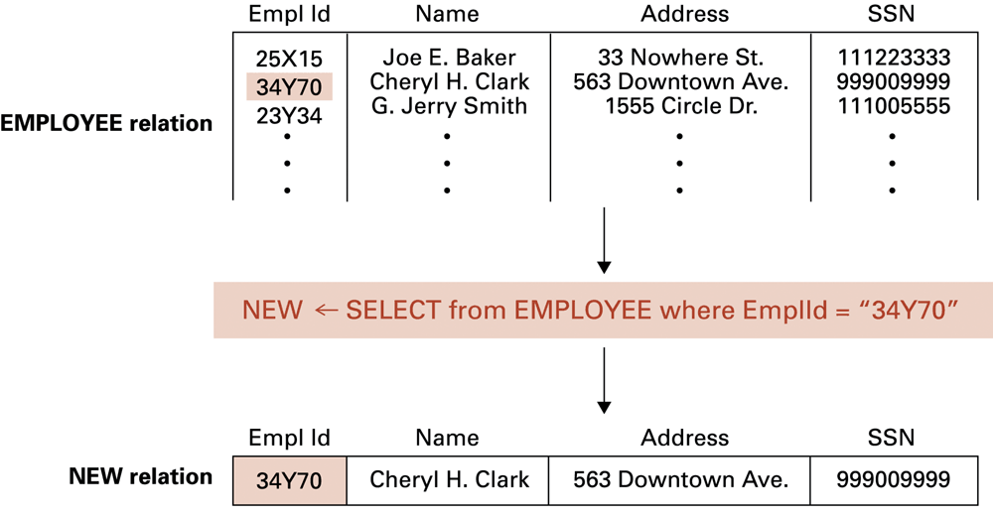
Figure 9.8 The SELECT operation

Slide 101
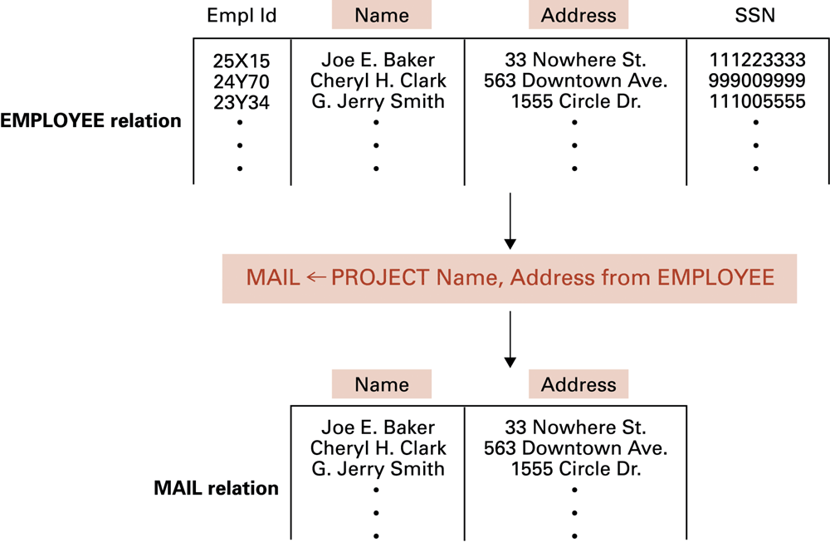
Figure 9.9 The PROJECT operation

Slide 102
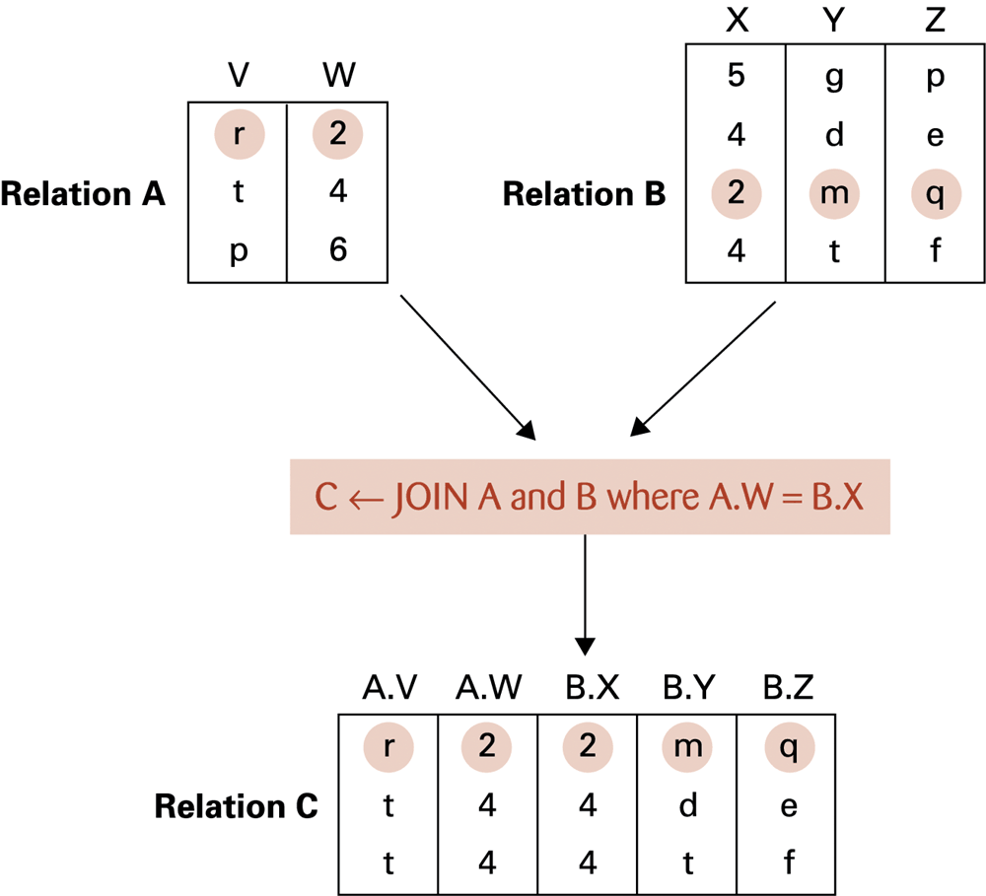
Figure 9.10 The JOIN operation

Slide 103
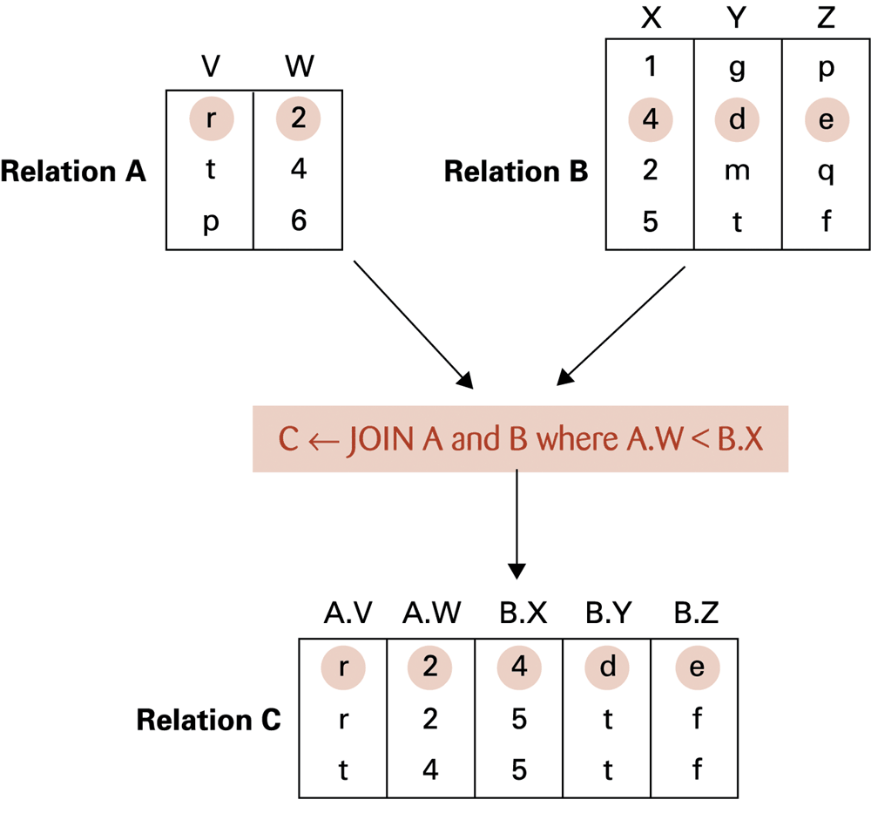
Figure 9.11 Another example of the JOIN operation

Slide 104
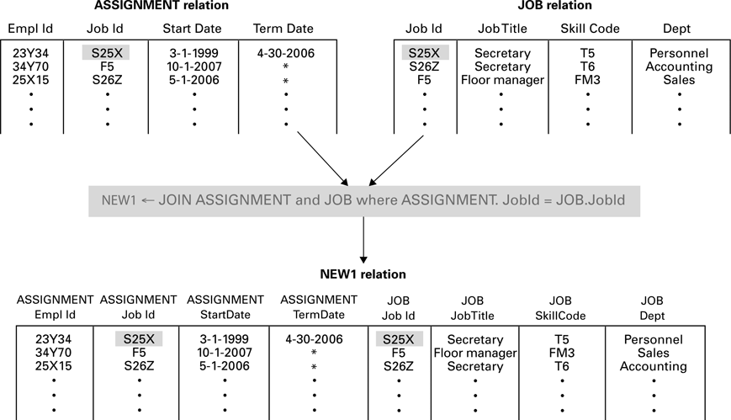
Figure 9.12 An application of the JOIN operation

Slide 105
Structured Query Language (SQL)
Operations to manipulate tuples
insert
update
delete
select

Slide 106
SQL Examples
select EmplId, Dept from ASSIGNMENT, JOB where ASSIGNMENT.JobId = JOB.JobId and ASSIGNMENT.TermData = “*”
insert into EMPLOYEE values (‘43212’, ‘Sue A. Burt’,
’33 Fair St.’, ‘444661111’)

Slide 107
SQL Examples (continued)
delete from EMPLOYEE where Name = ‘G. Jerry Smith’
update EMPLOYEE set Address = ‘1812 Napoleon Ave.’ where Name = ‘Joe E. Baker’

Slide 108
Maintaining Database Integrity
Transaction: A sequence of operations that must all happen together
Example: transferring money between bank accounts
Transaction log: A non-volatile record of each transaction’s activities, built before the transaction is allowed to execute
Commit point: The point at which a transaction has been recorded in the log
Roll-back: The process of undoing a transaction

