Slide 1
Personal Learning Environments? or Society’s Learning Environment?
Leslie Carr, Web and Internet Science,
University of Southampton, UK

Slide 2
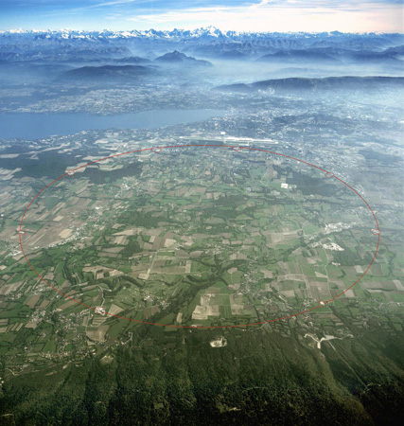
Where’s This?

Slide 3
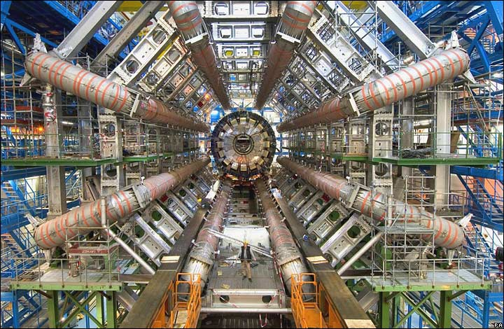
What’s This?

Slide 4
Remember This 2006 Headline?

Slide 5
Birth of the Web
From an underground nuclear bunker on the Swiss border, something did escape
In 1989 the Web took over the academia, industry and the world

Slide 6
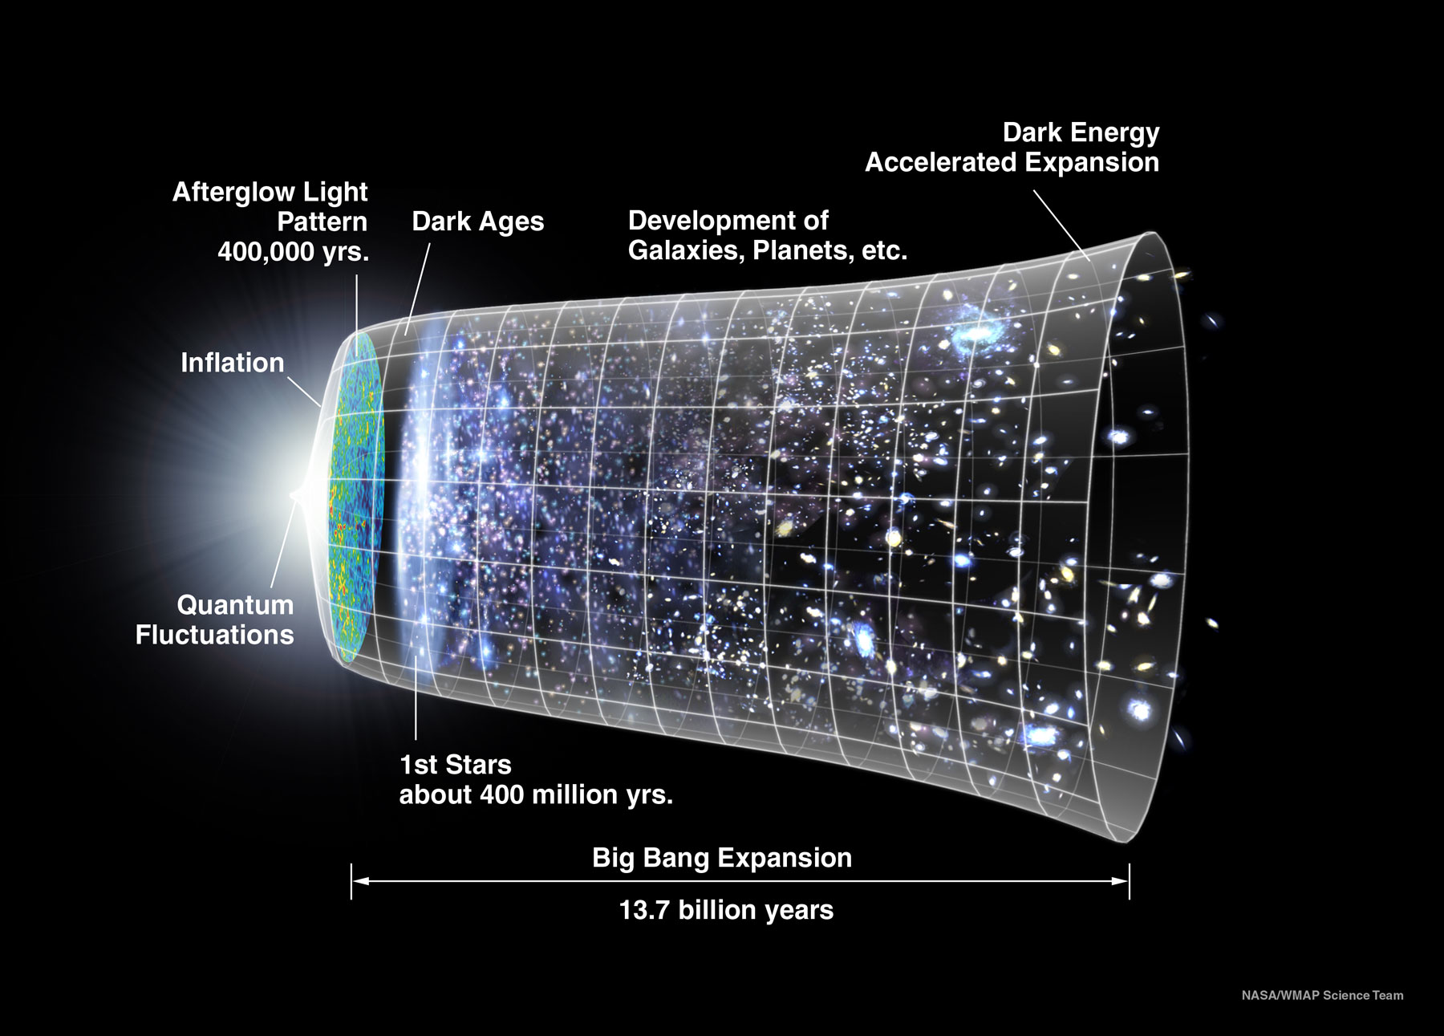
NASA WMAP Science Team http://map.gsfc.nasa.gov/news/3yr_release.html

Slide 7
Expansion of the Web
The Web spread the conditions of its initial creation throughout the whole of society as it underwent an initial inflationary phase.
The academy
government patronage
large-scale co-operation
sharing of intellectual property

Slide 8
Society is Diverse
Institution | Objective
Academy | Create and transmit knowledge
Commerce | Trade goods
Press | Report news
Media | Broadcast content
Military | Defend society
Government | Control society & share resources
Commerce
Academy
Society
Press
Government
Media
Military
The development of society as a whole (nuanced and structured and refined) is inextricably related to the technology of information provision, consumption and dissemination (e.g. writing, reading, printing, education). Different parts of society have different objectives and hence incompatible Web requirements, e.g. openness, security, transparency, privacy.

Slide 9
Less successful Webs from history
Sponsor | System | Scope | Real | Date | Important Properties
Press | Reuters | Professional, centralised | ✔ | 1850 | News & stock information (originally carrier pigeon and subsequently telegraph)
Private Institution | Mundaneum | Public, centralised | ✔ | 1920 | Based on indexing technology (the library card)
Military | Memex | Scholarly, individual, centralised | ✗ | 1945 | Aimed at Scientists and Technologists in WWII
Media | Xanadu | Public, decentralised | ✗ | 1960 | Focused on DRM, reuse and writing for “creatives”
Media | CEEFAX | Public, national, centralised | ✔ | 1970 | Broadcast, linked, not participatory
Government | Minitel | Public, national, centralised | ✔ | 1980 | Commercial services and information
Academy (CS & HEP) | FTP / Archie / Anarchie | Public, decentralised | ✔ | 1985 | Downloaded resources (papers, reports) to hard drives and printed them on LaserWriters.
Commerce | Hypercard, HyperTIES | Private, centralised | ✔ | 1988 | Personal applications, sometimes tied to multimedia resources on CDROMs / video disks
Academy (HEP) | WWW | Public, global, decentralised | ✔ | 1990 | Universal naming, linking, interoperability, participative. However no writing, no indexing.
Academy (CS) | Microcosm | Private, centralised | ✔ | 1990 | Sophisticated linking and openness for personal information stores
Academy (CS) | HyperG | Public, centralised | ✔ | 1990 | Extension of Web for with support for writing, indexing and consistency management.
Commerce | AOL, CompuServ | Public, centralised | ✔ | 1990 | Dialup access to email, forums, chat rooms and information resources

Slide 10
The Web is a Performance…
Create a homepage
Contribute to a genome
The middle space represents the activity of individuals (potentially acting in concert) who create interlinked resources that both reflect and reinforce the interlinkedness of society and social (economic, legal, personal) interaction.
Publish a paper
Society
Web Architecture
Edit a wikipedia entry
Communities
Special Interest Groups
Individuals
Companies
HTTP
URIs
Servers
Caches
Institutions
Government
HTML
RDF
Browsers
Blog
Tweet
Update Facebook
Place a bid at an auction
Make a YouTube video response
…and a record of that performance

Slide 11
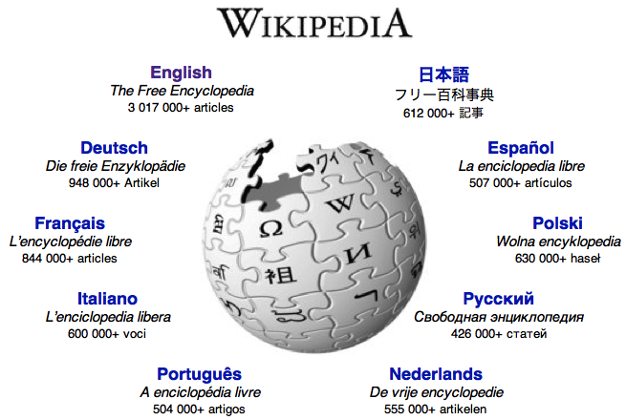
Performing on the Web
It’s something we do, not a product we buy
Information and Communication Technology
Informing and Communicating Technology
Wikipedia – new knowledge is edited and managed on the web through processes that are discussed and managed through the Web. Wikipedia only exists because of the wikipedia community; the wikipedia community only exists because of the Web. Both are a linked resource with an emerging set of values and standards.
Academia – new knowledge is created privately and sometimes presented on the Web. Centuries-old processes and values pre-exist in academic organisations and are re-interpreted for the prevailing technology.
Different parts of society have different needs to communicate for different ends.

Slide 12
PLE: New Kind of Performance?
Learning as a human modality:
Enquiry, discovery, guidance, evaluation, certification
What kinds of Web users are there?
Web 1.0: readers
Web 2.0: readers and content providers
Web 3.0: software agents & user-oriented apps
Wikipedia: readers, contributors, editors
Now: readers, commenters, content providers, commentators

Slide 13
Personal Learning or Society Learning
Not just individuals trying to increase their own cognitive competency in order to be able to improve their CV
Now society needs to do this
solving energy, climate, water
Does the PLE agenda offer a new kind of web performance

Slide 14
Discussion?

Slide 15
Cyborgs
Social theorist Donna Haraway emphasises the role that technology plays in creating our humanity
Union of human & technology makes a new kind of human
What sort of thing is human + smartphone ?
The web is not a thing acting alone. Computers cause nothing, but humans and computers together remake worlds.
paraphasing Donna Haraway, Social Theorist

Slide 16
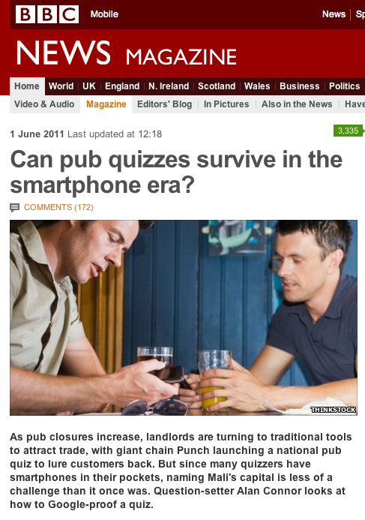
Cyborgs in the Pub
Lam, S., Pennock, D.M., Cosley, D. and Lawrence, S. (2003) 1 Billion Pages = 1 Million Dollars? Mining the Web to Play “Who Wants to be a Millionaire?” in Proc. of the 19th Conf. on Uncertainty in Artificial Intelligence, 2003

Slide 17
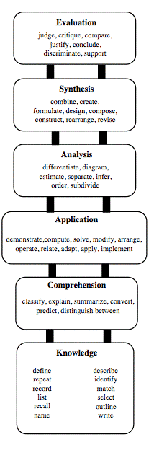
Bloom’s Taxonomy
Educational outcomes? or Cognitive competencies?
Everything is built on knowledge/recall
The only thing the Web provides is knowledge/recall

Slide 18
Discussion
What new Web features (services?) do we need
To Transform Personal Reading into Personal Learning

