Slide 1
The web 2.0 development survival guide
David Millard
dem@ecs.soton.ac.uk

Slide 2
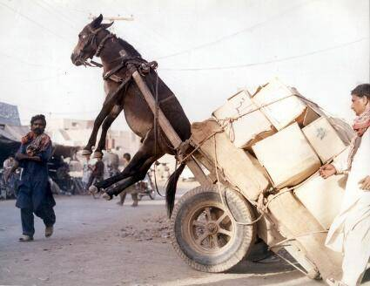
Part I: Everything’s Eventual Dealing with Scale

Slide 3
When RDMS Fail – Naïve Setup
Clients
That Write
DB
Clients
That Read
Understanding the "NoSQL movement" | Enterprise | Real World Computing | PC Pro
http://www.pcpro.co.uk/realworld/355477/understanding-the-nosql-movement

Slide 4
Slaving
Clients
That Write
Master DB
Data is replicated from Master to Slaves
Slave DB
Slave DB
Slave DB
Clients
That Read
Understanding the "NoSQL movement" | Enterprise | Real World Computing | PC Pro
http://www.pcpro.co.uk/realworld/355477/understanding-the-nosql-movement

Slide 5
Horizontal Partitioning (Sharding)
Clients
That Write
Data is split between Masters based on rows (e.g. Surnames A-M on DB1, and N-Z on DB2)
Master DB1
Master DB2
Data is replicated from Master to Slaves
Slave DB
Slave DB
Slave DB
Slave DB
Clients
That Read
Understanding the "NoSQL movement" | Enterprise | Real World Computing | PC Pro
http://www.pcpro.co.uk/realworld/355477/understanding-the-nosql-movement

Slide 6
Vertical Partitioning
Clients
That Write
Data is split between Masters based on columns (e.g.for each student: Personal Details on DB1, Enrolment Details on DB2)
Student Master DB1
Student Master DB2
Data is replicated from Master to Slaves
Slave DB
Slave DB
Slave DB
Slave DB
Clients
That Read
Understanding the "NoSQL movement" | Enterprise | Real World Computing | PC Pro
http://www.pcpro.co.uk/realworld/355477/understanding-the-nosql-movement

Slide 7
Big Problems with Transaction Consistency
Clients
That Write
Data is split between Masters based on columns (e.g.for each student: Personal Details on DB1, Enrolment Details on DB2)
Consider Phoebe
In the system she is recorded as Foebe, 18, Enrolled in CompSci
Student Master DB1
Student Master DB2
Data is replicated from Master to Slaves
Slave DB
Slave DB
Slave DB
Slave DB
Clients
That Read
Understanding the "NoSQL movement" | Enterprise | Real World Computing | PC Pro
http://www.pcpro.co.uk/realworld/355477/understanding-the-nosql-movement

Slide 8
Big Problems with Transaction Consistency
An Admin corrects her name and changes her course to SoftEng
Clients
That Write
Data is split between Masters based on columns (e.g.for each student: Personal Details on DB1, Enrolment Details on DB2)
Consider Phoebe
In the system she is recorded as Foebe, 18, Enrolled in CompSci
Student Master DB1
Student Master DB2
Data is replicated from Master to Slaves
Slave DB
Slave DB
Slave DB
Slave DB
At around the same time someone asks the system for her details
Clients
That Read
Understanding the "NoSQL movement" | Enterprise | Real World Computing | PC Pro
http://www.pcpro.co.uk/realworld/355477/understanding-the-nosql-movement

Slide 9
Big Problems with Transaction Consistency
An Admin corrects her name and changes her course to SoftEng
Clients
That Write
Data is split between Masters based on columns (e.g.for each student: Personal Details on DB1, Enrolment Details on DB2)
Consider Phoebe
In the system she is recorded as Foebe, 18, Enrolled in CompSci
Student Master DB1
Student Master DB2
Data is replicated from Master to Slaves
Slave DB
Slave DB
Slave DB
Slave DB
Answer(s):
Phoebe is on CompSci
Foebe is on CompSic
Phoebe is on SoftEng
Foebe is on SoftEng
At around the same time someone asks the system for her details
Clients
That Read
Understanding the "NoSQL movement" | Enterprise | Real World Computing | PC Pro
http://www.pcpro.co.uk/realworld/355477/understanding-the-nosql-movement

Slide 10
The CAP Theorem – Pick Any Two
Consistency
Availability
Partition Tolerance
Gilbert. Brewer's conjecture and the feasibility of consistent, available, partition-tolerant web services. ACM SIGACT News (2002)

Slide 11
The CAP Theorem – Pick Any Two
Consistency
RDBMS
Availability
Partition Tolerance
Gilbert. Brewer's conjecture and the feasibility of consistent, available, partition-tolerant web services. ACM SIGACT News (2002)

Slide 12
The CAP Theorem – Pick Any Two
Consistency
RDBMS
Enforced Consistency
Availability
Partition Tolerance
Gilbert. Brewer's conjecture and the feasibility of consistent, available, partition-tolerant web services. ACM SIGACT News (2002)

Slide 13
The CAP Theorem – Pick Any Two
Consistency
RDBMS
Enforced Consistency
Availability
Partition Tolerance
Eventual Consistency
Gilbert. Brewer's conjecture and the feasibility of consistent, available, partition-tolerant web services. ACM SIGACT News (2002)

Slide 14
Eventual Consistency
Strong consistency
After the update completes, any subsequent access will return the updated value.
Weak consistency
The system does not guarantee that subsequent accesses will return the updated value until some conditions have been met
The period between the update and the moment when it is guaranteed that any observer will always see the updated value is dubbed the inconsistency window.
Eventual consistency
This is a specific form of weak consistency where the condition is time
the storage system guarantees that if no new updates are made to the object, eventually all accesses will return the last updated value.
Vogels. Eventually consistent. Communications of the ACM (2009) vol. 52 (1) pp. 40-44

Slide 15
The NoSQL Movement
RDBMS
Good at maintaining complex interrelated data
But are complex to partition
Keep want to JOIN their tables across their partitions
(combine information from multiple tables that may be held in different partitions, typically using SQL commands – Structured Query Language)
Student ID | Name | School ID
1001 | Adrian Jones | S1
1002 | Bob Smith | S2
1003 | Celia Brown | S1
School ID | School Name
S1 | Engineering
S2 | Medicine
JOIN
Student ID | Name | School ID | School Name
1001 | Adrian Jones | S1 | Engineering
1002 | Bob Smith | S2 | Medicine
1003 | Celia Brown | S1 | Engineering
Leavitt. Will NoSQL Databases Live Up to Their Promise?. Computer (2010) vol. 43 (2) pp. 12-14

Slide 16
The NoSQL Movement
But many problems involve only unstructured data
Emails
Photos
Status updates
Bookmarks
Etc…
NoSQL solutions
Store unstructured data in a Simple way
Good for scalability
Easier to partition
Works well with Eventual Consistency
Photos
Emails
Leavitt. Will NoSQL Databases Live Up to Their Promise?. Computer (2010) vol. 43 (2) pp. 12-14

Slide 17
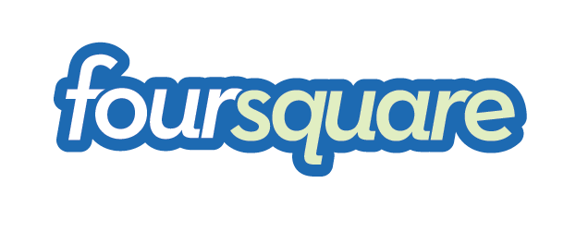
Document Approach
In practice Document often means JSON Objects
JavaScript Object Notation
(Can be used with little parsing overhead)

Slide 18
Document Approach
{
“firstName”: “Elizabeth”,
“lastName”: “Windsor",
“age”: 80,
“address”:
{
“streetAddress”: “Buckingham Palace”,
“city”: “London”,
“country”: “UK”
},
”interests":
[“Dissolving Parliaments”,
“Royal Engagements”,
“Corgis”]
}
In practice Document often means JSON Objects
JavaScript Object Notation
(Can be used with little parsing overhead)

Slide 19
Document Approach
Key/Value Approach
In practice Document often means JSON Objects
JavaScript Object Notation
(Can be used with little parsing overhead)
In practice Value often means simple structures
Strings / Numbers
Lists of Strings
Sets of Typed Values (struct)

Slide 20
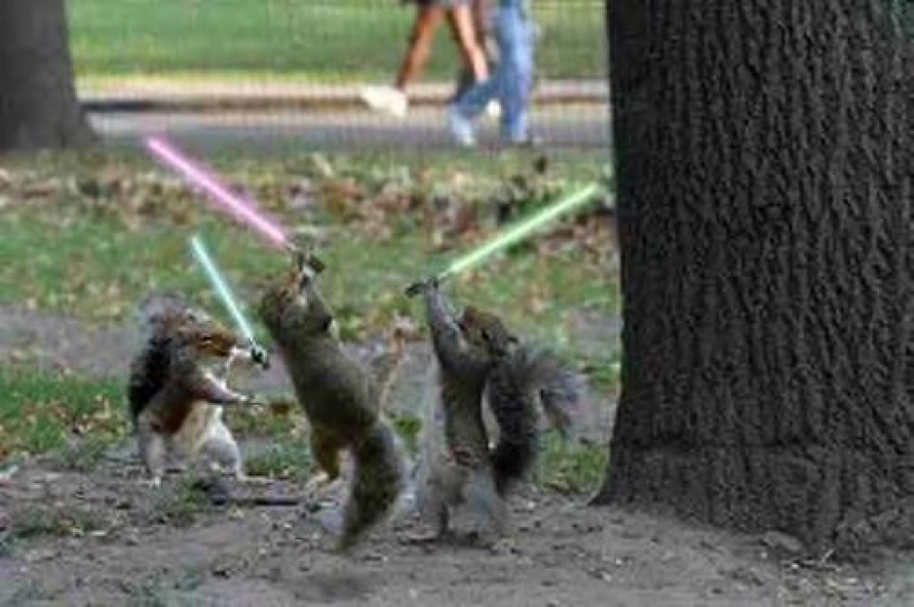
Part 2: Playing Nicely Interoperability and the Open Social Web

Slide 21
The Social Media Ecosystem
Primary Networks
Wouldn’t life be simple if everyone just used Facebook?

Slide 22
The Social Media Ecosystem
Primary Networks
Thankfully (for ethical and moral reasons!) they don’t. People can have more use more than one social network system

Slide 23
The Social Media Ecosystem
Primary Networks
Secondary Networks
In practice we increasingly use many services

Slide 24
The Social Media Ecosystem
Primary Networks
Secondary Networks
I tweet about music I like
They are entwined

Slide 25
The Social Media Ecosystem
Primary Networks
Secondary Networks
And good stuff I find
I tweet about music I like
They are entwined

Slide 26
The Social Media Ecosystem
Primary Networks
Secondary Networks
I blog about the really good stuff
And good stuff I find
I tweet about music I like
They are entwined

Slide 27
The Social Media Ecosystem
Primary Networks
Secondary Networks
I blog about the really good stuff
And make my poor friends read it!
And good stuff I find
I tweet about music I like
They are entwined

Slide 28
The Social Media Ecosystem
Primary Networks
Secondary Networks
I blog about the really good stuff
And make my poor friends read it!
And good stuff I find
I tweet about music I like
They are entwined

Slide 29
The Social Media Ecosystem
Primary Networks
But my Linkedin connections don’t see my tweets
Secondary Networks
I blog about the really good stuff
And make my poor friends read it!
And good stuff I find
I tweet about music I like
They are entwined

Slide 30
The Social Media Ecosystem
Primary Networks
But my Linkedin connections don’t see my tweets
Secondary Networks
I blog about the really good stuff
And make my poor friends read it!
And good stuff I find
My friends cant comment on my blogs
I tweet about music I like
They are entwined

Slide 31
The Social Media Ecosystem
Primary Networks
But my Linkedin connections don’t see my tweets
Secondary Networks
I blog about the really good stuff
And make my poor friends read it!
And good stuff I find
My friends cant comment on my blogs
I tweet about music I like
And my academic colleagues are not added to my LinkedIn connections
They are entwined

Slide 32
The Social Media Ecosystem
Tangle!
Primary Networks
But my Linkedin connections don’t see my tweets
Secondary Networks
I blog about the really good stuff
And make my poor friends read it!
And good stuff I find
My friends cant comment on my blogs
I tweet about music I like
And my academic colleagues are not added to my LinkedIn connections
They are entwined

Slide 33
How Might We Interoperate?

Slide 34
How Might We Interoperate?
We need an Identity – a digital representation of ourselves and a home for our personal information
Identity

Slide 35
How Might We Interoperate?
We need a way of signing on using that identity – preferably a single sign-on across many sites
Authorisation
We need an Identity – a digital representation of ourselves and a home for our personal information
Identity

Slide 36
How Might We Interoperate?
We need a way of using common applications and tools with that identity
Applications
We need a way of signing on using that identity – preferably a single sign-on across many sites
Authorisation
We need an Identity – a digital representation of ourselves and a home for our personal information
Identity

Slide 37
How Might We Interoperate?
Applications
Propriatary SNS (like Facebook or Twitter) give us:
An Identity (@hoosfoos)
A Home (twitter.com/hoosfoos)
But these companies own this data
And I am subject to their policies
And their economic fate
Authorisation
Identity

Slide 38
How Might We Interoperate?
Applications
OpenID is an attempt to give users back ownership of their identity (now at version 2.0)
A single identity that can be used on multiple sites
A Federated Sign-in
Based on a URI
When users log in to site using Open ID:
The site resolves the URI to find the providers URL
Transfers user to that URL to login
Provider authenticates user and passes back to original site
OpenID
Authorisation
Identity

Slide 39
How Might We Interoperate?
Applications
The good:
No centralised control – anyone can implement the OpenID protocol and provide OpenIDs
Separates identity from application (and identity providers from application providers)
OpenID
Authorisation
Identity

Slide 40
How Might We Interoperate?
The bad:
Two points of failure (identity and application providers)
Users find a URI confusing
Transferring to an external site to authenticate can spoil the user experience
Security issues
Compromised OpenIDs open many websites rather than one
Easier for phishing attacks to steal login details
37signals product blog, “We’ll be retiring our support of OpenID on May 1” 25/1/2011. http://productblog.37signals.com/products/2011/01/well-be-retiring-our-support-of-openid-on-may-1.html
Applications
OpenID
Authorisation
Identity

Slide 41
How Might We Interoperate?
OAuth:
An Authentication protocol that allows you to share private resources on one site with another
Your username/password is too powerful – blanket access
OAuth allows you to hand out Tokens that allow access to specific resources or information
A Delegated sign-in
Applications
OAuth
OpenID
Authorisation
Identity
Beginners guide to Oauth, Hueniverse.com, http://hueniverse.com/oauth/

Slide 42
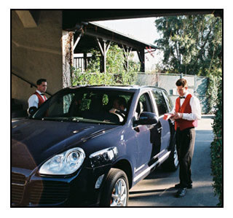
How Might We Interoperate?
OAuth works like a Valet key…
Applications
OAuth
OpenID
Authorisation
Identity
Beginners guide to Oauth, Hueniverse.com, http://hueniverse.com/oauth/

Slide 43
How Might We Interoperate?
Printing Service
Photo Service
Applications
OAuth
OpenID
?
Authorisation
Identity
Kaila P. OAuth and OpenID 2.0. From End-to-End to Trust-to-Trust, Proceedings of the Seminar on Network Security (2008) pp. 18-22

Slide 44
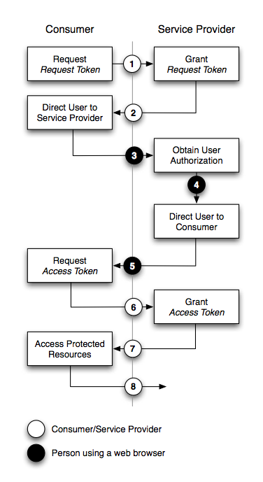
How Might We Interoperate?
Printing Service
Photo Service
Applications
OAuth
OpenID
Authorisation
Identity
Kaila P. OAuth and OpenID 2.0. From End-to-End to Trust-to-Trust, Proceedings of the Seminar on Network Security (2008) pp. 18-22

Slide 45
How Might We Interoperate?
The good:
Allows SNS to interoperate and exchange data
Seamless user experience (no need to create a separate identity)
Can also be used to commute all authentication (e.g. Sign In With Twitter)
The bad:
Still relies on redirects
Could be vulnerable to spoofing
Applications
OAuth
OpenID
Authorisation
Identity
Beginners guide to Oauth, Hueniverse.com, http://hueniverse.com/oauth/

Slide 46
How Might We Interoperate?
OpenSocial
Launched by Google
A common set of APIs from accessing SN information from a SN site
Allows applications to be created that are independent of any one social network
Based on XML, HTML and Javascript
OpenSocial
Applications
OAuth
OpenID
Authorisation
Identity

Slide 47
How Might We Interoperate?
<?xml version="1.0" encoding="UTF-8"?>
<Module>
<ModulePrefs title="Gifts part 1 - Friends">
<Require feature="opensocial-0.8"/>
</ModulePrefs>
<Content type="html">
<![CDATA[
<script type="text/javascript">
/* ... */
</script>
Hello World!
]]>
</Content>
</Module>
OpenSocial
Applications
OAuth
OpenID
Authorisation
Identity

Slide 48
How Might We Interoperate?
<?xml version="1.0" encoding="UTF-8"?>
<Module>
<ModulePrefs title="Gifts part 1 - Friends">
<Require feature="opensocial-0.8"/>
</ModulePrefs>
<Content type="html">
<![CDATA[
<script type="text/javascript">
/* ... */
</script>
Hello World!
]]>
</Content>
</Module>
OpenSocial
Applications
OAuth
OpenID
Authorisation
Identity
Basic HTML content

Slide 49
How Might We Interoperate?
<?xml version="1.0" encoding="UTF-8"?>
<Module>
<ModulePrefs title="Gifts part 1 - Friends">
<Require feature="opensocial-0.8"/>
</ModulePrefs>
<Content type="html">
<![CDATA[
<script type="text/javascript">
/* ... */
</script>
Hello World!
]]>
</Content>
</Module>
OpenSocial
Applications
OAuth
OpenID
Authorisation
Identity
Javascript to interact with hosting SNS

Slide 50
How Might We Interoperate?
Javascript APIs Key Concepts:
Owners and Viewers
Friendships
Activity Streams
Collection of Actions (e.g. profile update, receiving a gift, new high score)
Persistence
Key/Value Data Store
OpenSocial
Applications
OAuth
OpenID
Authorisation
Identity
http://www.opensocial.org/specs

Slide 51
How Might We Interoperate?
The good:
Easy way to build apps for many SNS at once
High impact for app developers
Instant pool of apps for new SNS
The Bad:
Lowest common denominator data model
Inconsistent: too long to settle – and still too ambiguous
Just a technology – no management of developers or effort
OpenSocial
Applications
OAuth
OpenID
Authorisation
Identity

Slide 52
Successful Examples
Twitter @Anywhere
Drop Twitter functionality onto any page
Twitter @Anywhere
OpenSocial
Applications
OAuth
OpenID
Authorisation
Identity

Slide 53
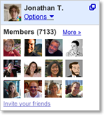
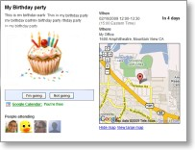
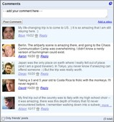
Successful Examples
Twitter @Anywhere
Drop Twitter functionality onto any page
Twitter @Anywhere
Google
Friend-
Connect
OpenSocial
Applications
OAuth
OpenID
Authorisation
Google FriendConnect
Social Gadgets powered by Google
Identity
Site members
Events
Comments

Slide 54
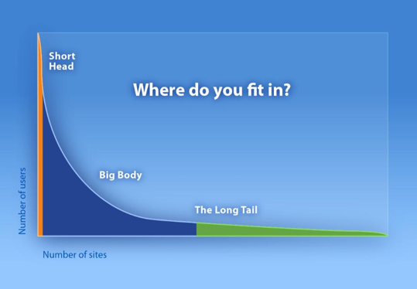
The Long Tail of Social Networking
SNS Big Players
Facebook
Twitter
MySpace
Etc…
OpenSocial, OpenID, and OAuth: Oh, My!, Joseph Smarr (Plaxo),
http://sites.google.com/site/io/opensocial-openid-and-oauth-oh-my

Slide 55
The Long Tail of Social Networking
SNS Big Players
Facebook
Twitter
MySpace
Etc…
Professional Players
News Providers, Retailers, Charities, Etc…
OpenSocial, OpenID, and OAuth: Oh, My!, Joseph Smarr (Plaxo),
http://sites.google.com/site/io/opensocial-openid-and-oauth-oh-my

Slide 56
The Long Tail of Social Networking
SNS Big Players
Facebook
Twitter
MySpace
Etc…
Casual Players
SMEs, Bloggers, Individuals,
Etc…
Professional Players
News Providers, Retailers, Charities, Etc…
OpenSocial, OpenID, and OAuth: Oh, My!, Joseph Smarr (Plaxo),
http://sites.google.com/site/io/opensocial-openid-and-oauth-oh-my

Slide 57
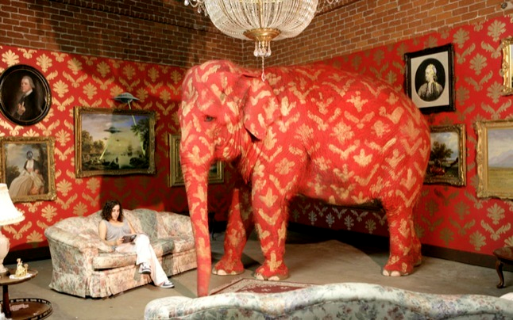
The Elephant in the Room?
Twitter @Anywhere
Google
Friend-
Connect
OpenSocial
Applications
OAuth
OpenID
Authorisation
Identity

Slide 58
The Elephant in the Room?
The Facebook Platform
Massive Market Share (500m+ members)
Tends to work outwardly
E.g. Does work with OAuth
The Graph API
FBML, Facebook Markup Language
FQL, Facebook Query Language
FBJS, Facebook's JavaScript system
Facebook Connect
Facebook Platform
Twitter @Anywhere
Google
Friend-
Connect
OpenSocial
Applications
OAuth
OpenID
Authorisation
Identity

Slide 59
Lessons Learned
Scalability
Traditional RDBMS Methods are struggling to cope with Internet Scale
NoSQL Movement
Solutions that are Eventually Consistent
Alternatives to RDBMs such as Document and Key/Value stores
Interoperability
Philosophical battle
Federated (OpenID) vs. Delegated (Oauth) Sign-in
Many APIs emerging for applications and connection
Trend seems to be for a branded experience
Facebook Connect
Twitter @Anywhere

Slide 60
Questions…
?
Dave Millard (dem@ecs.soton.ac.uk)
Thanassis Tiropanis (tt2@ecs.soton.ac.uk)

