Slide 1
COMP6049
Qualitative research analysis
http://www.edshare.soton.ac.uk/6367/

Slide 2
today
Quick overview
Exercise in data analysis
Discussion of ways of recording and analysing

Slide 3
Analysing qualitative data
Qualitative Data?
surveys – free text responses
Semi structured interviews
Focus groups
Texts
Sources from the ‘wild’
…video, images

Slide 4
Analysis tools

Slide 5
Basic analysis
Getting to know the text
  Read
  Identify ‘features’
  Note
  Categorise
  Reflect/learn
Debate – do we count what we see?

Slide 6
Exercise
Full handout is in EdShare
http://www.edshare.soton.ac.uk/6367/
Read the transcripts, individually review, analyse and ‘code’ the data ( individually and in pairs)
Watch the actual videos
Look at the analysis/conclusions which the researchers drew

Slide 7
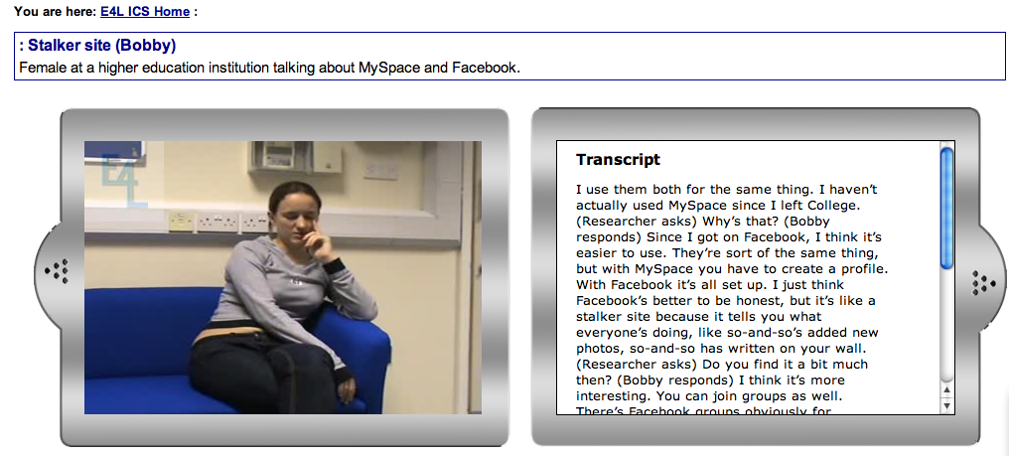
Stalker site
http://wb2.northampton.ac.uk/e4l/video.php?id=72

Slide 8
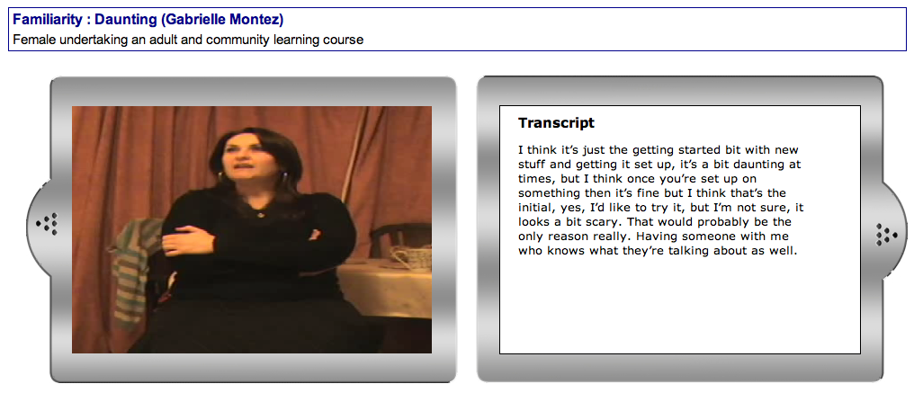
Darklight Familiarity - Daunting
http://wb2.northampton.ac.uk/e4l/video.php?id=50&catid=7&themeid=2

Slide 9
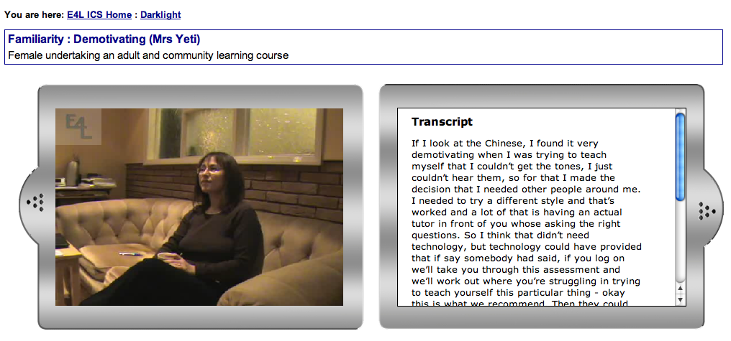
Darklight Familiarity Demotivating
http://wb2.northampton.ac.uk/e4l/video.php?id=45&catid=7&themeid=2

Slide 10
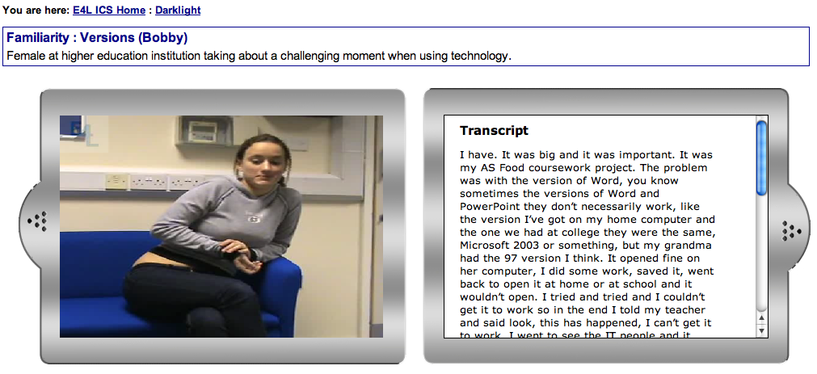
Darklight: Familiarity Versions
http://wb2.northampton.ac.uk/e4l/video.php?id=16&catid=7&themeid=2

Slide 11
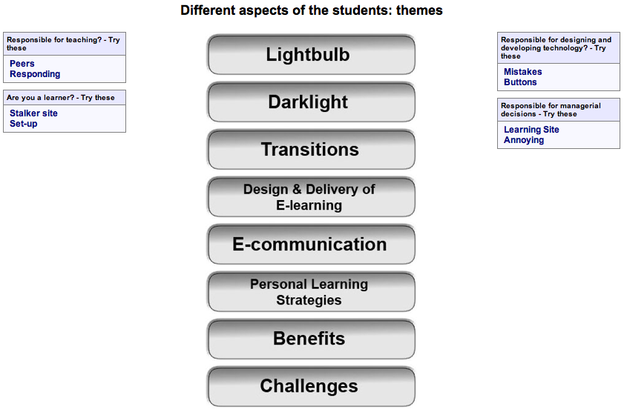
Some of the categories
http://wb2.northampton.ac.uk/e4l/

Slide 12
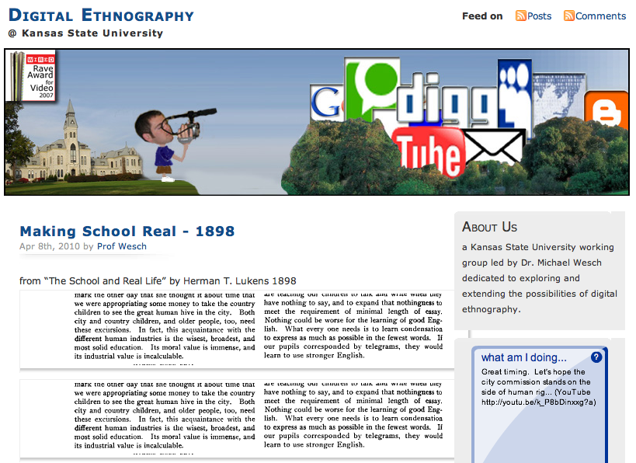
Other approaches
http://mediatedcultures.net/ksudigg/

Slide 13
Software in Southampton
QSRNvivo 8 sp2 to UDE workstations has been available since November 2008
Qsr Nvivo 8 sp2 software will be made available to public-workstation computers in B58 room 1049 and B58 room 1045
Following successful testing, the software will be deployed to public-workstation computers that had the old version of Nvivo (selected rooms at B58, B44, Avenue, B67, B2)

Slide 14
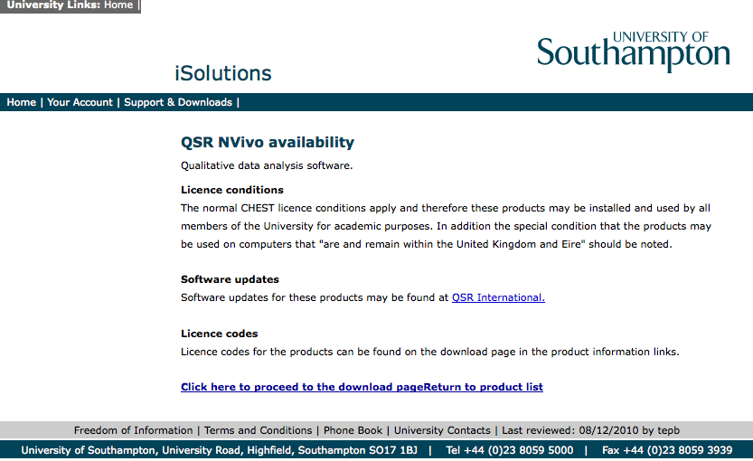
Nvivo on PCs
https://www.software.soton.ac.uk/

Slide 15
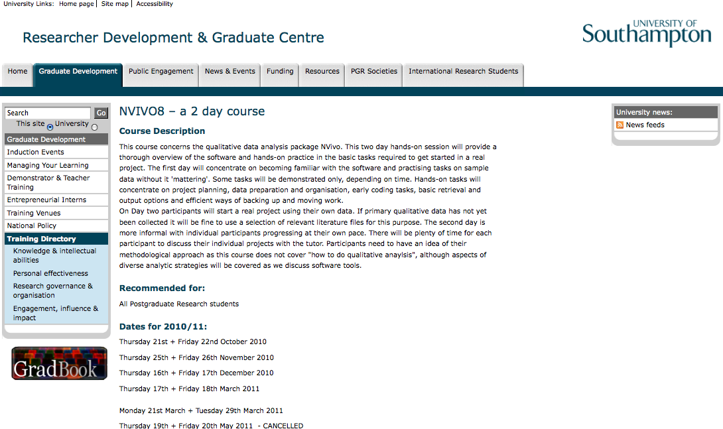
Grad School Training

Slide 16
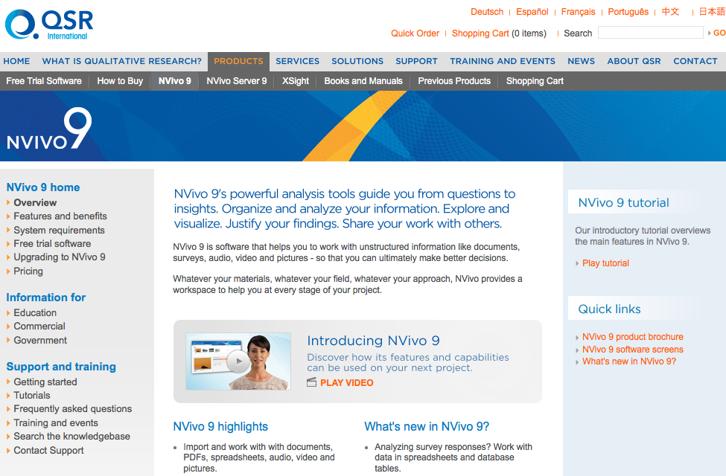
Nvivo
http://www.qsrinternational.com/products_nvivo.aspx

Slide 17
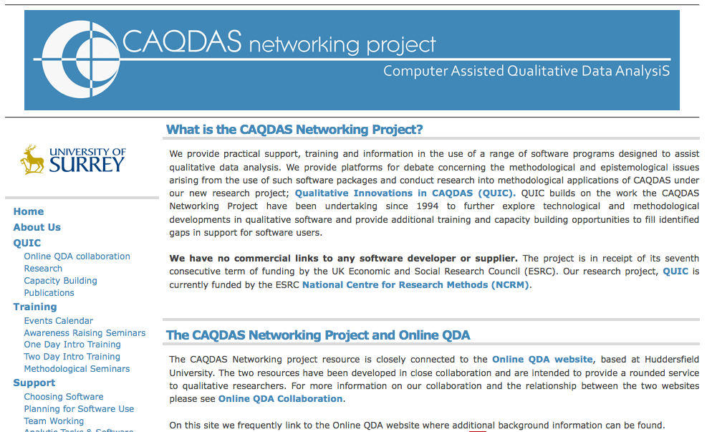
CAQDAS – support and training
http://caqdas.soc.surrey.ac.uk/

Slide 18
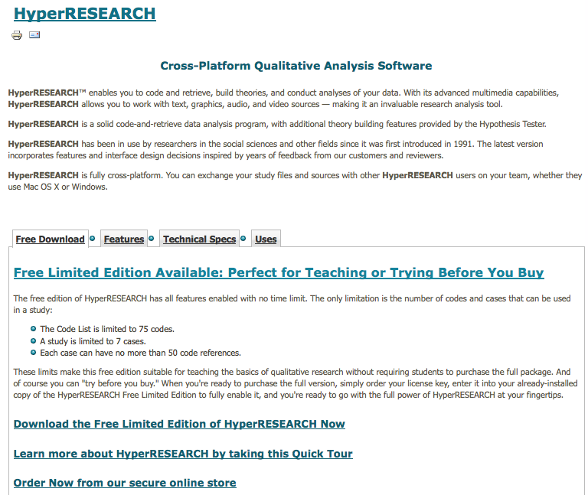
HyperRESEARCH – for macs

Slide 19
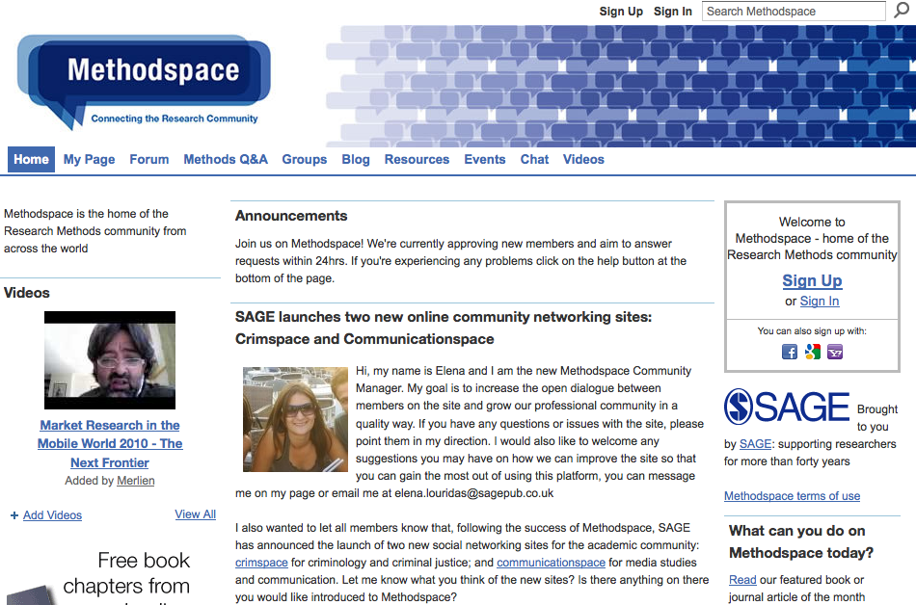
Method Space
http://www.methodspace.com/

Slide 20
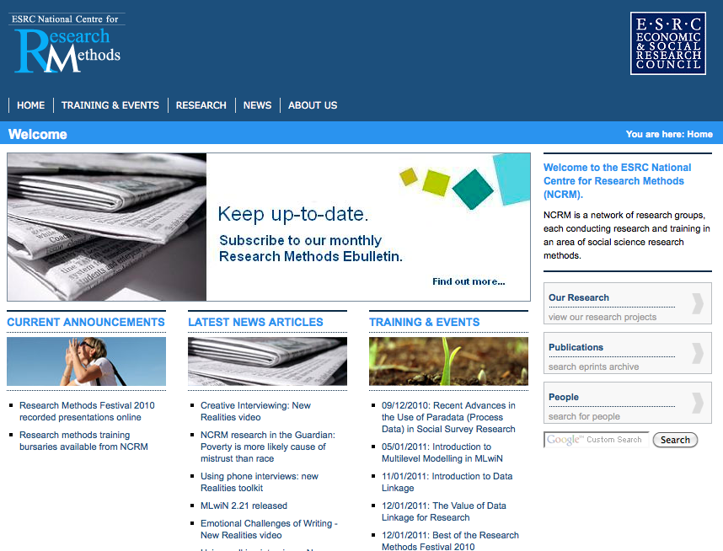
National Centre for Research Methods
http://www.ncrm.ac.uk/

Slide 21
references
Lewins & Silver (2007) Using Software in Qualitative Research : A Step-by-Step Guide, Sage Publications, London
http://caqdas.soc.surrey.ac.uk/usingqualsoftware.html
Bazeley, P., & Richards L. (2000). The NVivo qualitative project book. London: Sage

Slide 22
Webliography
CAQDAS - computer assisted qualitative data analysis
CAQDAS Centre, University of Surrey
http://caqdas.soc.surrey.ac.uk/index.html
QSR Nvivo
Online module http://www.erm.ecs.soton.ac.uk/ (University of Southampton)
HyperRESEARCH software

