Slide 1
Privacy.
Kieron O’Hara
23 November 2010
Notes:
Please use the dd month yyyy format for the date for example 11 January 2008. The main title can be one or two lines long.

Slide 2
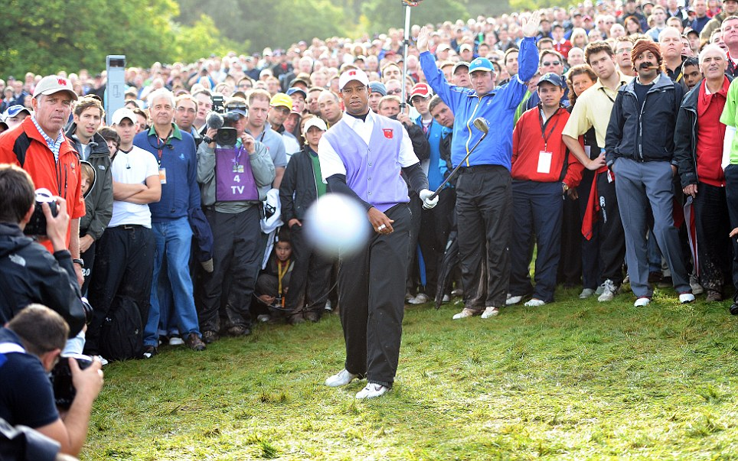
Woah, Tiger!

Slide 3
The Second Most Famous Man?

Slide 4
The Second Most Famous Man?

Slide 5
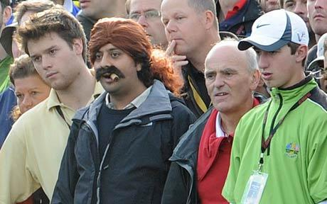
The Cigar Guy

Slide 6
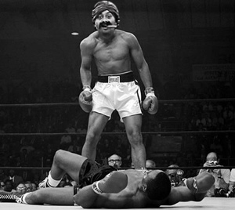
The Cigar Guy

Slide 7
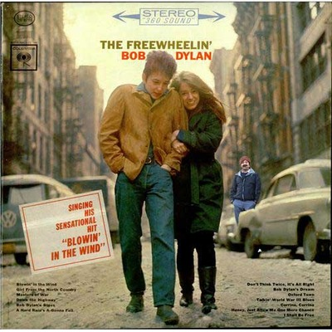
The Cigar Guy

Slide 8
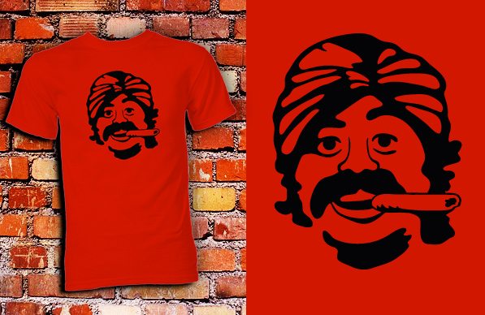
The Cigar Guy: Got the T-Shirt

Slide 9
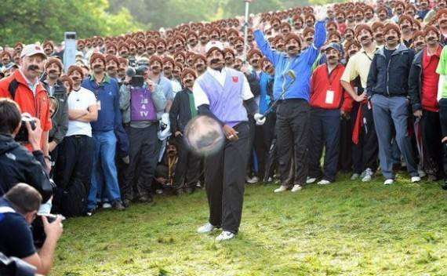
The Ultimate

Slide 10
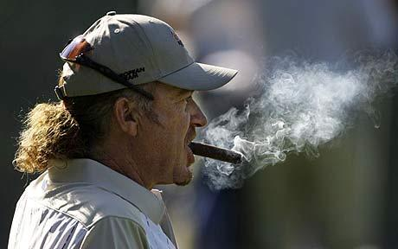
Going Viral
Cigar Guy is Rupesh Shingadia
  30 years old
  From Wallington, near Croydon
  Investment analyst
  Threadneedle Asset Management
  Fan of Miguel Angel Jimenez
“I've never done anything like this before, I'm just an ordinary guy who loves golf and follows Arsenal. If I had known the incredible reaction it would produce, the way that Cigar Guy has snowballed, I would probably never have put on my costume.”

Slide 11

Going Viral

Slide 12
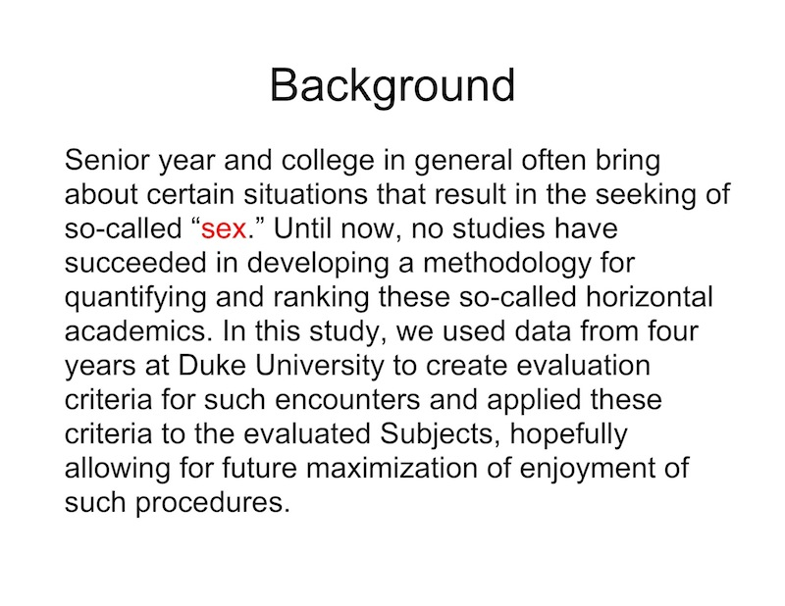
Oops!

Slide 13
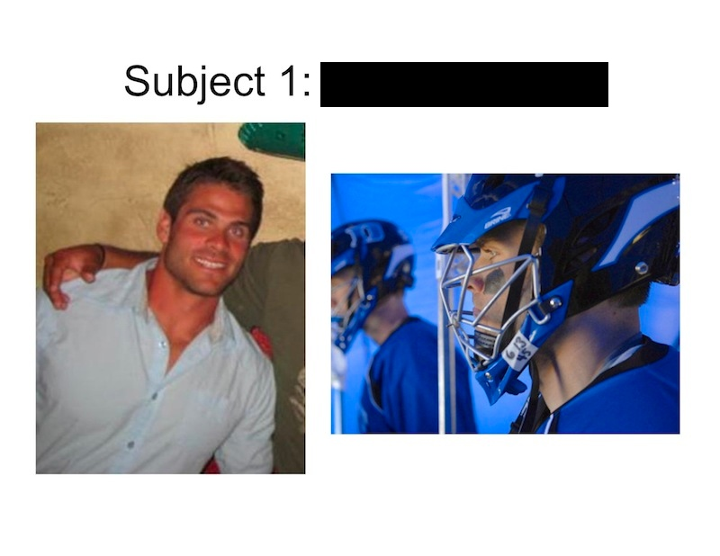
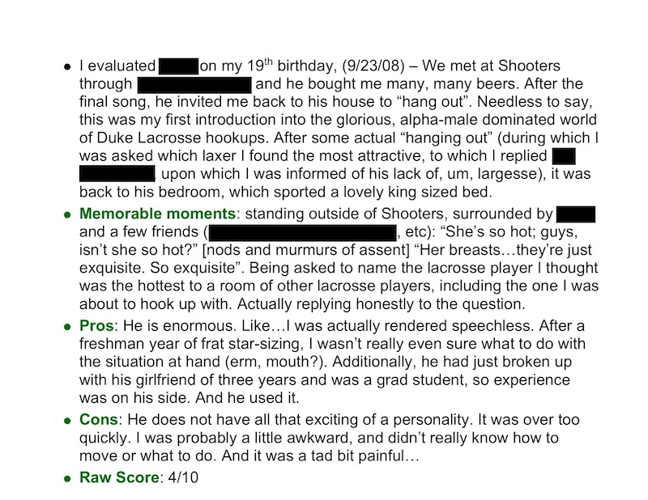
When In A Hole …

Slide 14
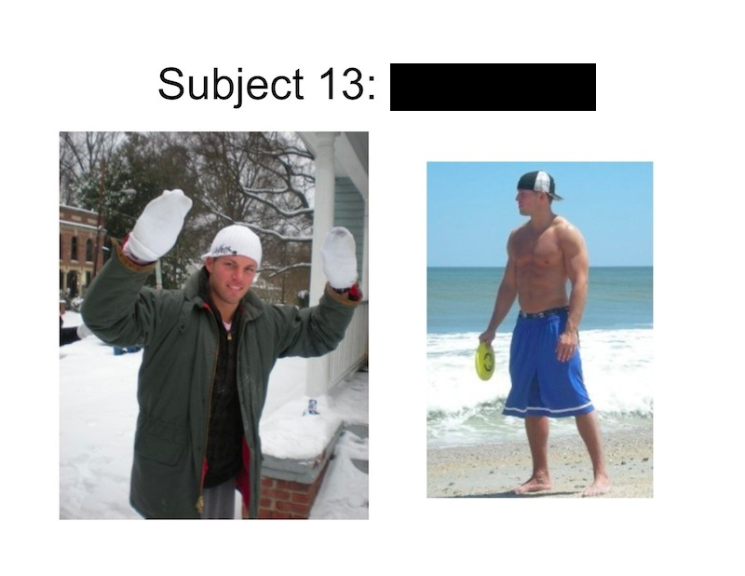
… Stop Digging

Slide 15
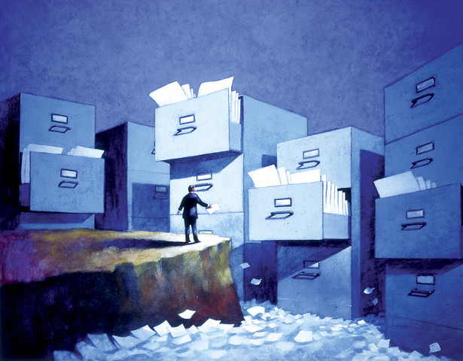
Practical Obscurity
Used to be our best protection
Information could be held, but not found easily
Information could be distributed over several sources
15

Slide 16
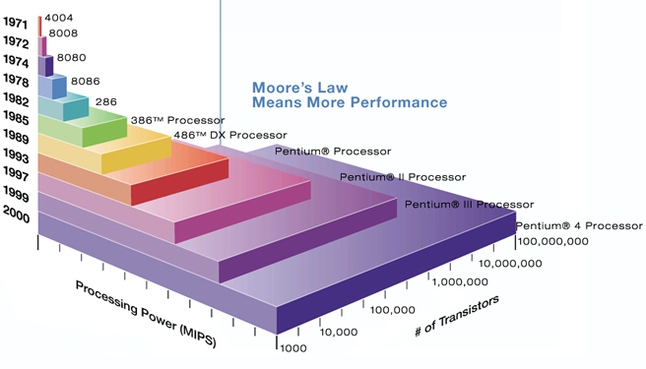
Moore’s Triple Whammy
Information is easier to:
  Collect (miniaturisation & mass production of devices)
  Store (increase of memory capacity)
  Retrieve (increase in computing power)
16

Slide 17
Lots of Good Things
17
We do derive great benefit from flow of information about us
  Scientific/medical research
  Holding governments to account
  Education
  Efficiency of administration
  Personalisation
  The Internet of Things
As life moves online, we leave traces

Slide 18
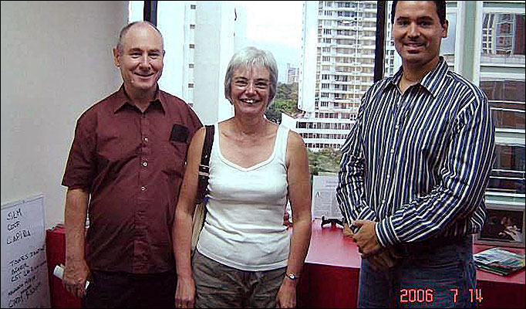
Who Gathers the Information?
Me
My friends
My employer
Companies
Police
Government
Social networks
Google (& other aggregators of Web presence)
Traffic monitoring systems
Healthcare organisations

Slide 19
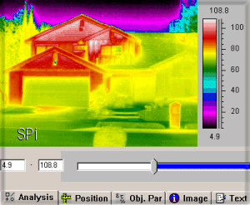
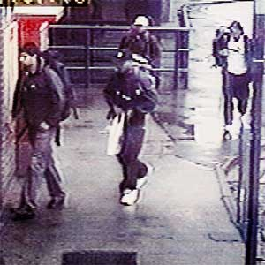
What is it?
Purchases
Photographs/images
Medical data
Location
Communications
Interactions with government
  Compulsory v voluntary
Social
Finance
Entertainment

Slide 20
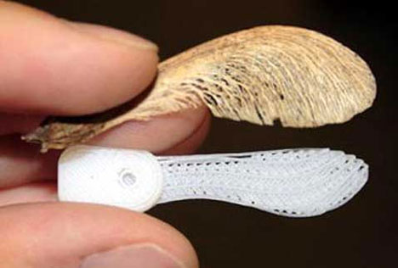
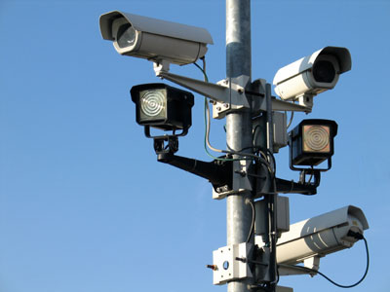
How?
Created especially or by-product of behaviour?
With or without my knowledge/consent?
Personal or aggregate?
Does it identify me?
Is it searchable?
  Is it tagged?
Who stores it?
Who has access to it?

Slide 21
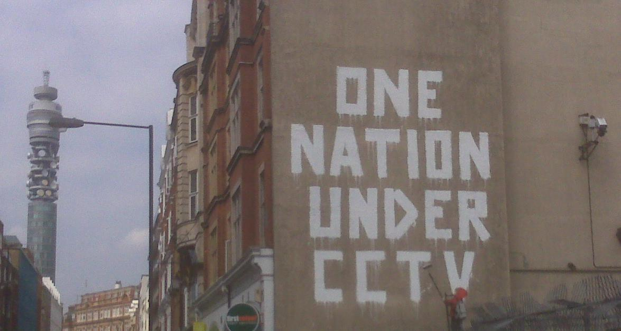
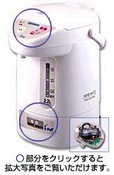
Why?
Smart environment
Efficient government
Surveillance/policing
Leisure/entertainment
Marketing
Lifelogging
Record keeping

Slide 22
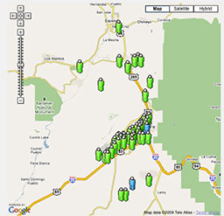
Humans in the Smart Environment

Slide 23
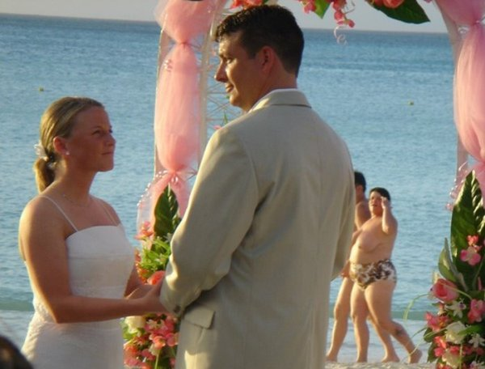
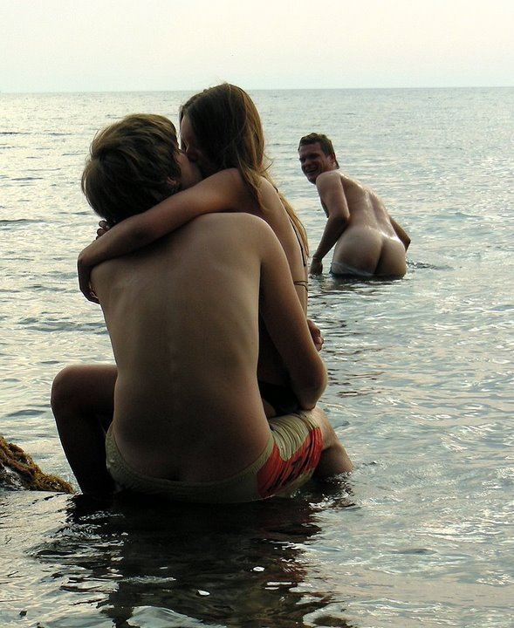
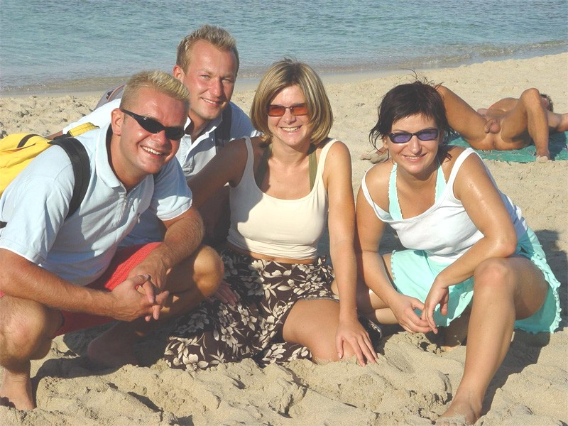
Everyone is Someone’s Background
23

Slide 24
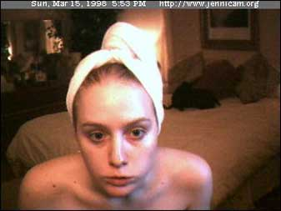

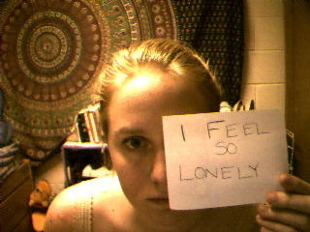
Exhibitionism
24

Slide 25
Intimacy 2.0
Increased willingness to give information online
  We only harm ourselves (?)
  Only objection is paternalistic (?)
Relative lack of general concern about privacy policies
  Polls are one thing, behaviour another
Technological determinism
  McNealy: “Get over it”
  Zuckerberg: Facebook policies reflect changes in privacy norms

Slide 26
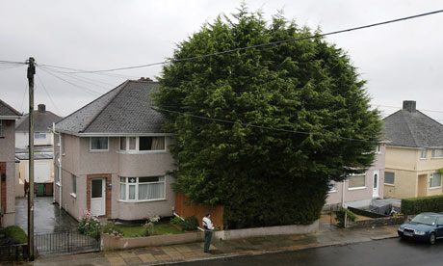
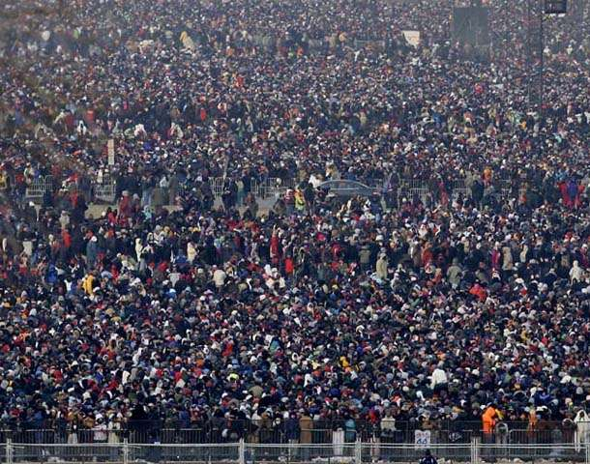
The Generation Gap
Control v anonymity

Slide 27
Generational Issues
The young are keen consumers and generally unconcerned
  Palfrey & Gasser, Born Digital
Uninterested in informational privacy
Lack of awareness
Will attitudes change?
  What will be the effects on identity?
  What will be the effects on biography/reputation?
Ignorance among potential teachers
What is legitimate in a democracy?

Slide 28
Consent
I give consent for my personal data to be used
What is personal data?
How can I enforce this?
Consent model: presumption that information cannot be used without permission
Accountability model: presumption that information will be used under conditions

Slide 29

What To Do?
What not to do
  Technology and security
    It’s a socio-technical system
  Regulation
    The Web needs freedom
  Markets
    Consumers will sacrifice privacy for small gains
Awareness
Care
Accountable information use
Usable technologies
Make this a political issue

Slide 30
Readings
Beate Rössler, The Value of Privacy
  Liberal defence of the right to privacy
Amitai Etzioni, The Limits of Privacy
  Communitarian attack on individual rights to privacy
Adam D. Moore (ed.), Information Ethics
  Collection of classic papers
Simson Garfinkel, Database Nation
  Early warning of trouble
David Brin, The Transparent Society
  Defence of the radical idea of sousveillance
Lawrence Lessig, Code
  Discussion of the relationship between architecture and regulation
Kieron O’Hara & Nigel Shadbolt, The Spy in the Coffee Machine
  Review of various technologies and their effects on privacy

