Slide 1
Knowledge Acquisition
Professor Nigel Shadbolt

Slide 2
Learning Objectives
Appreciate the maj0r features of expertise
Be able to describe at least four families of KA technique
Appreciate the pros and cons of various techniques
Familiarity with material in “Eliciting Expertise”
http://eprints.ecs.soton.ac.uk/14563/

Slide 3
Knowledge Acquisition
The process of capturing knowledge from whatever source including experts, documents, manuals, case studies etc.
Knowledge Elicitation
  techniques that are used to acquire knowledge direct from human experts
Machine Learning
  use of AI pattern recognition methods to infer patterns from sets of examples

Slide 4
Phases in KBS Construction
Risk Analysis
  Client Management
  Project Management
  QA Requirements
KA
  Requirements analysis
  Model of Expertise
Design and Implementation
  Functional Design
  Technical Design
Evaluation
  Debugging
  Verification and Validation
    Does it behave according to the specifications?
    Is this behaviour valid?

Slide 5
First Steps - Initial Understanding of the Domain
Problem Description
List knowledge resources (verify that knowledge really exists)
  Experts, Technical Authorities
  Text Books, Training Material
  Web Resources
  Manuals and Procedures
  Databases and Case Histories
Produce domain glossary & “yellow pages”
Establish performance metrics
Initial task environment analysis

Slide 6
Document and Text Analysis
Look at the structure
  how material is organised into topics and sub-topics
Content analysis
  Extract major linguistic categories
    nouns - objects and concepts
    verbs - relations
    modifiers - properties and values
    connectives - rules and links
Use Intermediate representations
  Pseudo production rules
  Small concept networks and hierarchies

Slide 7
Problems of Document and
Text Analysis
Documents and texts are written for specific purposes that may not reveal real knowledge
  Duty logs and rostas
  Teaching texts
All textual analysis is a form of content analysis - the interpreter may or may not be imputing the correct explanation
Difficult to reconstruct the context

Slide 8
Challenges of Elicitation
Experts
  poor appreciation of different types
  Ignorance
Techniques
  Limited range
  Ignorance
Modelling Expertise
  poor appreciation of different types
  ignorance
  need to organise knowledge into higher level units

Slide 9
Features of Expertise
Experts excel mainly in their own domains
Experts perceive large meaningful patterns in their domains
Experts are fast
Experts have superior LTM and STM for expert domains
Experts represent and encode at differently to non-experts
Experts spend time analysing problems qualitatively
Experts have strong self monitoring skills - use of the “meta-level”

Slide 10
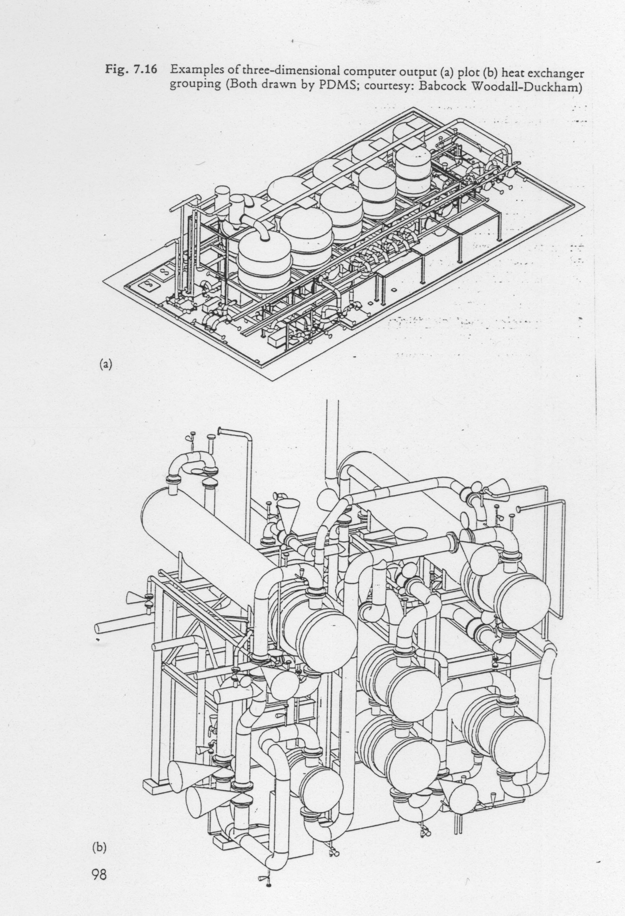
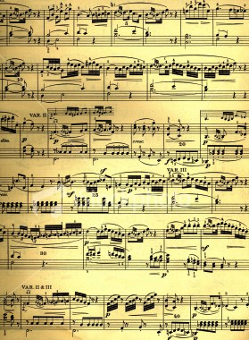
Experts Perceive Meaningful Structure in Complexity

Slide 11
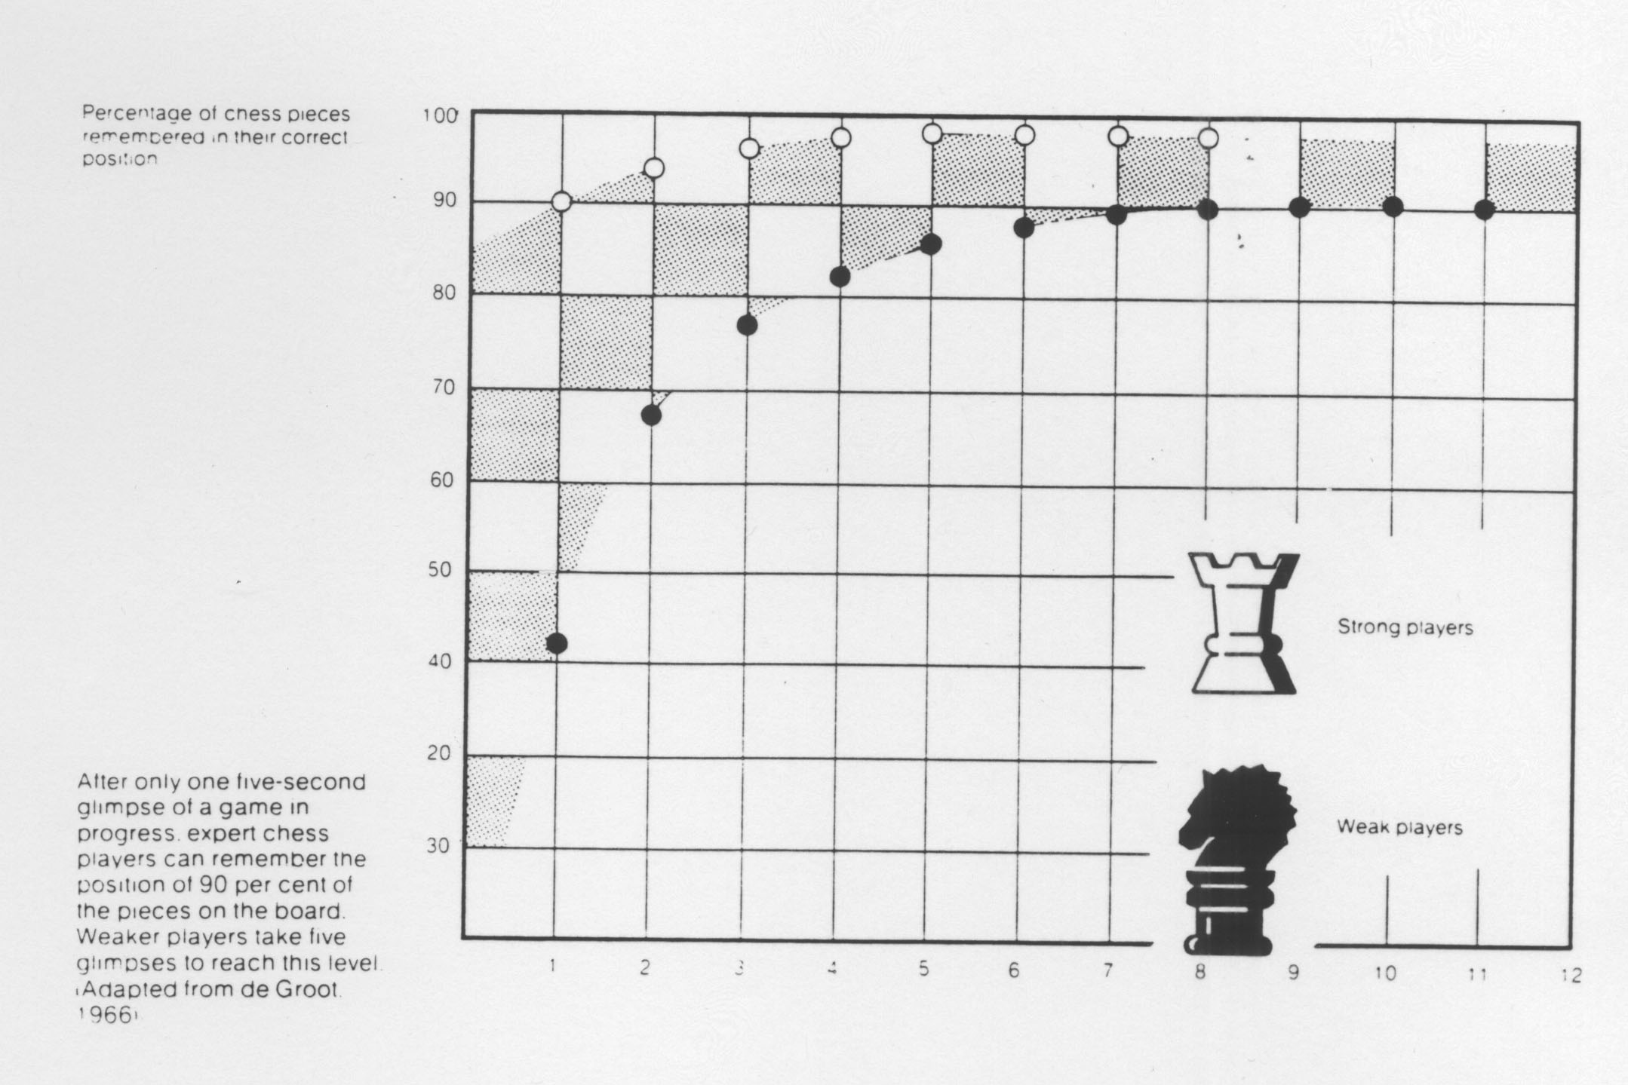
Effects of Expert Encoding

Slide 12
Profiling
Find out what knowledge/information people use and need
  What documents do you keep close to you ?
  What are the bookmarks on your web browser ?
  Whom do you call for help ?
  How has their knowledge and experience been derived ?
Focus on the key people responsible for achieving problem solving goals

Slide 13
Types of Expert
The Academic
  Values logical consistency
The Professional
  Solutions that work in the context of information overload
The Samurai
  Pure Performance
State of knowledge varies
Required solutions vary

Slide 14
Knowledge Elicitation Methods
NATURAL
Methods which the expert might informally adopt when expressing or displaying expertise
Typically easy to use
Typically liked by experts
Empirically least efficient
Essential for relationship building in early stages
CONTRIVED
Elicit knowledge in ways that are not usually familiar to the expert
Typically harder to use
Typically disliked by experts
Empirically most productive
Unsuitable in early stages

Slide 15
Some “Natural” Techniques
Talking about it
  Unstructured Interviews
  Semi-Structured Interviews
  Structured Interviews
Doing it
  Observation
  Protocol Analysis

Slide 16
Interviews
Successful one-shot interviewing requires two people:
  one to keep the conversation going
  one to write and sketch
Once a rapport is established with users / experts, you might reduce to one interviewer.
Tape recording interviews is highly beneficial but permission should be sought and interviewers must be sensitive.
Use methods covertly in a natural conversational style.

Slide 17
The Unstructured Interview
Knowledge Engineer has clear objectives and outline plan but mainly lets Expert direct the discussion
Useful in earliest stages, especially when Knowledge Engineer doesn’t know much about the domain.
Avoids imposing Knowledge Engineer’s assumptions too early.
Experts usually like talking. Beware getting stuck on irrelevant topics of great interest to the expert !
Hard work for Knowledge Engineer (working in a pair helps). Can be difficult to analyse unstructured transcripts.

Slide 18
Semi-Structured Interviews
Prompted Interviews
  Talk about something specific:
    e.g.: cases, forms, charts, products
Teach-Back
  Widely used in later stages
  Easy for Knowledge Engineer
  Interesting for Expert

Slide 19
The Structured Interview
Follows fixed plan set by Knowledge Engineer
  Delimit time and topic
  Review area 10-15 mins
  Set of probes for concepts, rules and relations mentioned in review
  Iterate over new material
P1.1 Could you tell me about a typical case?
F1.1 Provides an overview of the domain tasks and concepts
P1.2 Can you tell me about the last case you encountered?
F1.2 Provides an instance based overview of the domain tasks and concepts
P2.1 Why would you do that?
F2.1 Converts an assertion into a rule
:
P2.5 What if it were not the case that <currently true condition>?
F2.5 Generates rules for when current condition does not apply
P2.6 Can you tell me more about <any subject already mentioned>
F2.6 Used to generate further dialogue if expert dries up
:

Slide 20
The Structured Interview
Advantages:-
  Experts understand the process
  Easier for Knowledge Engineer
  Structured transcripts richer and easier to analyse
Problems:-
  Requires good prior understanding by Knowledge Engineer
  Time to transcribe and analyse (1 day per interview)
  Compiled knowledge & non-verbal knowledge
  Expert always wants to give a rational answer

Slide 21
Doing the Task
Observation
  Knowledge Engineer makes the observations
Protocols
  Expert describes the task
  Off-Line or On-Line
Valuable in confirming interview findings
Starts to elicit Tacit Knowledge

Slide 22
Think aloud verbal protocol
“To start off with it's obviously a fairly coarse-grained rock ... and you've got some nice big orthoclase crystals in here - this is actually SHAP GRANITE - I know it just because everybody's seen SHAP GRANITE - or it's a very strong possibility that it's SHAP GRANITE ... it's a typical teaching specimen - as I say the obvious things are these very big orthoclase crystals pink colouration and you can certainly see some cleavage in some of them - you can certainly make out there are feldspar cleavages in there - it's a coarse-grained rock anyway, you can see the crystals nice and coarsely - these large porphyritic crystals - you can see, in the ground mass, you can see quartz - get some light on it (HOLDS SPECIMAN UP TO WINDOW) quartz, which is this fairly clear mineral you can actually look into it and see through it as opposed to calcite or feldspars where it's more cloudy - you can't actually see any good crystal faces on these cut sections - small flakes of biotite, black micacious looking - small plates, without a hand lens….”

Slide 23
Doing the Task
Advantages:-
  Experts understand the process
  In depth review of one problem
  Reveals task structure and work flow
  State dependent memory
Problems:-
  Sampling
  Dual task
  Mis-attribution

Slide 24
Some “Contrived” Techniques
Concept Sorting
Repertory Grids
Laddering
“20 Questions”

Slide 25
Concept sorting
Range of specific techniques
Useful prompting device
Some experts dislike
Some Knowledge Engineers can turn it into a fun game
Can be helpful in comparing/combining different expert viewpoints

Slide 26
Card Sort
Set of cards listing elements from the domain
1 adamellite 2 andesite 3 basalt 4 dacite 5 diorite 6 dolerite 7 dunite 8 gabbro 9 granodiorite 10 granite 11 lherzolite 12 microgranite 13 peridotite 14 picrite basalt 15 rhyodacite 16 rhyolite 17 syenite 18 trachyte
Expert sorts into piles along salient dimensions
Sort 1: grain size Piles 1=coarse, 2=medium, 3=fine
Sort 2: colour Piles 1=melanocratic, 2=mesocratic, 3=leucocratic
Sort 3: emplacement Piles 1=intrusive, 2=extrusive
Sort 4: presence of olivine Piles 1=always, 2=possibly, 3=never
Sort 5: presence of quartz Piles 1=always, 2=possibly, 3=never
:
If expert dries up then use triadic presentation

Slide 27
Card Sort
Advantages:-
  Condensed and easy data
  Map of the domain
Problems:-
  Expert not familiar with technique
  Feels initially like a game
Note - experts opinions as to utility of a technique are no guide!

Slide 28
Repertory Grids
Derived from the Psychologist George Kelly’s work on Personal Construct Theory
Set of elements
Expert rates elements along salient dimensions
If expert dries up use triadic presentation
Cluster analysis reveals conceptual structure
Advantages:-
  Powerful visualisation of conceptual structure
  Extensions such as sociogrids, induction
Problems:-
  Statistical assumptions

Slide 29
Grid Example - Eliciting Constructs
Non Nickel-Iron Core
jupiter
saturn
neptune
uranus
pluto
mercury
mars
venus
earth
Nickel-Iron Core

Slide 30
A Repertory Grid Example - A Matrix

Slide 31
Repertory Grid - Cluster Analysis

Slide 32
Laddering
Elicit structure of domains through hierarchical analysis
Method (see Eliciting Expertise)
  Pick a seed item
  Move around the domain using structured prompts
Works well for a variety of hierarchically structured knowledge types
  concepts, actions, products, processes, tasks, goals ...

Slide 33
Laddering Prompts
To move DOWN the expert’s domain knowledge
  “Can you give examples of <ITEM> ?”
To move ACROSS the expert’s domain knowledge
  “What alternative examples of <CLASS> are there to <ITEM> ?”
To move UP the expert’s domain knowledge
  “What have <SAME LEVEL ITEMS> got in common ?”
  “What are <SAME LEVEL ITEMS> examples of ?”
To elicit essential properties of an item:
  “How can you tell it is <ITEM>?”
To discriminate items:
  “What is the key difference between <ITEM 1> and <ITEM 2> ?”

Slide 34
Laddered Grid Interview e.g.
KE So how could you tell something was dacite?
EX Well + examine the fresh surface and the weathered surfaces first + looking at grainsize, the relationship between the grains
KE Can I just stop you there. What type of grain size is it?
EX Coarse, medium, fine grain, oh, you want me to actually say what dacite is?
KE The grain, in dacite what would it be?
EX Er + medium grained.
KE Medium grained, right. So can you give me other examples of medium grained rocks?
EX Medium grained rocks + dolerite... Granodiorite as well... And we'll stay with that.
KE Right, erm, what alternative is there to a medium grained rock?
EX Well, you can have a coarse grained one or a fine grained one, those are sort of the three major ones.

Slide 35
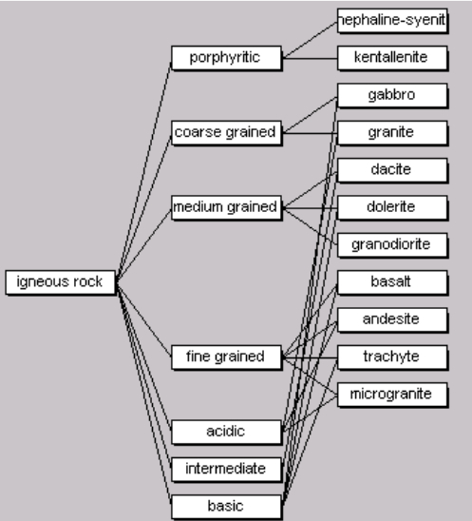
Laddering
Advantages:-
  Fast map of a hierarchically structured domain
  Knowledge Engineer doesn’t need much prior knowledge of domain
Problems:-
  Can get complex
  Heterogeneous links
  Justification

Slide 36
Limited Information Task
20 questions
Advantages:-
  Reveals paths of enquiry
Problems:-
  Knowledge Engineer needs to know a lot about the domain
  Sampling

Slide 37
Limited Information Task e.g.
EX: Is this in the manufacturing industry?
KE: Yes
EX: So we've ruled out things like fruit, vegetables, cows?
KE: Yes
EX: Is it the metal industry?
KE: The material is wood
EX: So we could be dealing with a large object here like a chair or table
KE: The object is large
EX: It's likely to be a 3-D object, you've got to pick it up and turn it over
KE: That's right
EX: So what I need now are the dimensions of this object in terms of the cube that will enclose it
KE: It would have similar dimensions to the table top
EX: Do I inspect one surface or all the surfaces?
KE: All of them
EX: Is the inspector looking for one or many faults?
KE: One particular fault
EX: Can you describe it for me?
KE: It's pencil marks about half an inch long
EX: What colour is the wood?
KE: Dark unfinished wood
EX: We've got a contrast problem here. At this point I'd go and look at the job + to see if the graphite pencil marks reflect light + sometimes it does, but it depends on the wood + if it does you can select the light to increase the contrast between the fault and the background
:
:
EX: I'd be doing this in three phases: first a general lighting, then specific for surface lighting, and then some directional light [expert then gives technical specifications for these types of light]

Slide 38
Machine Learning and Induction
Use of statistical techniques to suggest rules from data
Many problems with accuracy of actual rules produced (susceptible to noisy data)
Can provide very useful prompts for interviews

Slide 39
No single KA technique is sufficient
Different techniques elicit different types of knowledge
Different techniques are more or less expensive to use
Different techniques work on some experts not on others
You need a variety of knowledge perspectives to build models of decision making and domain expertise

