Slide 1
Knowledge Representation and Inference
Dr Nicholas Gibbins
nmg@ecs.soton.ac.uk
32/3019

Slide 2
Knowledge Representation
To be effective, acquired knowledge must be organised for later use
A good knowledge representation ‘naturally’ represents the problem domain
An unintelligible knowledge representation is wrong
Most AI systems consist of
  Knowledge Base
  Inference Mechanism (Engine)

Slide 3
Knowledge Representation
Knowledge Base (KB)
  Forms the system's intelligence source
  Inference mechanism uses contents of KB to reason and draw conclusions
Inference mechanism
  Set of procedures that are used to examine the knowledge base to answer questions, solve problems or make decisions within the domain

Slide 4
Common Knowledge
Representation Schemes
Logic
Production rules
Semantic Networks
Frames
Scripts

Slide 5
Logic

Slide 6
Logic and Other Schemas
General form of any logical process
Inputs (Premises)
Premises used by the logical process to create the output, consisting of conclusions (inferences)
Facts known true can be used to derive new facts that also must be true

Slide 7
Logic and Other Schemas
Symbolic logic: System of rules and procedures that permit the drawing of inferences from various premises
Two basic forms of Computational Logic
  Propositional logic (or propositional calculus)
  Predicate logic (or predicate calculus)

Slide 8
Propositional Logic
A proposition is a statement that is either true or false
Once known, it becomes a premise that can be used to derive new propositions or inferences
Rules are used to determine the truth (T) or falsity (F) of the new proposition
Limited in representing real-world knowledge

Slide 9
Propositional Logic: Symbols
Symbols represent propositions, premises or conclusions (atomic formulae)
  A = The sun is shining
  B = The weather is raining
  C = You are carrying an umbrella
  D = You are getting wet

Slide 10


Propositional Logic: Connectives
Small set of logical connectives:
  AND
  OR
  IMPLIES
  NOT
Symbols and connectives composed into formulae, e.g.

Slide 11
Propositional Logic:
Well-Formed Formulae
<symbol> ::= A | B | … | Z
<wff> ::= <symbol> |
<wff> |
<wff> <wff> |
<wff> <wff> |
<wff> <wff>

Slide 12
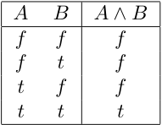
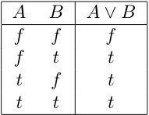
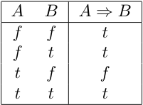
Truth Tables
If we assign a truth value (true or false) to each symbol in a formula, we can determine the truth or falsehood of the formula
A truth table is an exhaustive enumeration of the possible truth values for the symbols in a formula

Slide 13

Interpretation
An interpretation in propositional logic consists of a domain D (set of symbols or atomic formulae) and a mapping from the domain to the values true and false
An interpretation corresponds to a row in a truth table (a truth assignment)
Notes:
(A or not B) and (B or C) and (A implies C)
A truth assignment satisfies a formula if the formula is true for that assignment
P implies Q == (not P) or Q
Tautology: formula that is true under all interpretations
Contradiction: formula that is false under all interpretations

Slide 14
Inference Rules
Syntactic rules used to derive valid formulae from other formulae
Notation for inference rules has two parts:
  The premises above the line
  The conclusion below the line
If all of the premise formulae are true, we can infer the conclusion formula

Slide 15
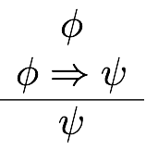
Inference: Modus Ponens
Modus ponens (the way by affirming) is as follows:
Modus ponens is valid
  The truth of its premises entails the truth of the conclusion

Slide 16

Inference: Modus Tollens
Modus tollens (the way by denying) is as follows:
Modus tollens is also valid

Slide 17
Predicate Logic
Also referred to as First-order logic (FOL) or First-order Predicate Logic (FOPL)
Predicate logic breaks a statement down into component parts, an object, object characteristic or some object assertion
Predicate calculus uses variables and functions of variables in a symbolic logic statement

Slide 18




Predicate Logic
A set of truth-valued functions (predicates):
A set of functions:
A set of constants:
The logical connectives:
The quantifiers: (forall and exists)
An infinite set of variables:
Notes:
The father of Socrates is Sophraniscus
Constants as 0-ary predicates

Slide 19






Interpretation
An interpretation of first order logic consists of a domain D, and mappings for function and predicate symbols
Truth tables are defined as follows:
  Propositional connectives apply as before
  is true if is true for all
  is true if is true for some

Slide 20

Other Logics
Variants of predicate logic
Modal logics introduce operators to represent necessity and possibility (□ and ◊ respectively)
Definition:
  Read as: “A is possible iff not-A is not necessary”
http://plato.stanford.edu/entries/logic-modal/

Slide 21
Modal Logics
Many variants of modal logic
Variants assign different meanings to the modal operators
  Temporal (always and eventually)
  Epistemic (knowledge and belief)
  Deontic (obligation and permission)

Slide 22


Temporal Logic
Prior’s Tense Logic
Four modal operators:
  P “it has at some time been the case that…”
  F “it will at some time be the case that…”
  H “it has always been the case that…”
  G “it will always be the case that…”
Notes:
P,F are weak tense operators
G,H are strong tense operators

Slide 23

Temporal Logic
“what will always be, will be”
“if p will always imply q, then if p will always be the case, so will q”

Slide 24

Epistemic Logic
K_{a}P – Agent a knows P (necessity)
B_{a}P – Agent a believes P (possibility)
  If an agent knows P, it does not believe not-P
Widely used in multi-agent systems
  Reasoning about own knowledge and knowledge of others
Many systems of modal logic, depending on choice of axioms
  More axioms = more expressive = more complex

Slide 25



Epistemic Axioms
  Necessitation rule
(K)
  Distribution axiom
  (modus ponens over the modal operator)
(D)
  Non-contradiction axiom
  (agents do not believe inconsistencies)

Slide 26



Epistemic Axioms
(4)
  Positive introspection axiom
  (an agent always knows what it knows)
(5)
  Negative introspection axiom
  (an agent always knows what it doesn’t know)
(T)
  Axiom of truth
  (everything an agent knows is true)

Slide 27
Deontic Logic
The Traditional Scheme:
  it is obligatory that (OB)
  it is permissible that (PE)
  it is impermissible that (IM)
  it is omissible that (OM)
  it is optional that (OP)

Slide 28



Deontic Logic
Notes:
PE = permissible
OB = obligatory
IM = impermissible
OM = omissible
OP = optional

Slide 29


Standard Deontic Logic
Notes:
OB-K
OB-D
MP
OB-NEC

Slide 30
Description Logics
First order predicate logic is highly expressive
  General theorem proving in FOPL is expensive
How can the complexity of FOPL be managed?
  Subset of FOPL with limited expressivity
  Restriction of theorem proving to certain tasks

Slide 31


Description Logics
Family of knowledge representation formalisms
Decidable subset of first order logic (FOL)
  Unary predicates denote class membership
  Binary predicates denote relations (roles) between instances
Model-theoretic formal semantics
Reasoning similar to that in modal logics

Slide 32
A Description Logic Primer

Slide 33
Description Logic Reasoning
Designed for three reasoning tasks:
  Satisfaction
  “Can this class have any instances?"
  Subsumption
  "Is every instance of class A necessarily an instance of class B?"
  Classification
  "What classes is this object an instance of?"

Slide 34
Defining ontologies with
Description Logics
Describe classes (concepts) in terms of their necessary and sufficient attributes
Consider an attribute A of a class C:
A is a necessary attribute of C
  If an object is an instance of C, then it has A
A is a sufficient attribute of C
  If an object has A, then it is an instance of C

Slide 35






Concept Constructors
Boolean class constructors
Restrictions on role successors
Number restrictions (cardinality constraints) on roles
Nominals (singleton concepts)
Universal class, top
Contradiction, bottom

Slide 36



Role Constructors
Concrete domains (datatypes)
Inverse roles
Transitive roles
Role composition

Slide 37



Boolean Class Operations
  The class of things which are both children and happy
  The class of things which are rich or famous (or both)
  The class of things which are not happy

Slide 38

Universal Restriction
The class of things all of whose pets are cats
Or, which only have pets that are cats
Note: includes those things which have no pets

Slide 39

Existential Restriction
The class of things which have some pet that is a cat
Note: must have at least one pet

Slide 40


Cardinality Restrictions
The class of things with more than one country of origin
The class of quadrapeds

Slide 41



Translating Description Logic to Predicate logic
Every concept is translated into a predicate logic formula
Boolean class constructors:
Property restrictions:

Slide 42
Knowledge Bases
A description logic knowledge base (KB) has two parts:
TBox: terminology
  A set of axioms describing the structure of the domain (i.e., a conceptual schema)
  Concepts, roles
ABox: assertions
  A set of axioms describing a concrete situation (data)
  Instances

Slide 43





TBox Axioms
Concept inclusion
  (C is a subclass of D)
Concept equivalence
  (C is equivalent to D)
Role inclusion
  (R is a subproperty of S)
Role equivalence
  (R is equivalent to S)
Role transitivity
  (R composed with itself is a subproperty of R)

Slide 44


Translating Description Logic to Predicate logic
Concept inclusion
Concept equivalence

Slide 45
ABox Axioms
Concept instantiation
  x:D
  x is of type D
Role instantiation
  <x,y>:R
  x has R of y

Slide 46

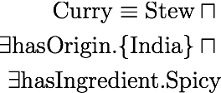
Axiom Exercises
Every person is either living or dead
Every successful man has a beautiful wife
No elephants can fly
A curry is an Indian stew with a spicy ingredient
All Englishmen are mad

Slide 47






Description Logic Semantics
is the domain (non-empty set of individuals)
Interpretation function maps:
  Concept expressions to their extensions
  (set of instances of that concept, subset of )
  Roles to subset of
  Individuals to elements of
Examples:
  is the set of instances of
  is the set of instances of either or

Slide 48
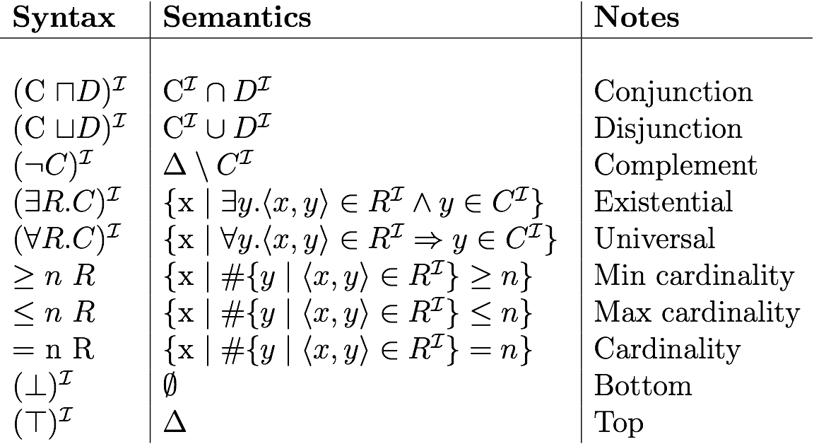
Description Logic Semantics

Slide 49
Interpretation Example
Δ
Δ = {v, w, x, y, z}
A^{I} = {v, w, x}
B^{I} = {x, y}
R^{I} = {(v, w), (v, x), (y, x), (x, z)}
(¬B)^{I} =
(A ⊔ B)^{I} =
(¬A ⊓ B) ^{I} =
(∃R.B)^{I} =
(∀ R.B)^{I} =
(∃ R. (∃ R.A))^{I} =
(∃ R. ¬(A ⊓ B))^{I} =
A^{I}
v
w
x
y
z
B^{I}

Slide 50
Answers
Δ
Δ= {v, w, x, y, z}
A^{I} = {v, w, x}
B^{I} = {x, y}
R^{I} = {(v, w), (v, x), (y, x), (x, z)}
(¬B)^{I} = {v, w, z}
(A ⊔ B)^{I} = {v, w, x, y}
(¬A ⊓ B) ^{I} = {y}
(∃R.B)^{I} = {v, y}
(∀ R.B)^{I} = {y, w, z}
(∃ R. (∃ R.A))^{I} = {}
(∃ R. ¬(A ⊓ B))^{I} = {v, x}
A^{I}
v
w
x
y
z
B^{I}

Slide 51
Tips for Creating Class Expressions
Don’t Panic!
No single ‘correct’ answer - different modelling choices possible
Break sentence down into pieces
  e.g. “successful man”, “spicy ingredient” etc
Look for indicators of axiom type:
  “Every X is Y” - inclusion axiom
  “X is Y” - equivalence axiom
Remember that ∀R.C is satisfied by instances which have no value for R

Slide 52
More Axiom Exercises
Every human is either a man or a woman
A mother is a woman with at least one child
A happy mother is a mother all of whose children are happy
Every happy child eats cake
Every child who eats only cake is an unhealthy child
No unhealthy child is happy

Slide 53
DL Reasoning Revisited
Satisfaction (can this class have any instances)
  C is satisfiable w.r.t. K iff
  there exists some model I of K, C^{I} ≠ {}
Subsumption
  C subsumes D w.r.t. K iff
  for every model I of K, C^{I} ⊇ D^{I}
Equivalence (mutual subsumption)
  C is equivalent to D w.r.t. K iff
  for every model I of K, C^{I} = D^{I}
Classification
  x is an instance of C w.r.t. K iff
  for every model I of K, x^{I} ∈ C^{I}
(where K is a knowledge base, I is an interpretation of K)

