Slide 1
COMP3028
Knowledge Technologies
Dr Nicholas Gibbins
nmg@ecs.soton.ac.uk

Slide 2
Course Aims
Introduce a range of methods and techniques that are currently used and researched in systems and applications that are based on domain-specific knowledge
Provide practical experience of the implementation of knowledge-based systems

Slide 3
Teaching Schedule
Week 1: Overview
Knowledge and Science
Ontologies
Week 2: Knowledge Representation: Logic
Week 3: Knowledge Representation:
Networks, Frames, Scripts and Rules
Week 4: Knowledge Representation: Uncertainty
Week 5: Knowledge Acquisition
Week 6: CLIPS

Slide 4
Teaching Schedule
Week 7: Automated Reasoning: Resolution and Analytic Tableaux
Week 8: Automated Reasoning:
Unification, Clause Form, and Skolemisation
Week 9: Automated Reasoning:
Explanation and Truth Maintenance
Week 10: Information Retrieval
Week 11: Implementing Information Retrieval
Christmas Vacation
Week 15: Review

Slide 5
Assessment
Examination: 80%
Expert system design coursework: 20%
  Implemented using CLIPS expert system shell
  Specification published in week 4
  Submission due week 9
  Feedback due week 15

Slide 6
Knowledge and Science

Slide 7
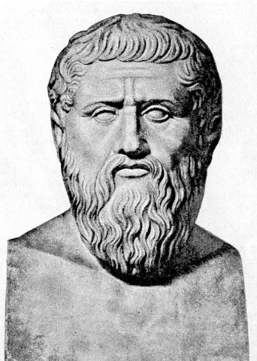
History of Science
Learning has roots in history and philosophy of science
Aim of science can be thought of as acquisition of knowledge through experimentation and observation of the world
The discussion and investigation of knowledge, and what is now known as science and the philosophy of science can be traced back to Plato and Aristotle
Knowledge as justified true belief (Plato)

Slide 8
The Age of Reason
In the Seventeenth Century, all this changed…
Philosophers and scientists believed that their work was entirely different from what went before
Sudden and rapid advance of science provided a new impetus to investigating the question of how knowledge, scientific or otherwise, was acquired.
Scientists such as Galileo and Newton produced remarkable and significant results

Slide 9
Early Empiricism and Naïve Inductivism
Definition: Empiricism is “the thesis that all knowledge of matter of fact as distinct from that of purely logical relations, is based on experience”
Francis Bacon was the first significant contributor to the methodology of science though he made no real contribution to science itself
Bacon’s new methodology was intended to search for the causes of observed effects

Slide 10
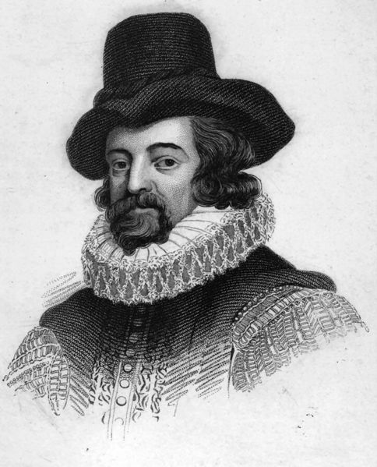
Bacon’s Methodology
Formulate hypotheses, test consequences against new data
Leads to the elimination of incorrect hypotheses
Eventually leads to the true explanation of the effect
Depends on a wide base of empirical information
Precursor of the more modern hypothetico-deductivism
Notes:
Assumption is that a hypothesis that can be successfully tested is correct
(but are the tests sufficient?)

Slide 11
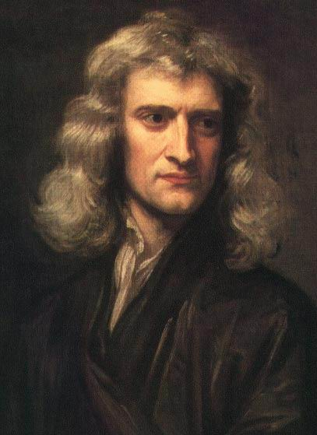
Isaac Newton
Certainty can be achieved by reasoning inductively from experiments and observations alone
Belief in uniformity of nature allows use of experimental ‘proofs’ and the deducibility of general conclusions from these observations
Hypotheses are neither necessary nor desirable for inductive reasoning
His claim of direct inference of general laws from specific observations became part of the problem of induction

Slide 12
The Problem of Induction
That is, does inductive reasoning work?
Can we generalise about the properties of a class of objects based on a finite number of observations of instances of that class?
Can we suppose that a sequence of events will continue in the future as it always has in the past?
Notes:
No matter how many positive observation you make, a single negative observation will disprove your new law

Slide 13
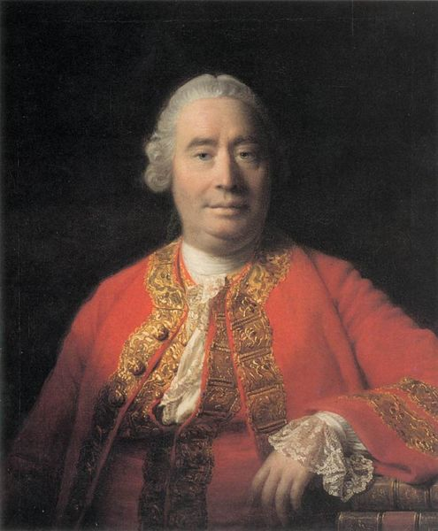
David Hume
Is it reasonable to believe in the uniformity of nature, or are there ever grounds for believing that exact conclusions can be attained by an inductive argument?
Denied the principle of the uniformity of nature, giving a psychological account of our belief in it
Inductive generalisations are never justified
Yet Hume provided a set of rules for scientific inquiry, a methodology - some pragmatism
Notes:
Uniformity of nature – are the laws of nature the same everywhere?
(if you’re constructing an inductive argument, you can’t be sure that the same laws hold elsewhere)

Slide 14
Logical Positivism
Empiricism of Hume and others provided a foundation for the influential school of logical positivism (or logical empiricism) which was established in the first half of 20th century
Empirical component maintained that all knowledge must be grounded on experience
Logical aspect was intended to systematize science through the manipulation of empirical propositions using symbolic logic in an attempt to provide a formal rendering of its structure
Any proposition that is not observable (i.e. theoretical) must thus be indirectly determined via observational propositions and the use of logic to specify relationship between the two
Notes:
“Hume and others” - Bertrand Russell was a particular influence, due to his Principia Mathematica

Slide 15
Logical Positivism
Logical Positivists made two important contributions:
Distinguished between the context of discovery in which hypotheses were developed, and the context of justification in which they were assessed
Emphasis on verification led to the development of the notion of confirmation. They maintained that collecting positive evidence confirming a hypothesis should increase the confidence in its truth

Slide 16
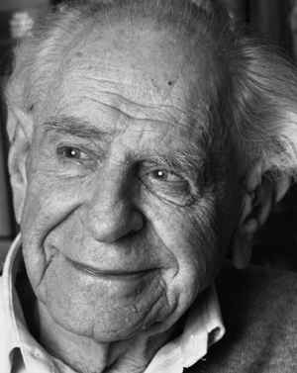
Against Verification
Logical Positivism has a serious flaw
General empirical statements cannot be verified because of the problem of induction - a major concern
Most effectively exposed by Karl Popper (among others), who proposed an alternative methodology for science
Popper attempted to replace the traditional concept of confirmation with falsification
(effectively modus tollens)
Notes:
Modus tollens:
IF P THEN Q
NOT Q
THEREFORE NOT P

Slide 17
Falsificationism
Based on the fact that logic permits the establishment of the falsity but not the truth of theories in the light of observations
Science thus begins with problems for which falsifiable hypotheses are formulated as solutions
Hypotheses are then subjected to experimentation and criticism so that some will be deductively refuted while others may remain
In testing hypotheses, data collected may lead to new problems that need to be accommodated
Introduces new hypotheses that must, in turn, be tested
Popper argues that continual application of conjectures and refutations is basis for progress of science
A hypothesis is not regarded as true even if it has passed a wide variety of tests, but may be considered superior to predecessors

Slide 18
Knowledge Engineering

Slide 19
The Role of Knowledge
Knowledge is vital to intelligence
Without knowledge (or with little or poor knowledge), capability for intelligence is seriously curtailed
Several research efforts are directed at encoding large amounts of knowledge to enable the construction of intelligent machines
Expert systems demonstrate capabilities of knowledge based systems
Though limited to small domains, the knowledge encoded within an expert system is useful and effective
Notes:
CYC – Douglas Lenat

Slide 20
Problems with Knowledge
Many problems with maintenance and acquisition of knowledge when humans are involved
The knowledge acquisition bottleneck
  Edward Feigenbaum refers to difficulties of expertise elicitation and knowledge transfer
  Typically 2-5 units of knowledge per day are acquired through the process of interviews between the computer specialist and the domain expert

Slide 21
Knowledge acquisition bottleneck
Associating jargon with concepts
Expert may not be able to articulate expertise
Expertise expressed may be incorrect - explicit statements may not correspond with behaviour
Expertise expressed may be incomplete - implicit dependencies and/or background knowledge may be missing
Expertise may be irrelevant - knowing which information is relevant to which problems, reliability of information sources, etc

Slide 22
More Problems
Knowledge is not static
  Some kinds of knowledge are dependent on the environment over time.
  What might be correct and consistent at one point may not be so at another
For example, we might encode the knowledge that Gordon Brown is PM in our knowledge base, only to discover later that David Cameron is PM instead

Slide 23
More Problems
Knowledge is not complete
  We continually discover new knowledge
  Applies equally to scientific research or communal knowledge and to an individual’s knowledge about their environment
  For example, advances in medicine (communal, scientific knowledge) have led to a greatly decreased infant mortality rate
  At individual level, can ‘discover’ that a tube of toothpaste is empty
Always potential to add to knowledge - must allow for addition of new knowledge to KBs

Slide 24
Reasoning Paradigms

Slide 25
Types of Logical Reasoning
We have two statements, a and b, and a rule a⇒b
(read a⇒b as ‘a implies b’)
Deduction
Given a and a⇒b, infer b (modus ponens)
Induction
Given a and b, infer a⇒b
Abduction
Given b and a⇒b, infer a

Slide 26
Validity
The form of an argument is logically valid if it cannot lead from true premises to a false conclusion
Induction and abduction are not logically valid, but both have roles to play in artificial intelligence
  Induction permits the learning of new rules from observations
  Abduction gives a way to explain probable causes for observations

Slide 27
Inductive Paradigm
Induce a general concept description from a sequence of instances of the concept and known counter-examples of the concept
Task is to build a concept description from which all previous positive instances can be rederived, but none of the negative instances by the same process

Slide 28
Induction vs Deduction
Deduction has a definite role to play in artificial intelligence but is unsuitable in many cases precisely because of its rigour
Deductive inferences reveal the relationships in existing knowledge
Inductive reasoning aims to create new knowledge or extend existing knowledge
Complementary to formal logic, but is not guaranteed to be correct or even to draw an inference at all
Notes:
Inductive reasoning – problem of induction

Slide 29
Inductive Paradigm
Description Language
  Language in which instances and concepts are represented may vary in representational power (e.g. propositional calculus, 1st order logic, etc)
  Typically, systems use a fixed vocabulary in that all relevant descriptors must be present at the outset
  Some work, however, addresses growth of languages during the learning cycle, labelling the process representational shift

Slide 30
Inductive Paradigm
Noise
  Early systems assumed noise-free data - examples assumed to be correctly classified
  This is too restrictive for the real world!
  Various kinds of error were addressed

Slide 31
Inductive Paradigm
Concept type
  Discriminant concepts - the concept description is a set of tests that separate all instances of the concept from all instances of other known concepts
  Characteristic concepts - systems strive for elegance and compactness in concept descriptions. Makes them easier for humans and other parts of a system, but may sacrifice accuracy
  Inductive bias is often expressed as preferences in the type of concept to be acquired

Slide 32
Inductive Paradigm
Source of instances
  Early work used an external teacher
  More recent work uses an external world. Here the learner must seek examples, cope with multiple concepts and seek its own classification by an oracle, experiments, or clustering
Incremental vs. One-shot induction
  One shot induction considers all positive and negative instances at one time and produces a concept description not open to further modification
  Incremental induction produces a best-guess concept or range of concepts consistent with the data so far
Allows interleaving of learning and performance

Slide 33
Analytic Paradigm
Analytic learning from a few exemplars plus a rich underlying domain theory.
Deductive rather than inductive, using past experience (exemplars) to guide which deductive chains to perform when solving new problems
Enables more efficient application of domain knowledge.
Improves efficiency rather than extends the library of concept descriptions.

Slide 34
Knowledge Representation and Ontologies

Slide 35
Knowledge Representation
Covered so far (in brief)
  The nature of knowledge
  The knowledge acquisition process
  Reasoning with knowledge
How do we structure knowledge in a form that we can effectively acquire and reason with it?

Slide 36
Knowledge Representation
Many types of knowledge representation
  Logical, procedural, network, structured/frames, etc
  Close relationship between representation and reasoning
One term used often in discussions of KR: ontology

Slide 37
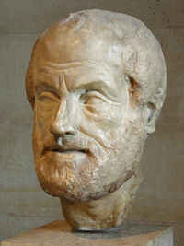
Defining the ‘O’ word
Ontology, n.
1. a. Philos. The science or study of being; that branch of metaphysics concerned with the nature or essence of being or existence.
Oxford English Dictionary, 2004

Slide 38
The Celestial Empire of Benevolent Knowledge
On those remote pages it is written that animals are divided into:
those that belong to the Emperor
embalmed ones
those that are trained
suckling pigs
mermaids
fabulous ones
stray dogs
those that are included in this classification
those that tremble as if they were mad
innumerable ones
those drawn with a very fine camel's hair brush
others
those that have just broken a flower vase
those that resemble flies from a distance
J-L Borges, The Analytical Language of John Wilkins, 1952

Slide 39
Defining the ‘O’ word
An ontology is a specification of a conceptualisation
Specification: A formal description
Conceptualisation: The objects, concepts, and other entities that are assumed to exist in some area of interest and the relationships that hold among them
Referred to in the philosophical literature as Formal Ontology
T. R. Gruber. A translation approach to portable ontologies. Knowledge Acquisition, 5(2):199-220, 1993

Slide 40
Ontology in Computer Science
Ontologies as engineered artifacts:
  constituted by a specific vocabulary used to describe a certain reality, plus
  a set of explicit assumptions regarding the intended meaning of the vocabulary
Shared understanding
Facilitate communication
  Establish a joint terminology for a community of interest
  Normative models…
Inter-operability: sharing and reuse

Slide 41
Ontology Structure
Ontologies typically have two distinct components:
Names for important concepts in the domain
  Elephant is a concept whose members are a kind of animal
  Herbivore is a concept whose members are exactly those animals who eat only plants or parts of plants
  Adult_Elephant is a concept whose members are exactly those elephants whose age is greater than 20 years
Background knowledge/constraints on the domain
  Adult_Elephants weigh at least 2,000 kg
  All Elephants are either African_Elephants or Indian_Elephants
  No individual can be both a Herbivore and a Carnivore

Slide 42
Informal Usage
Informally, ‘ontology’ may also be used to describe a number of other types of conceptual specification:
  Controlled vocabulary
  Taxonomy
  Thesaurus

Slide 43
Study of ontology is not limited to computer scientists and philosophers
Rich tradition of knowledge representation and ontology in library and information science…
…but they talk about classification and metadata schema instead of ontologies

Slide 44
Controlled Vocabularies
An explicitly enumerated list of terms, each with an unambiguous, non-redundant definition
No structure exists between terms - a controlled vocabulary is a flat list
Examples:
  Library of Congress Subject Headings (LCSH)
  Medical Subject Headings (MeSH)

Slide 45
Taxonomies
A collection of controlled vocabulary terms organised into a hierarchical structure
Each term is in one or more parent-child relationships
May be several different types of parent-child relationship:
  Type-instance
  Genus-species
  Part-whole (referred to as meronymy)

Slide 46
Taxonomy Examples
Library classification schemes
  Library of Congress
  Dewey Decimal
  UDC
Linnean Classification
  Kingdom, Phylum, Class, Order, Family, Genus, Species, Subspecies
MeSH Tree Structures

Slide 47
Taxonomy Examples
Dewey Decimal
  500s - Natural Sciences and Mathematics
  530s - Physics
  537 - Electricity and Electronics
Library of Congress
  Q - Science
  QA - Mathematics
  QA71-90 - Instruments and machines
  QA75-76.95 - Calculating machines
  QA75.5-76.95 - Electronic computers and computer science
  QA76-76.765 - Computer software

Slide 48
Polyhierarchical Taxonomies
Also known as faceted taxonomies
Define several orthogonal hierarchies
Objects may be classified under multiple hierarchies
Example: Universal Decimal Classification
  Facets for language, relation to other subjects
  007 - activity and organizing, information, communication and control
  007.52 - artificial intelligence
  616 - clinical medicine
  007.52=20 - artificial intelligence in English
  007.52:616 - artificial intelligence and clinical medicine
  007.52:616=20 - AI and clinical medicine in English

Slide 49
Thesauri
A thesaurus is a taxonomy with additional relations showing lateral connections
  Related Term (RT)
  See Also
Parent-child relation usually described in terms of Broader Terms (BT) and Narrower Terms (NT)
Thesauri also typically contain scope notes which define the meaning of a term

Slide 50
Thesaurus Example
Apples
Scope notes: The fruit of any member of the
species Malus pumila
Broader term: Foodstuffs
Related terms: Cooking Ingredients
Taxable Foodstuffs
Horticulture
Narrower terms: Granny Smiths
See also: Apple Trees
Use: For Apple computers use Personal
Computers (Apple)

Slide 51
Ontology
An ontology further specialises types of relationships (particularly related term)
A ontology typically includes:
  Class definitions and hierarchy
  Relation definitions and hierarchy
An ontology may also include the following:
  Constraints
  Axioms
  Rule-based knowledge

Slide 52
Summary
Controlled Vocabulary + Hierarchy = Taxonomy
Taxonomy + lateral relations = Thesaurus
Thesaurus + typed relations
+ constraints
+ rules
+ axioms = Ontology

