Slide 1
COMP3016
Spatial, Temporal and Conceptual Hypermedia
Dr Nicholas Gibbins
32/3019
nmg@ecs.soton.ac.uk

Slide 2

Beyond Navigation
http://www.flickr.com/photos/calsidyrose/4925267732/
Notes:
So far, we’ve concentrated on hypermedia systems where the dominant paradigm is one of navigation
Links are to be followed
In this lecture, we’ll consider hypermedia systems where linking structures are not primarily used for navigation

Slide 3

Spatial Hypermedia
http://www.flickr.com/photos/auntycookie/2668980959/

Slide 4
What is Spatial Hypermedia?
Tools for supporting emergent structure
Tools to visualise implicit or explicit relationships

Slide 5
What is Spatial Hypermedia?
A visual/spatial metaphor allows people to express the nuances of structure, especially ambiguous or partial
Focus on creation of structure
Focus on spatial properties:
  Colour
  Border
  Shape
  Font
These tools support common understanding
Less confusing than networks
Represent implicit structure and explicit structure

Slide 6
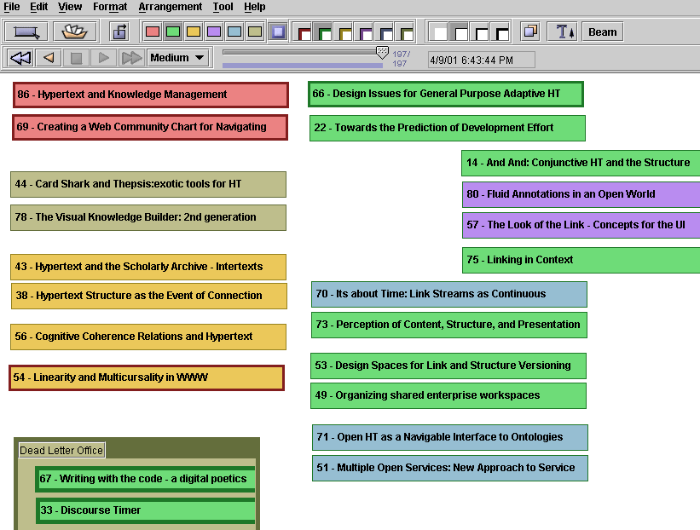
Visual Knowledge Builder
Notes:
Example 2nd Gen spatial hypertext system (2000-)
Based on experiences with VIKI (Shipman and Marshall)
Frank Shipman, Texas A&M

Slide 7
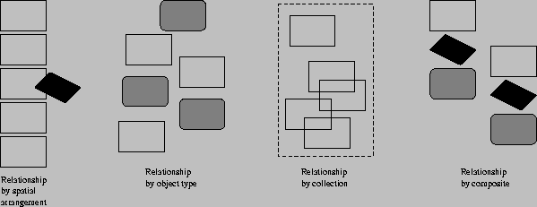
Structure and Spatial Hypertext
Aggregates arranged by
  Spatial arrangement
  Object type
  Collection (user selects)
  Composite (defined by template)

Slide 8
Spatial Parsers
Produce explicit structure by interpreting the implicit structure in a space
The problem is for the parser to understand what structure is deliberate and what is not intended
Rely heavily on heuristics determined for the user

Slide 9
Structure Parsing in VIKI
VIKI performs a bottom-up hierarchical parse using empirically-determined heuristics
Recognition is based on three attributes of visual symbols:
  position
  extent
  object type
The order of structure recognition is:
  Aggregates based on overlaps
  Sets based on homogeneity and alignment are found
  Then composites are located
Found structures are re-parsed according to the same rules to find higher level structures

Slide 10
Recognised Structures
Vertical list
Stack
Horizontal list
Pile

Slide 11
Spatial Hypertext Systems
Much of the literature is based around systems that have arisen from a particular line of SHS
  Notecards
  gIBIS
  VNS
  Aquanet
  VIKI
  VKB
This work emerged almost exclusively from Xerox PARC

Slide 12
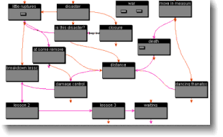
Storyspace (www.eastgate.com)
Storyspace is a hypertext writing tool..
Provides a variety of maps and views to help writers create, organize, and revise dynamically.

Slide 13
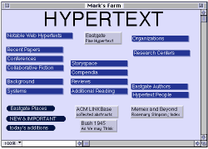
Websquirrel (www.eastgate.com)
Spatial URL shortcut/ bookmark organizer

Slide 14
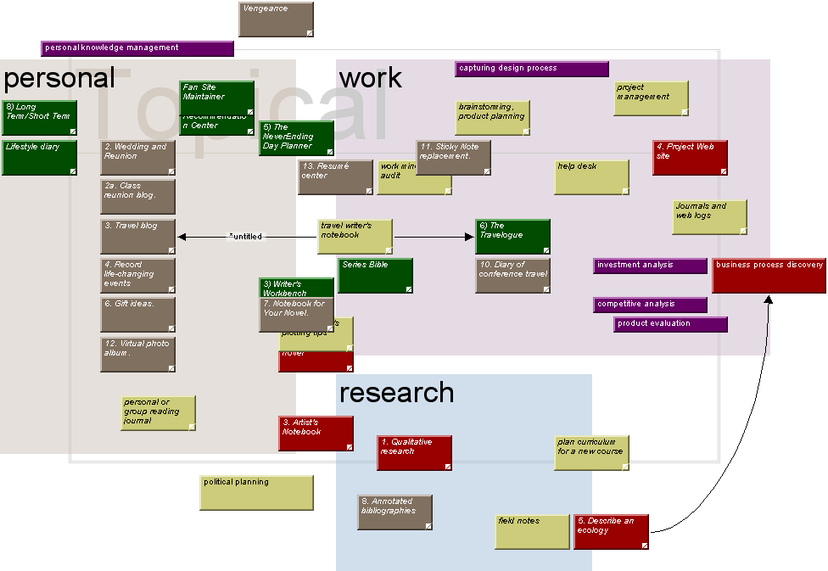
Tinderbox (www.eastgate.com)
A personal content management assistant
Agents that help to build structure from content

Slide 15
Cybergeography
See http://www.cybergeography.org/atlas/
Lots of research using visual tools to map
  The topology of hyperspace
  People’s browsing through hyperspace
  The social structures of hyperspace
  Individual web site maps
Important hypertext research in this area
  Visualising hypertext link clusters by presenting nodes in 3D space
  Better search engines (identifying hubs and authorities)

Slide 16
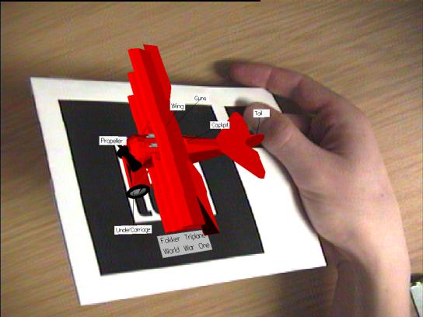
Augmented Reality
Annotate live video with links and computer-generated imagery
Notes:
Salt ‘n’ Pepper – Patrick Sinclair

Slide 17

Temporal Hypermedia
http://www.flickr.com/photos/rachelpasch/2405915548/

Slide 18
Time Based Hypertext
The business of inserting links into temporal and continuous media (sound, animations and video)
Links can be for
  Providing hypertext jumps to other contexts
  Annotation of the current item playing
  Synchronization of multiple media

Slide 19
Issues
Embed the links or point from outside?
Standards
  If embedded – what format media does this?
  If linking by reference, how to describe the place the link is?
Quality of Service (will things happen when they should?)

Slide 20
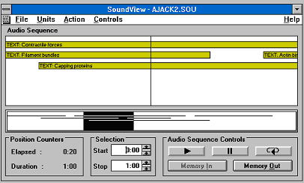
Microcosm Sound Viewer
(c. 1993)

Slide 21
Sound Viewer
Early innovative work on putting jump links into sound files
Top window shows clickable links and bar is the “now point”
Bottom window shows top window in context of whole file
Links can be user activated or automatically invoked (decided by author)
Link anchors described as start and finish times in seconds through file

Slide 22
Southampton Work on links in Video
Microcosm also supported links in Video using principally the same idea, visible links appeared as polygons within the picture, and could be authored so that they moved with an object.
Improvements in Windows component technology made it possible to develop a version of this framing the Windows Media Player.
Later work at Southampton has implemented combining streamed mm data (RTP / RTCP) with streamed metadata.

Slide 23
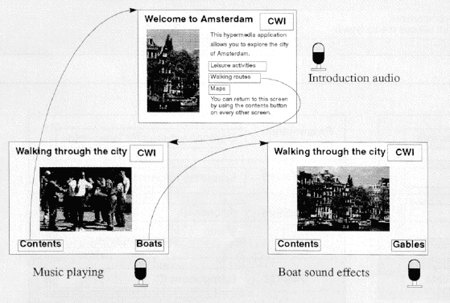
The Amsterdam Hypermedia Model c. 1994
Concerned with provision of systems to author multimedia presentations and synchronise multiple data streams

Slide 24
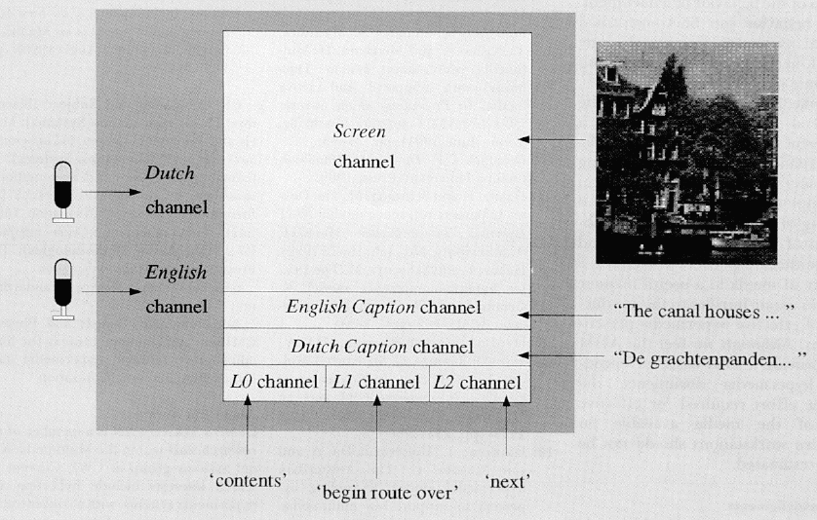
The Amsterdam Hypermedia Model
The model had an idea of parallel “channels”
Links into temporal media could be “offset” by some time.
But clickable links were limited to stationary hotspots
This work developed into SMIL

Slide 25
HyTime
Hypermedia/Time-based Structuring Language ISO/IEC 10744:1992 (and version 2 1997)
Added sophisticated cross document links to SGML – the predecessor to XML
The link mechanism is the basis of Xlink/ XPointer
Hub Document for linkbases
Multiple ways of doing links with sophisticated location addressing by
  Name (inserted in the SGML)
  Counting (including Document trees and reverse counts)
  (HyTime allowed counting in non SGML docs too)
  Query (find the bit that matches this HyQ query)

Slide 26
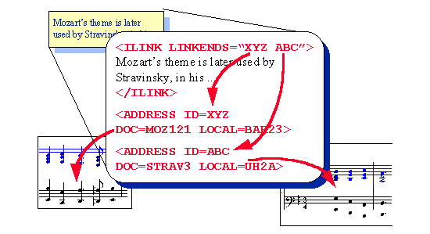
An Opaque HyTime Link

Slide 27
MPEG-7
MPEG-7 is a standard for describing features of multimedia content.
formally named “Multimedia Content Description Inter-face
describes multimedia content so users can search, browse, and retrieve that content (search engines for Multimedia)
MPEG-7 uses XML Schema for content description and is interoperable with other content description langauges (Dublin Core etc)

Slide 28
MPEG-7
Descriptions are based on
  catalogue (e.g., title, creator, rights)
  semantic (e.g., the who, what, when, where information about objects and events)
  structural (e.g., the colour histogram - measurement of the amount of colour associated with an image or the timbre of an recorded instrument)
The ability to describe objects within media means that we can also link to them
We can create semantically generated dynamic links – and semantic search engines

Slide 29
SMIL
Synchronized Multimedia Integration Language, the W3C format for multimedia on the Web
XML syntax encodes: timing, screen layout, interaction, adaptivity
Uses CSS, XPointer, XLink and namespaces
Nested par (parallel) and seq (sequence) elements
Switch element, which establishes alternative means of presenting the same information (e.g. for different users or different displays)
Originally link start points were pretty simple
Latest versions look more and more like HyTime and include animation in XML

Slide 30
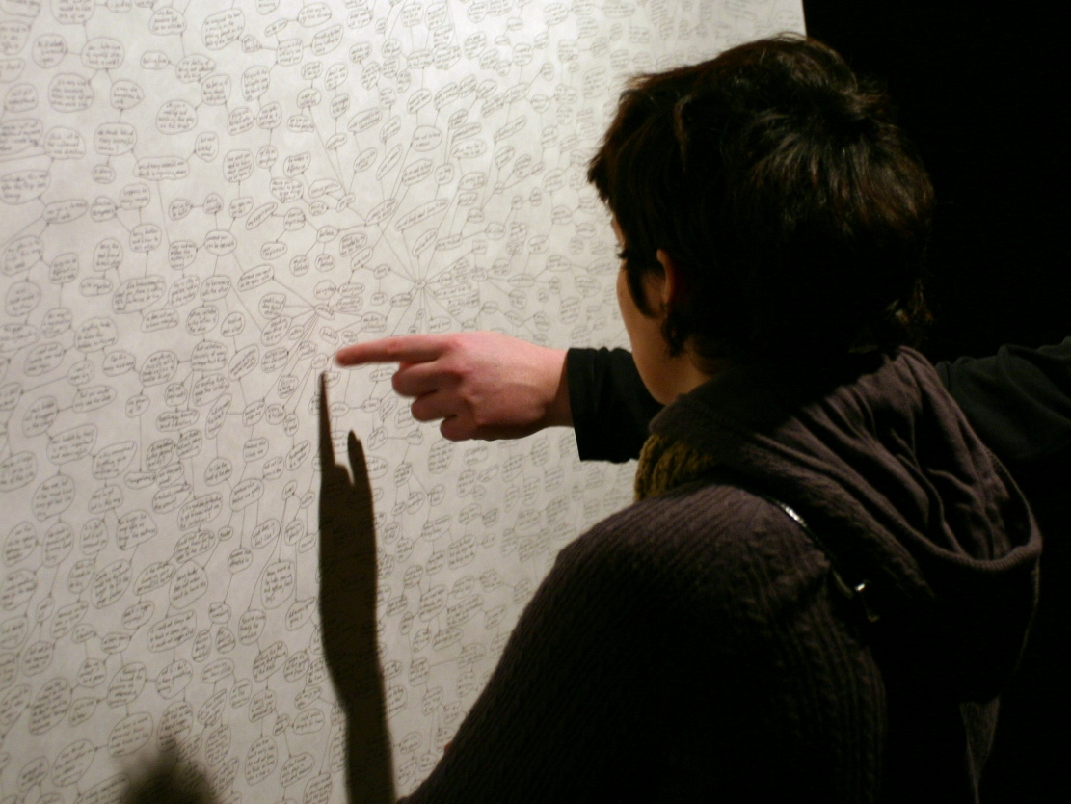
Conceptual Hypermedia
http://www.flickr.com/photos/binary_koala/2069692015/

Slide 31
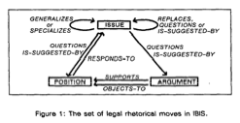
Origins: Typed links
Early Hypertext systems allowed links to be “typed”
Links have some semantics, or meaning
We have some understanding of what we will get by following a link
We may be able to infer further information
If the semantics are well defined, then maybe a machine can infer information too
Notes:
Randy Trigg’s PhD
Argumentation

Slide 32
What is Conceptual Hypermedia?
Conceptual Hypermedia = Hypermedia + Ontologies

Slide 33
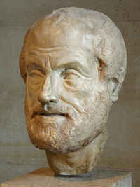
Defining the ‘O’ word
Ontology, n.
1. a. Philos. The science or study of being; that branch of metaphysics concerned with the nature or essence of being or existence.
Oxford English Dictionary, 2004

Slide 34
Defining the ‘O’ word
An ontology is a specification of a conceptualisation
Specification: A formal description
Conceptualisation: The objects, concepts, and other entities that are assumed to exist in some area of interest and the relationships that hold among them
Referred to in the philosophical literature as Formal Ontology
T. R. Gruber. A translation approach to portable ontologies. Knowledge Acquisition, 5(2):199-220, 1993

Slide 35
Ontology in Computer Science
Ontologies as engineered artifacts:
  constituted by a specific vocabulary used to describe a certain reality, plus
  a set of explicit assumptions regarding the intended meaning of the vocabulary
Shared understanding
Facilitate communication
  Establish a joint terminology for a community of interest
  Normative models…
Inter-operability: sharing and reuse

Slide 36
What is Ontological Hypermedia?
Hypertext is the study of what can be said using computer media, databases and links
  Computer-mediated extensions to familiar textual communication
Things that exist have complex relationships with each other
  Complex structures are required for expressing and exploring these relationships
  Ontologies formalise these complex structures
Conceptual Hypermedia is the kind of hypertext whose structure and links are derived from the relationships between objects in the real world
  Hypertext with an underlying ontological model

Slide 37
Conceptual Open Hypermedia
Hypermedia links can be viewed as navigable ontology relationships
Ontology used to improve linking
  Concepts used to disambiguate word sense of candidate link endpoints
  Links derived from ontology relations
http://cohse.semanticweb.org/

Slide 38
COHSE
ontology server
resource finder
John Smith
term
genid:js
related
hypertext

Slide 39
Ontology-derived Links
lexicon
ontology
author
term
employee-of
Acme Inc.
101 Widgets
John Smith
genid:js
homepage
name
title
url
url
url
Links for John Smith:
Homepage
Acme Inc.
Publications
  101 Widgets
hypertext

Slide 40
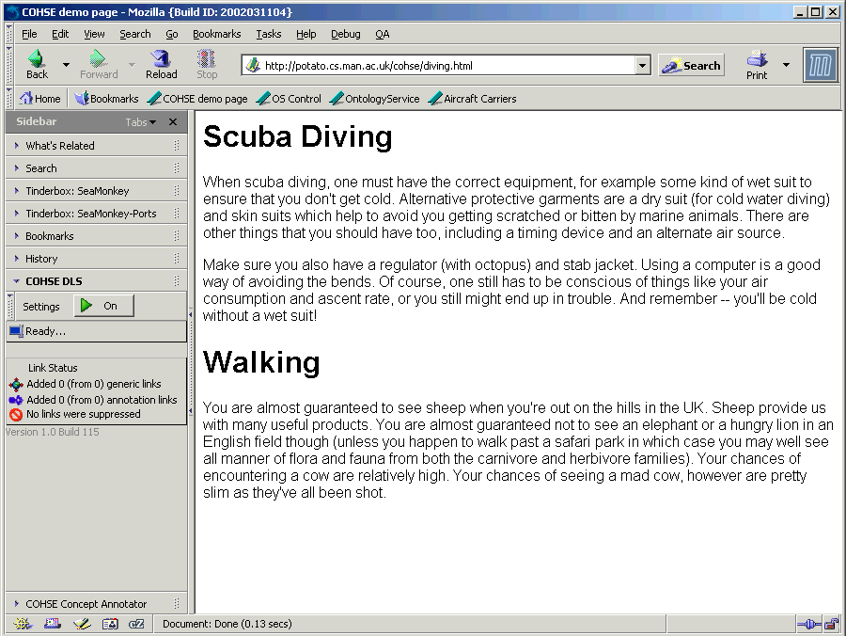

Slide 41
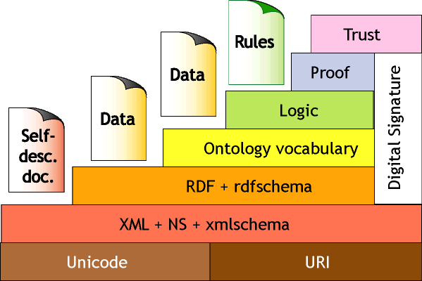
What about the Semantic Web?

Slide 42
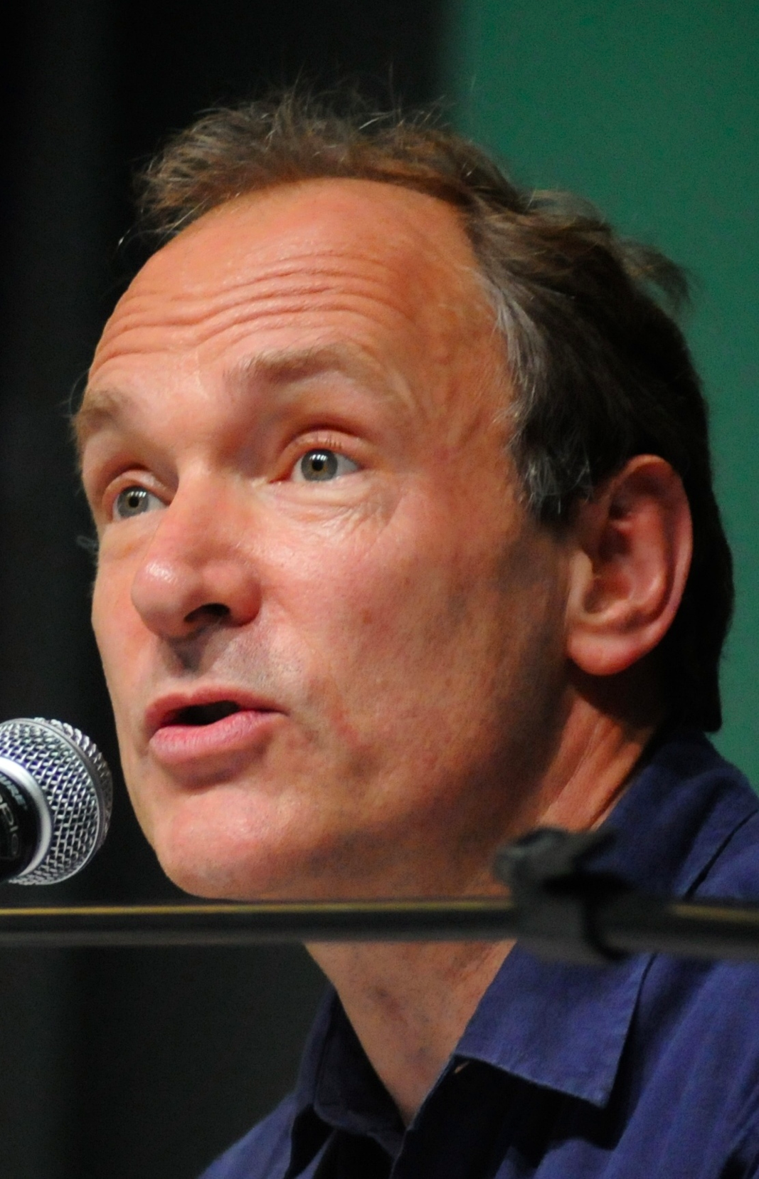
I have a dream for the Web [in which computers] become capable of analyzing all the data on the Web – the content, links, and transactions between people and computers. A ‘Semantic Web’, which should make this possible, has yet to emerge, but when it does, the day-to-day mechanisms of trade, bureaucracy and our daily lives will be handled by machines talking to machines. The ‘intelligent agents’ people have touted for ages will finally materialize.
Notes:
Tim Berners-Lee, WWW Keynote, 1999

Slide 43
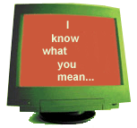

What is the Semantic Web?
The Semantic Web is an extension of the current Web in which information is given a well-defined meaning, better enabling computers and people to work in cooperation.
It is the idea of having data on the Web defined and linked in a way that it can be used for more effective discovery, automation, integration and reuse across various applications.
The Web can reach its full potential if it becomes a place where data can be processed by automated tools as well as people.
W3C Activity Statement

Slide 44
What’s Wrong with Google?
Find me some teaching materials to help 12 year olds understand basic programming concepts
How many days was it above 14 deg C in Western Australia in 2005?
Did anyone from the TOIA project also work on FREMA?
I want to go somewhere to do some windsurfing this Christmas. What’s the cheapest available way of doing this?

Slide 45
Principle Formats
XML - for the structured data
+ RDF - for the relationships
+ OWL – to represent the ontology and inference rules

Slide 46
Resource Description Framework
2001-05
The Semantic Web
date
title
name
Tim Berners-Lee
creator
publishedIn
creator
name
James Hendler
creator
name
Ora Lassila
title
Scientific American

Slide 47
Case Study CS AKTive Space
A tool for exploring activity within the UK Computer Science Research domain
  across multiple dimensions
  for multiple stakeholders (from funding agencies to individual researchers.)
Where would you get this data from?
Would it be machine processable?

Slide 48
CS AKTive Space Data Sources
This requires harvesting data from heterogeneous sources e.g.
  Funding councils’ databases
  University sites
  Bibliographical Sources (inc Abstracts and ePrints)
  Geographical gazetteers
  UK Research Assessment Exercise submissions
  Direct submissions by Partners
And fitting the information located to the domain ontology

Slide 49
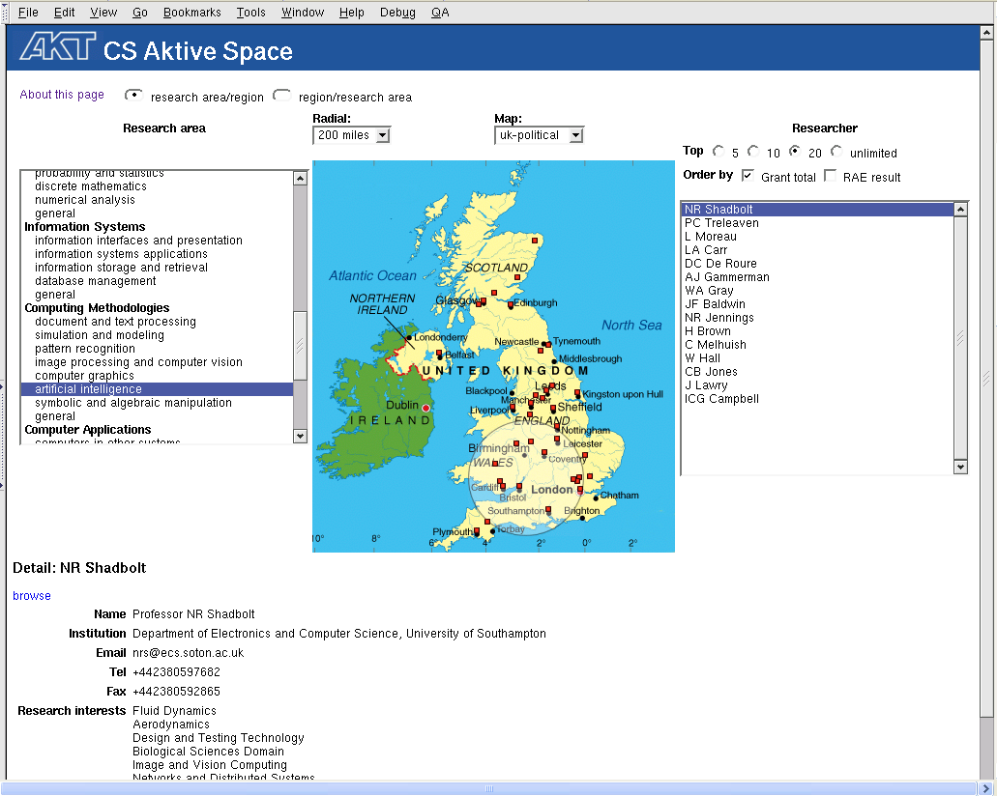

Slide 50
CS AKTive Space Research Issues
Sustainable acquisition and harvesting
Co-reference resolution
Scalable query and inference
Visualisation of complex data
Trust and Provenance
Sustainable maintenance as social activity

Slide 51
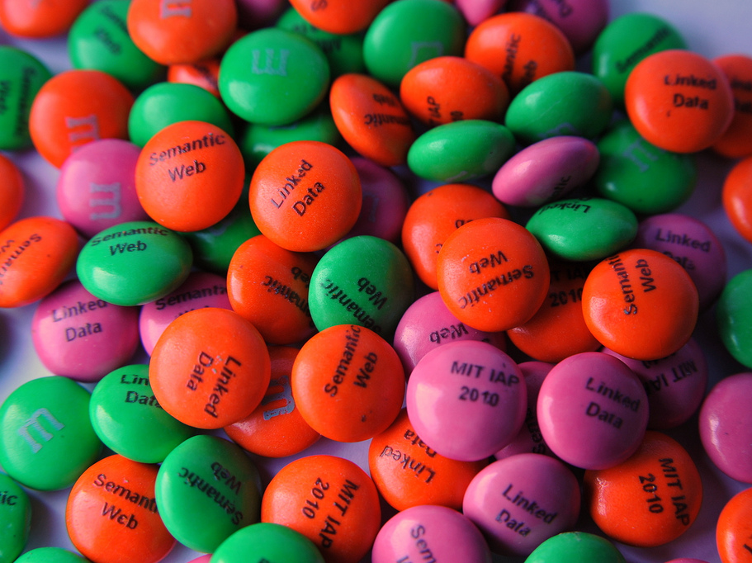
Linked Data
http://www.flickr.com/photos/reedsturtevant/4288406152/

Slide 52
Linked Data
The Web of Data
Tim Berners-Lee outlined four principles:
  Use URIs to identify things.
  Use HTTP URIs so that these things can be referred to and looked up ("dereference") by people and user agents.
  Provide useful information (i.e., a structured description — metadata) about the thing when its URI is dereferenced.
  Include links to other, related URIs in the exposed data to improve discovery of other related information on the Web.
e.G DBPedia

Slide 53
Some Issues for the Semantic Web
Linked Data starting to take off in some domains – data.gov.uk
Link and Data. We really need to be able to get semantic data from textual data -> RDFa and GRDDL.
The Semantic Gap – whose ontology?
If it did work would we be happy – or in control of the data – c.f. the Facebook API

