Slide 1
COMP3016 Hypertext Pioneers
Dr Nicholas Gibbins
32/3019
nmg@ecs.soton.ac.uk

Slide 2
Overview
Hypertext history
Contributions of pre-WWW Research
Hypertext models
Spatial
Temporal
Conceptual
Web 2.0 and Social Hypertext
Hypertext futures

Slide 3
Learning Outcomes
You will learn a lot about hypertext, and its best-known embodiment - the World Wide Web
You will learn to identify future trends from a body of literature
You will also learn a lot about working with a large body of literature
Identifying what to read
Skim reading vs deep reading
Managing complexity
Annotation and note-making

Slide 4
Eight Key Questions
What is hypertext? How are links represented and what do they mean?
To what extent has the vision of the original pioneers been realised?
Where did the research themes in open hypertext, spatial hypertext and time based hypertext lead us to?
What have been the critical success factors for the Web?
What can we do with semantics, and how can we get the semantic data?
Social Hypertext and Web 2.0: is this anything new?
What is the future for hypertext? What are the outstanding research issues?
Is Web Science anything new? Is it Science?

Slide 5
Hypertext Pioneers
http://www.flickr.com/photos/intherough/3470183543/

Slide 6
Paul Otlet
Belgian lawyer and internationalist
The father of Information Science
Created the Universal Decimal Classification for libraries (still in use around the world)
With Henri La Fontaine, established the Repertoire Bibliographique Universel in 1895
Notes:
UDC is Dewey based – Melville Dewey agreed to modifications, as long as UDC was not translated into English
RBU – fee-based service
15 million 3x5 index cards

Slide 7
The Mundaneum
A central repository for all the world’s knowledge
Founded in 1919 by Otlet and La Fontaine
Built on the earlier Repertoire Bibliographique Universel
Closed in 1934, damaged in 1940 under Nazi occupation
Notes:
Indexed using UDC
100,000s of files, 1,000,000s of images

Slide 8
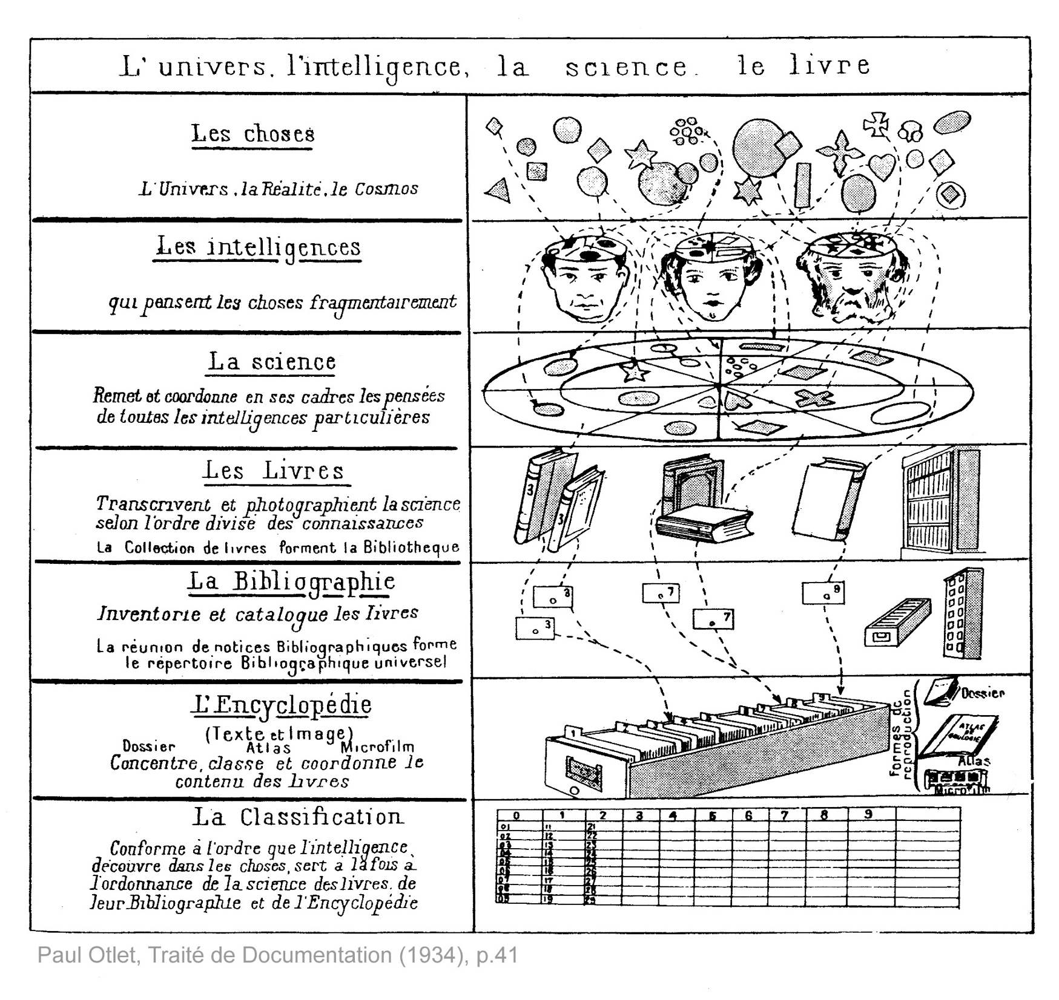

Slide 9
Vannevar Bush
Prewar work on analogue computing – the Differential Analyser
Director of the US Office of Scientific Research and Development during WWII
De facto director of the Manhattan Project until 1943
Notes:
While a professor at MIT, had Claude Shannon as a PhD student (information theory)
Work on the Differential Analyser informed developments in military fire control.

Slide 10
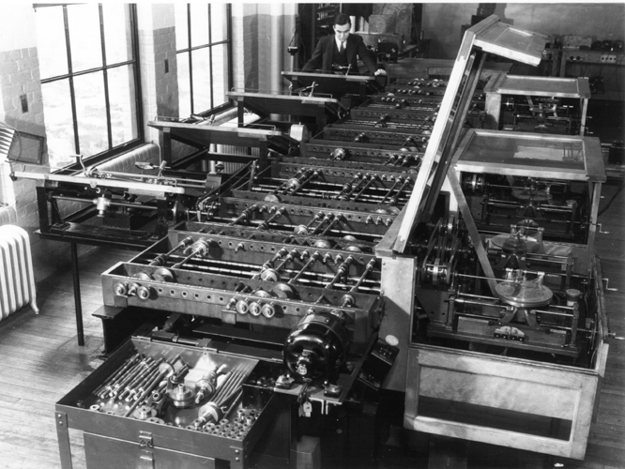

Slide 11
As We May Think
“The difficulty seems to be, not so much that we publish unduly in view of the extent and variety of present-day interests, but rather that publication has been extended far beyond our present ability to make real use of the record”
The Atlantic Monthly, July 1945

Slide 12
As We May Think
“…Our ineptitude in getting at the record is largely caused by the artificiality of systems of indexing. … Having found one item, moreover, one has to emerge from the system and re-enter on a new path. “
“The human mind does not work that way. It operates by association. With one item in its grasp, it snaps instantly to the next that is suggested by the association of thoughts”
“…the speed of action, the intricacy of trails, the detail of mental pictures, is awe-inspiring beyond all else in nature.”

Slide 13
The Memex
An analogue device for organising knowledge: microfilm, photocells and typewriters
Allowed user to create associative trails – arbitrary sequences of pages
Skip trails – relevant summaries
Allowed users to create commentaries on works

Slide 14
A Salient Prediction
“Wholly new forms of encyclopedias will appear, ready made with a mesh of associative trails running through them, ready to be dropped into the memex and there amplified.”

Slide 15
Doug Englebart
Member of the Stanford Research Institute
ARPA funding lead to the Augmentation Research Centre
Invented the computer mouse
Notes:
When ARC folded in the 70s, many researchers went to Xerox PARC

Slide 16
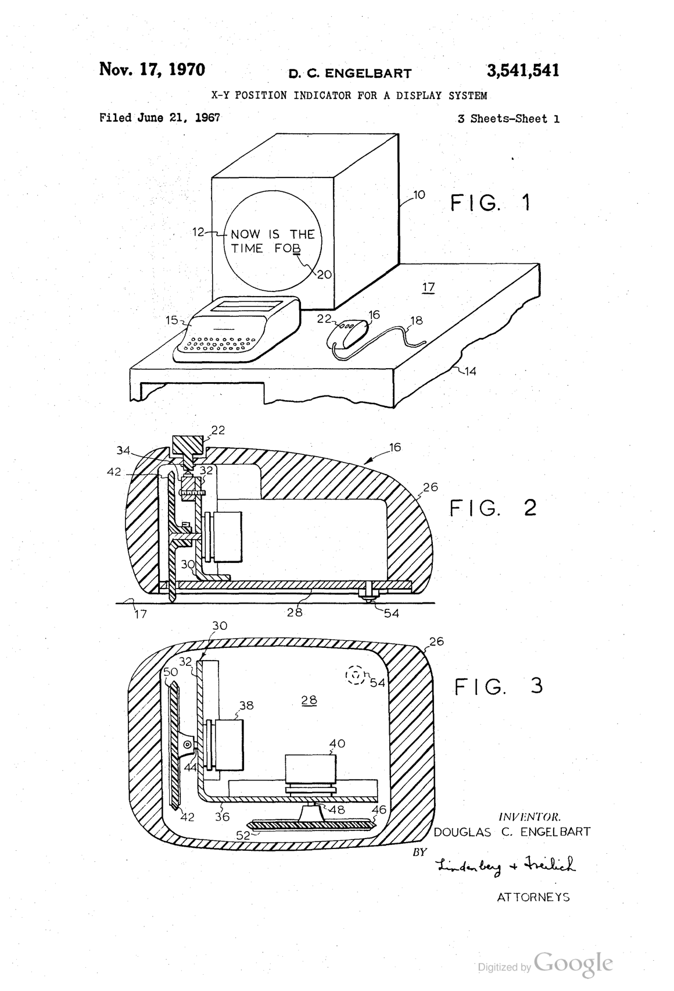

Slide 17
Augmenting Human Intellect
a new stage of human evolution, characterized by "automated external symbol manipulation”
NLS – the oNLine System
“placing in computer store all of our specifications, plans, designs, programs, documentation, reports, memos, bibliography and reference notes, etc., and doing all of our scratch work, planning, designing, debugging, etc., and a good deal of our intercommunication, via the consoles”.

Slide 18
NLS – the oN-Line System
Timesharing computer with multiple consoles
UI features:
Windowed display
Mouse
Chorded keyboard
Videoconferencing
Links in content
First demonstrated in December 1968 at the Fall Joint Computer Conference in San Francisco

Slide 19
The Mother of all Demos

Slide 20
Ted Nelson
Sociologist, philosopher and film maker
“A user interface should be so simple that a beginner in an emergency can understand it within ten seconds”
“most people are fools, most authority is malignant, God does not exist, and everything is wrong”
Coined the term “hypertext”
Notes:
Son of Ralph Nelson and Celeste Holm

Slide 21
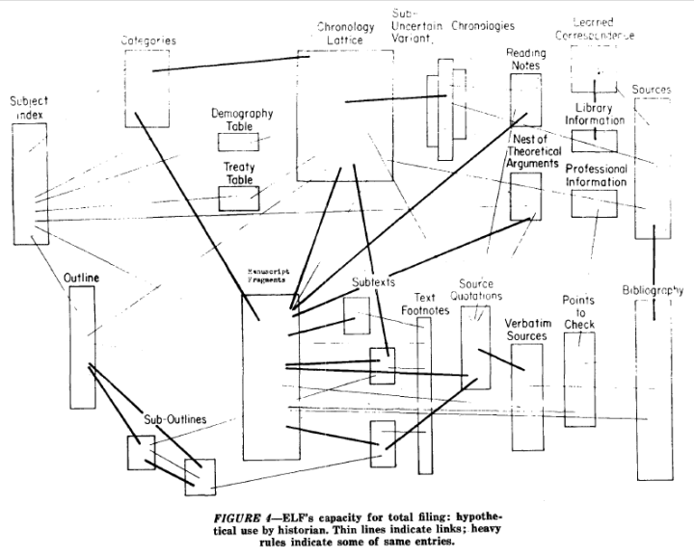
Notes:
A File Structure for the Complex, the Changing and the Indeterminate."
Proceedings of the ACM 20th National Conference (1965), pp. 84-100

Slide 22
Computer Lib/Dream Machines
“No one's life has yet been simplified by a computer.”
Two books in a dos-a-dos binding
Computer Lib is a clarion call for people to understand computers deeply
Dream Machines is a sketch of the flexible media potential of computers
Notes:
"Down with Cybercrud"
anti centralisation
democratisation of computing – computer experts intentionally obscure

Slide 23
A Vision in a Dream
In 1797, Samuel Taylor Coleridge wrote the poem Kubla Khan after awaking from an opium dream:
In Xanadu did Kubla Khan A stately pleasure-dome decree: Where Alph, the sacred river, ran Through caverns measureless to man Down to a sunless sea.
He was interrupted by a visitor from Porlock, and never completed the poem…

Slide 24
Project Xanadu
Founded in 1960, still ongoing(famously never finished)
Hugely influential, nonetheless
Described in Dream Machines, and Nelson’s subsequent book Literary Machines
Notes:
"longest-running vaporware story in the history of the computer industry” – Gary Wolf in WiReD
First demo version in 1972
With Roger Gregory, Mark Miller, Stuart Greene in 1979
1983-1992 – With Autodesk
1992- Xanadu Operating Company
Open-sourced in 1998
2007 - XanaduSpace

Slide 25
Project Xanadu
PROJECT XANADU MISSION STATEMENT: DEEP INTERCONNECTION WITH INTERCOMPARISON AND RE-USE
Since 1960, we have fought for a world of deep electronic documents-- with side-by-side intercomparison and frictionless re-use of copyrighted material.
We have an exact and simple structure. Our model handles automatic version management and rights management through deep connection.
Today's popular software simulates paper. The World Wide Web (another imitation of paper) trivializes our original hypertext model with one-way ever-breaking links and no management of version or contents.
WE FIGHT ON.

Slide 26
Project Xanadu
Intercomparison of parallel documents
World-wide publishing without barriers
Links that don't break
Versioning
Transclusion
Transpublishing-- a new copyright zone

Slide 27
Every Xanadu server is uniquely and securely identified.
Every Xanadu server can be operated independently or in a network.
Every user is uniquely and securely identified.
Every user can search, retrieve, create and store documents.
Every document can consist of any number of parts each of which may be of any data type.
Every document can contain links of any type including virtual copies ("transclusions") to any other document in the system accessible to its owner.
Links are visible and can be followed from all endpoints.
Permission to link to a document is explicitly granted by the act of publication.
Every document can contain a royalty mechanism at any desired degree of granularity to ensure payment on any portion accessed, including virtual copies of all or part of the document.
Every document is uniquely and securely identified.
Every document can have secure access controls.
Every document can be rapidly searched, stored and retrieved without user knowledge of where it is physically stored.
Every document is automatically moved to physical storage appropriate to its frequency of access from any given location.
Every document is automatically stored redundantly to maintain availability even in case of a disaster.
Every Xanadu service provider can charge their users at any rate they choose for the storage, retrieval and publishing of documents.
Every transaction is secure and auditable only by the parties to that transaction.
The Xanadu client-server communication protocol is an openly published standard. Third-party software development and integration is encouraged.

Slide 28
Nelson on the Web
“ The Xanadu project did not ‘fail to invent HTML’. HTML is precisely what we were trying to PREVENT-- ever-breaking links, links going outward only, quotes you can't follow to their origins, no version management, no rights management. ”

Slide 29
XanaduSpace

Slide 30
1987 - Conklin
In 1987 Jeff Conklin produced “A Survey of Hypertext”
This article attempted for the first time to define the scope of this area of computing.
“The concept of hypertext is quite simple: windows on the screen are associated with objects in a data base and links are provided between these objects, both graphically (i.e. as labelled icons) and in the data base (i.e. as pointers). “

Slide 31
Conklin’s Classifications
Macro Literary Systems
technologies to support large on-line libraries in which inter-document links are machine supported – all publishing, reading, collaboration, and criticism takes place within the network;
e.g. Memex, NLS/Augment, Nelson's Xanadu
Problem exploration tools
tools to support early unstructured thinking on a problem
Browsing systems
systems for teaching, reference, and public information, where speed of access and ease of use is crucial
General hypertext technology
to allow experimentation with a range of hypertext applications; most commonly applied to reading, writing, collaboration

Slide 32
The Essence of Hypertext
Nodes
The power to chunk information
Links
Importance of speed of link resolution
Direction?
Names?
Properties?
How many ends?
End as region or node?
Reference by name or by value
Display characteristics?

Slide 33
The Essence of Hypertext
Trees (strict hierarchies) or networks of links
Clusters of Links (webs/linkbases?)
Clusters of Nodes (Composites)
History
Trails
Authoring and Annotating!
Browsers (meaning node level)

Slide 34
Disadvantages of Hypertext
Disorientation: the tendency to lose one's sense of location and direction in a non-linear document; “Lost in Hyperspace”
Cognitive overhead: the additional effort and concentration necessary to maintain several tasks or trails at one time.

Slide 35
Second Generation Hypertext
1987 Conklin recognised that Hypertext lent itself to working with GUI’s with Windows, Icons, Mouse, Pointer Systems (WIMPs)
1987 Conklin identified a future for Hypermedia
1987 release of Windows 2 (overlapping windows) (Windows Help as Hypertext)
1987 release of Apple Mac SE. Bundled with Hypercard
From 1987 Hypertext/Hypermedia on a Personal Computer was a realistic option – 2nd Generation

Slide 36
NoteCards
An early second generation system
Developed at Xerox Parc (Trigg, Moran and Halasz) in 1986
Designed to support the task of transforming a chaotic collection of unrelated ideas to an integrated, orderly interpretation of the ideas and their interconnections.
Programmable API

Slide 37
NoteCards

Slide 38
NoteCards Links
A notecard is an electronic generalization of the 3x5 paper notecard.
Each link is a typed, directional connection between a source card and a destination card
Links anchored at a particular location in the source card by a link icon but point to their destination card as a whole.

Slide 39
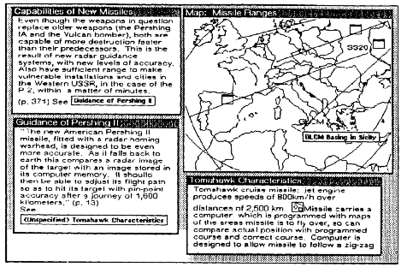
NoteCards Showing card with iconic anchors

Slide 40
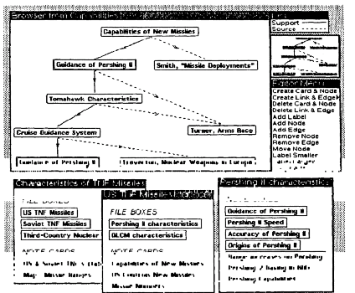
NoteCards Showing browser

Slide 41
Halasz’s 7 Issues
Frank Halasz was one of the Notecards team
In 1989 he wrote a paper in CACM summarizing the Notecards project and discussing the issues for the next generation of HT systems

Slide 42
The seven issues
Issue 1: Search and query in a hypermedia network
Link Navigation is not always the best way to find things
Better might be Content Based or Structural Search
Issue 2: Composites - augmenting the basic model
A way of representing and dealing with sets (or sub-networks) of nodes and links as unique entities separate from their components
Issue 3: Virtual structures
Virtual Structures would be created by a query and would be equivalent to virtual tables in a relational database

Slide 43
The seven issues
Issue 4: Computation in (over) hypermedia networks
The idea is to provide APIs to allow cards to be orchestrated and scripts to be executed when certain events occur
Issue 5: Versioning
Halasz argued that versioning was a natural feature of OSs that got lost with DOS. Versioning of HTs is difficult.
Issue 6: Support for collaborative work
Issue 7: Extensibility and tailorability
The ability to change the system to extend and change behaviours, have different appearances and use different hypertext models

Slide 46
1990
Three new Hypertext systems made their first appearance
The World Wide Web
Hyper-G
Microcosm
The above list is in ascending order of their compliance with 7 issues
And in descending order of their uptake

Slide 47
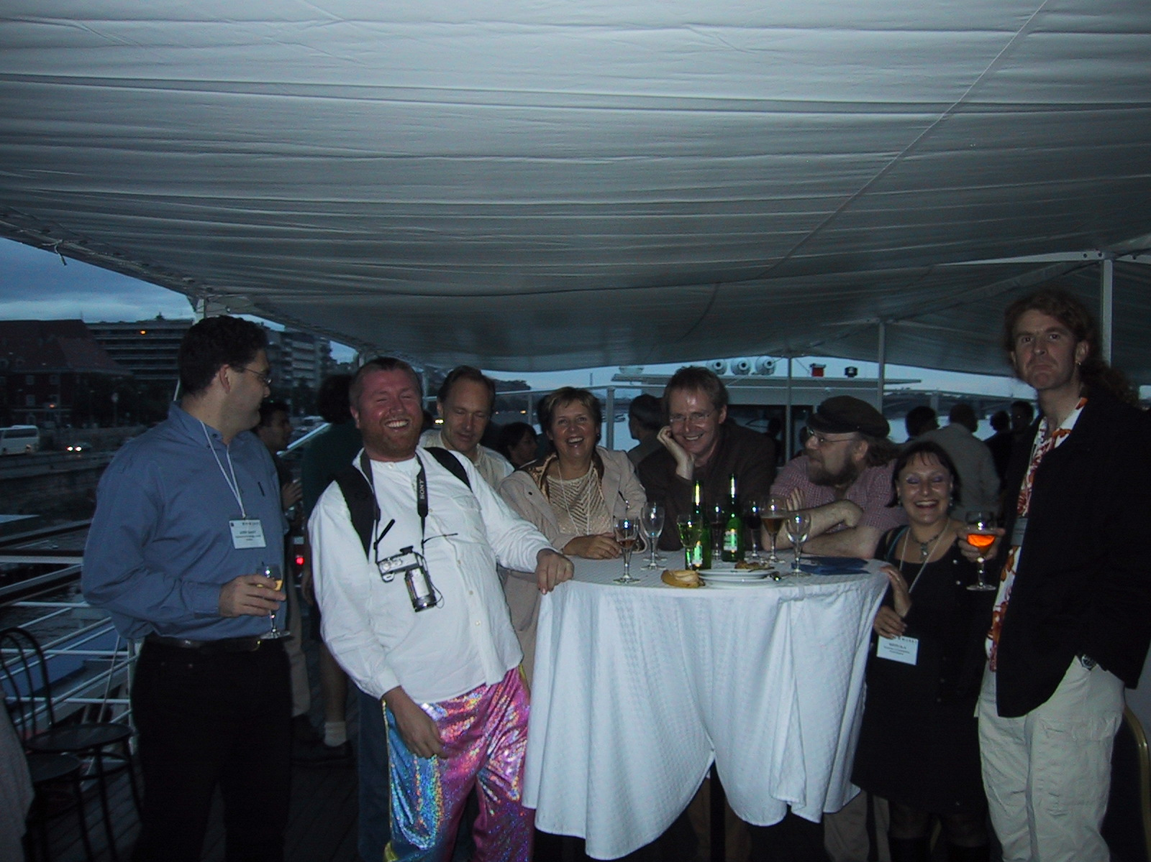

Slide 48
What is (was) the Web?
The idea of a boundless information world in which all items have a reference by which they can be retrieved - address system (URIs)
A network protocol to fetch addressed items - (HTTP)
A mark-up language (HTML) which every client must understand how to render - and which can contain hotlinks to given addresses

