Slide 1
Marine Carbonate δ¹³C
Revision Lecture
Helen Griffin

Slide 2
What can downcore δ¹³C variations tell us?
-water mass movement
-palaeoproductivity
-changes in the terrestrial biosphere
And on..
So lots of potentially very useful information, but…
to interpret the δ¹³C record you need to have an understanding of;
δ¹³C and the global carbon cycle
how the δ¹³C signal is incorporated into foraminiferal calcite

Slide 3
First, notation..
Carbon: 2 stable isotopes:
¹²C = 98.89%; ¹³C = 1.11% (abundances)
δ¹³C_{sample}= (¹³C/¹²C_{sample})-(¹³C/¹²C_{standard})
X 1000
(¹³C/¹²C_{standard})
Units= per mille (‰) (parts per thousand), standard (0‰) = VPDB
Notes:
Fractionation is…

Slide 4
Organic carbon cycle – driven by photosynthesis
CO₂ + H₂O + energy (sunlight) ⇒ CH₂O + O₂
Photosynthesis discriminates in favour of ¹²C against ¹³C
i.e. photosynthesis involves a significant isotopic fractionation
the carbon fixed in plant tissue (organic matter) is enriched in ¹²C

Slide 5
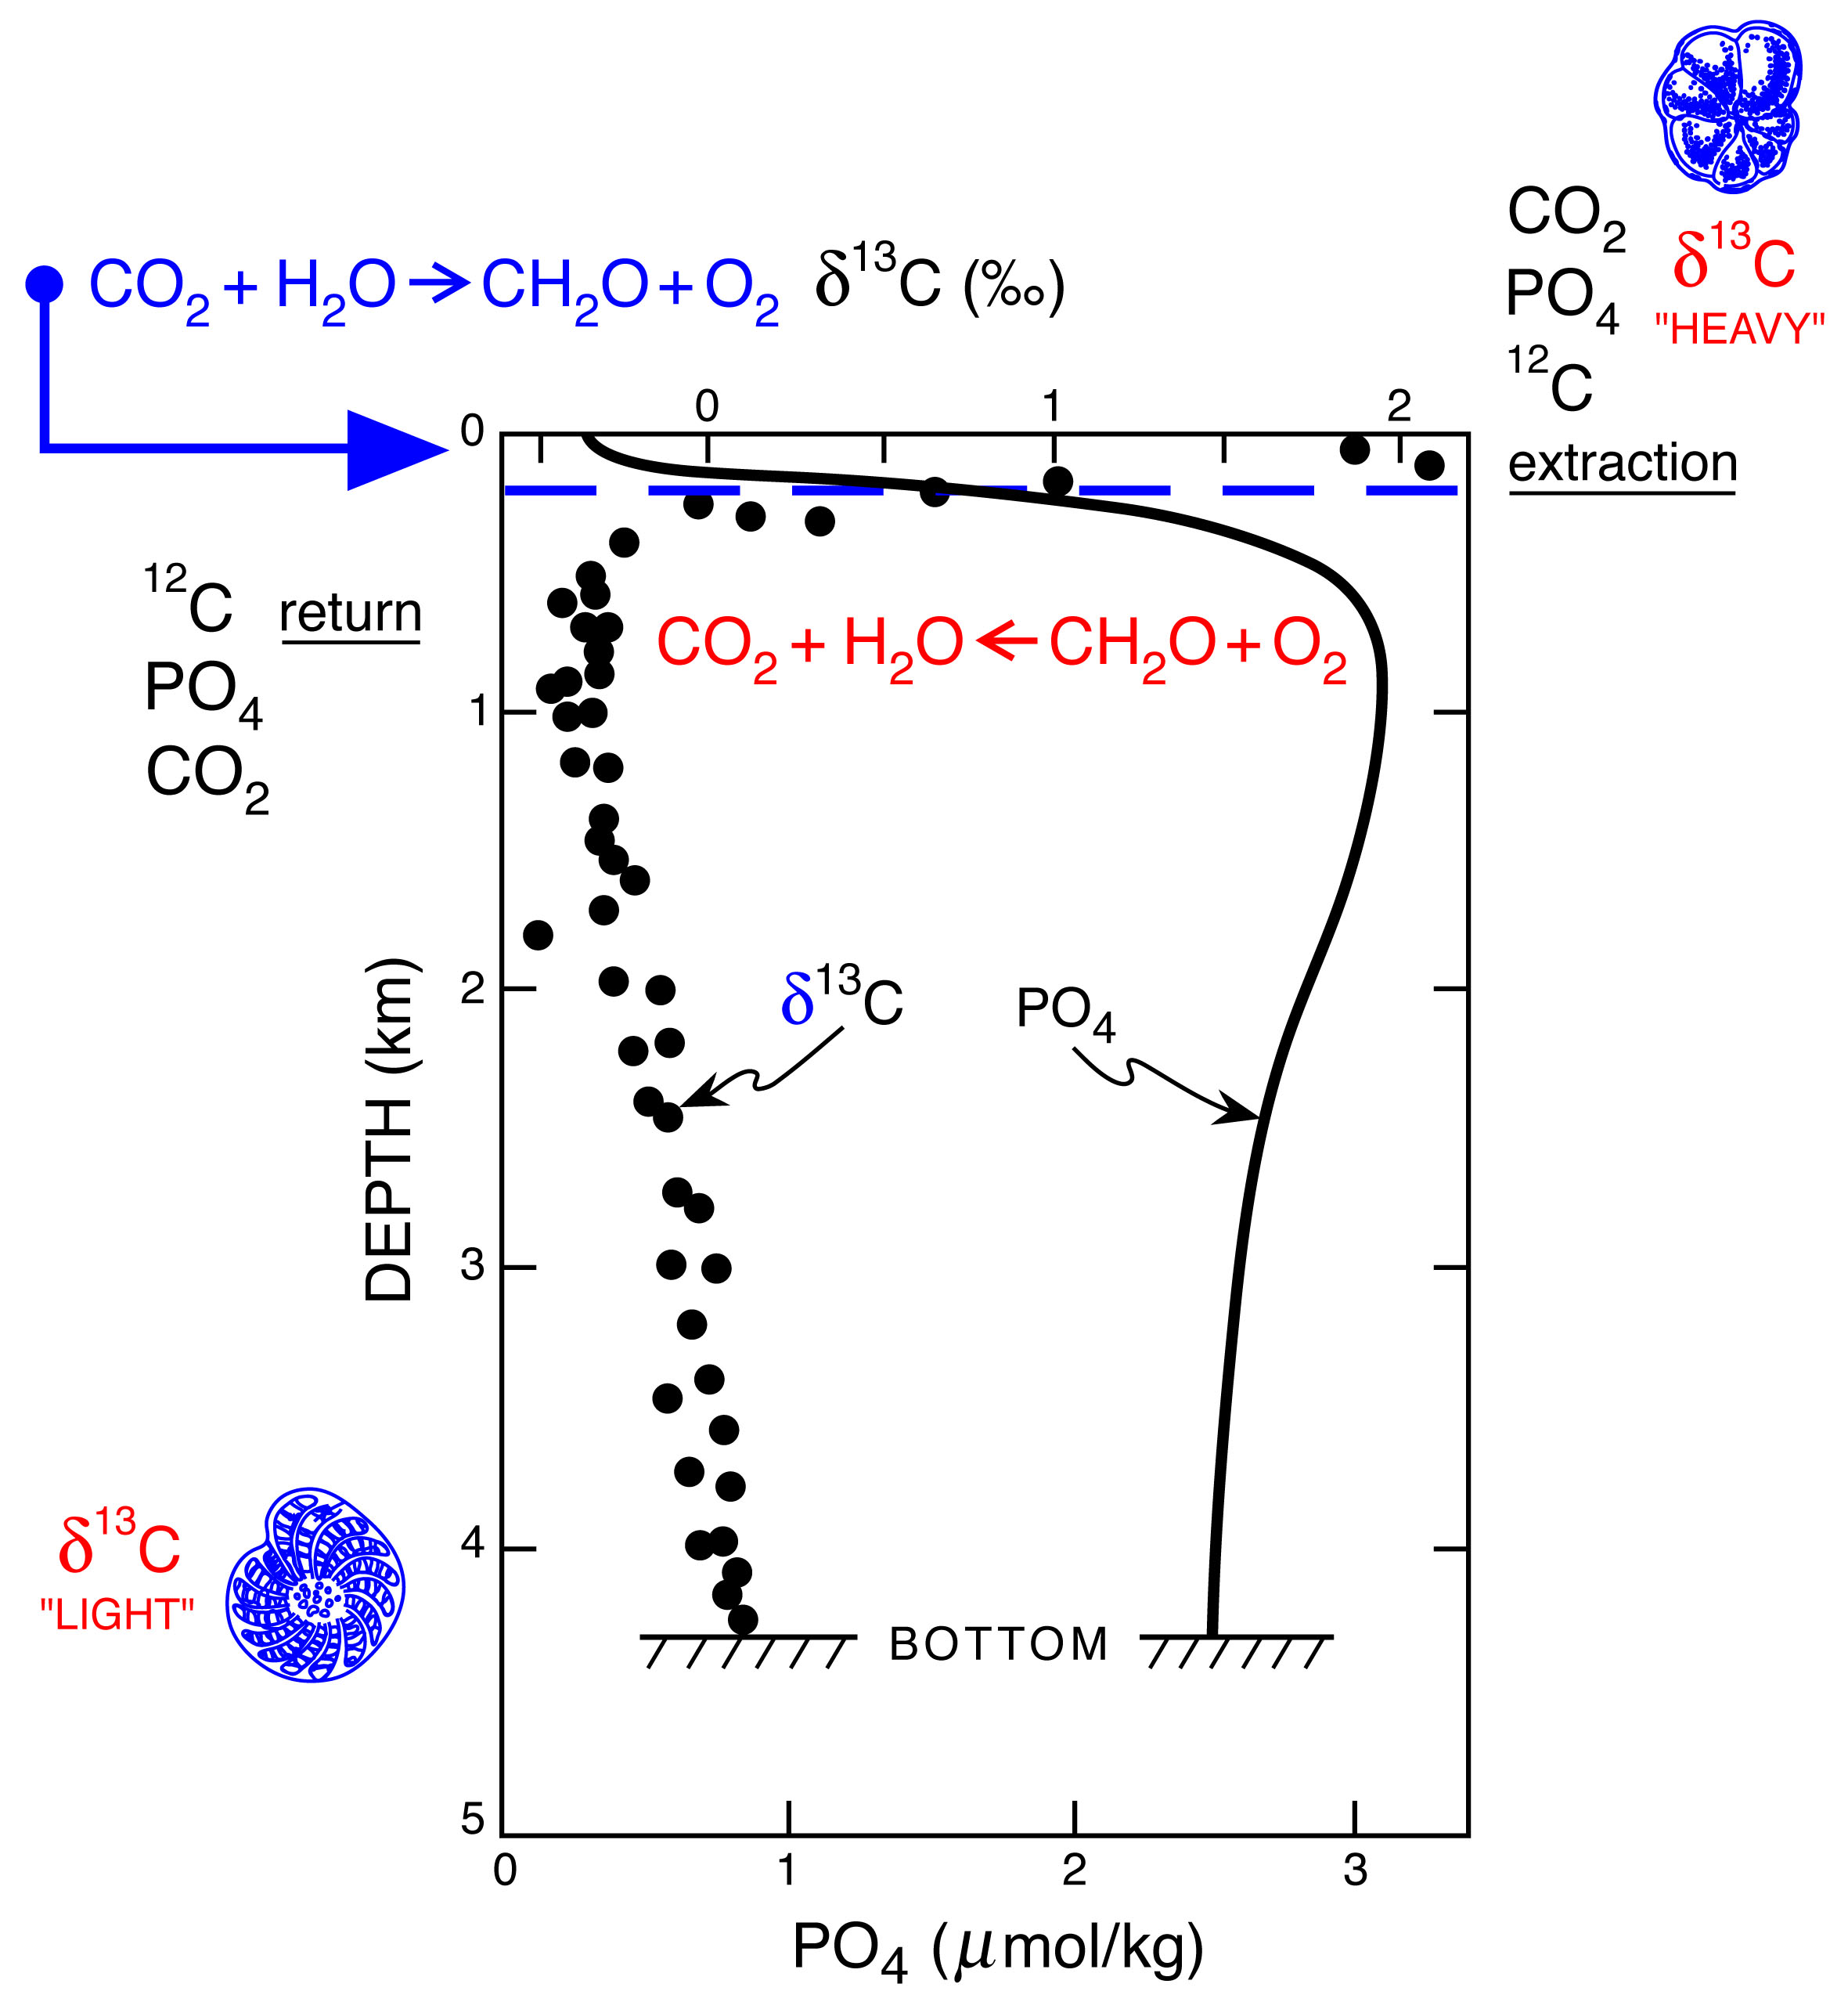
Surface - photosynthesis
δ¹³C C_{org} decreases
δ¹³C seawater increases
Therefore:
Surface – Deep δ¹³C gradient reflects export production
δ¹³C gradient recorded in planktic vs benthic foraminifera
Export flux
‘release’ of ¹²C through oxidation of C_{org} (respiration) at depth
δ¹³C seawater decreases
Notes:
Export flux = loss of organic matter from mixed layer

Slide 6
Same as before but with equations:
CO₂
AIR
Isotopic Equilibration
H₂O + CO₂
Surface water
relatively ¹³C
enriched
Preferential
¹²C uptake
SURFACE
OCEAN
WATER
Photosynthesis
CH₂O + O₂
H₂O + CO₂
H⁺ + HCO₃⁻
¹³C enriched
Planktic calcifiers
HCO₃⁻ + Ca²⁺ 6 CaCO³ + H⁺
Organic matter
δ¹³C -20 to -23%o
Carbonate formation
2HCO₃⁻+ Ca²⁺<=>CaCO₃+ H₂O+CO₂
Deep waters
¹³C depleted
Respiration
H₂O + CO₂
H⁺ + HCO₃⁻
DEEP
OCEAN
WATER
Benthic calcifiers
HCO₃⁻ + Ca²⁺ 6 CaCO³ + H⁺
Carbonate formation
Part of Organic C cycle
Part of Inorganic C cycle

Slide 7
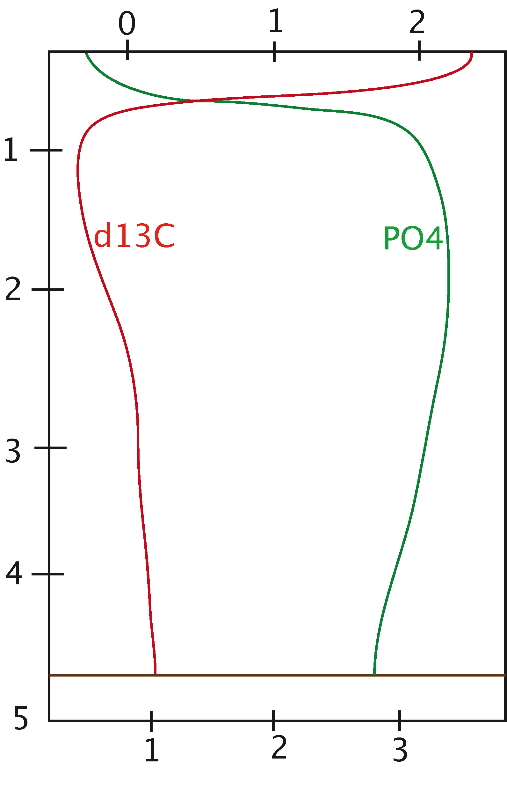
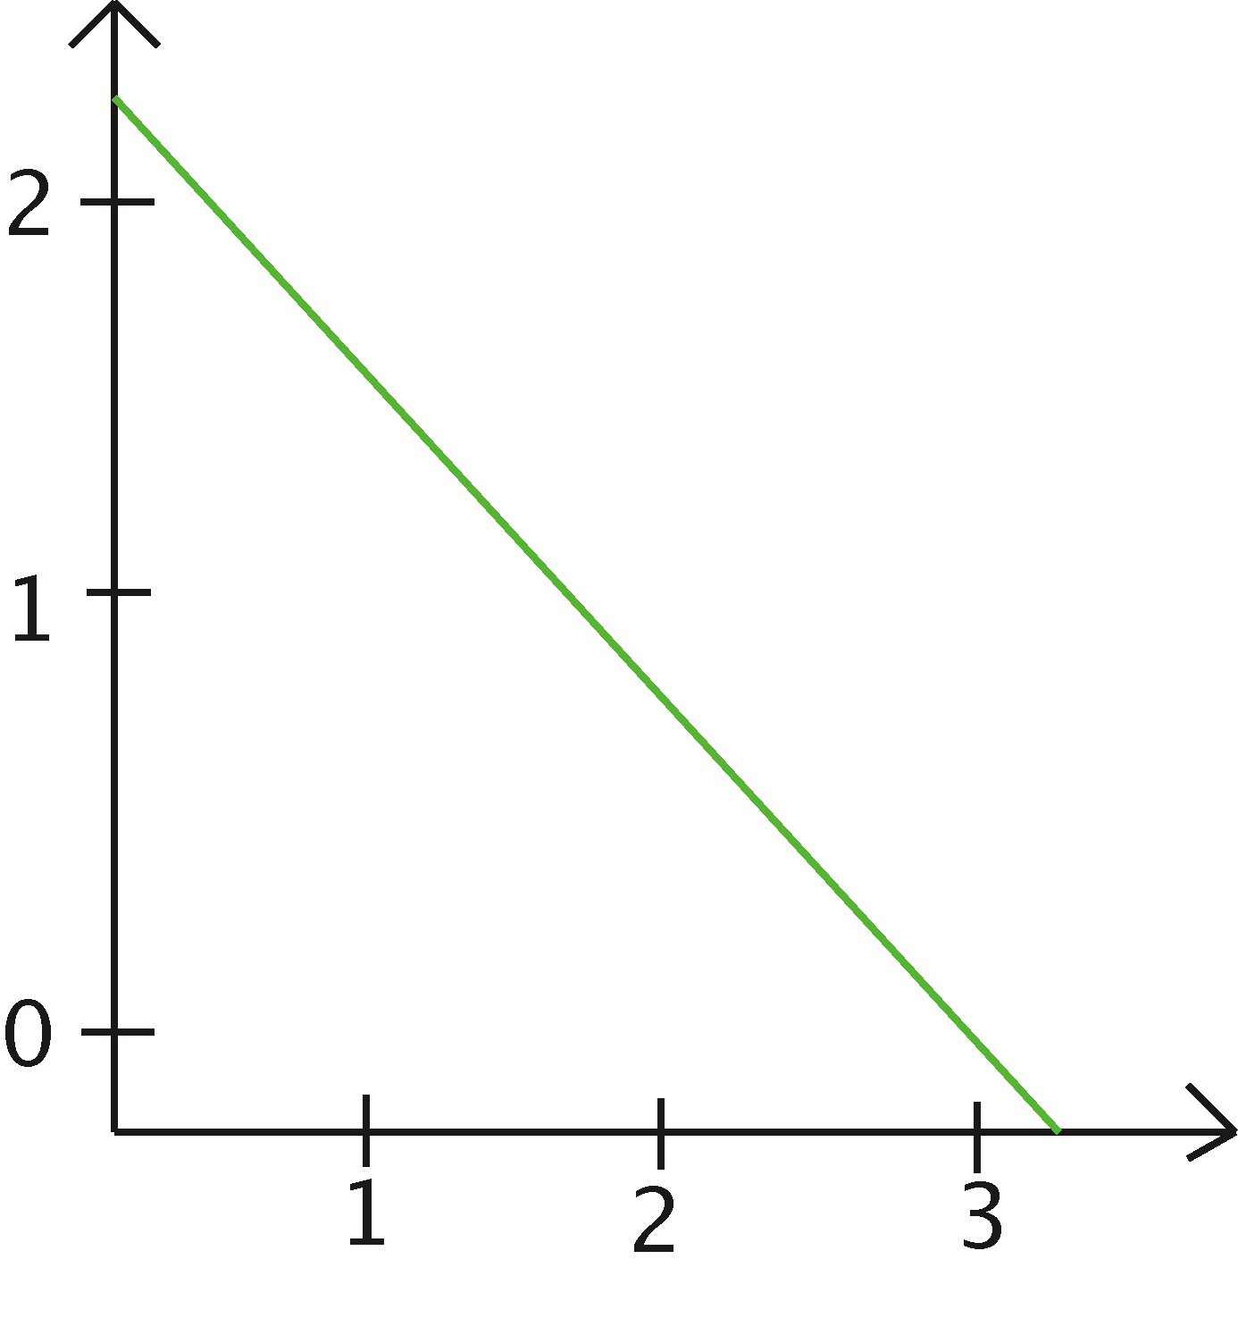
δ¹³C (‰)
δ¹³C as a nutrient tracer
Remineralisation of organic matter at depth releases δ¹³C depleted CO₂ and nutrients
Depth (km)
Good correlation between nutrient concentrations and δ¹³C in modern ocean
PO₄ (umol/kg)
Expected relationship between δ¹³C and [phosphate] = -0.93 ‰ per umol/kg (Broecker & Peng, 1982)
δ¹³C (‰)
Best when used in conjunction with e.g. Cd/Ca
PO₄ (umol/kg)

Slide 8
0 mol m⁻³
Total dissolved carbon
2.4 mol m⁻³
0m
δ¹³C and water mass ‘age’
Atlantic
Pacific
‘Age’ of water mass =
Amount of organic matter remineralisation water mass has sustained
depth
Depends on:
True age of water mass
Export production
Speed of reaction – temperature dependent
5000m
24ppm
Carbon
29ppm
δ¹³C high
δ¹³C high
δ¹³C high
δ¹³C high
GIN seas
δ¹³C low
δ¹³C low
δ¹³C low
Atlantic
Indian
Pacific
δ¹³C → → → → progressively -ve

Slide 9
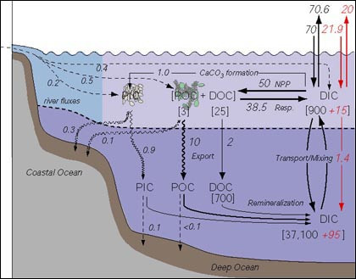
Interactions between the organic carbon cycle and inorganic carbon cycle
Ocean carbon cycle
Courtesy of MIT OPEN COURSEWARE
http://mitocw.vocw.edu.vn/OcwWeb/Earth--Atmospheric--and-Planetary-Sciences/12-746Spring-2005/CourseHome/index.htm
Retrieved: 21.08.2010
Some typical values for δ¹³C Corg (PDB):
• marine modern = -12 to –29‰ (ave.~ -20‰)
• marine ancient = -25 to –30‰ (higher pCO₂atms)
• terrestrial C₃ plants = -27‰ C₄ plants = -13‰ (different photosynth. pathways)
• methane hydrate = -60‰ (bacteria)
• atmospheric (today) = -8‰ (pre-industrial) = -6.5‰ (combustion fossil fuel)
Notes:
δ¹³C of dissolved CO₂ also equilibrates with the marine bicarbonate (HCO₃⁻) reservoir which is a major component of the inorganic pool: Most of the carbon in sea water is present as bicarbonate HCO₃⁻
HCO₃⁻ & CO₃²⁻ are also delivered to the oceans via riverine & hydrothermal input (together with Ca).

Slide 10
δ¹³C in Atmospheric CO₂ varies:
Spatially
DIC in sea water is δ¹³C enriched relative to the atmosphere
Fractionation becomes weaker with increasing temp.
Temporally
-e.g. re-growth of terrestrial vegetation after LGM
-C3 vs C4 plants
e.g. mid miocene increase in C4 plant domination
-mean enrichment in atmospheric δ¹³C by terrestrial plants reduced
-may explain late miocene shift to lower δ¹³C in marine carbonates
Important as oceanic CO₂ equilibrates, through the air-sea interface, with atmospheric CO₂
trees
C₃ plants = -27‰
grasses
C₄ plants = -13‰

Slide 11
Carbon Burial and global δ¹³C shifts
Enhanced organic matter preservation & removal from the system through burial in sediments
Removal of ¹²C rich organic matter
Positive δ¹³C excursion
e.g. Cretaceous OAEs
Organic carbon pool exerts dominant influence on global δ¹³C signal
Inorganic carbon pool ‘records’ δ¹³C signal
Mostly due to very long residence time (10⁸ yrs) and enormous volume of sedimentary carbonate
See Cooke & Rohling 1999 for further explanation
Opposite scenario: burning of fossil fuels
(= organic matter)
Adds CO₂ to atmosphere & causes ¹³C depletion once oceans have equilibrated with atmosphere

Slide 12
Carbon isotope ratios in foraminiferal calcite
Equilibrium fractionation:
1. Equilibrium between carbonate and dissolved inorganic carbon
Uncertainty in isotopic depletion of CO₃²⁻ relative to HCO₃⁻
Apparent disequilibrium:
depths/microhabitats
Planktonic foraminifera
-changes in depth of calcification during growth
-different species prefer different depths
For more details see:
Sexton, Wilson and Pearson, (2006) Palaeoecology of late middle Eocene planktic foraminifera and evolutionary implications, Marine Micropaleontology, Volume 60, Issue 1, 27 June 2006, Pages 1-16,
( http://www.sciencedirect.com/science/article/B6VCV-4JVTBSD-1/2/c2c5009b15217c086ce0af46a82962b1 )

Slide 13
Microhabitats continued..
Benthic foraminifera
Infaunal
Epifaunal
e.g. Uvigerina mediterranea
e.g. Cibicidoides wuellerstorfi
Calcify in equilibrium with ambient pore-water
δ¹³C of which becomes more depleted (lighter) with depth in the sediment due to decomposition of organic matter
Calcify closer to equilibrium to bottom waters

Slide 14
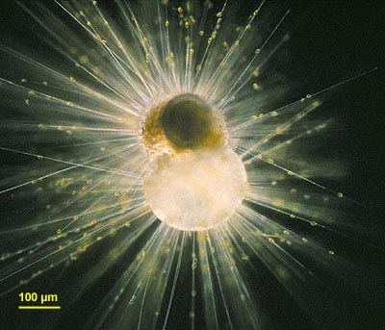
Deviations from equilibrium δ¹³C in foraminiferal carbonate
1. Respiratory CO₂
Incorporation of isotopically light metabolic CO₂ into the carbonate skeleton
2. Symbiont photosynthesis
Globigerinoides spp. with symbionts
Increased light intensity has been shown to result in heavier shell and δ¹³C values in photosymbiont bearing forams.
Due to the symbionts preferential uptake of ¹²C (photosynthesis), leaving a microenvironment depleted in ¹²C
Copyright: O. R. Anderson
http://starcentral.mbl.edu/microscope/portal.php?pagetitle=assetfactsheet&imageid=962 Image retrieved 13.10.2010

Slide 15
Growth effects (ontogeny)
Symbiont density is thought to increase with test size… (increased photosynthesis leads to increasingly ¹³C enriched foram shell)
Carbonate ion concentration effect
¹³C in foraminiferal carbonate decreases with increasing carbonate ion concentration (Spero et al., 1997)
magnitude of response is species-specific

Slide 16
Summary
Major controls on δ¹³C of sea water:
GLOBAL
-changes in terrestrial vegetation
-large-scale burial/ oxidation of sedimentary organic matter
LOCAL
-export production
-respiration at depth
-age of deep water
Controls on δ¹³C in foraminiferal calcite:
-carbonate and DIC
-depth/microhabitats
-Respiratory CO₂
-Symbiont Photosynthesis
-Changes with growth
-Carbonate ion concentration
+ case studies e.g. PETM, K/T

Slide 17
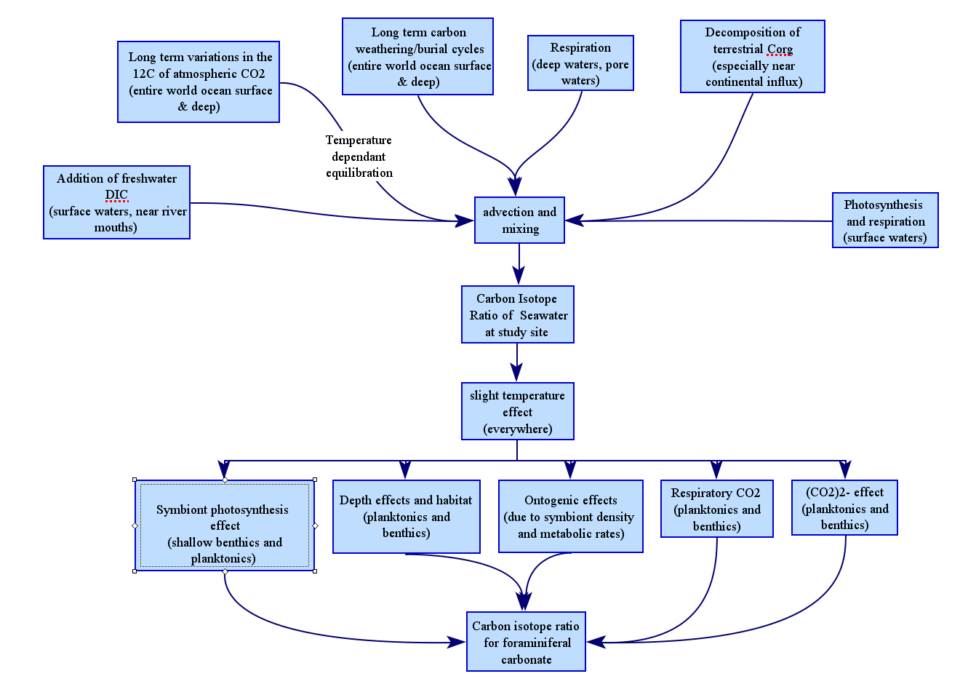

Slide 18
Copyright Statement
This resource was created by the University of Southampton and released as an open educational resource through the 'C-change in GEES' project exploring the open licensing of climate change and sustainability resources in the Geography, Earth and Environmental Sciences. The C-change in GEES project was funded by HEFCE as part of the JISC/HE Academy UKOER programme and coordinated by the GEES Subject Centre.
This resource is licensed under the terms of the Attribution-Non-Commercial-Share Alike 2.0 UK: England & Wales license (http://creativecommons.org/licenses/by-nc-sa/2.0/uk/).
However the resource, where specified below, contains other 3rd party materials under their own licenses. The licenses and attributions are outlined below:
The name of the University of Southampton and its logos are registered and/or unregistered trademarks of the University. The University reserves all rights to these items beyond their inclusion in these CC resources
The JISC logo, the C-change logo and the logo of the Higher Education Academy Subject Centre for the Geography, Earth and Environmental Sciences are licensed under the terms of the Creative Commons Attribution -non-commercial-No Derivative Works 2.0 UK England & Wales license. All reproductions must comply with the terms of that license.
The photo on slide 14 is copyright O. R. Anderson. It is available for download from:http://starcentral.mbl.edu/microscope/portal.php?pagetitle=assetfactsheet&imageid=962 The content of “micro*scope” is freely available for personal and non-commercial uses, although acknowledgement should be given if the material is used in its original or in a modified form.

