Slide 1
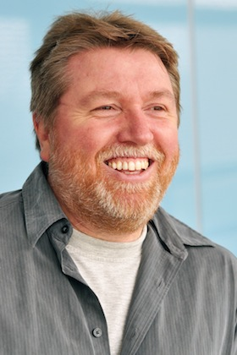
Where did the Web come from?
Prof Leslie Carr
Web Science Institute

Slide 2
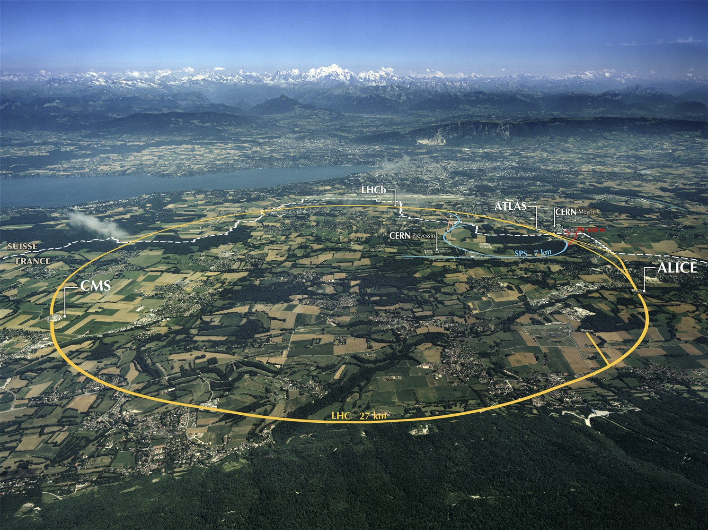
Where’s This, and What Has it to Do with The Web?

Slide 3
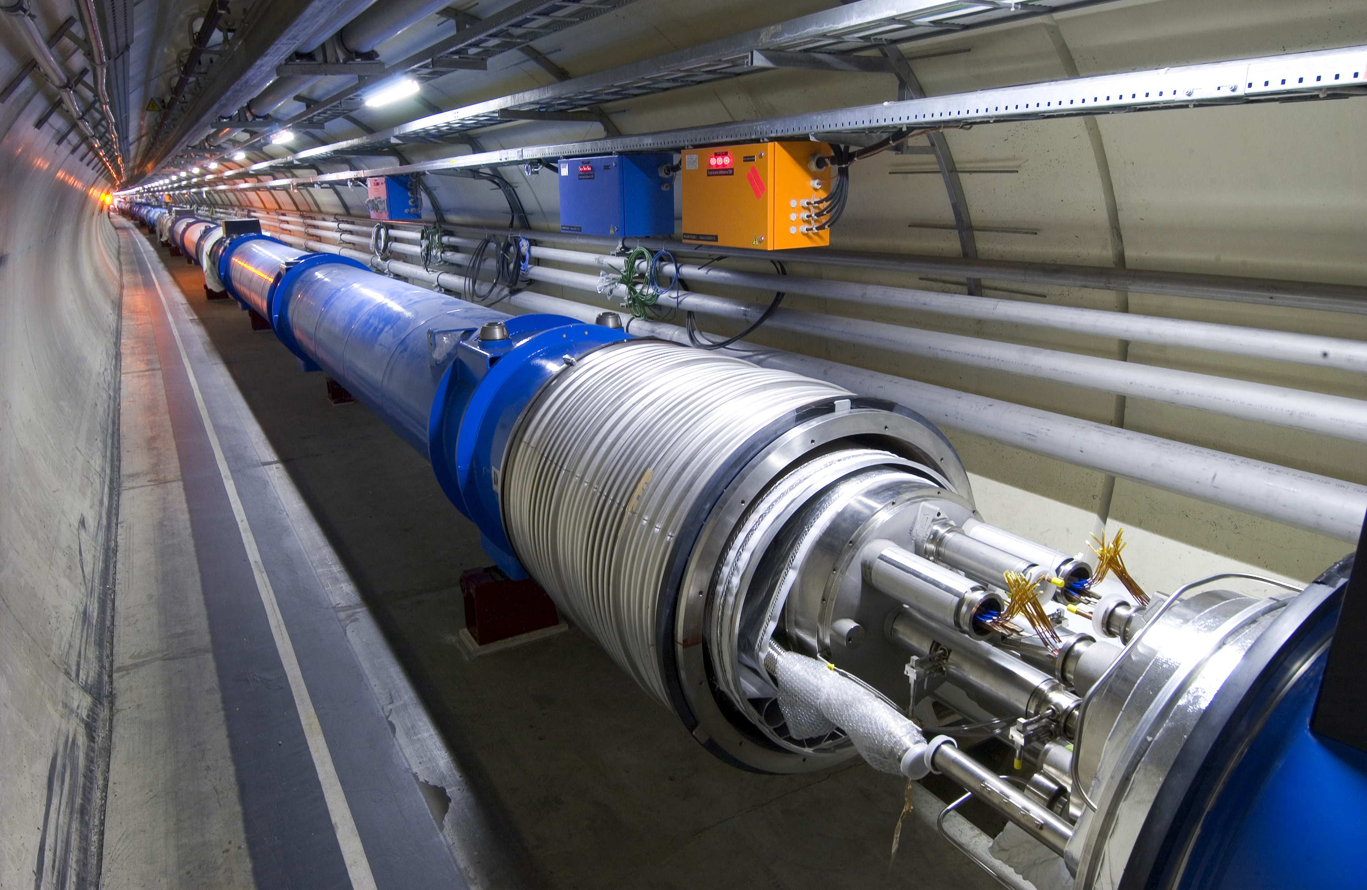
What’s This?

Slide 4
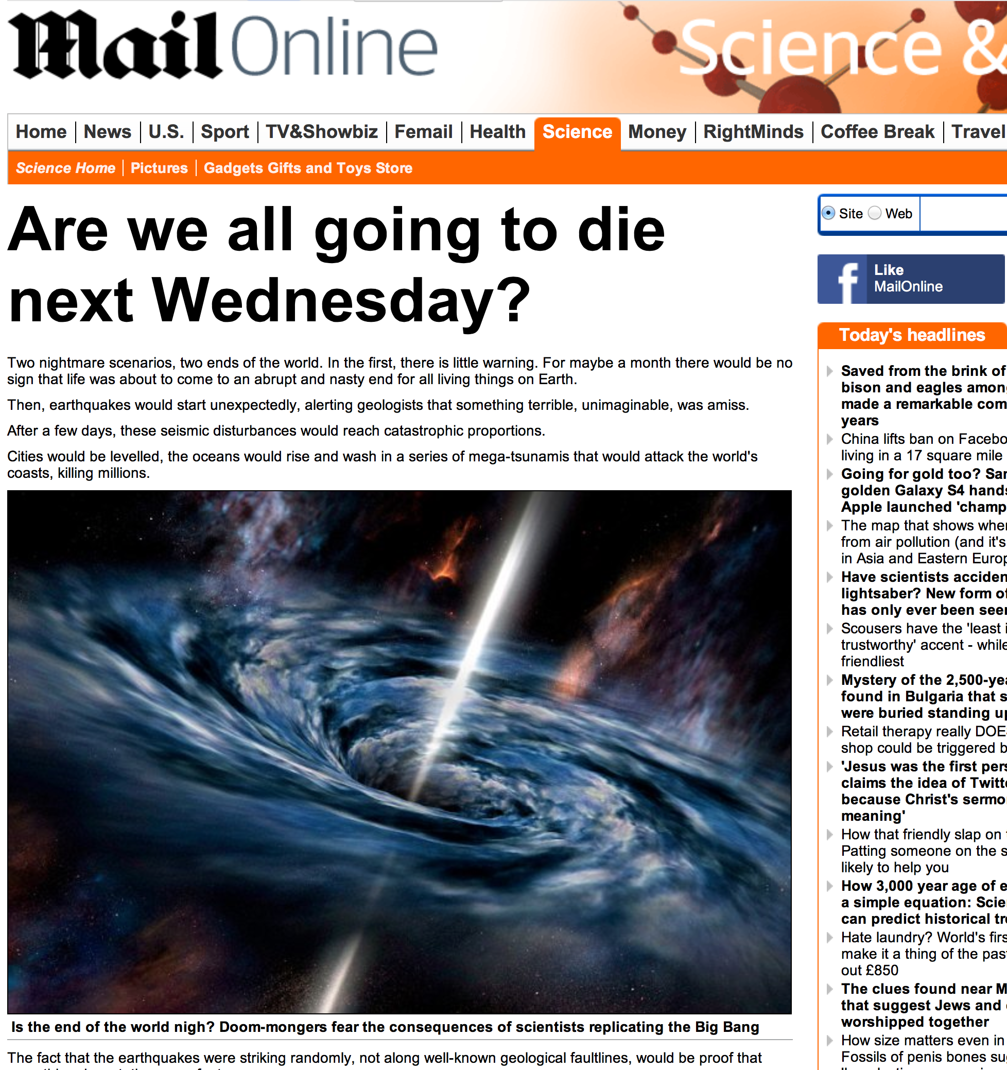
Remember These Headlines?

Slide 5
Birth of the Web
From an underground nuclear bunker on the Swiss border, something did escape
In 1989 the Web took over the academia, industry and the rest of the world

Slide 6
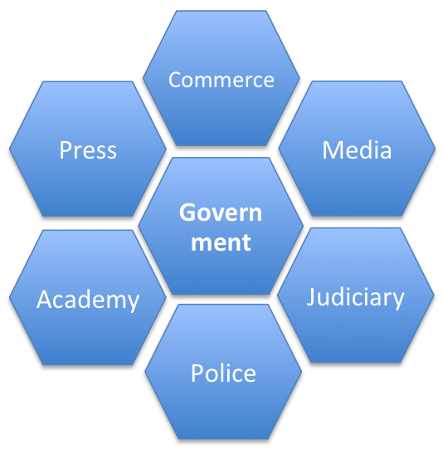
Society is Diverse. One Web Fits All?
Institution | Objective
Academy | Create and transmit knowledge
Commerce | Make and trade goods
Press | Investigate and report news
Media | Create and broadcast content
Police | Maintain order and public surveillance
Judiciary | Apply law and resolve disputes
Government | Control society and share resources
The development of society as a whole (nuanced and structured and refined) is inextricably related to the technology of information provision, consumption and dissemination (e.g. writing, reading, printing, education). Different parts of society have different objectives and hence incompatible Web requirements, e.g. openness, security, transparency, privacy.

Slide 7
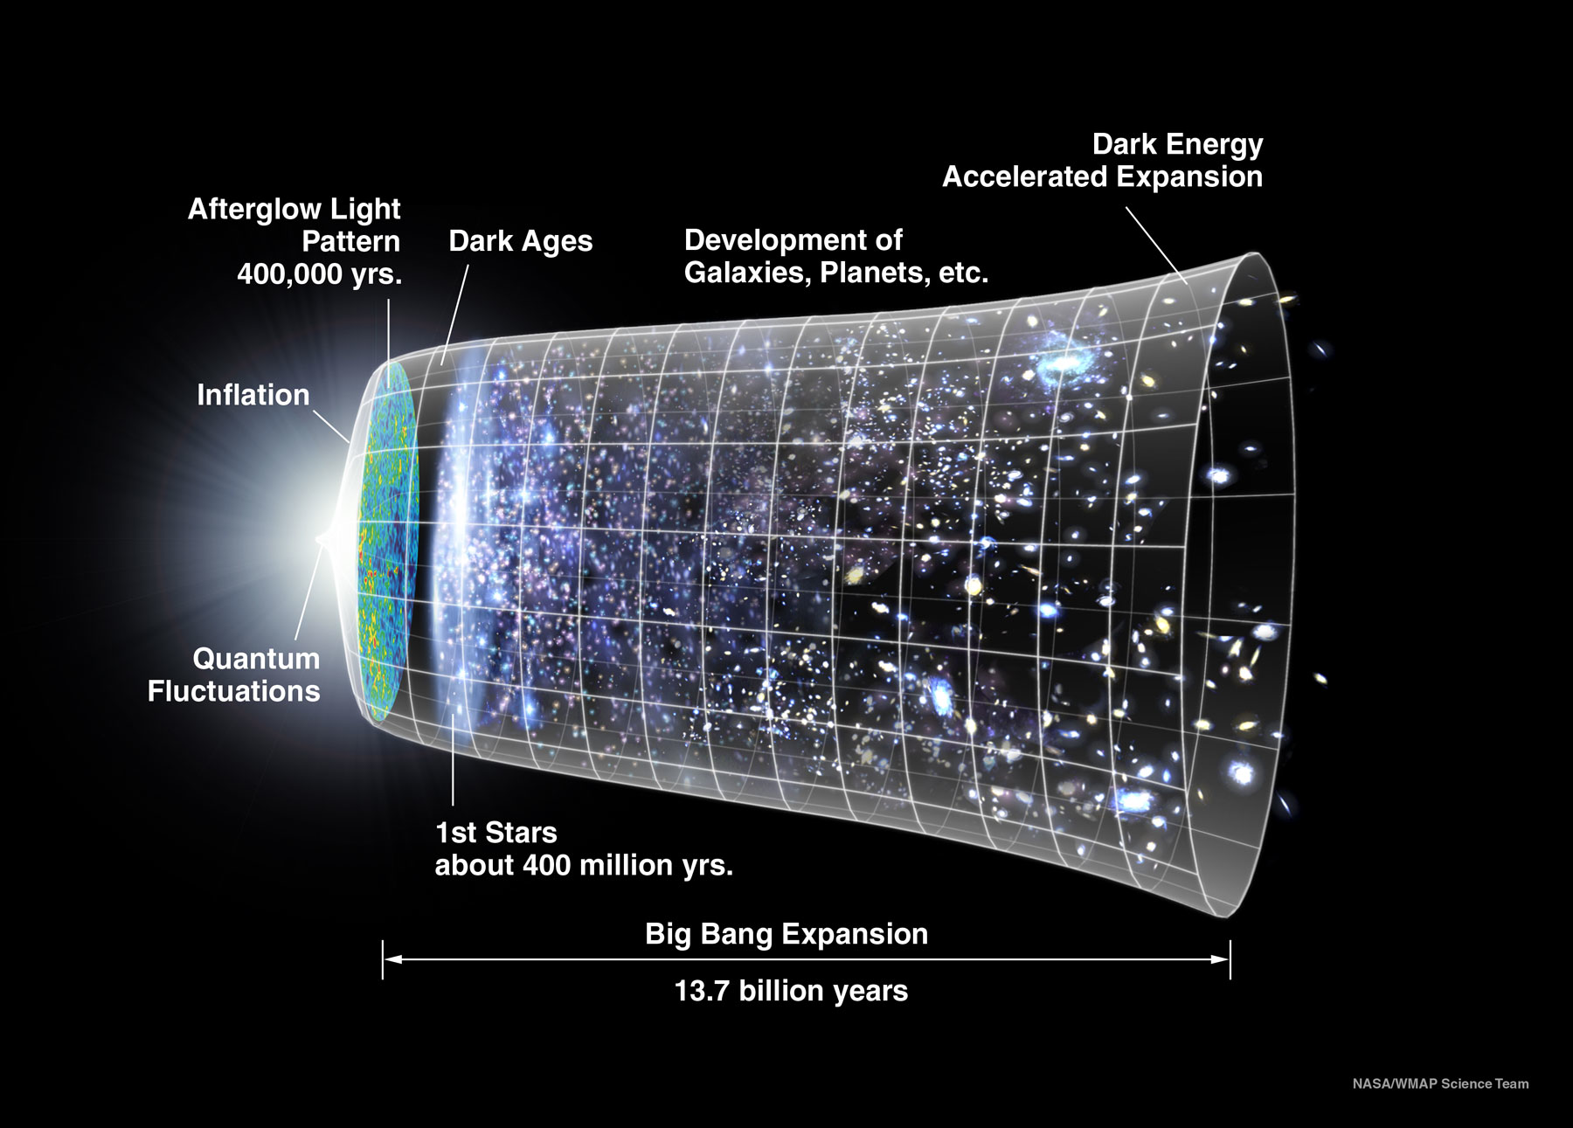
Expansion of the Web
The Web spread the conditions of its initial creation throughout the whole of society as it underwent an initial inflationary phase.
The academy has
government patronage
large-scale co-operation
sharing of intellectual property with others
This is not like other areas of society – e.g. media, industry, commerce.

Slide 8
Historic Attempts at Webs
Sponsor | System | Scope | Real | Date | Important Properties
Finance / Press | Reuters | Professional, centralised | ✔ | 1850 | News & stock information (originally carrier pigeon and subsequently telegraph)
Private Institution | Mundaneum | Public, centralised | ✔ | 1920 | Based on indexing technology (the library card)
Military | Memex | Scholarly, individual, centralised | ✗ | 1945 | Aimed at Scientists and Technologists in WWII
Media | Xanadu | Public, decentralised | ✗ | 1960 | Focused on DRM, reuse and writing for “creatives”
Media | CEEFAX | Public, national, centralised | ✔ | 1970 | Broadcast, linked, not participatory
Government | Minitel | Public, national, centralised | ✔ | 1980 | Commercial services and information
Academy (CS & HEP) | FTP / Archie / Anarchie | Public, decentralised | ✔ | 1985 | Download resources (papers, reports) to hard drives and print them on LaserWriters.
Commerce | Hypercard, HyperTIES | Private, centralised | ✔ | 1988 | Personal applications, sometimes tied to multimedia resources on CDROMs / video disks
Academy (HEP) | WWW | Public, global, decentralised | ✔ | 1990 | Universal naming, linking, interoperability, participative. However no writing, no indexing in public version.
Academy (CS) | Microcosm | Private, centralised | ✔ | 1990 | Sophisticated linking and openness for personal information stores
Academy (CS) | HyperG | Public, centralised | ✔ | 1990 | Extension of Web for with support for writing, indexing and consistency management.
Commerce | AOL, CompuServ | Public, centralised | ✔ | 1990 | Dialup walled garden access to email, forums, chat rooms and information resources

Slide 9
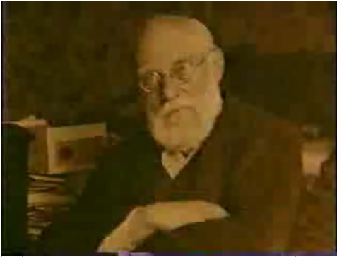
Paul Otlet, 1868-1944
Belgian lawyer
Introduced US 3"x5" library card to Europe
Traité de Documentation (1934)
the systematic organisation of all knowledge and thought
Mundanaeum: 15 million index card bibliographic index, 1 million documents and images, classified and searchable. Query became part of the bibliographic record. Content was interlinked.

Slide 10
Available Technology
The library card, used for the mundaneum

Slide 11
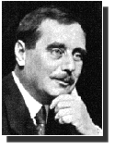
H. G. Wells, World Brain: The Idea of a Permanent World Encyclopaedia, Encyclopédie Française, August, 1937
Encyclopaedias of the past sufficed for the needs of a cultivated minority
universal education was unthought of
gigantic increase in recorded knowledge
more gigantic growth in the numbers of human beings requiring accurate and easily accessible information
Discontent with the role of universities and libraries in the intellectual life of mankind
Universities multiply but do not enlarge their scope
thought & knowledge organization of the world
No obstacle to the creation of an efficient index to all human knowledge, ideas and achievement

Slide 12
Available Technology
The microfilm (modern example), proposed for the World Brain

Slide 13
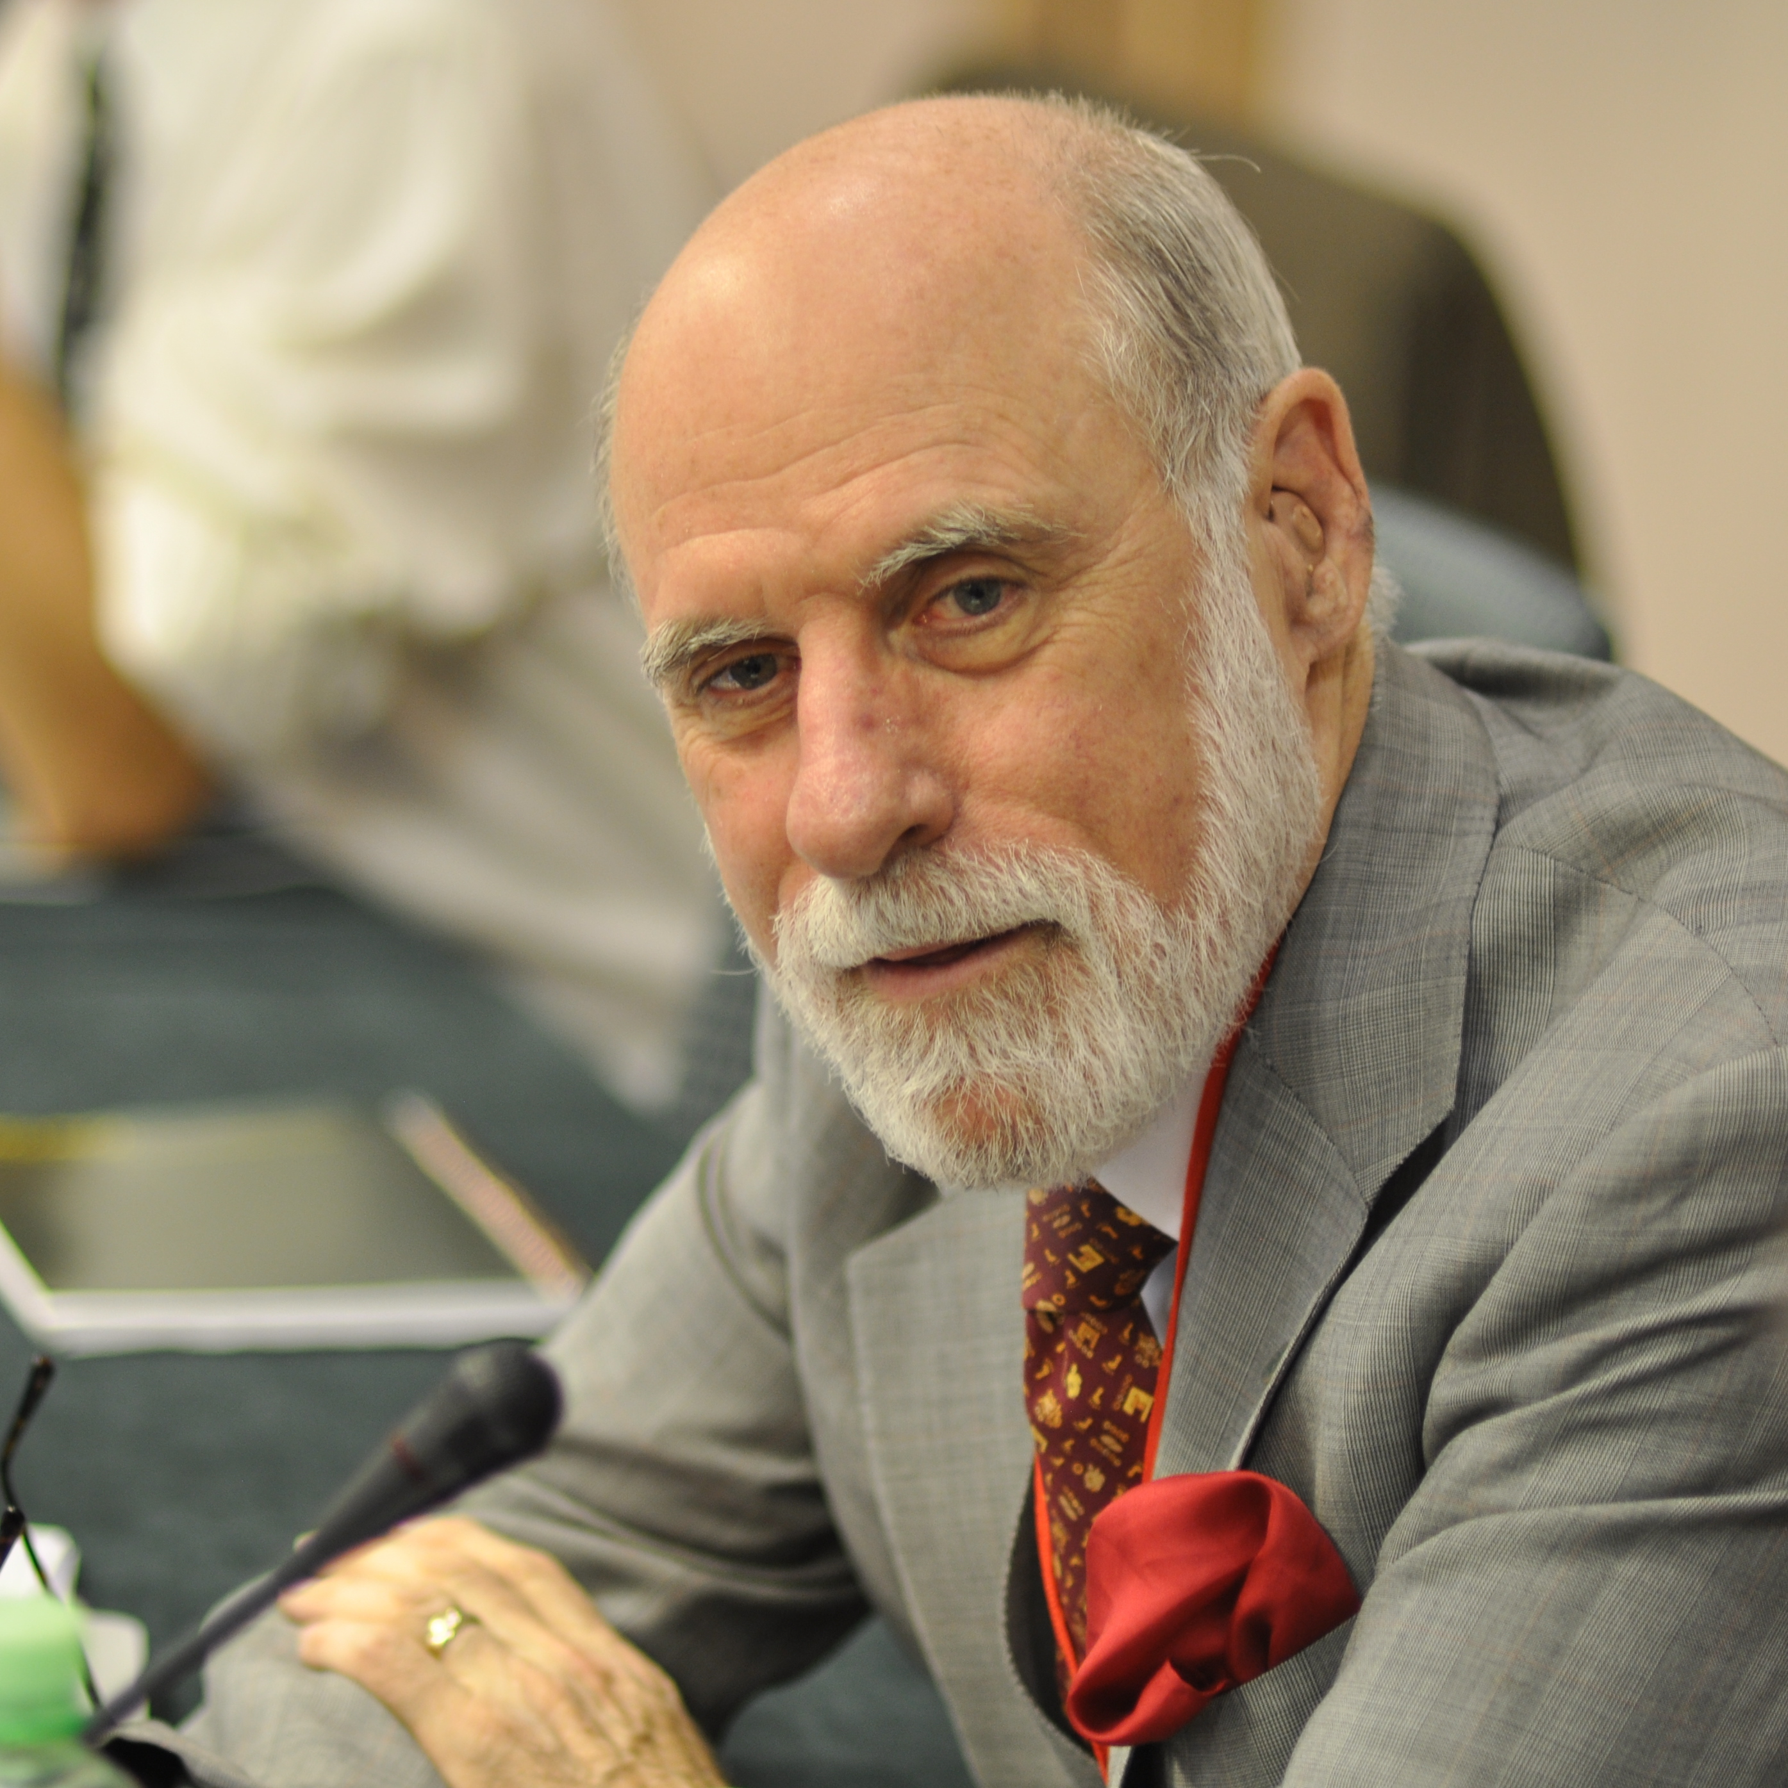
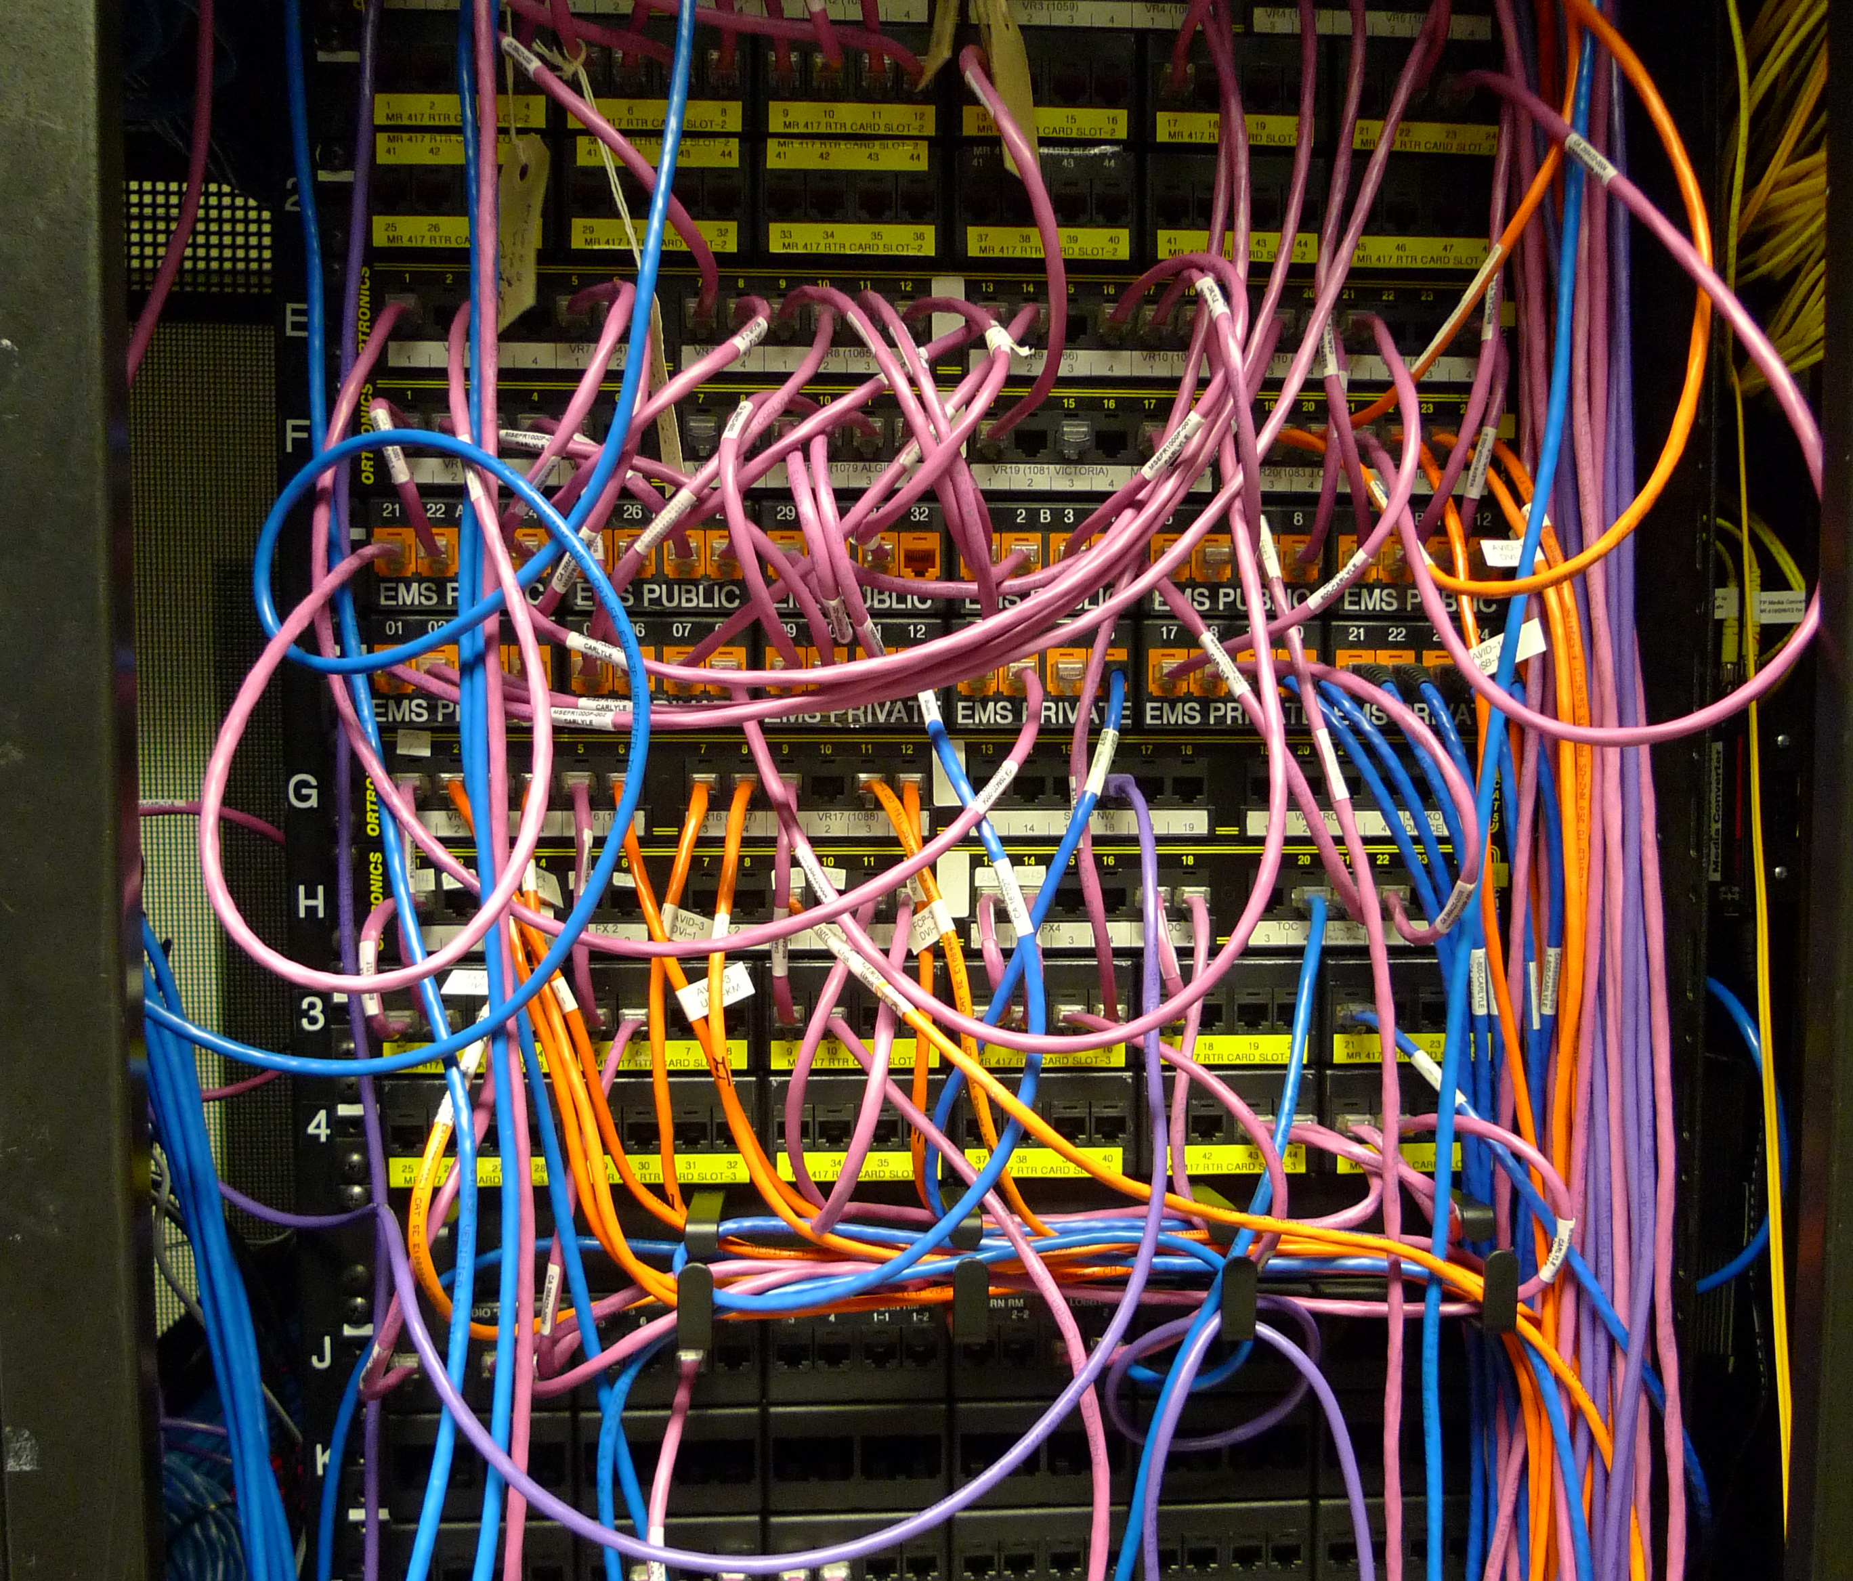
Vint Cerf
A “father of” the Internet (1970s & 1980s)
A network of computers and routers and cables and clients and servers. In fact, lots of networks all networked together. An inter-net. A worldwide network of computers sending and receiving messages
FTP (file transfer protocol)
Upload a document (plain text or PostScript printer instructions) to a server
Download document from server to workstation hard disk
Send it to printer

Slide 14
Available Technology
The network that forms a (very very very small) part of the Internet

Slide 15
What the Web Was
Tim Berners-Lee, had one big vision, with 3 big ideas
URI uniform resource identifiers (or URLs locators) – everything has an identifier, or name
HTTP – once you know the ID, a copy of anything can be obtained by a conversation between a client computer and a server on the Internet
HTML – the format of the information obtained doesn’t just handle the way that the information should be laid out on the printed page, but the way that information is laid out across the Internet. A document with embedded links that readers can interact with.

Slide 16
What the Web Became
The first Web browser & server were opened up to CERN and the to World to use.
And then the world took it on, and hundreds of people in different sectors of society, gradually turned this “online document library” into…
Online shopping
Internet TV
Social media
Internet porn
Web journalism
Search engines
E-health services
Streaming music services
Computer dating
Internet piracy…

