Slide 2
The Web and Graph Theory
COMP3227 Web Architecture & Hypertext Technologies
Dr Heather Packer – hp3@ecs.soton.ac.uk

Slide 3
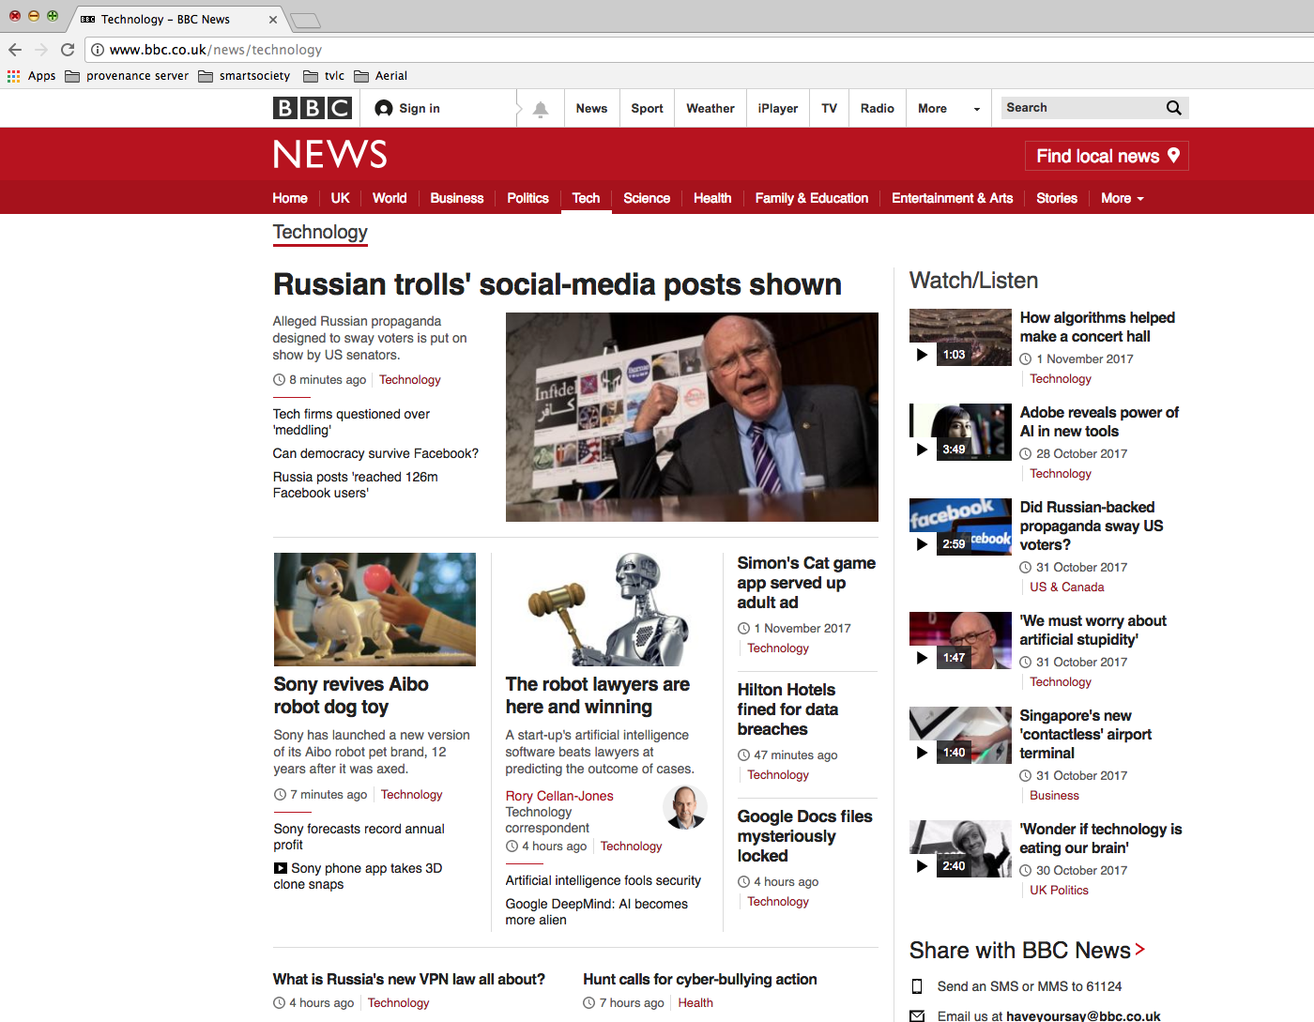
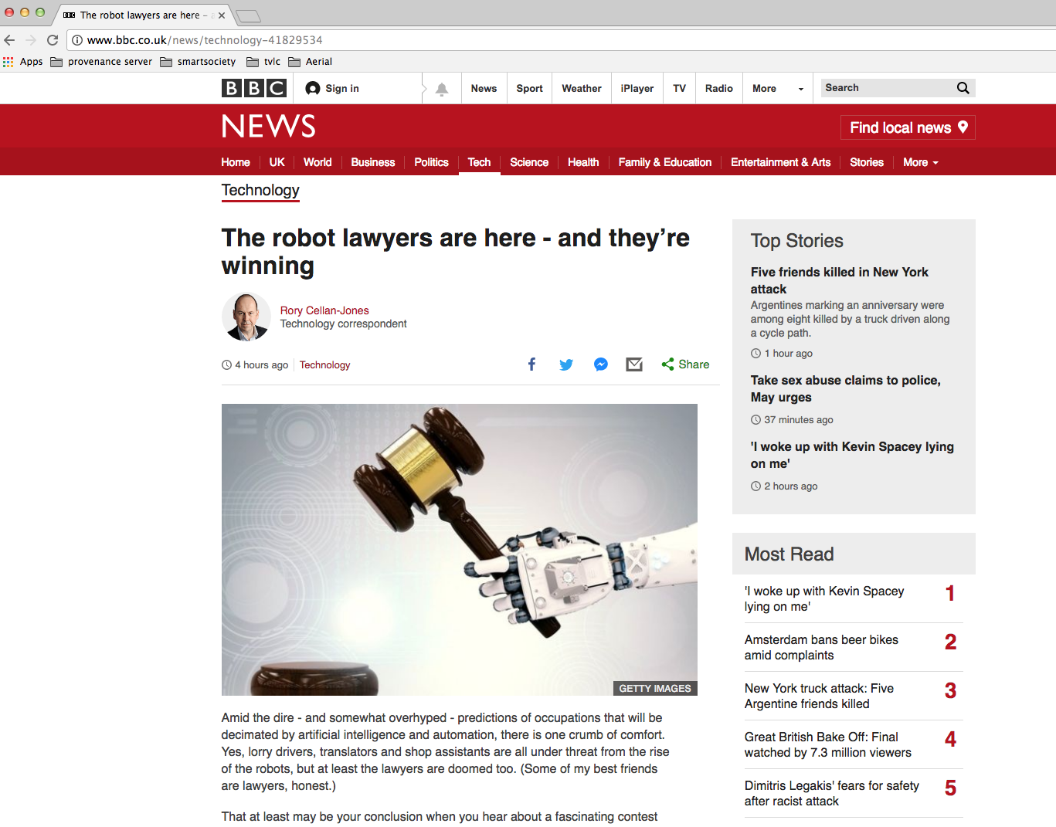
How is the Web Structured?
The Web
Facebook users
Tweets
Publications
Bitcoin/Block chain transactions
Graph Theory: Pages are nodes & links are directed edges

Slide 4
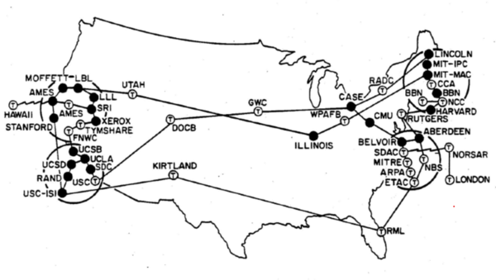
ARPANET access points in the 1970s

Slide 5
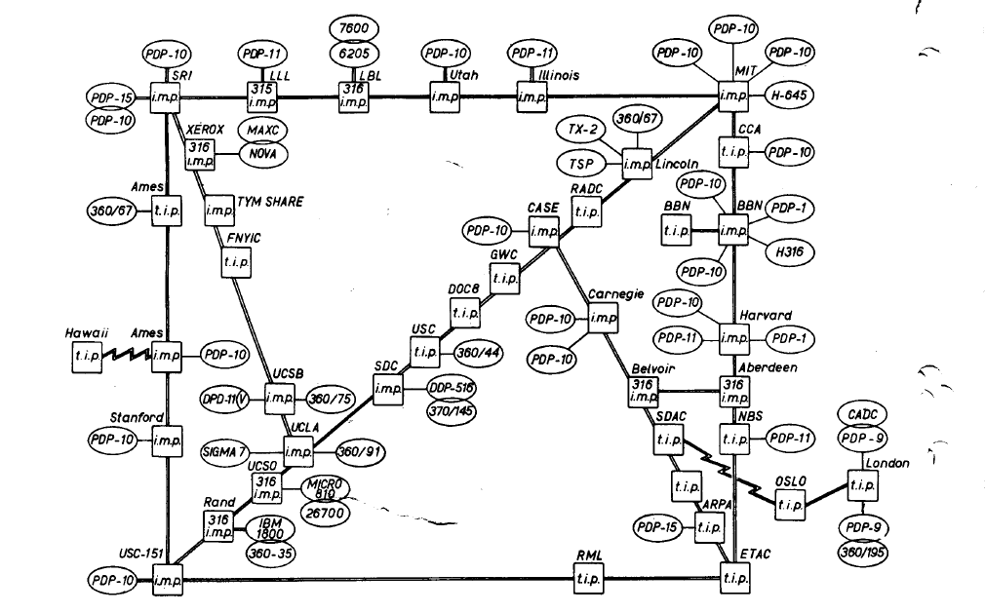
ARPANET 1973

Slide 6
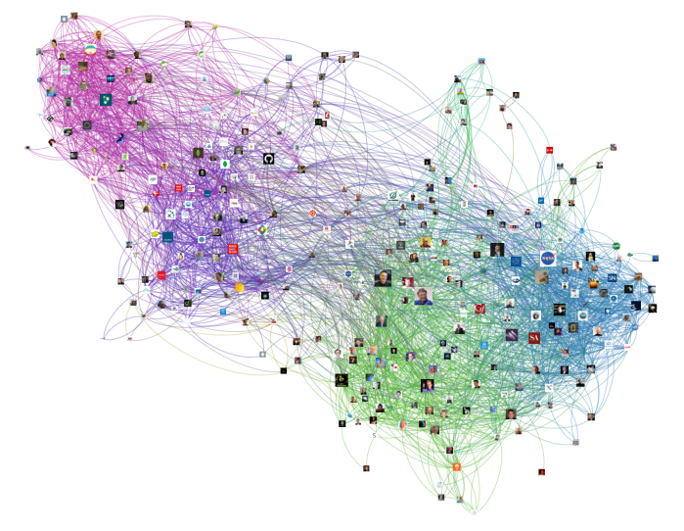
Twitter Graph

Slide 7
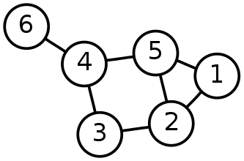
Graph Theory – Useful Measures
Distance between two vertices (v and v’)
Diameter of a graph, longest distance between any two vertices
Average-case diameter, average distance between any pair of nodes (v and v’)
Degree of a vertex, number of edges connected to it
Density of network, ratio of edges to vertices
A graph is made from Nodes or Vertices (V) and Edges (E)
G = (V, E)
Network size, total number of vertices (N)

Slide 8
Graph Theory – Is this Node Important?
Importance measures using centrality:
Degree centrality
Betweenness centrality
Nearness/Closeness centrality
Eigenvector centrality
*Central as in important, vital or `at the heart of’, not near the centre

Slide 9
Degree Centrality
F
F
Degree centrality focuses on individual nodes – it simply counts the number of edges that a node has
Hub nodes with high degree usually play an important role in a network
B
B
deg(E)=5
G
G
C
C
A
E
A
E
deg(A)=4
deg(A)=4
H
H
D
D
I
I
J
J

Slide 10
Degree Centrality – In Degree
F
In degree – links to a vertex
Often used as a proxy for popularity
A web page is important if lots of things link to it
A twitter user is important if lots of other users follow it
A journal article is important if lots of other articles cite it
B
inDeg(E)=4
G
C
A
E
H
D
I
J

Slide 11
Degree Centrality – Out Degree
F
Out degree – links from this vertex
Authorities on a topic
B
inDeg(E)=4
G
C
A
E
outDeg(E)=1
H
D
I
J

Slide 12
Degree Distributions
Degree distributions p(k)
A plot showing the degree of nodes in a graph
F
1
B
1
G
1
C
1
A
E
Number of Nodes
4
5
H
D
1
1
I
Number of links
2
J
1

Slide 13
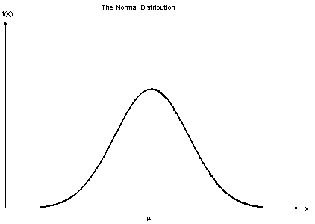
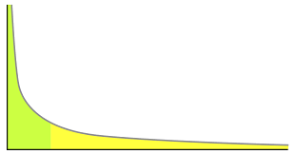
Degree Distribution Examples
Normal distribution
The average degree is most likely
Very high and very low degrees are highly unlikely
Power law distribution
No meaningful average degree
Very low degrees are likely, but very high degrees are unlikely

Slide 14
Power Law Networks
Some nodes have a tremendous number of connections to other nodes (hubs)
Most nodes have just a handful of links
Robust against accidental failures, but vulnerable to coordinated attacks
Nodes can have millions of links: The network appears to have no scale (no limit)
Power Law is a property of a scale free network
hubs

Slide 15
Betweenness Centrality
Number of shortest paths going through a node
A node that has high betweenness is vital to the communication of the network
Many/most messages between two nodes must travel through it.
E
B
A
D
F
C

Slide 16
Betweenness Centrality
Betweeness Centrality for A
B to D
B to E
B to F
C to D
C to E
C to F
BC(A) = 6
E
B
A
D
F
C

Slide 17
Closeness Centrality
Closeness is the average of the shortest distances to all other nodes in the graph
It can describe how far and close vertexes are
E
B
1 ms
1 ms
1 ms
3 ms
A
D
2 ms
1 ms
F
C

Slide 18
Closeness Centrality
Closeness centrality of A
A to B = 1 ms
A to C = 1 ms
A to D = 1 ms
A to E = 2 ms
A to F = 3 ms
CC(A) = (1+1+1+2+3)/5 = 1.6 ms
E
B
1 ms
1 ms
1 ms
3 ms
A
D
2 ms
1 ms
F
C

Slide 19
Eigenvector Centrality
Eigenvector measures the popularity by looking at the quality of links
Identifies whether a node is connected to influential nodes
A
B
D
C

Slide 20
Surfer Model
A random surfer model can start on any webpage.
Follows links and makes occasional haphazard jumps

Slide 21
Websites and Links
1 links
2 backlinks
A
B
2 links
2 backlinks
D
C
2 links
1 backlinks
2 links
2 backlinks

Slide 22
Probability of Page Traversal
A B C D
A 0
B 1
C 0
D 0
A
1
B
D
C

Slide 23
Probability of Page Traversal
A B C D
A 0 0
B 1 0
C 0 .5
D 0 .5
A
1
A
B
0.5
0.5
D
C

Slide 24
Probability of Page Traversal
A B C D
A 0 0 .5
B 1 0 0
C 0 .5 0
D 0 .5 .5
A
1
B
0.5
0.5
0.5
D
C
0.5

Slide 25
Probability of Page Traversal
A B C D
A 0 0 .5 .5
B 1 0 0 .5
C 0 .5 0 0
D 0 .5 .5 0
A
1
B
0.5
0.5
0.5
0.5
0.5
D
C
0.5

Slide 26
Surfer Model
A random surfer model can start on any webpage.
Follows links and makes occasional haphazard jumps

Slide 27
Random Surfer
25%
25%
A B C D
0 0 .5 .5
1 0 0 .5
0 .5 0 0
0 .5 .5 0
A
B
D
C
R0
A .25
B .25
C .25
D .25
25%
25%

Slide 28
Random Surfer
A
B
A B C D
0 0 .5 .5
1 0 0 .5
0 .5 0 0
0 .5 .5 0
R0
.25
.25
.25
.25
x
D
C

Slide 29
Random Surfer
A B C D
0 0 .5 .5
1 0 0 .5
0 .5 0 0
0 .5 .5 0
R0
.25
.25
.25
.25
0x.25 + 0x.25 + .5x.25 + .5x.25
1x.25 + 0x.25 + 0x.25 + .5x.25
0x.25 + .5x.25 + 0x.25 + 0x.25
0x.25 + .5x.25 + .5x.25 + 0x.25
R1
.25
.375
.125
.25
x
=
=

Slide 30
Random Surfer
A B C D
0 0 .5 .5
1 0 0 .5
0 .5 0 0
0 .5 .5 0
R1
.25
.375
.125
.25
R2
.1875
.375
.1875
.25
x
=

Slide 31
Random Surfer
A B C D
0 0 .5 .5
1 0 0 .5
0 .5 0 0
0 .5 .5 0
R2
.1875
.375
.1875
.25
R3
.219
.313
.188
.281
x
=

Slide 32
Random Surfer
A B C D
0 0 .5 .5
1 0 0 .5
0 .5 0 0
0 .5 .5 0
Rn
.1875
.375
.1875
.25
Rn+1
.217
.348
.174
.261
x
=

Slide 33
Random Surfer
A
B
Rank
A .217 3
B .348 1
C .174 4
D .261 2
D
C

Slide 34
Eigenvector Centrality
Build a matrix representing the graph
Transform the matrix with an Eigenvector
The resulting transformation can be used to rank the nodes
A B C
A 0 1/2 1
B 1 0 0
C 0 1/2 0
B
A B C
A 0 1/2 1
B 1 0 0
C 0 1/2 0
1/3
1/3
1/3
3/6
2/6 1/6
C
A
x
=

Slide 35
What do the Measures Tell Me?
Degree: exposure to the network, opportunity to directly influence
Betweenness: informal power, gate keeping, brokering, controls flow of browsing
Closeness: estimates time to receive information, indirect influence, point of rapid diffusion
Eigenvector: connected to influential nodes of high degree, “not what you know but who you know”

Slide 36
Graph Dynamics and the Web

Slide 37
Graph Theory and Graph Dynamics
Graph theory mostly focuses on static graphs
Almost all real-world networks are dynamic
Evolution over time creates a new level of complexity

Slide 38
Growing a Network
Simulate growth
Number of nodes
Number of links

Slide 39
Thresholds
When average degree goes above 1
Large scale structures start to form
May not be completely connected

Slide 40
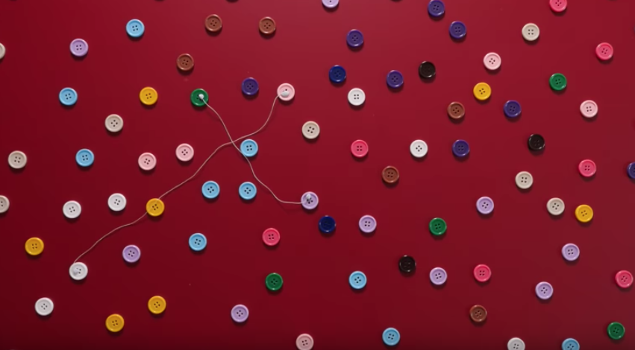
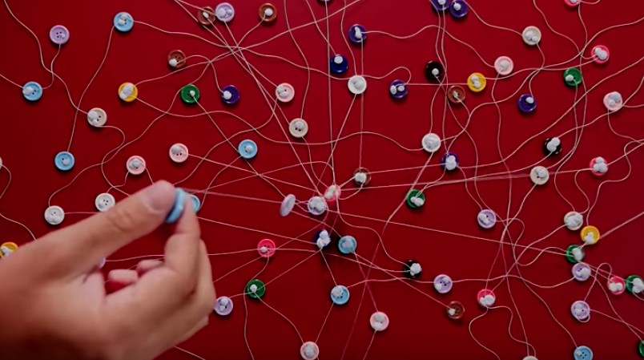
Small World Network – Erdos 1950s
Threshold identified by Paul Erdos
When the number of connections is lower than 1, the network is fragmented
When it’s above 1 it’s connected

Slide 41
Small World Network
Six Degrees of separation is a theory that everyone is 6 or fewer steps away from any other person in the world
Experiment by Stanley Milgram in the 1960s
200 letters
Sent to intermediary person on a first name basis
64 letters arrived
Average of 5.2 intermediaries
Small World Network is a graph where most nodes are not neighbours but most nodes can be reached by a small number of connections
Website links
Social networks
Wikipedia
Many hubs – pages with in links
Hubs significance can be modeled with degree centrality
Robust for random node deletions

Slide 42
Thresholds
When average degree goes above 1
Nodes have an average degree of log(n)
Graph starts to become connected

Slide 43
Real World Graphs
Real world graphs aren’t built randomly
There are lots of social phenomena that effects the links between real world graphs
Reciprocity
Social Influence
Social Capital
Homophily
Preferential attachment
Experimental Observations [Barabasi, Albert (1999)]
Most real networks are sparse graphs
Power Law

Slide 44
Barabasi and Albert Experimental Methodology
Intuition: Network grows by iterative process
Simulate growing a network and then examine it’s properties
Experiment with different models
Graphs created with the Barabasi-Albert model

Slide 45
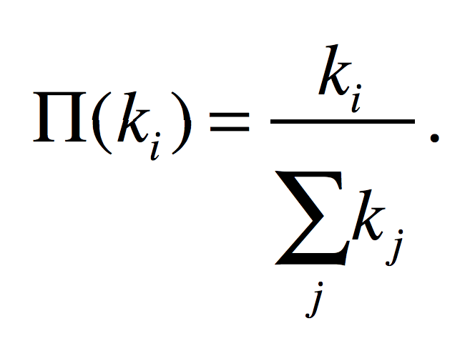
Preferential Attachment
The probability of a new node linking to an existing node is proportional to the degree of that node. The probability Π(k_{i}) that a link of the new node connects to node i depends on the degree k_{i} as:
A new node is free to connect to any node in the network
For example, if a new node has a choice between a degree-two and a degree-four node, it is twice as likely that it connects to the degree-four node

Slide 46
Why Does Preferential Attachment reflect links on the Web?
Quality resources are likely to be popular
Findability – the more obscure something is the less findable it is, and thus is less likely to be linked to
Human nature – the more popular a website is, the more likely it is to be shares and thus linked to, similar to PageRank’s assumption

Slide 47
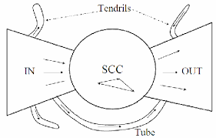
The Shape of the Web – The Bowtie
The Shape of the Web [Broder et al. (2000)]
Bowtie
Strongly Connected Core
In links
Out links
Tendrils and Tubes
The diameter of the central core is at least 28, and the diameter of the graph as a whole is over 500
The probability of a path between randomly chosen pairs is only 24%
Average directed path length is about 16
Average undirected path length is about 6

Slide 48
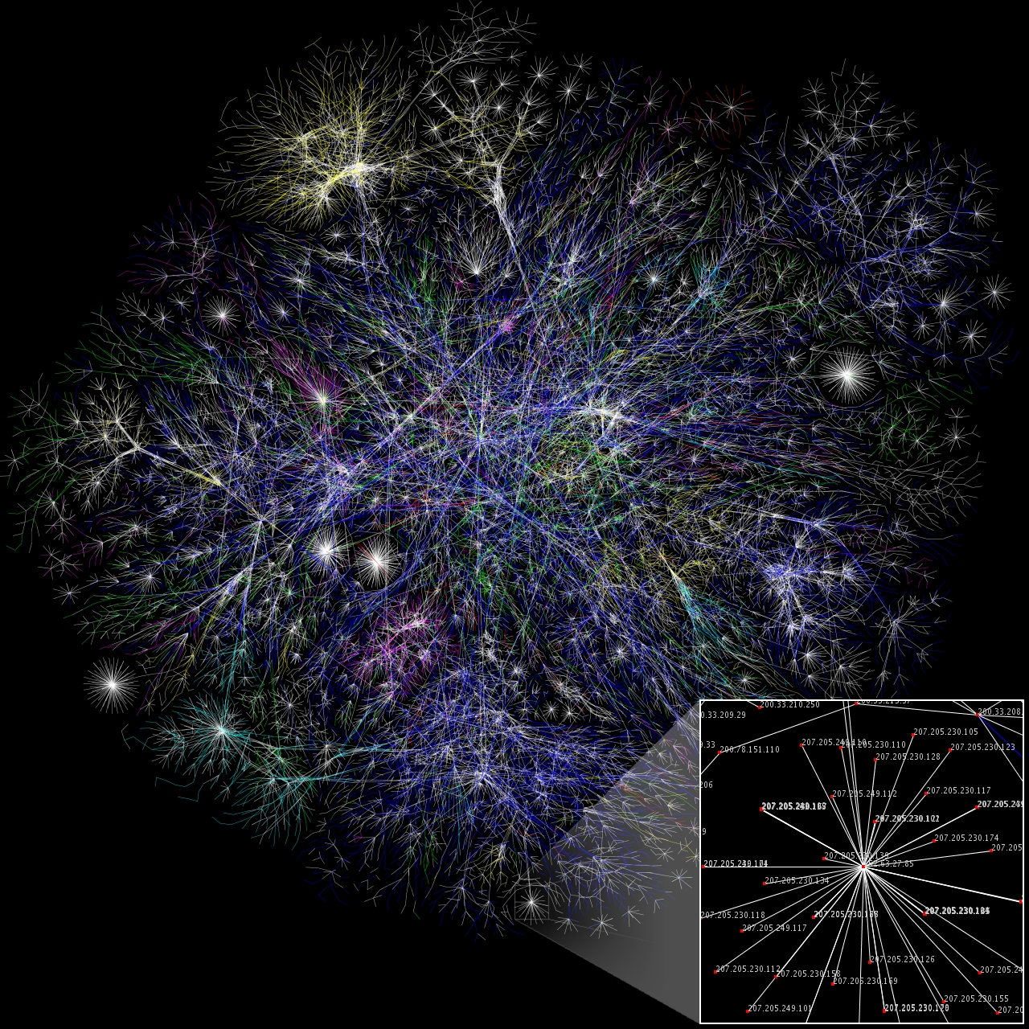
The Opte-Project 2003
Aimed to map the Internet
200 million nodes
1 billion edges
Partial map in Jan 2005
Nodes are IP address
Length of the lines denote delay

Slide 49
Modern Web Research
Temporal aspects – how is the Web Graph evolving over time?
Information aspects – how does new information propagate throughout the web (or blogsphere, or twitter..)
Finer-grained structure – how to define and computer “communities” in information and social networks

Slide 50
PageRank

Slide 51
PageRank
51
Algorithm to rank webpages
Larry Page developed page rank in 1996
Utilises graph theory of importance
Important websites are likely to receive more links from other websites

Slide 52
PageRank: Original Formula
52
PageRank (PR) of page u is given by the summation of the PR of all pages in the set of all pages linking to page u (v∈B_{u}), divided by the number of L(v) of links from page v
Iterative formula, starting with rank 1/n for all n pages
It can handle the scale of the web

Slide 53
Websites and Links
A
B
D
C

Slide 54
Websites and Links
54
A
B
D
C
 | Iteration 1
A | 1/n = 1/4
B | 1/n = 1/4
C | 1/n = 1/4
D | 1/n = 1/4
First iteration ranks all pages 1/n, where n is the number of pages

Slide 55
Websites and Links
55
A
B
D
C
 | Iteration 1
A | 1/4
B | 1/4
C | 1/4
D | 1/4

Slide 56
Websites and Links
56
A
B
D
C
2 links
2 links
 | Iteration 1 | Iteration 2
A | 1/4 | ¼ / 2 + ¼ / 2 = 2/8
B | 1/4
C | 1/4
D | 1/4

Slide 57
Websites and Links
57
A
B
1 links
D
C
2 links
 | Iteration 1 | Iteration 2
A | 1/4 | ¼ / 2 + ¼ / 2 = 2/8
B | 1/4 | ¼ / 1 + ¼ / 2 = 3/8
C | 1/4
D | 1/4

Slide 58
Websites and Links
58
A
B
2 links
D
C
 | Iteration 1 | Iteration 2
A | 1/4 | ¼ / 2 + ¼ / 2 = 2/8
B | 1/4 | ¼ / 1 + ¼ / 2 = 3/8
C | 1/4 | ¼ / 2 = 1/8
D | 1/4

Slide 59
Websites and Links
59
A
B
2 links
D
C
2 links
 | Iteration 1 | Iteration 2
A | 1/4 | ¼ / 2 + ¼ / 2 = 2/8
B | 1/4 | ¼ / 1 + ¼ / 2 = 3/8
C | 1/4 | ¼ / 2 = 1/8
D | 1/4 | ¼ / 2 + ¼ /2 = 2/8

Slide 60
Websites and Links
60
A
B
D
C
 | Iteration 1 | Iteration 2
A | 1/4 | 2/8
B | 1/4 | 3/8
C | 1/4 | 1/8
D | 1/4 | 2/8

Slide 61
Websites and Links
61
A
B
D
C
2 links
2 links
 | Iteration 1 | Iteration 2 | Iteration 3
A | 1/4 | 2/8 | 1/8 / 2 + 2/8 / 2 = 3/16
B | 1/4 | 3/8
C | 1/4 | 1/8
D | 1/4 | 2/8

Slide 62
Websites and Links
62
A
B
1 links
D
C
2 links
 | Iteration 1 | Iteration 2 | Iteration 2
A | 1/4 | 2/8 | 1/8 / 2 + 2/8 / 2 = 3/16
B | 1/4 | 3/8 | 2/8 / 1 + 2/8 / 2 = 6/16
C | 1/4 | 1/8
D | 1/4 | 2/8

Slide 63
Websites and Links
63
A
B
2 links
D
C
 | Iteration 1 | Iteration 2 | Iteration 2
A | 1/4 | 2/8 | 1/8 / 2 + 2/8 / 2 = 3/16
B | 1/4 | 3/8 | 2/8 / 1 + 2/8 / 2 = 6/16
C | 1/4 | 1/8 | 3/8 / 2 = 3/16
D | 1/4 | 2/8

Slide 64
Websites and Links
64
A
B
2 links
D
C
2 links
 | Iteration 1 | Iteration 2 | Iteration 2
A | 1/4 | 2/8 | 1/8 / 2 + 2/8 / 2 = 3/16
B | 1/4 | 3/8 | 2/8 / 1 + 2/8 / 2 = 6/16
C | 1/4 | 1/8 | 3/8 / 2 = 3/16
D | 1/4 | 2/8 | 3/8 / 2 + 1/8 / 2 = 4/16

Slide 65
Websites and Links
65
A
B
D
C
 | Iteration 1 | Iteration 2 | Iteration 3
A | 1/4 | 2/8 | 3/16
B | 1/4 | 3/8 | 6/16
C | 1/4 | 1/8 | 3/16
D | 1/4 | 2/8 | 4/16

Slide 66
Websites and Links
66
A
B
D
C
 | Iteration 1 | Iteration 2 | Iteration 3 | Rank
A | 1/4 | 2/8 | 3/16 | 3
B | 1/4 | 3/8 | 6/16 | 1
C | 1/4 | 1/8 | 3/16 | 3
D | 1/4 | 2/8 | 4/16 | 2

Slide 67
Websites and Links
67
A
B
D
C
 | Iteration 3 | Rank | Iteration 10 | Rank
A | 3/16 | 3 | 0.220458984375 | 3
B | 6/16 | 1 | 0.3505859375 | 1
C | 3/16 | 3 | 0.17041015625 | 4
D | 4/16 | 2 | 0.258544921875 | 2

Slide 68
Websites and Links
A
B
D
C
 | Iteration 1 Rank | Iteration 2 Rank | Iteration 3 Rank | Iteration 10 Rank
A | 1 | 2 | 3 | 3
B | 1 | 1 | 1 | 1
C | 1 | 3 | 3 | 4
D | 1 | 2 | 2 | 2

Slide 69
PageRank
Assumes important websites are likely be linked to
Similar to a voting:
where in links are votes
the quality of a vote is determined by the number of votes (in links)
your vote is worth more if you have a higher page rank

Slide 70
Google’s PageRank Algorithm
Number of links
Pages with more in-links rank higher, than a page fewer in-links
Link Quality
A link from an important page is worth more than many links from relatively unknown sites
Link Context
The text in and around out links relates to the page they point at.
Ranking boosts on text styles

Slide 71
Next Lecture: Search Engines

