Slide 2
A Description Logic Primer
COMP6215 Semantic Web Technologies
Dr Nicholas Gibbins - nmg@ecs.soton.ac.uk

Slide 3
Why do we need Description Logics?
RDF Schema isn’t sufficient for all tasks
  There are things you can’t express
  There are things you can’t infer

Slide 4
Description Logics
A family of knowledge representation formalisms
  A subset of first order predicate logic (FOPL)
  Decidable – trade-off of expressivity against algorithmic complexity
  Well understood – derived from work in the mid-80s to early 90s
  Model-theoretic formal semantics
  Simpler syntax than FOPL
This module assumes that you're familiar with FOPL.
If you need a refresher, the following resources are available:
  Lecture notes for COMP1215 Foundations of Computer Science (on ECS intranet)
  Johnsonbaugh, R. (2014) Discrete Mathematics, 7th ed. Chapter 1. (ebook via library)
Notes:
KL-ONE – 1985
LOOM – 1987
CLASSIC – 1991

Slide 5
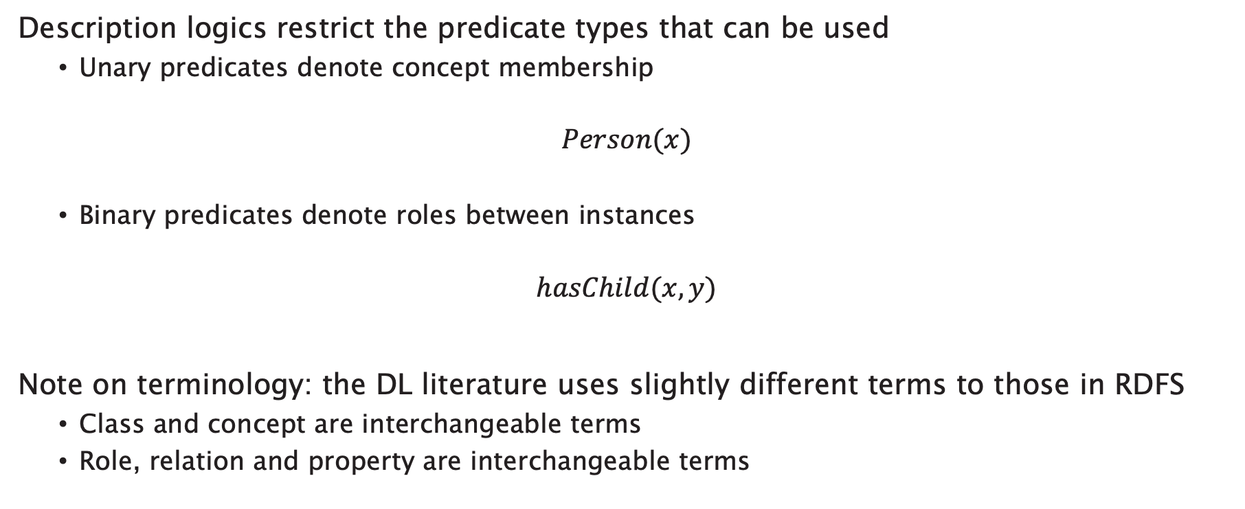
Description Logics
Description logics restrict the predicate types that can be used
  Unary predicates denote concept membership
$$Person(x)$$
  Binary predicates denote roles between instances
$$hasChild(x,y)$$
Note on terminology: the DL literature uses slightly different terms to those in RDFS
  Class and concept are interchangeable terms
  Role, relation and property are interchangeable terms
Notes:
Nomenclature:
Concept = class
Role = property or relation

Slide 6
Defining ontologies with Description Logics
Describe classes (concepts) in terms of their necessary and sufficient conditions
Consider an attribute A of a class C:
Attribute A is a necessary condition for membership of C
  If an object is an instance of C, then it has A
Attribute A is a sufficient condition for membership of C
  If an object has A, then it is an instance of C

Slide 7
Description Logic Reasoning Tasks
Satisfaction
  “Can this class have any instances?"
Subsumption
  "Is every instance of class C necessarily an instance of class D?"
Classification
  "What classes is this object an instance of?"

Slide 8
Concepts as sets
A
B
v
y
x
w
z
R

Slide 9
Syntax

Slide 10
Expressions
Description logic expressions consist of:
Concept and role descriptions:
  Atomic concepts: Person
  Atomic roles: hasChild
  Complex concepts: “person with two living parents”
  Complex roles: “has parent’s brother” (i.e. "has uncle")
Axioms that make statements about how concepts or roles are related to each other:
  “Every person with two living parents is thankful”
  “hasUncle is equivalent to has parent’s brother”

Slide 11
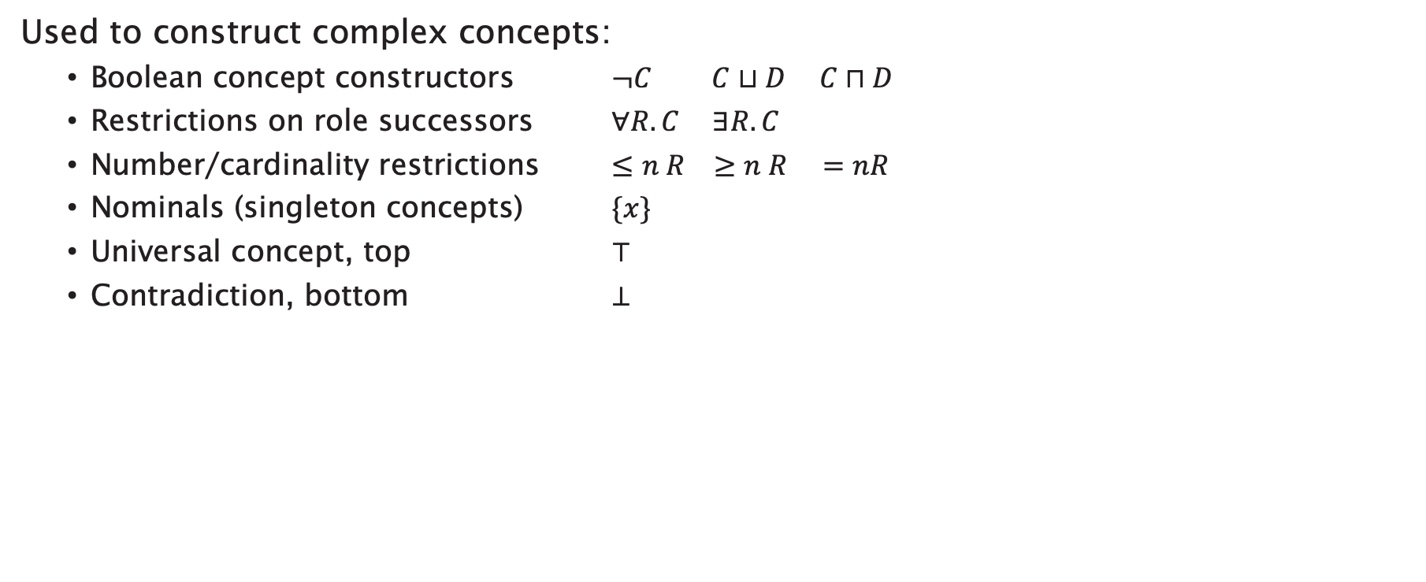
Concept Constructors
Used to construct complex concepts:
  Boolean concept constructors $¬C C⊔D C⊓D$
  Restrictions on role successors $∀R.C ∃R.C$
  Number/cardinality restrictions $≤n R ≥n R =nR$
  Nominals (singleton concepts) $\{x\}$
  Universal concept, top $⊤$
  Contradiction, bottom $⊥$

Slide 12

Role Constructors
Used to construct complex roles:
  Concrete domains (datatypes)
  Inverse roles $R^{−}$
  Role composition $R∘S$
  Transitive roles $R^{+}$

Slide 13
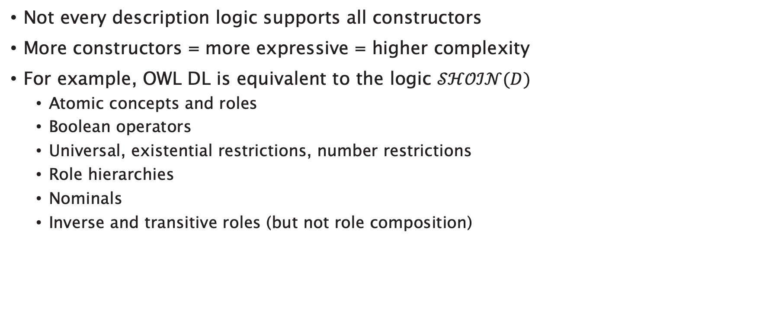
OWL and Description Logics
Not every description logic supports all constructors
More constructors = more expressive = higher complexity
For example, OWL DL is equivalent to the logic $𝒮ℋ𝒪ℐ𝒩(D)$
  Atomic concepts and roles
  Boolean operators
  Universal, existential restrictions, number restrictions
  Role hierarchies
  Nominals
  Inverse and transitive roles (but not role composition)

Slide 14
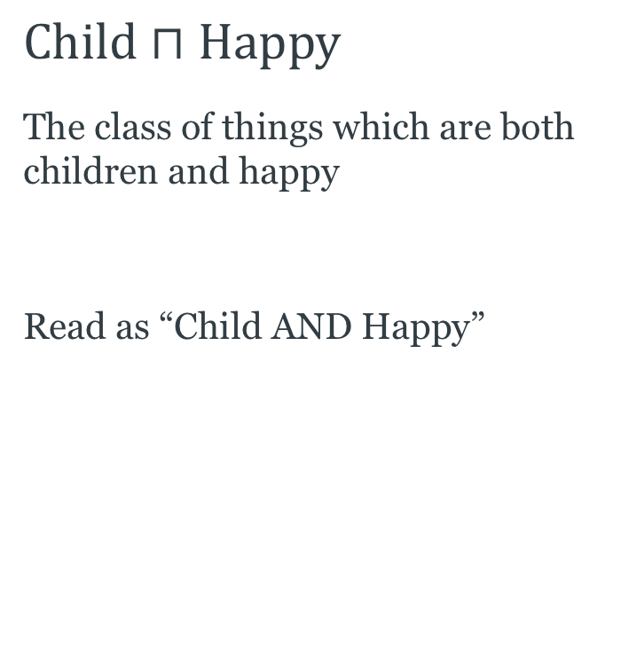
Boolean Concept Constructors: Intersection
$$Child⊓Happy$$
The class of things which are both children and happy
Read as “Child AND Happy”
Child
Happy

Slide 15
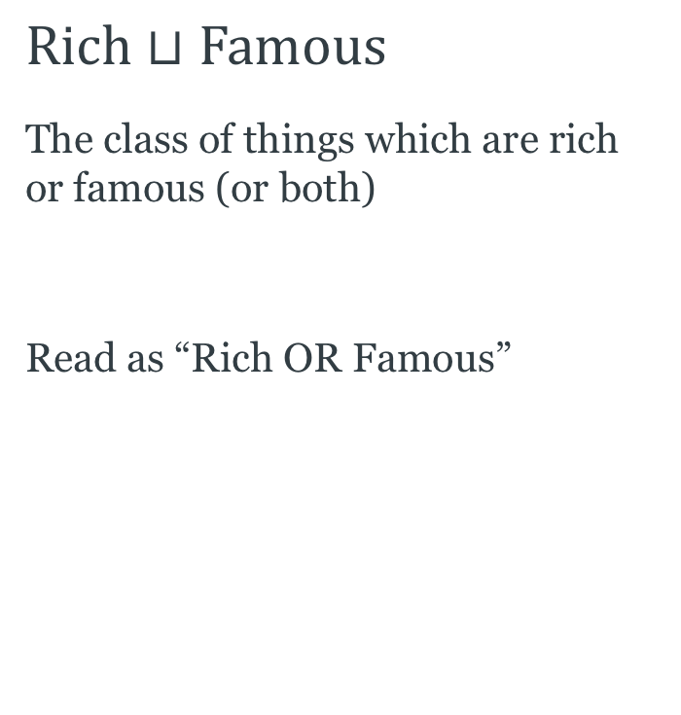
Boolean Concept Constructors: Union
$$Rich⊔Famous$$
The class of things which are rich or famous (or both)
Read as “Rich OR Famous”
Rich
Famous

Slide 16
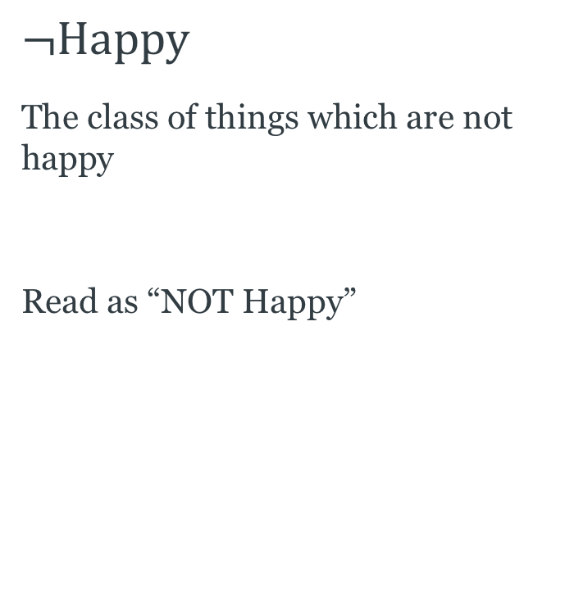
Boolean Concept Constructors: Complement
$$¬Happy$$
The class of things which are not happy
Read as “NOT Happy”
Happy

Slide 17
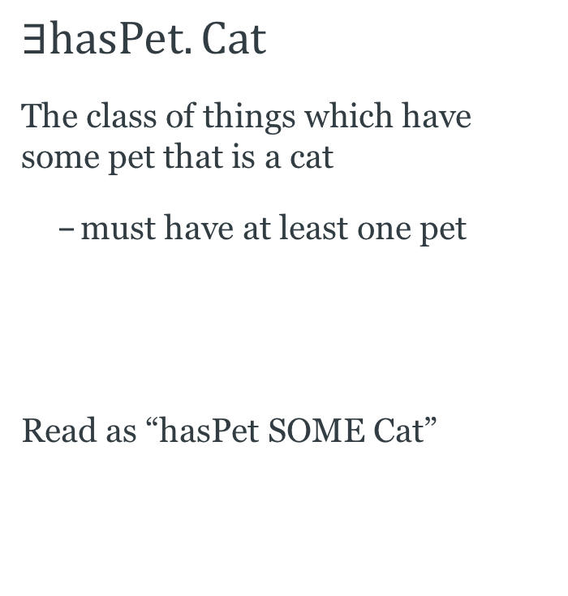
Restrictions: Existential
$$∃hasPet.Cat$$
The class of things which have some pet that is a cat
  must have at least one pet
Read as “hasPet SOME Cat”
john
Cat
Dog
felix
fluffy
fido
jane
jenny
hasPet

Slide 18
Restrictions: Existential
$$∃hasPet.Cat$$
The class of things which have some pet that is a cat
  must have at least one pet
Read as “hasPet SOME Cat”
john
Cat
Dog
felix
fluffy
fido
jane
jenny
hasPet

Slide 19
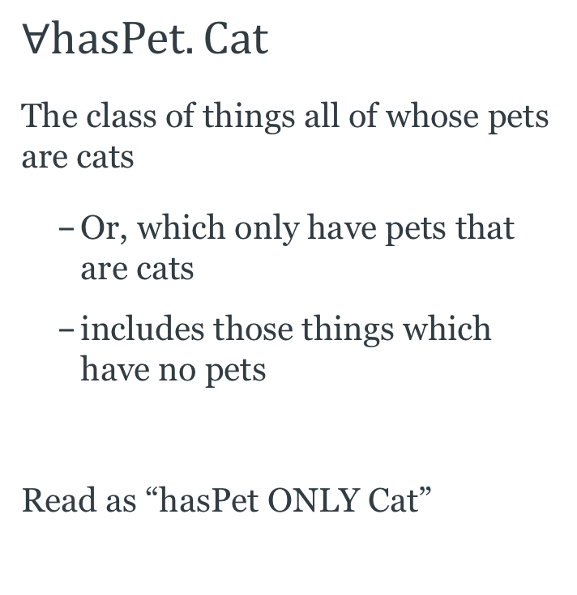
Restrictions: Universal
$$∀hasPet. Cat$$
The class of things all of whose pets are cats
  Or, which only have pets that are cats
  includes those things which have no pets
Read as “hasPet ONLY Cat”
john
Cat
Dog
felix
fluffy
fido
jane
jenny
hasPet
Notes:
Note that felix, fluffy and fido are also members of the class, because none of them have pets either!

Slide 20
Restrictions: Universal
$$∀hasPet. Cat$$
The class of things all of whose pets are cats
  Or, which only have pets that are cats
  includes those things which have no pets
Read as “hasPet ONLY Cat”
john
Cat
Dog
felix
fluffy
fido
jane
jenny
hasPet
Notes:
Note that felix, fluffy and fido are also members of the class, because none of them have pets either!

Slide 21
Restrictions: Universal
$$∀hasPet. Cat$$
The class of things all of whose pets are cats
  Or, which only have pets that are cats
  includes those things which have no pets
Read as “hasPet ONLY Cat”
john
Cat
Dog
felix
fluffy
fido
jane
jenny
hasPet
Notes:
Note that felix, fluffy and fido are also members of the class, because none of them have pets either!

Slide 22
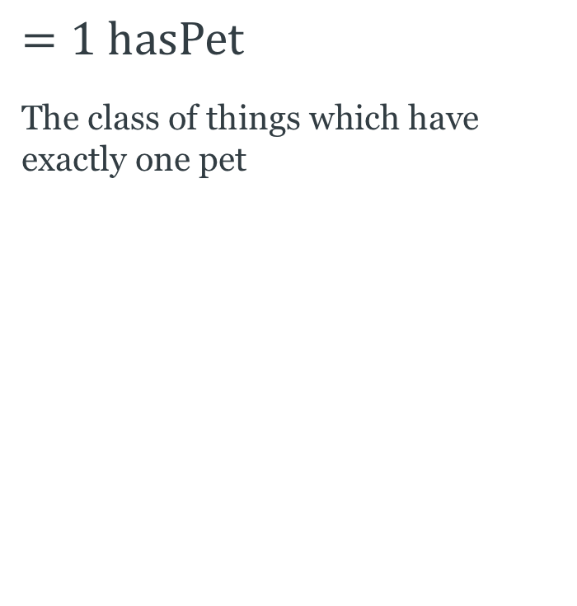
Restrictions: Number
$$=1 hasPet$$
The class of things which have exactly one pet
john
Cat
Dog
felix
fluffy
fido
jane
jenny
hasPet

Slide 23
Restrictions: Number
$$=1 hasPet$$
The class of things which have exactly one pet
john
Cat
Dog
felix
fluffy
fido
jane
jenny
hasPet

Slide 24
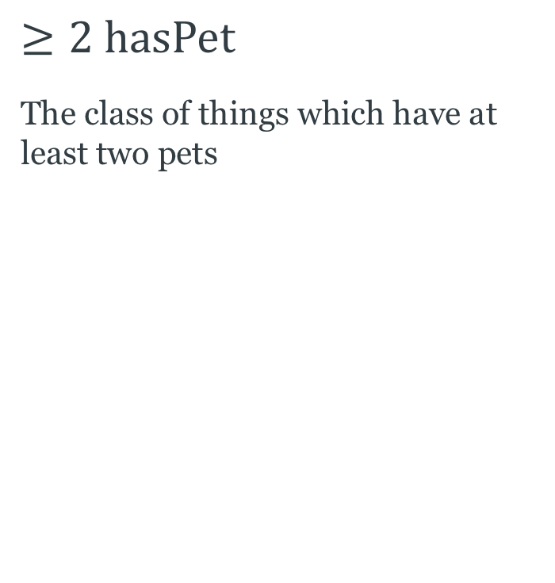
Restrictions: Number
$$≥2 hasPet$$
The class of things which have at least two pets
john
Cat
Dog
felix
fluffy
fido
jane
jenny
hasPet

Slide 25
Restrictions: Number
$$≥2 hasPet$$
The class of things which have at least two pets
john
Cat
Dog
felix
fluffy
fido
jane
jenny
hasPet

Slide 26
Knowledge Bases
A description logic knowledge base (KB) has two parts:
TBox: terminology
  A set of axioms describing the structure of the domain
  (i.e., a conceptual schema)
  Concepts, roles
ABox: assertions
  A set of axioms describing a concrete situation (data)
  Instances

Slide 27
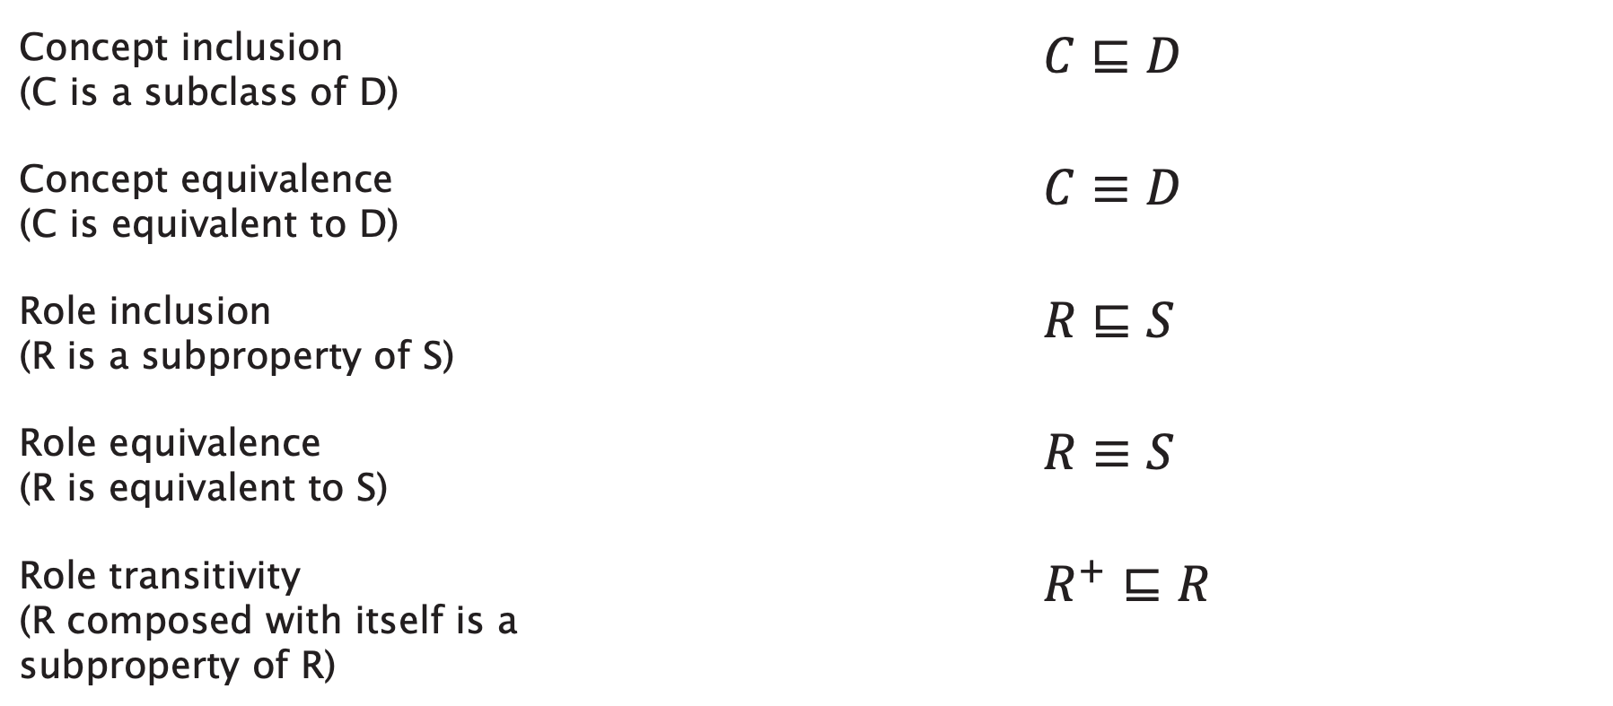
TBox Axioms
Concept inclusion (C is a subclass of D) | $$C⊑D$$
Concept equivalence (C is equivalent to D) | $$C≡D$$
Role inclusion (R is a subproperty of S) | $R⊑S$
Role equivalence (R is equivalent to S) | $R≡S$
Role transitivity (R composed with itself is a subproperty of R) | $$R^{+}⊑R$$

Slide 28
Revisiting Necessary and Sufficient Conditions
“Attribute A is a necessary/sufficient condition for membership of C”
Instead of talking directly about A, we can make a class expression (using the concept constructors) that represents the class of things with attribute A – call it D
  Membership of D is necessary/sufficient for membership of C

Slide 29
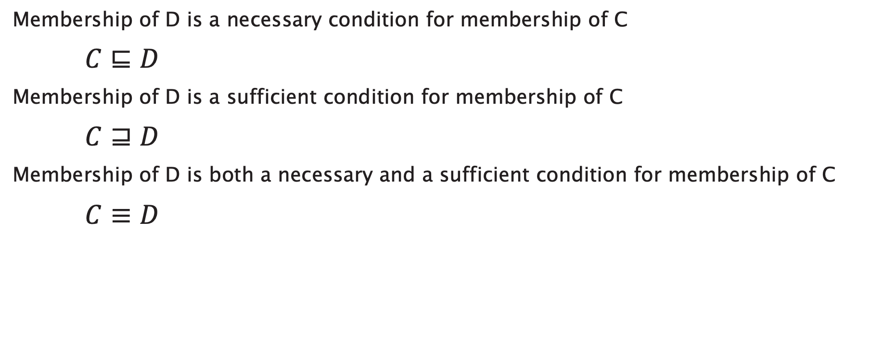
Revisiting Necessary and Sufficient Conditions
Membership of D is a necessary condition for membership of C
$C⊑D$
Membership of D is a sufficient condition for membership of C
$C⊒D$
Membership of D is both a necessary and a sufficient condition for membership of C
$C≡D$

Slide 30
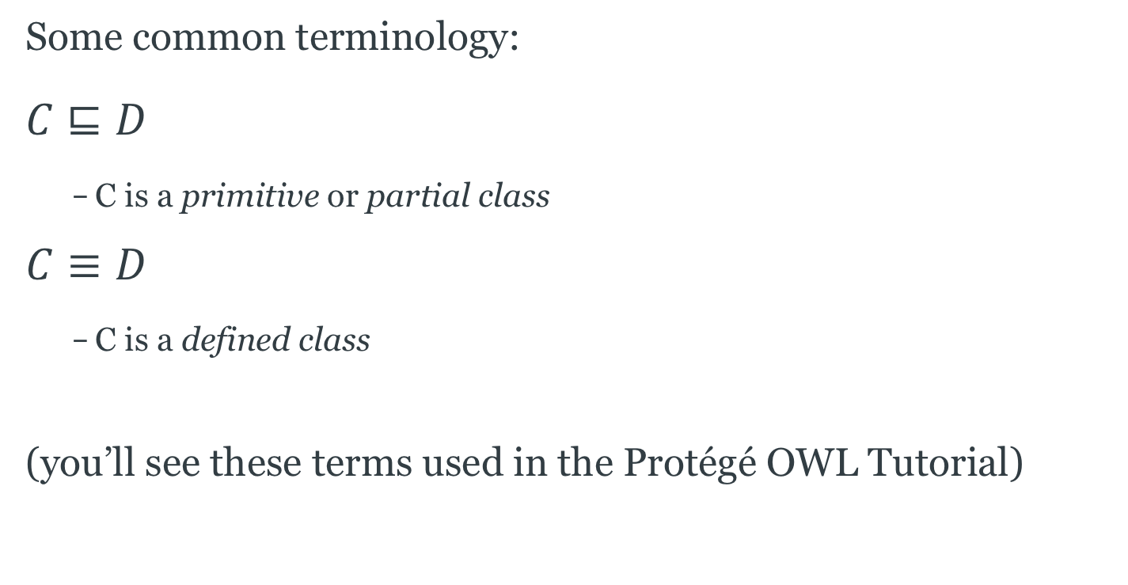
Revisiting Necessary and Sufficient Conditions
Some common terminology:
$$C⊑D$$
  C is a primitive or partial class
$$C≡D$$
  C is a defined class
(you’ll see these terms used in the Protégé OWL Tutorial)

Slide 31
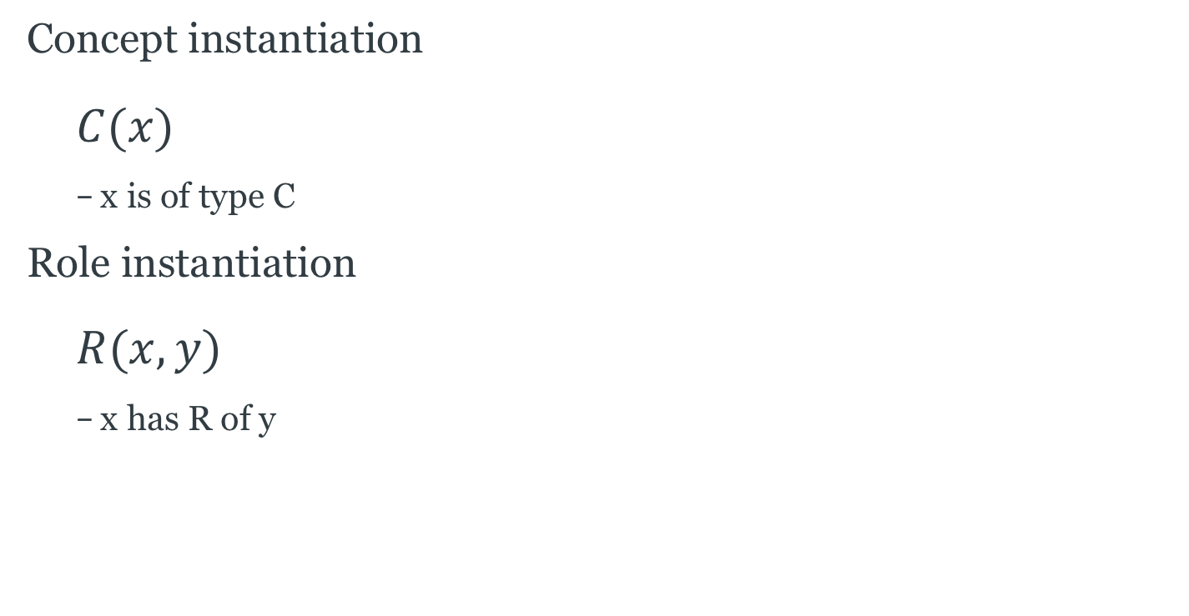
ABox Axioms
Concept instantiation
  $$C(x)$$
  x is of type C
Role instantiation
  $$R(x, y)$$
  x has R of y

Slide 32
Axiom Examples
Every person is either living or dead
Every happy child has a loving parent
Every child who eats only cake is unhealthy
No elephants can fly
A mole is a sauce from Mexico that contains chili
All Englishmen are mad

Slide 33
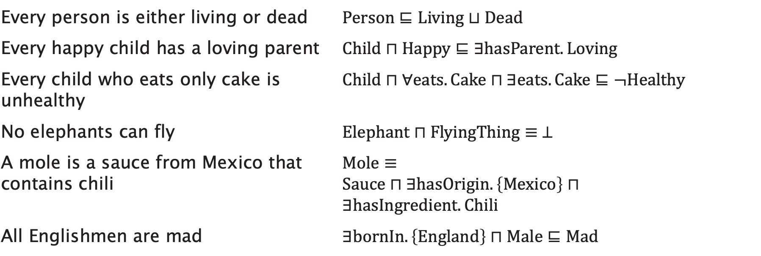
Axiom Examples
Every person is either living or dead | $$Person⊑Living⊔Dead$$
Every happy child has a loving parent | $$Child⊓Happy⊑∃hasParent.Loving$$
Every child who eats only cake is unhealthy | $$Child⊓∀eats.Cake⊓∃eats.Cake⊑¬Healthy$$
No elephants can fly | $$Elephant⊓FlyingThing≡ ⊥$$
A mole is a sauce from Mexico that contains chili | $$Mole≡ \\ Sauce⊓∃hasOrigin.\left\{Mexico\right\}⊓ \\ ∃hasIngredient.Chili$$
All Englishmen are mad | $$∃bornIn.\left\{England\right\}⊓Male⊑Mad$$

Slide 34
Tips for Description Logic Axioms
No single ‘correct’ answer - different modelling choices
Break sentence down into pieces
  e.g. “successful man”, “spicy ingredient” etc
  Look for nouns and adjectives (concepts)
  Look for verb phrases (roles)
Look for indicators of axiom type:
  “Every X is Y” - inclusion axiom
  “X is Y” - equivalence axiom
Remember that ∀R.C is satisfied by instances which have no value for R

Slide 35


Slide 36
Semantics

Slide 37
Description Logics and Predicate Logic
Description Logics are a subset of first order Predicate Logic with a simplified syntax
Every DL expression can be converted into an equivalent FOPL expression

Slide 38
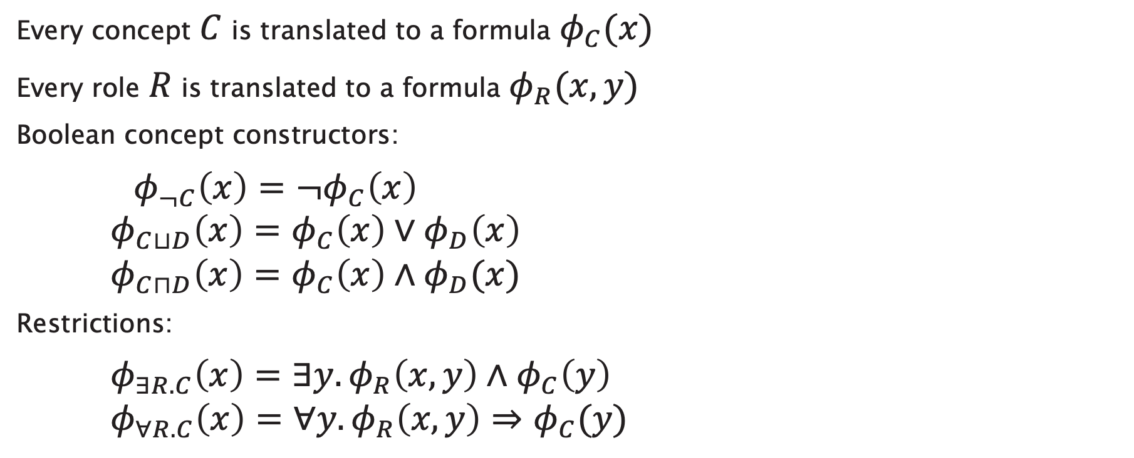
Description Logics and Predicate logic
Every concept $C$ is translated to a formula $φ_{C}(x)$
Every role $R$ is translated to a formula $φ_{R}(x,y)$
Boolean concept constructors:
$φ_{¬C}\left(x\right)=¬φ_{C}\left(x\right)$
$φ_{C⊔D}\left(x\right)=φ_{C}\left(x\right)∨φ_{D}\left(x\right)$
$φ_{C⊓D}\left(x\right)=φ_{C}\left(x\right)∧φ_{D}(x)$
Restrictions:
$φ_{∃R.C}\left(x\right)=∃y.φ_{R}\left(x,y\right)∧φ_{C}\left(y\right)$
$φ_{∀R.C}\left(x\right)=∀y.φ_{R}\left(x,y\right)⇒φ_{C}(y)$

Slide 39
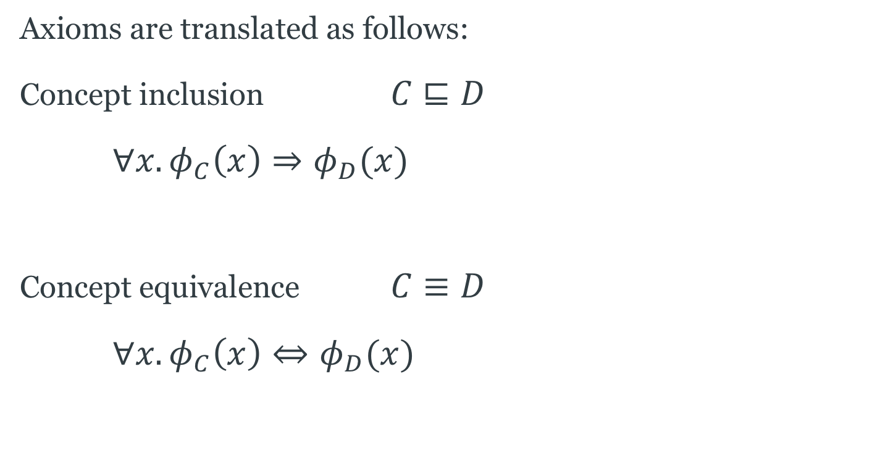
Description Logics and Predicate logic
Axioms are translated as follows:
Concept inclusion $C⊑D$
$∀x.φ_{C}\left(x\right)⇒φ_{D}(x)$
Concept equivalence $C≡D$
$∀x.φ_{C}\left(x\right)⇔φ_{D}(x)$
Notes:
EXAMPLE: Every person is male or female

Slide 40
Example
“Every child who eats cake is happy”

Slide 41

Example
“Every child who eats cake is happy”
$$Child⊓∃eats.Cake⊑Happy$$

Slide 42

Example
“Every child who eats cake is happy”
$$Child⊓∃eats.Cake⊑Happy$$
$$∀x φ_{Child⊓∃eats.Cake}\left(x\right)⇒φ_{Happy}\left(x\right)$$

Slide 43
Example
“Every child who eats cake is happy”
$$Child⊓∃eats.Cake⊑Happy$$
$$∀x φ_{Child⊓∃eats.Cake}\left(x\right)⇒φ_{Happy}\left(x\right)$$

Slide 44
Example
“Every child who eats cake is happy”
$$Child⊓∃eats.Cake⊑Happy$$
$$∀x φ_{Child⊓∃eats.Cake}\left(x\right)⇒φ_{Happy}\left(x\right)$$

Slide 45
Example
“Every child who eats cake is happy”
$$Child⊓∃eats.Cake⊑Happy$$
$$∀x φ_{Child⊓∃eats.Cake}\left(x\right)⇒φ_{Happy}\left(x\right)$$

Slide 46
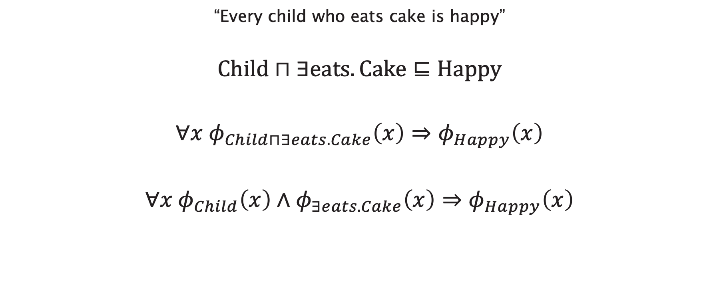
Example
“Every child who eats cake is happy”
$$Child⊓∃eats.Cake⊑Happy$$
$$∀x φ_{Child⊓∃eats.Cake}\left(x\right)⇒φ_{Happy}\left(x\right)$$
$$∀x φ_{Child}\left(x\right)∧φ_{∃eats.Cake}\left(x\right)⇒φ_{Happy}\left(x\right)$$

Slide 47
Example
“Every child who eats cake is happy”
$$Child⊓∃eats.Cake⊑Happy$$
$$∀x φ_{Child⊓∃eats.Cake}\left(x\right)⇒φ_{Happy}\left(x\right)$$
$$∀x φ_{Child}\left(x\right)∧φ_{∃eats.Cake}\left(x\right)⇒φ_{Happy}\left(x\right)$$

Slide 48
Example
“Every child who eats cake is happy”
$$Child⊓∃eats.Cake⊑Happy$$
$$∀x φ_{Child⊓∃eats.Cake}\left(x\right)⇒φ_{Happy}\left(x\right)$$
$$∀x φ_{Child}\left(x\right)∧φ_{∃eats.Cake}\left(x\right)⇒φ_{Happy}\left(x\right)$$

Slide 49
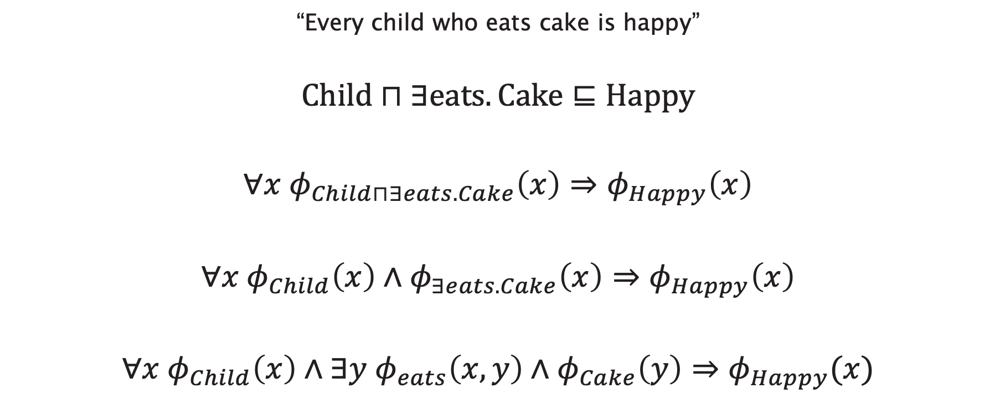
Example
“Every child who eats cake is happy”
$$Child⊓∃eats.Cake⊑Happy$$
$$∀x φ_{Child⊓∃eats.Cake}\left(x\right)⇒φ_{Happy}\left(x\right)$$
$$∀x φ_{Child}\left(x\right)∧φ_{∃eats.Cake}\left(x\right)⇒φ_{Happy}\left(x\right)$$
$$∀x φ_{Child}\left(x\right)∧∃y φ_{eats}\left(x,y\right)∧φ_{Cake}\left(y\right)⇒φ_{Happy}(x)$$

Slide 50
Example
“Every child who eats cake is happy”
$$Child⊓∃eats.Cake⊑Happy$$
$$∀x φ_{Child⊓∃eats.Cake}\left(x\right)⇒φ_{Happy}\left(x\right)$$
$$∀x φ_{Child}\left(x\right)∧φ_{∃eats.Cake}\left(x\right)⇒φ_{Happy}\left(x\right)$$
$$∀x φ_{Child}\left(x\right)∧∃y φ_{eats}\left(x,y\right)∧φ_{Cake}\left(y\right)⇒φ_{Happy}(x)$$

Slide 51
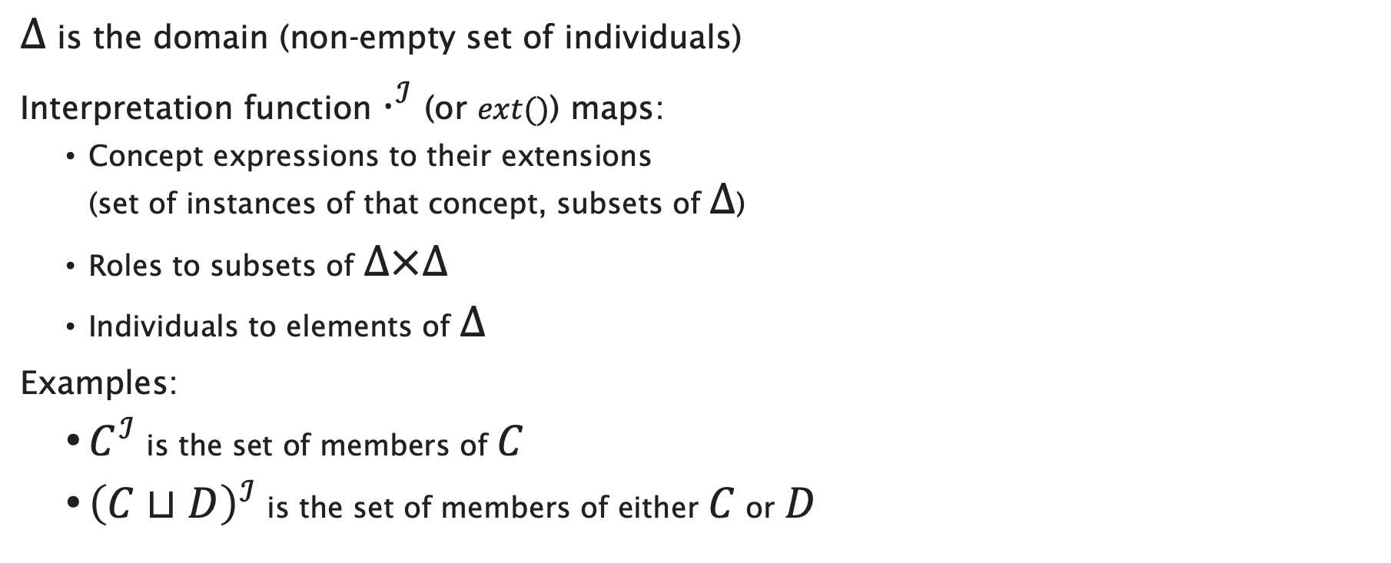
Description Logic Semantics
$Δ$ is the domain (non-empty set of individuals)
Interpretation function $⋅^{ℐ}$ (or $ext()$) maps:
  Concept expressions to their extensions
  (set of instances of that concept, subsets of $Δ$)
  Roles to subsets of $Δ×Δ$
  Individuals to elements of $Δ$
Examples:
  $C^{ℐ}$ is the set of members of $C$
  ${\left(C⊔D\right)}^{ℐ}$ is the set of members of either $C$ or $D$

Slide 52
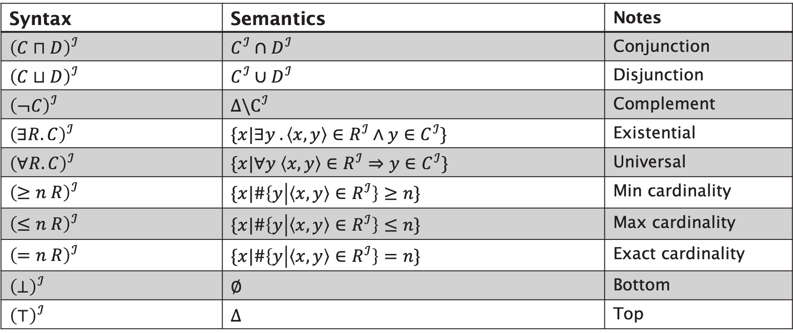
Description Logic Semantics
Syntax | Semantics | Notes
$${\left(C⊓D\right)}^{ℐ}$$ | $$C^{ℐ}∩D^{ℐ}$$ | Conjunction
$${\left(C⊔D\right)}^{ℐ}$$ | $$C^{ℐ}∪D^{ℐ}$$ | Disjunction
$${\left(¬C\right)}^{ℐ}$$ | $$Δ\backslash C^{ℐ}$$ | Complement
$${\left(∃R.C\right)}^{ℐ}$$ | $$\{x|∃y .\left\langle x, y\right\rangle ∈R^{ℐ}∧y∈C^{ℐ}\}$$ | Existential
$${\left(∀R.C\right)}^{ℐ}$$ | $$\{x|∀y \left\langle x, y\right\rangle ∈R^{ℐ}⇒y∈C^{ℐ}\}$$ | Universal
$${\left(≥n R\right)}^{ℐ}$$ | $$\{x|\#\left\{y | \left\langle x, y\right\rangle ∈R^{ℐ}\right\}≥n\}$$ | Min cardinality
$${\left(≤n R\right)}^{ℐ}$$ | $$\{x|\#\left\{y | \left\langle x, y\right\rangle ∈R^{ℐ}\right\}≤n\}$$ | Max cardinality
$${\left(=n R\right)}^{ℐ}$$ | $$\{x|\#\left\{y | \left\langle x, y\right\rangle ∈R^{ℐ}\right\}=n\}$$ | Exact cardinality
$${\left(⊥\right)}^{ℐ}$$ | $$∅$$ | Bottom
$${\left(⊤\right)}^{ℐ}$$ | $$Δ$$ | Top

Slide 53



Interpretation Example
Δ
$Δ=\left\{v, w, x, y, z\right\}$
$$A^{ℐ}=\left\{v, w, x\right\} \\ B^{ℐ}=\left\{x, y\right\} \\ R^{ℐ}=\{\left\langle v,w\right\rangle ,\left\langle v,x\right\rangle ,\left\langle y,x\right\rangle ,\left\langle x,z\right\rangle \}$$
$$A^{ℐ}$$
$$B^{ℐ}$$
v
y
x
w
z
R

Slide 54
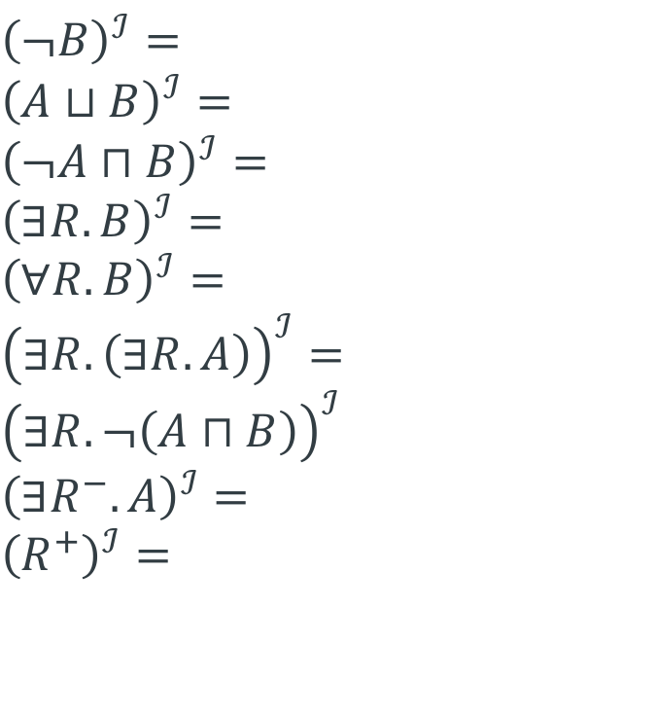
Interpretation Example
Δ
$${\left(¬B\right)}^{ℐ}= \\ {\left(A⊔B\right)}^{ℐ}= \\ {\left(¬A⊓B\right)}^{ℐ}= \\ {\left(∃R.B\right)}^{ℐ}= \\ {\left(∀R.B\right)}^{ℐ}= \\ {\left(∃R.\left(∃R.A\right)\right)}^{ℐ}= \\ {\left(∃R.¬\left(A⊓B\right)\right)}^{ℐ} \\ {\left(∃R^{−}.A\right)}^{ℐ}= \\ {\left(R^{+}\right)}^{ℐ}=$$
$$A^{ℐ}$$
$$B^{ℐ}$$
v
y
x
w
z
R

Slide 55
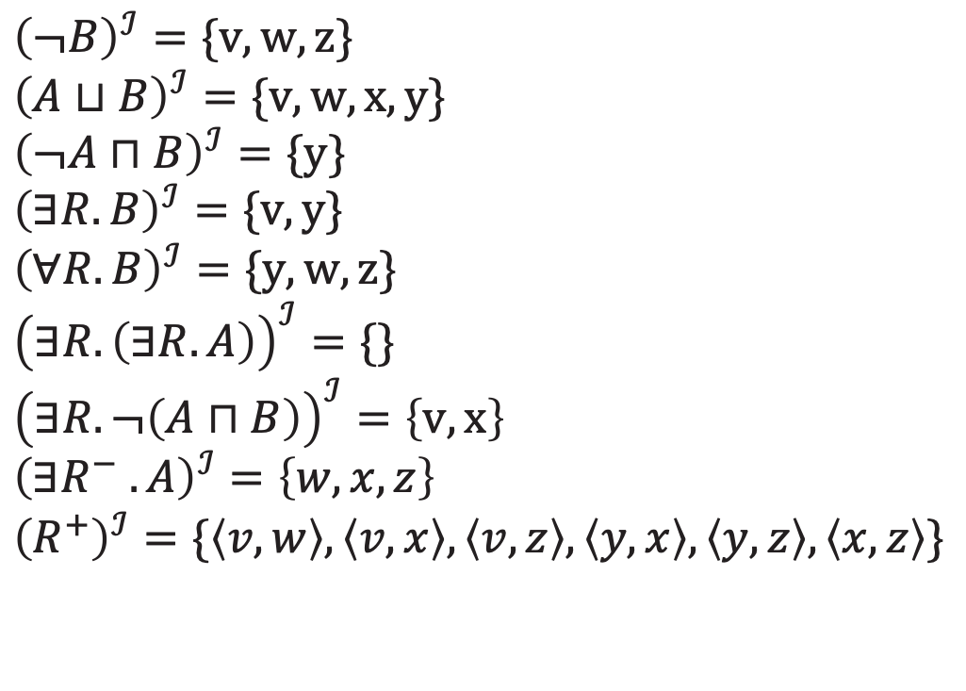
Answers
Δ
$${\left(¬B\right)}^{ℐ}=\{v,w,z\} \\ {\left(A⊔B\right)}^{ℐ}=\{v,w,x,y\} \\ {\left(¬A⊓B\right)}^{ℐ}=\{y\} \\ {\left(∃R.B\right)}^{ℐ}=\{v,y\} \\ {\left(∀R.B\right)}^{ℐ}=\{y,w,z\} \\ {\left(∃R.\left(∃R.A\right)\right)}^{ℐ}=\{\} \\ {\left(∃R.¬\left(A⊓B\right)\right)}^{ℐ}=\left\{v,x\right\} \\ {\left(∃R^{−} .A\right)}^{ℐ}=\left\{w, x, z\right\} \\ {\left(R^{+}\right)}^{ℐ}=\{\left\langle v,w\right\rangle ,\left\langle v,x\right\rangle ,\left\langle v,z\right\rangle , \left\langle y,x\right\rangle , \left\langle y,z\right\rangle ,\left\langle x,z\right\rangle \}$$
$$A^{ℐ}$$
$$B^{ℐ}$$
v
y
x
w
z
R

Slide 56
DL Reasoning Revisited

Slide 57
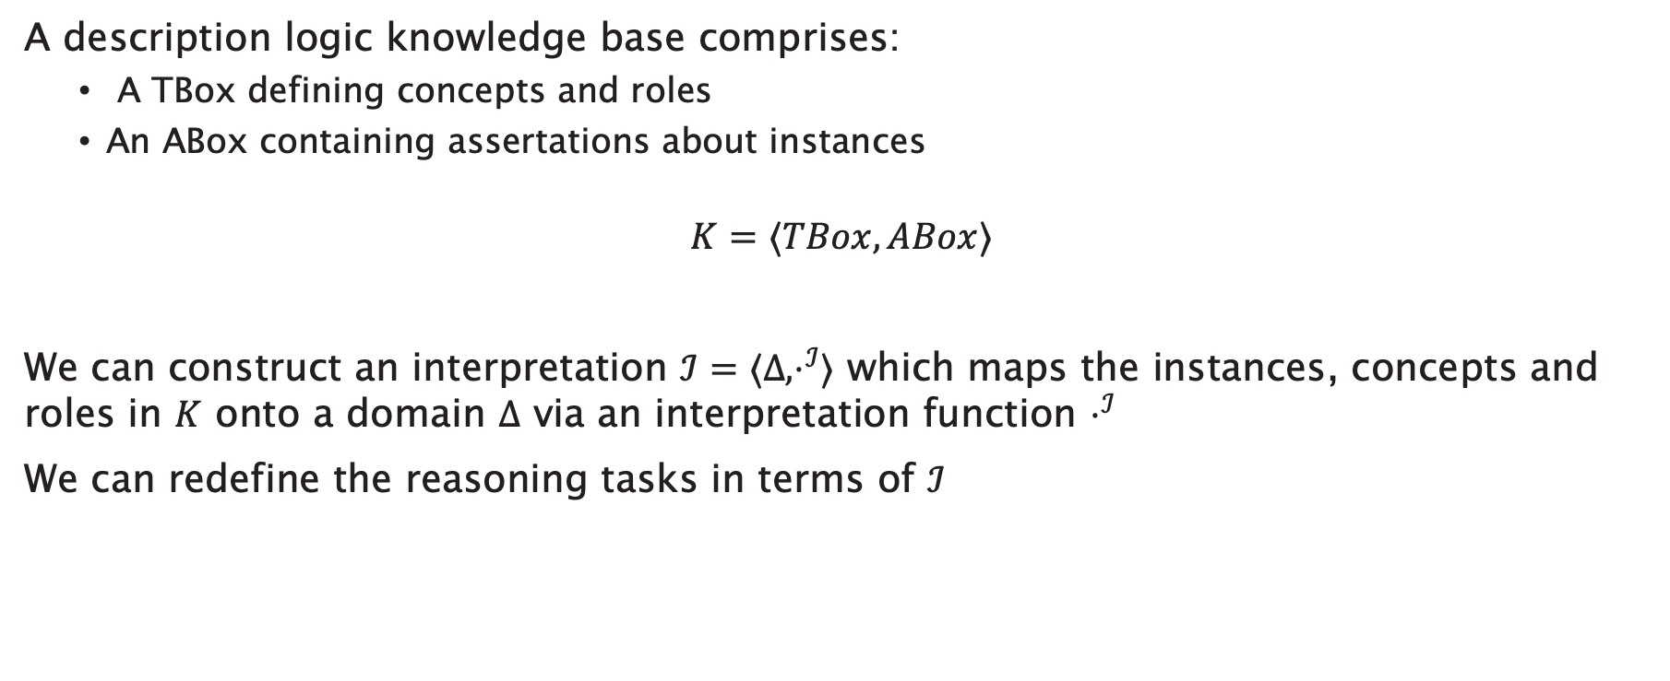
DL Reasoning Revisited
A description logic knowledge base comprises:
  A TBox defining concepts and roles
  An ABox containing assertations about instances
$$K=⟨TBox, ABox⟩$$
We can construct an interpretation $ℐ=⟨Δ,⋅^{ℐ}⟩$ which maps the instances, concepts and roles in $K$ onto a domain $Δ$ via an interpretation function $⋅^{ℐ}$
We can redefine the reasoning tasks in terms of $ℐ$

Slide 58
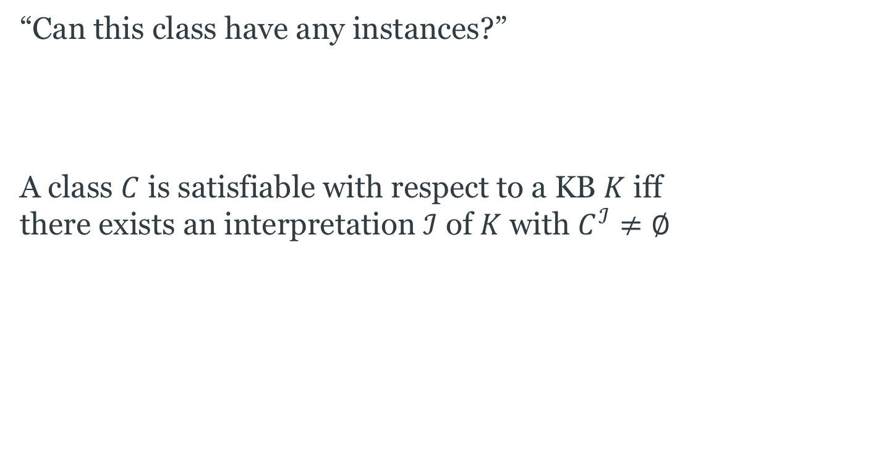
Satisfaction
“Can this class have any instances?”
A class $C$ is satisfiable with respect to a KB $K$ iff
there exists an interpretation $ℐ$ of $K$ with $C^{ℐ}≠∅$

Slide 59
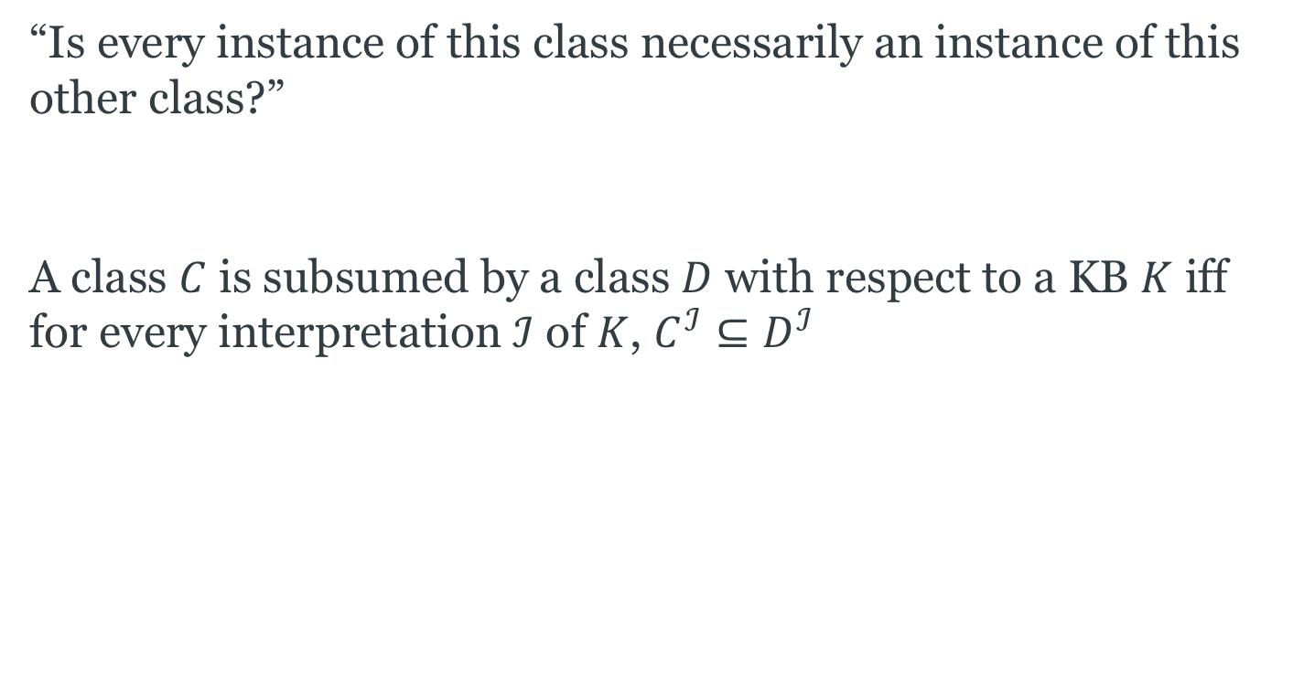
Subsumption
“Is every instance of this class necessarily an instance of this other class?”
A class $C$ is subsumed by a class $D$ with respect to a KB $K$ iff
for every interpretation $ℐ$ of $K$, $C^{ℐ}⊆D^{ℐ}$

Slide 60
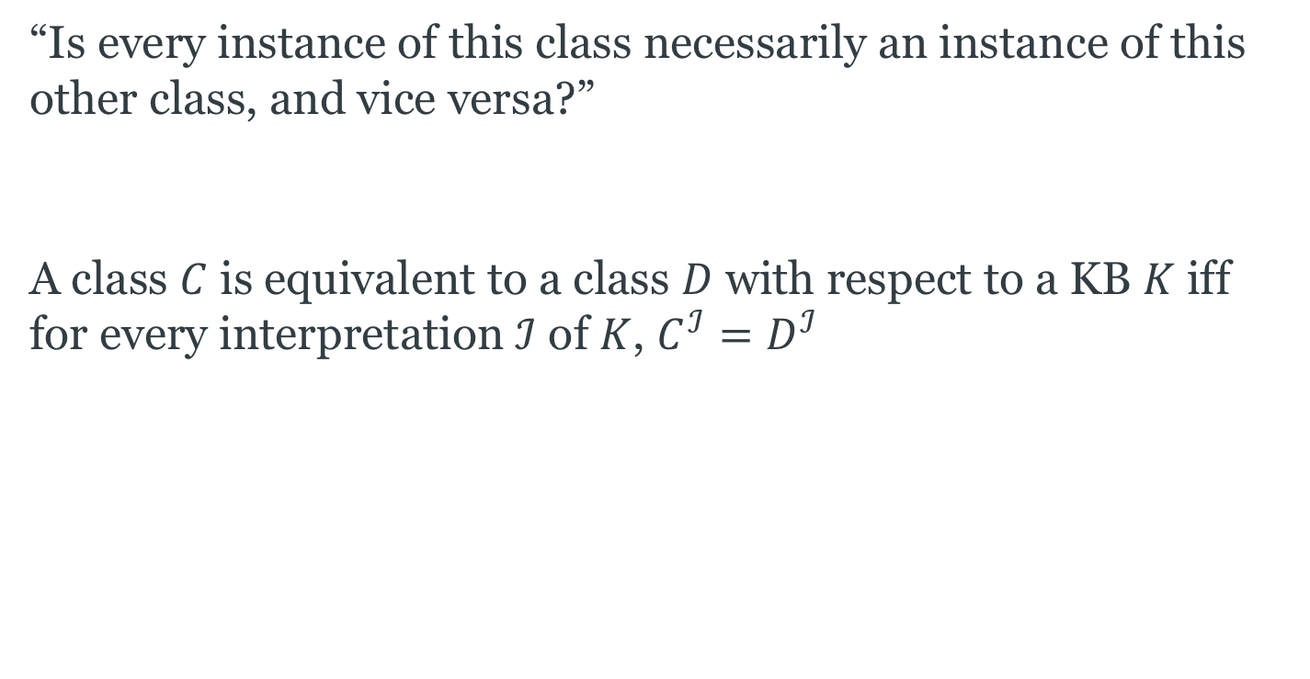
Equivalence
“Is every instance of this class necessarily an instance of this other class, and vice versa?”
A class $C$ is equivalent to a class $D$ with respect to a KB $K$ iff
for every interpretation $ℐ$ of $K$, $C^{ℐ}=D^{ℐ}$

Slide 61
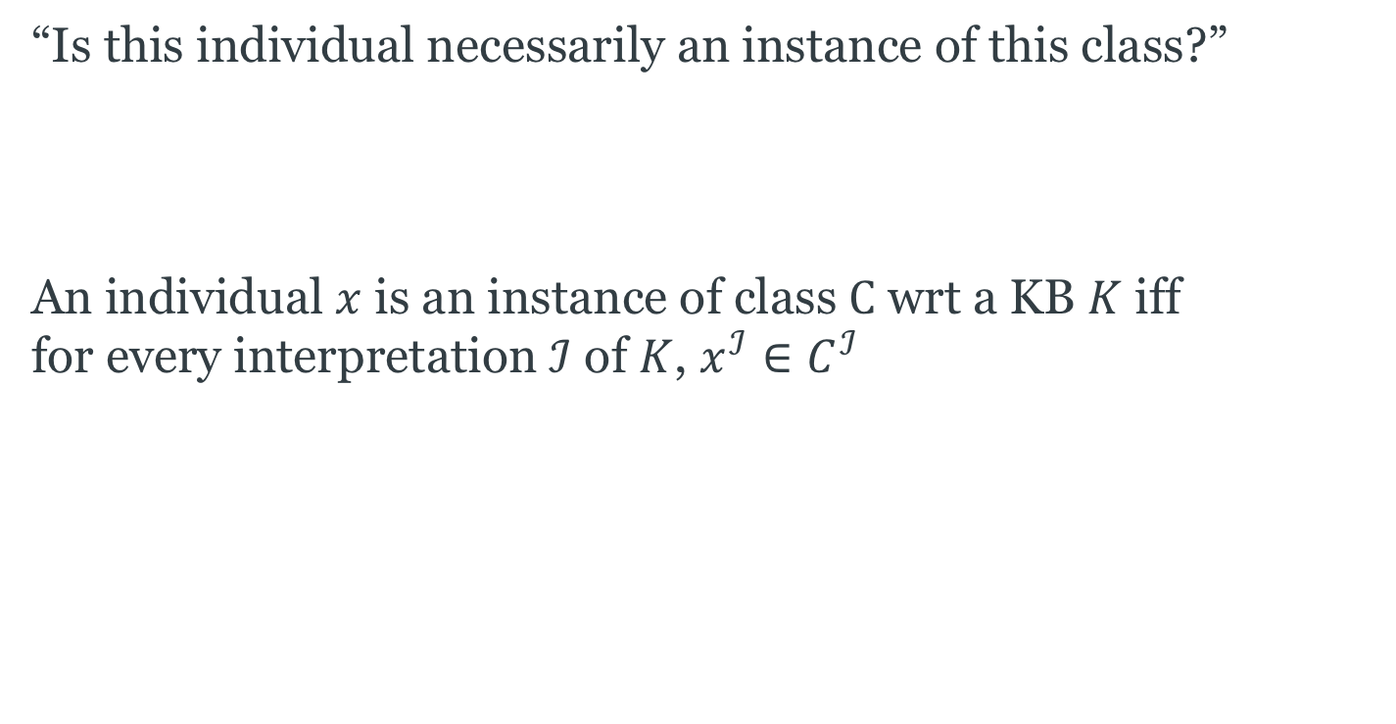
Classification
“Is this individual necessarily an instance of this class?”
An individual $x$ is an instance of class $C$ wrt a KB $K$ iff
for every interpretation $ℐ$ of $K$, $x^{ℐ}∈C^{ℐ}$

Slide 62
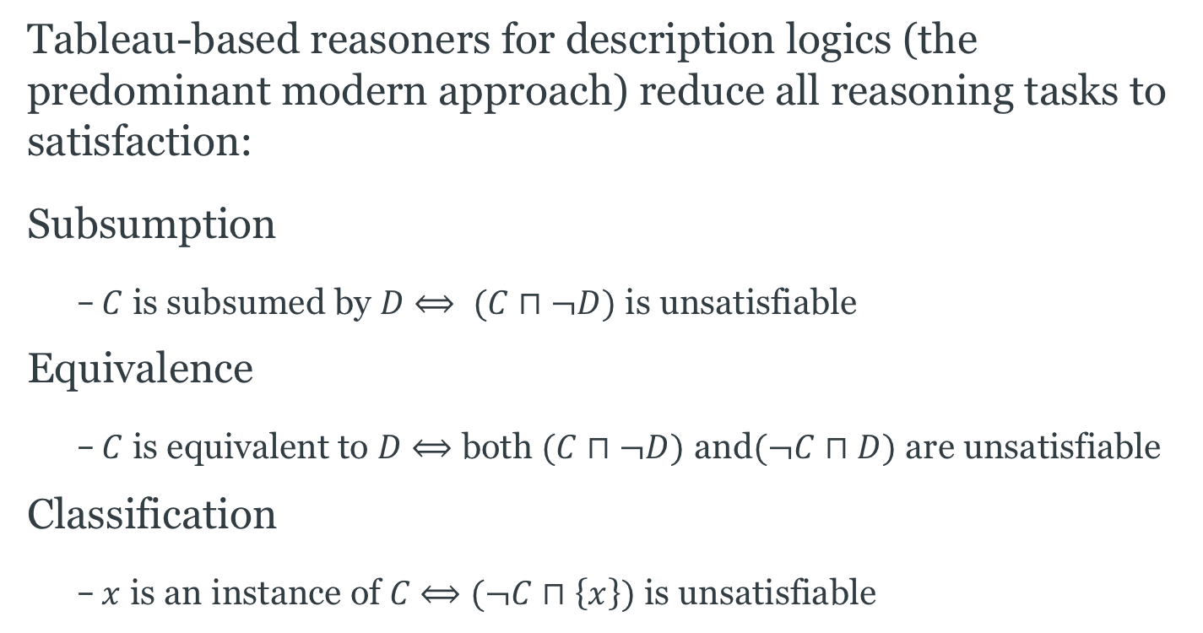
Reduction to Satisfaction
Tableau-based reasoners for description logics (the predominant modern approach) reduce all reasoning tasks to satisfaction:
Subsumption
  $C$ is subsumed by $D$ $⟺$ $(C⊓¬D)$ is unsatisfiable
Equivalence
  $C$ is equivalent to $D$ $⟺$ both $(C⊓¬D)$ and$(¬C⊓D)$ are unsatisfiable
Classification
  $x$ is an instance of $C$ $⟺$ $(¬C⊓\left\{x\right\})$ is unsatisfiable

Slide 63
Further Reading
Daniele Nardi and Ronald J. Brachman (2003) An Introduction to Description Logics, in Franz Baader, Diego Calvanese, Deborah L. McGuinness, Daniele Nardi and Peter F. Patel-Schneider (eds) The Description Logic Handbook: Theory, implementation and applications, Cambridge University Press, 2003, pp.1-40.
F. Baader and W. Nutt (2003) Basic Description Logics, in Franz Baader, Diego Calvanese, Deborah L. McGuinness, Daniele Nardi and Peter F. Patel-Schneider (eds) The Description Logic Handbook: Theory, implementation and applications, Cambridge University Press, 2003, pp.47-100.

Slide 64
Next Lecture: OWL

