Slide 1
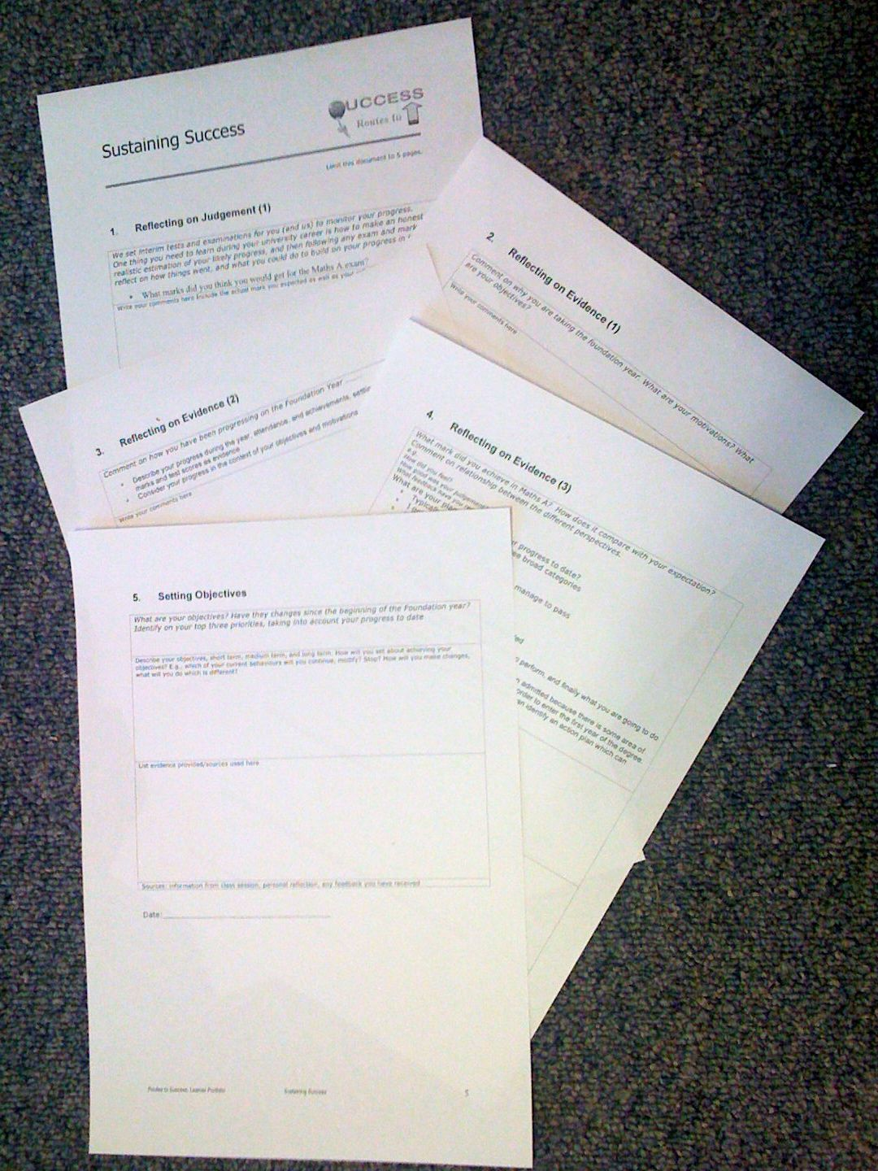
Foundation Year Routes to Success Part III - Sustaining Success Su White, ECS
Su White Semester 2
overview
Notes
Introduction
Consolidation
Completion
Resource set in Edshare http://edshare.soton.ac.uk/19741/
Notes:
Objective to get to know the each other and establish framework for future sessions
Introduce think pair share
Establish expectations for portfolio contribution for this part of the course
Much of the session will be run via discussion and question and answer
The slides will be used according to need, but can form a useful note for review and revision.
They can also be used as reference by students who do not attend the session.

Slide 2
Welcome:-)
Dr Su White ECS, University of Southampton

Slide 3
Hacking your degree
Hack your degree in just six weeks and five easy steps

Slide 4
How to use these slides
The slides are the basis for the material we will cover through the module
You can refer to them later on to remind yourself of what we plan to do
Read them in conjunction with any other materials provided via blackboard
All the materials are stored in the same EdShare record
Resource set in Edshare http://edshare.soton.ac.uk/19741/

Slide 5
Progress through the slides
Typically, we cover the material up to slide 22 in week 1
Includes
Overview: essential dates
Why are you taking the foundation year?
What are you doing to help you succeed?

Slide 6
Introduction:
Hello and Overview

Slide 7
Intros
You
Me
The team
The module ( and us ☺)
Notes:
Need to establish how the classes will be run
E.g. Q&A
Think share pair
zappers

Slide 8
Its all about you
RTS-3 may seem nothing like any other of your study on the foundation year so far…
But it covers essentials which you can use for the rest of your life

Slide 9
The Portfolio and how we assess it

Slide 10
Intros: The big picture themes
learning
self knowledge
Using feedback
Future planning
Assessment Interviews tbc likely w/c 9th March
Hand in Wed 4th March
reflection
Notes:
1) Exam
2) Your motivations
3) Your progress
4) Self knowledge
5) Future Objectives
Explaining how the classes will be used to to fill out the portfolio

Slide 11
The portfolio process
Portfolio…
You need to write …
Use the template
I will mail a copy directly to each you
Complete each section
cover pages
evidence pages
reflection pages
Hand in on time
Attend the interview
My job
to help you with this task
Your job
do the very best you can
Guidance:
Answer specific questions
Reflect on your answers
Evaluate your motivations
I will ask you to do something between each meeting

Slide 12
About this slide set
Typically I will have covered some aspects of these notes verbally during the class as I explained the activities to you
Use the notes
To guide you through the out of class activities between lectures

Slide 13
Me - briefly

Slide 14
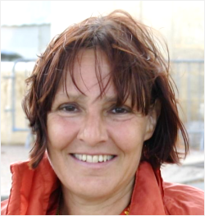
Intros: me, the support team and you?
What about you?
Leader for this section
Dr Su White
Academic in ECS
saw@ecs.soton.ac.uk
Researcher in Web and Internet Science – ECS
Why I am here
Senior tutor on the foundation year
Believe that all students can learn and succeed
Understand that learning is individual and personal
I will read your personal portfolios – and mark your work
Notes:
Objective to get some general feedback from the students – who are you, why are you here? This is also the opening question to the Portfolio interview
Establish the diversity of objectives, but also the commonality
Reminder – from induction….
Extra info - degree profile of students from FY same as that of A level point entry
Students may go on to do degree different to that first selected
Some students take the year a second time
Some students go on to study at another university
You have to pass the course to progress

Slide 15
The team..
This term:
John Mills and I
Will conduct some interviews
Discuss your portfolio
you may meet postgrad’s
in lectures
conducting research
surveys
group discussions
we are interested in the whole general question of how you are learning on the foundation year
we are relying on you to participate in all of the various activities

Slide 16
Intros: Why we are here
Each week we will rehearse some of the portfolio
Routes to success!
It’s a module
You have coursework
This is the lecture series
I want to make it useful
I need you to join in

Slide 17
Some thinking exercises
Each exercise is relevant to some part of the portfolio

Slide 18
So what about you?
Why are you taking the foundation year?
What or who was your motivation?
A teacher?
Your family?
An interest?
Discussion time

Slide 19
Complete the sheet Then speak with your neighbor(s)
Notes:
There are set of exercises associated with week one in the end share collection

Slide 20
You: An (old?) vision of students
https://youtu.be/dGCJ46vyR9o?list=PL77BB94D4838EAD4C
Notes:
Every student’s circumstance is different, and it has changed a lot since I was an undergrad

Slide 21
We don’t have time to make a video…
But I have a quick survey for you to complete
… and some time to talk scheduled
Consider
What was true for you about the video?
Where could you improve or change the information?

Slide 22
Complete the paper version of the survey

Slide 23
End of class for week 1
Look out for emails
inviting you to the survey
providing you with the template
suggesting tasks before next week

Slide 24
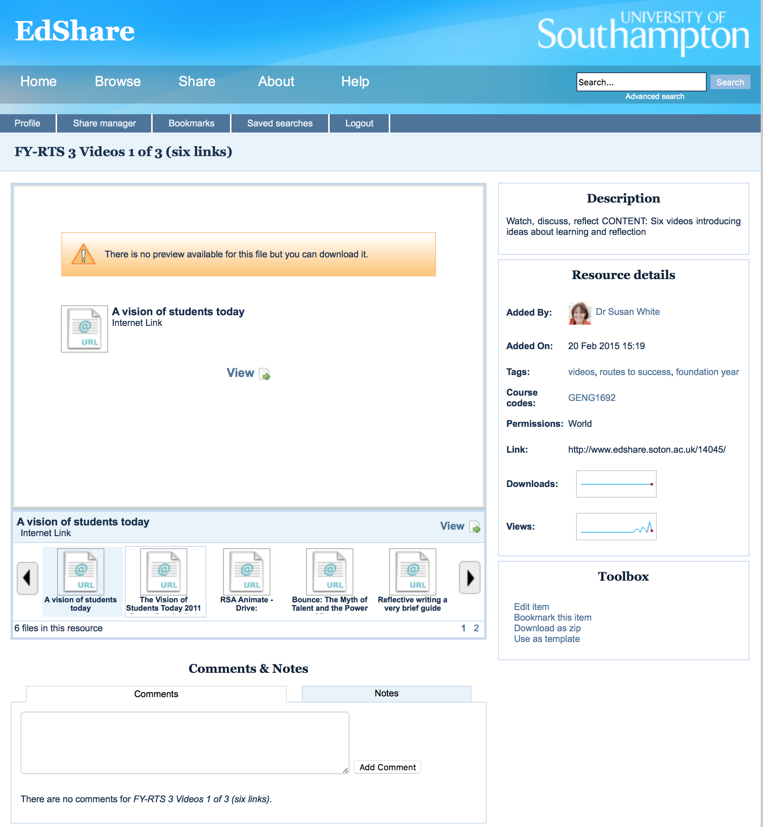
We have collections of videos
The whole collection
Context
Study advice
How to learn anything fast
Flow
First Collection
Mike Wesch, Students Today (2)
Matt Syed, Bounce
RSA Animate, Drive
Reflective Writing
Critical thinking
Watch right now
http://www.edshare.soton.ac.uk/14045/

Slide 25
Further notes for week 1

Slide 26
About these notes
Typically I will have covered some aspects of these notes verbally during the class as I explained the activities to you
Use the notes
To guide you through the out of class activities between lectures

Slide 27
About the Process
What you have to do

Slide 28
Reminder: The big picture themes
learning
self knowledge
Using feedback
Future planning
Assessment Interviews tbc likely w/c 9th March
Hand in Wed 4th March
reflection
Notes:
1) Exam
2) Your motivations
3) Your progress
4) Self knowledge
5) Future Objectives
Explaining how the classes will be used to to fill out the portfolio

Slide 29
Lecture/Learning Structure:
How the work is paced by the class:

Slide 30
I will help you
Supporting tasks
Watch the videos
Complete surveys
Write a draft before the final version
Videos
Help you see the bigger picture
Quizzes
Pace you through the reflection which goes with the course
Drafts
Help you produce an excellent final version
Student work improved after we introduced the surveys and videos
Complete the tasks: they can help you get better marks!

Slide 31
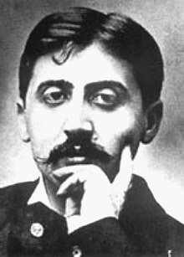
reminder
“We don't receive wisdom; we must discover it for ourselves after a journey that no one can take for us …”
Marcel Proust (French novelist 1871 – 1922)

Slide 32
It’s the journey…

Slide 33
Remember
Studying is not simply about transferring a set of facts from lecturer to students
This module assists you:
Developing your individual learning
Recognising how you can be responsible for your own learning
Learn how to become a resilient learner
Develop skills so you
Understand how you best learn
Reflect on how you can improve
This module needs you to actively engage with this process ☺

Slide 34
If studying alone or revising W1
Look at the questions and complete on your own – you will be sent a link to an online version

Slide 35
Notes
Remember, this whole set of slides is referred to during the next five weeks of RTS
In the class – and between lectures
You will be prompted to complete the portfolio
Its much easier, and more productive for you if you draft your portfolio as you go along
I will record the lectures and upload them to Panopto

Slide 36
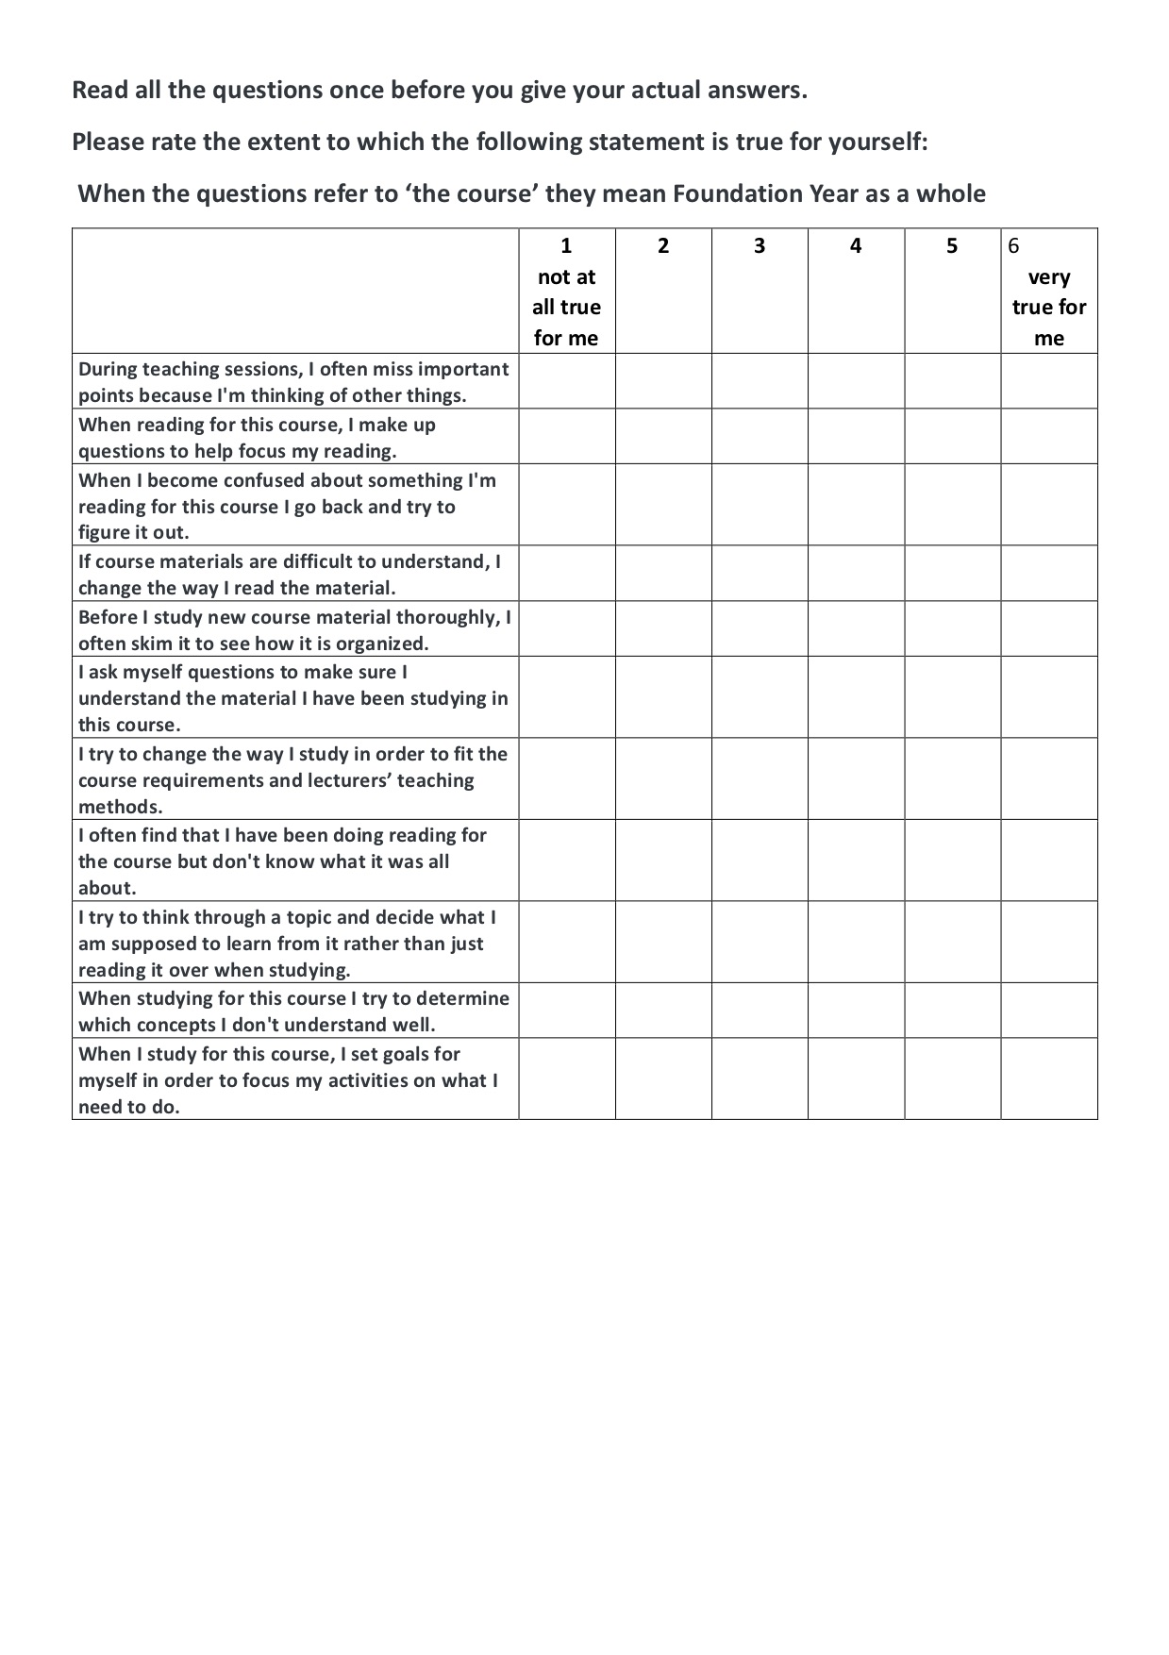
How do you go about learning?
W1 – complete in class
Before W2 – submit online
We will talk about the overview next week

Slide 37
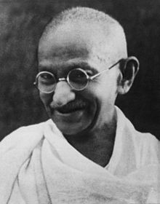
Life and Learning
“Live as if you were to die tomorrow. Learn as if you were to live forever.”
Mahatma Gandhi, Indian politician and activist 1869 –1948

Slide 38
Reminder: overview of RTS
Engineering
John Mills Introductory Sessions
Mike Hogg Thinking about the Problem
Su White Building on foundations

Slide 39
Your opportunity
“Education is the most powerful weapon which you can use to change the world”
Nelson Mandela (South African politician and activist 1918-2013)

Slide 40
What we expect of you during thisd part of the module
Work and study independently but also…
Discuss the task with fellow students
Face-to-face is often better than online
find time over a coffee or in a social context
Watch the videos together
Proof read work in progress

Slide 41
What we expect of you 2
Complete surveys if asked
you will get email invitations
… and reminders
Work on your portfolio draft every week
the best students always manage to write excellent portfolios
but you don’t have to be a great author
just write the answers to the guidance questions

Slide 42
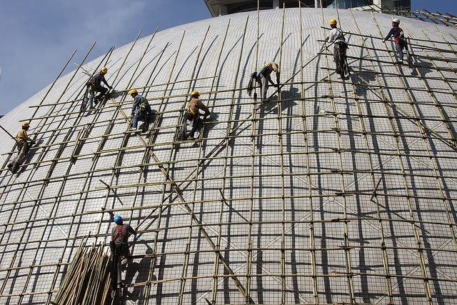
We Providing Scaffolding
The videos, readings and tasks are designed to build a scaffolding for you to use
As thinking exercises
When you are doing the coursework
In the immediate future, helping you make good decisions about your study habits
In the longer term during your degree studies
photo by Anne Roberts
Notes:
photo by photo by Anne Roberts

Slide 43
Every student is different
The quizzes provide real data about the students
Anonymously
In general terms
The surveys and information from Blackboard provides
A more accurate picture about how much use you are making of the resources
In general how students are interacting with this part of the module
your collective answers online are anonymous the analysis helps us understand your overall attitudes

Slide 44
Understanding your assessment

Slide 45
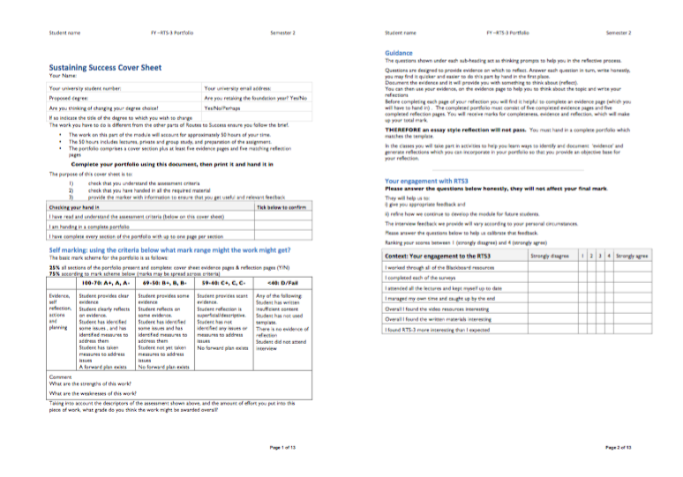
Looking at the portfolio
W1 printout in class
Notes:
This is where we get to in week 1

Slide 46
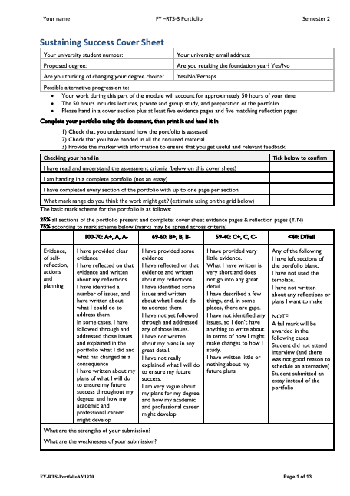
Portfolio Contents
Cover sheet
Five sections
Complete every section

Slide 47
Portfolio Contents
Answer all questions

Slide 48
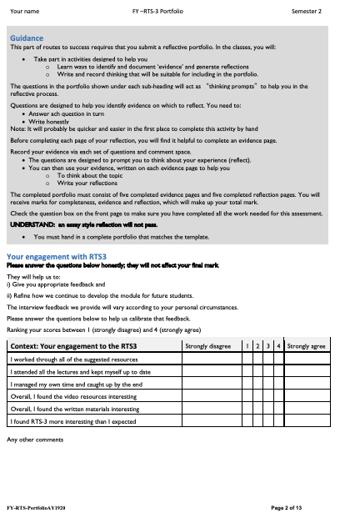
Read the text and answer the questions

Slide 49
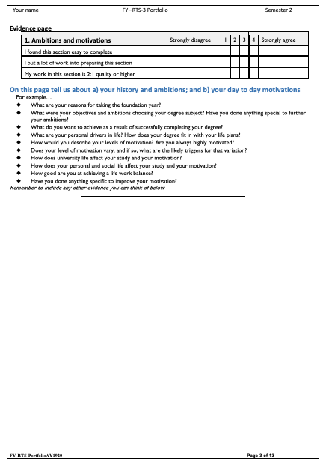
Ambitions and motivations

Slide 50
Any reflections on your ambitions and motivations?
What have you done to further your ambitions?

Slide 51
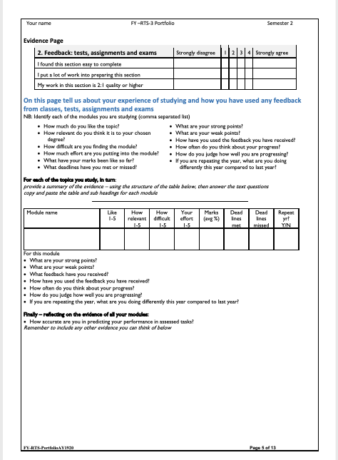
For each different part of the course that you study
how do you get on?

Slide 52
Progress through the year: continuous assessment

Slide 53
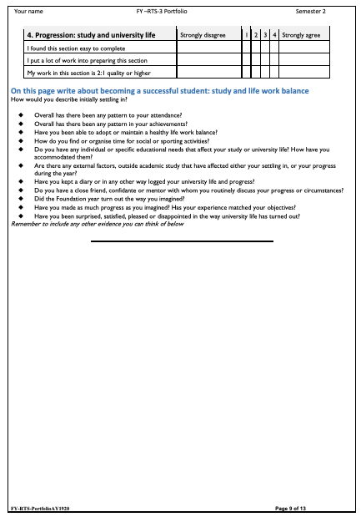
Becoming a student

Slide 54
Becoming a university student: reflections

Slide 55
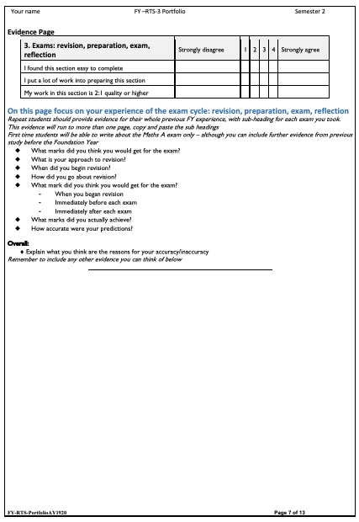
Preparing for exams

Slide 56
Learning from exams

Slide 57
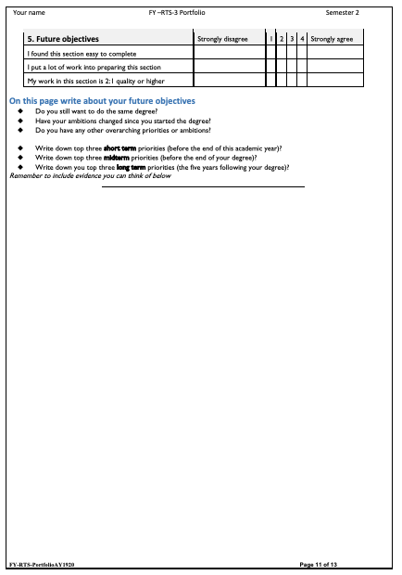
Planning for the future

Slide 58
Looking back over the year so far: reflections

Slide 59
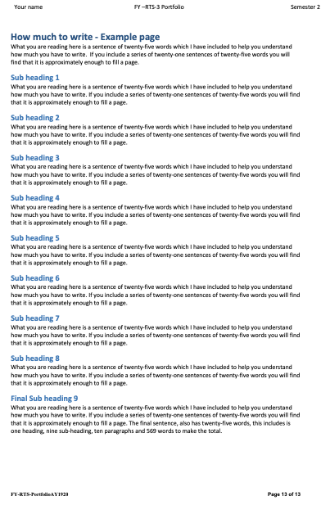
How much you have to write

Slide 60
When you used the template
Did you have any issues?
Page size?
Don’t know how to edit it
Cant control the layout
….

Slide 61
Mental Jogging

Slide 62
A (sort of) competition
What are the mistakes a student can make which will derail their progress
List
1 point for a ‘common’ mistake
2 points for a mistake that two or three other people have
3 points for each unique mistake

Slide 63
Round two
Now solve the problems
Same scoring rules apply

Slide 64
Activity

Slide 65
Writing – and how to do it!
Exercise
We are going to spend five minutes free writing
Use the final page of the portfolio
Spend five minutes writing about your understanding of feedback, what you do and why you do it the way you do

Slide 66
Rely on your brain….

Slide 67
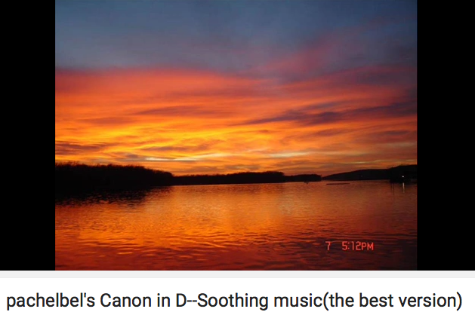
Start Now
https://youtu.be/hOA-2hl1Vbc

Slide 68
What we know about writing
It can be a thinking tool
You can get rid of fear by writing , freely, for a short while every day
Want to accept a challenge?
http://750words.com/
Sign up – one month free – just right for the portfolio ☺

Slide 69
Now look at the portfolio (1st section)
http://www.edshare.soton.ac.uk/18185/
First section pages 3-4
What are your ambitions?
Do you have goals?
Use paper and index card (in class) *
think about your goals
What do you want to achieve over the next few weeks?
Write quickly – rough ideas
Select and write down three or more goals that relate to the portfolio
* Studying alone, find a piece of paper and write it down on that
Although a card is best because you can carry it around with you as a reminder afterwards

Slide 70
Use this model for reflection
you can use these set questions to help
think about the evidence and complete the portfolio
What?
So What?
Now What?

Slide 71
Explaining the model: What?
What?
Use the specific:
“I completed a lab and received a mark (xxx) for some work (yyy)”
Avoid the general
“I keep missing deadlines and loose marks”
“My marks for this module are OK… Although:”
Explain what actually happens
Try starting with a general, and applying critical thinking, can lead you to the specific
if your first response is to provide a general answer ask yourself how you can make it much more specific

Slide 72
Explaining the model: So What?
So What?
My work got a: | 1st, 2:1,2:2;3rd, Fail (near pass), Fail
I expected a mark of: | 1st, 2:1,2:2;3rd, Fail (near pass), Fail, no idea
When I handed in I felt: | {your emotion/confidence/state of mind}
When I got the mark | {your emotion/confidence/state of mind}
The reason the for the relationship between my expectations, mark, and feeling was: | A logical analysis of the evidence and observations

Slide 73
Explaining the model: So what?
So What?
An explanation of any logical conclusions which you draw:
examples
I think I was {over optimistic, unrealistic, realistic}
The outcome might have been better if….
The outcome was satisfactory/excellent but….
What you will write will be an objective evaluation of your experience

Slide 74
Explaining the model: Now What
Now What?
A realistic and objective suggestion of changes you will make:
Examples:
How you might
Change your behaviours and do things differently
Look at things differently
NB: it will be different for everyone

Slide 75
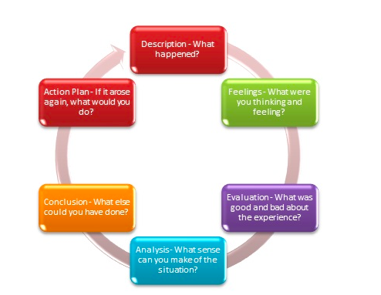
Another way of thinking about it

Slide 76
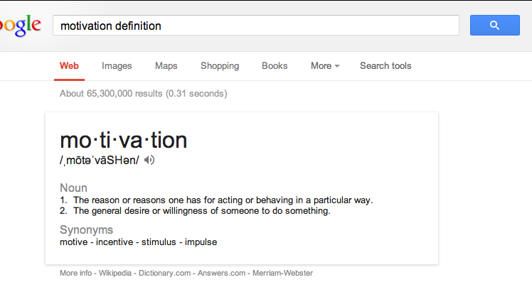
Think about your motivation

Slide 77
Your Task…
About 20 available days from start to the deadline

Slide 78
Self Study: Look at the Portfolio
Notes:
Show the portfolio using the visualiser
Have a one page handout of the sections

Slide 79
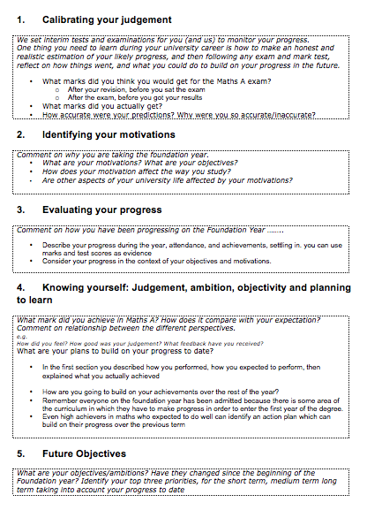
Intro Portfolio
Look at your handout
What would you put in the sections?
Notes:
Each look at the handout individually
Verbal questioning, do you have a problem with section?

Slide 80
Intros: what you have to think about
motivations
exam
progress
self knowledge
Future plans
Notes:
What you have to think about
Exam (performance and progression)
Motivations
Progress
Self Knowledge
Future Plans

Slide 81
Suggested watching and reading
A vision of students today
How to Get the Most Out of Studying: Part 1 of 5, "Beliefs That Make You Fail... Or Succeed"
How to Learn Anything... Fast - Josh Kaufman
GLADWELL, M. (2008). Outliers, the story of success, Penguin (Audio Book on YouTube)
RSA Animate - Drive: The surprising truth about what motivates us
SYED, M. (2010) Bounce: The Myth of Talent and the Power of Practice, Fourth Estate (video of recent presentation by Matt Syed
The Visions of Students Today 2011 Remix One (trailer)
Plus a few others – the list is constantly renewing – look in edshare

Slide 82
Your formal objectives:
The module - Sustaining Success
Three portfolio components
Getting Started in Higher Education ✔
Making Progress ✔
Sustaining Success: NOW
Notes:
Recap on what has gone, and what is expected
Gauging the level of engagement, and motivation

Slide 83
Bigger Objective
Successfully complete the foundation year
Gain a brilliant degree
Secure the future of you choice/dreams

Slide 84
Objectives (task)
Ambition, desire, need, want….
Identify your own objectives
Think for a moment…
What do you want to achieve?
Today
Tomorrow
This semester, year,
During the life of your degree
Should relate to why you are here :-)
Notes:
Relate the whole routes to success class back to the personal

Slide 85
About Feedback
How do we get it?
How? When? So What?

Slide 86
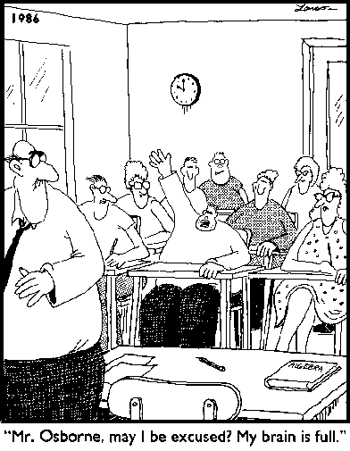
Varieties of Feedback: Full Brain?
Notes:
Opening for discussion of the range of types of feedback
Learning taking place in three domains
Cognitive
Affective
Psycho-motor

Slide 87
Think about this module (RTS)
What have you done? What have *you* achieved?
Q How do you rate it so far?
Obviously useful
Surprisingly useful
Still not sure
Don’t think it is helping
Notes:
Interactive discussion, write feedback on board/acetate

Slide 88
Reflection and Feedback 1
True of False?
You can only get feedback on your work from the lecturers or demonstrators
Notes:
Ask the question, get a vote, have some discussion

Slide 89
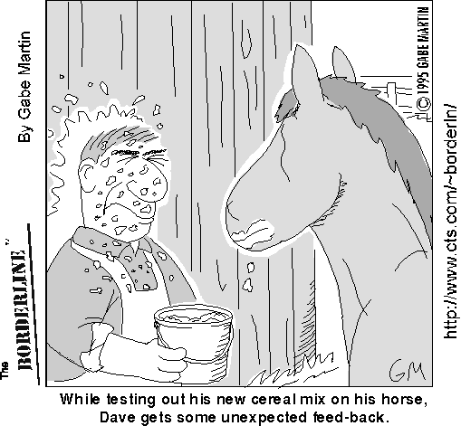
reflection and feedback 2
How can you get feedback from an exam?
Choose any which apply
Listen to the general feedback on how we all did
Think about how I did
Talk to fellow students about how we did
Read and analyse at my marked exam script
Attempt the exam a second time
Notes:
Discussion of different types of feedback
Relation between feedback and reflection
Peer learning

Slide 90
exams
Remember
Think back
Before your exam
Make a note now…
TODAY - Think back
Reflecting on your exam performance
As you are thinking about it today…
Make a note

Slide 91
Your Tasks
Some things for you…
And the portfolio ;-)

Slide 92
1) Progress review
Think about your progress so far this year
What will you continue?
What will you modify?
What will you stop?
By the end of next week
Complete the self evaluation quiz
Read each section of the portfolio and sketch in some responses

Slide 93
Thank You :-)

Slide 94
Essential Activities..
Think about evidence…
Where will you get evidence?
What sort of evidence can you use?
Watch the videos
think about *your* education
Think about *your* learning
Take a look at EdShare - how could you use it to assemble evidence?

Slide 95
Video: A vision of students today
Swap to web browser! Linked from EdShare
Work by Michael Wesch of Kansas State University - Digital Ethnography Project
http://www.edshare.soton.ac.uk/67/
Notes:
This is a five minute video clip which looks at the student experience from the students perspective
Opens up discussion into the tensions between academic and non academic life
Need for work life balance

Slide 96
Introductory resources
These slides
The portfolio template
The first survey
Your free writing
Your goals
The videos (linked from blackboard)
review all the information in these resources review these slides

