Slide 1
Presentations, Team Work and Organisation
Hugh Davis Oct 2018

Slide 2
The Best Presentations
Have Emotional Impact on the audience (engaging, interactive, challenging, beautiful….?)
Present Information (right amount and well represented)
Tell a Story that the audience can relate to
Are memorable
https://www.vecteezy.com/vector-art/94240-comic-style-background-illustration

Slide 3
Tips on Making Presentations (1)
Dress smartly
Say hello and smile when you greet the audience:
Speak clearly. Don't speak too quickly:
Use silence to emphasise points
It’s OK to use humour,
Keep within the allotted time for your talk
Eye contact is crucial to holding the attention of your audience.
Walk around a little and gesture with your hands.
Involve your audience by asking them questions
https://www.kent.ac.uk/careers/presentationskills.htm

Slide 4
Tips on Making Presentations (2)
Practice
Don't read out your talk – find a way to give yourself prompts
Organise your talk, and make the clear
Build variety into your talk and the media
Its OK to be a bit nervous
Don’t let a mistake upset you – people don’t mind!
Don’t stand in front of, or talk to, your slides
Practice smooth transitions
Practice again

Slide 5
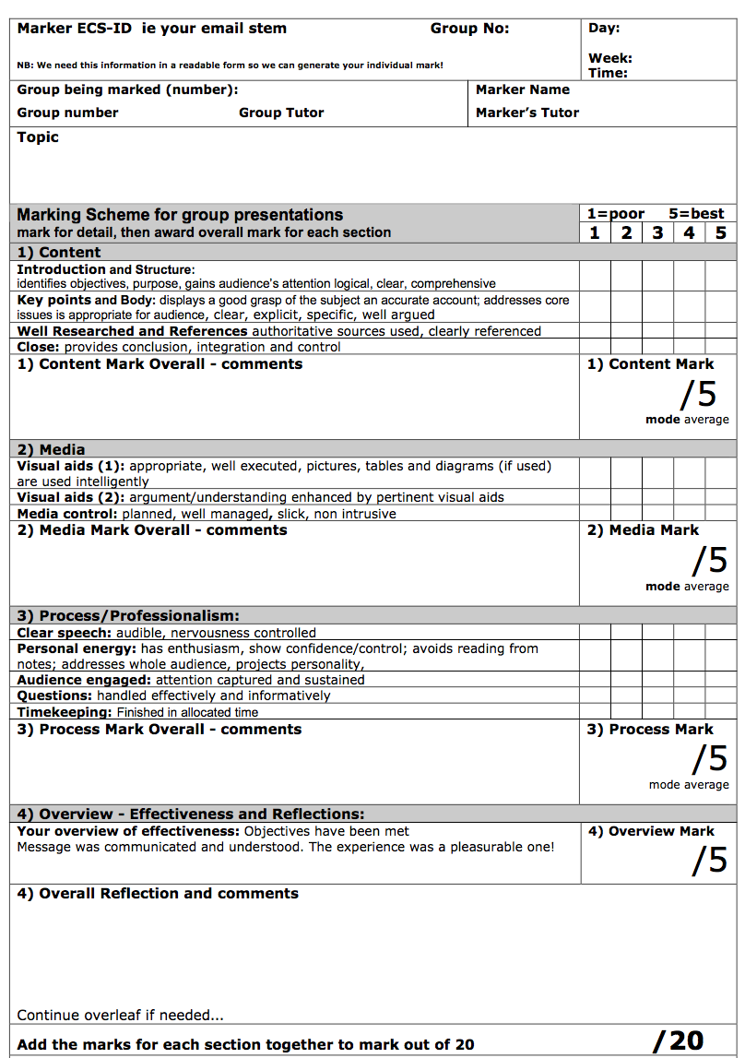
Assessment Criteria
The criteria are designed to:
steer you towards learning from the task you undertake
Learning by doing
Reflecting on your experience
Learning from your mistakes

Slide 6
1. Content
1.1 Introduction and structure:
Identifies objectives, & purpose,
gains audience’s attention
logical, clear, comprehensive
1.2 Key points and body:
displays a good grasp of the subject
an accurate account;
addresses core issues is appropriate for audience,
clear, explicit, specific, well argued
1.3 Well researched/referenced:
authoritative sources used,
clearly referenced
1.4 Close:
provides conclusion,
demonstrates integration and control

Slide 7
2. Media
2.1 Visual aids (1):
appropriate, well executed
pictures, tables and diagrams (if used) are used intelligently
2.2 Visual aids (2):
argument/understanding enhanced by pertinent visual aids
2.3 Media control:
planned
well managed
slick, non intrusive

Slide 8
Good media means preparation
https://www.fotolia.com/id/124983058
And remember to reference borrowed media

Slide 9
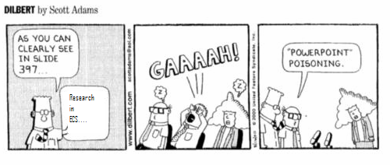
Will you have enough slides?
Approx 1 min per slide
Each must present, practice the timings, present your argument
Notes:
1 minute per slide

Slide 10
3 Process & Professionalism
3.3 Audience engaged
attention captured and sustained
3.4 Questions
handled effectively and informatively
3.5 Timekeeping:
Finished in allocated time
3.1 Clear speech:
audible,
nervousness controlled
3.2 Personal energy:
has enthusiasm
shows confidence/control
avoids reading from notes
addresses whole audience
projects personality

Slide 11
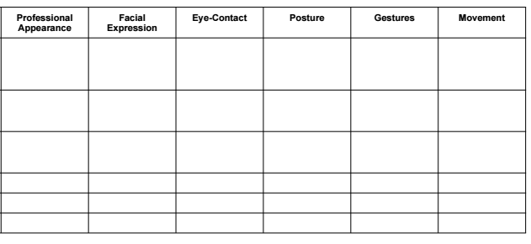
Extra things to think about
Notes:
Shiny head

Slide 12
4 Overall Effectiveness
Your overview of effectiveness:
Objectives have been met
Message was communicated and understood.
The experience was a pleasurable one!

Slide 13
Advice for the actual presentation…
Be yourself
Plan and rehearse
Talk to your audience
Tell a story
Start middle end
Use cues
Pen to point
Think about fonts
Diagrams
Pictures
Eye contact
Project voice
Try out different methods
Order is important

Slide 14
Record yourself
Play it back
Time yourself
“Ummmm….”
“Aaahhh….”
“Ok, so…..”

Slide 15
Everyone speaks
Rehearse as a group
Make one group presentation NOT four individual presentations

Slide 16
Impress them!

Slide 17
Look at some other presentations. E.g. Compare and critique
https://www.youtube.com/watch?v=BfDQNrVphLQ Jeff Dean- Artificial Intelligence
https://www.youtube.com/watch?v=GHmkuv69PQE Pablos Holman
Notes:
Eye contact, pauses for impact. Sure of themselves- charisma

Slide 18
Build on what you know already….
As a consumer of presentations
Think about a memorable presentation
What made it good?
Three things….
That you like to see in presentations
That make presentations a disaster
Chat with your friends about this
Use this knowledge in your group

Slide 19
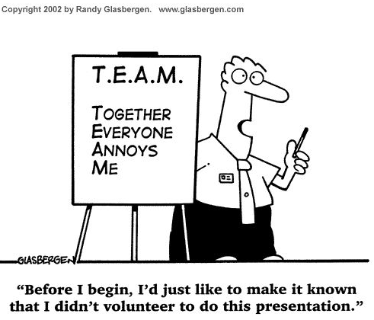
Teamwork

Slide 20
Advice for effective teamwork
Come to a common understanding of the nature of the task or goal
Adopt complementary roles
Agree targets, and strategies for meeting them
Review progress and communicate openly
Lead when appropriate
Respect everyone’s contribution and give constructive feedback
Accept that groups go through phases
Celebrate achievement

Slide 21
Communicating effectively
When working as a team, think about:
Language you use
Tone of voice
Turn-taking
Expressing yourself clearly in speech and in writing
Listening carefully
Aspects of body language such as:
facial expression
where you sit or stand in relation to others
engaged posture to show that you are interested

Slide 22
Ways folks Hinder teamwork
blocking | – interfering with team progress
aggressing | – criticising or blaming others
seeking recognition | – attempting to call attention to oneself
withdrawing | – being indifferent or passive, resorting to excessive formality, whispering
dominating | – trying to assert authority in manipulating the group, interrupting

Slide 23
Suggested ground rules
Turn up to meetings
Agree on agenda for meetings
Nobody to speak for longer than 3 minutes at a time
No interrupting
No putting others down: criticise the idea not the process
Encourage everyone to speak
Start and end meetings on time
Set deadlines and stick to them
Everyone to do what they agree

Slide 24
Dealing with difficulties
Problem | Possible solution
Uneven workload | Agree who does what at the start and write it down. Ask why work isn’t being done and explain the effect on the group.
Too much work involved | Revisit task. Are there more effective approaches?
Resources not available | Plan for this at the start.
Confusion | Discuss goals as a group and revisit.
Quiet group members | Ask their views – encourage comment (be positive).
Disruptive group members | Ask ‘talkatives’ to let somebody else speak – be assertive.

Slide 25
What we expect
Discuss and agree an approach to the topic
Allocate roles
Research the topic
Construct an argument
Present the argument
Harness the information
Prepare a draft
Review/revise
Practice, practice, practice
Demonstrate competence
Research
Collate
Assemble
Review
Revise
Plan
The assessment criteria are always designed to steer you towards learning from the tasks you undertake

Slide 26
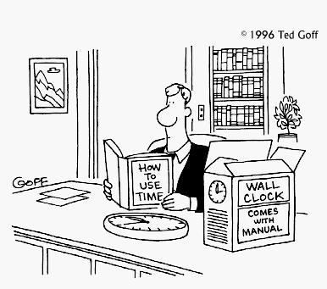
Time Management and Planning

Slide 27
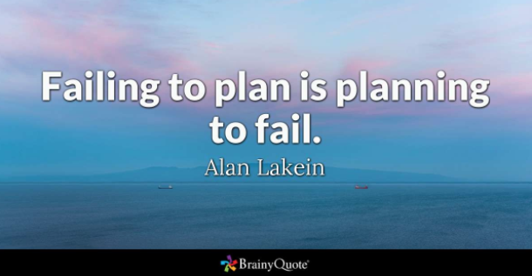
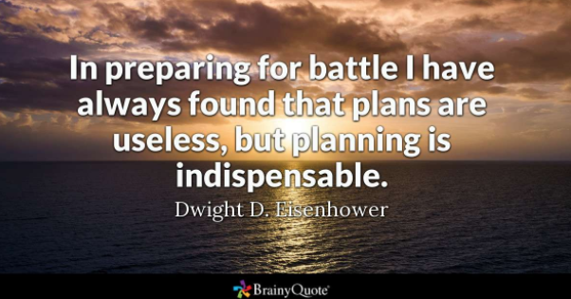
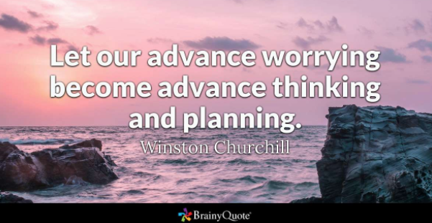

Slide 28
What does planning buy you?
If you articulate the objectives you have then you are more likely to achieve them
Helps you differentiate the important from the urgent
Helps to stop procrastination
A plan gives you just one thing you should be doing – rather than trying to decide which of many things to tackle.
Leaves you in control which reduces anxiety

Slide 29
How Good a Planner are you?
Do you have a diary with important deadlines?
Do you write down daily plans, to allocate time for your deadlines?
Do you allow flexibility in your plans?
How often do you accomplish all you plan for a given day?
How often do you plan time for what matters most to you?
Do you get through your daily plan without interruptions?
Score 1= never 2 = seldom 3 = sometimes 4 = often 5 = always
Adapted from Quiz written for USA WEEKEND by time management expert Hyrum Smith, chairman of the Franklin Covey Co.

Slide 30
Results
6-10: Terrible Life just happens to you. And it often goes wrong.
11-15: Below average planner. More effective planning will help to reduce the stress and lack of control you feel in your life.
16-20: Average planner. Not bad. But may need help focusing on priorities and dealing with urgent interruptions.
21-25: Good planner. You are in control of your life
26-30: Excellent planner--or obsessive compulsive? Make sure you’re in control of your planning rather than letting it control you.

Slide 31
Time Management Technique - example
Articulate your aims
I want to get an excellent degree
Set Goals to achieve these aims
I want to do well in COMP1205 CW2
Identify things you can do to achieve these goals
Meet group to choose subject, identify good angle, select media etc
Identify deadlines and other time constraints
For COMP1205 I have coursework deadlines…
Allocate time in a daily planner to meet the deadlines

Slide 32
Some things in student life that need scheduling
Lectures, tutorials etc.
Time to do courseworks
Time to understand lecture notes (pre and post reading), and do examples
Time to revise for exams
Time for exercise
Time for recreational activities
Employment?
Time to do things needed for longer term goals (write CV’s, job applications, attend meetings etc.)
And don’t forget time to reflect on progress and to re-schedule things!

Slide 33
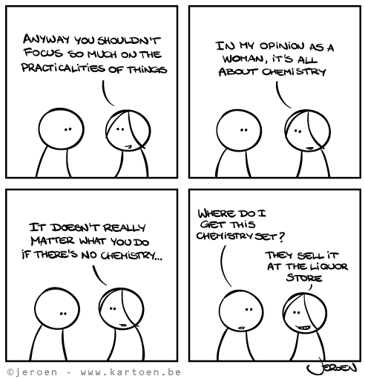
The Coursework (Some Practicalities)

Slide 34
Some Questions Answered
How does peer reviewing work - and why?
Can we change the proposed subject?
What does a summary for a presentation look like?
What would make a good presentation plan?
How to deal with nervous performers?
How to manage non-performers.
The Value of the Feedback Session!
Any Other Questions?

