Slide 1
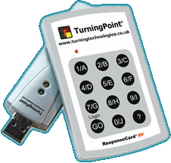
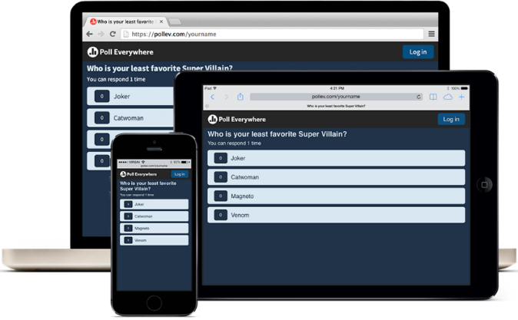
Student Response Systems. Enabling instant feedback
Adam Warren

Slide 2
meetoo.io
Multiple-choice and multiple-response polls
Good messaging with optional moderation
PowerPoint add-in (requires Windows laptop)
Free institutional trial for AY 16/17 (100 students)
go.lumiinsight.com/studentplan

Slide 3
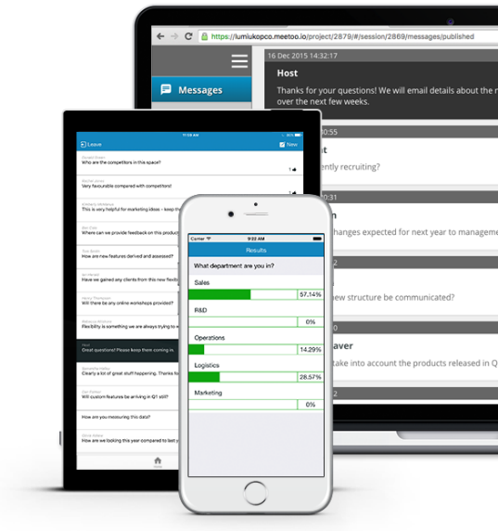
How to vote using Meetoo
Open the web browser on your phone/tablet/laptop
Go to www.meetoo.io
Click Join Meeting button at top of page
Type in the Meeting ID and click Join
You can now answer on-screen questions
You can download the free MeeToo app from the iTunes or Google Play stores
Meeting ID
176-255-374

Slide 4
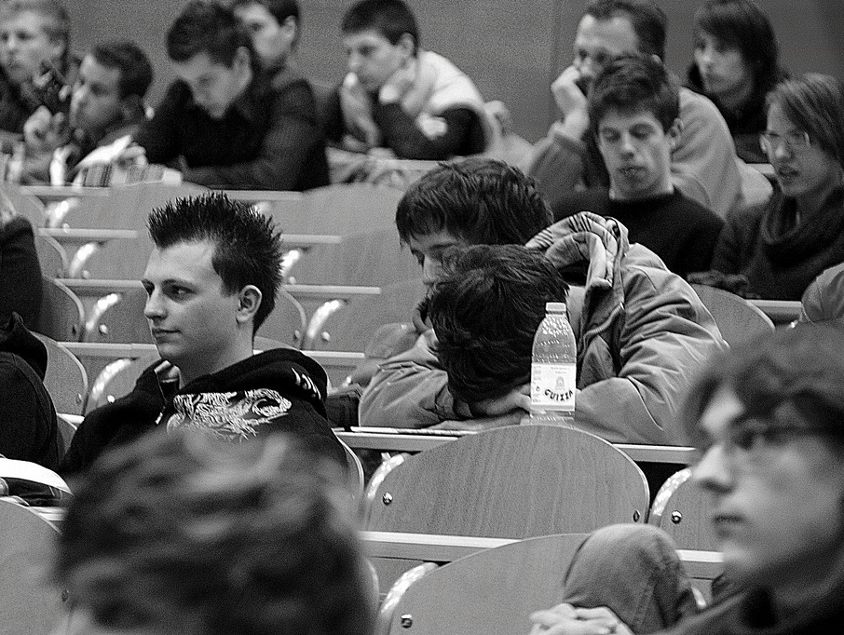
Lecture snooze
What do we know about large lectures?
Photo credit: http://www.flickr.com/photos/tadeeej/3228729514/

Slide 5
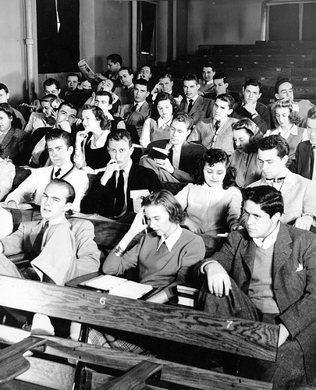
What does the tutor do?
What do the students do?
Do students respond to questions?
Do students ask the tutor questions?
How does the tutor know if the students are taking in what is said?
How do they evaluate, discuss or apply what they are learning?
CC Image: Duke University 1940s

Slide 6
Blended learning using student response systems
Check understanding
Provide instant feedback
Gather opinions
Facilitate debate
In-class tests
Evaluation of teaching
Better use of face-to-face time
More effective didactic content
Increase student engagement
New possibilities for activities

Slide 7
Educational benefits
Anonymous, so students feel ‘safe’
Requires them to commit to an answer
Refreshes student attention
Directs students to key points
Good questions make use of common misconceptions
Tutor explains why answers are correct AND incorrect

Slide 8
“ Clickers create learning environments characterized by greater activity, cooperation and conceptual application compared to traditional, lecture-based instruction.”
Angel Hoekstra (2008)
Hoekstra, Angel(2008) Vibrant student voices: exploring effects of the use of clickers in large college courses, Learning, Media and Technology,33:4,329 — 341

Slide 9
“ As an educational tool, clickers do not simply augment the classroom, they transform it because of the new responsibilities given to students to guide and affect classroom dynamics.”
Trees, A. R., & Jackson, M. H. (2007). The learning environment in clicker classrooms: student processes of learning and involvement in large university‐level courses using student response systems. Learning, Media and Technology (Vol 32, Iss1)

Slide 10
Individual feedback
Tutor
Sets a problem
Student
Answers question using clicker
Tutor
Displays and discusses results
Tutor
Did the class get this right?
Student
Did I get this right?

Slide 11
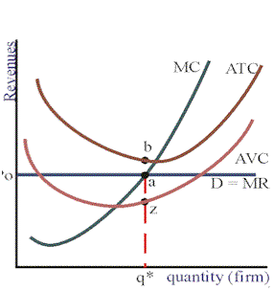
Did you understand the lecture so far?
From the graph, which of the following is not true:
The firm will have positive economic profits if price rises above point b.
Given the demand curve, the firm has economic losses.
Due to the economic losses present, the firm will exit the industry.
When MC = MR = min ATC, economic profits will equal to zero.

Slide 12
Encouraging constructivist learning
Tutor
Sets a problem
Students
Think and THEN discuss solution
Student
Answers question using clicker
Tutor
Displays and discusses results
Tutor
Did the class get this right?
Student
Did I get this right?

Slide 13
Icebergs in your bath
Your bath contains 100 litres of cold tap-water. You add a giant ice cube that weighs 10kg, which floats in the bath.
You mark the level of the water on the side of the bath. The next day, the ice cube has melted. Has the level of the water:
A – risen?
B – stayed the same?
C – fallen?

Slide 14
Icebergs in your bath
The water level remains the same when the ice cube melts.
A floating object displaces an amount of water equal to its own weight. Since water expands when it freezes, one kilogram of frozen water has a larger volume than one litre of liquid water, so it is less dense and floats.

Slide 15
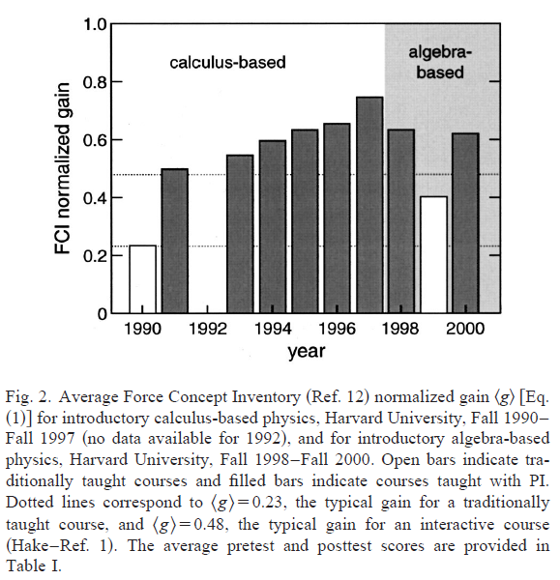
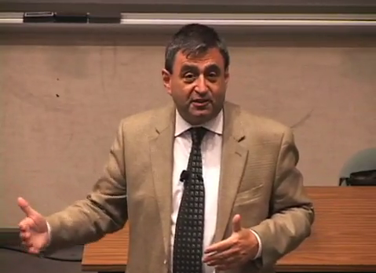
Peer Instruction: Dr Eric Mazur
Peer Instruction: Ten years of experience and results
American Journal of Physics 69 (9) September 2001
From Questions to Concepts (2:30) http://www.youtube.com/watch?v=lBYrKPoVFwg
Confessions of a Converted Lecturer (80:09) http://www.youtube.com/watch?v=WwslBPj8GgI
Peer Instruction: Ten years of experience and results: http://tinyurl.com/82wphxe

Slide 16
Peer Instruction: a type of flipped learning
Tutor
Defines self-study material
Student
Studies material > online test
Student
Identifies difficult aspects
Tutor
Creates session to address these
Lecture
3 or 4 PI ConcepTest questions

Slide 17
Peer Instruction
Tutor sets problem
Students discuss solutions
Students vote
Students vote again
Students discuss result
Tutor shows 1st result
Tutor shows 2nd result
Tutor discusses solution
Mazur, E. 1997. Peer instruction: A user’s manual. Upper Saddle River, NJ: Prentice Hall.

Slide 18
Using peer instruction
Did almost all students choose the correct answer?
yes
Move on
no
Did they mostly choose the same incorrect answer?
yes
Re-explain
no
Get them to discuss the question
and
Vote again

Slide 19
How to find ConcepTest questions
You’ll probably have to write your own!
Google:
<your discipline> ConcepTest
<your discipline> “Concept Test”
<your discipline> “Peer Instruction”
Peer Instruction Network
http://www.peerinstruction.net/
Developing collections

Slide 20
Shift from passive to active student role: requires framing
Cultural expectations about the role of the professor
Integrated or supplemental?
Number and type of questions each session?

Slide 21
“ The success of the clickers is in many ways dependent on social, not technological, factors. Instructors must work to facilitate student acceptance and to frame student perceptions of the technology. Students must use them skilfully and faithfully. Students must also embrace the ways that clickers will change their learning experience.”
Trees, A. R., & Jackson, M. H. (2007). The learning environment in clicker classrooms: student processes of learning and involvement in large university‐level courses using student response systems. Learning, Media and Technology (Vol 32, Iss1)

Slide 22
Start of term
Explain why you are using SRS
Immediate feedback to students and tutor
Opportunities for discussion
Maybe as a ‘back channel’ for questions
Will it be used every lecture?
What if someone can’t vote?

Slide 23
Running your first poll
Provide clear instructions on a slide
Write access codes on the board
Start with web access
A couple of questions that require discussion?
Only one person per small group responds?
Simple (manual) countdown?
Download app before next lecture?

Slide 24
How many questions?
When do the students need feedback on progress?
When do you need feedback about the cohort?
Questions that test understanding, not recall
Or the ability to perform a calculation etc.
Questions based on common misconceptions?
Working in small groups: think, discuss, vote

Slide 25
Beyond correct/incorrect
Best answer?
Correct, probably correct, probably incorrect, incorrect, don’t know
Multiple response (2 or more choices possible)
Assertion:reason to check understanding
A is true because B is true (Reason is correct)
A is true and B is true (Reason is incorrect)
A is true and B is false
A is false and B is true
A is false and B is false

Slide 26
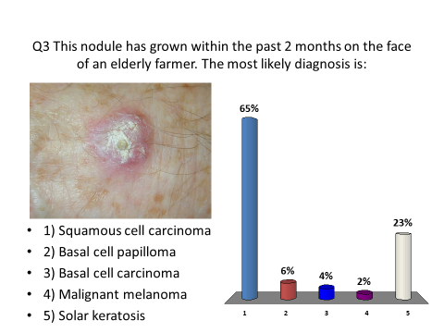
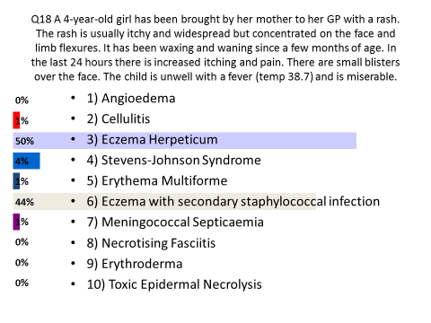
SRS for in-class tests
Why SRS?
Plan B
The safety net
Question-by-question
Identifying students
Providing feedback
Pass or fail?

Slide 27
SRS outside the university
Outreach in schools and colleges (clickers)
Asking about ambitions, interests, knowledge
Team games
Use in conferences (mobile)
Voting on options
Asking about opinions or experience
Back-channel for questions
Use for research (live audiences)
Anonymity (reliability?)

Slide 28
Advantages
Disadvantages
Uses students own mobile devices
Requires Wi-Fi or 3/4G
No limit on numbers
Limited integration with PowerPoint
Text-entry questions
Uses students own mobile devices
Suitable device?
Sufficient battery?
Cannot include images effectively
Site licence required?

Slide 29
Turning Point clickers

Slide 30
Advantages
Disadvantages
Integrated with PowerPoint
Available in all CLS teaching spaces
Reliable and simple to use
Does not require WiFi or mobile devices
Need to book, collect and return handsets
The Library has 6 loan sets (240 clickers)
Need to distribute and collect handsets

Slide 31
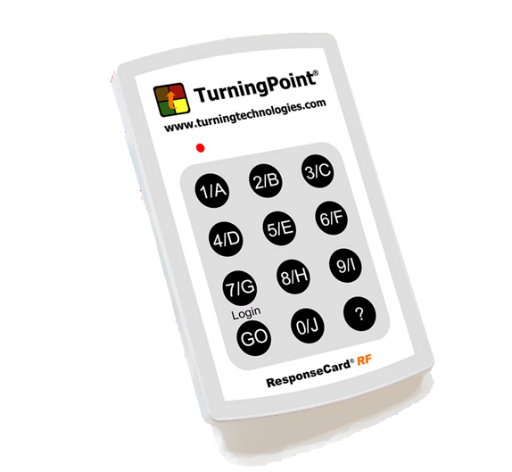
How to vote using your clicker
Press a button to select your answer. (Note that 0/J = 10)
You may want to press it twice to make sure!
You can change your answer (until polling closes) by pressing another button. Only your final answer counts.
It will not accept invalid answers.
Please don’t press the GO button as it is used to change channel.

Slide 32
Use the question on the next slide to check your clicker
If this lights up green when you answer, your clicker is OK.
If it flashes yellow and red, your clicker is not set up correctly.
If so, please put up your hand and tell your tutor.
They will give you a replacement.

Slide 33
A question to test your clicker
What did you drink with your breakfast this morning?
What’s breakfast?
Coffee
Tea
Fruit Juice
Water
Nothing
Other
Remember to check that the light flashes green when you vote!

Slide 34
Basic use for simple tests
Simple, primarily factual questions
At start of session:
evaluate prior knowledge
test recall from previous session
quiz about preparatory reading
At end of session:
emphasise main points
provide feedback to students

Slide 35
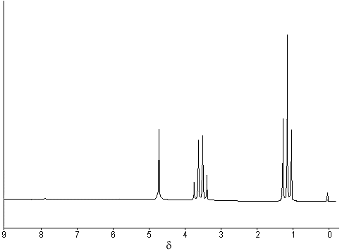
Which is the correct assignment?
C
B
A
C
A
B
A
B
C
C
B
A
C
A
B
1

Slide 36
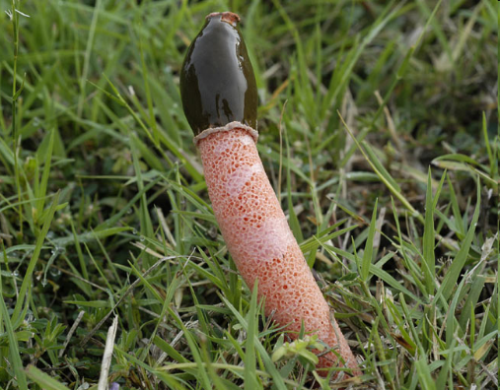
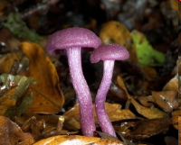
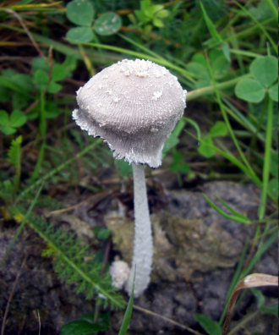
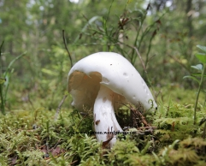
Which one of these fungi is deadly poisonous?
A.
B.
Dog Stinkhorn
Amythest Deceiver
Cowpat Fungus
Destroying Angel
C.
D.

Slide 37
Use to promote debate
Questions that have no ‘right answer’
Questions that expose misconceptions

Slide 38
Do you think that the UK ought to build new nuclear power stations?
Yes
No
Undecided

Slide 39
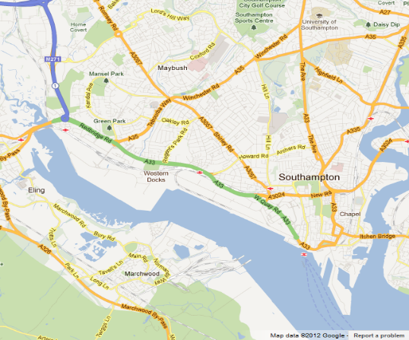
Do you think that the UK ought to build a new nuclear power station at Marchwood?
Yes
No
Undecided

Slide 40
Geometry 101: Radius Refresher
R = radius of a circle
C = circumference
π = pi = 3.14159
For a circle, C = 2π x R
So if R = 1m, C=6.28m
R
C

Slide 41
ConcepTest question about radii
Imagine the Earth is perfectly smooth and spherical (radius 6378 km).
A rope is stretched around the equator so it touches the ground.
The rope is made 10 metres longer and floats an even distance above the ground all the way round. What is the largest organism that can pass beneath the rope without touching it?
A bacterium (1μm)
An amoeba (200 μm)
An ant (2 mm)
A mouse (20 mm)
A human (2 m)

Slide 42
ConcepTest question about radii
Imagine the Earth is perfectly smooth and spherical (radius 6378 km).
A rope is stretched around the equator so it touches the ground.
The rope is made 10 metres longer and floats an even distance above the ground all the way round. What is the largest organism that can pass beneath the rope without touching it?
A bacterium (1μm)
An amoeba (200 μm)
An ant (2 mm)
A mouse (20 mm)
A human (2 m)

Slide 43
Geometry 101: Radius Refresher
C = 2π x R
C2 = 2π x R2
(C+10) = 2π x R2
(2π x R) + 10 = 2π x R2
Divide both sides by 2π
R + 10/ (2π) = R2
R2 – R = 10/6.28 = 1.59m
C2
R2
R2-R
R
C

Slide 44
Support from ILIaD
Consultancy on and support for learning design;
Assisting development of appropriate activities;
Special interest group/events for sharing and dissemination;
In-house events as requested by individual faculties;
http://www.southampton.ac.uk/iliad/
Community of Practice SRS Special Interest Group http://blog.soton.ac.uk/iliadcommunity/
Online support for SRS
http://elearn.southampton.ac.uk/

