Slide 1
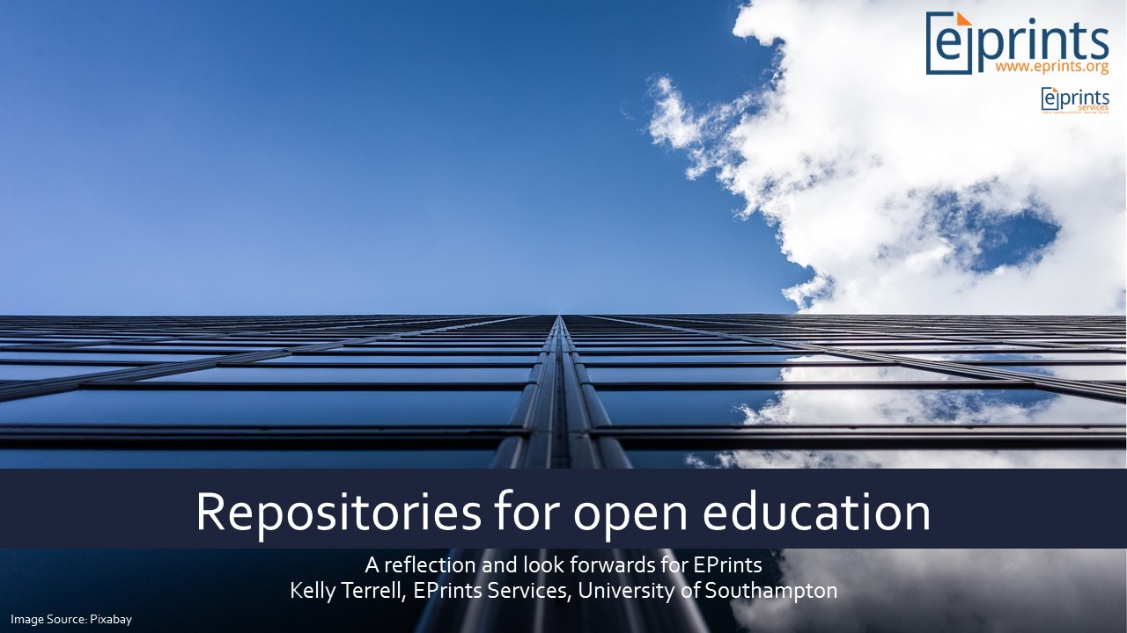

Slide 2
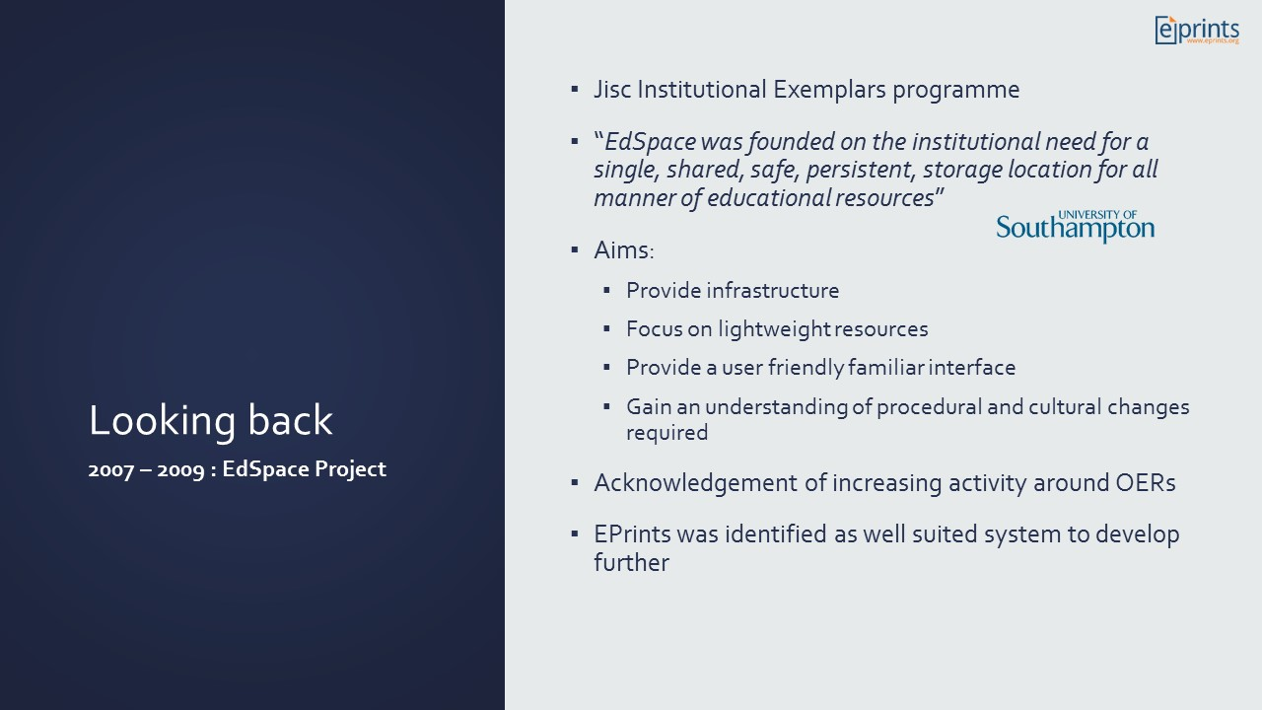
Notes:
Institutional needs for a single platform was identified – funded by university and some money from Jisc
LMSs/VLEs we looked at as potential solution:
LMSs had a heavy focus on learning objects, passive delivery, not user friendly
VLEs beneficial primarily in delivery, lots of barriers to access, links change
Project bid acknowledge growing activity around OERs – MIT opening access to its courseware, OECD, Hewlett Flora Foundation and UNESCO all recognizing the potential of OE and OERs
EPrints was chosen for multiple reasons
a well established, stable repository solution
“Since EPrints is agnostic about the type of materials it manages there is no reason why the system should not equally be used as a repository for learning resources”
Since any materials can be managed in the system it was well suited to be equally used for learning resources
It needed work to adapt it for a very different user experience and community role

Slide 3
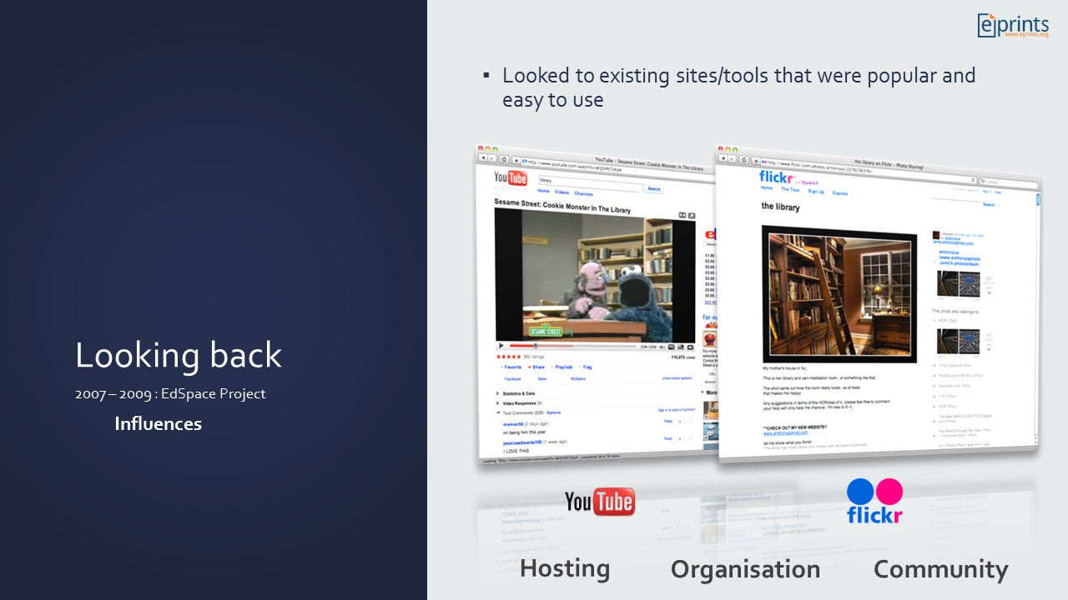
Notes:
Default Eprints needed to be adapted to suit submission and presentation needs around T&L materials and overall user experience
Project team looked at what existing media sharing sites were providing
Three themes arose: Hosting, Organisation, Community
> Hosting – the content is uploaded and stored – deposit doesn’t usually care or need to worry about it
> Organisation – using tags, collections, albums content is arranged – flexibility to suit preferences
> Community – Comments, Ratings, accessing user information – contributors are visible to others, networking, feedback

Slide 4
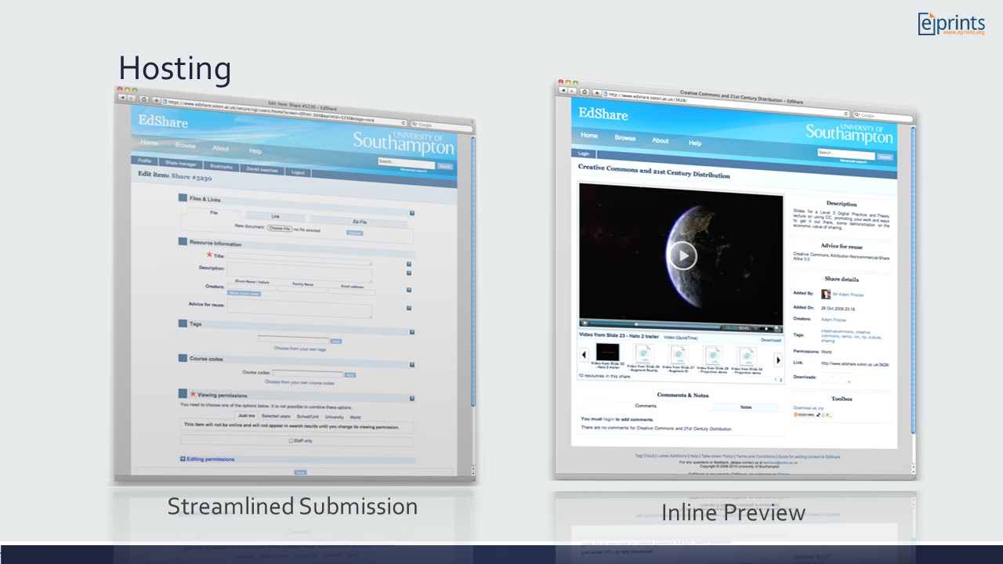
Notes:
These areas were applied to EPrints.
Workflow – default thrown away:
Minimal metadata required for submission
Resources go live immediately
Project went beyond institutional sharing by adding rights to share with World, and allow others to edit (OERs)
Abstract page – default thrown away
Page prioritise the media content – inline previews

Slide 5
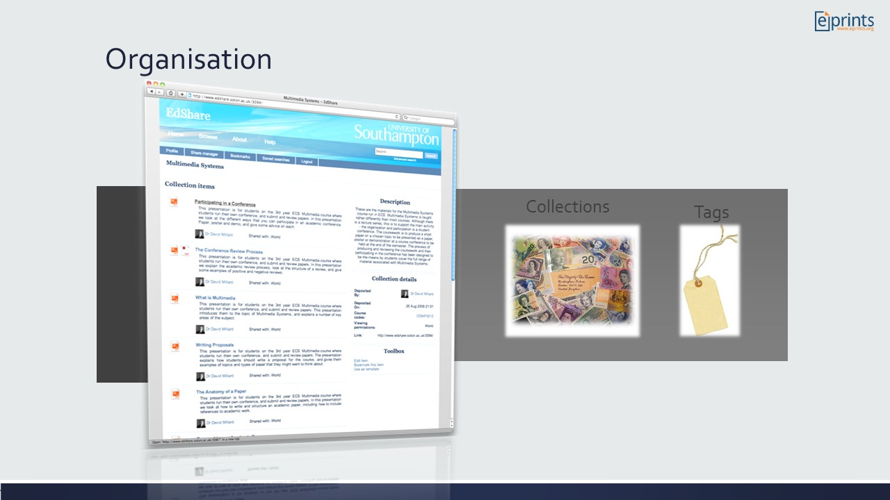
Notes:
Multiple ways of sorting / arranging information so that can be found
Flexible, not forced
Individual preference – some may use tags, others may use collections, both

Slide 6
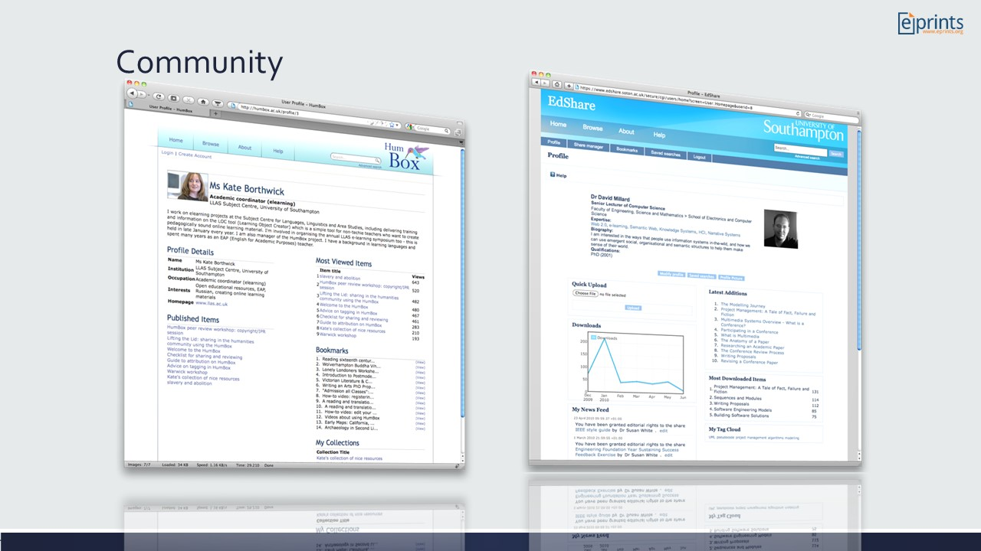
Notes:
MePrints, which is now more common across the community
> Contributors don’t just deposit they have an identity, are visible, activity is shared – we want the community to be visible
> Log-in and have their own area that they can personalise – feeling of ownership and control over their presence

Slide 7
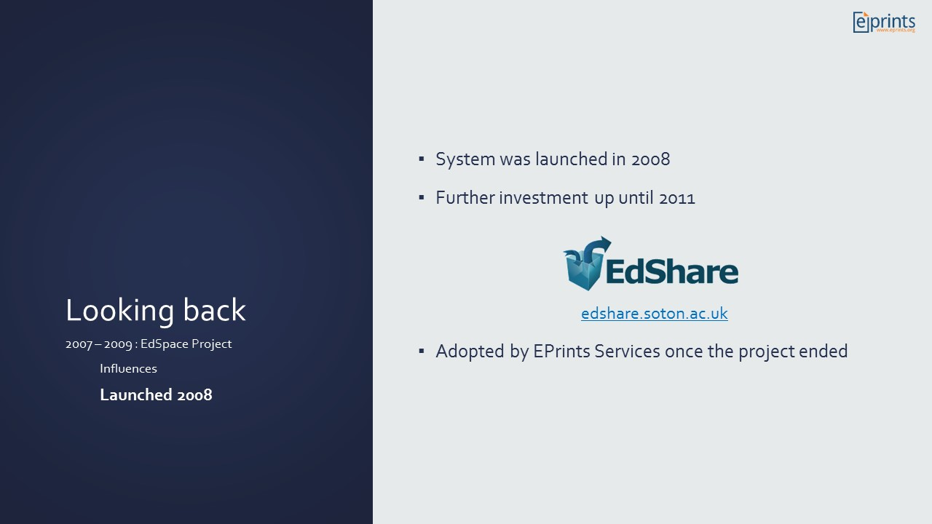
Notes:
EdShare Soton launched in 2008 - still a supported service
- Over 4000 live educational resources and collections
- Nearly 40000 files uploaded
EdShare product was taken on by EPrints Services and developed further and made available to the community

Slide 8
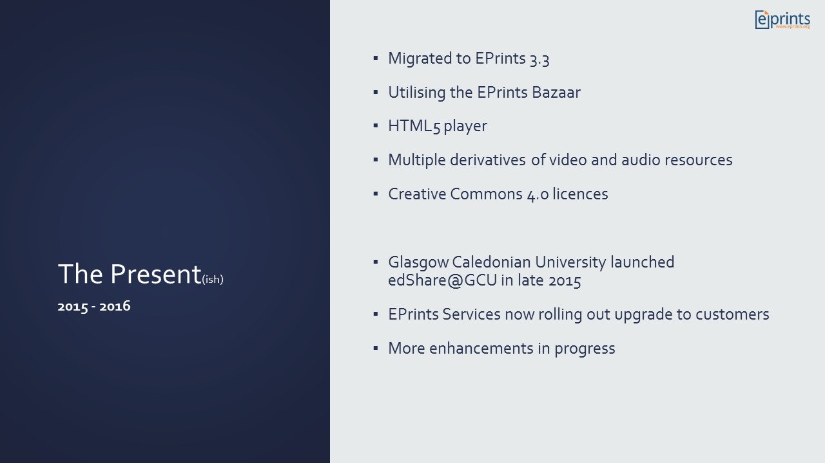
Notes:
EdShare up until this point had its own core that was no longer in sync with the main EPrints releases
We migrated EdShare to operate cleanly on a EPrints 3.3 core (thinking ahead to flavours)
Other updates/improvements included:
Reliance on flowplayer was removed, now rendering video/audio with HTML5
Multiple derivatives so there is better support across multiple devices
GCU (edshare.gcu.ac.uk) were our first instance to launch on this version, which is now being rolled out to customer and more enhancements are underway

Slide 9
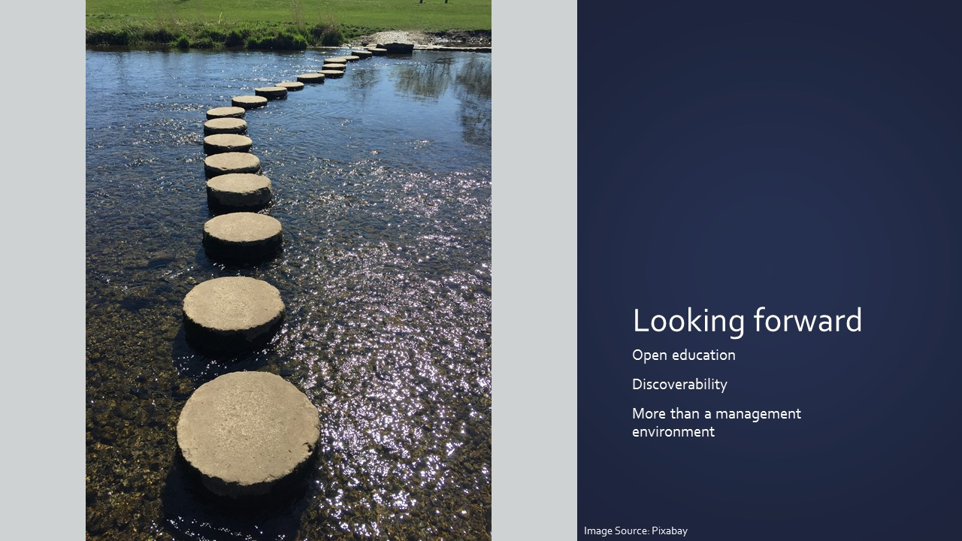
Notes:
The EdSpace project was about creating a sharing platform, but the choices made by the project team (visibility options, editing options, choosing Eprints) = we have an OER repository solution.
Migration to 3.3 was stepping stone to extending the solution further to better support the aims of open education – pushing the boundaries once more

Slide 10
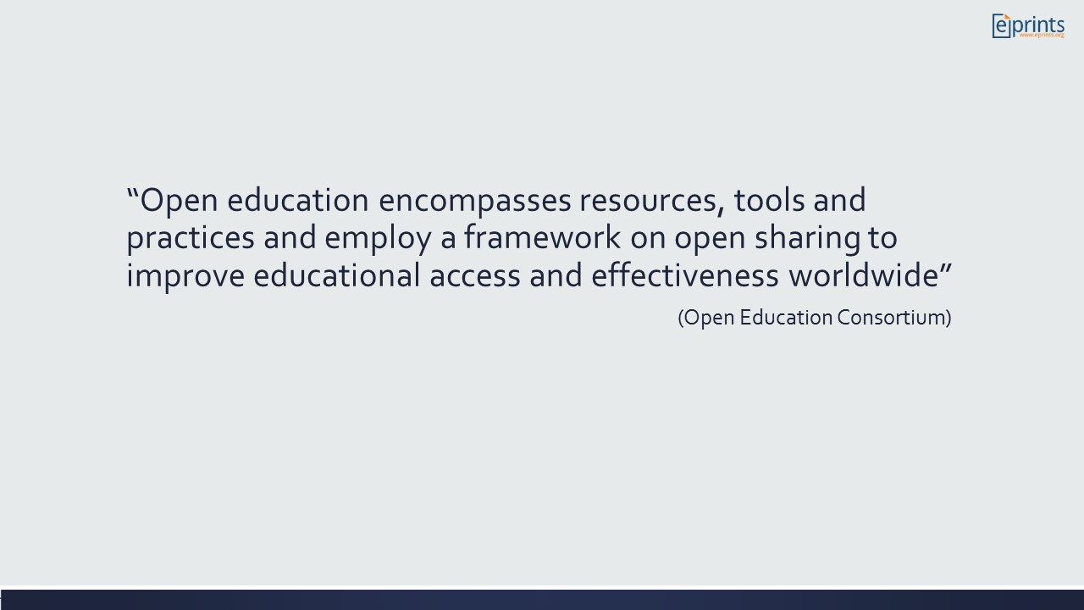
Notes:
For those less familiar ….
OE is a collective term to capture a range of resources, software tools and educational practices which focus on the concept of open sharing
Open is the really key part – as is a focus on sharing with a global community

Slide 11
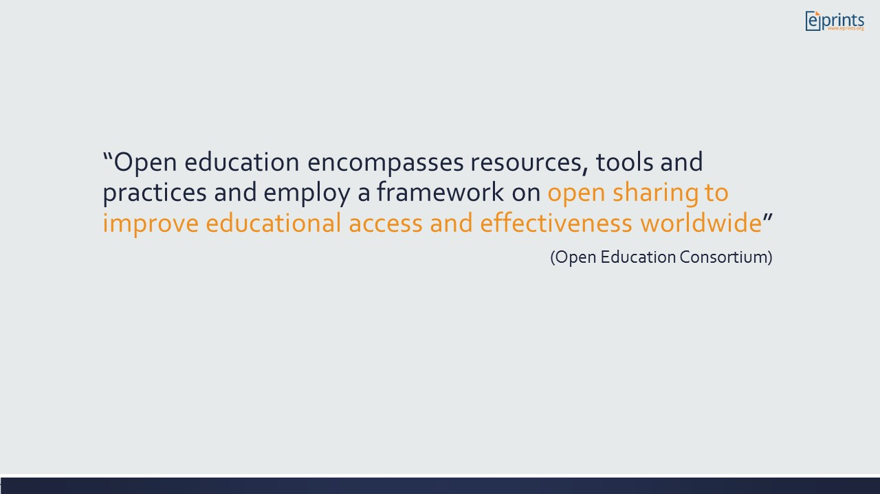
Notes:
Open is the really key part:
OE policies, software, materials, digital badges, data

Slide 12
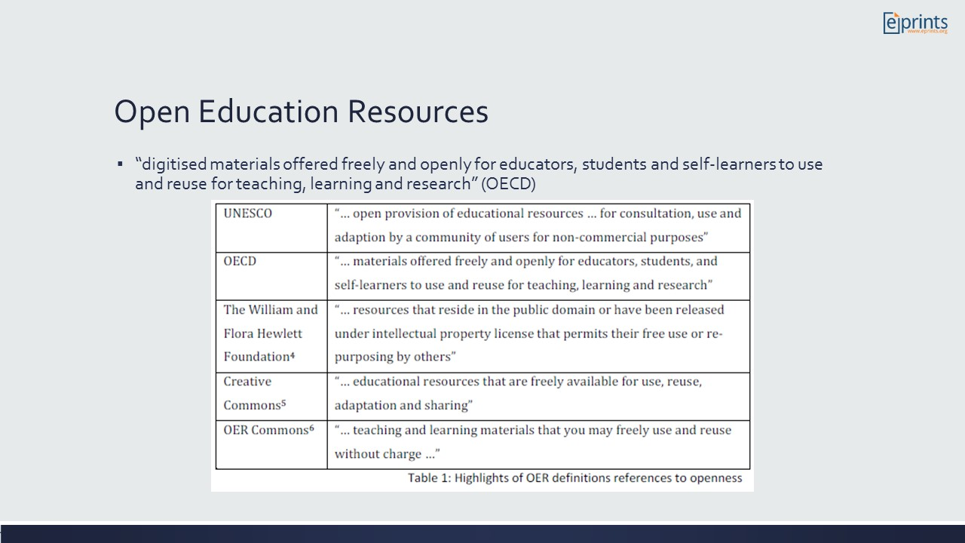
Notes:
A number of definitions of OERs exist but consistent through them all is their reference to being open and freely available
Not just about sharing within our existing communities, distributed networks or country – access for anyone regardless of where they are geographically, socially or demographically

Slide 13
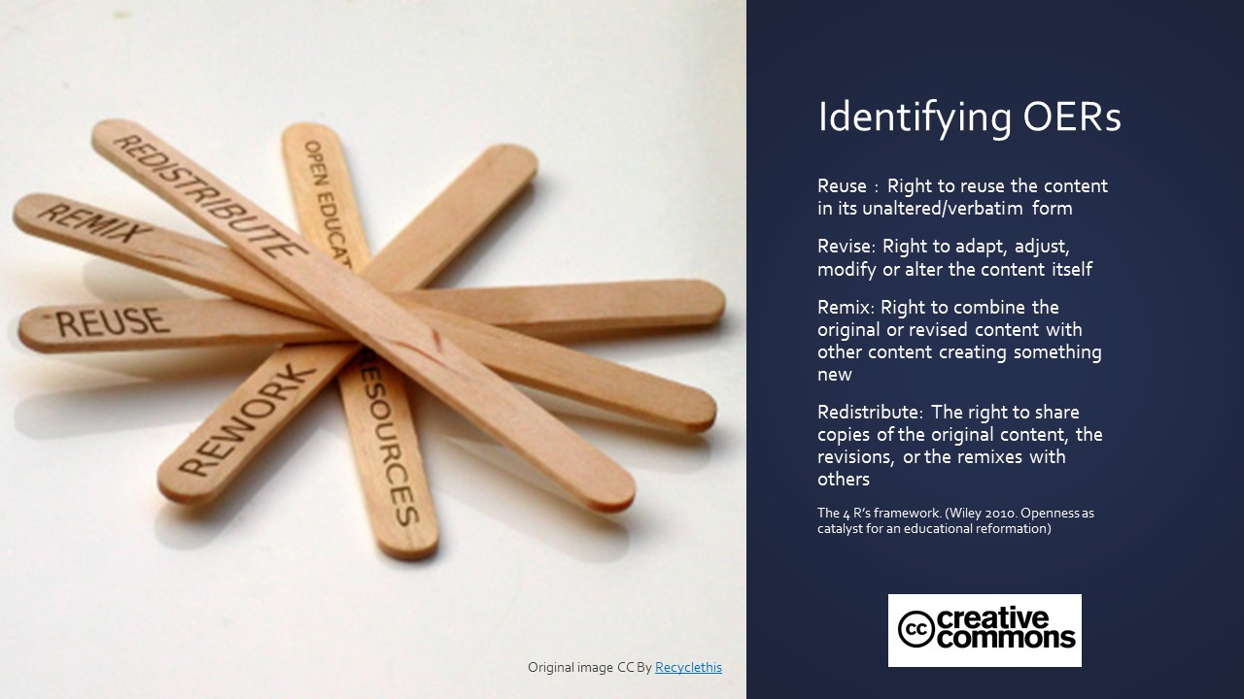
Notes:
How do we know an OER when we see it?
licence for use/reuse – declare how open your materials are – just because its on the web doesn’t mean you can do what you want
Applying a licence can be affected by motivations behind putting resource online – often for convenience and flexibility vs OE purpose
People still don’t really understand OER and licences available. Much like EPrints for OA, repositories will always have champions that lead the way – we want to provide them with the tools to succeed.
The repository needs to guide users more (just as we do with copyright guidance – Sherpa romeo), and we need to enable people to search directly by those resources which have CC licences, perhaps even prioritising content with CC to the surface of the repository

Slide 14
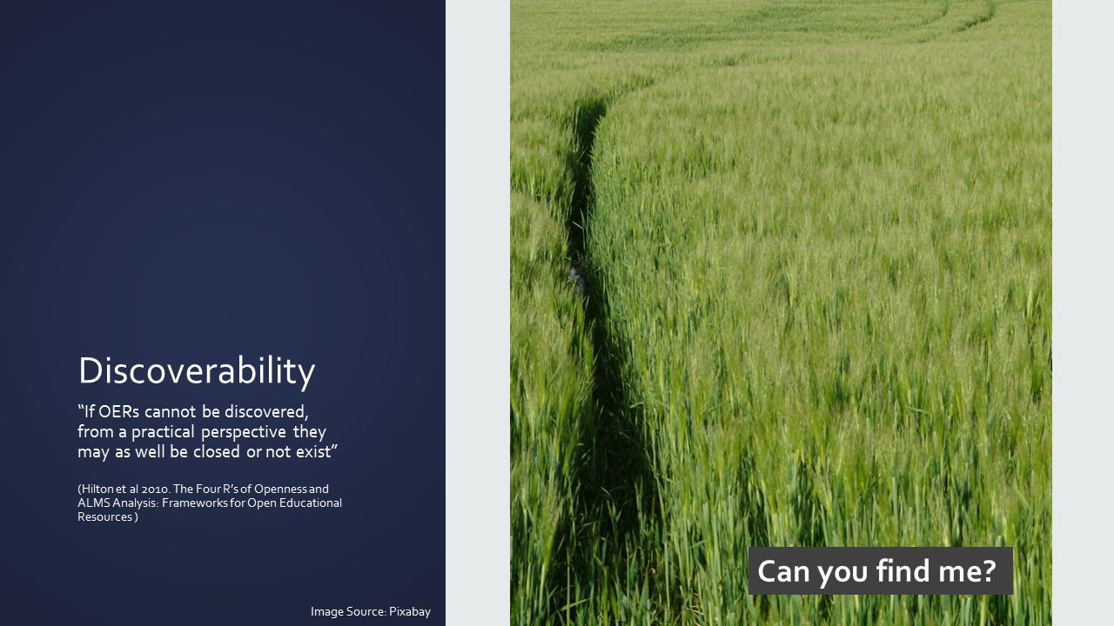
Notes:
Overwhelming focus to date of achieving a critical mass of content on the web and less attention on reaching a global audience
But if no-one can find it, it may as well be closed.
OERs are diferent to publications, people wont be coming via Google Scholar – they may not arrive in the right place
Different tactics are needed – very different audience who are making different decisions to those looking for a paper
When I looked across a sample of institutions and groups who had shared OER, there was little evidence of strategies in place to reach a global audience
Often to share with other academics, existing students – others would be a side effect, rather than goal.
Critical mass was objective, not wider aims of engaging with OE (not a criticism, but something we now need to pause and think about)
If we don’t consider the global audience, we are just feeding our existing communities and not being truly open.
Repositories are good at > managing, structuring and exposing the metadata to search engines.
> Aiding the perception in the quality

Slide 15
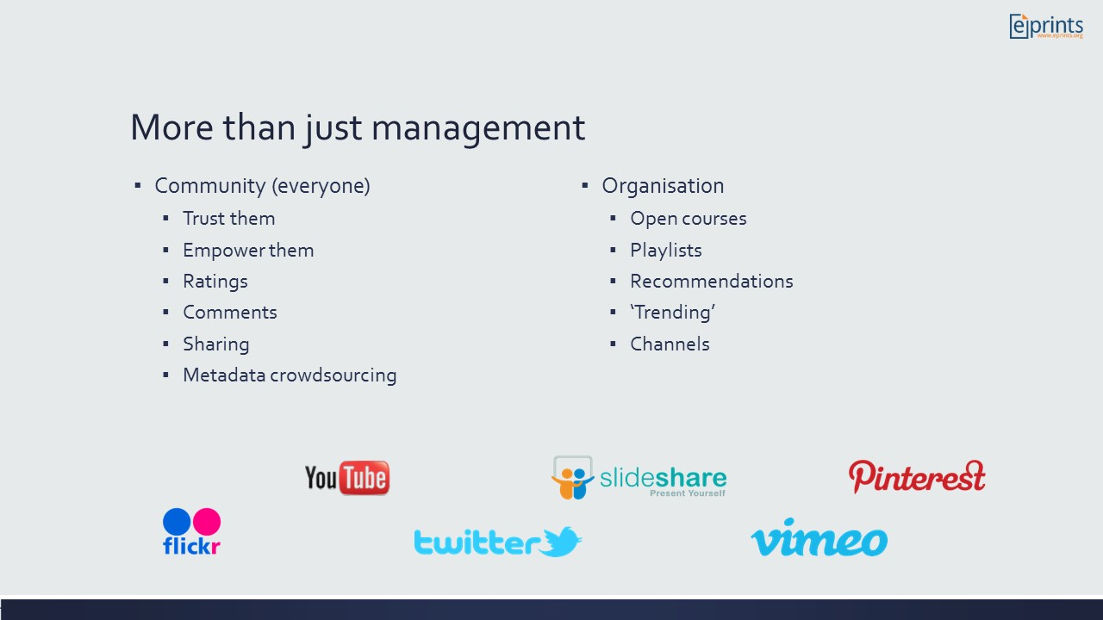
Notes:
Repositories can and should do much more than just manage the content when it comes to presenting resources to its audience
Again no need to reinvent the wheel – revisiting social media sites, what is they do so well
Comments and ratings should not be feared
Crowdsourcing – example of ECS EPrints, if someone derives another version of your OER, let them indicate this so a relation is made
Organisation to increase exposure and see resources in their context of use
Let individuals create their own open courses – informally structure, or more formal structure like a MOOC
plenty of case of people being blocked from running a course in institutional VLE, so they just go elsewhere! Presenting OERs in context of a course is hugely valuable for those outside the university walls
Playlists – User created or provider created
Recommendations – based on what is being viewed or ‘favourites’ topics people are interested in
Channels – we have a repository feeding iTunes, allowing subscriptions for particular themes
Trending – extension of the data being collated under IRStats2
Reach and wider audience beyond the university walls, but can benefit everyone

Slide 16
